Slide 1
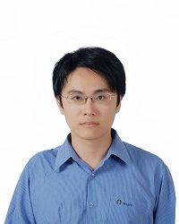
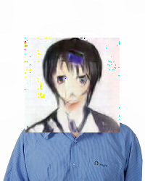
機械学習で美少女化 ~ あるいはNEW GAME! の世界
Source: http://qiita.com/Hi-king/items/8d36d9029ad1203aac55

Slide 2
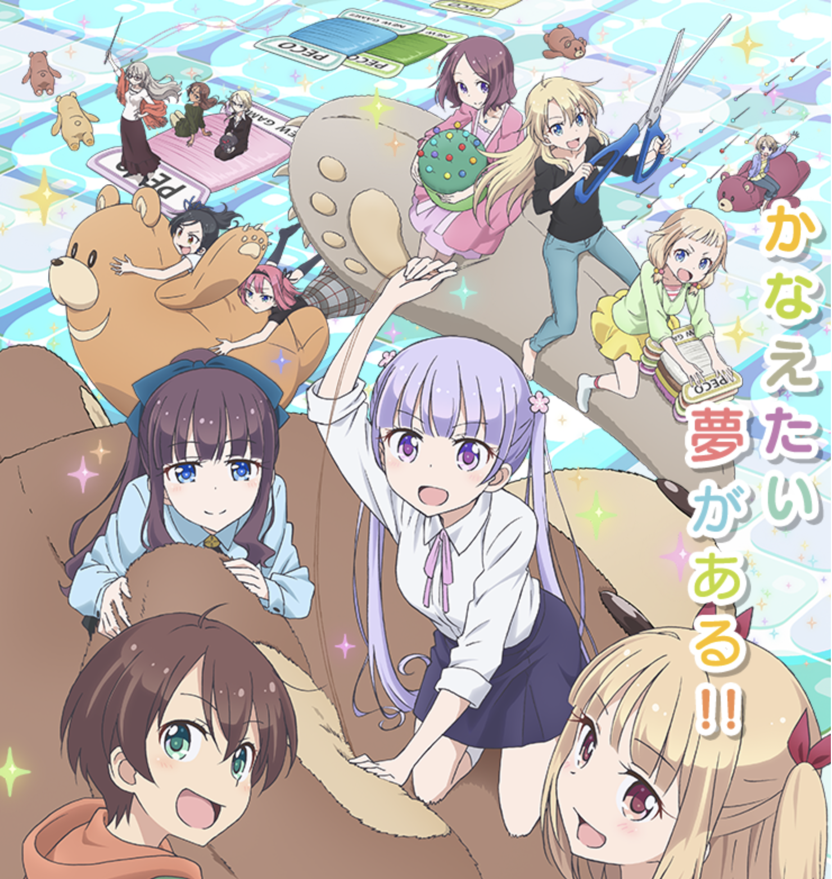
Introduction
An anime named NEW GAME!
Imagine everybody as anime characters
Transfer real images to anime images
Without any paired data
Every OTAKU’s dream
from the blog
Three steps
Notes:
, 不代表本人立場

Slide 3
Step 1
DCGAN
Training Data:
https://nico-opendata.jp/en/index.html

Slide 4
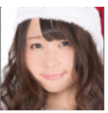
Step 2
?
Train an auto-encoder of code, image as bottleneck
Train vectorizer only

Slide 5
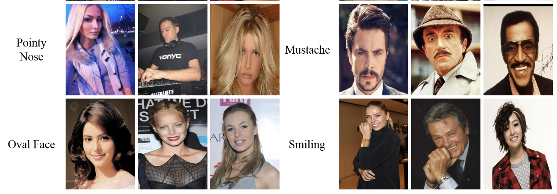
Step 3
The input image of vectorizer (real) has the same attribute as generator output (anime)
Jointly training (?)

Slide 6
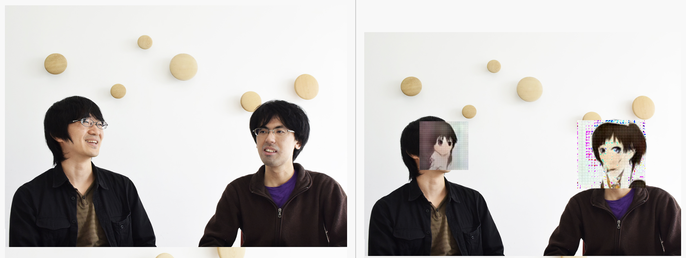
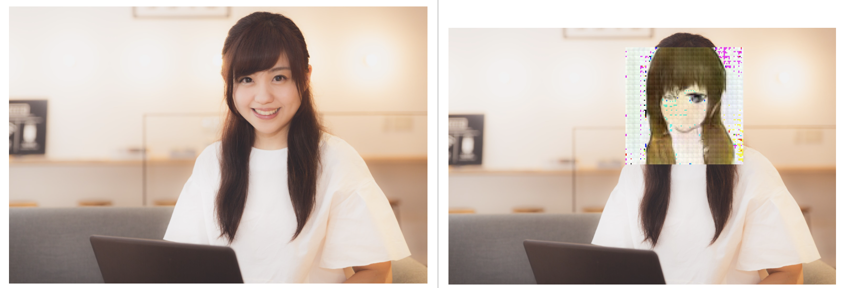
Results

