Slide 1
Unsupervised Conditional Generation
Notes:
沒講
http://paintstransfer.com
https://www.bilibili.com/video/av17537429/

Slide 2
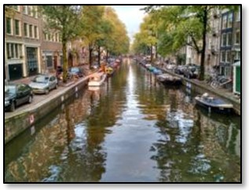
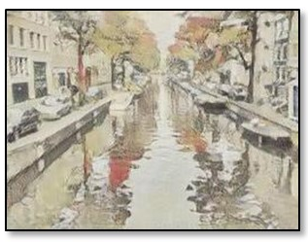
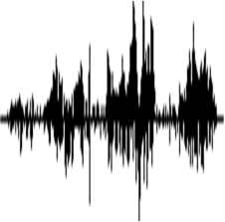
Unsupervised Conditional Generation
G
Domain X
Domain Y
Transform an object from one domain to another without paired data (e.g. style transfer)
Domain X
Domain Y
male
female
It is good.
It is bad.
It’s a good day.
It’s a bad day.
I love you.
I don’t love you.
Notes:
landscape photo
Van Gogh
Transform an object from one domain to another without paired data

Slide 3
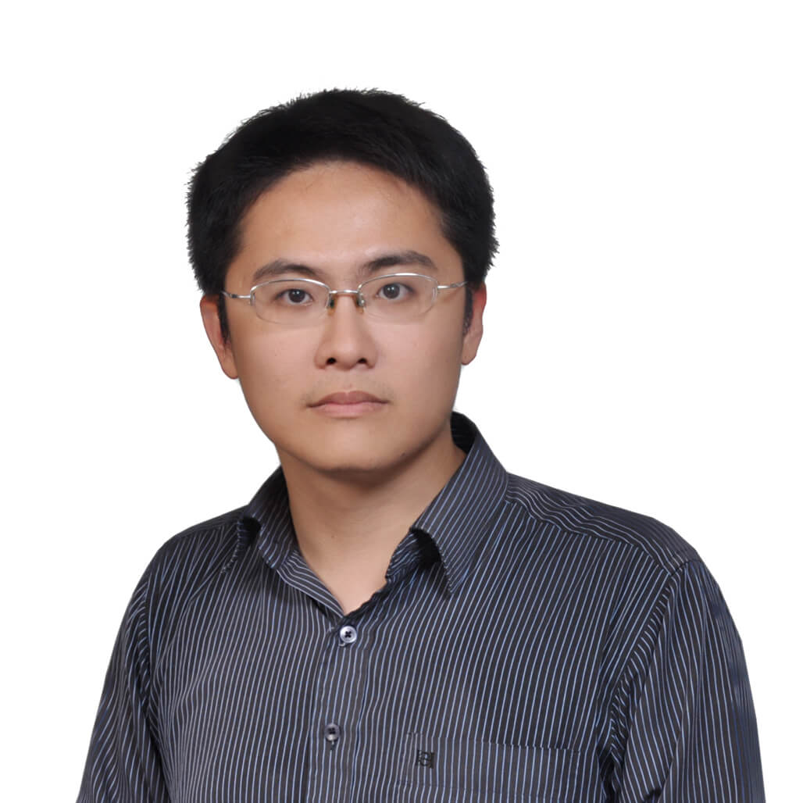
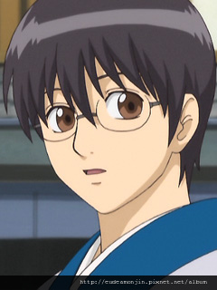
Unsupervised Conditional Generation
Approach 1: Direct Transformation
Approach 2: Projection to Common Space
$$G_{X→Y}$$
?
For texture or color change
Domain X
Domain Y
$${EN}_{X}$$
$${DE}_{Y}$$
Domain X
Encoder of domain X
Face
Attribute
Decoder of domain Y
Domain Y
Larger change, only keep the semantics
Notes:
This is not real example.

Slide 4
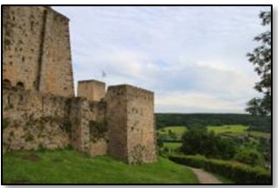
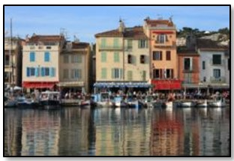
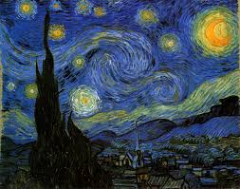
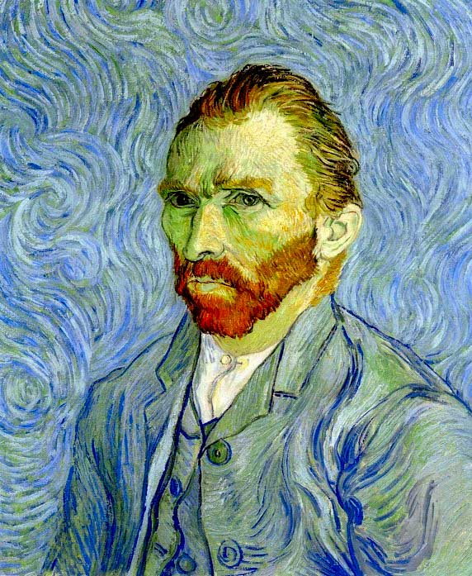
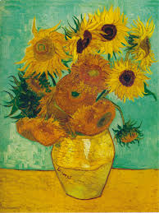
Direct Transformation
Domain X
Domain Y
Become similar to domain Y
Domain X
$$G_{X→Y}$$
?
$$D_{Y}$$
scalar
Input image belongs to domain Y or not
Domain Y
Notes:
https://arxiv.org/abs/1703.10593
https://junyanz.github.io/CycleGAN/
Berkeley AI Research (BAIR) laboratory, UC Berkeley

Slide 5
Direct Transformation
Domain X
Domain Y
Become similar to domain Y
Domain X
$$G_{X→Y}$$
Not what we want!
ignore input
$$D_{Y}$$
scalar
Input image belongs to domain Y or not
Domain Y
Notes:
https://arxiv.org/abs/1703.10593
https://junyanz.github.io/CycleGAN/
Berkeley AI Research (BAIR) laboratory, UC Berkeley

Slide 6
Direct Transformation
Domain X
Domain Y
Become similar to domain Y
Domain X
$$G_{X→Y}$$
Not what we want!
ignore input
$$D_{Y}$$
scalar
The issue can be avoided by network design.
Input image belongs to domain Y or not
Simpler generator makes the input and output more closely related.
[Tomer Galanti, et al. ICLR, 2018]
Notes:
https://arxiv.org/abs/1703.10593
https://junyanz.github.io/CycleGAN/
Berkeley AI Research (BAIR) laboratory, UC Berkeley

Slide 7
Direct Transformation
Domain X
Domain Y
Become similar to domain Y
Domain X
$$G_{X→Y}$$
$$D_{Y}$$
scalar
Encoder
Network
Encoder
Network
pre-trained
Input image belongs to domain Y or not
as close as possible
Baseline of DTN [Yaniv Taigman, et al., ICLR, 2017]
Notes:
https://arxiv.org/abs/1703.10593
https://junyanz.github.io/CycleGAN/
Berkeley AI Research (BAIR) laboratory, UC Berkeley

Slide 8
Direct Transformation
[Jun-Yan Zhu, et al., ICCV, 2017]
as close as possible
Cycle consistency
$$G_{X→Y}$$
$$G_{Y→X}$$
Lack of information for reconstruction
$$D_{Y}$$
scalar
Input image belongs to domain Y or not
Domain Y

Slide 9
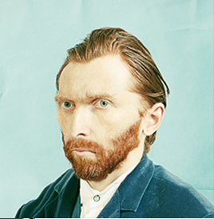
Direct Transformation
as close as possible
$$G_{X→Y}$$
$$G_{Y→X}$$
scalar: belongs to domain X or not
$$D_{Y}$$
scalar: belongs to domain Y or not
$$D_{X}$$
$$G_{Y→X}$$
$$G_{X→Y}$$
as close as possible
Notes:
http://sunreader1309.pixnet.net/blog/post/394665458-%E6%94%9D%E5%BD%B1%E8%88%87%E7%95%AB%E4%BD%9C%EF%BC%8C%E6%A2%B5%E8%B0%B7%E8%87%AA%E7%95%AB%E5%83%8F%E7%9A%84%E7%9C%9F%E9%9D%A2%E7%9B%AE%3F--------------

Slide 10
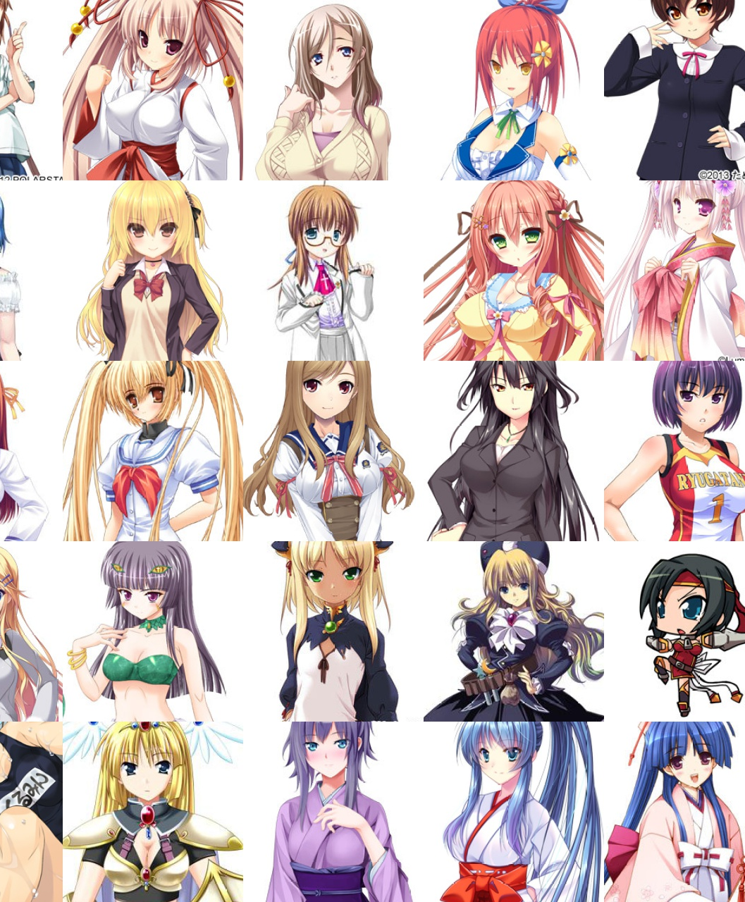
Cycle GAN – Silver Hair
https://github.com/Aixile/chainer-cyclegan

Slide 11
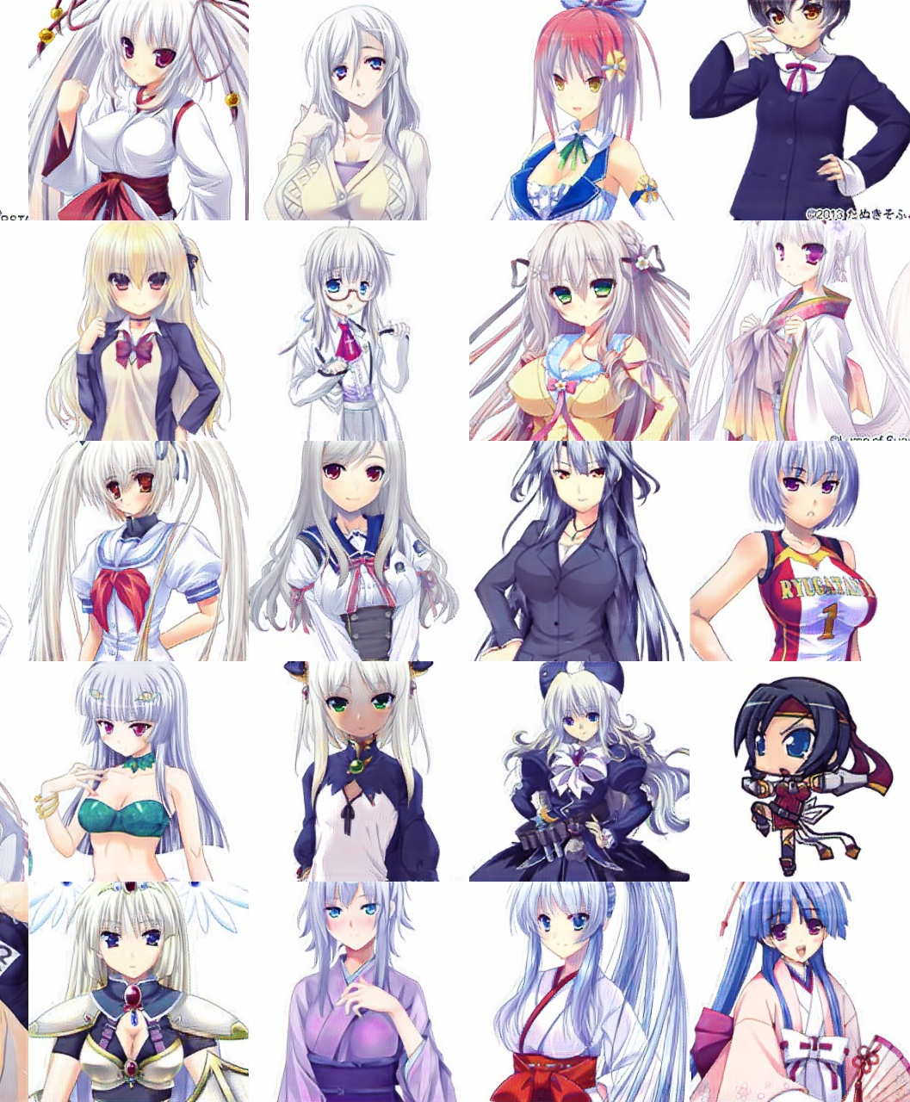
Cycle GAN – Silver Hair
https://github.com/Aixile/chainer-cyclegan

Slide 12
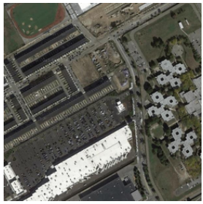
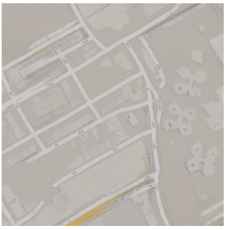
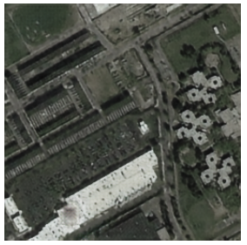
Issue of Cycle Consistency
CycleGAN: a Master of Steganography (隱寫術)
[Casey Chu, et al., NIPS workshop, 2017]
$$G_{X→Y}$$
$$G_{Y→X}$$
The information is hidden.
Notes:
Steg no gra phy

Slide 13
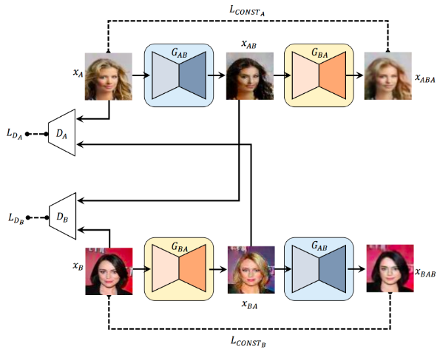
Disco GAN
[Taeksoo Kim, et al., ICML, 2017]
Dual GAN
[Zili Yi, et al., ICCV, 2017]
Cycle GAN
[Jun-Yan Zhu, et al., ICCV, 2017]

Slide 14
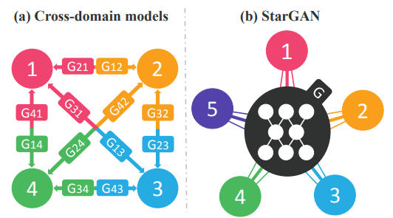
StarGAN
For multiple domains, considering starGAN
[Yunjey Choi, arXiv, 2017]
Notes:
StarGAN: Unified Generative Adversarial Networks for Multi-Domain Image-to-Image Translation

Slide 15
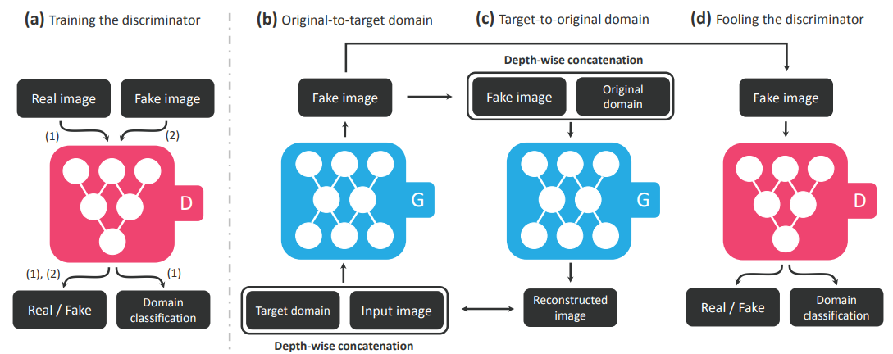
StarGAN

Slide 16
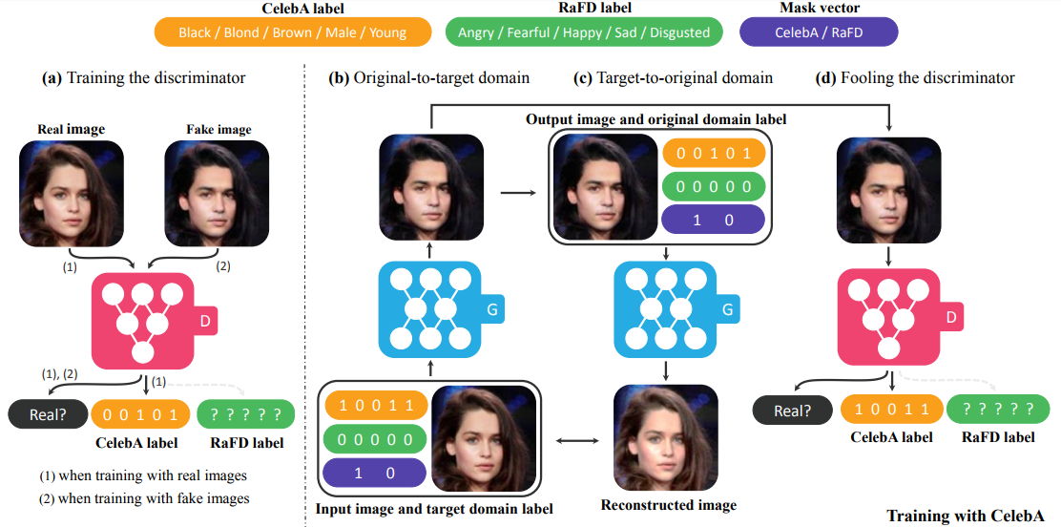
StarGAN

Slide 17
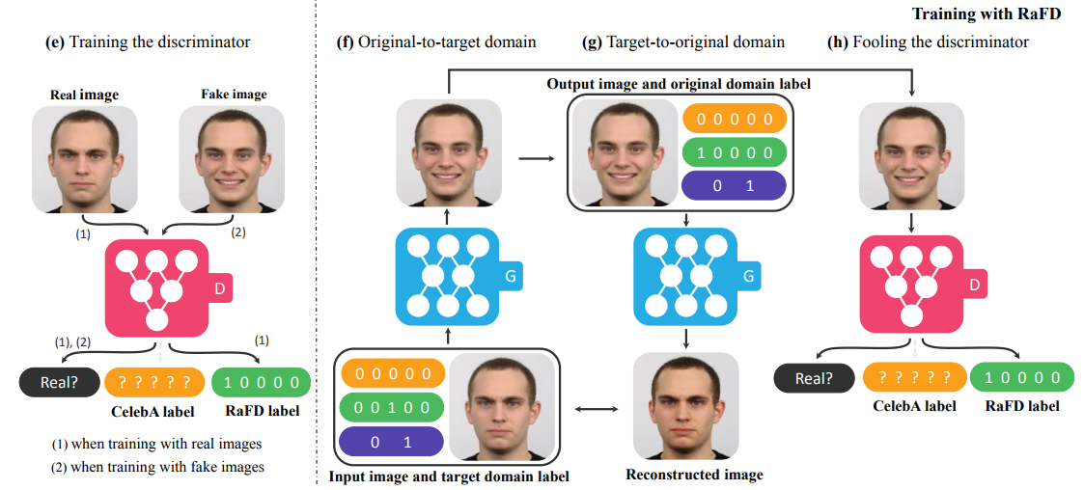
StarGAN

Slide 18
Unsupervised Conditional Generation
Approach 1: Direct Transformation
Approach 2: Projection to Common Space
$$G_{X→Y}$$
?
For texture or color change
Domain X
Domain Y
$${EN}_{X}$$
$${DE}_{Y}$$
Domain X
Encoder of domain X
Face
Attribute
Decoder of domain Y
Domain Y
Larger change, only keep the semantics
Notes:
This is not real example.

Slide 19
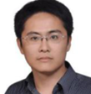
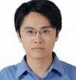
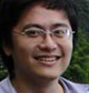
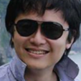
Projection to Common Space
Target
image
$${EN}_{X}$$
$${DE}_{X}$$
image
image
$${EN}_{Y}$$
$${DE}_{Y}$$
image
Face
Attribute
Domain X
Domain Y

Slide 20
Projection to Common Space
Training
Minimizing reconstruction error
image
$${EN}_{X}$$
$${DE}_{X}$$
image
image
$${EN}_{Y}$$
$${DE}_{Y}$$
image
Domain X
Domain Y

Slide 21
Projection to Common Space
Training
Minimizing reconstruction error
Discriminator of X domain
image
$${EN}_{X}$$
$${DE}_{X}$$
image
$$D_{X}$$
image
$${EN}_{Y}$$
$${DE}_{Y}$$
image
$$D_{Y}$$
Discriminator of Y domain
Minimizing reconstruction error
Because we train two auto-encoders separately …
The images with the same attribute may not project to the same position in the latent space.

Slide 22
Projection to Common Space
Training
$${EN}_{X}$$
$${DE}_{X}$$
$${EN}_{Y}$$
$${DE}_{Y}$$
Sharing the parameters of encoders and decoders
Couple GAN[Ming-Yu Liu, et al., NIPS, 2016]
UNIT[Ming-Yu Liu, et al., NIPS, 2017]

Slide 23
Projection to Common Space
Training
Minimizing reconstruction error
Discriminator of X domain
image
$${EN}_{X}$$
$${DE}_{X}$$
image
$$D_{X}$$
image
$${EN}_{Y}$$
$${DE}_{Y}$$
image
$$D_{Y}$$
Discriminator of Y domain
Domain
Discriminator
${EN}_{X}$ and ${EN}_{Y}$ fool the domain discriminator
From ${EN}_{X}$ or ${EN}_{Y}$
The domain discriminator forces the output of ${EN}_{X}$ and ${EN}_{Y}$ have the same distribution.
[Guillaume Lample, et al., NIPS, 2017]

Slide 24
Projection to Common Space
Training
Minimizing reconstruction error
Discriminator of X domain
image
$${EN}_{X}$$
$${DE}_{X}$$
image
$$D_{X}$$
image
$${EN}_{Y}$$
$${DE}_{Y}$$
image
$$D_{Y}$$
Discriminator of Y domain
Cycle Consistency:
Used in ComboGAN
[Asha Anoosheh, et al., arXiv, 017]

Slide 25
Projection to Common Space
Training
To the same latent space
Discriminator of X domain
image
$${EN}_{X}$$
$${DE}_{X}$$
image
$$D_{X}$$
image
$${EN}_{Y}$$
$${DE}_{Y}$$
image
$$D_{Y}$$
Discriminator of Y domain
Semantic Consistency:
Used in DTN [Yaniv Taigman, et al., ICLR, 2017] and XGAN [Amélie Royer, et al., arXiv, 2017]

Slide 26
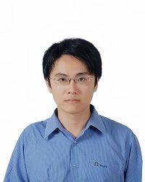
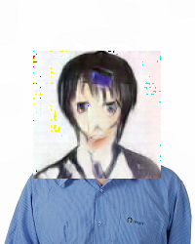
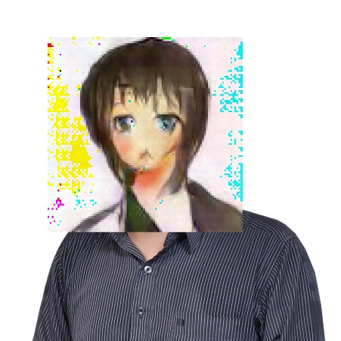
世界二次元化
Using the code: https://github.com/Hi-king/kawaii_creator
It is not cycle GAN, Disco GAN
input
output domain
Notes:
很有用
線上課程

Slide 27
Voice Conversion

Slide 28
In the past
Speaker A
Speaker B
How are you?
How are you?
Good morning
Good morning
Today
Speaker A
Speaker B
天氣真好
How are you?
再見囉
Good morning
Speakers A and B are talking about completely different things.

Slide 29
Speaker A
Speaker B
我
感謝周儒杰同學提供實驗結果

Slide 30
Reference
Jun-Yan Zhu, Taesung Park, Phillip Isola, Alexei A. Efros, Unpaired Image-to-Image Translation using Cycle-Consistent Adversarial Networks, ICCV, 2017
Zili Yi, Hao Zhang, Ping Tan, Minglun Gong, DualGAN: Unsupervised Dual Learning for Image-to-Image Translation, ICCV, 2017
Tomer Galanti, Lior Wolf, Sagie Benaim, The Role of Minimal Complexity Functions in Unsupervised Learning of Semantic Mappings, ICLR, 2018
Yaniv Taigman, Adam Polyak, Lior Wolf, Unsupervised Cross-Domain Image Generation, ICLR, 2017
Asha Anoosheh, Eirikur Agustsson, Radu Timofte, Luc Van Gool, ComboGAN: Unrestrained Scalability for Image Domain Translation, arXiv, 2017
Amélie Royer, Konstantinos Bousmalis, Stephan Gouws, Fred Bertsch, Inbar Mosseri, Forrester Cole, Kevin Murphy, XGAN: Unsupervised Image-to-Image Translation for Many-to-Many Mappings, arXiv, 2017

Slide 31
Reference
Guillaume Lample, Neil Zeghidour, Nicolas Usunier, Antoine Bordes, Ludovic Denoyer, Marc'Aurelio Ranzato, Fader Networks: Manipulating Images by Sliding Attributes, NIPS, 2017
Taeksoo Kim, Moonsu Cha, Hyunsoo Kim, Jung Kwon Lee, Jiwon Kim, Learning to Discover Cross-Domain Relations with Generative Adversarial Networks, ICML, 2017
Ming-Yu Liu, Oncel Tuzel, “Coupled Generative Adversarial Networks”, NIPS, 2016
Ming-Yu Liu, Thomas Breuel, Jan Kautz, Unsupervised Image-to-Image Translation Networks, NIPS, 2017
Yunjey Choi, Minje Choi, Munyoung Kim, Jung-Woo Ha, Sunghun Kim, Jaegul Choo, StarGAN: Unified Generative Adversarial Networks for Multi-Domain Image-to-Image Translation, arXiv, 2017

