Slide 1
Improving Sequence Generation by GAN
李宏毅
Hung-yi Lee
Notes:
一日搞懂 GAN：https://www.slideshare.net/tw_dsconf/ss-78795326
Q: 可以做得很好? 為什麼?
Q: VAE 為何不好?
Q: unroll GAN有用嗎？

Slide 2
Outline
Conditional Sequence Generation
RL (human feedback)
GAN (discriminator feedback)
Unsupervised Abstractive Summarization
Unsupervised Conditional Sequence Generation
Unsupervised Translation
Text Style Transfer
Notes:
RF and GAN for chat-bot
Human provides feedback
GAN for chat-bot
Machine (discriminator) provides feedback
Rewarding for Every Generation Step
MCMC
Rewarding Partial Decoded Sequence

Slide 3
Conditional Sequence Generation
How are you
Machine Learning
I am fine.
Generator
Generator
Generator
機 器 學 習
How are you?
ASR
Translation
Chatbot
The generator is a typical seq2seq model.
With GAN, you can train seq2seq model in another way.
Notes:
Sequence to sequence learning: Both input and output are both sequences with different lengths.

Slide 4
Review: Sequence-to-sequence
Maximize likelihood
Chat-bot as example
I’m good.
Output:
Not bad
I’m John.
Human
better
output sentence x
Training Criterion
better
Training data:
Encoder
Decoder
……
A: How are you ?
B: I’m good.
Generator
Input sentence c
……
How are you ?

Slide 5
Outline of Part III
Improving Supervised Seq-to-seq Model
RL (human feedback)
GAN (discriminator feedback)
Unsupervised Seq-to-seq Model
Text Style Transfer
Unsupervised Abstractive Summarization
Unsupervised Translation
Notes:
RF and GAN for chat-bot
Human provides feedback
GAN for chat-bot
Machine (discriminator) provides feedback
Rewarding for Every Generation Step
MCMC
Rewarding Partial Decoded Sequence

Slide 6
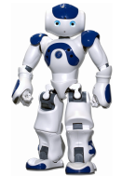
Introduction
https://image.freepik.com/free-vector/variety-of-human-avatars_23-2147506285.jpg
http://www.freepik.com/free-vector/variety-of-human-avatars_766615.htm
Machine obtains feedback from user
Chat-bot learns to maximize the expected reward
How are you?
Hello
Bye bye ☺
Hi ☺
-10
3
Notes:
Consider that you have a non-differentiable objective function
This is cost!
Ignore multiple turns here

Slide 7
Maximizing Expected Reward
Learn to maximize expected reward
Policy Gradient
Input sentence c
En
De
response sentence x
Chatbot
Input sentence c
Human
$$R\left(c,x\right)$$
response sentence x
reward
[Li, et al., EMNLP, 2016]
Notes:
I am not going to derive the formulation
I will directly give you the results.

Slide 8
Maximizing Expected Reward
Encoder
Generator
Human
$$h$$
$$x$$
$$R\left(h,x\right)$$
update
$$θ$$
$$θ^{∗}=arg\max_{θ}{{\overline{R}}_{θ}}$$
Maximizing expected reward
$$=\sum_{h}{P\left(h\right)\sum_{x}{R\left(h,x\right) P_{θ}\left(x|h\right)}}$$
$${\overline{R}}_{θ}$$
Randomness in generator
Probability that the input/history is h

Slide 9
Maximizing Expected Reward
Encoder
Generator
Human
$$h$$
$$x$$
$$R\left(h,x\right)$$
update
$$θ$$
$$θ^{∗}=arg\max_{θ}{{\overline{R}}_{θ}}$$
Maximizing expected reward
$$=\sum_{h}{P\left(h\right)\sum_{x}{R\left(h,x\right) P_{θ}\left(x|h\right)}}$$
$$=E_{h\sim P\left(h\right)}\left[E_{x\sim P_{θ}\left(x|h\right)}\left[R\left(h,x\right)\right]\right]$$
$${\overline{R}}_{θ}$$
$$≈\frac{1}{N}\sum_{i=1}^{N}{R\left(h^{i},x^{i}\right)}$$
$$=E_{h\sim P\left(h\right),x\sim P_{θ}\left(x|h\right)}\left[R\left(h,x\right)\right]$$
Where is $θ$?
Sample:
$$\left(h^{1},x^{1}\right),\left(h^{2},x^{2}\right),⋯,\left(h^{N},x^{N}\right)$$

Slide 10
Policy Gradient
$$\frac{dlog\left(f\left(x\right)\right)}{dx}=\frac{1}{f\left(x\right)}\frac{df\left(x\right)}{dx}$$
$$=\sum_{h}{P\left(h\right)\sum_{x}{R\left(h,x\right) P_{θ}\left(x|h\right)}}$$
$$≈\frac{1}{N}\sum_{i=1}^{N}{R\left(h^{i},x^{i}\right)}$$
$${\overline{R}}_{θ}$$
$$≈\frac{1}{N}\sum_{i=1}^{N}{R\left(h^{i},x^{i}\right){∇logP}_{θ}\left(x|h\right)}$$
$$=\sum_{h}{P\left(h\right)\sum_{x}{R\left(h,x\right){∇P}_{θ}\left(x|h\right)}}$$
$$∇{\overline{R}}_{θ}$$
$$=\sum_{h}{P\left(h\right)\sum_{x}{R\left(h,x\right)P_{θ}\left(x|h\right)\frac{{∇P}_{θ}\left(x|h\right)}{P_{θ}\left(x|h\right)}}}$$
Sampling
$$=\sum_{h}{P\left(h\right)\sum_{x}{R\left(h,x\right)P_{θ}\left(x|h\right){∇logP}_{θ}\left(x|h\right)}}$$
$$=E_{h\sim P\left(h\right),x\sim P_{θ}\left(x|h\right)}\left[R\left(h,x\right){∇logP}_{θ}\left(x|h\right)\right]$$

Slide 11
Policy Gradient
Gradient Ascent
$$θ^{new}←θ^{old}+η∇{\overline{R}}_{θ^{old}}$$
$$∇{\overline{R}}_{θ}≈\frac{1}{N}\sum_{i=1}^{N}{R\left(h^{i},x^{i}\right){∇logP}_{θ}\left(x^{i}|h^{i}\right)}$$
$R\left(h^{i},x^{i}\right)$ is positive
After updating $θ$, $P_{θ}\left(x^{i}|h^{i}\right)$will increase
$R\left(h^{i},x^{i}\right)$ is negative
After updating $θ$, $P_{θ}\left(x^{i}|h^{i}\right)$will decrease

Slide 12
Policy Gradient - Implemenation
$$θ^{t+1}←θ^{t}+η∇{\overline{R}}_{θ^{t}}$$
$$θ^{t}$$
$$\frac{1}{N}\sum_{i=1}^{N}{R\left(c^{i},x^{i}\right){∇logP}_{θ^{t}}\left(x^{i}|c^{i}\right)}$$
$$\left(c^{1},x^{1}\right)$$
$$R\left(c^{1},x^{1}\right)$$
$R\left(c^{i},x^{i}\right)$ is positive
$$\left(c^{2},x^{2}\right)$$
$$R\left(c^{2},x^{2}\right)$$
Updating $θ$ to increase $P_{θ}\left(x^{i}|c^{i}\right)$
……
……
$R\left(c^{i},x^{i}\right)$ is negative
$$\left(c^{N},x^{N}\right)$$
$$R\left(c^{N},x^{N}\right)$$
Updating $θ$ to decrease $P_{θ}\left(x^{i}|c^{i}\right)$

Slide 13
Comparison
Maximum Likelihood
Reinforcement Learning
$$\frac{1}{N}\sum_{i=1}^{N}{{logP}_{θ}\left({\hat{x}}^{i}|c^{i}\right)}$$
$$\frac{1}{N}\sum_{i=1}^{N}{R\left(c^{i},x^{i}\right){logP}_{θ}\left(x^{i}|c^{i}\right)}$$
Objective
Function
$$\frac{1}{N}\sum_{i=1}^{N}{∇{logP}_{θ}\left({\hat{x}}^{i}|c^{i}\right)}$$
$$\frac{1}{N}\sum_{i=1}^{N}{R\left(c^{i},x^{i}\right){∇logP}_{θ}\left(x^{i}|c^{i}\right)}$$
Gradient
Training
Data
$$\left\{\left(c^{1},{\hat{x}}^{1}\right),…,\left(c^{N},{\hat{x}}^{N}\right)\right\}$$
$$\left\{\left(c^{1},x^{1}\right),…,\left(c^{N},x^{N}\right)\right\}$$
$$R\left(c^{i},{\hat{x}}^{i}\right)=1$$
obtained from interaction
weighted by $R\left(c^{i},x^{i}\right)$

Slide 14
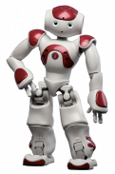
Alpha GO style training !
I am busy.
Let two agents talk to each other
How old are you?
How old are you?
See you.
I am 16.
See you.
I though you were 12.
See you.
What make you think so?
Using a pre-defined evaluation function to compute R(h,x)
Notes:
(sometimes generate good dialogue, sometimes bad)
Integrate the method of Reinforcement Learning
To model the future reward
Simulate dialogue between two virtual agent
Using policy-gradient method to reward sequence with 3 properties
Informativity
Coherence
Ease of answering

Slide 15
Outline of Part III
Improving Supervised Seq-to-seq Model
RL (human feedback)
GAN (discriminator feedback)
Unsupervised Seq-to-seq Model
Text Style Transfer
Unsupervised Abstractive Summarization
Unsupervised Translation
Notes:
RF and GAN for chat-bot
Human provides feedback
GAN for chat-bot
Machine (discriminator) provides feedback
Rewarding for Every Generation Step
MCMC
Rewarding Partial Decoded Sequence

Slide 16
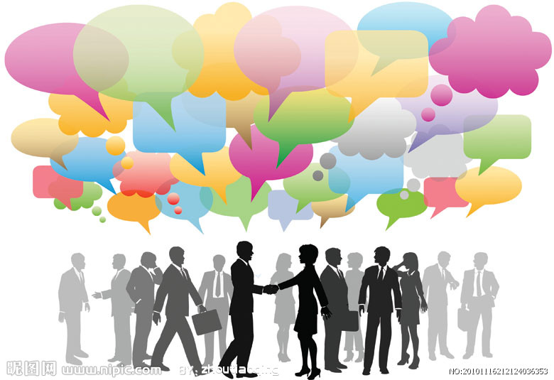
Conditional GAN
http://www.nipic.com/show/3/83/3936650kd7476069.html
Input sentence c
En
De
response sentence x
Chatbot
Input sentence c
Discriminator
Real or fake
response sentence x
“reward”
human
dialogues
[Li, et al., EMNLP, 2017]

Slide 17
Algorithm
Training data:
Pairs of conditional input c and response x
Initialize generator G (chatbot) and discriminator D
In each iteration:
Sample input $c$ and response $x$ from training set
Sample input $c′$ from training set, and generate response $\tilde{x}$ by G($c′$)
Update D to increase $D\left(c,x\right)$ and decrease $D\left(c^{′},\tilde{x}\right)$
Update generator G (chatbot) such that
En
De
Discrimi
nator
$$c$$
scalar
Chatbot
update

Slide 18
En
De
Discrimi
nator
scalar
scalar
Chatbot
update
Discriminator
Can we use gradient ascent?
B
A
A
NO!
A
A
A
B
B
B
Update Parameters
Due to the sampling process, “discriminator+ generator” is not differentiable
<BOS>
A
B
Notes:
(it does not use RNN)

Slide 19
Three Categories of Solutions
“Reinforcement Learning”
[Yu, et al., AAAI, 2017][Li, et al., EMNLP, 2017][Tong Che, et al, arXiv, 2017][Jiaxian Guo, et al., AAAI, 2018][Kevin Lin, et al, NIPS, 2017][William Fedus, et al., ICLR, 2018]
Gumbel-softmax
[Matt J. Kusner, et al, arXiv, 2016]
Continuous Input for Discriminator
[Sai Rajeswar, et al., arXiv, 2017][Ofir Press, et al., ICML workshop, 2017][Zhen Xu, et al., EMNLP, 2017][Alex Lamb, et al., NIPS, 2016][Yizhe Zhang, et al., ICML, 2017]
Notes:
https://blog.csdn.net/qq_25737169/article/details/78259631

Slide 20
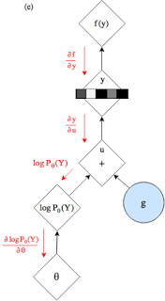
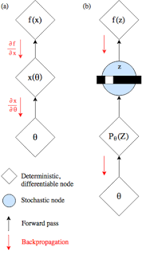
Gumbel-softmax
https://gabrielhuang.gitbooks.io/machine-learning/reparametrization-trick.html
https://casmls.github.io/general/2017/02/01/GumbelSoftmax.html
http://blog.evjang.com/2016/11/tutorial-categorical-variational.html

Slide 21
Three Categories of Solutions
“Reinforcement Learning”
[Yu, et al., AAAI, 2017][Li, et al., EMNLP, 2017][Tong Che, et al, arXiv, 2017][Jiaxian Guo, et al., AAAI, 2018][Kevin Lin, et al, NIPS, 2017][William Fedus, et al., ICLR, 2018]
Gumbel-softmax
[Matt J. Kusner, et al, arXiv, 2016]
Continuous Input for Discriminator
[Sai Rajeswar, et al., arXiv, 2017][Ofir Press, et al., ICML workshop, 2017][Zhen Xu, et al., EMNLP, 2017][Alex Lamb, et al., NIPS, 2016][Yizhe Zhang, et al., ICML, 2017]
Notes:
https://blog.csdn.net/qq_25737169/article/details/78259631

Slide 22
En
De
Discrimi
nator
scalar
scalar
Chatbot
update
Discriminator
Use the distribution as the input of discriminator
B
A
A
Avoid the sampling process
A
A
A
B
B
B
Update Parameters
We can do backpropagation now.
<BOS>
A
B
Notes:
(it does not use RNN)

Slide 23
What is the problem?
Real sentence
Generated
1
0
0
0
0
0
1
0
0
0
0
0
1
0
0
0
0
0
1
0
0
0
0
0
1
Discriminator can immediately find the difference.
0.9
0.1
0
0
0
0.1
0.9
0
0
0
0.1
0.1
0.7
0.1
0
0
0
0.1
0.8
0.1
0
0
0
0.1
0.9
Can never be 1-of-N
WGAN is helpful

Slide 24
Three Categories of Solutions
“Reinforcement Learning”
[Yu, et al., AAAI, 2017][Li, et al., EMNLP, 2017][Tong Che, et al, arXiv, 2017][Jiaxian Guo, et al., AAAI, 2018][Kevin Lin, et al, NIPS, 2017][William Fedus, et al., ICLR, 2018]
Gumbel-softmax
[Matt J. Kusner, et al, arXiv, 2016]
Continuous Input for Discriminator
[Sai Rajeswar, et al., arXiv, 2017][Ofir Press, et al., ICML workshop, 2017][Zhen Xu, et al., EMNLP, 2017][Alex Lamb, et al., NIPS, 2016][Yizhe Zhang, et al., ICML, 2017]
Notes:
https://blog.csdn.net/qq_25737169/article/details/78259631

Slide 25
Reinforcement Learning?
Consider the output of discriminator as reward
Update generator to increase discriminator = to get maximum reward
Using the formulation of policy gradient, replace reward $R\left(c,x\right)$ with discriminator output $D\left(c,x\right)$
Different from typical RL
The discriminator would update
En
De
Discrimi
nator
scalar
Chatbot
update
Notes:
The score of current utterances being human-generated ones assigned by the discriminator is used as a reward for generator, which is trained to maximize the expected reward of generated utterances using REINFORCE algorithm.
Actor critic

Slide 26
d-step
discriminator
$$x$$
$$c$$
fake
real
g-step
D
$$θ^{t+1}←θ^{t}+η∇{\overline{R}}_{θ^{t}}$$
$$θ^{t}$$
$$\frac{1}{N}\sum_{i=1}^{N}{R\left(c^{i},x^{i}\right){∇logP}_{θ^{t}}\left(x^{i}|c^{i}\right)}$$
$$D\left(c^{i},x^{i}\right)$$
$$D\left(c^{1},x^{1}\right)$$
$$\left(c^{1},x^{1}\right)$$
$$R\left(c^{1},x^{1}\right)$$
$R\left(c^{i},x^{i}\right)$ is positive
$$D\left(c^{i},x^{i}\right)$$
$$D\left(c^{2},x^{2}\right)$$
$$\left(c^{2},x^{2}\right)$$
$$R\left(c^{2},x^{2}\right)$$
Updating $θ$ to increase $P_{θ}\left(x^{i}|c^{i}\right)$
……
……
$$D\left(c^{i},x^{i}\right)$$
$R\left(c^{i},x^{i}\right)$ is negative
$$D\left(c^{N},x^{N}\right)$$
$$\left(c^{N},x^{N}\right)$$
$$R\left(c^{N},x^{N}\right)$$
Updating $θ$ to decrease $P_{θ}\left(x^{i}|c^{i}\right)$

Slide 27
Reward for Every Generation Step
$$∇{\overline{R}}_{θ}≈\frac{1}{N}\sum_{i=1}^{N}{D\left(c^{i},x^{i}\right){∇logP}_{θ}\left(x^{i}|c^{i}\right)}$$
$c^{i}$ = “What is your name?”
$D\left(c^{i},x^{i}\right)$ is negative
$x^{i}$ = “I don’t know”
Update $θ$ to decrease $logP_{θ}\left(x^{i}|c^{i}\right)$
$logP_{θ}\left(x^{i}|c^{i}\right)=logP\left(x_{1}^{i}|c^{i}\right)+logP\left(x_{2}^{i}|c^{i},x_{1}^{i}\right)+$ $logP\left(x_{3}^{i}|c^{i},x_{1:2}^{i}\right)$
$$P\left("I"|c^{i}\right)$$
$c^{i}$ = “What is your name?”
$D\left(c^{i},x^{i}\right)$ is positive
$x^{i}$ = “I am John”
Update $θ$ to increase $logP_{θ}\left(x^{i}|c^{i}\right)$
$logP_{θ}\left(x^{i}|c^{i}\right)=logP\left(x_{1}^{i}|c^{i}\right)+logP\left(x_{2}^{i}|c^{i},x_{1}^{i}\right)+$ $logP\left(x_{3}^{i}|c^{i},x_{1:2}^{i}\right)$
$$P\left("I"|c^{i}\right)$$

Slide 28
Reward for Every Generation Step
$h^{i}$ = “What is your name?”
$x^{i}$ = “I don’t know”
$logP_{θ}\left(x^{i}|h^{i}\right)=logP\left(x_{1}^{i}|c^{i}\right)+logP\left(x_{2}^{i}|c^{i},x_{1}^{i}\right)+$ $logP\left(x_{3}^{i}|c^{i},x_{1:2}^{i}\right)$
$$P\left("I"|c^{i}\right)$$
$$P\left("don′t"|c^{i},"I"\right)$$
$$P\left("know"|c^{i},"I don′t"\right)$$
$$∇{\overline{R}}_{θ}≈\frac{1}{N}\sum_{i=1}^{N}{D\left(c^{i},x^{i}\right){∇logP}_{θ}\left(x^{i}|c^{i}\right)}$$
$$∇{\overline{R}}_{θ}≈\frac{1}{N}\sum_{i=1}^{N}{\sum_{t=1}^{T}{\left(Q\left(c^{i},x_{1:t}^{i}\right)−b\right){∇logP}_{θ}\left(x_{t}^{i}|c^{i},x_{1:t−1}^{i}\right)}}$$
Method 1. Monte Carlo (MC) Search
[Yu, et al., AAAI, 2017]
Method 2. Discriminator For Partially Decoded Sequences
[Li, et al., EMNLP, 2017]

Slide 29
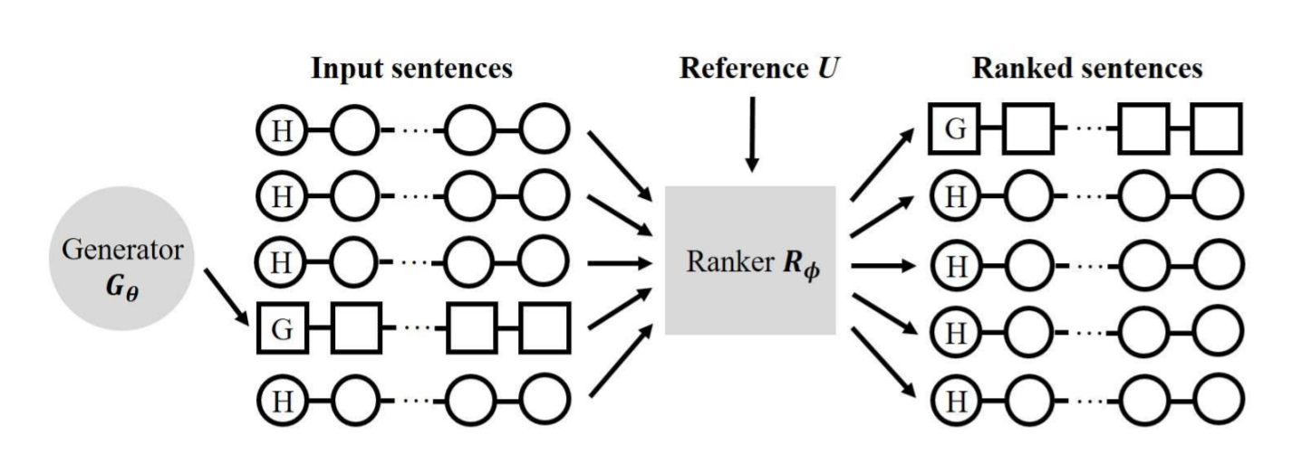
Tips: RankGAN
Kevin Lin, Dianqi Li, Xiaodong He, Zhengyou Zhang, Ming-Ting Sun, “Adversarial Ranking for Language Generation”, NIPS 2017
Image caption generation:
Notes:
For a large variety of natural language expressions, this binary predication is too restrictive, since the diversity and richness inside the sentences are constrained by the degenerated distribution due to binary classification

Slide 30
Experimental Results
Input | We've got to look for another route.
MLE | I'm sorry.
GAN | You're not going to be here for a while.
Input | You can save him by talking.
MLE | I don't know.
GAN | You know what's going on in there, you know what I mean?
MLE frequently generates “I’m sorry”, “I don’t know”, etc. (corresponding to fuzzy images?)
GAN generates longer and more complex responses (however, no strong evidence shows that they are better)
Find more comparison in the survey papers.
[Lu, et al., arXiv, 2018][Zhu, et al., arXiv, 2018]
Notes:
Sidi Lu, Yaoming Zhu, Weinan Zhang, Jun Wang, Yong Yu, Neural Text Generation: Past, Present and Beyond, arXiv, 2018
Yaoming Zhu, Sidi Lu, Lei Zheng, Jiaxian Guo, Weinan Zhang, Jun Wang, Yong Yu, Texygen: A Benchmarking Platform for Text Generation Models, arXiv, 2018
(unpublished)
{\bf Input} & i 'm shaking .\\\hline*****
{\bf MLE} & i 'm sorry .\\
{\bf stepGAN} & okay ?\\\hline\hline
{\bf Input} & i got the money right here .\\\hline*****
{\bf MLE} & i 'm sorry .\\
{\bf stepGAN} & i 'll take you home .\\\hline\hline
{\bf Input} & we 've got to look for another route .\\\hline*****
{\bf MLE} & i 'm sorry .\\
{\bf stepGAN} & you 're not going to be here for a while .\\\hline\hline
{\bf Input} & sort of .\\\hline*****
{\bf MLE} & i 'm sorry .\\
{\bf stepGAN} & you 're right .\\\hline\hline
{\bf Input} & i was so stupid to think that anything could ever change you .\\\hline*****
{\bf MLE} & i 'm sorry .\\
{\bf stepGAN} & you 're gonna be all right .\\\hline\hline
{\bf Input} & thank you , thank you .\\\hline*****
{\bf MLE} & i 'm sorry .\\
{\bf stepGAN} & you 're welcome .\\\hline\hline
{\bf Input} & i don 't think so .\\\hline*****
{\bf MLE} & i don 't know .\\
{\bf stepGAN} & what 's your name ?\\\hline\hline
{\bf Input} & what choice ?\\\hline*****
{\bf MLE} & i don 't know .\\
{\bf stepGAN} & what 's going on ?\\\hline\hline
{\bf Input} & weren 't you saying what a beautiful day it was ?\\\hline*****
{\bf MLE} & i don 't know .\\
{\bf stepGAN} & i don 't know what you 're talking about .\\\hline\hline
{\bf Input} & you can save him by talking .\\\hline*****
{\bf MLE} & i don 't know .\\
{\bf stepGAN} & you know what 's going on in there , you know what i mean ?\\\hline\hline
{\bf Input} & hey , dad , why don 't you get remarried ?\\\hline*****
{\bf MLE} & i don 't know .\\
{\bf stepGAN} & i don 't want you to go out there .\\\hline\hline
{\bf Input} & you need to go somewhere where you can get a genuine rest .\\\hline*****
{\bf MLE} & i don 't know .\\
{\bf stepGAN} & what 's the matter with you two ?\\\hline\hline
{\bf Input} & god , you know , i cannot wait .\\\hline*****
{\bf MLE} & i don 't know .\\
{\bf stepGAN} & i got you guys .\\\hline\hline
{\bf Input} & that 's funny .\\\hline*****
{\bf MLE} & i don 't know .\\
{\bf stepGAN} & you 're funny .\\\hline\hline

Slide 31
More Applications
Supervised machine translation [Wu, et al., arXiv 2017][Yang, et al., arXiv 2017]
Supervised abstractive summarization [Liu, et al., AAAI 2018]
Image/video caption generation [Rakshith Shetty, et al., ICCV 2017][Liang, et al., arXiv 2017]
If you are using seq2seq models,
consider to improve them by GAN.
Notes:
IRGAN: A Minimax Game for Unifying Generative and Discriminative Information Retrieval Models
Improving Neural Machine Translation with Conditional Sequence Generative Adversarial Nets，

Slide 32
Outline of Part III
Conditional Sequence Generation
RL (human feedback)
GAN (discriminator feedback)
Unsupervised Abstractive Summarization
Unsupervised Conditional Sequence Generation
Unsupervised Translation
Text Style Transfer
Notes:
RF and GAN for chat-bot
Human provides feedback
GAN for chat-bot
Machine (discriminator) provides feedback
Rewarding for Every Generation Step
MCMC
Rewarding Partial Decoded Sequence

Slide 33
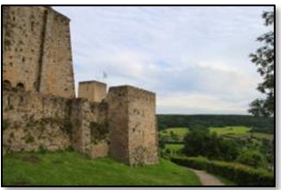
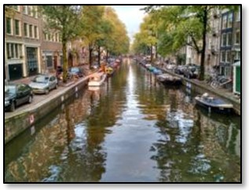
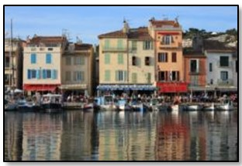
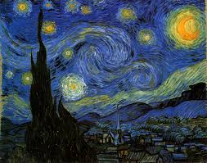
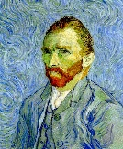
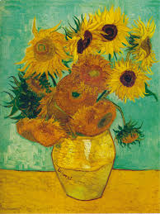
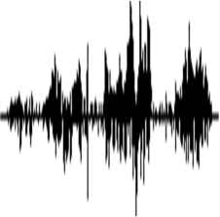
Text Style Transfer
Domain X
Domain Y
male
female
It is good.
It is bad.
It’s a good day.
It’s a bad day.
I love you.
I don’t love you.
positive sentences
negative sentences
Notes:
Transform an object from one domain to another without paired data
Oerview: https://arxiv.org/abs/1711.06861

Slide 34
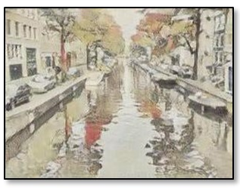
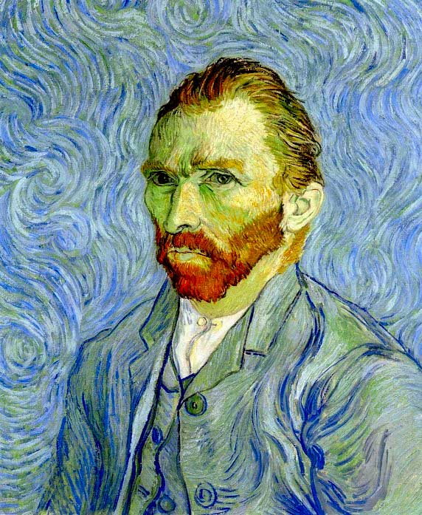
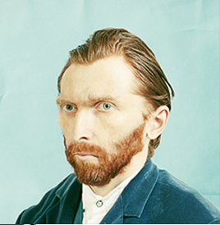
Direct Transformation
as close as possible
$$G_{X→Y}$$
$$G_{Y→X}$$
scalar: belongs to domain X or not
$$D_{Y}$$
scalar: belongs to domain Y or not
$$D_{X}$$
$$G_{Y→X}$$
$$G_{X→Y}$$
as close as possible

Slide 35
Direct Transformation
as close as possible
$$G_{X→Y}$$
$$G_{Y→X}$$
It is bad.
It is good.
It is bad.
negative
positive
negative
$$D_{Y}$$
$$D_{X}$$
positive sentence?
negative sentence?
I love you.
$$G_{Y→X}$$
$$G_{X→Y}$$
I hate you.
I love you.
positive
negative
positive
as close as possible

Slide 36
Direct Transformation
Discrete?
Word embedding
[Lee, et al., ICASSP, 2018]
as close as possible
$$G_{X→Y}$$
$$G_{Y→X}$$
It is bad.
It is good.
It is bad.
negative
positive
negative
$$D_{Y}$$
$$D_{X}$$
positive sentence?
negative sentence?
I love you.
$$G_{Y→X}$$
$$G_{X→Y}$$
I hate you.
I love you.
positive
negative
positive
as close as possible

Slide 37
Negative sentence to positive sentence: it's a crappy day $→$ it's a great day i wish you could be here $→$ you could be here it's not a good idea $→$ it's good idea i miss you $→$ i love you i don't love you $→$ i love you i can't do that $→$ i can do that i feel so sad $→$ i happy it's a bad day $→$ it's a good day it's a dummy day $→$ it's a great day sorry for doing such a horrible thing $→$ thanks for doing a great thing my doggy is sick $→$ my doggy is my doggy my little doggy is sick $→$ my little doggy is my little doggy
Notes:
$\text{antonym}→$KK[ˋæntə͵nɪm]
The antonym of sick

Slide 38
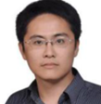
Projection to Common Space
Discriminator of X domain
$${EN}_{X}$$
$${DE}_{X}$$
$$D_{X}$$
$${EN}_{Y}$$
$${DE}_{Y}$$
$$D_{Y}$$
Discriminator of Y domain

Slide 39
Projection to Common Space
Decoder hidden layer as discriminator input
[Shen, et al., NIPS, 2017]
Discriminator of X domain
Positive
Sentence
$${EN}_{X}$$
$${DE}_{X}$$
Positive
Sentence
$$D_{X}$$
Negative
Sentence
$${EN}_{Y}$$
$${DE}_{Y}$$
Negative
Sentence
$$D_{Y}$$
Discriminator of Y domain
${EN}_{X}$ and ${EN}_{Y}$ fool the domain discriminator
Domain
Discriminator
From ${EN}_{X}$ or ${EN}_{Y}$
[Zhao, et al., arXiv, 2017]
[Fu, et al., AAAI, 2018]

Slide 40
Outline of Part III
Improving Supervised Seq-to-seq Model
RL (human feedback)
GAN (discriminator feedback)
Unsupervised Seq-to-seq Model
Text Style Transfer
Unsupervised Abstractive Summarization
Unsupervised Translation
Notes:
RF and GAN for chat-bot
Human provides feedback
GAN for chat-bot
Machine (discriminator) provides feedback
Rewarding for Every Generation Step
MCMC
Rewarding Partial Decoded Sequence

Slide 41
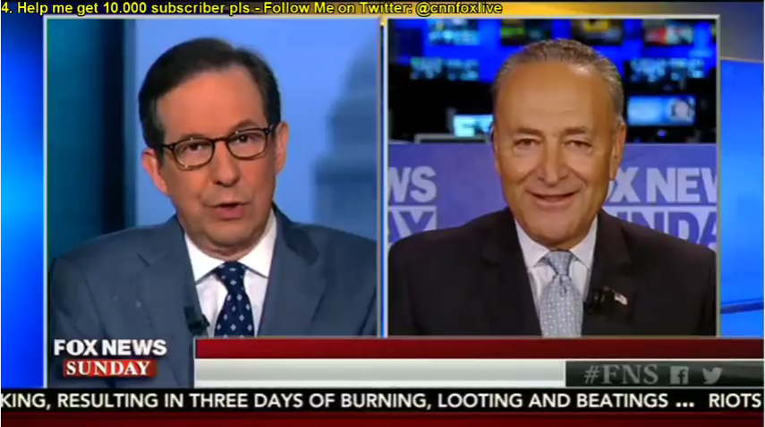
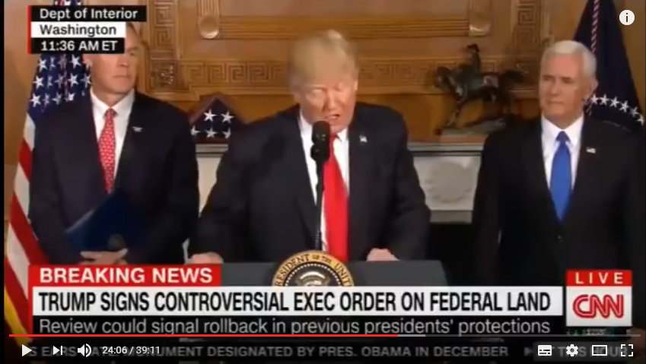
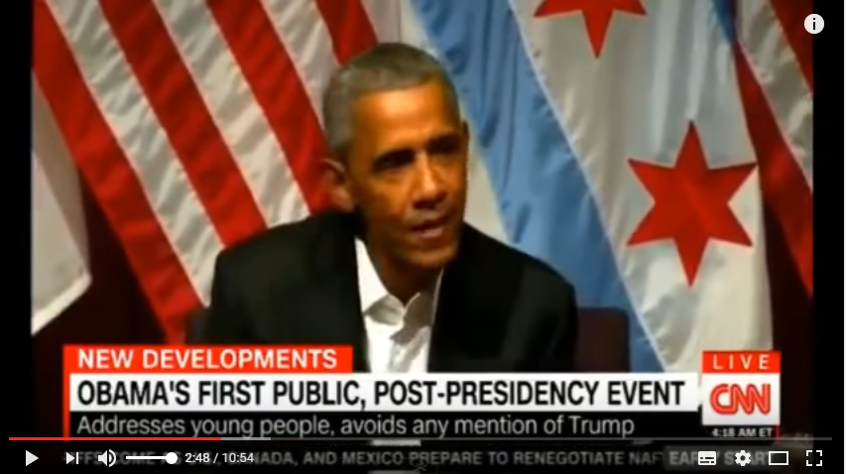
Abstractive Summarization
Now machine can do abstractive summary by seq2seq (write summaries in its own words)
summary 1
summary 2
summary
(in its own words)
summary 3
seq2seq
Supervised: We need lots of labelled training data.
Training Data
Notes:
Title generation: abstractive summary with one sentence

Slide 42
Review: Unsupervised Conditional Generation
Domain X
Domain Y
Speaker A
Speaker B
document
summary

Slide 43
Unsupervised Abstractive Summarization
Human written summaries
Real or not
D
Discriminator
word
sequence
document
Summary?
G
Seq2seq

Slide 44
Unsupervised Abstractive Summarization
Human written summaries
Real or not
D
Discriminator
word
sequence
document
document
G
R
Seq2seq
Seq2seq
minimize the reconstruction error

Slide 45
Unsupervised Abstractive Summarization
Only need a lot of documents to train the model
This is a seq2seq2seq auto-encoder.
Using a sequence of words as latent representation.
not readable …
word
sequence
document
document
G
R
Summary?
Seq2seq
Seq2seq

Slide 46
Unsupervised Abstractive Summarization
REINFORCE algorithm is used.
Human written summaries
Real or not
Let Discriminator considers my output as real
D
Discriminator
word
sequence
document
document
Readable
G
R
Summary?
Seq2seq
Seq2seq

Slide 47
Unsupervised Abstractive Summarization
感謝 王耀賢 同學提供實驗結果
Document:澳大利亞今天與13個國家簽署了反興奮劑雙邊協議,旨在加強體育競賽之外的藥品檢查並共享研究成果 ……
Summary:
Human:澳大利亞與13國簽署反興奮劑協議
Unsupervised:澳大利亞加強體育競賽之外的藥品檢查
Document:中華民國奧林匹克委員會今天接到一九九二年冬季奧運會邀請函,由於主席張豐緒目前正在中南美洲進行友好訪問,因此尚未決定是否派隊赴賽 ……
Summary:
Human:一九九二年冬季奧運會函邀我參加
Unsupervised:奧委會接獲冬季奧運會邀請函

Slide 48
Unsupervised Abstractive Summarization
感謝 王耀賢 同學提供實驗結果
Document:據此間媒體27日報道,印度尼西亞蘇門答臘島的兩個省近日來連降暴雨,洪水泛濫導致塌方,到26日為止至少已有60人喪生,100多人失蹤 ……
Summary:
Human:印尼水災造成60人死亡
Unsupervised:印尼門洪水泛濫導致塌雨
Document:安徽省合肥市最近為領導幹部下基層做了新規定:一律輕車簡從,不準搞迎來送往、不準搞層層陪同 ……
Summary:
Human:合肥規定領導幹部下基層活動從簡
Unsupervised:合肥領導幹部下基層做搞迎來送往規定:一律簡

Slide 49
Semi-supervised Learning
(unpublished result)
Using matched data
(3.8M pairs are used)

Slide 50
Outline of Part III
Improving Supervised Seq-to-seq Model
RL (human feedback)
GAN (discriminator feedback)
Unsupervised Seq-to-seq Model
Text Style Transfer
Unsupervised Abstractive Summarization
Unsupervised Translation
Notes:
RF and GAN for chat-bot
Human provides feedback
GAN for chat-bot
Machine (discriminator) provides feedback
Rewarding for Every Generation Step
MCMC
Rewarding Partial Decoded Sequence

Slide 51
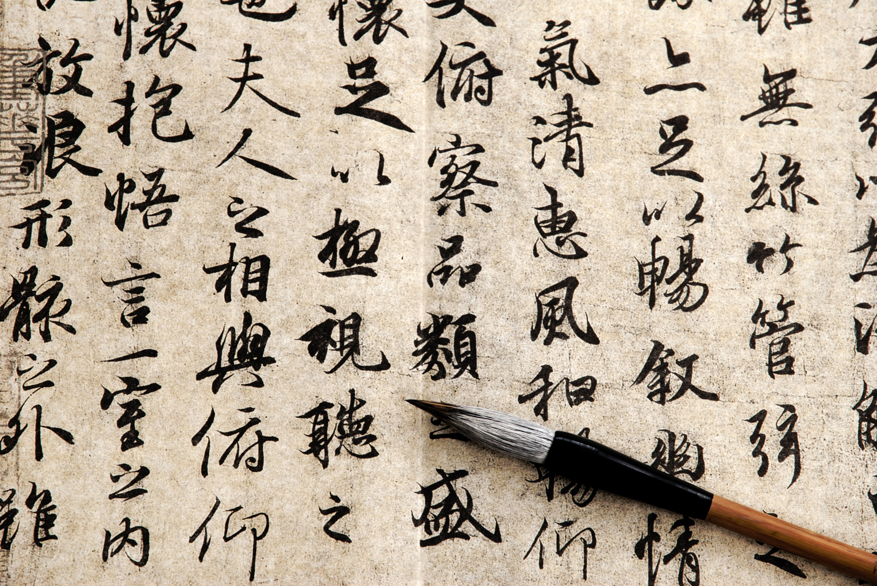
Unsupervised Machine Translation
Domain X
Domain Y
male
female
positive sentences
[Alexis Conneau, et al., ICLR, 2018]
[Guillaume Lample, et al., ICLR, 2018]
Notes:
Transform an object from one domain to another without paired data
Facebook AI Research,

Slide 52
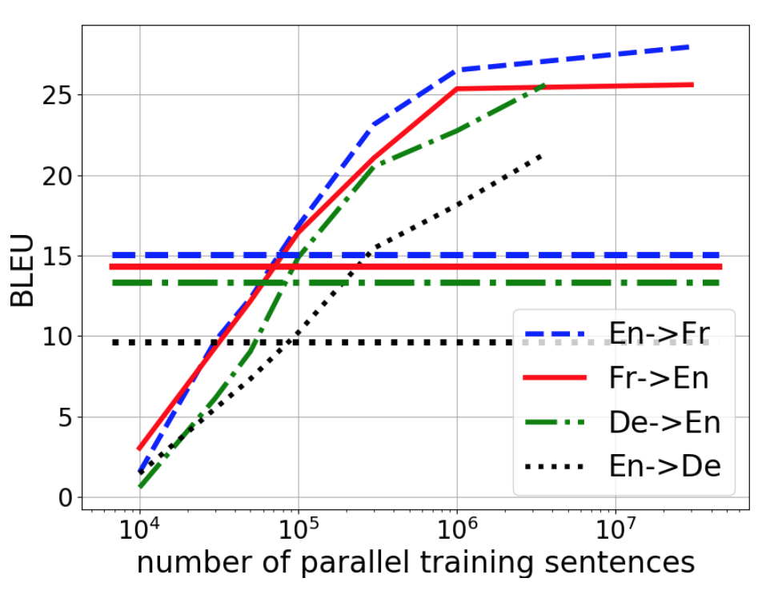
supervised
unsupervised
Unsupervised learning with 10M sentences
$$=$$
Supervised learning with 100K sentence pairs
Notes:
de 德文 German
Star War
C-3PO learnt the Ewok language through observation.
https://scifi.stackexchange.com/questions/124394/how-did-c3po-know-the-ewok-language
The 3PO-series protocol droids are equipped with a TranLang III communications module. It comes with up to six million galactic languages - common and obscure, organic and inorganic - at purchase. It also possessed phonetic pattern analysers that provides the capability to learn and translate new languages not in its existing database.
Same corpus or not?
Unsupervised Machine Translation

Slide 53
Unsupervised Speech Recognition
p₁
p₂
p₃
p₄
The dog is ……
The cats are ……
p₁
p₃
p₂
The woman is ……
p₁
p₄
p₃
p₅
p₅
Cycle GAN
The cat is ……
p₁
p₅
p₄
p₃
The man is ……
Acoustic Pattern Discovery
Can we achieve unsupervised speech recognition?
p₁
=
“The”
[Liu, et al., arXiv, 2018] [Chen, et al., arXiv, 2018]

Slide 54
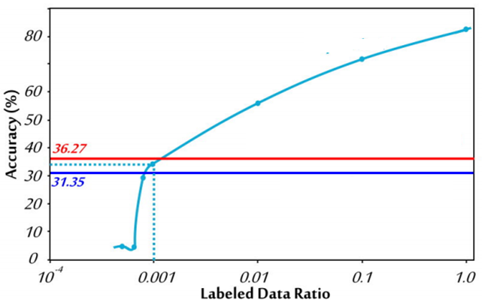
Unsupervised Speech Recognition
Audio: TIMIT
Text: WMT
Phoneme recognition
supervised
Gumbel-softmax
WGAN-GP
Notes:
I admit

Slide 55
Concluding Remarks
Conditional Sequence Generation
RL (human feedback)
GAN (discriminator feedback)
Unsupervised Abstractive Summarization
Unsupervised Conditional Sequence Generation
Unsupervised Translation
Text Style Transfer
Notes:
RF and GAN for chat-bot
Human provides feedback
GAN for chat-bot
Machine (discriminator) provides feedback
Rewarding for Every Generation Step
MCMC
Rewarding Partial Decoded Sequence

Slide 56
Concluding Remarks
from A to Z
Notes:
https://arxiv.org/pdf/1706.04987.pdf
Alpha GAN compare different approach

Slide 57
A
B
C
D
E
F
ACGAN
BiGAN
CycleGAN
DCGAN
EBGAN
fGAN
DuelGAN
G
H
I
J
K
L
GAN
?
InfoGAN
?
?
LSGAN
(only list those mentioned in class)
Notes:
ACGAN, semi, tripleGAN 2
Style transfer: double, Duel, star …. 2
Feature disentangle 1
Progressive GAN, stack GAN 1

Slide 58
M
N
O
P
Q
R
MMGAN
NSGAN
?
Progressive
GAN
?
Rank
GAN
S
T
U
V
W
X
StackGAN
Triple
GAN
Unroll
GAN
VAEGAN
WGAN
XGAN
StarGAN
SeqGAN
Y
Z
?
?

Slide 59
Reference
Conditional Sequence Generation
Jiwei Li, Will Monroe, Alan Ritter, Michel Galley, Jianfeng Gao, Dan Jurafsky, Deep Reinforcement Learning for Dialogue Generation, EMNLP, 2016
Jiwei Li, Will Monroe, Tianlin Shi, Sébastien Jean, Alan Ritter, Dan Jurafsky, Adversarial Learning for Neural Dialogue Generation, EMNLP, 2017
Matt J. Kusner, José Miguel Hernández-Lobato, GANS for Sequences of Discrete Elements with the Gumbel-softmax Distribution, arXiv 2016
Tong Che, Yanran Li, Ruixiang Zhang, R Devon Hjelm, Wenjie Li, Yangqiu Song, Yoshua Bengio, Maximum-Likelihood Augmented Discrete Generative Adversarial Networks, arXiv 2017
Lantao Yu, Weinan Zhang, Jun Wang, Yong Yu, SeqGAN: Sequence Generative Adversarial Nets with Policy Gradient, AAAI 2017

Slide 60
Reference
Conditional Sequence Generation
Sai Rajeswar, Sandeep Subramanian, Francis Dutil, Christopher Pal, Aaron Courville, Adversarial Generation of Natural Language, arXiv, 2017
Ofir Press, Amir Bar, Ben Bogin, Jonathan Berant, Lior Wolf, Language Generation with Recurrent Generative Adversarial Networks without Pre-training, ICML workshop, 2017
Zhen Xu, Bingquan Liu, Baoxun Wang, Chengjie Sun, Xiaolong Wang, Zhuoran Wang, Chao Qi , Neural Response Generation via GAN with an Approximate Embedding Layer, EMNLP, 2017
Alex Lamb, Anirudh Goyal, Ying Zhang, Saizheng Zhang, Aaron Courville, Yoshua Bengio, Professor Forcing: A New Algorithm for Training Recurrent Networks, NIPS, 2016
Yizhe Zhang, Zhe Gan, Kai Fan, Zhi Chen, Ricardo Henao, Dinghan Shen, Lawrence Carin, Adversarial Feature Matching for Text Generation, ICML, 2017
Jiaxian Guo, Sidi Lu, Han Cai, Weinan Zhang, Yong Yu, Jun Wang, Long Text Generation via Adversarial Training with Leaked Information, AAAI, 2018
Kevin Lin, Dianqi Li, Xiaodong He, Zhengyou Zhang, Ming-Ting Sun, Adversarial Ranking for Language Generation, NIPS, 2017
William Fedus, Ian Goodfellow, Andrew M. Dai, MaskGAN: Better Text Generation via Filling in the______, ICLR, 2018
Notes:
Adversarial generation for natural language -> This paper has CNN v.s. RNN

Slide 61
Reference
Conditional Sequence Generation
Sidi Lu, Yaoming Zhu, Weinan Zhang, Jun Wang, Yong Yu, Neural Text Generation: Past, Present and Beyond, arXiv, 2018
Yaoming Zhu, Sidi Lu, Lei Zheng, Jiaxian Guo, Weinan Zhang, Jun Wang, Yong Yu, Texygen: A Benchmarking Platform for Text Generation Models, arXiv, 2018
Zhen Yang, Wei Chen, Feng Wang, Bo Xu, Improving Neural Machine Translation with Conditional Sequence Generative Adversarial Nets, NAACL, 2018
Lijun Wu, Yingce Xia, Li Zhao, Fei Tian, Tao Qin, Jianhuang Lai, Tie-Yan Liu, Adversarial Neural Machine Translation, arXiv 2017
Linqing Liu, Yao Lu, Min Yang, Qiang Qu, Jia Zhu, Hongyan Li, Generative Adversarial Network for Abstractive Text Summarization, AAAI 2018
Rakshith Shetty, Marcus Rohrbach, Lisa Anne Hendricks, Mario Fritz, Bernt Schiele, Speaking the Same Language: Matching Machine to Human Captions by Adversarial Training, ICCV 2017
Xiaodan Liang, Zhiting Hu, Hao Zhang, Chuang Gan, Eric P. Xing, Recurrent Topic-Transition GAN for Visual Paragraph Generation, arXiv 2017

Slide 62
Reference
Text Style Transfer
Zhenxin Fu, Xiaoye Tan, Nanyun Peng, Dongyan Zhao, Rui Yan, Style Transfer in Text: Exploration and Evaluation, AAAI, 2018
Tianxiao Shen, Tao Lei, Regina Barzilay, and Tommi Jaakkola, Style Transfer from Non-Parallel Text by Cross-Alignment, NIPS 2017
Chih-Wei Lee, Yau-Shian Wang, Tsung-Yuan Hsu, Kuan-Yu Chen, Hung-Yi Lee, Lin-shan Lee, Scalable Sentiment for Sequence-to-sequence Chatbot Response with Performance Analysis, ICASSP, 2018
Junbo (Jake) Zhao, Yoon Kim, Kelly Zhang, Alexander M. Rush, Yann LeCun, Adversarially Regularized Autoencoders, arxiv, 2017
Notes:
Igor Melnyk, Cicero Nogueira dos Santos, Kahini Wadhawan, Inkit Padhi, Abhishek Kumar, Improved Neural Text Attribute Transfer with Non-parallel Data, NIPS Workshop, 2017

Slide 63
Reference
Unsupervised Machine Translation
Alexis Conneau, Guillaume Lample, Marc'Aurelio Ranzato, Ludovic Denoyer, Hervé Jégou, Word Translation Without Parallel Data, ICRL 2018
Guillaume Lample, Ludovic Denoyer, Marc'Aurelio Ranzato, Unsupervised Machine Translation Using Monolingual Corpora Only, ICRL 2018
Unsupervised Speech Recognition
Da-Rong Liu, Kuan-Yu Chen, Hung-Yi Lee, Lin-shan Lee, Completely Unsupervised Phoneme Recognition by Adversarially Learning Mapping Relationships from Audio Embeddings, arXiv, 2018
Yi-Chen Chen, Chia-Hao Shen, Sung-Feng Huang, Hung-yi Lee, Towards Unsupervised Automatic Speech Recognition Trained by Unaligned Speech and Text only, arXiv, 2018

