Slide 1
Generative Adversarial Network
李宏毅
Hung-yi Lee
Notes:
TODO:
Example for summarization??????
Do people compare different text style???
Q: the iterative approach definitely converge???
Pg converge to Pdata
Q: Why not learn generator and discriminator jointly?
You can
Q: rumer about the prior discribution
I don’t know
Q: minmax and maxmin
Maxmin <minmax
Q: how about directly use regularization in WGAN
I don’t know.
Q: AE-GAN alpha GAN
This one looks good: https://becominghuman.ai/gans-for-simulation-representation-and-inference-d215c251ed12
https://lilianweng.github.io/lil-log/2017/08/20/from-GAN-to-WGAN.html
Gradient descent GAN optimization is locally stable
MMD

Slide 2
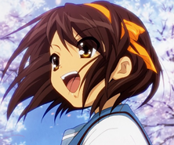
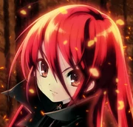
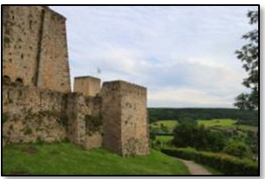
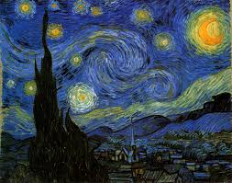
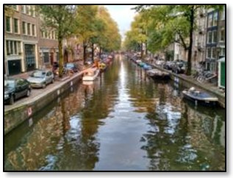
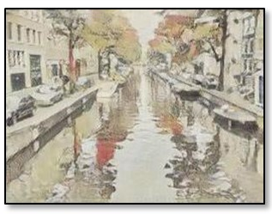
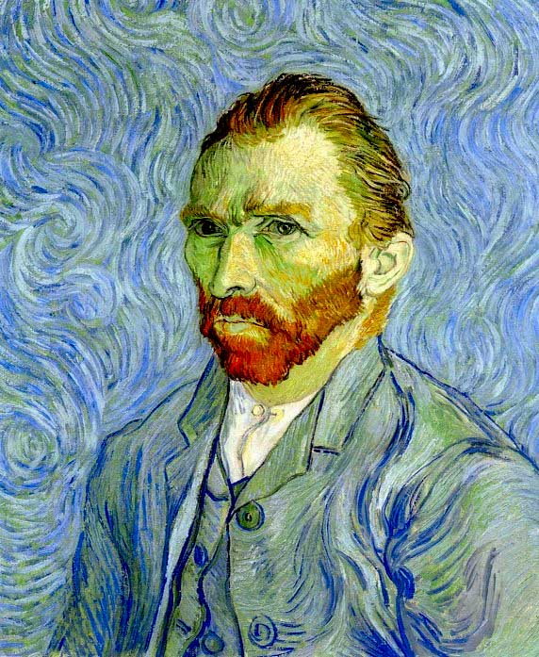
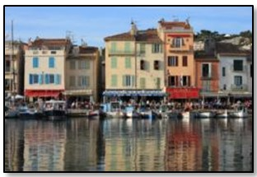
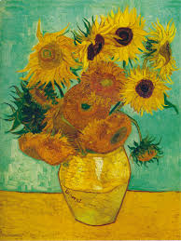
Three Categories of GAN
1. Typical GAN
$$\left[\begin{aligned}−0.3 \\ 0.1 \\ ⋮ \\ 0.9\end{aligned}\right]$$
Generator
random vector
image
2. Conditional GAN
blue eyes,
red hair,
short hair
Generator
“Girl with red hair”
paired data
text
image
3. Unsupervised Conditional GAN
domain x
domain y
x
y
Generator
Photo
Vincent van Gogh’s style
unpaired data

Slide 3
Generative Adversarial Network (GAN)
Anime face generation as example
Generator
high dimensional vector
image
vector
Discri-minator
image
score
Larger score means real, smaller score means fake.

Slide 4
Algorithm
G
D
Initialize generator and discriminator
In each training iteration:
Step 1: Fix generator G, and update discriminator D
sample
Update
1
1
1
1
D
generated objects
Database
0
0
0
0
randomly sampled
G
vector
Fix
vector
vector
vector
Discriminator learns to assign high scores to real objects and low scores to generated objects.

Slide 5
Algorithm
G
D
Initialize generator and discriminator
In each training iteration:
Step 2: Fix discriminator D, and update generator G
Generator learns to “fool” the discriminator
hidden layer
NN
Generator
Discri-minator
0.13
vector
update
fix
large network
Backpropagation

Slide 6
Algorithm
G
D
Initialize generator and discriminator
In each training iteration:
Sample some real objects:
Update
1
1
1
1
Learning
D
D
Generate some fake objects:
0
0
0
0
G
vector
fix
vector
vector
vector
Learning
G
image
G
image
D
1
vector
image
vector
vector
vector
image
update
fix

Slide 7
https://crypko.ai/#/

Slide 8
GAN is hard to train ……
There is a saying ……
(I found this joke from 陳柏文’s facebook.)

Slide 9
Three Categories of GAN
1. Typical GAN
$$\left[\begin{aligned}−0.3 \\ 0.1 \\ ⋮ \\ 0.9\end{aligned}\right]$$
Generator
random vector
image
2. Conditional GAN
blue eyes,
red hair,
short hair
Generator
“Girl with red hair”
paired data
text
image
3. Unsupervised Conditional GAN
domain x
domain y
x
y
Generator
Photo
Vincent van Gogh’s style
unpaired data

Slide 10
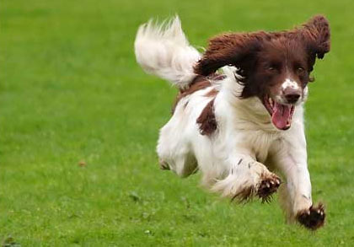
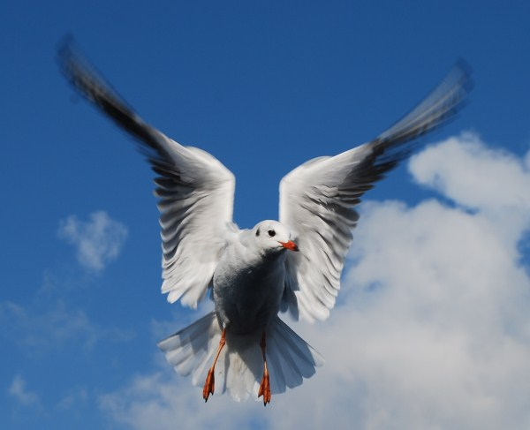
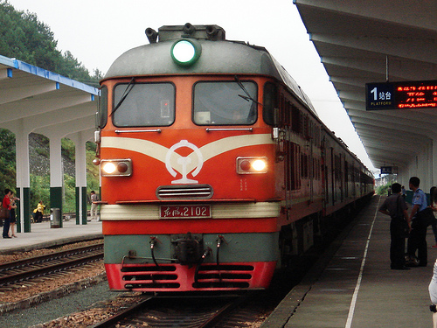
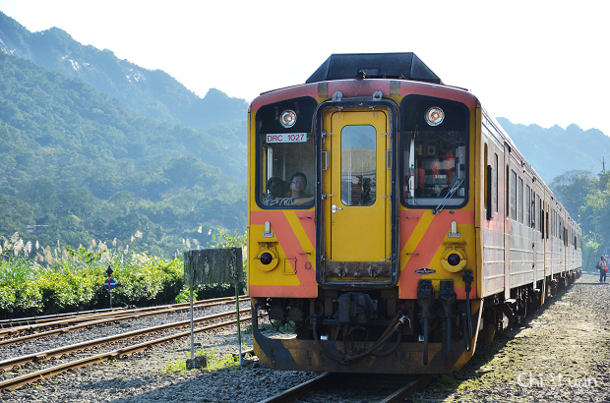
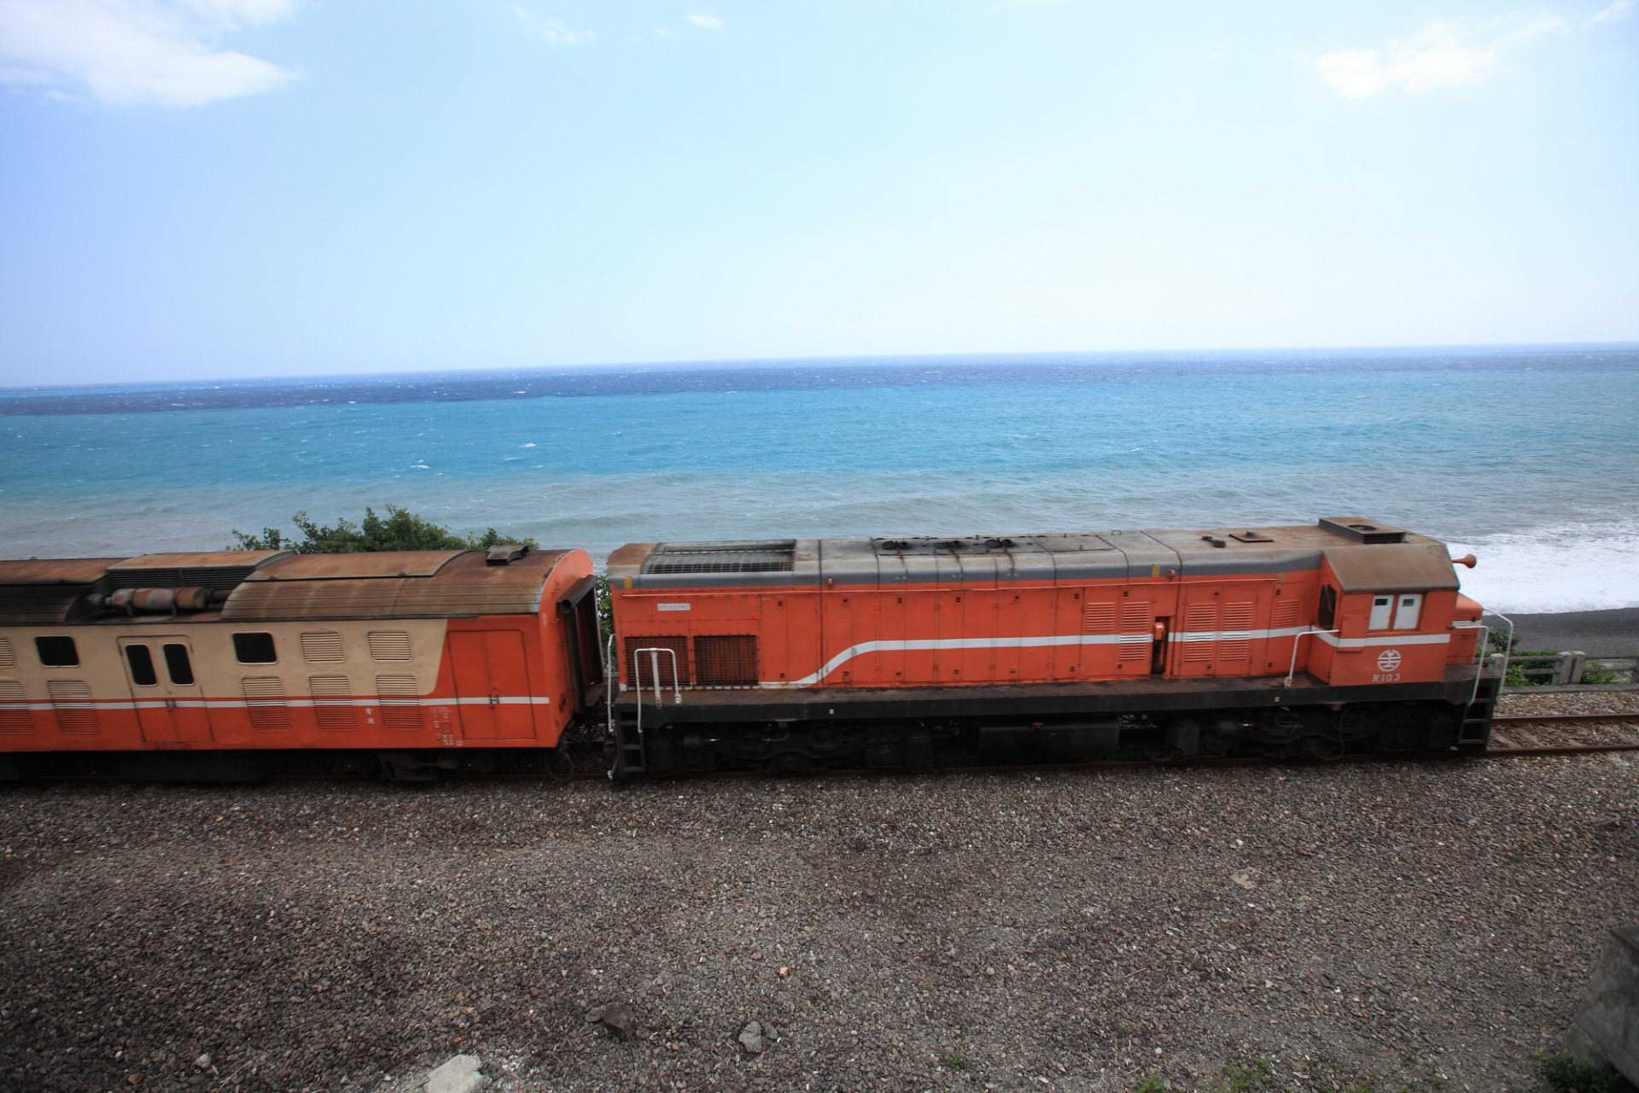
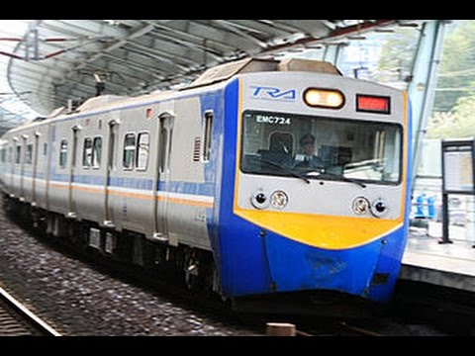
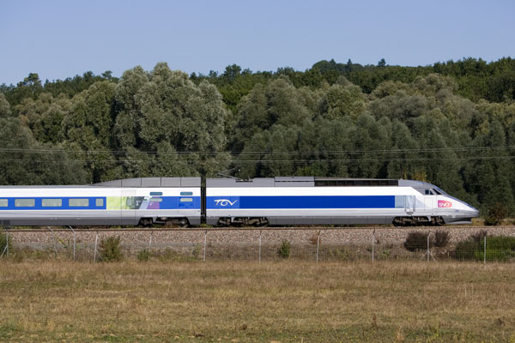
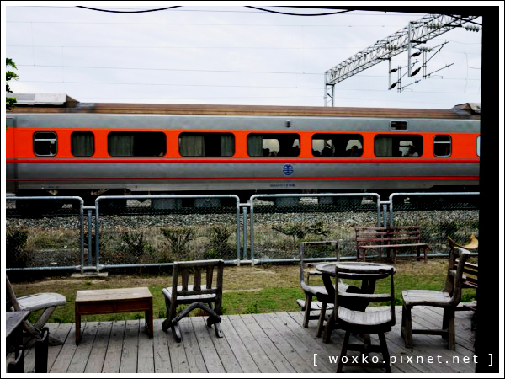
Text-to-Image
a dog is running
a bird is flying
Traditional supervised approach
Image
NN
c¹: a dog is running
as close as possible
Text: “train”
Target of NN output
A blurry image!

Slide 11
Conditional GAN
[Scott Reed, et al, ICML, 2016]
c: train
G
Image
x = G(c,z)
Normal distribution
$$z$$
x is real image or not
D
(original)
Generator will learn to generate realistic images ….
$$x$$
scalar
But completely ignore the input conditions.
Real images:
1
Generated images:
0

Slide 12
Conditional GAN
[Scott Reed, et al, ICML, 2016]
c: train
G
Image
x = G(c,z)
Normal distribution
$$z$$
$$c$$
D
(better)
x is realistic or not +
c and x are matched or not
scalar
$$x$$
(train , )
True text-image pairs:
1
(cat , )
0
(train , )
0

Slide 13
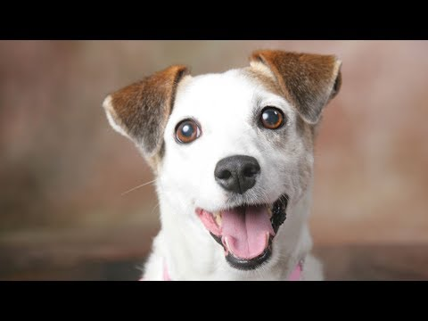
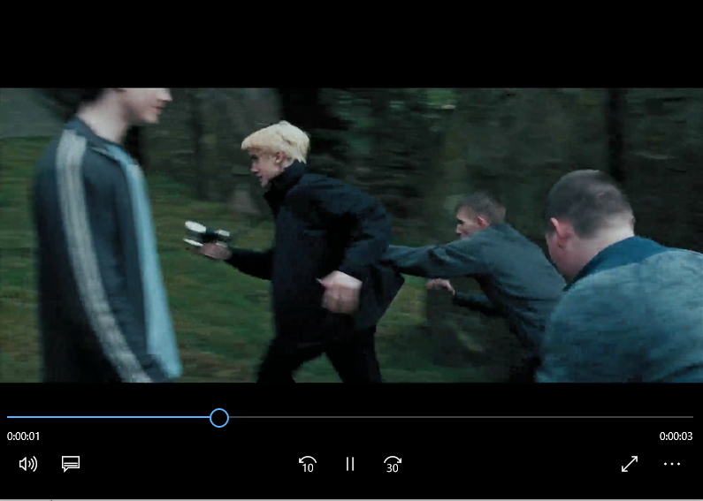
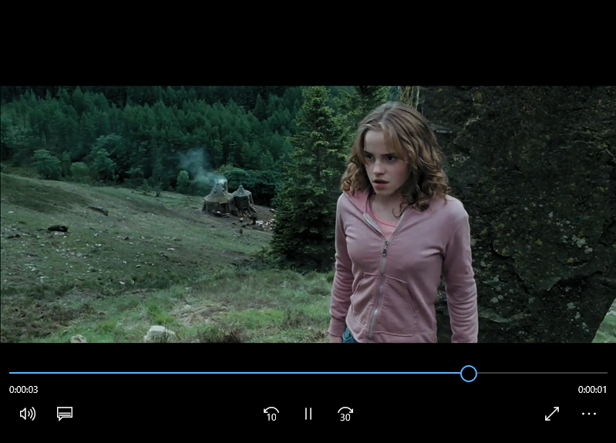
Conditional GAN - Sound-to-image
G
Image
c: sound
"a dog barking sound"
Training Data Collection
video
Notes:
Sound to vector

Slide 14
Conditional GAN - Sound-to-image
The images are generated by Chia-Hung Wan and Shun-Po Chuang.
https://wjohn1483.github.io/audio_to_scene/index.html
Louder
Audio-to-image
Notes:
Waterfall
splash

Slide 15
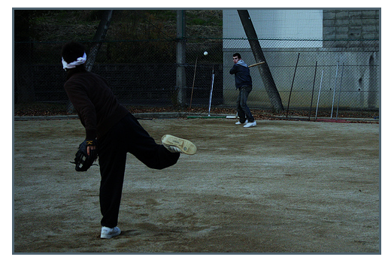
Conditional GAN - Image-to-label
Multi-label Image Classifier = Conditional Generator
Input condition
Generated output
Notes:
Considering multi-label classification

Slide 16
Conditional GAN - Image-to-label
F1 | MS-COCO | NUS-WIDE
VGG-16 | 56.0 | 33.9
+ GAN | 60.4 | 41.2
Inception | 62.4 | 53.5
+GAN | 63.8 | 55.8
Resnet-101 | 62.8 | 53.1
+GAN | 64.0 | 55.4
Resnet-152 | 63.3 | 52.1
+GAN | 63.9 | 54.1
Att-RNN | 62.1 | 54.7
RLSD | 62.0 | 46.9
The classifiers can have different architectures.
The classifiers are trained as conditional GAN.
[Tsai, et al., submitted to ICASSP 2019]

Slide 17
Conditional GAN - Image-to-label
F1 | MS-COCO | NUS-WIDE
VGG-16 | 56.0 | 33.9
+ GAN | 60.4 | 41.2
Inception | 62.4 | 53.5
+GAN | 63.8 | 55.8
Resnet-101 | 62.8 | 53.1
+GAN | 64.0 | 55.4
Resnet-152 | 63.3 | 52.1
+GAN | 63.9 | 54.1
Att-RNN | 62.1 | 54.7
RLSD | 62.0 | 46.9
The classifiers can have different architectures.
The classifiers are trained as conditional GAN.
Conditional GAN outperforms other models designed for multi-label.

Slide 18
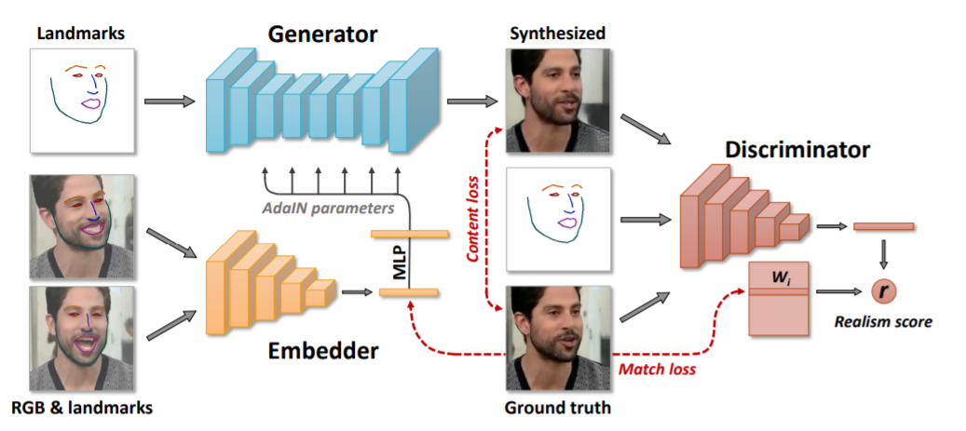
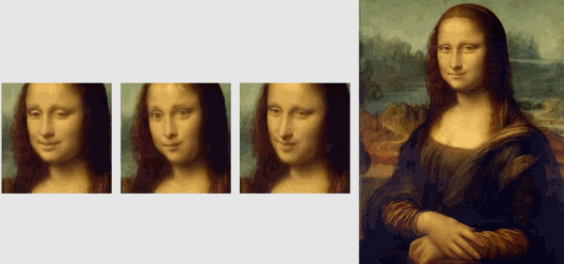
Talking Head
https://arxiv.org/abs/1905.08233

Slide 19
Three Categories of GAN
1. Typical GAN
$$\left[\begin{aligned}−0.3 \\ 0.1 \\ ⋮ \\ 0.9\end{aligned}\right]$$
Generator
random vector
image
2. Conditional GAN
blue eyes,
red hair,
short hair
Generator
“Girl with red hair”
paired data
text
image
3. Unsupervised Conditional GAN
domain x
domain y
x
y
Generator
Photo
Vincent van Gogh’s style
unpaired data

Slide 20
Cycle GAN
Domain X
Domain Y
Become similar to domain Y
Domain X
$$G_{X→Y}$$
?
$$D_{Y}$$
scalar
Input image belongs to domain Y or not
Domain Y
Notes:
https://arxiv.org/abs/1703.10593
https://junyanz.github.io/CycleGAN/
Berkeley AI Research (BAIR) laboratory, UC Berkeley

Slide 21
Cycle GAN
Domain X
Domain Y
Become similar to domain Y
Domain X
$$G_{X→Y}$$
Not what we want!
ignore input
$$D_{Y}$$
scalar
Input image belongs to domain Y or not
Domain Y
Notes:
https://arxiv.org/abs/1703.10593
https://junyanz.github.io/CycleGAN/
Berkeley AI Research (BAIR) laboratory, UC Berkeley

Slide 22
Cycle GAN
[Jun-Yan Zhu, et al., ICCV, 2017]
as close as possible
Cycle consistency
$$G_{X→Y}$$
$$G_{Y→X}$$
Lack of information for reconstruction
$$D_{Y}$$
scalar
Input image belongs to domain Y or not
Domain Y

Slide 23
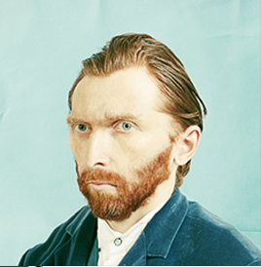
Cycle GAN
as close as possible
$$G_{X→Y}$$
$$G_{Y→X}$$
scalar: belongs to domain X or not
$$D_{Y}$$
scalar: belongs to domain Y or not
$$D_{X}$$
$$G_{Y→X}$$
$$G_{X→Y}$$
as close as possible
Notes:
http://sunreader1309.pixnet.net/blog/post/394665458-%E6%94%9D%E5%BD%B1%E8%88%87%E7%95%AB%E4%BD%9C%EF%BC%8C%E6%A2%B5%E8%B0%B7%E8%87%AA%E7%95%AB%E5%83%8F%E7%9A%84%E7%9C%9F%E9%9D%A2%E7%9B%AE%3F--------------

Slide 24
Cycle GAN
as close as possible
$$G_{X→Y}$$
$$G_{Y→X}$$
It is bad.
It is good.
It is bad.
negative
positive
negative
$$D_{Y}$$
$$D_{X}$$
positive sentence?
negative sentence?
I love you.
$$G_{Y→X}$$
$$G_{X→Y}$$
I hate you.
I love you.
positive
negative
positive
as close as possible

Slide 25
Discrete Issue
Seq2seq model
hidden layer
with discrete output
$$G_{X→Y}$$
It is bad.
It is good.
negative
positive
update
$$D_{Y}$$
positive sentence?
large network
fix
Backpropagation

Slide 26
Three Categories of Solutions
“Reinforcement Learning”
[Yu, et al., AAAI, 2017][Li, et al., EMNLP, 2017][Tong Che, et al, arXiv, 2017][Jiaxian Guo, et al., AAAI, 2018][Kevin Lin, et al, NIPS, 2017][William Fedus, et al., ICLR, 2018]
Gumbel-softmax
[Matt J. Kusner, et al, arXiv, 2016]
Continuous Input for Discriminator
[Sai Rajeswar, et al., arXiv, 2017][Ofir Press, et al., ICML workshop, 2017][Zhen Xu, et al., EMNLP, 2017][Alex Lamb, et al., NIPS, 2016][Yizhe Zhang, et al., ICML, 2017]
Notes:
https://blog.csdn.net/qq_25737169/article/details/78259631

Slide 27
文句改寫
感謝 王耀賢 同學提供實驗結果
Negative sentence to positive sentence:
it's a crappy day -> it's a great day i wish you could be here -> you could be here it's not a good idea -> it's good idea i miss you -> i love you i don't love you -> i love you i can't do that -> i can do that i feel so sad -> i happy it's a bad day -> it's a good day it's a dummy day -> it's a great day sorry for doing such a horrible thing -> thanks for doing a great thing my doggy is sick -> my doggy is my doggy my little doggy is sick -> my little doggy is my little doggy

Slide 28
文句改寫
感謝 張瓊之 同學提供實驗結果
Negative sentence to positive sentence:
胃疼 , 沒睡醒 , 各種不舒服 -> 生日快樂 , 睡醒 , 超級舒服
我都想去上班了, 真夠賤的! -> 我都想去睡了, 真帥的 !
暈死了, 吃燒烤、竟然遇到個變態狂 -> 哈哈好 ~ , 吃燒烤 ~ 竟然遇到帥狂
我肚子痛的厲害 -> 我生日快樂厲害
感冒了, 難受的說不出話來了 ! -> 感冒了, 開心的說不出話 來 !

Slide 29
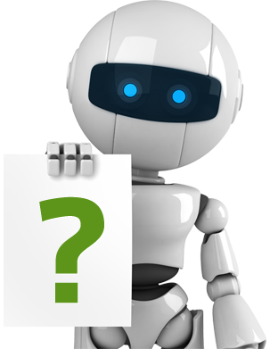
Speech Recognition
Supervised Learning
Human
Teacher
I can do speech recognition
after teaching
This utterance is
“good morning”.
Supervised learning needs lots of annotated speech.
However, most of the languages are low resourced.

Slide 30
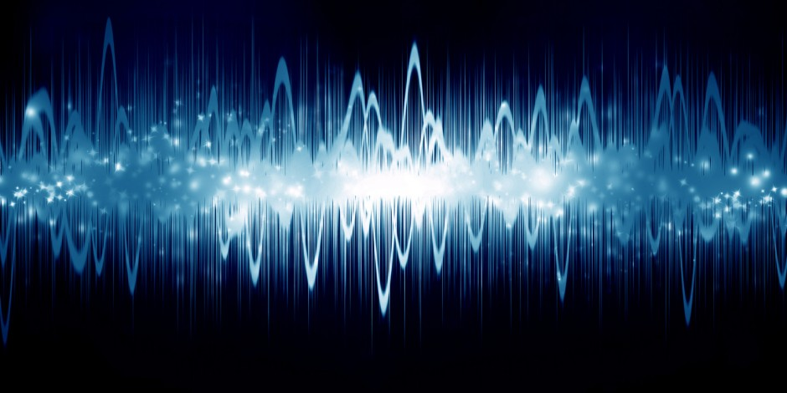
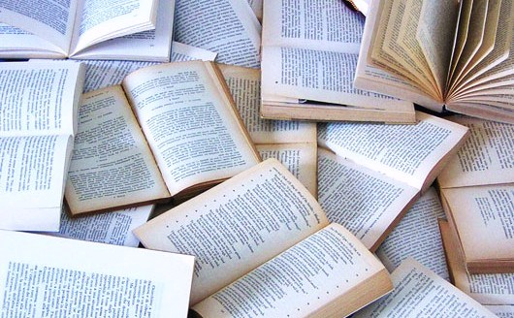
Speech Recognition
Supervised Learning
Human
Teacher
I can do speech recognition
after teaching
This utterance is
“good morning”.
Unsupervised Learning
I can automatically learn speech recognition
Listening to human talking
Reading text on the Internet

Slide 31
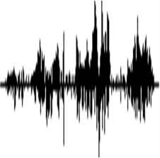
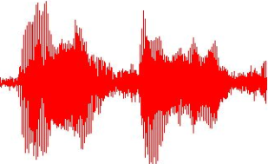
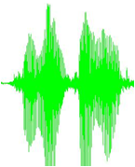
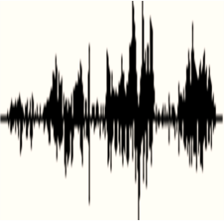
Acoustic Token Discovery
Acoustic tokens can be discovered from audio collection without text annotation.
Acoustic tokens: chunks of acoustically similar audio segments with token IDs
[Zhang & Glass, ASRU 09]
[Huijbregts, ICASSP 11]
[Chan & Lee, Interspeech 11]

Slide 32
Acoustic Token Discovery
Token 3
Token 2
Token 1
Token 2
Token 3
Token 1
Token 1
Token 4
Token 3
Acoustic tokens can be discovered from audio collection without text annotation.
Acoustic tokens: chunks of acoustically similar audio segments with token IDs
[Zhang & Glass, ASRU 09]
[Huijbregts, ICASSP 11]
[Chan & Lee, Interspeech 11]

Slide 33
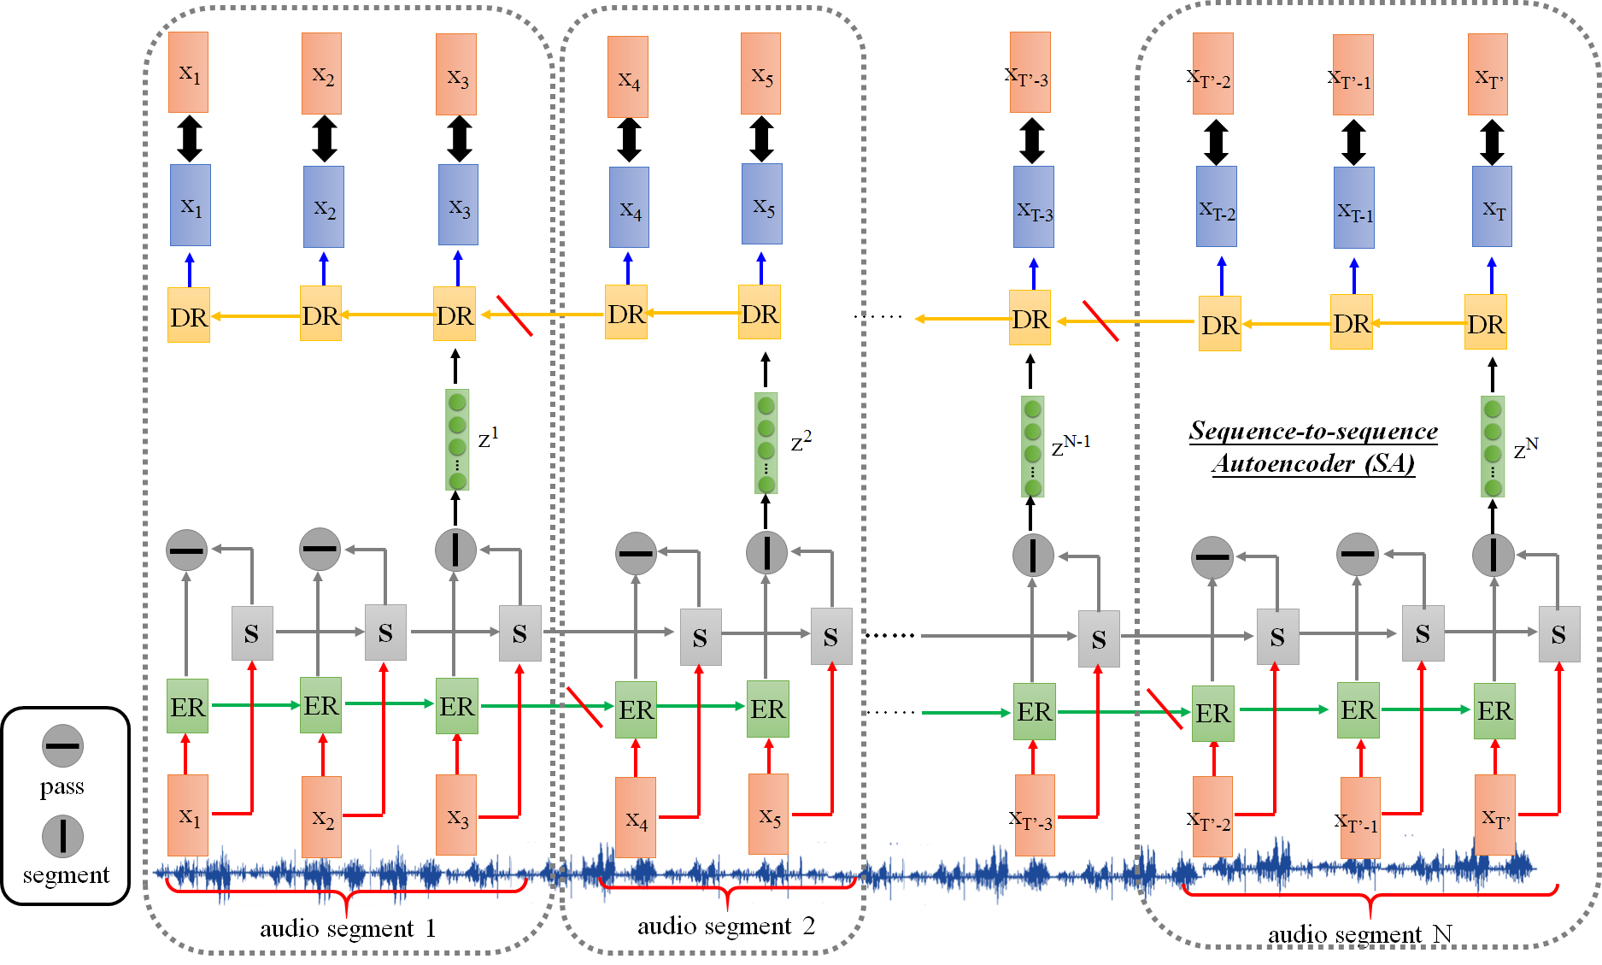
Acoustic Token Discovery
[Wang, et al., ICASSP, 2018]
Phonetic-level acoustic tokens are obtained by segmental sequence-to-sequence autoencoder.

Slide 34
Unsupervised Speech Recognition
p₁
p₂
p₃
p₄
AY L AH V Y UW
p₁
p₃
p₂
G UH D B AY
HH AW AA R Y UW
p₁
p₄
p₃
p₅
p₅
Cycle
GAN
AY M F AY N
p₁
p₅
p₄
p₃
T AY W AA N
Phone-level Acoustic
Pattern Discovery
Phoneme sequences
from Text
[Liu, et al., INTERSPEECH, 2018]
p₁
=
“AY”
[Chen, et al., arXiv, 2018]

Slide 35
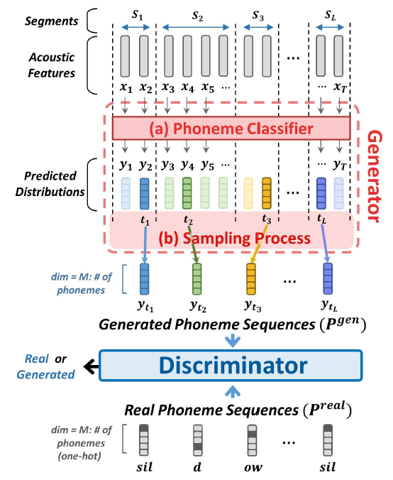
Model

Slide 36
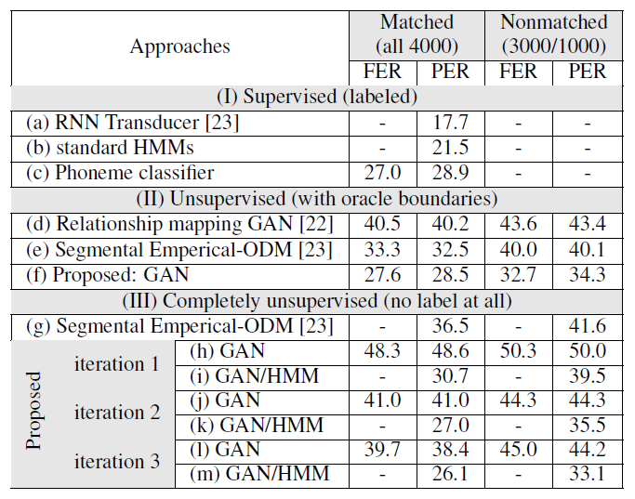
Experimental Results

Slide 37
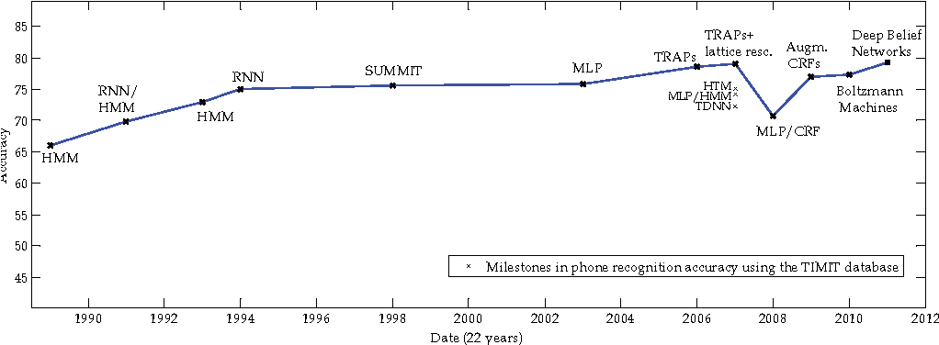
The progress of supervised learning
Accuracy
Unsupervised learning today (2019) is as good as supervised learning 30 years ago.
The image is modified from: Phone recognition on the TIMIT database Lopes, C. and Perdigão, F., 2011. Speech Technologies, Vol 1, pp. 285--302.

Slide 38
Three Categories of GAN
1. Typical GAN
$$\left[\begin{aligned}−0.3 \\ 0.1 \\ ⋮ \\ 0.9\end{aligned}\right]$$
Generator
random vector
image
2. Conditional GAN
blue eyes,
red hair,
short hair
Generator
“Girl with red hair”
paired data
text
image
3. Unsupervised Conditional GAN
domain x
domain y
x
y
Generator
Photo
Vincent van Gogh’s style
unpaired data

Slide 39
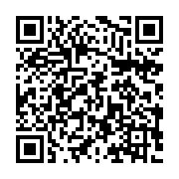
To Learn More …
You can learn more from the YouTube Channel

