Slide 1
10.0 Speech-based Information Retrieval

Slide 2
Text/Speech-based Information Retrieval
Text-based information retrieval extremely successful
  information desired by the users can be obtained very efficiently
  all users like it
  producing very successful industry
All roles of texts can be accomplished by voice
  spoken content or multimedia content with voice in audio part
  voice instructions/queries via handheld devices
Speech-based information retrieval
user
instructions/queries
Server
Internet
Server
Documents/Information

Slide 3
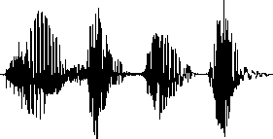
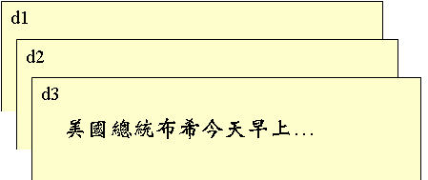
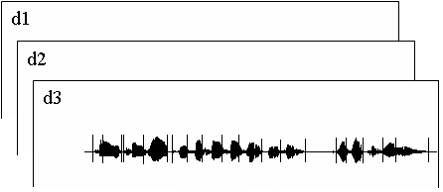

Speech-based Information Retrieval
Spoken Instructions/Queries
Text Instructions/Queries
US president？
Text Content
Spoken content
(multimedia content including audio part)
Barack Obama
Barack Obama
…
…
.
.
User instructions and/or network content can be in form of voice
  text queries/spoken content : spoken document retrieval, spoken term detection
  spoken queries/text content : voice search
  spoken queries/spoken content : query by example
$$\left[\begin{aligned}\text{spoken} \text{content} \\ \text{retrieval} \end{aligned}\right]$$

Slide 4
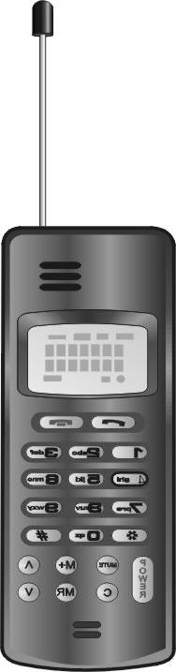
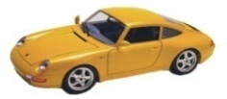
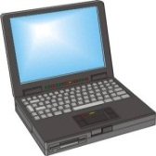
Wireless and Multimedia Technologies are Creating An Environment for Speech-based Information Retrieval
text
information
Text Content
Multimedia and Spoken Content
Text-to-Speech Synthesis
Internet
voice information
Spoken and multi-modal Dialogue
Spoken Content Retrieval
voice input/ output
Multimedia Content Analysis
Text Content Retrieval
Many hand-held devices with multimedia functionalities available
Unlimited quantities of multimedia content fast growing over the Internet
User-content interaction necessary for retrieval can be accomplished by spoken and multi-modal dialogues
Network access is primarily text-based today, but almost all roles of texts can be accomplished by voice

Slide 5


Basic Approach for Spoken Content Retrieval
Recognition Engine
Acoustic Models
Language Model
Lexicon
Spoken
Content
Retrieval Results
(list of spoken documents/utterances)
Transcriptions
Text-based
Search
Engine
user
Query Q
(text or transcribed if in voice)
  Transcribe the spoken content
  Search over the transcriptions as they are texts
  Recognition errors cause serious performance degradation

Slide 6
Lattices for Spoken Content Retrieval
Low recognition accuracies for spontaneous speech including Out-of-Vocabulary (OOV) words under adverse environment
  considering lattices with multiple alternatives rather than 1-best output
  higher probability of including correct words, but also including more noisy words
  correct words may still be excluded (OOV and others)
  huge memory and computation requirements
W₁
W₂
End node
Start node
W₅
W₃
W₄
W₆
W₈
W₉
W₁₀
W₇
W_{i}: word hypotheses
W₈
Time index
Notes:
[Chelba & Acero, ACL 05]
[Can & Saraclar, ICASSP 09]

Slide 7
Other Approach Examples in addition to Lattices
Confusion Matrices
  use of confusion matrices to model recognition errors and expand the query/document, etc.
Pronunciation Modeling
  use of pronunciation models to expand the query, etc.
Fuzzy Matching
  query/content matching not necessarily exact

Slide 8
OOV or Rare Words Handled by Subword Units
OOV Word W=w₁w₂w₃w₄ can’t be recognized and never appears in lattice
  w_{i} : subword units : phonemes, syllables…
  a, b, c, d, e : other subword units
  W=w₁w₂w₃w₄ hidden at subword level
  can be matched at subword level without being recognized
Frequently Used Subword Units
  Linguistically motivated units: phonemes, syllables/characters, morphemes, etc.
  Data-driven units: particles, word fragments, phone multigrams, morphs, etc.
w₃w₄b
Lattice:
a
w₁w₂
w₃w₄
bcd
w₁w₂
w₃w₄
e
w₂w₃
Time index

Slide 9
Performance Measures (1/2)
Recall and Precision Rates
A A+B
Precision rate =
Recall rate =
B A C
A A+C
retrieved documents
relevant documents
  recall rate may be difficult to evaluate, while precision rate is directly perceived by users
  recall-precision plot with varying thresholds

Slide 10
Performance Measures (1/2)
  MAP (mean average precision)
  area under recall-precision curve
  a performance measure frequently used for information retrieval
MAP = 0.586
MAP = 0.484

Slide 11
References
General or basic Spoken Content Retrieval
  http://www.superlectures.com/asru2011/lecture.php?lang=en&id=5 Spoken Content Retrieval - Lattices and Beyond (Lin-shan Lee’s talk at ASRU 2011)
  Chelba, C., Hazen, T.J., Saraclar, M., "Retrieval and browsing of spoken content," Signal Processing Magazine, IEEE , vol.25, no.3, pp.39-49, May 2008
  Martha Larson and Gareth J. F. Jones (2012) " Spoken Content Retrieval: A Survey of Techniques and Technologies ", Foundations and Trends in Information Retrieval: Vol. 5: No 4-5, pp 235-422
  “An Introduction to Voice Search”, Signal Processing Magazine, IEEE, Vol. 25, 2008
Text-based Information Retrieval
  http://nlp.stanford.edu/IR-book/
  Christopher D. Manning, Prabhakar Raghavan, Hinrich Schütze, Introduction to Information Retrieval, Cambridge University Press. 2008.

Slide 12
Vector Space Model
Vector Representations of query Q and document d
  for each type j of indexing feature (e.g. syllable, word, etc.) a vector is generated
  each component in this vector is the weighted statistics z_{jt} of a specific indexing term t (e.g. syllable s_{i})
    c_{t}: frequency counts for the indexing term t present in the query q or document d (for text), or sum of normalized recognition scores or confidence measures for the indexing term t (for speech)
    N: total number of documents in the database
    N_{t}: total number of documents in the database which include the indexing term t
    IDF: the significance (or importance) or indexing power for the indexing term t
The Overall Relevance Score is the Weighted Sum of the Relevance Scores for all Types of Indexing Features
Term Frequency
(TF)
Inverse Document Frequency
(IDF)

Slide 13
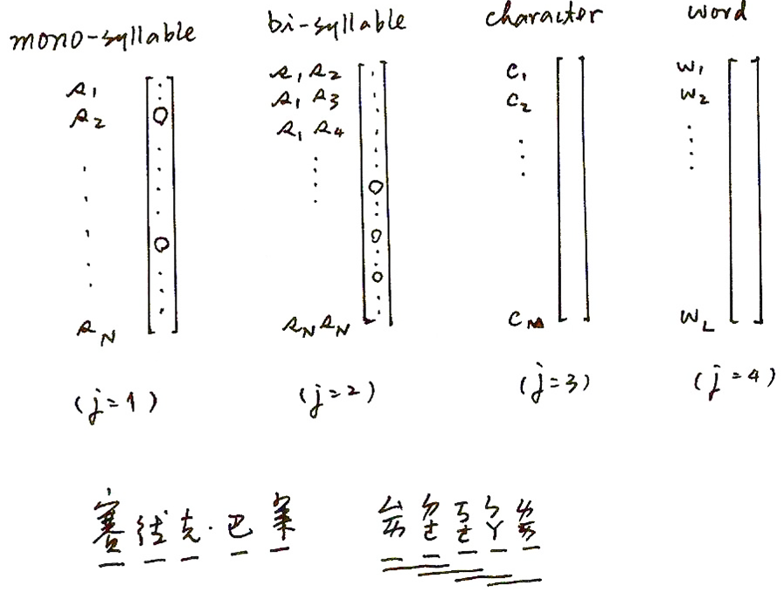
Vector Space Model

Slide 14
Difficulties in Speech-based Information Retrieval for Chinese Language
Even for Text-based Information Retrieval, Flexible Wording Structure Makes it Difficult to Search by Comparing the Character Strings Alone
  name/title 李登輝→李前總統登輝，李前主席登輝(President T.H Lee)
  arbitrary abbreviation 北二高→北部第二高速公路(Second Northern Freeway)
  華航→中華航空公司(China Airline)
  similar phrases 中華文化→中國文化(Chinese culture)
  translated terms 巴塞隆那→巴瑟隆納(Barcelona)
Word Segmentation Ambiguity Even for Text-based Information Retrieval
  腦科(human brain studies) →電腦科學(computer science)
  土地公(God of earth) →土地公有政策(policy of public sharing of the land)
Uncertainties in Speech Recognition
  errors (deletion, substitution, insertion)
  out of vocabulary (OOV) words, etc.
  very often the key phrases for retrieval are OOV

Slide 15
Syllable-Level Indexing Features for Chinese Language
A Whole Class of Syllable-Level Indexing Features for Better Discrimination
  Overlapping syllable segments with length N
  Syllable pairs separated by M syllables
Character- or Word-Level Features can be Similarly Defined
S₁ S₂ S₃ S₄ S₅ ………S₁₀
S(N), N=1
N=2
N=3
P(M), M=1
M=2
Syllable Pair Separated by M syllables | Examples
P(M), M=1 | (s₁ s₃) (s₂ s₄)……(s₈ s₁₀)
P(M), M=2 | (s₁ s₄) (s₂ s₅)……(s₇ s₁₀)
P(M), M=3 | (s₁ s₅) (s₂ s₆)……(s₆ s₁₀)
P(M), M=4 | (s₁ s₆) (s₂ s₇)……(s₅ s₁₀)

Slide 16
Syllable-Level Statistical Features
Single Syllables
  all words are composed by syllables, thus partially handle the OOV problem
  very often relevant words have some syllables in common
  each syllable usually shared by more than one characters with different meanings, thus causing ambiguity
Overlapping Syllable Segments with Length N
  capturing the information of polysyllabic words or phrases with flexible wording structures
  majority of Chinese words are bi-syllabic
  not too many polysyllabic words share the same pronunciation
Syllable Pairs Separated by M Syllables
  tackling the problems arising from the flexible wording structure, abbreviations, and deletion, insertion, substitution errors in speech recognition
Notes:
還有就是syllable pairs separated by M syllables這種建索引的方式,
則可多少解決中文flexible的wording structure及語音辨識所造成的insertion, deletion, substitution 等 errors
實驗結果顯示:
當我們適當的結合這兩類的音節索引資訊的話,
在檢索上面會有很好的表現

Slide 17
Improved Syllable-level Indexing Features
Syllable-aligned Lattices and syllable-level utterance verification
  Including multiple syllable hypothesis to construct syllable-aligned lattices for both query and documents
  Generating multiple syllable-level indexing features from syllable lattices
  filtering out indexing terms with lower acoustic confidence scores
Infrequent term deletion (ITD)
  Syllable-level statistics trained with text corpus used to prune infrequent indexing terms
Stop terms (ST)
  Indexing terms with the lowest IDF scores are taken as the stop terms
syllables with higher acoustic confidence scores
syllables with lower acoustic confidence scores
syllable pairs S(N), N=2 pruned by ITD
syllable pairs S(N), N=2 pruned by ST

Slide 18
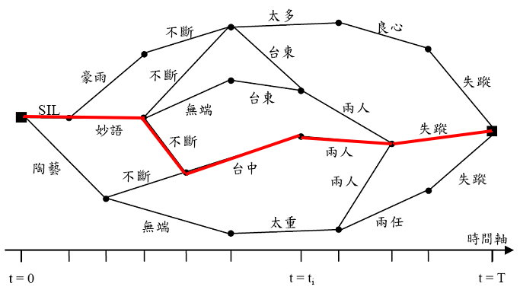
Expected Term Frequencies
  E(t,x): expected term frequency for term t in the lattice of an utterance x
  u: a word sequence (path) in the lattice of an utterance x
  P(u|x): posterior probability of the word sequence u given x
  N(t,u): the occurrence count of term t in word sequence u
  L(x): all the word sequences (paths) in the lattice of an utterance x
lattice of utterance x
L(x)
u

Slide 19
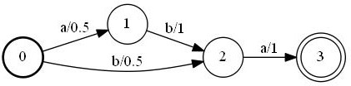
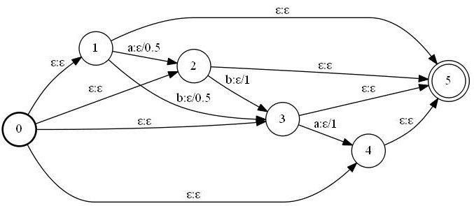
WFST for Retrieval (1/4)
Factor Automata
  The finite state machines accepting all substrings of the original machine
  retrieval is to have all substrings considered
aba
ba
Accept
Accept
a
ab

Slide 20
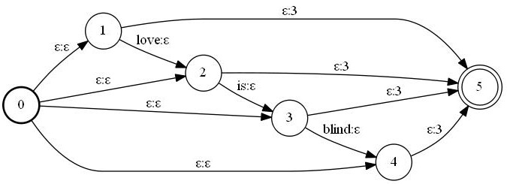
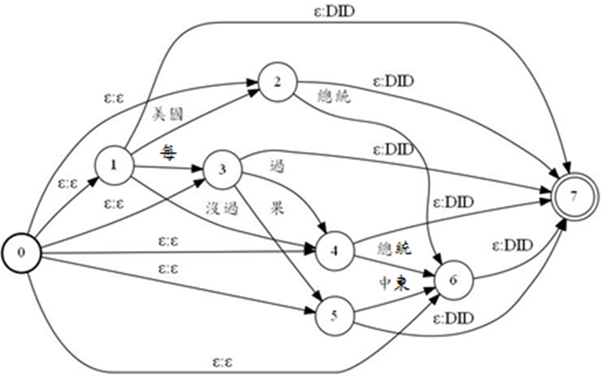
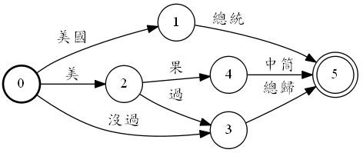

WFST for Retrieval (2/4)
The index transducer of text document
  Every substring of the document is transduced into the corresponding document ID (e.g., 3014)
For spoken documents, the index transducers are generated from lattices directly
The index transducer of the whole corpus
  Union of all transducers of all utterances

Slide 21
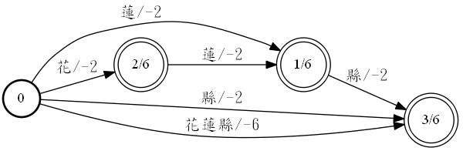
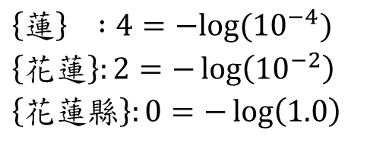
WFST for Retrieval (3/4)
Query Transducer
  Split the query string into words, characters, syllables, etc.
  Generate the query transducer
  Factorize the automaton
  Distribute weights over different transitions
Ex:花蓮縣
Accept
-2-2+6=2
「花」「蓮」
「花蓮縣」
Accept
-6+6=0
  $$\left\{蓮\right\} :4=−log⁡({10}^{−4})$$
  $$\left\{\text{花}蓮\right\}:2=−\log\left({10}^{−2}\right)$$
  $$\left\{\text{花}蓮縣\right\}:0=−\log\left(1.0\right)$$

Slide 22








WFST for Retrieval (4/4)
Index Transducer
User
Document 1
Query
Transducer:
花蓮縣
Document 2
…
Document 5034
Composition
花蓮縣:2033/0.7
蓮:737/5.6

Slide 23
Improved Retrieval by Training
  Improve the retrieval with some training data
  Training data: a set of queries and associated relevant/irrelevant utterances
  Can be collected from user data
    e.g. click-through data
  Improve text-based search engine
  e.g. learn weights for different clues (such as different recognizers, different subword units …)
  Optimize the recognition models for retrieval performance
  Considering retrieval and recognition processes as a whole
  Re-estimate HMM parameters
Query Q₁
Query Q₂
Query Q_{n}
time 1:10 F
time 2:01 F
time 3:04 T
time 5:31 T
time 1:10 T
time 2:01 F
time 3:04 T
time 5:31 T
time 1:10 T
time 2:01 F
time 3:04 T
time 5:31 F
……

Slide 24

HMM Parameter Re-estimation
Retrieval considered on top of recognition output in the past
  recognition and retrieval as two cascaded stages
  retrieval performance relying on recognition accuracy
Considering retrieval and recognition processes as a whole
  acoustic models re-estimated by optimizing retrieval performance
  acoustic models better matched to each respective data set
Acoustic Models
Retrieval Model
Retrieval Output
user
Recognition
Engine
Search
Engine
Spoken
Archive
Query Q
lattices
Recognition
Retrieval

Slide 25
HMM Parameter Re-estimation
Objective Function for re-estimating HMM
λ: set of HMM parameters, : re-estimated parameters for retrieval
Q_{train}: training query set
x_{t}, x_{f}: positive/negative examples for query Q
: relevance score of utterance x given query Q and model parameters set λ
(Since S(Q,x) is obtained from lattice, it depends on HMM parameters λ.)
Find new HMM parameters for recognition
such that the relevance scores of positive and negative
examples are better separated.

Slide 26
References
WFST for Retrieval
  Cyril Allauzen, Mehryar Mohri, and Murat Saraclar, “General indexation of weighted automata: application to spoken utterance retrieval,” in Proceedings of the Workshop on Interdisciplinary Approaches to Speech Indexing and Retrieval at HLT-NAACL, Stroudsburg, PA, USA, 2004, SpeechIR ’04, pp. 33–40, Association for Computational Linguistics.
  D. Can and M. Saraclar, “Lattice indexing for spoken term detection,” IEEE Transactions on Audio, Speech, and Language Processing, vol. 19, no. 8, pp. 2338–2347, 2011.

Slide 27
References
Spoken Content in Mandarin Chinese
  “Discriminating Capabilities of Syllable-based Features and Approaches of Utilizing Them for Voice Retrieval of Speech Information in Mandarin Chinese”, IEEE Transactions on Speech and Audio Processing, Vol.10, No.5, July 2002, pp.303-314.
Training Retrieval Systems
  Click-through data
    Thorsten Joachims. 2002. Optimizing search engines using clickthrough data. In Proceedings of the eighth ACM SIGKDD international conference on Knowledge discovery and data mining (KDD '02)
  Improve text-based search engine
    “Improved Lattice-based Spoken Document Retrieval by Directly Learning from the evaluation Measures”, IEEE International Conference on Acoustics, Speech and Signal Processing, 2009
  Re-estimate HMM parameters
    "Integrating Recognition and Retrieval With Relevance Feedback for Spoken Term Detection," Audio, Speech, and Language Processing, IEEE Transactions on , vol.20, no.7, pp.2095-2110, Sept. 2012

Slide 28
Pseudo-relevance Feedback (PRF) (1/3)
Collecting training data can be expensive
Pseudo-relevance feedback (PRF):
  Generate training data automatically
  Procedure:
    Generate first-pass retrieval results
    assume the top N objects on the first-pass retrieval results are relevant (pseudo relevant)
    assume the bottom M objects on the first-pass retrieval results are irrelevant (pseudo irrelevant)
    Re-ranking: scores of objects similar to the pseudo-relevant/irrelevant objects increased/decreased

Slide 29
Pseudo-relevance Feedback (PRF) (2/3)
Spoken
archive
Search
Engine
Query Q
Final Results
Top N
“assumed” relevant
time 1:01
time 2:05
time 1:45
…
time 2:16
time 7:22
time 9:01
time 1:01
time 2:16
time 7:22
…
time 2:05
time 1:45
time 9:01
time 1:01
time 2:05
Compute acoustic similarity
(pseudo-relevant)
Bottom N
“assumed” irrelevant
time 7:22
time 9:01
(pseudo-irrelevant)
First-pass Retrieval Results
Re-rank
Re-rank: increase/decrease the score of utterances having higher acoustic similarity with pseudo-relevant/-irrelevant utterances
Notes:
29

Slide 30
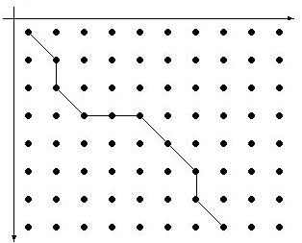
Pseudo-relevance Feedback (PRF) (3/3)
Acoustic similarity between two utterances x_{i} and x_{j}
Dynamic Time Warping (DTW)
similarity between utterance x_{i} and x_{j}
lattice for utterance x_{i}
C
B
A
B
Q
B
A
hypothesized region for query Q
hypothesized region for query Q
acoustic feature sequence
acoustic feature sequence
C
Q
E
lattice for utterance x_{j}
A
F
D

Slide 31
Improved PRF – Graph-based Approach (1/4)
Graph-based approach
  only the top N/bottom N utterances are taken as references in PRF
  not necessarily reliable
  considering the acoustic similarity structure of all utterances in the first-pass retrieval results globally using a graph

Slide 32
Improved PRF – Graph-based Approach (2/4)
Construct a graph for all utterances in the first-pass retrieval results
  nodes : utterances
  edge weights: acoustic similarities between utterances
x₃
x₁
x₂
x₅
x₄
…..
x₂
x₁
x₅
x₃
x₄
First-pass Retrieval Results

Slide 33
Improved PRF – Graph-based Approach (3/4)
Utterances strongly connected to (similar to) utterances with high relevance scores should have relevance scores increased
x₃
x₁
x₂
x₅
x₄
…..
x₂
high
high
?
x₁
x₅
high
x₃
x₄
first-pass retrieval results

Slide 34
Improved PRF – Graph-based Approach (3/4)
Utterances strongly connected to (similar to) utterances with low relevance scores should have relevance scores reduced
x₃
x₁
x₂
x₅
x₄
…..
x₂
low
?
low
x₁
x₅
low
x₃
x₄
first-pass retrieval results
Notes:
34

Slide 35
Improved PRF – Graph-based Approach (4/4)
Relevance scores propagate on the graph
  relevance scores smoothed among strongly connected nodes
x₃
x₁
x₂
x₅
x₄
…..
x₂
x₃
x₁
x₂
x₅
x₄
…..
x₁
x₅
x₃
x₄
first-pass retrieval results
Re-ranked

Slide 36
PageRank and Random Walk (1/2)
Object ranking by their relations
  Rank web pages for Google search
Basic Idea
  Objects having high connectivity to other high-score objects are popular (given higher scores)
from
1/3
to
v₁
1
v₃
1/3
1/3
1/2
1/2
1/2
Transition matrix
v₂
v₄
1/2

Slide 37
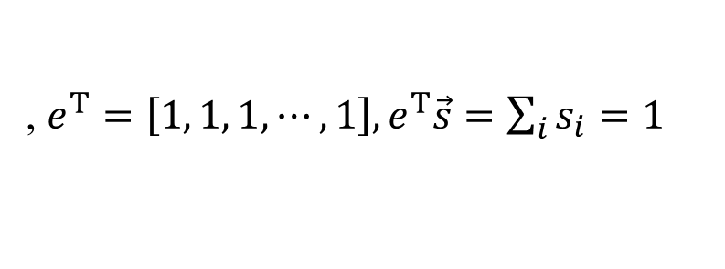
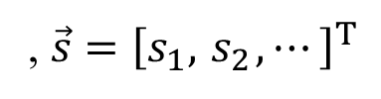
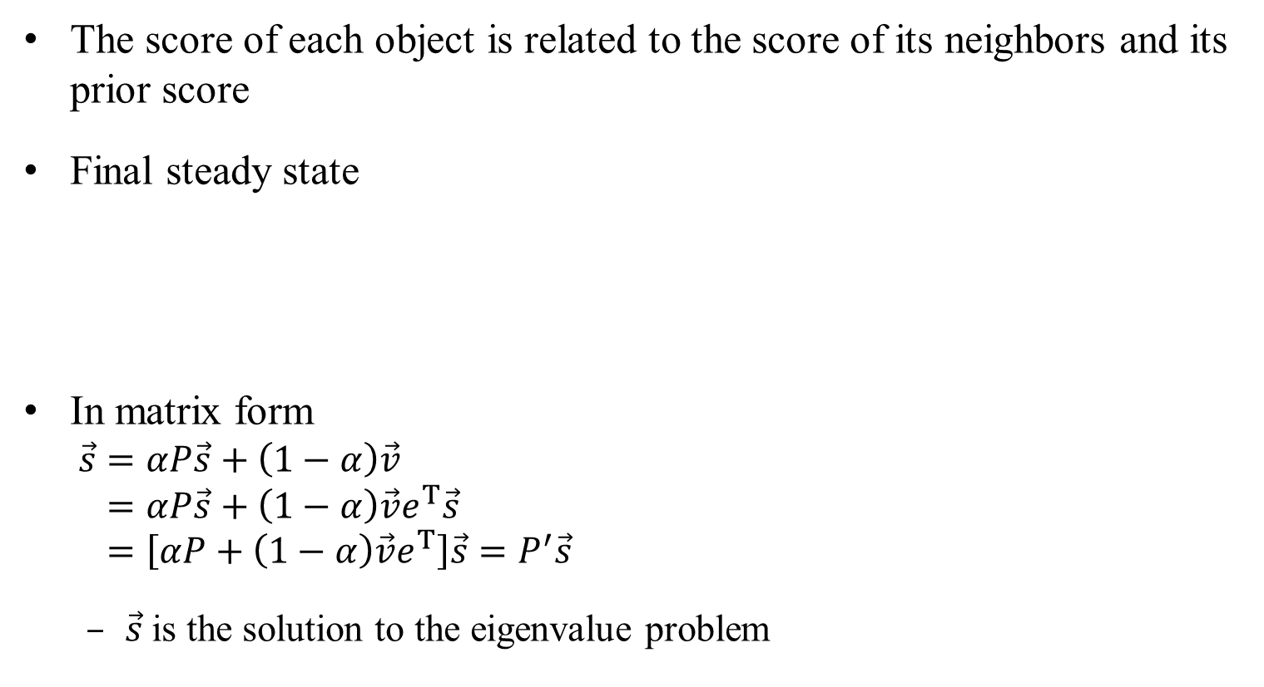
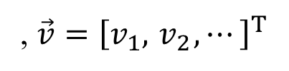
PageRank and Random Walk (2/2)
The score of each object is related to the score of its neighbors and its prior score
Final steady state
In matrix form
  $$\vec{s}=αP\vec{s}+\left(1−α\right)\vec{v} \\ =αP\vec{s}+\left(1−α\right)\vec{v}e^{Τ}\vec{s} \\ =\left[αP+\left(1−α\right)\vec{v}e^{Τ}\right]\vec{s}=P^{′}\vec{s}$$
  $\vec{s}$is the solution to the eigenvalue problem
final score
interpolation weight
Score propagation
Prior score
,$\vec{s}={\left[s_{1}, { s}_{2}, ⋯\right]}^{Τ}$
,$\vec{v}={\left[v_{1}, { v}_{2}, ⋯\right]}^{Τ}$
,$e^{Τ}=\left[1, 1, 1,⋯, 1\right], e^{Τ}\vec{s}=\sum_{i}{s_{i}=1}$

Slide 38
References
For Graph and Random walk
  Kurt Bryan¹, Tanya Leise, “The $25,000,000,000 eigenvector: the linear algebra behind google”
  Amy. N. Langville, Carl.D. Meyer, “Deeper inside PageRank”, Internet Mathematics, Vol. 1
  “Improved Spoken Term Detection with Graph-Based Re-Ranking in Feature Space”, in ICASSP 2011
  “Open-Vocabulary Retrieval of Spoken Content with Shorter/Longer Queries Considering Word/Subword-based Acoustic Feature Similarity”, Interspeech, 2012

Slide 39
Support Vector Machine (SVM) (1/2)
Problem definition
  suppose there are two classes of objects (positive and negative)
  goal: classify new objects given training examples
Represent each object as an N-dimensional feature vector
  o: positive example
  x: negative example
Find a hyperplane separating positive and negative examples
Classify new objects by this hyperplane
  point A is positive, point B is negative
B
A

Slide 40
Support Vector Machine (SVM) (1/2)
Many hyperplanes can separate positive and negative examples
Support vectors
Choose the one maximizing the “margin”
  margin: the minimum distance between the examples and the hyperplane
Some noise may change the feature vectors of the testing objects
  large margin may minimize the chance of misclassification
Maximized
margin

Slide 41
SVM – Soft Margin
Hard Margin
Soft Margin
outlier
Ignore the outlier
Hard Margin:
  If some training examples are outliers, separating all positive/negative examples may not be the best solution
Soft Margin:
  Tolerate some non-separable cases (outliers)

Slide 42
SVM – Feature Mapping
Original feature vectors (Non-separable)
Map original feature vectors onto a higher-dimensional space
B(-1,1)
A(1,1)
B(1,1,-1)
A(1,1,1)
C(1,1,1)
D(1,1,-1)
C(-1,-1)
D(1,-1)
(Can be separated by hyperplane z=xy=0)
If positive and negative examples are not linearly separable in the original feature vector form, map their feature vectors onto a higher-dimensional space where they may become separable

Slide 43
Improved PRF – SVM(1/3)
Spoken
archive
Search
Engine
Query Q
Final Results
Top N
“assumed” relevant
time 1:01
time 2:05
Positive examples
Feature Extraction
time 1:01
time 2:16
time 7:22
…
time 2:05
time 1:45
time 9:01
time 1:01
time 2:05
time 1:45
…
time 2:16
time 7:22
time 9:01
First-pass retrieval results
time 7:22
time 9:01
SVM
Negative examples
Bottom N
“assumed” irrelevant
Feature Extraction
Re-ranking
Train an SVM for each query
Notes:
Each iteration will improve
43

Slide 44
Improved PRF – SVM (2/3)
Representing each utterance by its hypothesized region segmented by HMM states, with feature vectors in each state averaged and concatenated
State Boundaries
A
B
F
E
F
C
D
Q
B
. . .
D
B
…
Feature Vector
Sequence
…
…
averaged
…
Hypothesized Region
a feature vector

Slide 45
Improved PRF – SVM (3/3)
Context consistency
  the same term usually have similar context; while quite different context usually implies the terms are different
Feature Extraction
Q
0.2
B
V - dimensional vector
(V : lexicon size)
0.2
E
0.2
A
0.4
0.9
F
C
F
0.5
0.3
B
0.1
D
D
Q
A | B | C | D | … | Q
0.2 | 0.0 | 0.5 | 0.0 | … | 0.0
0.1
0.2
0.2
0.3
B
Immediate left context
A | B | C | D | … | Q
0.0 | 0.3 | 0.0 | 0.0 | … | 0.0
Immediate right context
A | B | C | D | … | Q
0.2 | 0.6 | 0.5 | 0.3 | … | 0.4
whole segment
Concatenated into a 3V - dimensional feature vector

Slide 46
References
SVM
  http://cs229.stanford.edu/materials.html
  (Lecture notes 3)
  "A Tutorial on Support Vector Machines for Pattern Recognition," Data Mining and Knowledge Discovery, vol. 2, no. 2, pp. 121-167, 1998.
  Bishop, C.M.
  <http://library.wur.nl/WebQuery/clc?achternaam==Bishop>, "Pattern recognition and machine learning." Chapter 7.
  Nello Cristianini and John Shawe-Taylor. "An Introduction to Support Vector Machines: And Other Kernel-Based Learning Methods."
SVM Toolkit
  http://www.csie.ntu.edu.tw/~cjlin/libsvm/
  LibSVM
  http://svmlight.joachims.org/
  SVMlight

Slide 47
References
Pseudo-relevance Feedback (PRF)
  “Improved Spoken Term Detection by Feature Space Pseudo-Relevance Feedback”, Annual Conference of the International Speech Communication Association, 2010
  SVM-based Reranking
    “Improved Spoken Term Detection Using Support Vector Machines Based on Lattice Context Consistency”, International Conference on Acoustics, Speech and Signal Processing, Prague, Czech Republic, May 2011, pp. 5648-5651.
    “Improved Spoken Term Detection Using Support Vector Machines with Acoustic and Context Features From Pseudo-Relevance Feedback”, IEEE Workshop on Automatic Speech Recognition and Understanding, Hawaii, Dec 2011, pp. 383-388.
    “Enhanced Spoken Term Detection Using Support Vector Machines and Weighted Pseudo Examples”, IEEE Transactions on Audio, Speech and Language Processing , Vol. 21, No. 6, Jun 2013, pp. 1272-1284

Slide 48
Language Modeling Retrieval Approach (Text or Speech)
Both query Q and spoken document d are represented as language models θ_{Q} and θ_{d} (consider unigram only below, may be smoothed (or interpolated) by a background model θ_{b} )
Given query Q, rank spoken documents d according to S_{LM}(Q,d)
  Inverse of KL divergence (KL distance) between θ_{Q} and θ_{d}
  The documents with document models θ_{d} similar to query model θ_{Q} are more likely to be relevant
  Query model
N(t, Q): Occurrence count or expected term frequency for term t in query Q
  Document model
N(t, d): Occurrence count or expected term frequency for term t in document d
E(t, x): Expected term frequency for term t in the
lattice of utterance x (for speech)

Slide 49
Semantic Retrieval by Query Expansion
  Concept matching rather than Literal matching
  Returning utterances/documents semantically related to the query (e.g. Obama)
  not necessarily containing the query (e.g. including US and White House, but not Obama)
  Expand the query (Obama) with semantically related terms (US and White House)
  Query expansion with language modeling retrieval approach
  Realized by PRF
  Find common term distribution in pseudo-relevant documents and use it to construct a new query for 2nd-phase retrieval

Slide 50
Semantic Retrieval by Query Expansion
Query model
Text Query Q
Top N documents as pseudo-relevant documents
Document model for doc 101
w₁
w₂
w₃
w₄
w₅
doc 101
doc 205
doc 145
…
…
w₁
w₂
w₃
w₄
w₅
……
Retrieval Engine
Document model for doc 205
Archive of Document Model’s θ_{d}
First-pass Retrieval Results
w₁
w₂
w₃
w₄
w₅
……

Slide 51
Semantic Retrieval by Query Expansion
Query model
Text Query Q
common patterns estimated from the pseudo-relevant document models and the original query model
Top N documents as pseudo-relevant documents
w₁
w₂
w₃
w₄
w₅
doc 101
doc 205
doc 145
…
…
w₁
w₂
w₃
w₄
w₅
……
Retrieval Engine
Archive of Document Model’s θ_{d}
First-pass Retrieval Results
w₁
w₂
w₃
w₄
w₅
……
w₁
w₂
w₃
w₄
w₅
……
New Query Model

Slide 52
Semantic Retrieval by Query Expansion
Query model
Text Query Q
Final Result
Retrieval Engine
Top N documents as pseudo-relevant documents
w₁
w₂
w₃
w₄
w₅
doc 101
doc 205
doc 145
…
…
w₁
w₂
w₃
w₄
w₅
……
Retrieval Engine
Archive of Document Model’s θ_{d}
First-pass Retrieval Results
w₁
w₂
w₃
w₄
w₅
……
w₁
w₂
w₃
w₄
w₅
……
New Query Model

Slide 53
Semantic Retrieval by Document Expansion
Document expansion
  Consider a document only has terms US and White House
  Add some semantically related terms (Obama) into the document model
Document expansion for language modeling retrieval approach
P(T_{i}|d): probability of observing topic T_{i} given document d
P(t|T_{i}): probability of observing term t given topic T_{i}
    Obtained by latent topic analysis (e.g. PLSA)
θ_{d}: original document model
α: interpolation weight
θ_{d}': expanded document model

Slide 54
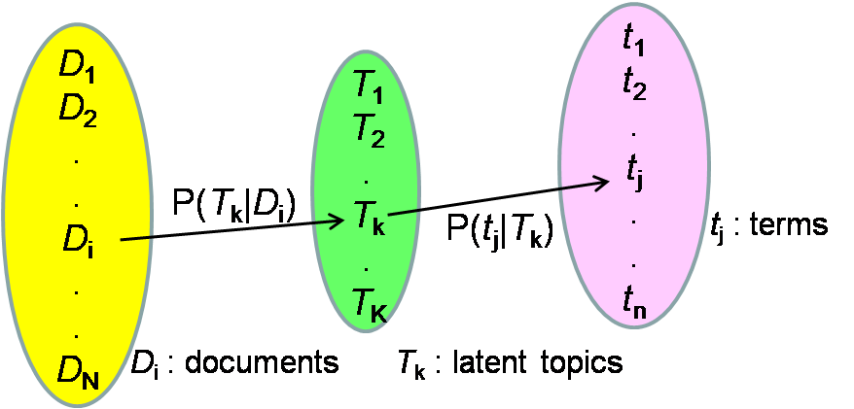
Latent Topic Analysis
An example: Probabilistic Latent Semantic Analysis (PLSA)
Creating a set of latent topics between a set of terms and a set of documents
  modeling the relationships by probabilistic models trained with EM algorithm
Other well-known approaches: Latent Semantic Analysis (LSA), Non-negative Matrix Factorization (NMF), Latent Dirichlet Allocation (LDA) … …

Slide 55
References
Semantic Retrieval of Spoken Content
  “Improved Semantic Retrieval of Spoken Content by Language models Enhanced with Acoustic Similarity Graph”, IEEE Workshop on Spoken Language Technology, 2012
  T. K. Chia, K. C. Sim, H. Li, and H. T. Ng, “Statistical lattice-based spoken document retrieval,” ACM Trans. Inf. Syst., vol. 28, pp. 2:1–2:30, 2010.

Slide 56
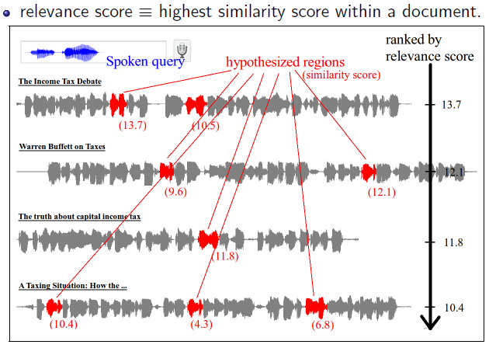
Unsupervised Spoken Term Detection (STD) with Spoken Queries
No recognition, without annotated data, without knowledge about the language
Search speech by speech
Bypass the difficulties of recognition : annotated data for the target domain, OOV words, recognition errors, noise conditions, etc.

Slide 57
Two major approaches for Unsupervised STD
Template matching (signal-to-signal matching)
  Dynamic Time Warping (DTW) based
  Precise but less compatible to signal variations (by different speakers, different acoustic conditions, etc.) with higher computation requirements
Model-based approach with automatically discovered patterns
  Discovering acoustic patterns and training corresponding models without annotated data
  Apply recognition-like approach with discovered models

Slide 58
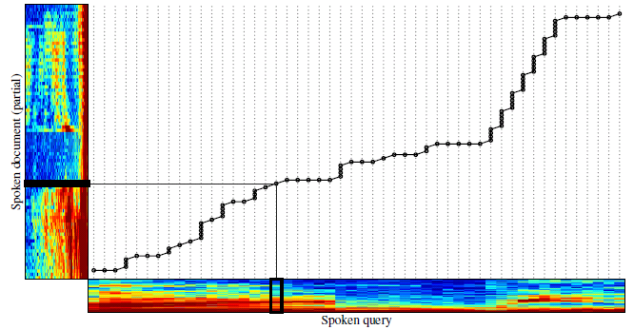
Template Matching
Dynamic time warping (DTW)
  Find possible speech regions that are similar to the query

Slide 59
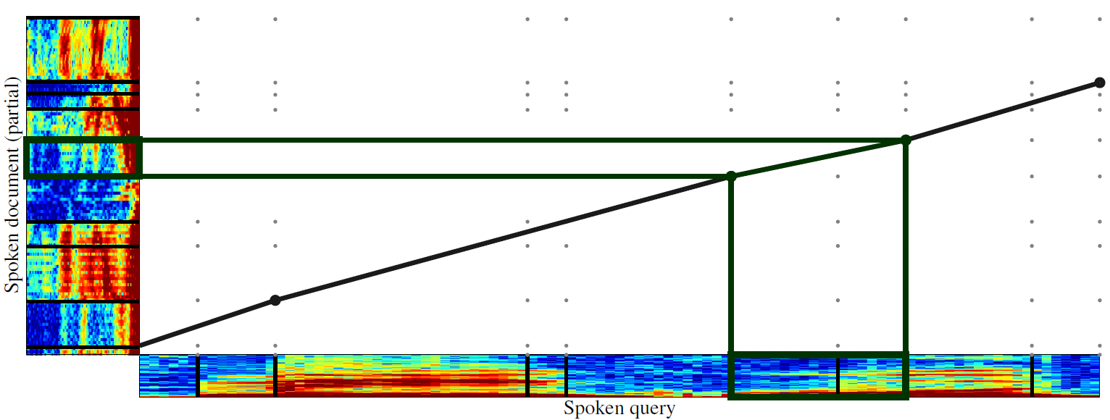
Template Matching
Segment-based DTW
  divide signals into segments of consecutive similar frames
  segment-by-segment matching rather than frame-by-frame
  Segment-based DTW (much faster but less precise) followed by frame-based DTW (slow but precise)

Slide 60
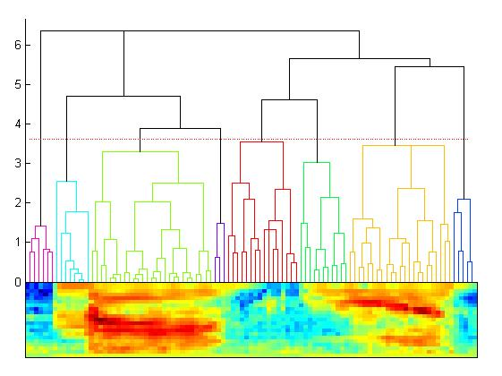
Hierarchical Agglomerative Clustering (HAC)
Merge Loss Li

Slide 61
Hierarchical Agglomerative Clustering (HAC)
Initial Condition
  Each frame of signal (i.e. a MFCC vector) is a segment
Merge
  calculate the distance between each pair of adjacent segments
  merge the pair with minimum distance into a single segment
  represent the merged segment by a vector (e.g. the mean)
  repeat

Slide 62
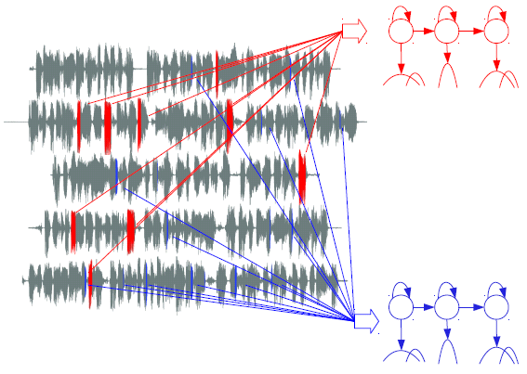
Model-based approach
Learn models from data

Slide 63
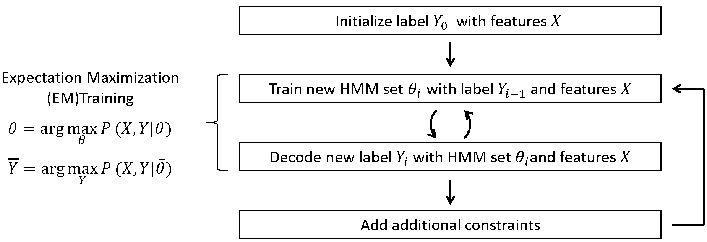
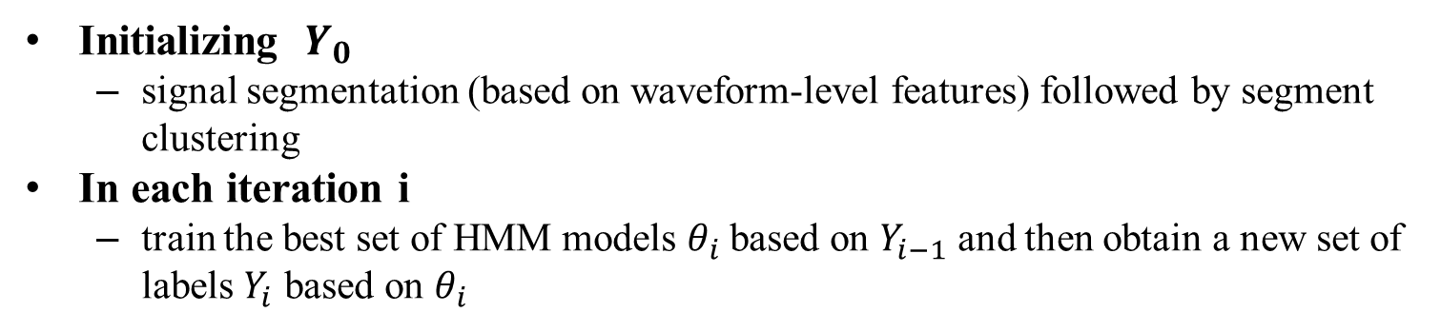
Unsupervised Pattern Discovery
Unsupervised Discovery
  without annotated data
  all patterns automatically learned from a set of corpora in unknown languages without linguistic knowledge
X: features for the corpora
Y: labels for the corpora
Initializing $Y_{0}$
  signal segmentation (based on waveform-level features) followed by segment clustering
In each iteration i
  train the best set of HMM models $θ_{i}$ based on $Y_{i−1}$ and then obtain a new set of labels $Y_{i}$ based on $θ_{i}$

Slide 64
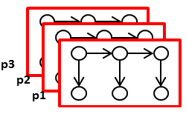
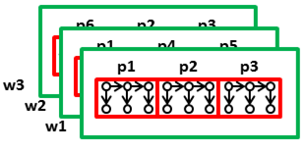
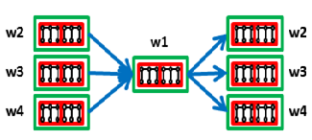
Unsupervised Automatic Discovery of Linguistic Structure
Hierarchical Linguistic Structure Automatically Discovered
  Subword-like pattern HMMs
  Word-like pattern lexicon
  Word-like pattern language model

Slide 65
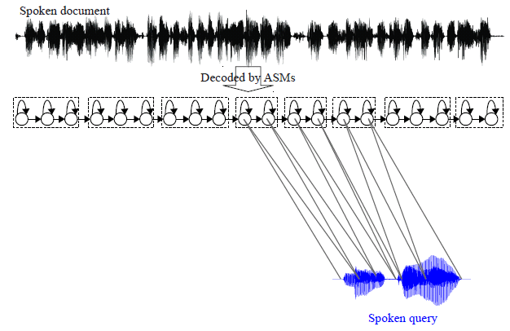
Search Based on Model of Acoustic patterns
Apply recognition-like approach with discovered models
Acoustic Pattern Models
Viterbi decoding

Slide 66
References
Unsupervised Discovery of Acoustic Patterns
  “Unsupervised Discovery of Linguistic Structure Including Two-level Acoustic Patterns Using Three Cascaded Stages of Iterative Optimization, ” International Conference on Acoustics, Speech and Signal Processing, Vancouver, Canada, May 2013.
Unsupervised Spoken Term Detection
  “Integrating Frame-Based and Sgement-Based Dynamic Time Warping for Unsupervised Spoken Term Detection with Spoken Queries”, International Conference on Acoustics, Speech and Signal Processing, Prague, Czech Republic, May 2011, pp. 5652-5655.
  “Toward Unsupervised Model-based Spoken Term Detection with Spoken Queries without Annotated Data, ” International Conference on Acoustics, Speech and Signal Processing, May 2013
  “Model-based Unsupervised Spoken Term Detection with Spoken Queries”, IEEE Transactions on Audio, Speech, and Language Processing, Vol. 21, No. 7, Jul 2013, pp. 1330-1342.
HAC
  Unsupervised Optimal Phoneme Segmentation: Objectives, Algorithm and Comparisons, Yu Qiao, Naoya Shimomura, and Nobuaki Minematsu, ICASSP 2008

Slide 67
References
Mobile/Video Search
  “In-Car Media Search”, IEEE Signal Processing Magazine, July 2011
  “Speech and Multimodal Interaction in Mobile Search”, IEEE Signal Processing Magazine, July 2011
  “Reusing Speech Techniques for Video Semantic Indexing”, IEEE Signal Processing Magazine, March 2013

