Slide 1
12.0 Computer-Assisted Language Learning (CALL)
References:
“An Overview of Spoken Language Technology for Education”, Speech Communications, 51, pp.832-844, 2009
“Computer-assisted Language Learning (CALL) Systems”, Tutorial, Interspeech 2012
“A Dialogue Game Framework with Personalized Training using Reinforcement Learning for Computer-Assisted Language Learning”, International Conference on Acoustics, Speech and Signal Processing, Vancouver, Canada, May 2013.
“Toward Unsupervised Discovery of Pronunciation Error Patterns using Universal Phoneme Posteriorgram for Computer-Assisted Language Learning”, Internatio Conference on Acoustics, Speech and Signal Processing, Vancouver, Canada, May 2013.

Slide 2
Computer-Assisted Language Learning (CALL)
Globalized World
  every one needs to learn one or more languages in addition to the native language
Language Learning
  one-to-one tutoring most effective but with high cost
Computers not as good as Human Tutors
  software reproduced easily
  used repeatedly any time, anywhere
  never get tired or bored

Slide 3
Target Skills of CALL
Components and sentence composition
  Phoneme set, Vocabulary, Grammar
Pronunciation: Phonetic and Prosodic
  Phoneme
  Word + tones, stress, etc.
  Sentence + intonation, etc.
  Paragraph + prominence, etc.
  Computer-aided Pronunciation Training (CAPT)
Reading
Writing (Chinese characters, etc.)
Listening
Speaking
Dialogues and Communications
  travel/shopping, business/negotiation, etc.

Slide 4
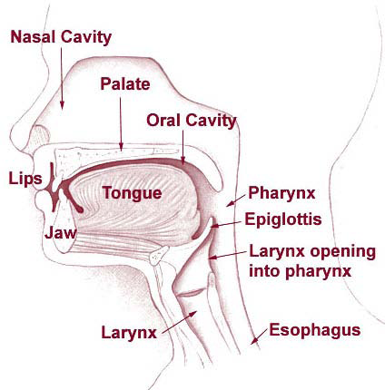
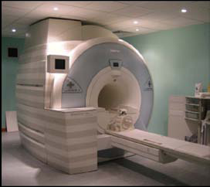
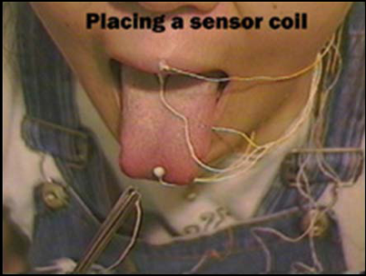
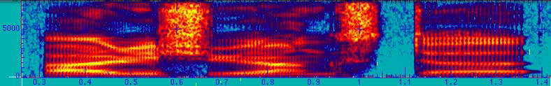
From Articulation to Speech
Learners are supposed to learn how to control the articulators (vocal tract)
But the movement of these organs is not easy to observe
Observation from signals is feasible, but not easy to learn based on signals either

Slide 5
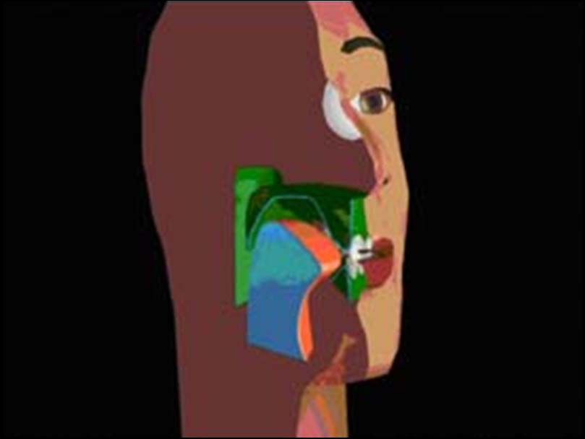
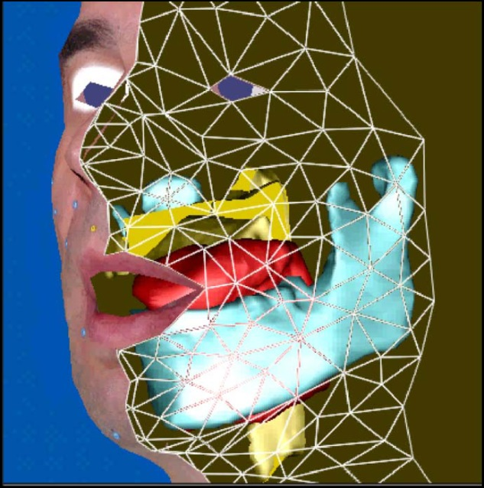
Visual Presentation of Articulation
Talking Head showing correct articulation
Acoustic-to-articulatory inversion to estimate the articulatory movements
Still difficult for learners

Slide 6



Commonly Used Approaches
Computer-Aided Pronunciation Training (CAPT)
  Qualitative assessment of pronunciation for learners
  Error pattern detection
Your pronunciation score is 78.2
I wear blue close today
You mispronounced /th/ as /f/
Notes:
As speech technology matures,
the field of CALL develops very rapidly in recent decades.
We take spoken language education for example,
CAPT is one of the popular sub-fields.
Lots of researches have focused on measuring the pronunciation performance of a language learner by computer.
It scores the utterance produced by the speaker on sentence or word level.
Another group of people put their emphasis on pinpointing the pronunciation error made by the learners,
giving feedback on where and how the learner goes wrong.

Slide 7

Commonly Used Approaches
Computer-Aided Pronunciation Training (CAPT)
  Qualitative assessment of pronunciation for learners
  Error pattern detection
Spoken Dialogue System
  Immersive interactive environment
I wear blue close today
Oh, It looks nice on you!
Thanks
You’re welcome
Notes:
Also, the use of spoken dialogue system has also been extensively researched on CALL.
Due to their immersive environment with the computer, learners can further acquire conversation skills.

Slide 8

Commonly Used Approaches
Computer-Aided Pronunciation Training (CAPT)
  Qualitative assessment of pronunciation for learners
  Error pattern detection
Spoken Dialogue System
  Immersive interactive environment
  Corrective feedback during interaction
I wear blue close today
Do you mean CLOTH?
Oh yes, cloth
Great

Slide 9
Pronunciation Scoring and Error Pattern Detection
Speech
Signal Representation
Prosodic Models
Alignment/
Segmentation
Acoustic Models
Error Pattern
Detection
Pronunciation
Models
Scoring

Slide 10
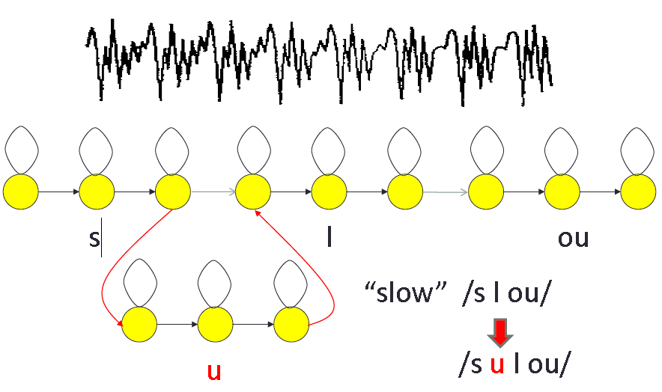
Alignment Problem – Insertion Error

Slide 11
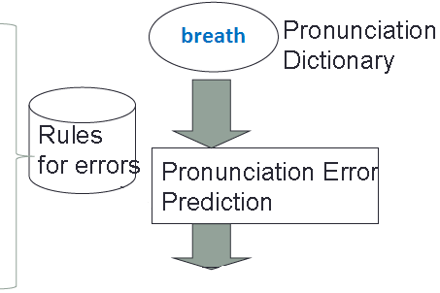
Error Prediction in Pronunciation Modeling
No corresponding syllable in L1
(ex.) sea → she
No corresponding phoneme in L1
(ex.) r → l, v → b
Vowel insertions
(ex.) b-r → b-uh-r
r
th
S
b
eh
uh
E
uh
l
s
Error

Slide 12
Pronunciation Scoring / Error Pattern Detection
Native-likeness
  How close to golden native speakers?
  who are the “golden” speakers?
  Models trained with a group of “good” speakers
Intelligibility
  How distinguishable (less confusable) from other phonemes?
Learning from Human Language Teachers
  Trained to offer scores or error patterns close to scores or patterns given by human language teachers

Slide 13
Example 1:
Dialogue Game for Pronunciation Learning

Slide 14

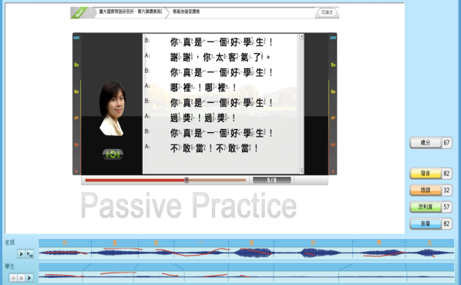
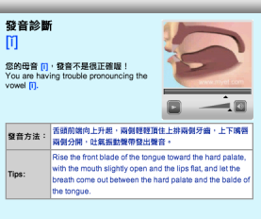
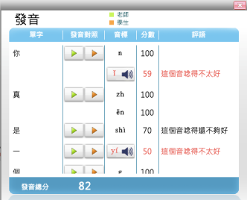
Goal of Dialogue Game (1/3)
CALL – CAPT
  NTU Chinese offers a score and multi-faceted corrective feedbacks to each pronunciation unit
learner/ref
comparison
Qualitative
assessment
Corrective
feedback
Notes:
As speech technology matures,
the field of CALL develops very rapidly in recent decades.
We take spoken language education for example,
CAPT is one of the popular sub-fields.
Lots of researches have focused on measuring the pronunciation performance of a language learner by computer.
It scores the utterance produced by the speaker on sentence or word level.
Another group of people put their emphasis on pinpointing the pronunciation error made by the learners,
giving feedback on where and how the learner goes wrong.

Slide 15
Goal of Dialogue Game (1/3)
CALL – CAPT
  NTU Chinese offers a score and multi-faceted corrective feedbacks to each pronunciation unit
  Different learners have very different performance distributions over different pronunciation units
score
learner1
score
units
learner2
score
units
learner3
units
Notes:
As speech technology matures,
the field of CALL develops very rapidly in recent decades.
We take spoken language education for example,
CAPT is one of the popular sub-fields.
Lots of researches have focused on measuring the pronunciation performance of a language learner by computer.
It scores the utterance produced by the speaker on sentence or word level.
Another group of people put their emphasis on pinpointing the pronunciation error made by the learners,
giving feedback on where and how the learner goes wrong.

Slide 16
Goal of Dialogue Game (2/3)
We wish for each individual learner and each pronunciation unit
  The worse the score is, the more practice
  The higher the score is, the less care
  No need for repeated practice on the same sentence, but participating in a more interesting dialogue game
  The needed practice opportunities automatically appears along the dialogue
score
score
units
score
units
units
Notes:
As speech technology matures,
the field of CALL develops very rapidly in recent decades.
We take spoken language education for example,
CAPT is one of the popular sub-fields.
Lots of researches have focused on measuring the pronunciation performance of a language learner by computer.
It scores the utterance produced by the speaker on sentence or word level.
Another group of people put their emphasis on pinpointing the pronunciation error made by the learners,
giving feedback on where and how the learner goes wrong.

Slide 17
Goal of Dialogue Game (3/3)
Personalized learning materials based on learning status dynamically obtained on-line along the dialogue game
To achieve this goal
  Recursive tree-structured dialogue script
  Best path within the dialogue script for each individual learner found by MDP
Notes:
As speech technology matures,
the field of CALL develops very rapidly in recent decades.
We take spoken language education for example,
CAPT is one of the popular sub-fields.
Lots of researches have focused on measuring the pronunciation performance of a language learner by computer.
It scores the utterance produced by the speaker on sentence or word level.
Another group of people put their emphasis on pinpointing the pronunciation error made by the learners,
giving feedback on where and how the learner goes wrong.

Slide 18
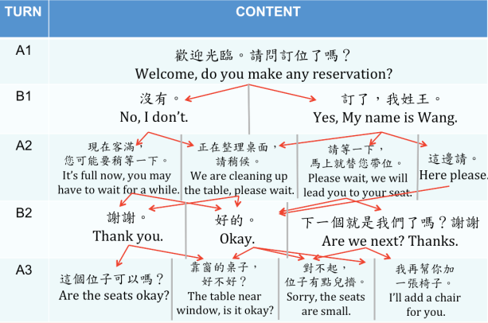
Dialogue Game Script (1/2)
Tree-structured turn-taking dialogue
  Restaurant scenario: seating and meal ordering
  A as Waiter B as Customer
Notes:
We set the interaction between the human and the computer in forms of dialogue game.
A tree-structured turn-taking dialogue between two people is proposed.
It is provided by ICLP at NTU.
The whole script is in restaurant scenario,
and 9 sub-dialogues with successive topics are cascaded.
There are 176 turns and more than 400 sent. in all.

Slide 19
Dialogue Game Script (2/2)
Tree-structured turn-taking dialogue
  Restaurant scenario
  9 sub-dialogues linked recursively
(1)
Phone invitation
(2) Restaurant reservation
(3)
Meeting and directions
(4)
Seating and meal ordering
.
.
(9)
Saying goodbye
(8)
Bill paying
(7)
Chatting 2
(6)
Meal serving
(5)
Chatting 1
  Almost infinite number of paths within the recursive trees
  Different paths contain different distributions of the pronunciation units for practice
  Different paths good for different learners
Notes:
We set the interaction between the human and the computer in forms of dialogue game.
A tree-structured turn-taking dialogue between two people is proposed.
It is provided by ICLP at NTU.
The whole script is in restaurant scenario,
and 9 sub-dialogues with successive topics are cascaded.
There are 176 turns and more than 400 sent. in all.

Slide 20



System Objective (1/2)
Based on the recursive dialogue script, the system provides personalized learning materials for each individual learner considering his learning status
User:
Computer:
Scores
85.8
User:
66.3
92.0
49.1
Computer:
:
:
User:
  Learning Status: Scores of each unit evaluated by NTU Chinese
Notes:
In this dialogue segment, after the user produce an utterance,
The system get to know learner status, that is, the score of every units marked by NTU Chinese.

Slide 21



System Objective (2/2)
The system selects on-line the path with the most practice for the lower-scored units for the learner so far, and return the corresponding next sentence to practice
User:
Computer:
User:
Computer:
User:
  More practice in the present sentence doesn’t necessarily imply
  the same for the future sentences along the path
Notes:
It tries to select user’s next sentence in order to provide practice on weak units previously produced by the user.
Then it reply with the corresponding sentence.
So this is the objective and how we wish the system to act.
In the next slide, we’ll talk about how to cast this system on an mathematical framework.

Slide 22
Markov Decision Process (MDP) (1/4)
States
  learning status of the learner
Represented by
  Present dialogue turn
  Learner’s average score for every pronunciation unit so far
  (high-dimensional continuous state space)
(2)
Unit | b | p | m | f | … | 45
Score | 53.4 | 89.0 | 74.7 | 80.3 | … | 97.0
(1)
Notes:
Markov decision process,
It is a mathematical framework for decision making problem, and contains some parameters.
State, it indicates the system’s situation.
Action, a set of action the system can take in certain state.
Reward, this is a measurement of how good an action is taken at a state.
And the goal of this setting is to come out with a policy that can maximize the expected total reward.
And policy is a mapping from state to action, it decide which action to take in a certain state.

Slide 23
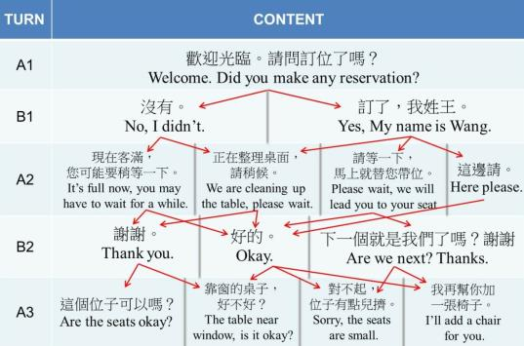
Markov Decision Process (MDP) (2/4)
Actions
  The set of sentences to be selected for the learner to practice
User:
Computer:
User:
Computer:
User:

Slide 24
Markov Decision Process (MDP) (3/4)
System goal setting
  all pronunciation units (or a subset of focused units) scored 75 or higher over 7 times for the learner in minimum number of dialogue turns, etc.
  Reward
  set cost -1 for every dialogue turn: the less number of turns the better
  Game ends when system goal reached
Policy
  Best system action to take at each
  state
  to be trained
(1)
Phone invitation
(2)
Restaurant reservation
(3)
Finding the restaurant
(4)
Seating and meal ordering
(9)
Saying goodbye
(8)
Bill paying
(7)
Chatting 2
(6)
Meal serving
(5)
Chatting 1
Notes:
Markov decision process,
It is a mathematical framework for decision making problem, and contains some parameters.
State, it indicates the system’s situation.
Action, a set of action the system can take in certain state.
Reward, this is a measurement of how good an action is taken at a state.
And the goal of this setting is to come out with a policy that can maximize the expected total reward.
And policy is a mapping from state to action, it decide which action to take in a certain state.

Slide 25
Markov Decision Process (MDP) (4/4)
25
S1
a4
U:
C:
U:
C:
a3
a1
ST
a2
S2
  Dialogue Game
  MDP model

Slide 26
Markov Decision Process (MDP) (4/4)
26
S1
U:
C:
U:
C:
  Dialogue Game
  MDP model

Slide 27
Markov Decision Process (MDP) (4/4)
27
S1
a4
U:
C:
U:
C:
a3
a1
a2
  Dialogue Game
  MDP model

Slide 28
Markov Decision Process (MDP) (4/4)
28
S1
U:
C:
U:
C:
a2
S2
  Dialogue Game
  MDP model

Slide 29
Markov Decision Process (MDP) (4/4)
29
S1
U:
C:
U:
C:
ST
a2
R
a1
S2
  Dialogue Game
  MDP model

Slide 30
Learner Simulation (1/3)
Policy training needs sufficient training data
Since we need real learner’s language learning behavior
  It is not easily available
Learner Simulation Model is developed for generating a large number of training data
Real learner data
  278 learners from 36 countries (balanced gender)
  Each leaner recorded 30 phonetically balanced sentences

Slide 31


Learner Simulation (2/3)
Learner Simulation
Model: GMM
Simulated Learners
Sample
. . .
Simulated scores
over the script
/b/
/p/
/m/
.
.
.
/a/
/i/
/u/
.
.
88.6
Real Learner Data
63.7
70.0
.
.
.
.
.
.
.
Pronunciation Score Vector (PSV)
of an Utterance produced by a learner
Each mixture represents a group of learners with a specific pronunciation characteristics

Slide 32



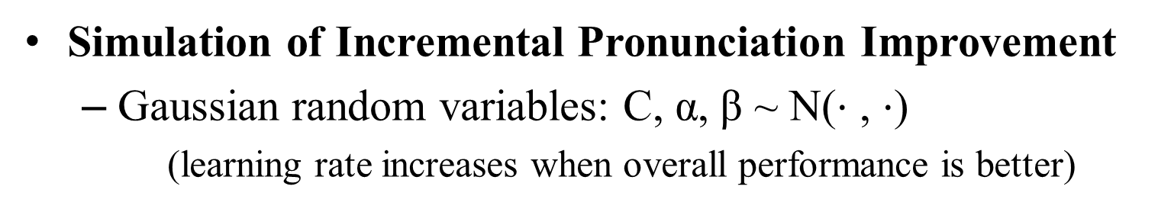
Learner Simulation (3/3)
Simulation of Incremental Pronunciation Improvement
  Gaussian random variables: C, α, β ~ N($⋅$ , $⋅$)
    (learning rate increases when overall performance is better)
Mean vector
. . . .
Simulated Learner
$$μ_{\text{/}a\text{/}}$$
Covariance Matrix
$$σ_{/a/}^{2}$$
. . . . .
When a unit is practiced C times:
Recursive
Dialogue Script
its mean value increased by α (better)
variance value decreased by β (more
stable)
Notes:
Markov decision process,
It is a mathematical framework for decision making problem, and contains some parameters.
State, it indicates the system’s situation.
Action, a set of action the system can take in certain state.
Reward, this is a measurement of how good an action is taken at a state.
And the goal of this setting is to come out with a policy that can maximize the expected total reward.
And policy is a mapping from state to action, it decide which action to take in a certain state.

Slide 33

Complete Framework
Learner
Simulation
Model
Corpora
Simulated Learners
Real Learner Data
MDP
Training
Pedagogical
Dialogue Manager
Script of
Cascaded
Sub-dialogues
Sentence Selection Policy
Automatic Pronunciation Evaluator
(State)
Utterance
Input
Selected
Sentences
(Action)
Learner

Slide 34
Example 2:
Unsupervised Error Pattern Discovery

Slide 35
Error Patterns
Error Patterns (EPs) of L2 learning:
  Patterns of erroneous pronunciation frequently produced by language learners.
  Usually caused by some articulatory mechanism present in L2 but missing in L1.
  Useful in providing corrective feedbacks, if accurately detected
Different L1-L2 pairs requires different EPs.
Commonly used approaches for deriving EPs:
  Summarization by language teachers
  Literatures of second language learning
  Compare orthographic transcriptions with the actual pronunciation of learns (human labeled or machine transcribed) in a data set
Goal: Unsupervised Error Pattern Discovery
  Based on a corpus of learners’ data
  Automatically discovering the error patterns from the corpus without human labels

Slide 36
Unsupervised EP Discovery
correct pronunciation
incorrect pronunciation

Slide 37
Unsupervised EP Discovery
Remove the correct pronunciation templates

Slide 38
Unsupervised EP Discovery
Automatically cluster the incorrect pronunciation templates into groups, each representing an error pattern

Slide 39
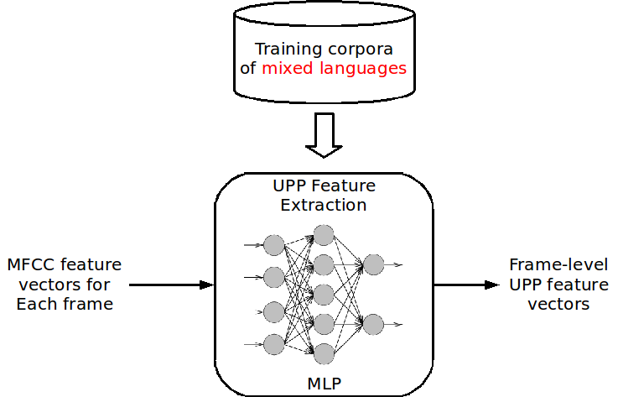
Universal Phoneme Posteriorgram (UPP)

Slide 40
Universal Phoneme Posteriorgram (UPP)
Motivation: Span the pronunciation space with units from multiple languages

Slide 41
Universal Phoneme Posteriorgram (UPP)
Motivation: Span the pronunciation space with units from multiple languages

Slide 42
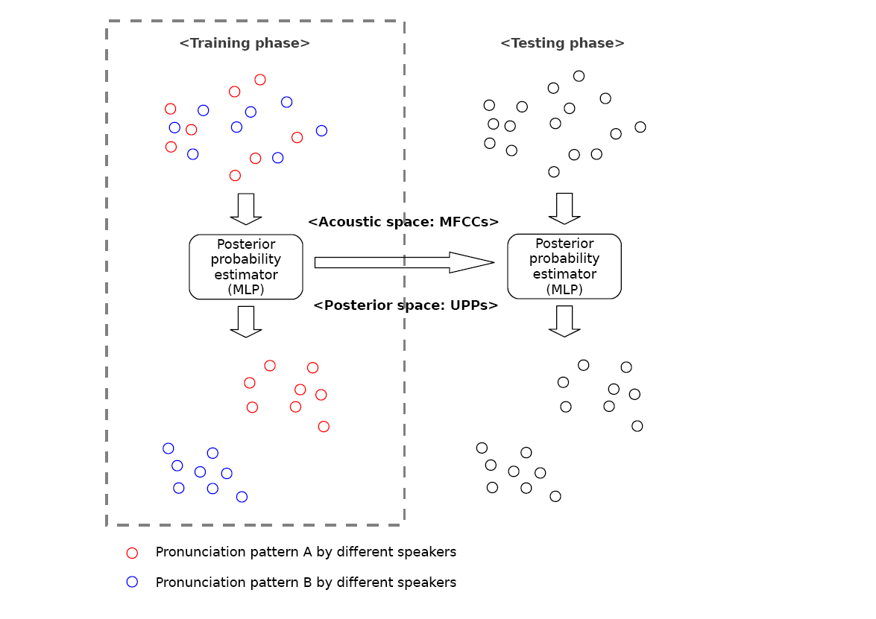
Universal Phoneme Posteriorgram (UPP)

Slide 43
Universal Phoneme Posteriorgram (UPP)
Spanned by MFCC

Slide 44
Universal Phoneme Posteriorgram (UPP)
Spanned by MFCC
Training corpora
of mixed languages

Slide 45
Universal Phoneme Posteriorgram (UPP)
Spanned by MFCC
Training corpora
of mixed languages
Spanned by phoneme posteriors

Slide 46
Universal Phoneme Posteriorgram (UPP)
Spanned by MFCC
Training corpora
of mixed languages
Spanned by phoneme posteriors

Slide 47
Universal Phoneme Posteriorgram (UPP)
Spanned by MFCC
Spanned by MFCC
Training corpora
of mixed languages
Spanned by phoneme posteriors
Spanned by phoneme posteriors

Slide 48
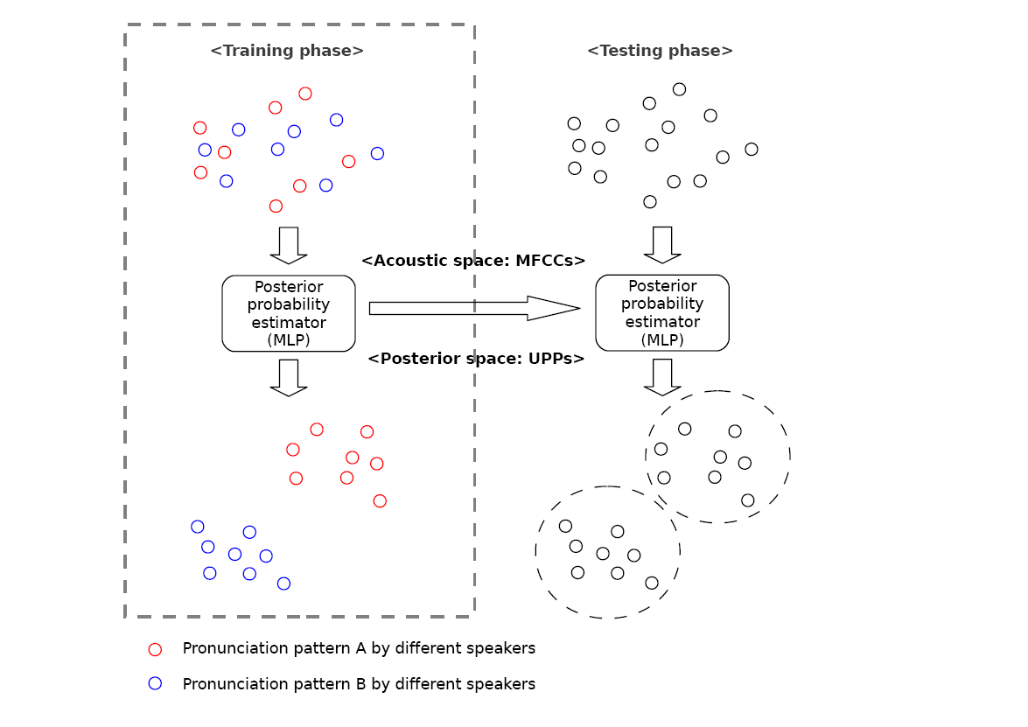
Universal Phoneme Posteriorgram (UPP)
Spanned by MFCC
Spanned by MFCC
Training corpora
of mixed languages
Spanned by phoneme posteriors
Spanned by phoneme posteriors
Better for pronunciation pattern clustering

Slide 49
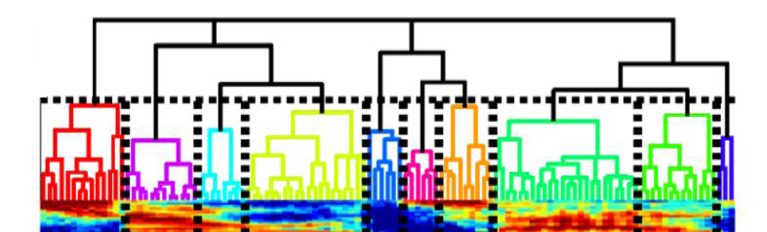
Hierarchical Agglomerative Clustering (HAC)
Purpose: unify the dimensionality of feature vectors for each phoneme
  The length (# of frames) of each segment varies
  transforming varying-length, frame-level features into fixed-length, segment-level features

Slide 50
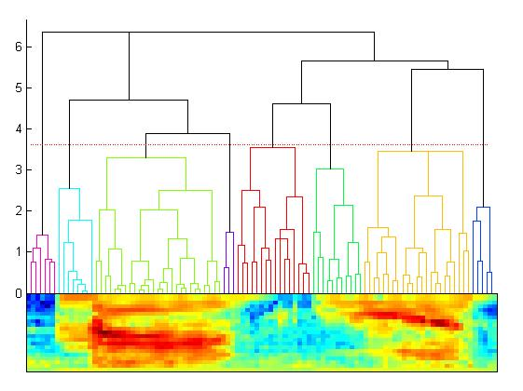
Hierarchical Agglomerative Clustering (HAC) (P.53 of 10.0)
Merge Loss Li

Slide 51

Hierarchical Agglomerative Clustering (HAC)
Iteratively merge adjacent frames with highest similarity
  tree-structured hierarchy
Frame-level
Feature vectors

Slide 52

Hierarchical Agglomerative Clustering (HAC)
Iteratively merge adjacent frames with highest similarity
  tree-structured hierarchy
Choose a threshold
  partition the whole segment into selected number of sub-segments
Frame-level
Feature vectors

Slide 53
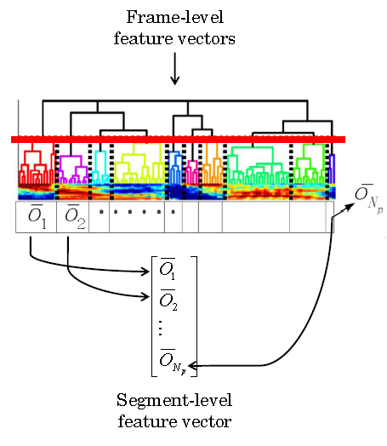
Hierarchical Agglomerative Clustering (HAC)
Iteratively merge adjacent frames with highest similarity
  tree-structured hierarchy
Choose a threshold of similarity
  partition the whole segment into selected number of sub-segments
Take average in each sub-segments, and concatenate

Slide 54
Hierarchical Agglomerative Clustering (HAC)
Iteratively merge adjacent frames with highest similarity
  tree-structured hierarchy
Choose a threshold of similarity
  partition the whole segment into selected number of sub-segments
Take average in each sub-segments, and concatenate
Sub-segmental variation can be retained better!

Slide 55

UNSUPERVISED CLUSTERING
K-means clustering
  Clustering criteria: minimal distance
    Euclidean, Cosine, Symmetric KL-divergence
  Assume number of clusters K is known (= number of EPs summarized by language teachers)
Gaussian Mixture Model with Minimum Description Length criteria (GMM-MDL)
  Clustering criteria: maximal likelihood
  Automatically-derived number of clusters
  Training: maximize the objective function

Slide 56
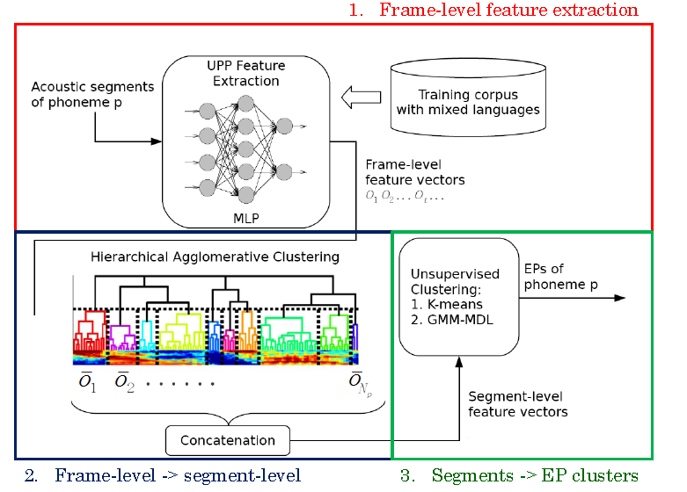

Complete FRAMEWORK

