Slide 1
13.0 Speaker Variabilities: Adaption and Recognition
References: 1. 9.6 of Huang
2. “ Maximum A Posteriori Estimation for Multivariate Gaussian
Mixture Observations of Markov Chains”, IEEE Trans. on
Speech and Audio Processing, April 1994
3. “ Maximum Likelihood Linear Regression for Speaker
Adaptation of Continuous Density Hidden Markov
Models”, Computer Speech and Language, Vol.9 ,1995
4. Jolliffe, “ Principal Component Analysis ”, Springer-Verlag, 1986
5. “ Rapid Speaker Adaptation in Eigenvoice Space”, IEEE Trans. on
Speech and Audio Processing, Nov 2000
6. “ Cluster Adaptive Training of Hidden Markov Models”, IEEE
Trans. on Speech and Audio Processing, July 2000
7. “ A Compact Model for Speaker-adaptive Training”, International
Conference on Spoken Language Processing, 1996
8. “ A Tutorial on Text-independent Speaker Verification”, EURASIP
Journal on Applied Signal Processing 2004

Slide 2
Speaker Dependent/Independent/Adaptation
Speaker Dependent (SD)
  trained with and used for 1 speaker only, requiring huge quantity of training data, best accuracy
  practically infeasible
Multi-speaker
  trained for a (small) group of speakers
Speaker Independent (SI)
  trained from large number of speakers, each speaker with limited quantity of data
  good for all speakers, but with relatively lower accuracy
Speaker Adaptation (SA)
  started with speaker independent models, adapted to a specific user with limited quantity of data (adaptation data)
  technically achievable and practically feasible
Supervised/Unsupervised Adaptation
  supervised: text (transcription) of the adaptation data is known
  unsupervised: text (transcription) of the adaptation data is unknown, based on recognition results with speaker-independent models, may be performed iteratively
Batch/Incremental/On-line Adaptation
  batch: based on a whole set of adaptation data
  incremental/on-line: adapted step-by-step with iterative re-estimation of models
  e.g. first adapted based on first 3 utterances, then adapted based on next 3 utterances or first 6 utterances,...

Slide 3
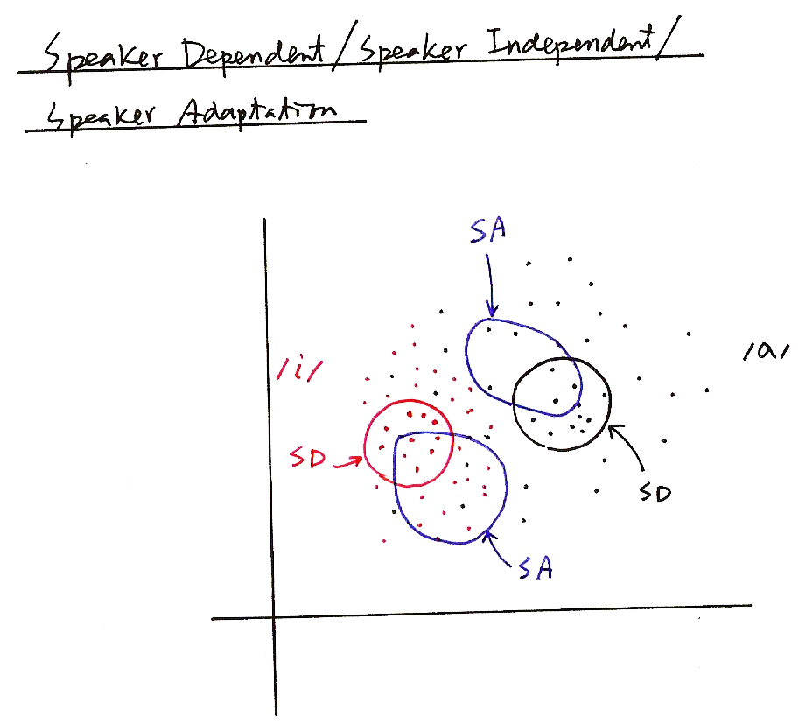
Speaker Dependent/Independent/Adaptation
SA
/a/
/i/
SD
SD
SA

Slide 4
MAP (Maximum A Posteriori) Adaptation
Given Speaker-independent Model set Λ={λ_{i}=(A_{i}, B_{i}, π_{i}), i=1, 2,...M} and A set of Adaptation Data O = (o₁, o₂,...o_{t},...o_{T}) for A Specific Speaker
With Some Assumptions on the Prior Knowledge Prob [Λ] and some Derivation (EM Theory)
  example adaptation formula
  a weighted sum shifting μ_{jk} towards those directions of o_{t} (in j-th state and k-th Gaussian)
  larger τ_{jk} implies less shift
Only Those Models with Adaptation Data will be Modified, Unseen Models remain Unchanged — MAP Principle
  good with larger quantity of adaptation data
  poor performance with limited quantity of adaptation data
arg max
Λ
τ_{jk}: a parameter having to do the prior knowledge about μ_{jk}
may have to do with number of samples used to trainμ_{jk}

Slide 5
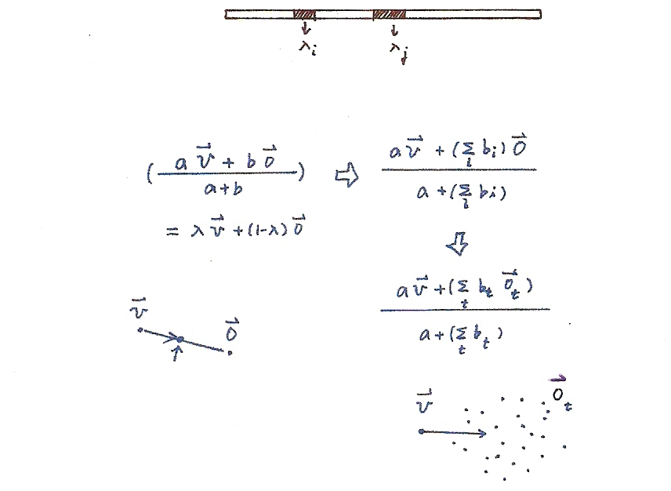
MAP Adaptation

Slide 6
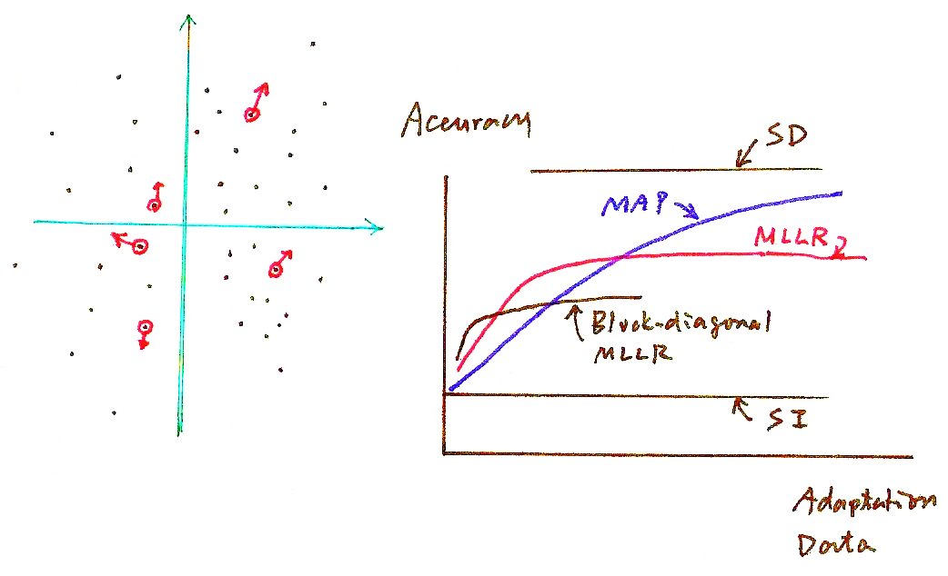
MAP Adaptation
Accuracy
SD
MAP
MLLR
Block-diagonal MLLR
SI
Adaptation Data

Slide 7
Maximum Likelihood Linear Regression (MLLR)
Divide the Gaussians (or Models) into Classes C₁, C₂,...C_{L}, and Define Transformation-based Adaptation for each Class
  linear regression with parameters A, b estimated by maximum likelihood criterion
  All Gaussians in the same class up-dated with the same A_{i}, b_{i}: parameter sharing, adaptation data sharing
  unseen Gaussians (or models) can be adapted as well
  A_{i} can be full matrices, or reduced to diagonal or block-diagonal to have less parameters to be estimated
  faster adaptation with much less adaptation data needed, but saturated at lower accuracy with more adaptation data due to the less precise modeling
Clustering the Gaussians (or Models) into L Classes
  too many classes requires more adaptation data, too less classes becomes less accurate
  basic principle: Gaussian (or models) with similar properties and “ just enough” data form a class
  data-driven (e.g. by Gaussian distances) primarily, knowledge driven helpful
Tree-structured Classes
  the node including minimum number of Gaussians (or models) but with adequate adaptation data is a class
  dynamically adjusting the classes as more adaptation data are observed

Slide 8
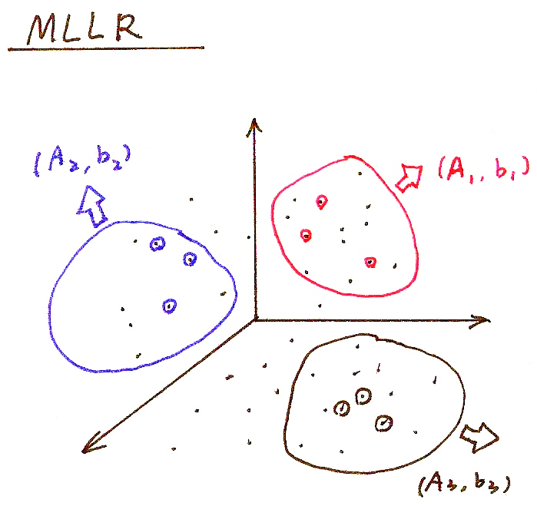
MLLR
(A₂, b₂)
(A₁, b₁)
(A₃, b₃)

Slide 9
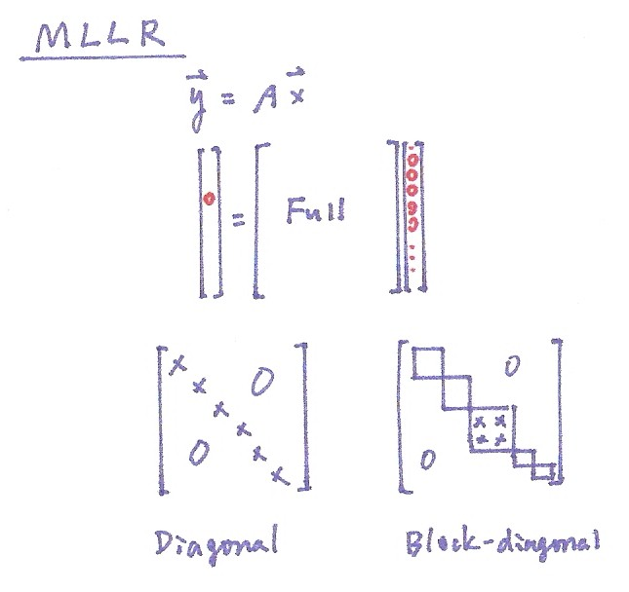
MLLR

Slide 10

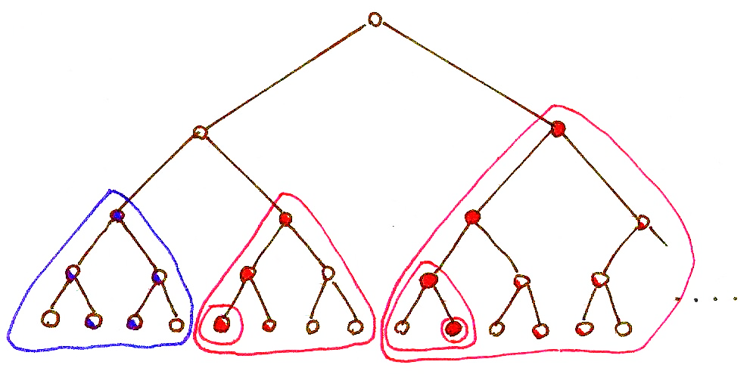
MLLR

Slide 11

Principal Component Analysis (PCA)
Problem Definition:
  for a zero mean random vector x with dimensionality N, x∈R^{N}, E(x)=0, iteratively find a set of k (k≤N) orthonormal basis vectors {e₁, e₂,…, e_{k}} so that
  (1) var (e₁^{T} x)=max (x has maximum variance when projected on e₁ )
  (2) var (e_{i}^{T} x)=max, subject to e_{i}⊥ e_{i-1} ⊥…… ⊥e₁ , 2≤ i ≤k
  (x has next maximum variance when projected on e₂ , etc.)
Solution: {e₁, e₂,…, e_{k}} are the eigenvectors of the covariance matrix Σ for x corresponding to the largest k eigenvalues
  new random vector y ∈R^{k} : the projection of x onto the subspace spanned by A=[e₁ e_{2 ……} e_{k}], y=A^{T}x
  a subspace with dimensionality k≤N such that when projected onto this subspace, y is “closest” to x in terms of its “randomness” for a given k
  var (e_{i}^{T} x) is the eigenvalue associated with e_{i}
Proof
  var (e₁^{T} x) = e₁^{T} E (x x^{T})e₁ = e₁^{T}Σe₁ = max, subject to |e₁|²=1
  using Lagrange multiplier
  J(e₁)= e₁^{T} E (x x^{T})e₁ -λ(|e₁|²⁻1) ,
  ⇒ E (xx^{T}) e₁ = λ₁e₁ , var(e₁^{T} x) = λ₁= max
  similar for e₂ with an extra constraint e₂^{T}e₁ = 0, etc.
J(e₁)
e₁
$$Aυ=u$$
$$Aυ=λυ$$
= 0
eigenvector
eigenvalue

Slide 12
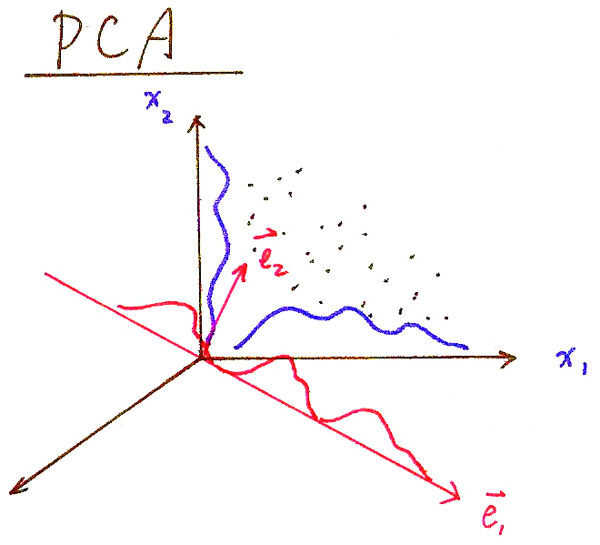
PCA

Slide 13

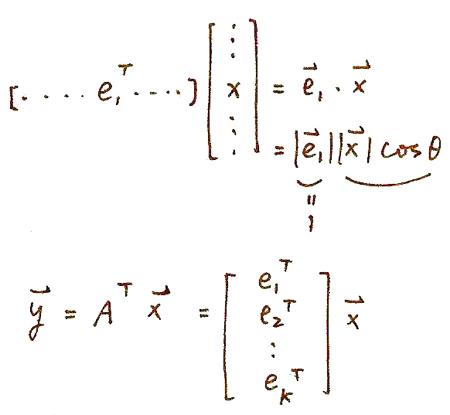
PCA

Slide 14
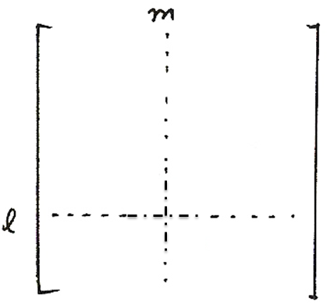
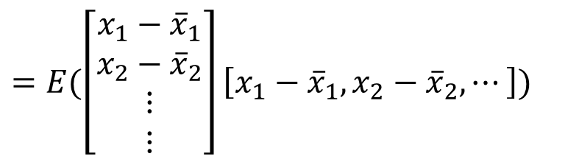



Basic Problem 3 (P.35 of 4.0)

Slide 15
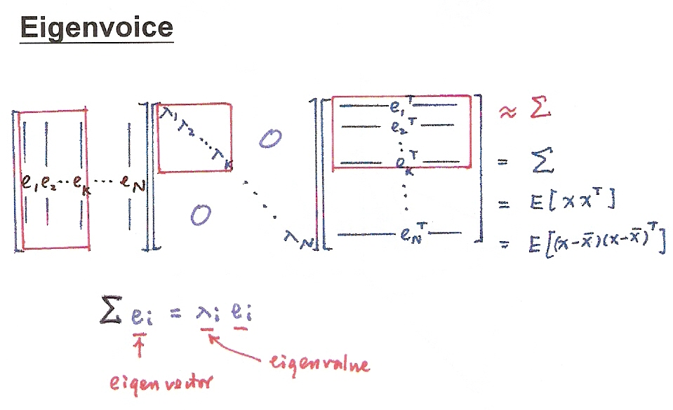
PCA
$$Aυ=u$$
$$Aυ=λυ$$
eigenvector
eigenvalue

Slide 16
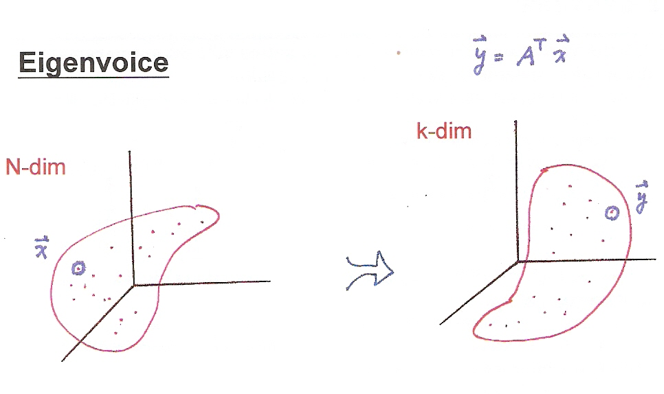
PCA
k-dim
N-dim

Slide 17
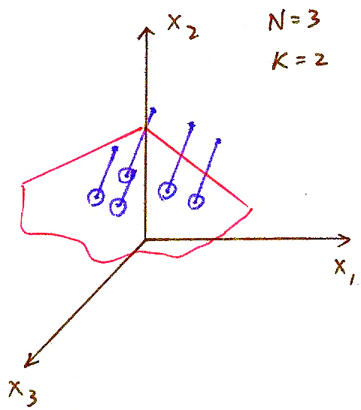
PCA
N=3
k=2

Slide 18
Eigenvoice
A Supervector x constructed by concatenating all relevant parameters for the speaker specific model of a training speaker
  concatenating the mean vectors of Gaussians in the speaker-dependent phone models
  concatenating the columns of A, b in MLLR approach
  x has dimensionality N (N = 5,000×3×8×40 = 4,800,000 for example)
    SD model mean parameters (m)
    transformation parameters (A, b)
A total of L (L = 1,000 for example) training speakers gives L supervectors x₁,x₂,...x_{L}
  x₁, x₂, x₃..... x_{L} are samples of the random vector x
  each training speaker is a point (or vector) in the space of dimensionality N
Principal Component Analysis (PCA)
  x'= x-E(x) , Σ= E(x' x'^{T}) ,
  {e₁,e₂ ,.....e_{k}}: eigenvectors with maximum eigenvalues λ₁> λ₂... > λ_{k}
  k is chosen such that λ_{j}, j>k is small enough (k=50 for example)

Slide 19
Eigenvoice
Principal Component Analysis (PCA)
  x'= x-E(x) , Σ= E(x' x'^{T}),
  {e₁,e₂ ,.....e_{k}}: eigenvectors with maximum eigenvalues λ₁> λ₂... > λ_{k}
  k is chosen such that λ_{j}, j>k is small enough (k=50 for example)
Eigenvoice Space: spanned by {e₁,e₂ ,.....e_{k}}
  each point (or vector) in this space represents a whole set of phone model parameters
  {e₁,e₂ ,.....e_{k}} represents the most important characteristics of speakers extracted from huge quantity of training data by large number of training speakers
  each new speaker as a point (or vector)
  in this space,
  a_{i} estimated by maximum likelihood
  principle (EM algorithm)
Features and Limitations
  only a small number of parameters a₁...a_{k} is needed to specify the characteristics of a new speaker
  rapid adaptation requiring only very limited quantity of training data
  performance saturated at lower accuracy (because too few free parameters)
  high computation/memory/training data requirements
Training Speaker 1
Training Speaker 2
New Speaker
New Speaker

Slide 20
Speaker Adaptive Training (SAT) and Cluster Adaptive Training (CAT)
Speaker Adaptive Training (SAT)
  trying to decompose the phonetic variation and speaker variation
  removing the speaker variation among training speakers as much as possible
  obtaining a “compact” speaker-independent model for further adaptation
  y=Ax+b in MLLR can be used in removing the speaker variation
Clustering Adaptive Training (CAT)
  dividing training speakers into R clusters by speaker clustering techniques
  obtaining mean models for all clusters(may include a mean-bias for the “compact” model in SAT)
  models for a new speaker is interpolated from the mean vectors
Speaker Adaptive Training (SAT)
  Training Speakers
Cluster Adaptive Training (CAT)
cluster
mean 1
a₁
Speaker 1
L
Training Speakers
A₁, b₁
MAP
“Compact” Speaker - independent model
cluster
mean 2
a₂
Speaker 2
A₂, b₂
MLLR
Σ
a_{R}
mean for a new speaker
A_{L}, b_{L}
cluster
mean R
Speaker L
1
mean-bias
, m_{i}: cluster mean i, m_{b}: mean-bias

Slide 21
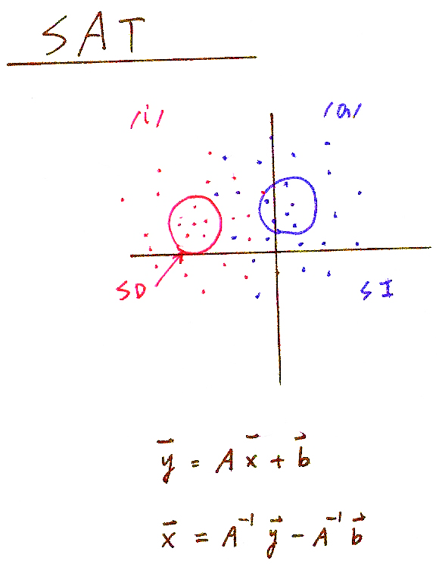
SAT
/i/
/a/
SD
SI

Slide 22
Speaker Recognition/Verification
To recognize the speakers rather than the content of the speech
  phonetic variation/speaker variation
  speaker identification: to identify the speaker from a group of speakers
  speaker verification: to verify if the speaker is as claimed
Gaussian Mixture Model (GMM)
  λ_{i}={(w_{j}, μ_{j}, Σ_{j},), j=1,2,...M} for speaker i
  for O = o₁o₂ ...o_{t} ...o_{T} ,
  maximum likelihood principle
Feature Parameters
  those carrying speaker characteristics preferred
  MFCC
  MLLR coefficients A_{i},b_{i}, eigenvoice coefficients a_{i}, CAT coefficients a_{i}
Speaker Verification
  text dependent: higher accuracy but easily broken
  text independent
  likelihood ratio test
  speech recognition based verification

Slide 23
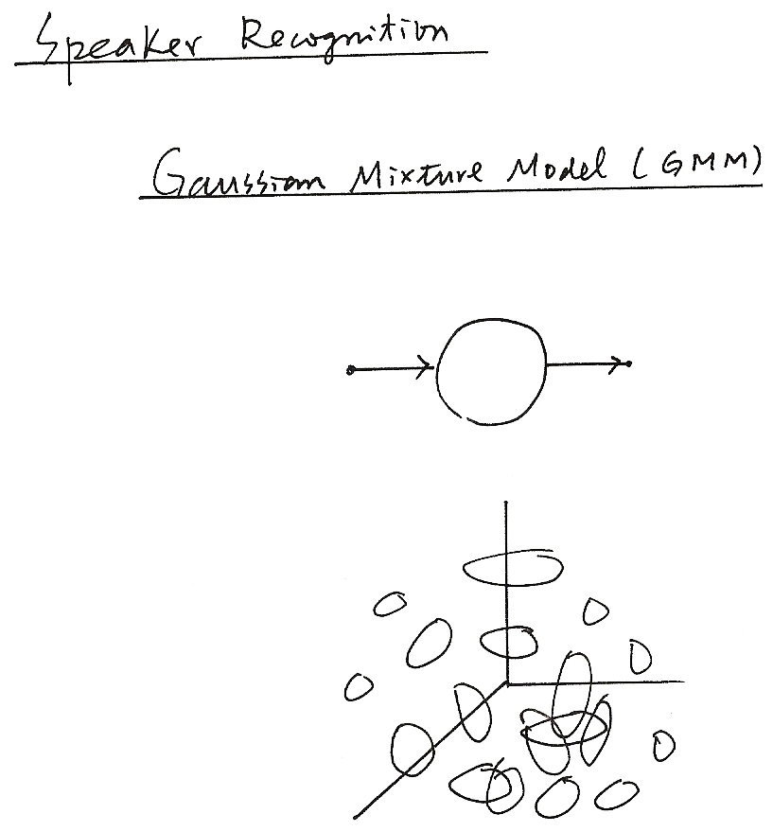
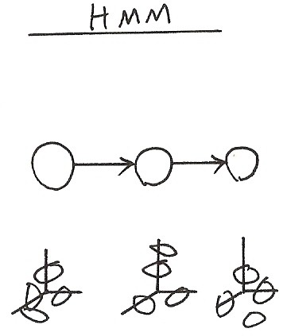
Speaker Recognition
Gaussian Mixture Model (GMM)
HMM

Slide 24
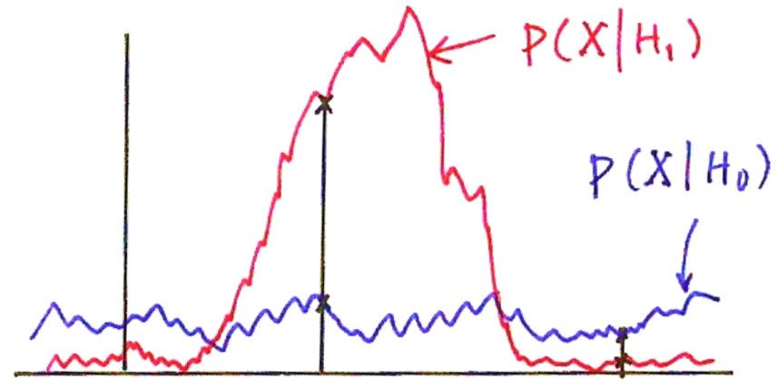
Likelihood Ratio Test
Detection Theory― Hypothesis Testing/Likelihood Ratio Test
  2 Hypotheses: H₀, H₁ with prior probabilities: P(H₀),P(H₁)
  observation: X with probabilistic law: P(X H₀), P(X H₁)
  MAP principle
  choose H₀ if P(H₀ X)> P(H₁ X)
  choose H₁ if P(H₁ X)> P(H₀ X)
  Likelihood Ratio Test
  P (H_{i} X) = P(X H_{i}) P (H_{i})/P(X), i=0,1
H₀
>
H₀
<
>
1
H₁
<
likelihood ratio-Likelihood Ratio Test
H₁
P(X| H₁)
P(X| H₀)
X
x₂
x₁
  Type I error: missing (false rejection)
  Type II error: false alarm (false detection)
  false alarm rate, false rejection rate, detection rate, recall rate, precision rate
  Th: a threshold value adjusted by balancing among different performance rates

Slide 25
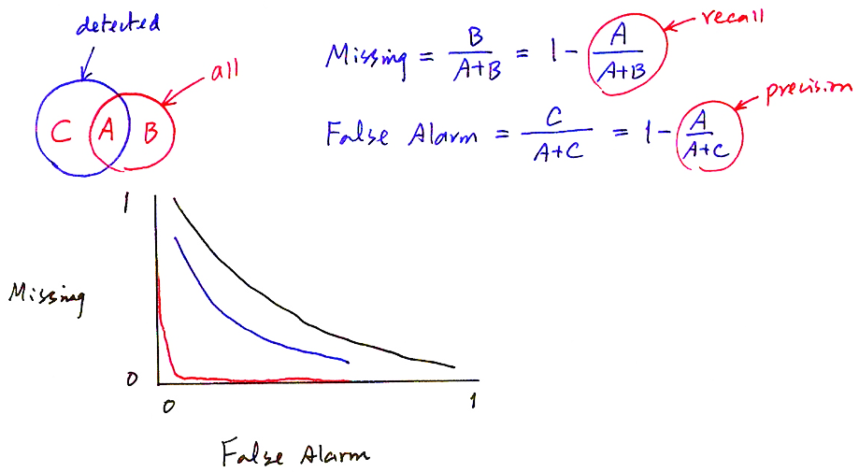


Receiver Operating Characteristics (ROC) Curve
detected
recall
all
precision
1
Missing
0
0
1
False Alarm

