Slide 1
14.0 Linguistic Processing and Latent Topic Analysis

Slide 2
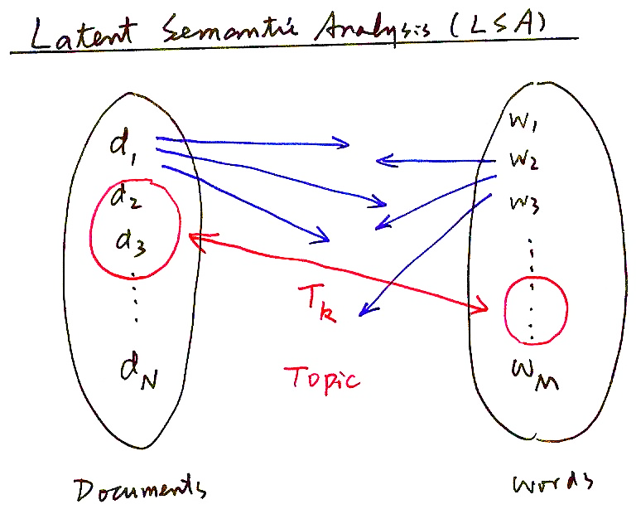
Latent Semantic Analysis (LSA)
T_{k}
Topic
Documents
Words

Slide 3
Latent Semantic Analysis (LSA) - Word-Document Matrix Representation
Vocabulary V of size M and Corpus T of size N
  V={w₁,w₂,...w_{i},..w_{M}} , w_{i}: the i-th word ,e.g. M=2×10⁴
  T={d₁,d₂,...d_{j},..d_{N}} , d_{j}: the j-th document ,e.g. N=10⁵
  c_{ij}: number of times w_{i} occurs in d_{j}
  n_{j}: total number of words present in d_{j}
  t_{i} = Σ_{j} c_{ij} : total number of times w_{i} occurs in T
Word-Document Matrix W
  W = [w_{ij}]
  each row of W is a N-dim “feature vector” for a word w_{i} with respect to all documents d_{j}
  each column of W is a M-dim “feature vector” for a document d_{j} with respect to all words w_{i}
d₁ d₂ ........ d_{j} .......... d_{N}
w₁ w₂
w_{i}
w_{M}
w_{ij}

Slide 4
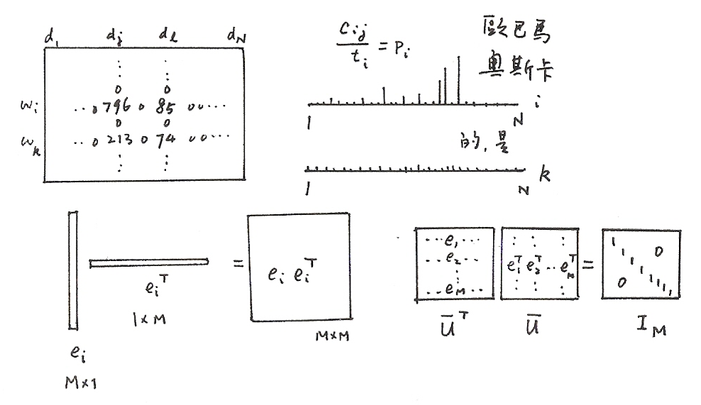
Latent Semantic Analysis (LSA)
_{j}

Slide 5
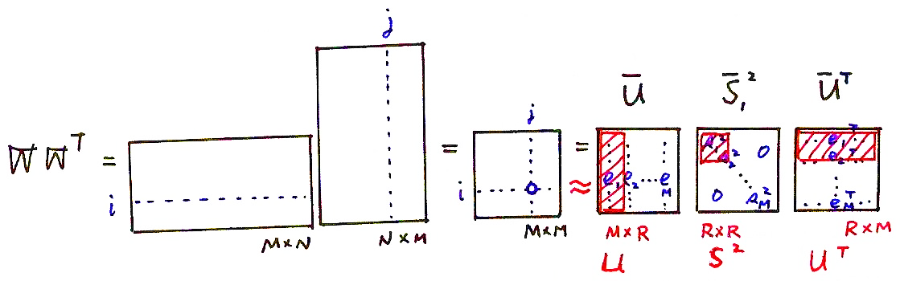
Dimensionality Reduction (1/2)
T
2
  dimensionality reduction: selection of R largest eigenvalues (R=800 for example)
R “concepts” or “latent semantic concepts”

Slide 6
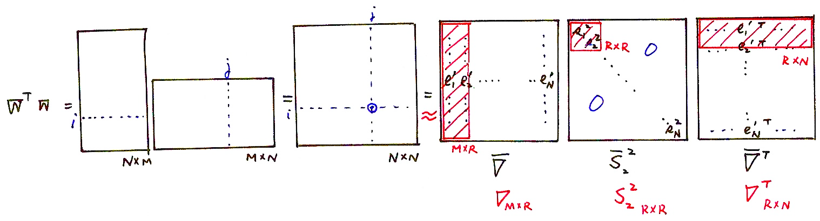
Dimensionality Reduction (2/2)
T
2
T
  dimensionality reduction: selection of R largest eigenvalues
(i, j) element of W^{T} W : inner product of i-th and j-th columns of W
“similarity” between d_{i} and d_{j}
T
s_{i}² : weights (significance of the “component matrices” e’_{i} e’_{i}^{T})
R “concepts” or “latent semantic concepts”
N
N

Slide 7
Singular Value Decomposition (SVD)
Singular Value Decomposition (SVD)
  s_{i}: singular values, s₁≥ s₂.... ≥ s_{R}
  U: left singular matrix, V: right singular matrix
Vectors for word w_{i}: u_{i}S=u_{i} (a row)
  a vector with dimentionality N reduced to a vector u_{i}S=u_{i} with dimentionality R
  N-dimentional space defined by N documents reduced to R-dimentional space defined by R “concepts”
  the R row vectors of V^{T}, or column vectors of V, or eigenvectors {e’₁,..e’_{R}}, are the R orthonormal basis for the “latent semantic space” with dimentionality R, with which u_{i}S = u _{i} is represented
  words with similar “semantic concepts” have “closer” location in the “latent semantic space”
    they tend to appear in similar “types” of documents, although not necessarily in exactly the same documents
d₁ d₂ ........ d_{j} . ......... d_{N}
d₁ d₂ ........ d_{j} .......... d_{N}
w₁ w₂
w_{i}
w_{M}
w₁ w₂
w_{i}
w_{M}
s₁
^{T}
U
v_{j}
V^{T}
s_{R}
w_{ij}
=
R×R
R×N
u_{i}
M×R

Slide 8
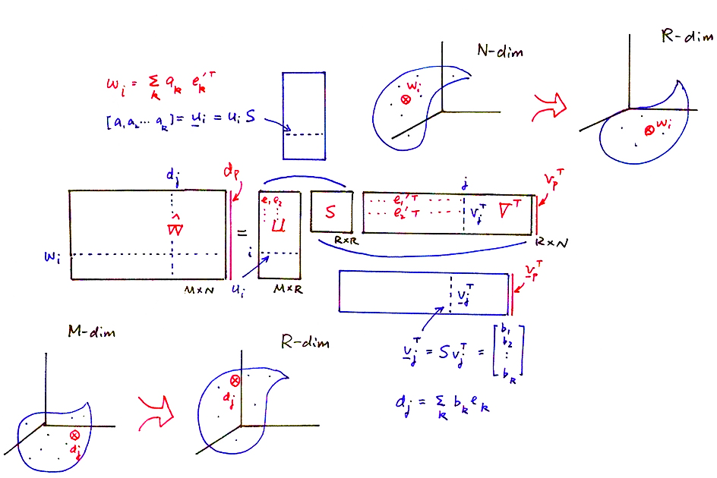
Singular Value Decomposition (SVD)
  d_{p}=USv_{p}^{T} (just as a column in W= USV^{T})

Slide 9
Singular Value Decomposition (SVD)
Singular Value Decomposition (SVD)
Vectors for document d_{j}: v_{j}S=v_{j} (a row, or v_{j} = S v_{j}^{T} for a column)
  a vector with dimentionality M reduced to a vector v_{j}S=v_{j} with dimentionality R
  M-dimentional space defined by M words reduced to R-dimentional space defined by R “concepts”
  the R columns of U, or eigenvectors{e₁,...e_{R}}, are the R orthonormal basis for the “latent semantic space” with dimensionality R, with which v_{j}S=v_{j} is represented
  documents with similar “semantic concepts” have “closer” location in the “latent semantic space”
    they tend to include similar “types” of words, although not necessarily exactly the same words
The Association Structure between words w_{i} and documents d_{j} is preserved with noisy information deleted, while the dimensionality is reduced to a common set of R “concepts”
d₁ d₂ ........ d_{j} . ......... d_{N}
d₁ d₂ ........ d_{j} .......... d_{N}
w₁ w₂
w_{i}
w_{M}
w₁ w₂
w_{i}
w_{M}
s₁
^{T}
U
s_{R}
v_{j}
V^{T}
w_{ij}
=
R×R
R×N
u_{i}
M×R
^{T}

Slide 10
Example Applications in Linguistic Processing
Word Clustering
  example applications: class-based language modeling, information retrieval ,etc.
  words with similar “semantic concepts” have “closer” location in the “latent semantic space”
    they tend to appear in similar “types” of documents, although not necessarily in exactly the same documents
  each component in the reduced word vector u_{j}S=u_{j} is the “association” of the word with the corresponding “concept”
  example similarity measure between two words:
Document Clustering
  example applications: clustered language modeling, language model adaptation, information retrieval, etc.
  documents with similar “semantic concepts” have “closer” location in the “latent semantic space”
    they tend to include similar “types” of words, although not necessarily exactly the same words
  each component on the reduced document vector v_{j}S=v_{j} is the “association” of the document with the corresponding “concept”
  example “similarity” measure between two documents:
2
2

Slide 11
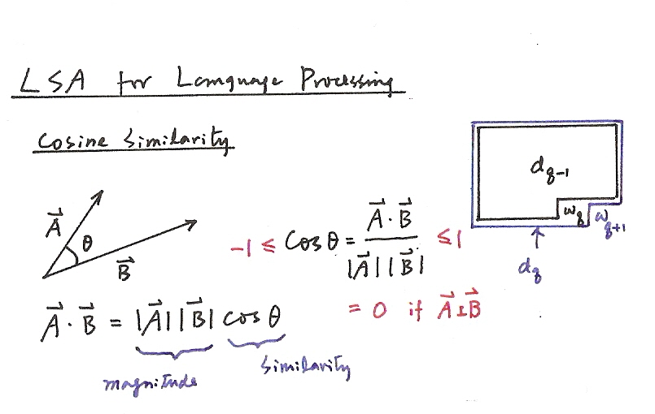
LSA for Linguistic Processing

Slide 12
Example Applications in Linguistic Processing
Information Retrieval
  “concept matching” vs “lexical matching” : relevant documents are associated with similar “concepts”, but may not include exactly the same words
  example approach: treating the query as a new document (by “folding-in”), and evaluating its “similarity” with all possible documents
Fold-in
  consider a new document outside of the training corpus T, but with similar language patterns or “concepts”
  construct a new column d_{p} ,p>N, with respect to the M words
  assuming U and S remain unchanged
  d_{p}=USv_{p}^{T} (just as a column in W= USV^{T})
  v _{p} = v_{p}S = d_{p}^{T}U as an R-dim representation of the new document
  (i.e. obtaining the projection of d_{p} on the basis e_{i} of U by inner product)

Slide 13
Integration with N-gram Language Models
Language Modeling for Speech Recognition
  Prob(w_{q}|d_{q-1})
  w_{q}: the q-th word in the current document to be recognized (q: sequence index)
  d_{q-1}: the recognized history in the current document
  v _{q-1}=d_{q-1}^{T}U : representation of d_{q-1} by v_{q-1} (folded-in)
  Prob(w_{q}|d_{q-1}) can be estimated by u_{q} and v _{q-1} in the R-dim space
  integration with N-gram
  Prob(w_{q}|H_{q-1}) =Prob(w_{q}|h_{q-1}, d_{q-1})
  H_{q-1}: history up to w_{q-1}
  h_{q-1}:<w_{q-n+1}, w_{q-n+2},... w_{q-1} >
  N-gram gives local relationships, while d_{q-1} gives semantic concepts
  d_{q-1} emphasizes more the key content words, while N-gram counts all words similarly including function words
v _{q-1} for d_{q-1} can be estimated iteratively
  assuming the q-th word in the current document is w_{i}
(n)
(n)
T
i-th dimentionality out of M
v _{q} moves in the R-dim space initially, eventually settle down somewhere

Slide 14
Probabilistic Latent Semantic Analysis (PLSA)
t_{j}: terms
Exactly the same as LSA, using a set of latent topics{ }to construct a new relationship between the documents and terms, but with a probabilistic framework
Trained with EM by maximizing the total likelihood
: frequency count of term in the document
D_{i}: documents
T_{k}: latent topics

Slide 15
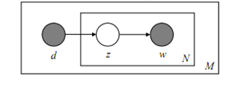
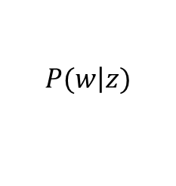
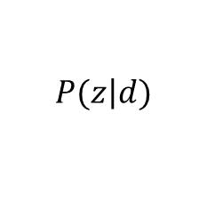
Probabilistic Latent Semantic Analysis (PLSA)
$$P(z\left|d\right.)$$
$$P(w\left|z\right.)$$
w: word
z: topic
d: document
N: words in document d
M: documents in corpus

Slide 16
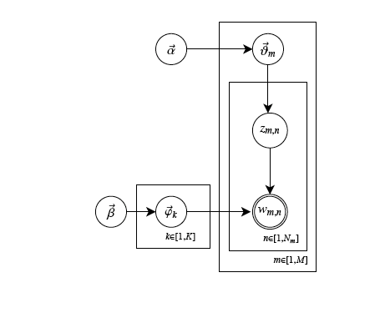


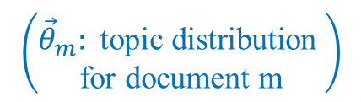
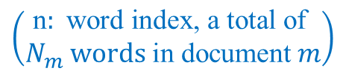

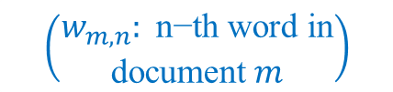
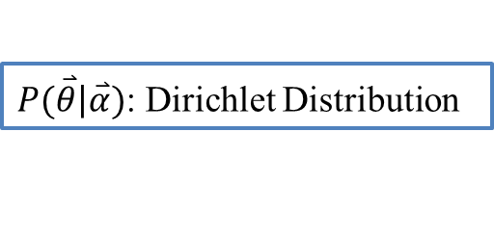
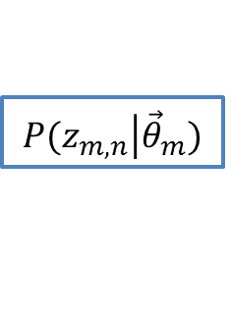
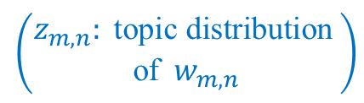
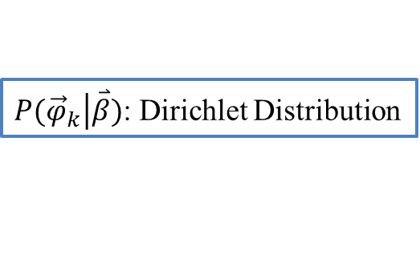
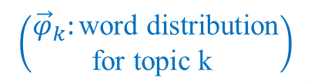
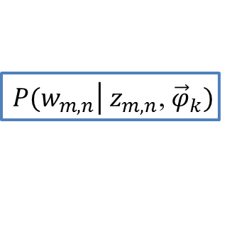
Latent Dirichlet Allocation(LDA)
$P(\overset{⃑}{θ}\left|\overset{⃑}{α}\right.)$: Dirichlet Distribution
$( \overset{⃑}{α}$: prior for ${\vec{θ}}_{m}$)
$$\left(\begin{aligned}{\vec{θ}}_{m}: \text{topic} \text{d}\text{istribution} \\ \text{for} \text{document} \text{m}\end{aligned}\right)$$
$$P(z_{m,n}\left|{\vec{θ}}_{m}\right.)$$
$P({\vec{φ}}_{k}\left|\overset{⃑}{β}\right.)$: Dirichlet Distribution
$$\left(\begin{aligned}z_{m,n}: \text{topic} \text{d}\text{istribution} \\ \text{of} w_{m,n}\end{aligned}\right)$$
$( \overset{⃑}{β}$: prior for ${\vec{φ}}_{k})$
$$\left(\begin{aligned}w_{m,n}: \text{n}\text{−}\text{t}\text{h} \text{word} \text{in} \\ \text{document} m\end{aligned}\right)$$
$$\left(\begin{aligned}{\vec{φ}}_{k}:\text{word} \text{distribution} \\ \text{for} \text{topic} \text{k} \end{aligned}\right)$$
$$\left(\begin{aligned}\text{n}: \text{word} \text{index}\text{, }\text{a} \text{total} \text{of} \\ N_{m} \text{words} \text{in} \text{document} m\end{aligned}\right)$$
( k: topic index, a total of K topics )
$$\left(\begin{aligned}\text{m}:\text{document} \text{index}\text{,} \text{a} \\ \text{total} \text{of} \text{M} \text{documents} \\ \text{in} \text{the} \text{corpus} \end{aligned}\right)$$
A document is represented as random mixtures of latent topics
Each topic is characterized by a distribution over words
$P(w_{m,n}\left|{ z}_{m,n}\text{,} \right.{\vec{φ}}_{k})$

Slide 17
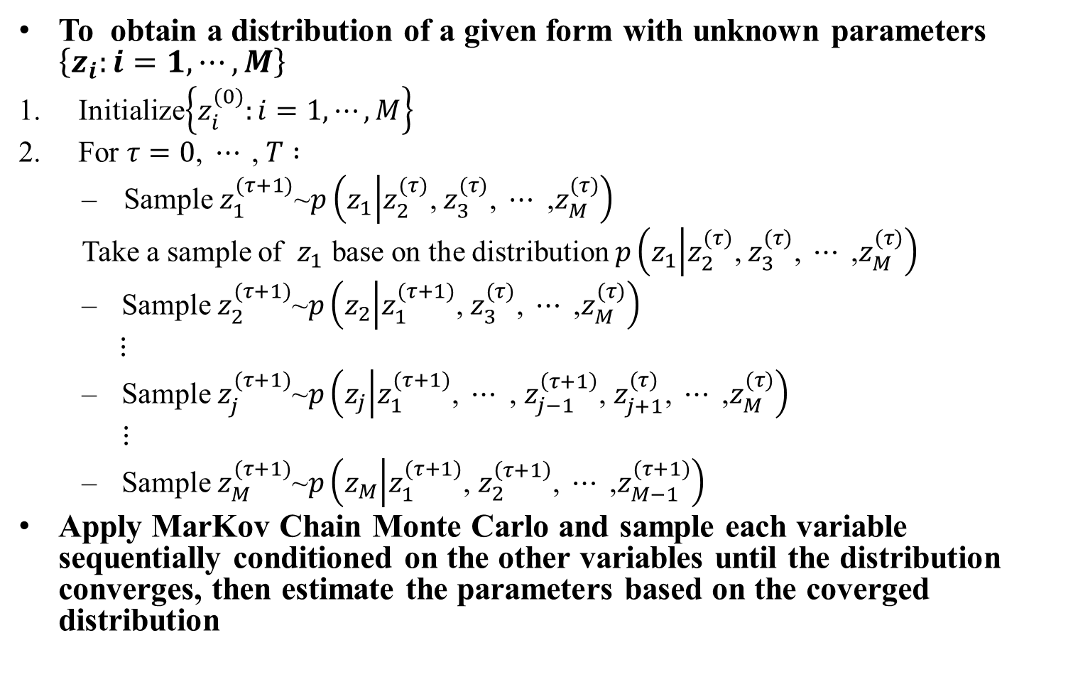
Gibbs Sampling in general
To obtain a distribution of a given form with unknown parameters $\left\{z_{i}:i=1,⋯, M\right\}$
Initialize$\left\{z_{i}^{(0)}:i=1,⋯, M\right\}$
For $τ=$ $0\text{,} ⋯ \text{,} T :$
Sample $z_{1}^{(τ+1)}$~$p\left(z_{1} | z_{2}^{(τ)}\text{,} z_{3}^{(τ)}\text{,} ⋯ \text{,}z_{M}^{(τ)}\right)$
Take a sample of $z_{1}$ base on the distribution $p\left(z_{1} | z_{2}^{(τ)}\text{,} z_{3}^{(τ)}\text{, }⋯\text{ ,}z_{M}^{(τ)}\right)$
Sample $z_{2}^{(τ+1)}$~$p\left(z_{2} | z_{1}^{(τ+1)}\text{,} z_{3}^{(τ)}\text{, }⋯\text{ ,}z_{M}^{(τ)}\right)$
$⋮$
Sample $z_{j}^{(τ+1)}$~$p\left(z_{j} | z_{1}^{(τ+1)}\text{,} ⋯\text{ ,} z_{j−1}^{\left(τ+1\right)}\text{, }z_{j+1}^{(τ)}\text{, }⋯\text{ ,}z_{M}^{(τ)}\right)$
$⋮$
Sample $z_{M}^{(τ+1)}$~$p\left(z_{M} | z_{1}^{(τ+1)}\text{, }z_{2}^{\left(τ+1\right)}\text{, }⋯\text{ ,}z_{M−1}^{(τ+1)}\right)$
Apply MarKov Chain Monte Carlo and sample each variable sequentially conditioned on the other variables until the distribution converges, then estimate the parameters based on the coverged distribution

Slide 18
Gibbs Sampling applied on LDA
Sample P(Z,W) :
?
?
?
?
Topic
…
w11
w12
w13
w1n
Word
Doc 1
?
?
?
?
…
w21
w22
w23
w2n
Doc 2
…

Slide 19
Gibbs Sampling applied on LDA
Sample P(Z,W) :
Random Initialization
…
w11
w12
w13
w1n
Doc 1
…
w21
w22
w23
w2n
Doc 2
…

Slide 20
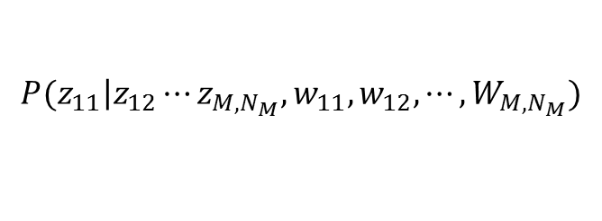
Gibbs Sampling applied on LDA
Sample P(Z,W) :
Random Initialization
Erase Z11, and draw a new Z11 ~
?
…
w11
w12
w13
w1n
Doc 1
$$P(z_{11}\left|z_{12}\right.⋯z_{M,N_{M}},w_{11},w_{12},⋯,W_{M,N_{M}})$$
…
w21
w22
w23
w2n
Doc 2
…

Slide 21
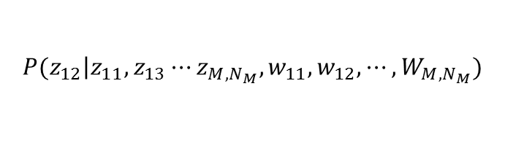
Gibbs Sampling applied on LDA
Sample P(Z,W) :
Random Initialization
Erase Z11, and draw a new Z11 ~
Erase Z12, and draw a new Z12 ~
?
…
w11
w12
w13
w1n
Doc 1
$$P(z_{11}\left|z_{12}\right.⋯z_{M,N_{M}},w_{11},w_{12},⋯,W_{M,N_{M}})$$
…
w21
w22
w23
w2n
$$P(z_{12}\left|z_{11},z_{13}\right.⋯z_{M,N_{M}},{w_{11},w}_{12},⋯,W_{M,N_{M}})$$
Doc 2
…

Slide 22
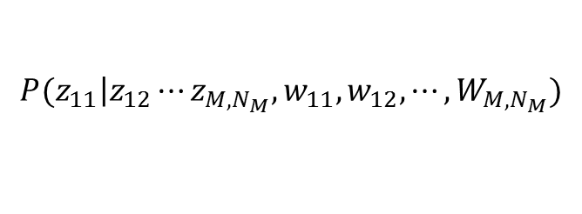
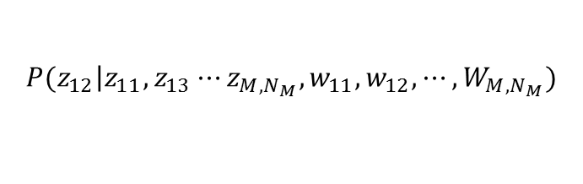
Gibbs Sampling applied on LDA
Sample P(Z,W) :
Random Initialization
Erase Z11, and draw a new Z11 ~
Erase Z12, and draw a new Z12 ~
…
w11
w12
w13
w1n
Doc 1
$$P(z_{11}\left|z_{12}\right.⋯z_{M,N_{M}},w_{11},w_{12},⋯,W_{M,N_{M}})$$
…
w21
w22
w23
w2n
$$P(z_{12}\left|z_{11},z_{13}\right.⋯z_{M,N_{M}},{w_{11},w}_{12},⋯,W_{M,N_{M}})$$
Doc 2
Iteratively update topic assignment for each word until converge
Compute θ, φ according to the final setting
…

Slide 23
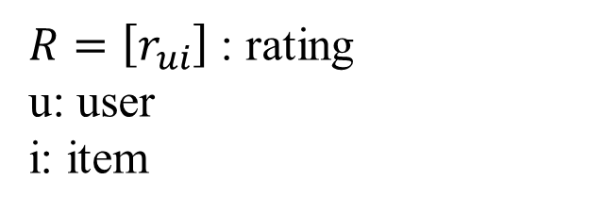
Matrix Factorization (MF) for Recommendation systems
 | Movie1 | Movie2 | Movie3 | Movie4 | Movie5 | Movie6 | Movie7 | Movie8 | Movie9
User A | 3.7 |  |  |  | 4.0
User B | 4.0 |  |  |  |  | 4.3
User C |  |  | 4.1
User D |  | 2.3 |  |  |  |  |  |  | 2.5
User E |  |  |  |  |  |  |  | 3.3
User F |  |  |  | 2.9
User G |  | 2.6 |  |  |  |  | 2.7
$R=\left[r_{ui}\right]$ : rating
u: user
i: item

Slide 24





Matrix Factorization (MF)
Mapping both users and items to a joint latent factor space of dimensionality f
latent factor: towards male, seriousness, etc.
1
I
f
1
I
i
i
1
1
=
$$q_{i}$$
f
u
$$r_{ui}$$
u
$$p_{u}^{T}$$
U
U

Slide 25
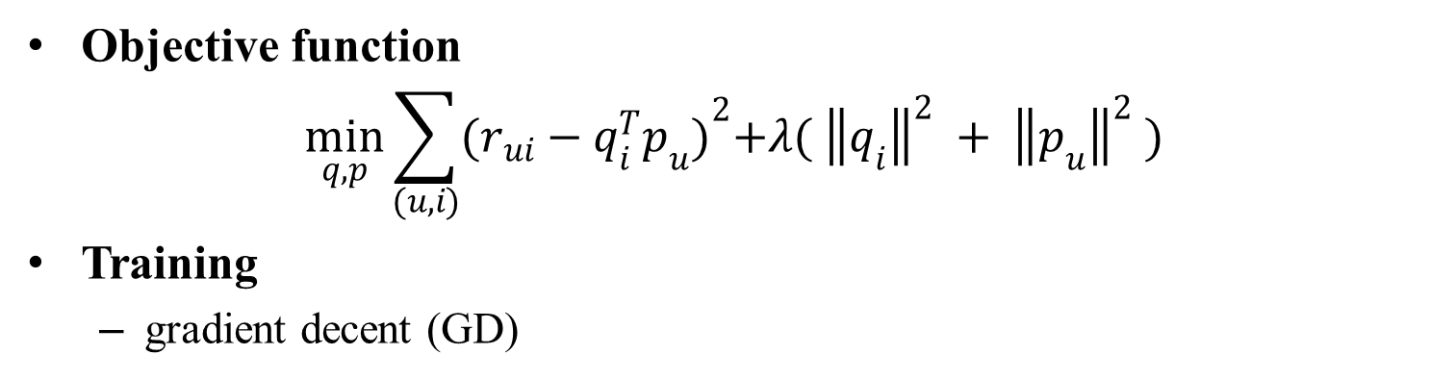
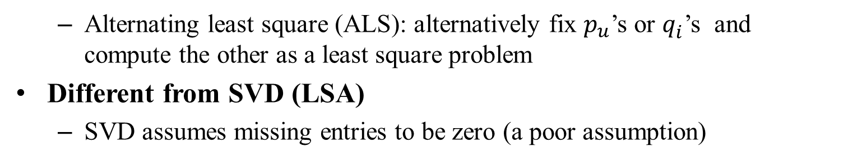
Matrix Factorization (MF)
Objective function
$$\min_{q,p}{\sum_{(u, i)}{{(r_{ui}−q_{i}^{T}p_{u})}^{2}+λ( {\left\|q_{i}\right\|}^{2} + {\left\|p_{u}\right\|}^{2} )}}$$
Training
  gradient decent (GD)
  Alternating least square (ALS): alternatively fix $p_{u}^{}$’s or $q_{i}^{}$’s and compute the other as a least square problem
Different from SVD (LSA)
  SVD assumes missing entries to be zero (a poor assumption)

Slide 26
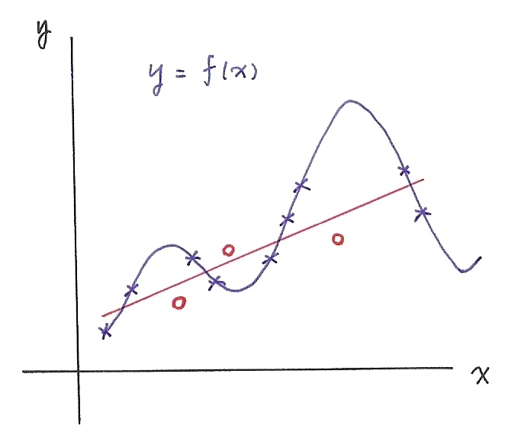
Overfitting Problem
A good model is not just to fit all the training data
  needs to cover unseen data well which may have distributions slightly different from that of training data
  too complicated models with too many parameters usually leads to overfitting

Slide 27

Extensions of Matrix Factorization (MF)
Biased MF
  add global bias μ (usually = average rating) , user bias b_{u} , and item bias b_{i} as parameters
Non-negative Matrix Factorization
  restrict the value in each component of p_{u} and q_{i} to be non-negative

Slide 28
References
LSA and PLSA
  “Exploiting Latent Semantic Information in Statistical Language Modeling”, Proceedings of the IEEE, Aug 2000
  “Latent Semantic Mapping”, IEEE Signal Processing Magazine, Sept. 2005, Special Issue on Speech Technology in Human-Machine Communication
  “Probabilistic Latent Semantic Indexing”, ACM Special Interest Group on Information Retrieval (ACM SIGIR), 1999
  “Probabilistic Latent Semantic Indexing”, Proc. of Uncertainty in Artificial Intelligence, 1999
  “Spoken Document Understanding and Organization”, IEEE Signal Processing Magazine, Sept. 2005, Special Issue on Speech Technology in Human-Machine Communication
LDA and Gibbs Sampling
  Christopher M. Bishop, Pattern Recognition and Machine Learning, Springer 2006
  Blei, David M.; Andrew Y. Ng, Michael I. Jordan. "Latent Dirichlet Allocation”, Journal of Machine Learning Research 2003
  Gregor Heinrich, ”Parameter estimation for text analysis”, 2005

Slide 29
References
Matrix Factorization
  A Linear Ensemble of Individual and Blended Models for Music Rating Prediction. In JMLR W&CP, volume 18, 2011.
  Y. Koren, R. M. Bell, and C. Volinsky. Matrix factorization techniques for recommender systems. Computer, 42(8):30-37, 2009.
  Introduction to Matrix Factorization Methods Collaborative Filtering (http://www.intelligentmining.com/knowledge/slides/Collaborative.Filtering.Factorization.pdf)
  GraphLab API: Collaborative Filtering (http://docs.graphlab.org/collaborative_filtering.html)
  J Mairal, F Bach, J Ponce, G Sapiro, Online learning for matrix factorization and sparse coding, The Journal of Machine Learning, 2010

