Slide 1
15.0 Robustness for Acoustic Environment
References: 1. 10.5, 10.6 of Huang
2. “Robust Speech Recognition in Additive and Convolutional Noise Using Parallel
Model Combination” Computer Speech and Language, Vol. 9, 1995
3. “A Vector Taylor Series Approach for Environment Independent Speech
Recognition”, International Conference on Acoustics, Speech and Signal
Processing, 1996
4. “Signal Bias Removal by Maximum Likelihood Estimation for Robust Telephone
Speech Recognition”, IEEE Trans. on Speech & Audio Processing, Jan 1996
5. “Cepstral Domain Segmental Feature Vector Normalization for Noise Robust
Speech Recognition”, Speech Communication, Vol. 25, pp. 133-147, August 1998
6. “Non-linear Transformation of the Feature Space for Robust Speech
Recognition”, in Proceedings of International Conference on Acoustics, Speech
and Signal Processing, 2002, pp. 401-404
7. “RASTA Processing of Speech”, IEEE Trans. on Speech & Audio Processing,
April 1994
8. 3.8 of Duda, Hart and Stork, “Pattern Classification”, John Wiley and sons, 2001
9. “Optimization of Temporal Filters for Constructing Robust Features in Speech
Recognition”, IEEE Trans. on Speech and Audio Processing, May 2006
10. “Suppression of Acoustic Noise in Speech Using Spectral Subtraction” ,IEEE Trans.
on Acoustics, Speech and Signal Processing, Apr 1979
11. “A Perceptually Constrained GSVD-based Approach for Enhancing Speech
Corrupted by Color Noise”, IEEE Transactions on Audio, Speech and Language
Processing, Jan 2007

Slide 2
Mismatch in Statistical Speech Recognition
x[n]
y[n]
Feature
Extraction
O =o₁o₂…o_{T}
Search
W=w₁w₂...w_{R}
h[n]
original speech
input
signal
feature vectors
output
sentences
acoustic reception
microphone distortion
phone/wireless channel
n₁(t)
n₂(t)
Speech
Corpus
Acoustic
Models
Lexicon
Language
Model
Text
Corpus
additive
noise
convolutional noise
additive
noise
Mismatch between Training/Recognition Conditions
  Mismatch in Acoustic Environment ⎯ Environmental Robustness
    additive/convolutional noise, etc.
  Mismatch in Speaker Characteristics ⎯ Speaker Adaptation
  Mismatch in Other Acoustic Conditions
    speaking mode:read/prepared/conversational/spontaneous speech, etc.
    speaking rate, dialects/accents, emotional effects, etc.
  Mismatch in Lexicon ⎯ Lexicon Adaptation
    out-of-vocabulary(OOV) words, pronunciation variation, etc.
  Mismatch in Language Model ⎯ Language Model Adaptation
    different task domains give different N-gram parameters, etc.
Possible Approaches for Acoustic Environment Mismatch
O =o₁o₂…o_{T}
Acoustic
Models
x[n]
Feature
Extraction
Model
Training
λ_{i} = (A_{i} , B_{i} , π_{i} )
(training)
(recognition)
y[n]
Feature
Extraction
O’ =o’₁o’₂…o’_{T}
Search and
Recognition
Acoustic
Models
λ’_{i} = (A’_{i} , B’_{i} , π’_{i} )
Speech Enhancement
Feature-based Approaches
Model-based Approaches

Slide 3
Model-based Approach Example 1― Parallel Model Combination (PMC)
Basic Idea
  primarily handling the additive noise
  the best recognition accuracy can be achieved if the models are trained with matched noisy speech, which is impossible
  a noise model is generated in real-time from the noise collected in the recognition environment during silence period
  combining the noise model and the clean-speech models in real-time to generate the noisy-speech models
Basic Approaches
  performed on model parameters in cepstral domain
  noise and signal are additive in linear spectral domain rather than the cepstral domain, so transforming the parameters back to linear spectral domain for combination
  allowing both the means and
  variances of a model set to be modified
Parameters used :
  the clean speech
  models
  a noise model
Clean speech HMM
Noisy speech HMM
Cepstral domain
Noise HMM
C⁻¹
C
exp
log
Model combination
Linear Spectral domain

Slide 4
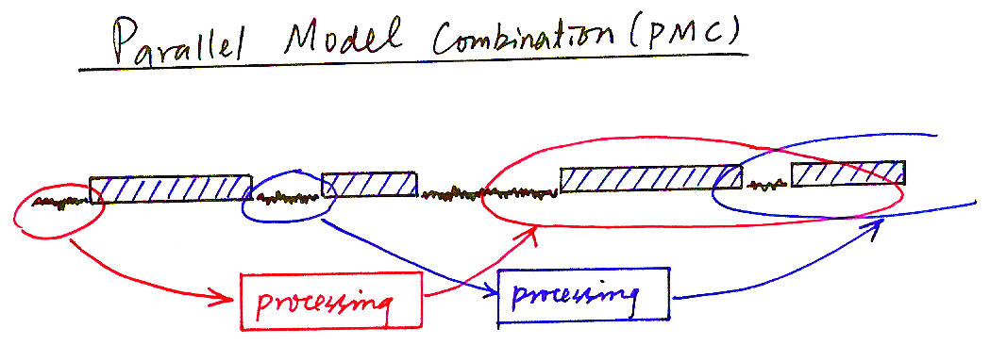
Parallel Model Combination (PMC)
processing
processing

Slide 5
Model-based Approach Example 1 ― Parallel Model Combination (PMC)
The Effect of Additive Noise in the Three Different Domains and the Relationships
Linear power spectral domain
X(ω)=S(ω) +N(ω)
log
X^{l}=log(X),
S^{l}=log(S)➔S=exp(S^{l})
N^{l}=log(N) ➔N=exp(N^{l})
exp
Log spectral domain
X ^{c}=CX ^{l},
S ^{c}=CS ^{l}➔S ^{l}=C⁻¹S ^{c}
N ^{c}=CN ^{l}➔N ^{l}=C⁻¹N ^{c}
C
Nonlinear
combination
C⁻¹
Cepstral domain

Slide 6
Model-based Approach Example 1 ― Parallel Model Combination (PMC)
The Steps of Parallel Model Combination (Log-Normal Approximation) :
  based on various assumptions and approximations to simplify the mathematics and reduce the computation requirements
Log-spectral domain
Linear spectral domain
Cepstral domain
Noise HMM’s
Clean speech HMM’s
Noisy speech HMM’s

Slide 7
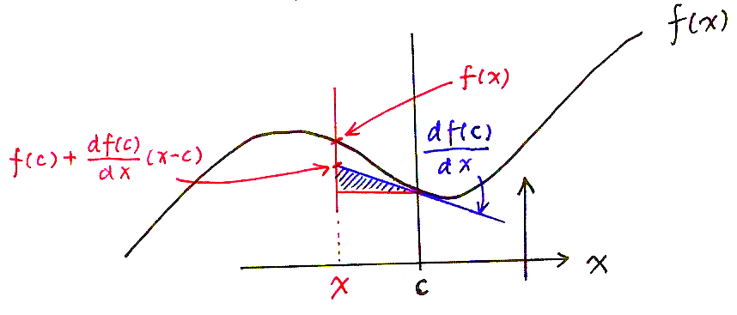
Model-based Approach Example 2― Vector Taylor’s Series (VTS)
Basic Approach
  Similar to PMC, the noisy-speech models are generated by combination of clean speech HMM’s and the noise HMM
  Unlike PMC, this approach combines the model parameters directly in the log-spectral domain using Taylor’s Series approximation
  Taylor’s Series Expansion for l-dim functions:
f(x)
f(x)
x
x
c

Slide 8
Vector Taylor’s Series (VTS)
Given a nonlinear function z=g(x, y)
  x, y, z are n-dim random vectors
  assuming the mean of x, y, μ_{x}, μ_{y} and covariance of x, y, Σ_{x}, Σ_{y} are known
  then the mean and covariance of z can be approximated by the Vector Taylor’s Series
Now Replacing z=g (x, y) by the Following Function
  the solution can be obtained
i, j: dimension index

Slide 9
Feature-based Approach Example 1— Cepstral Moment Normalization (CMS, CMVN) and Histogram Equalization (HEQ)
Cepstral Mean Subtraction(CMS) - Originally for Covolutional Noise
  convolutional noise in time domain becomes additive in cepstral domain (MFCC)
  y[n] = x[n]∗h[n] ⇒ y = x+h , x, y, h in cepstral domain
  most convolutional noise changes only very slightly for some reasonable time interval
  x = y−h if h can be estimated
Cepstral Mean Subtraction(CMS)
  assuming E[ x ] = 0 , then E[ y ] = h , averaged over an utterance or a moving
  window, or a longer time interval
  x_{CMS} = y−E[ y ]
  CMS features are immune to convolutional noise
  x[n] convolved with any h[n] gives the same x_{CMS}
  CMS doesn't change delta or delta-delta cepstral coefficients
Signal Bias Removal
  estimating h by the maximum likelihood criteria
  h*= ^{arg max} Prob[Y = (y₁y₂…y_{T}) | λ , h] , λ : HMM for the utterance Y
  iteratively obtained via EM algorithm
CMS, Cepstral Mean and Variance Normalization (CMVN) and Histogram Equalization (HEQ)
  CMS equally useful for additive noise
  CMVN: variance normalized as well
  HEQ: the whole distribution equalized
  Successful and popularly used
h
x_{CMVN}= x_{CMS}/[Var(x_{CMS})]^{1/2}
y=CDF_{y}⁻¹[CDF_{x}(x)]

Slide 10
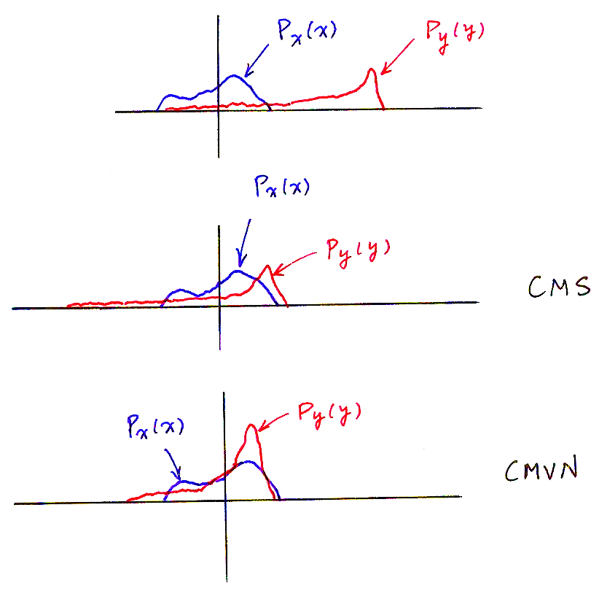
Cepstral Moment Normalization
  CMVN: variance normalized as well
x_{CMVN}= x_{CMS}/[Var(x_{CMS})]^{1/2}
P_{x}(x)
P_{y}(y)
P_{x}(x)
P_{y}(y)
CMS
P_{x}(x)
P_{y}(y)
CMVN

Slide 11
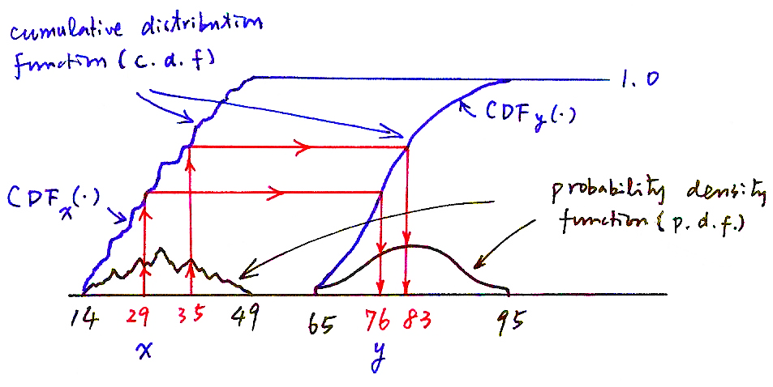
Histogram Equalization
  HEQ: the whole distribution equalized
y = CDF_{y}⁻¹[CDF_{x}(x)]
cumulative distribution
function (c. d. f.)
1.0
CDF_{y}(‧)
CDF_{x}(‧)
probability density
function (p. d. f.)
x
y

Slide 12
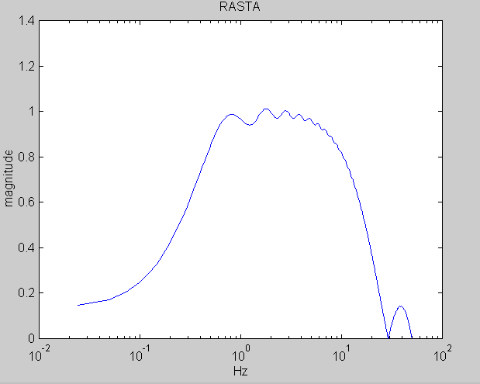
Feature-based Approach Example 2 ― RASTA ( Relative Spectral) Temporal Filtering
Temporal Filtering
  each component in the feature vector (MFCC coefficients) considered as a signal or “time trajectories” when the time index (frame number) progresses
  the frequency domain of this signal is called the “modulation frequency”
  performing filtering on these signals
RASTA Processing :
  assuming the rate of change of nonlinguistic components in speech (e.g. additive and convolutional noise) often lies outside the typical rate of the change of the vocal tract shape
  designing filters to try to suppress the spectral components in these “time trajectories” that change more slowly or quickly than this typical rate of change of the vocal tract shape
  a specially designed temporal filter for such “time trajectories”
MFCC Features
New Features
B(z)
y_{t}
B(z)
B(z)
feature
vectors
Frame index
Frame index
Modulation Frequency (H_{z} )

Slide 13
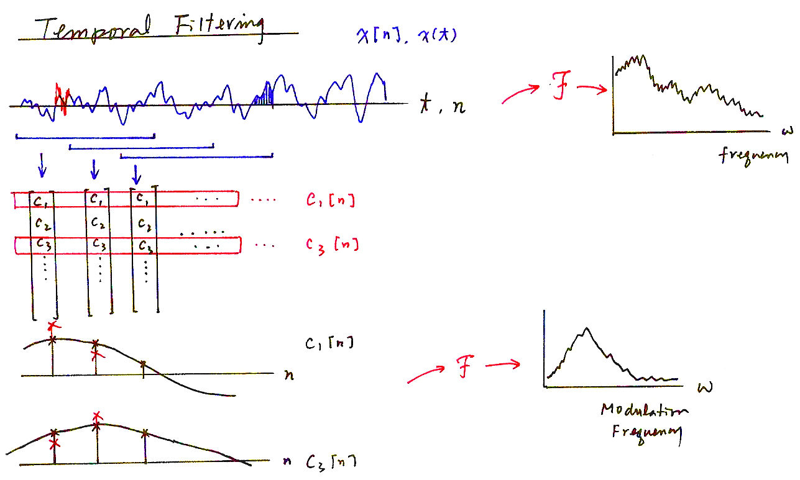
Temporal Filtering
x[n], x(t)
F
t, n
Frequency
C₁[n]
C₃[n]
C₁[n]
F
Modulation
Frequency
C₃[n]

Slide 14
Features-based Approach Example 3 ― Data-driven Temporal Filtering (1)
PCA-derived temporal filtering
  temporal filtering is equivalent to the weighted sum of a sequence of a specific MFCC coefficient with length L slided along the frame index
  maximizing the variance of such a weighted sum is helpful in recognition
  the impulse response of B_{k}(z) can be the first eigenvector of the covariance matrix for z_{k} ,for example
  B_{k}(z) is different for different k
B₁(z)
B₂(z)
Original feature
stream y_{t}
B_{n}(z)
Frame index
L
z_{k}(1)
z_{k}(2)
z_{k}(3)

Slide 15
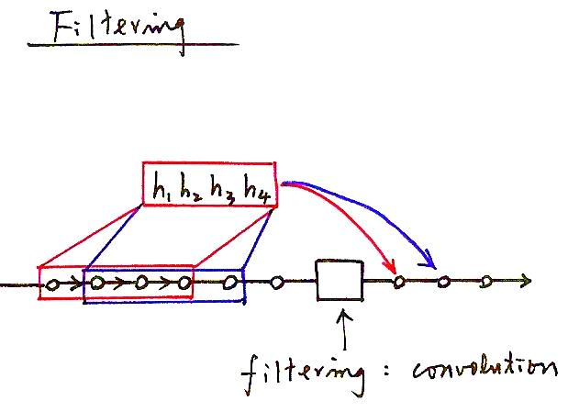
Filtering
filtering: convolution

Slide 16
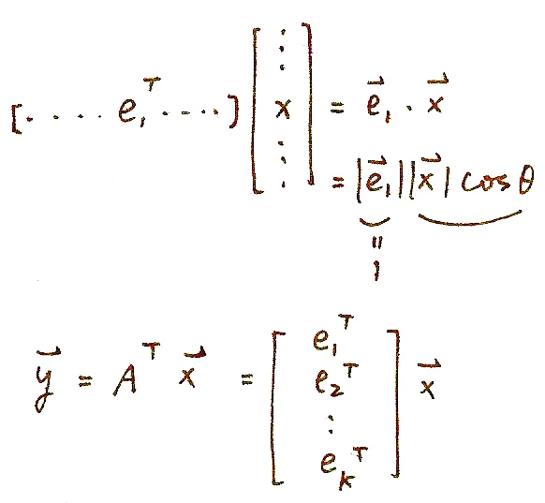
Principal Component Analysis (PCA) (P.13 of 13.0)

Slide 17
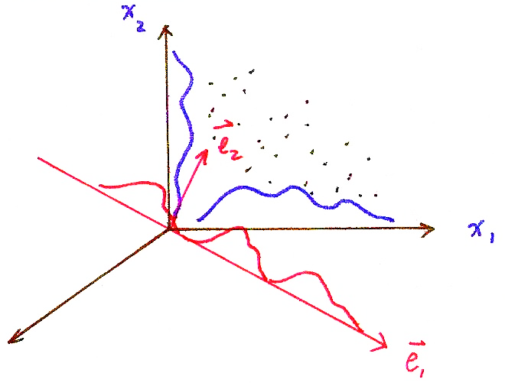
Principal Component Analysis (PCA) (P.12 of 13.0)

Slide 18
Principal Component Analysis (PCA) (P.11 of 13.0)
Problem Definition:
  for a zero mean random vector x with dimensionality N, x∈R^{N}, E(x)=0, iteratively find a set of k (k≤N) orthonormal basis vectors {e₁, e₂,…, e_{k}} so that
  (1) var (e₁^{T} x)=max (x has maximum variance when projected on e₁ )
  (2) var (e_{i}^{T} x)=max, subject to e_{i}⊥ e_{i-1} ⊥…… ⊥e₁ , 2≤ i ≤k
  (x has next maximum variance when projected on e₂ , etc.)
Solution: {e₁, e₂,…, e_{k}} are the eigenvectors of the covariance matrix Σ for x corresponding to the largest k eigenvalues
  new random vector y ∈R^{k} : the projection of x onto the subspace spanned by A=[e₁ e_{2 ……} e_{k}], y=A^{T}x
  a subspace with dimensionality k≤N such that when projected onto this subspace, y is “closest” to x in terms of its “randomness” for a given k
  var (e_{i}^{T} x) is the eigenvalue associated with e_{i}
Proof
  var (e₁^{T} x) = e₁^{T} E (x x^{T})e₁ = e₁^{T}Σe₁ = max, subject to |e₁|²=1
  using Lagrange multiplier
  J(e₁)= e₁^{T} E (x x^{T})e₁ -λ(|e₁|²⁻1) ,
  ⇒ E (xx^{T}) e₁ = λ₁e₁ , var(e₁^{T} x) = λ₁= max
  similar for e₂ with an extra constraint e₂^{T}e₁ = 0, etc.
J(e₁)
e₁
= 0

Slide 19
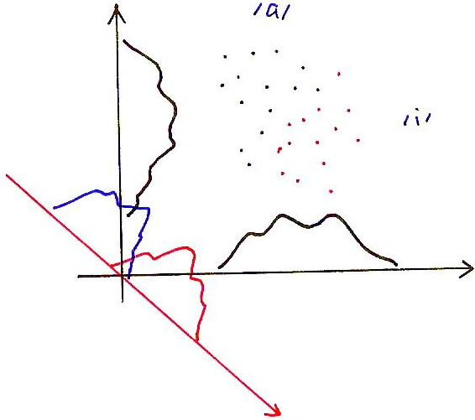
Linear Discriminative Analysis (LDA)
Linear Discriminative Analysis (LDA)
  while PCA tries to find some “principal components” to maximize the variance of the data, the Linear Discriminative Analysis (LDA) tries to find the most “discriminative” dimensions of the data among classes
x₂
/a/
/i/
x₁
w₁

Slide 20

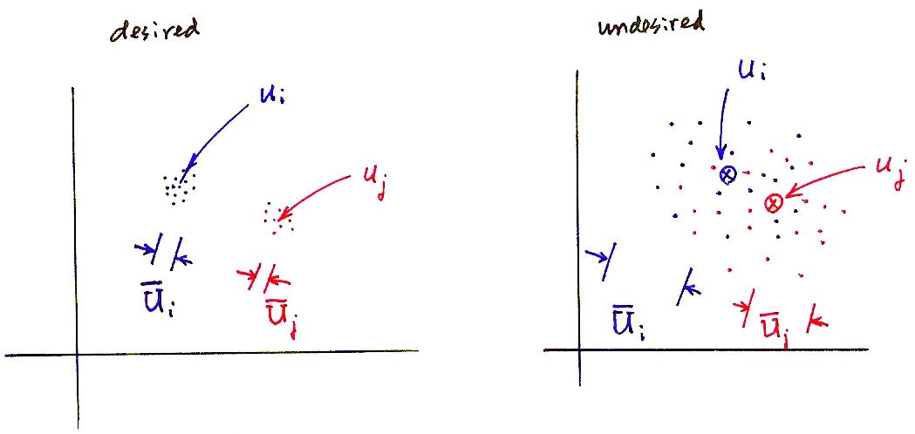
Linear Discriminative Analysis (LDA)
  within-class scatter matrix:
desired
undesired

Slide 21
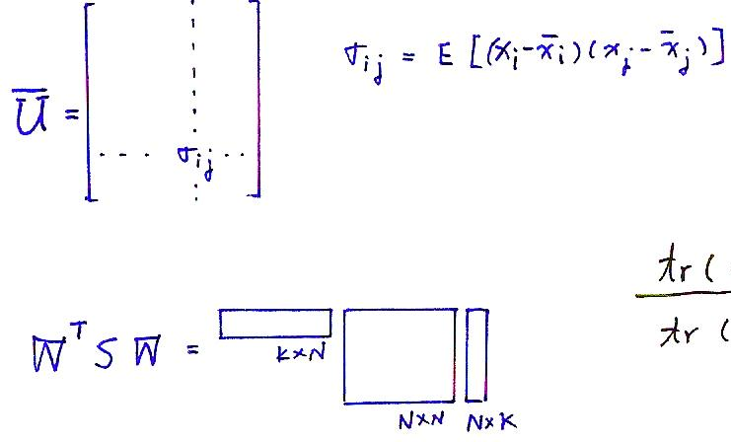
Linear Discriminative Analysis (LDA)
  tr(M): trace of a matrix M, the sum of eigenvalues, or the “total scattering”
  W^{T}S_{B,W}W: the matrix S_{B,W} after projecting on the new dimensions

Slide 22
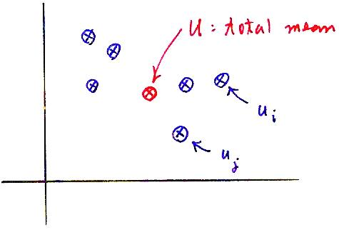
Linear Discriminative Analysis (LDA)
  Between-class scatter matrix:

Slide 23
Linear Discriminative Analysis (LDA)
Problem Definition
  w_{j}, μ_{j} and U_{j} are the weight (or number of samples), mean and covariance for the random vectors of class j, j=1……N,μ is the total mean
  find W=[w₁ w₂ ……w_{k}], a set of orthonormal basis such that
  tr(M): trace of a matrix M, the sum of eigenvalues, or the “total scattering”
  W^{T}S_{B,W}W: the matrix S_{B,W} after projecting on the new dimensions
Solution
  the columns of W are the eigenvectors of S_{w}⁻¹S_{B} with the largest eigenvalues

Slide 24
Features-based Approach Example 3 ― Data-driven Temporal Filtering (2)
LDA/MCE-derived Temporal Filtering
For a specific time
trajectory
k
Frame index
1 2 3 4 5
Divided into classes
LDA/MCE criteria
LDA/MCE-derived filter
z_{k}(1)
z_{k}(2)
z_{k}(3)
3
2
Class 1
z_{k}
(w_{k1} , w_{k2}, w_{k3} )=w_{k}^{T}
x_{k} =w_{k}^{T}z_{k}
New time trajectory
of features
Filtered parameters are weighted sum of parameters along the time trajectory (or inner product)

Slide 25
Speech Enhancement Example 1 ― Spectral Subtraction (SS)
Speech Enhancement
  producing a better signal by trying to remove the noise
  for listening purposes or recognition purposes
Background
  Noise n[n] changes fast and unpredictably in time domain, but relatively slowly in frequency domain, N(w)
  y[n] = x[n] + n[n]
Spectrum Subtraction
  |N(w)| estimated by averaging over M frames of locally detected silence parts, or up-dated by the latest detected silence frame
  |N(w)|_{i}= β|N(w)|_{i-1}+(1- β) |N(w)|_{i,n}
  |N(w)|_{i}: |N(w)| used at frame i |N(w)|_{i,n} : latest detected at frame i
  signal amplitude estimation
  |X(w)|_{i} = |Y(w)|_{i}- |N(w)|_{i} , if |Y(w)|_{i}- |N(w)|_{i}>α |Y(w)|_{i}
    =α |Y(w)|_{i} if |Y(w)|_{i}- |N(w)|_{i}≤α |Y(w)|_{i}
    transformed back to x[n] using the original phase
    performed frame by frame
  useful for most cases, but may produce some “musical noise” as well
  many different improved versions
^
^

Slide 26
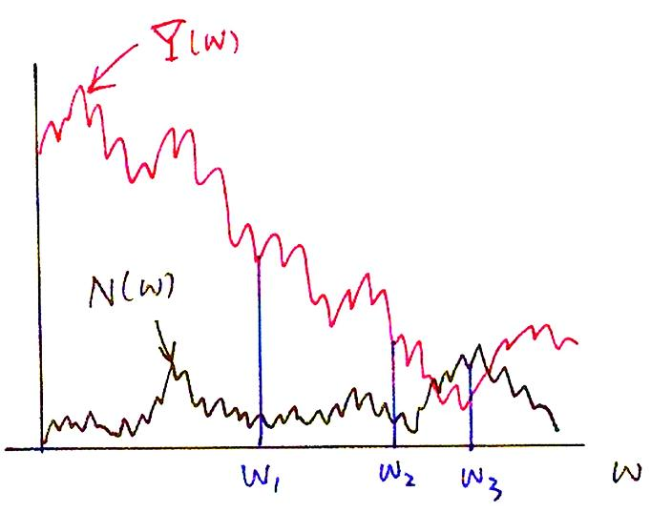
Spectral Subtraction
Y(ω)
N(ω)
ω₁ ω₂ ω₃
ω

Slide 27
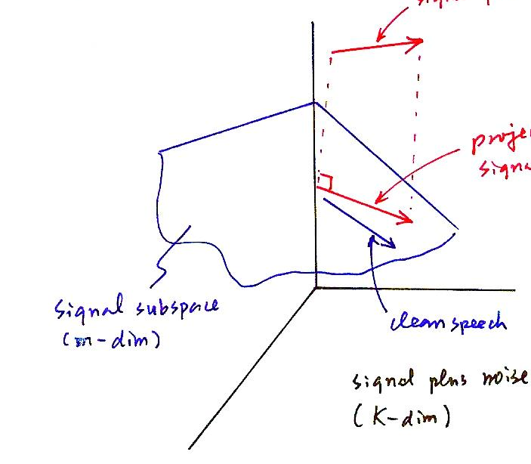
Speech Enhancement Example 2 ― Signal Subspace Approach
Signal Subspace Approach
  representing signal plus noise as a vector in a K-dimensional space
  signals are primarily spanned in a m-dimensional signal subspace
  the other K-m dimensions are primarily noise
  projecting the received noisy signal onto the signal subspace
signal plus noise
projected on signal subspace
signal subspace
(m-dim)
clean speech
signal plus noise
(K-dim)

Slide 28
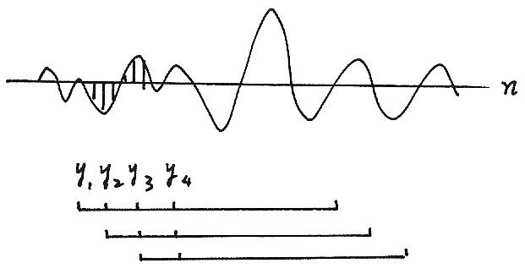
Speech Enhancement Example 2 ― Signal Subspace Approach
An Example
  Hankel-form matrix
  signal samples: y₁y₂y₃…y_{k}…y_{L}…y_{M}
  y₁ y₂ y₃ y₄… y_{k}
  y₂ y₃ y₄…… y_{k+1}
  H_{y}= y₃ y₄……….y_{k+2}
  . . . .
  . . . .
  . . . .
  y_{L} y_{L+1} y_{M}
  Generalized Singular Value Decomposition (GSVD)
  U^{T}H_{y}X = C =diag(c₁, c₂, …c_{k}), c₁≥c₂≥… ≥c_{k}
  V^{T}H_{n}X = S =diag(s₁, s₂, …s_{k}), s₁≤s₂≤…≤s_{k}
  subject to
  U, V, X : matrices composed by orthogonal vectors
  Which gives c_{i} > s_{i} for 1 ≤ i ≤ m, signal subspace
  s_{i} > c_{i} for m+1 ≤ i ≤ k, noise subspace
n
－ H_{y} for noisy speech
－ H_{n} for noise frames

Slide 29

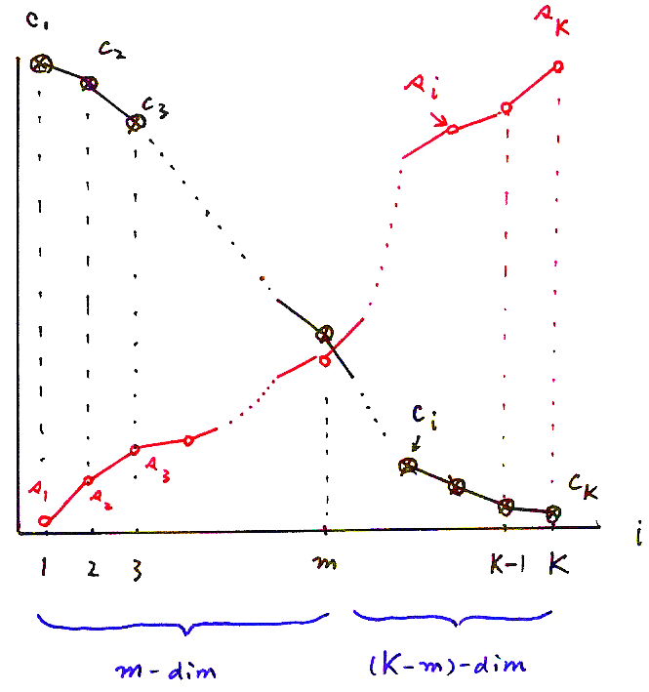
Signal Subspace
(m-dim)
(K-m)-dim

Slide 30
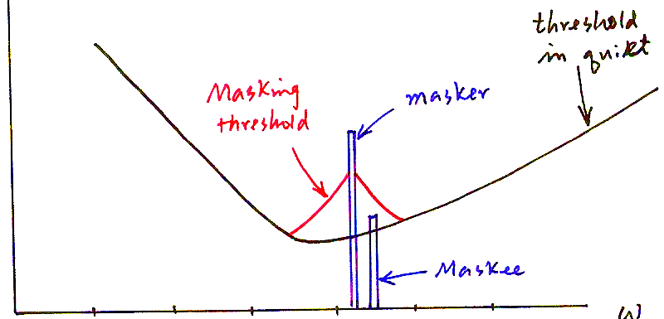
Speech Enhancement Example 3 ― Audio Masking Thresholds
Audio Masking Thresholds
  without a masker, signal inaudible if below a “threshold in quite”
  low-level signal (maskee) can be made inaudible by a simultaneously occurring stronger signal (masker).
  masking threshold can be evaluated
  global masking thresholds obtainable from many maskers given a frame of speech signals
  make noise components below the masking thresholds
threshold
in quiet
masking threshold
masker
maskee
0.01 0.1 1 10 100 1000

Slide 31
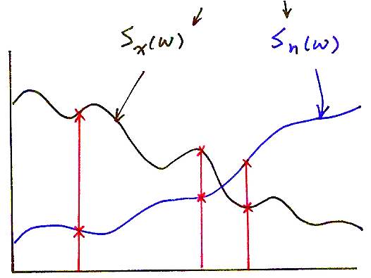
Speech Enhancement Example 4 ― Wiener Filtering
Wiener Filtering
  estimating clean speech from noisy speech in the sense of minimum mean square error given statistical characteristics
    x(t)
  clean speech n(t)
  noise
  an example solution : assuming x(t), n(t) are independent
y(t)
E[(y(t)-x(t))²]=min
Power Spectral Density

