Slide 1
5.0 Acoustic Modeling
References: 1. 2.2, 3.4.1, 4.5, 9.1~ 9.4 of Huang
2. “ Predicting Unseen Triphones with Senones”,
IEEE Trans. on Speech & Audio Processing, Nov 1996

Slide 2
Unit Selection for HMMs
Possible Candidates
  phrases, words, syllables, phonemes.....
Phoneme
  the minimum units of speech sound in a language which can serve to distinguish one word from the other
    e.g. b at / p at , b a d / b e d
  phone : a phoneme’s acoustic realization
  the same phoneme may have many different realizations
  e.g. sa t / me t er
Coarticulation and Context Dependency
  context: right/left neighboring units
  coarticulation: sound production changed because of the neighboring units
  right-context-dependent (RCD)/left-context-dependent (LCD)/ both
  intraword/interword context dependency
For Mandarin Chinese
  character/syllable mapping relation
  syllable: Initial (聲母) / Final (韻母) / tone (聲調)

Slide 3
Unit Selection Principles
Primary Considerations
  accuracy: accurately representing the acoustic realizations
  trainability: feasible to obtain enough data to estimate the model parameters
  generalizability: any new word can be derived from a predefined unit inventory
Examples
  words: accurate if enough data available, trainable for small vocabulary, NOT generalizable
  phone : trainable, generalizable
  difficult to be accurate due to context dependency
  syllable: 50 in Japanese, 1300 in Mandarin Chinese, over 30000 in English
Triphone
  a phone model taking into consideration both left and right neighboring phones
  (60)³→ 216,000
  very good generalizability, balance between accuracy/ trainability by parameter-sharing techniques

Slide 4
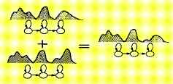
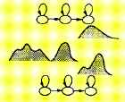
Sharing of Parameters and Training Data for Triphones
Sharing at Model Level
Sharing at State Level
Generalized Triphone
Shared Distribution Model (SDM)
clustering similar triphones and merging them together
those states with quite different distributions do not have to be merged

Slide 5
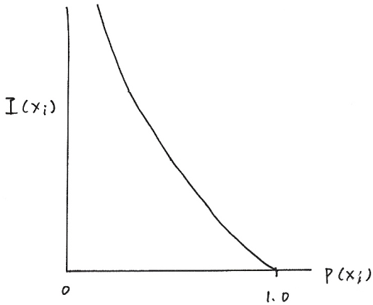
Some Fundamentals in Information Theory
Quantity of Information Carried by an Event (or a Random Variable)
  Assume an information source: output a random variable m_{j} at time j
  Define I(x_{i})= quantity of information carried by the event m_{j}= x_{i}
Desired properties:
  1. I(x_{i}) 0
  2. I(x_{i}) = 0
  3. I(x_{i}) > I(x_{j}) , if P(x_{i}) < P(x_{j})
  4.Information quantities are additive
  I(x_{i}) = bits (of information)
  H(S) = entropy of the source = average quantity of information out of the source each time
  =
  = the average quantity of information carried by each random variable
U = m₁m₂m₃m_{4.....,}m_{j}: the j^{-th} event, a random variable
S
m_{j} ε｛x₁,x₂,...x_{M}｝, M different possible kinds of outcomes
P(x_{i})= Prob [m_{j}=x_{i}] , , P(x_{i}) 0, i= 1,2,.....M
I(x_{i})
P(x_{i})
0
1.0

Slide 6
Fundamentals in Information Theory
M=2, {x₁, x₂} = {0, 1}
→U = 110100101011001……
P(0)=P(1)=½
U = 111111111……
P(1)=1, P(0)=0
U = 10111111111011111111……
P(1) ≈ 1, P(0) ≈ 0
S
M=4, {x₁, x_{2,} x₃, x₄} = {00, 01, 10, 11}
→U = 01 00 10 11 01……
S

Slide 7
Some Fundamentals in Information Theory
Examples
  M = 2, {x₁, x₂}= {0,1}, P(0)= P(1)=
  I(0)= I(1)= 1 bit (of information), H(S)= 1 bit (of information)
  M =4, {x₁, x₂, x₃, x₄}, P(x₁)= P(x₂)= P(x₃)= P(x₄)=
  I(x₁)= I(x₂)= I(x₃)= I(x₄)= 2 bits (of information), H(S)= 2 bits (of information)
  M = 2, {x₁, x₂}= {0,1}, P(0)= , P(1)=
  I(0)= 2 bits (of information), I(1)= 0.42 bits (of information)
  H(S)= 0.81 bits (of information)

Slide 8
Fundamentals in Information Theory
Example :
M=2, { x₁, x₂ } = { 0, 1 }, P(0)=P(1)=½
U = 01101101001010110……
↑
This binary digit carries exactly 1 bit of information
Example :
M=4, {x₁, x_{2,} x₃, x₄} = {00, 01, 10, 11}
P(00) = P(01) = P(10) = P(11) = ¼
U = 01 00 01 11 10 10 11……
↑
This symbol (represented by two binary digits) carries exactly 2 bits of information
Example :
M=2, { x₁, x₂ } = { 0, 1 }, P(0)=¼, P(1)=¾
U = 11101111100111110……
↑ ↑
This binary digit carries This binary digit carries
0.42 bit of information 2 bits of information

Slide 9
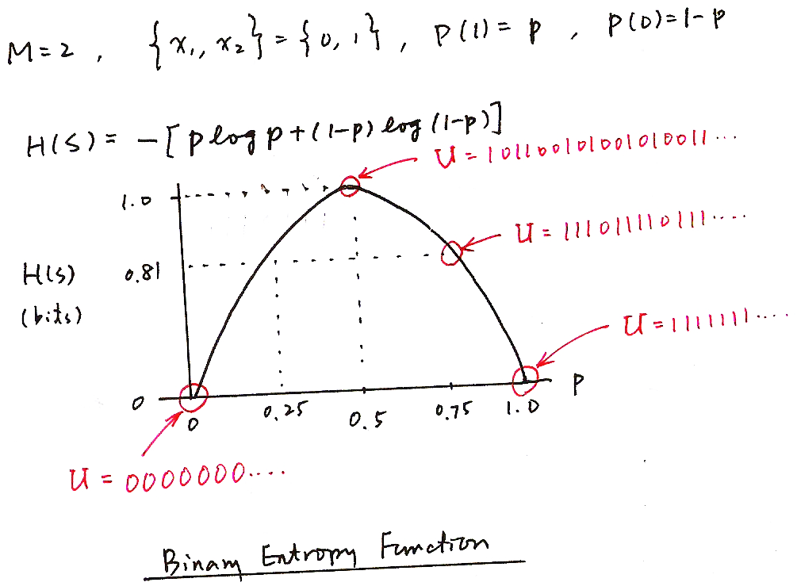
Fundamentals in Information Theory
M=2, { x₁, x₂ } = { 0, 1 }, P(1)=p, P(0)=1-p
H(S)=-[plog p + (1-p) log (1-p) ]
H(S)
(bits)
p
Binary Entropy Function

Slide 10
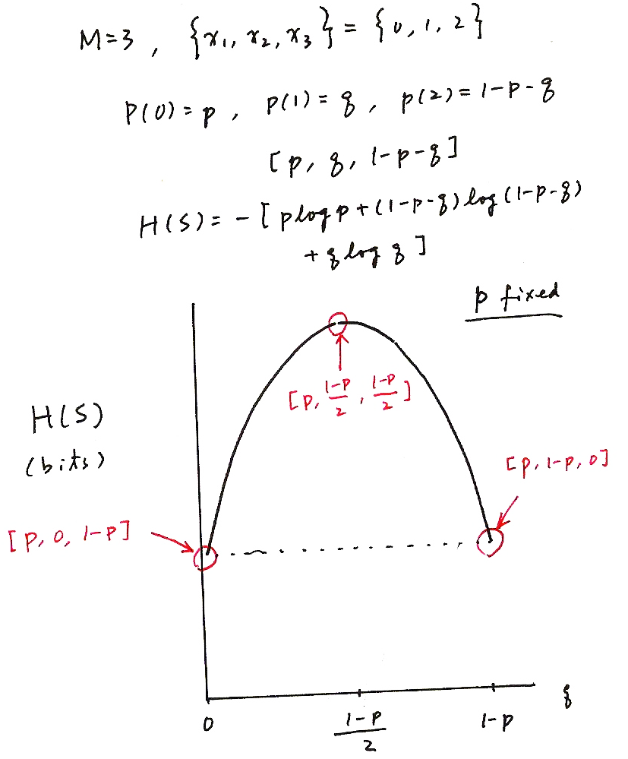
Fundamentals in Information Theory
M=3, {x₁, x_{2,} x₃} = {0, 1, 2}
P(0) = p, P(1) = q, P(2) = 1-p-q
[p, q, 1-p-q]
H(S)=-[plog p + (1-p-q) log (1-p-q) + qlog q ]
p fixed
H(S)
(bits)
q

Slide 11
Fundamentals in Information Theory
It can be shown
degree of uncertainty
quantity of information
entropy
for a random variable with a probability distribution
, M: number of different symbols
equality when
P(x_{j})= 1, some j
P(x_{k})=0, k≠ j
equality when
P(x_{i})= , all i

Slide 12
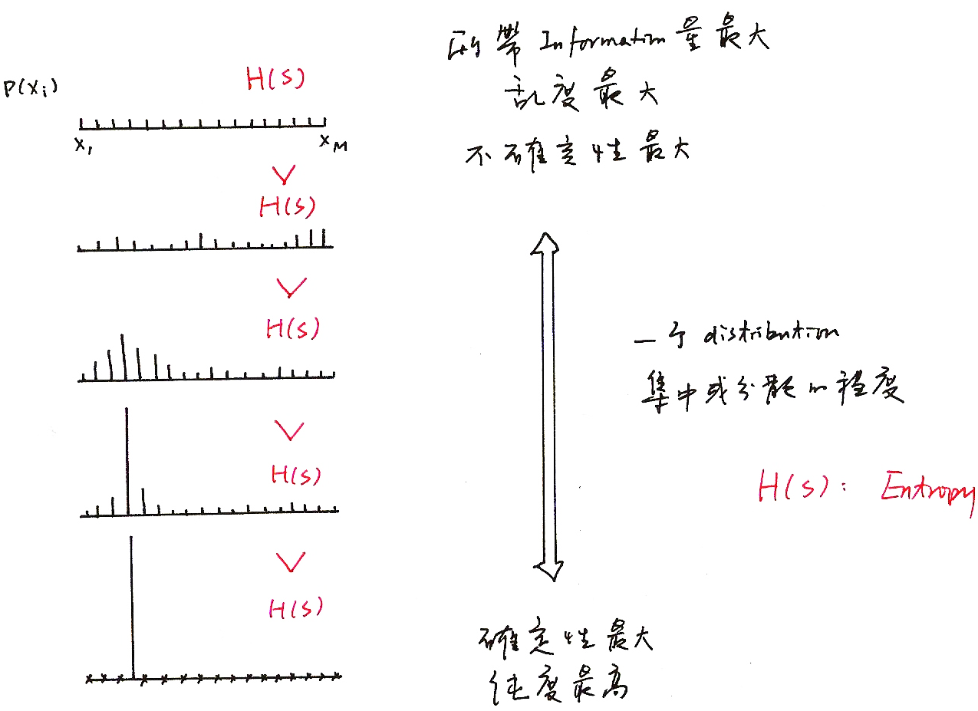
Fundamentals in Information Theory
所帶Information 量最大
亂度最大，最random
不確定性最大
一個 distribution
集中或分散的程度
H(S)：Entropy
確定性最大，最不random
純度最高

Slide 13
Some Fundamentals in Information Theory
Jensen’s Inequality
      q(x_{i}): another probability distribution, q(x_{i}) ≥ 0,
    equality when p(x_{i})= q(x_{i}), all i
  proof: log x≤ x-1, equality when x=1
  replacing p(x_{i}) by q(x_{i}), the entropy is increased
  using an incorrectly estimated distribution giving higher degree of uncertainty
Cross-Entropy (Relative Entropy)
  difference in quantity of information (or extra degree of uncertainty) when p(x) replaced by q(x), a measure of distance between two probability distributions, asymmetric
  Kullback-Leibler(KL) distance
Continuous Distribution Versions

Slide 14
Classification and Regression Trees (CART)
An Efficient Approach of Representing/Predicting the Structure of A Set of Data — trained by a set of training data
A Simple Example
  dividing a group of people into 5 height classes without knowing the heights:
  Tall(T), Medium-tall(t), Medium(M), Medium-short(s),Short(S)
  several observable data available for each person: age, gender, occupation....(but not the height)
  based on a set of questions about the available data
Y
1
N
2
S
Y
N
Age > 12 ?
Occupation= professional basketball player ?
Milk Consumption > 5 quarts per week ?
gender = male ?
T
3
Y
N
t
4
Y
N
M
s
question: how to design the tree to make it most efficient?

Slide 15
Splitting Criteria for the Decision Tree
Assume a Node n is to be split into nodes a and b
  weighted entropy
    ₌
    : percentage of data samples for class i at node n
    p(n): prior probability of n, percentage of samples at node n out of total number of samples
  entropy reduction for the split for a question q
  choosing the best question for the split at each node
    q* =
It can be shown
  weighting by number of samples also taking into considerations the reliability of the statistics
Entropy of the Tree T
  the tree-growing (splitting) process repeatedly reduces
n
n
n
a
b
arg max
q
n
n
n
a
b
a(x): distribution in node a, b(x) distribution in node b
n(x): distribution in node n , : cross entropy
terminal n
n

Slide 16
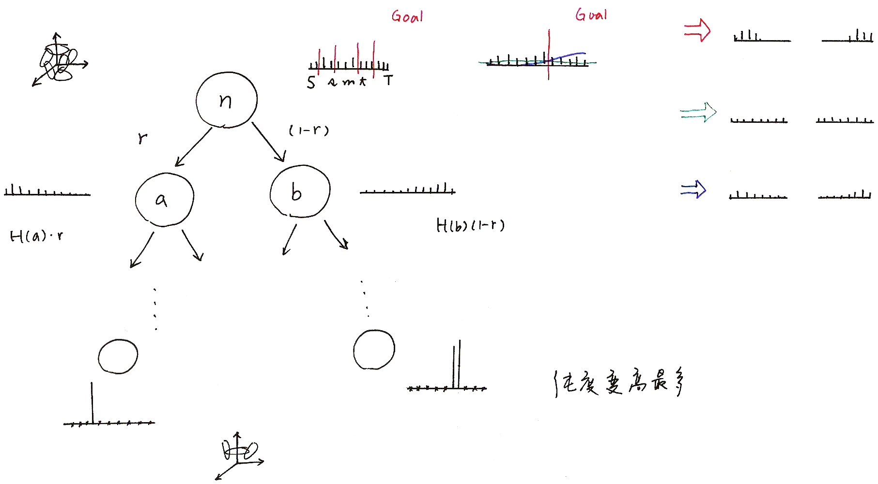
Node Splitting
純度變高最多

Slide 17
Training Triphone Models with Decision Trees
Construct a tree for each state of each base phone (including all possible context dependency)
  e.g. 50 phones, 5 states each HMM
    5*50=250 trees
Develop a set of questions from phonetic knowledge
Grow the tree starting from the root node with all available training data
Some stop criteria determine the final structure of the trees
  e.g. minimum entropy reduction, minimum number of samples in each leaf node
For any unseen triphone, traversal across the tree by answering the questions leading to the most appropriate state distribution
The Gaussion mixture distribution for each state of a phone model for contexts with similar linguistic properties are “tied” together, sharing the same training data and parameters
The classification is both data-driven and linguistic-knowledge-driven
Further approaches such as tree pruning and composite questions
(e.g. )

Slide 18
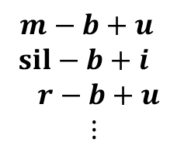
Training Tri-phone Models with Decision Trees
An Example: “( _ ‒ ) b ( +_ )”
12
yes
no
30
sil-b+u
a-b+u
o-b+u
y-b+u
Y-b+u
32
46
42
U-b+u
u-b+u
24
i-b+u
Example Questions:
12: Is left context a vowel?
24: Is left context a back-vowel?
30: Is left context a low-vowel?
32: Is left context a rounded-vowel?
e-b+u
r-b+u
50
N-b+u
M-b+u
E-b+u

Slide 19
Phonetic Structure of Mandarin Syllables

Slide 20
Phonetic Structure of Mandarin Syllables
巴 拔 把 霸 吧：5 syllables, 1 base-syllable
ㄕ ㄐ ㄇ ㄒ ㄐ ㄉ 聲母(INITIAL’s) 空聲母
ㄨ ㄧ ㄚ ㄧ ㄩ ㄨ 韻母(FINAL’s) 空韻母
ㄢ ㄝ ㄢ
-n ：ㄣ ㄢ
-ng：ㄥ ㄤ
Same RCD INITIAL’S
ㄅ ㄅ ㄅ ㄅ
ㄚ ㄢ ㄠ ㄤ
ㄚ ㄚ ㄚ
ㄣ ㄨ ㄥ
Medials
Tone：聲調
4 Lexical tones 字調
1 Neutral tone 輕聲
Nasal ending

Slide 21
Subsyllabic Units Considering Mandarin Syllable Structures
Considering Phonetic Structure of Mandarin Syllables
  INITIAL / FINAL’s
  Phone-like-units / phones
Different Degrees of Context Dependency
  intra-syllable only
  intra-syllable plus inter-syllable
  right context dependent only
  both right and left context dependent
Examples :
  113 right-context-dependent (RCD) INITIAL’s extended from 22 INITIAL’s plus 37 context independent FINAL’s: 150 intrasyllable RCD INITIAL/FINAL’s
  33 phone-like-units extended to 145 intra-syllable right-context-dependent phone-like-units, or 481 with both intra/inter-syllable context dependency
  At least 4,600 triphones with intra/inter-syllable context dependency

Slide 22
Comparison of Acoustic Models Based on Different Sets of Units
Typical Example Results
INITIAL/FIANL (IF) better than phone for small training set
Context Dependent (CD) better than Context Independent (CI)
Right CD (RCD) better than Left CD (LCD)
Inter-syllable Modeling is Better
Triphone is better
Approaches in Training Triphone Models are Important

