Slide 1
8.0 Search Algorithms for Speech Recognition
References: 1. 12.1-12.5 of Huang, or
2. 7.2-7.6 of Becchetti, or
3. 5.1-5.7, 6.1-6.5 of Jelinek
4. “ Progress in Dynamic Programming Search for LVCSR
(Large Vocabulary Continuous Speech Recognition)”,
Proceedings of the IEEE, Aug 2000

Slide 2

Basic Approach for Large Vocabulary Speech Recognition
A Simplified Block Diagram
Example Input Sentence
this is speech
Acoustic Models
(th-ih-s-ih-z-s-p-ih-ch)
Lexicon (th-ih-s) → this
(ih-z) → is
(s-p-iy-ch) → speech
Language Model (this) – (is) – (speech)
P(this) P(is | this) P(speech | this is)
P(w_{i}|w_{i-1}) bi-gram language model
P(w_{i}|w_{i-1},w_{i-2}) tri-gram language model,etc
Input Speech
Front-end
Signal Processing
Feature
Vectors
Linguistic Decoding
and
Search Algorithm
Output
Sentence
Speech
Corpora
Acoustic
Model
Training
Acoustic
Models
Language
Model
Language
Model
Construction
Text
Corpora
Lexicon

Slide 3
DTW and Dynamic Programming
Dynamic Time Warping (DTW)
  well accepted pre-HMM approach
  find an optimal path for matching two templates with different length
  good for small-vocabulary isolated-word recognition even today
Test Template [y_{j}, j=1,2,...N] and Reference Template [x_{i}, i=1,2,..M]
  warping both templates to a common length L
  warping functions: f_{x}(m)= i, f_{y}(m)= j, m=1,2,...L
  endpoint constraints: f_{x}(1)= f_{y}(1)= 1, f_{x}(L)=M, f_{y}(L)= N
  monotonic constraints: f_{x}(m+1) ≥ f_{x}(m), f_{y}(m+1) ≥ f_{y}(m)
  matching pair: for every m, m: index for matching pairs
  recursive relationship:
  global constraints/local constraints
  lack of a good approach to train a good reference pattern
Dynamic Programming
  replacing the problem by a smaller sub-problem and formulating an iterative procedure
Search Algorithm within a Given HMM―Viterbi Algorithm in Basic Problem 2
  application example: isolated word recognition
  Reference: 4.7 up to 4.7.3 of Rabiner and Juang

Slide 4
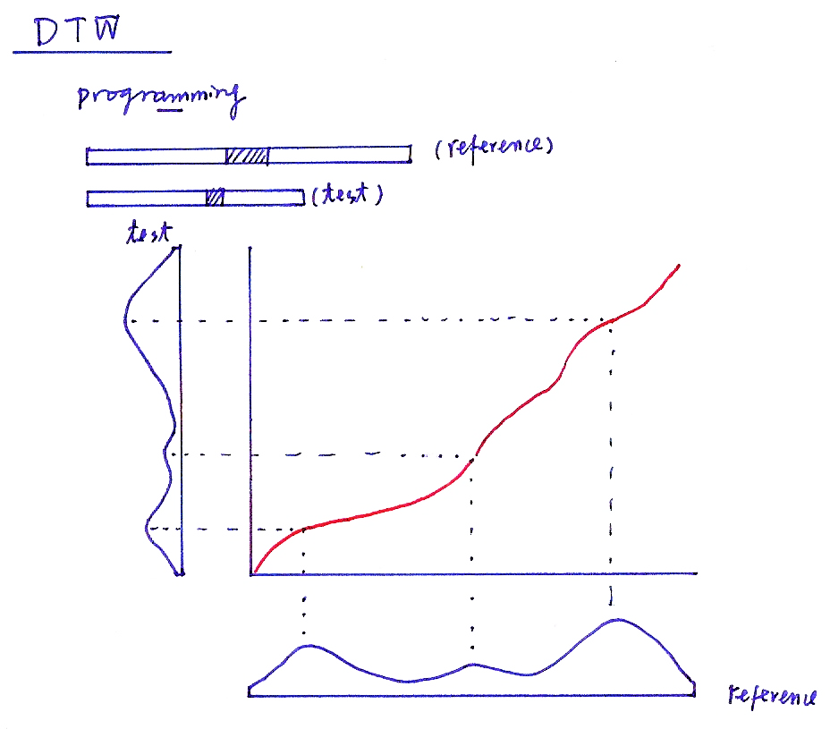
DTW
programming
(reference)
(test)
test
reference

Slide 5
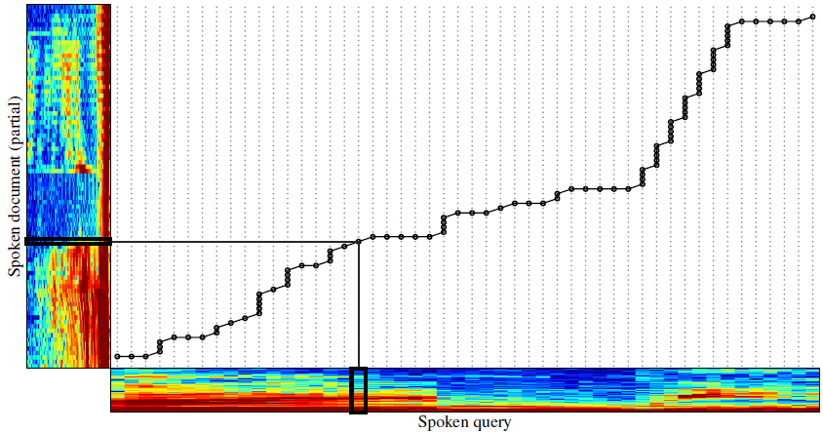
DTW

Slide 6
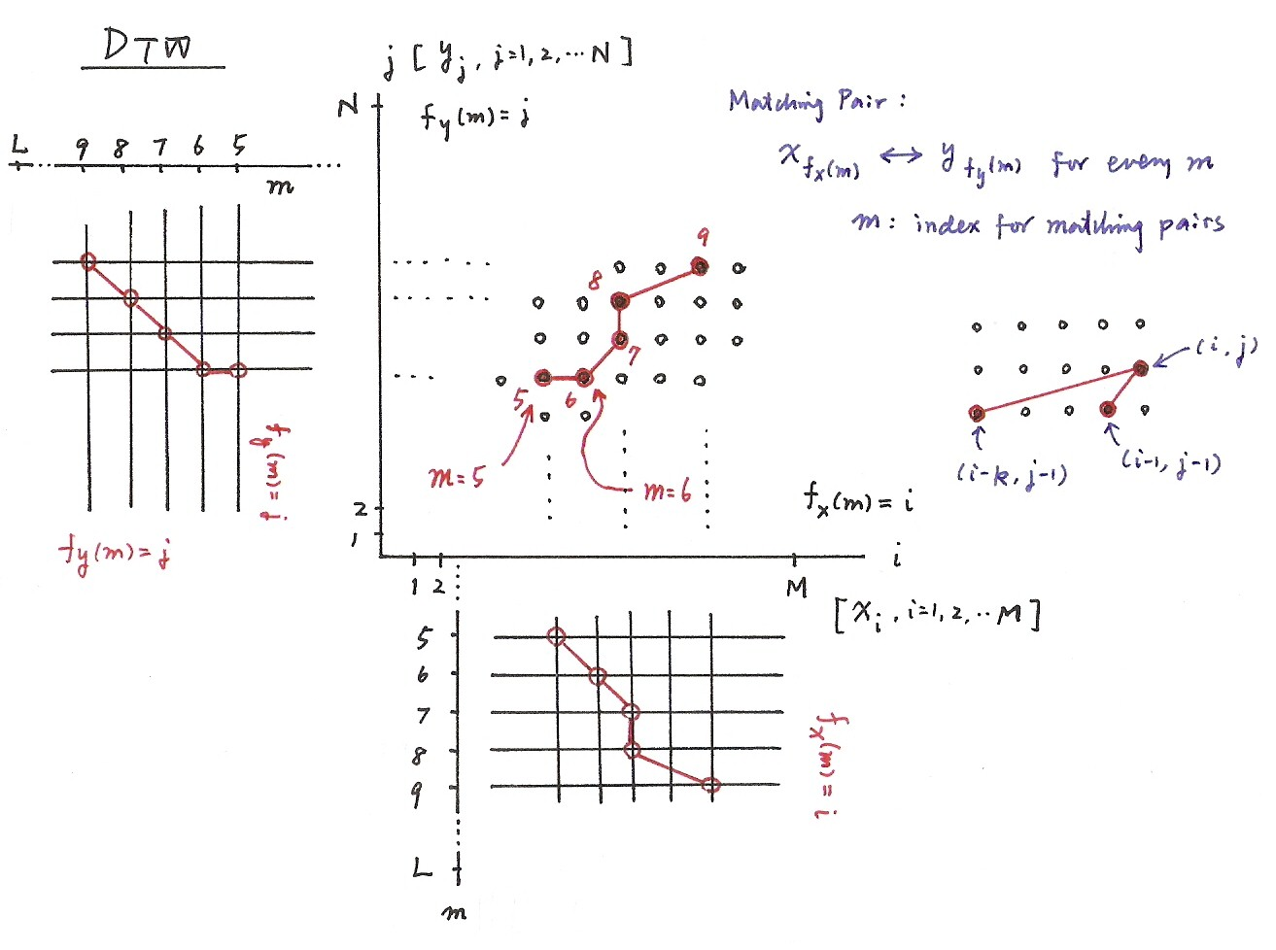
DTW
  f_{x}(m)= i, f_{y}(m)= j, m=1,2,...L
  f_{x}(1)= f_{y}(1)= 1, f_{x}(L)=M, f_{y}(L)= N
  f_{x}(m+1) ≥ f_{x}(m), f_{y}(m+1) ≥ f_{y}(m)

Slide 8
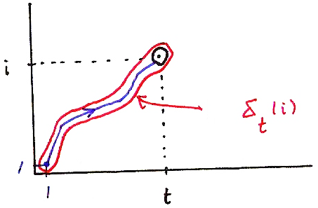
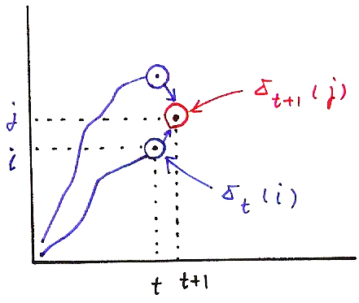
Viterbi Algorithm (P.21 of 4.0)
δ_{t+1}( j) = max [δ_{t}(i)a_{ij}] • b_{j}(o_{t+1})
i
i
δ_{t+1}(j)
j
δ_{t}(i)
i
δ_{t}(i)
1
1
t
δ_{t}(i) = max P[q₁,q₂,…q_{t-1}, q_{t} = i, o₁,o₂,…,o_{t} |λ]
t
t+1
q₁,q₂,…q _{t-1}

Slide 9
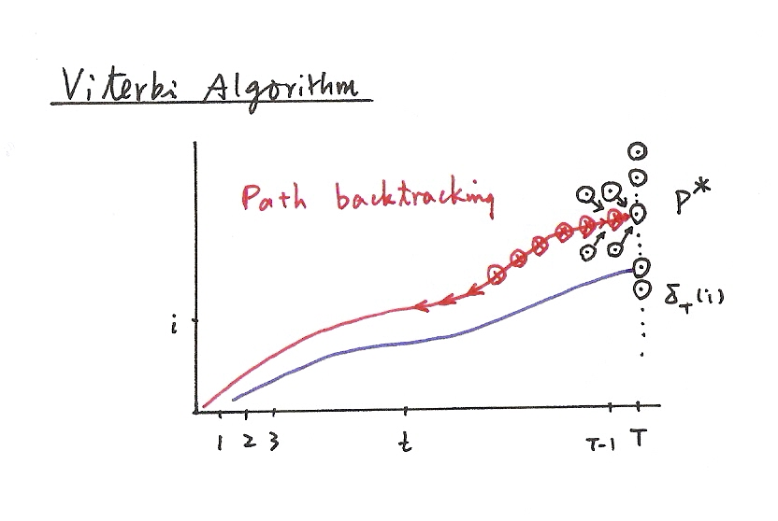
Viterbi Algorithm (P.22 of 4.0)

Slide 10
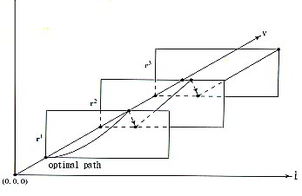
Continuous Speech Recognition Example: Digit String Recognition― One-stage Search
Unknown Number of Digits
No Lexicon/Language Model Constraints
Search over a 3-dim Grid
0
1
0
1
9
9
9
2
0
1
t
Switched to the First State of the Next Model at the End of the Previous Model
May Result with Substitution, Deletion and Insertion

Slide 11
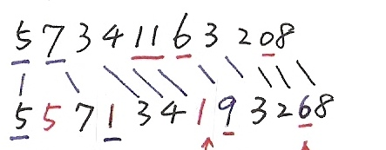
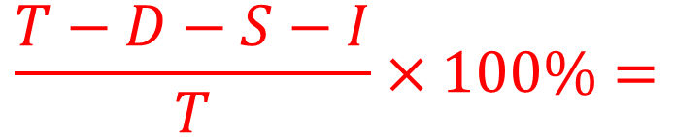
Recognition Errors
Reference:
(T)
Recognized:
insertion
(I)
deletion
(D)
substitution
(S)
$$\frac{T−D−S−I}{T}×100\%=$$
Accuracy

Slide 12
Continuous Speech Recognition Example: Digit String Recognition ― Level-Building
Known Number of Digits
No Lexicon/Language Model Constraints
Higher Computation Complexity, No Deletion/Insertion
0
1
.
9
0
1
.
9
0
1
.
9
0
1
.
9
State
01...9
number of levels = number of digits in an utterance
automatic transition from the last state of the previous model to the first state of the next model
01...9
01...9
01...9
t

Slide 13
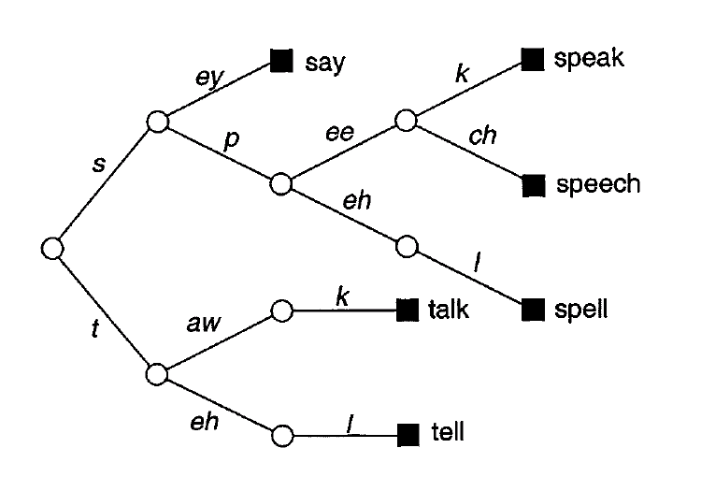
Time (Frame)- Synchronous Viterbi Search for Large-Vocabulary Continuous Speech Recognition
MAP Principle
An Approximation
  the word sequence with the highest probability for the most probable state sequence usually has approximately the highest probability for all state sequences
  Viterbi search, a sub-optimal approach
Viterbi Search―Dynamic Programming
  replacing the problem by a smaller sub-problem and formulating an iterative procedure
  time (frame)- synchronous: the best score at time t is updated from all states at time t-1
Tree Lexicon as the Basic Working Structure
from
HMM
from Language Model
each arc is an HMM (phoneme, tri-phone, etc.)
each leaf node is a word
search processes for a segment of utterance through some common units for different words can be shared
search space constrained by the lexicon
the same tree copy reproduced at each leaf node in principle

Slide 14
Basic Problem 2 for HMM (P.24 of 4.0)
․Application Example of Viterbi Algorithm
- Isolated word recognition
.
.
.
observation
1
≤
i
≤
n
1
≤
i
≤
n
Basic Problem 1
Forward Algorithm
(for all paths)
Basic Problem 2
Viterbi Algorithm
(for a single best path)
The model with the highest probability for the most probable path
usually also has the highest probability for all possible paths.

Slide 15
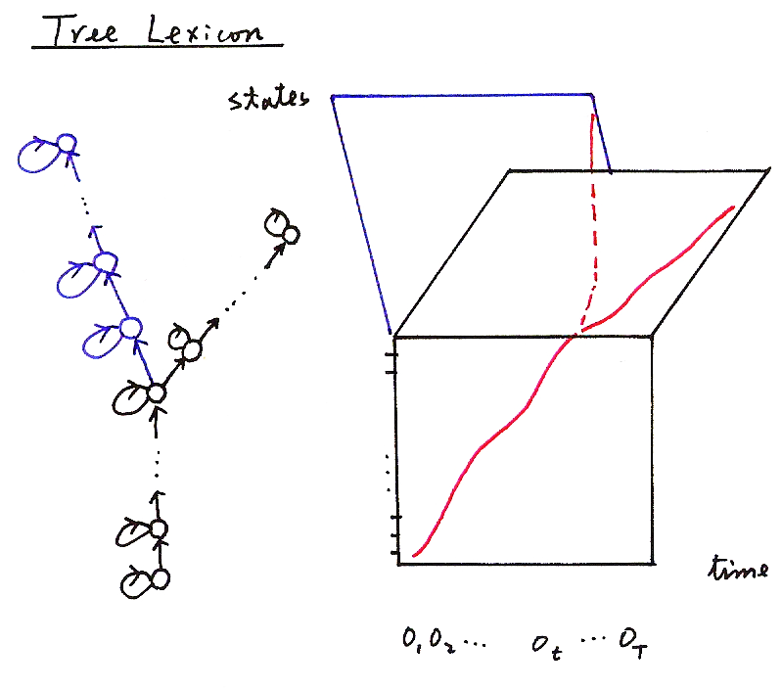
Tree Lexicon
states
time
o₁ o₂ …. o_{t} …. o_{T}

Slide 16
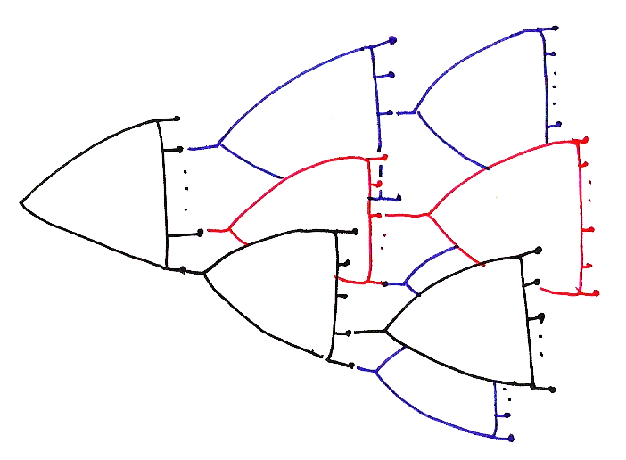

Slide 17
Time (Frame)- Synchronous Viterbi Search for Large –Vocabulary Continuous Speech Recognition
Define Key Parameters
  D (t, q_{t}, w) : objective function for the best partial path ending at time t in state q_{t} for the word w
  h (t, q_{t}, w) : backtrack pointer for the previous state at the pervious time when the best partial path ends
  at time t in state q_{t} for the word w
Intra-word Transition―HMM only, no Language Model
Inter-word Transition―Language Model only, no HMM (bi-gram as an example)

Slide 18
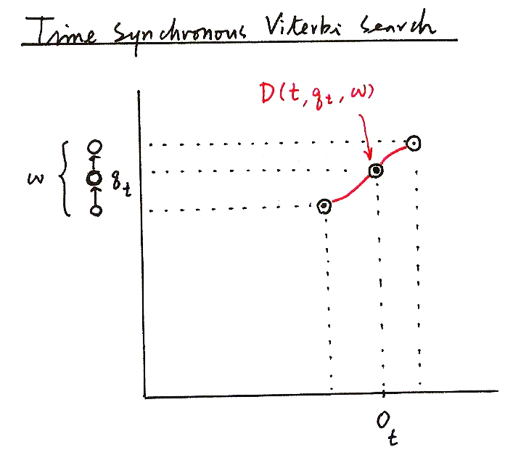
Time Synchronous Viterbi Search
D (t, q_{t} , w)
w
q_{t}
_{ot}

Slide 19
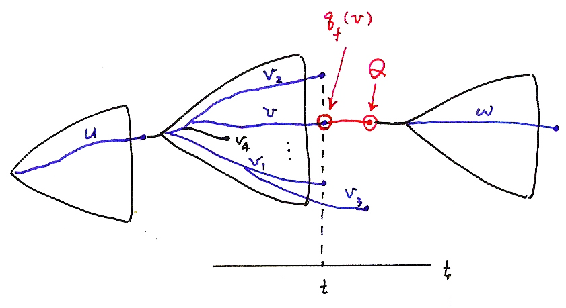
q_{f} (v)
Q
t
t

Slide 20
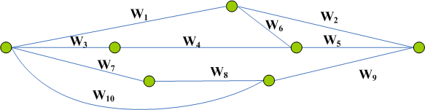
Time (Frame)- Synchronous Viterbi Search for Large-Vocabulary Continuous Speech Recognition
Beam Search
  at each time t only a subset of promising paths are kept
  example 1: define a beam width L (i.e. keeping only L paths at each time)
  example 2: define a threshold Th (i.e. all paths with D< D_{max,t}-Th are deleted)
  very helpful in reducing the search space
Two-pass Search (or Multi-pass Search)
  use less knowledge or less constraints (e.g. acoustic model with less context dependency or language with lower order) in the first stage, while more knowledge or more constraints in rescoring in the second path
  search space significantly reduced by decoupling the complicated search process into simpler processes
N-best List and Word Graph (Lattice)
  W₁ W₂
  W₁ W₆ W₅
  W₃ W₄ W₅
  W₇ W₈ W₉
  W₁₀ W₉
  similarly constructed with dynamic programming iterations
N-best List or
Word Graph
Generation
N-best
List
Rescoring
X
W
Word
Graph
Time

Slide 21
Some Search Algorithm Fundamentals
An Example – a city traveling problem
8.5
3
C
3
2.8
A
5.7
E
3
S: starting
G: goal
to find the minimum distance path
3
4
S
5
G
10
4
5
2
B
D
F
3.0
10.3
7.0
Search Tree(Graph)
Blind Search Algorithms
  Depth-first Search: pick up an arbitrary alternative and proceed
  Breath-first Search: consider all nodes on the same level before going to the next level
  no sense about where the goal is
3
S
2
A
6
B
6
7
6
B
C
A
D
11
11
D
11
F
9
E
C
E
9
C
14
16
E
G
12
G
14
Heuristic Search
  Best-first Search
  based on some knowledge, or “heuristic information”
  f(n) = g(n)+h*(n)
  g(n): distance up to node n
  h*(n): heuristic estimate for the remaining distance up to G
  heuristic pruning
S
11.5
A
h*(n):
straight-line distance
11.7
11.8
C
E
12.0
G

Slide 22
Heuristic Search: Another Example
Problem: Find a path with the highest score from root node “A” to some leaf node (one of “L1”,”L2”,”L3”,”L4”)
A
4
3
2
B
C
D
3
4
8
3
E
F
G
L4
2
Node g(n) h*(n) f(n)
A 0 15 15
B 4 9 13
C 3 12 15
D 2 5 7
E 7 4 11
F 7 2 9
G 11 3 14
L1 9 0 9
L2 8 0 8
L3 12 0 12
L4 5 0 5
1
1
L1
L2
L3
List of Candidate Steps
Top | Candidate List
A(15) | A(15)
C(15) | C(15), B(13), D(7)
G(14) | G (14), B(13), F(9), D(7)
B(13) | B(13), L3(12), F(9), D(7)
L3(12) | L3 (12), E(11), F(9), D(7)

Slide 23
A* Search and Speech Recognition
Admissibility
  a search algorithm is admissible if it is guaranteed that the first solution found is optimal, if one exists (for example, beam search is NOT admissible)
It can be shown
  the heuristic search is admissible if
  for all n with a highest-score problem
  A* search when the above is satisfied
Procedure
  Keep a list of next-step candidates, and proceed with the one with the highest f(n) (for a highest-score problem)
A* search in Speech Recognition
  example 1: estimated average score per frame as the heuristic information
  example 2: use of weak constraints in the first pass to generate heuristic estimates in multi-pass search

