Slide 1
Digital Speech Processing HW3
呂相弘
2014/11/19

Slide 2
Outline
Introduction
SRILM
Requirement
Submission Format

Slide 3
Outline
Introduction
SRILM
Requirement
Submission Format

Slide 4
Introduction
讓 他 十分 ㄏ怕
只 ㄒ望 ㄗ己 明ㄋ 度 別 再 這ㄇ ㄎ命 了
演ㄧ ㄩ樂 產ㄧ ㄐ入 積ㄐ ㄓ型 提ㄕ 競爭ㄌ
Your HW3
讓 他 十分 害怕
只 希望 自己 明年 度 別 再 這麼 苦命 了
演藝 娛樂 產業 加入 積極 轉型 提升 競爭力

Slide 5
Introduction
Imperfect acoustic model with some phone losses.
The finals of some characters are lost.
What can we do for decoding 注音文？
Acoustic Model
Acoustic Model
一ㄢㄧ ㄩㄌㄜ ㄔㄢㄧㄝ
演ㄧ ㄩ樂 產ㄧ

Slide 6
Introduction
In general, we can use a language model
For example, let Z = 演ㄧ ㄩ樂 產ㄧ
P(Z) is independent of W
W = w₁w₂…w_{N} , Z = z₁z₂…z_{N}
Available from Bigram Language Model

Slide 7
Introduction
演
ㄧ
ㄩ
樂
0.1
餘
業
0.01
0.02
演
0.01
娛
0.3
樂
0.2
藝
0.02
於
0.01
0.01

Slide 8
So…
We need to build a bigram character-based language model.
Use the language model to decode the sequence.
There is a nice toolkit to help you.

Slide 9
Outline
Introduction
SRILM
Requirement
Submission Format

Slide 10
SRILM
SRI Language Model Toolkit http://www.speech.sri.com/projects/srilm/
A toolkit for building and applying various statistical language models
C++ classes in SRILM are very useful
Using and reproducing some programs of SRILM in this homework

Slide 11
SRILM
Download the executable from the course website
Different platform:
i686 for 32-bit GNU/Linux
i686-m64 for 64-bit GNU/Linux (CSIE workstation)
Cygwin for 32-bit Windows with cygwin environment
If you want to use the C++ library, you can build it from the source code

Slide 12
SRILM
You are strongly recommended to read FAQ on the course website
Possibly useful codes in SRILM
$SRIPATH/misc/src/File.cc (.h)
$SRIPATH/lm/src/Vocab.cc (.h)
$SRIPATH/lm/src/ngram.cc (.h)
$SRIPATH/lm/src/testError.cc (.h)

Slide 13
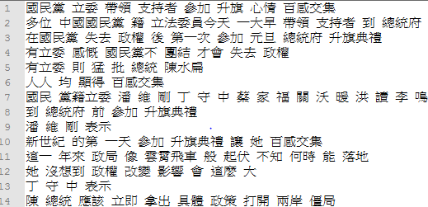
SRILM
perl separator_big5.pl corpus.txt > corpus_seg.txt

Slide 14
SRILM
./ngram-count –text corpus_seg.txt –write lm.cnt –order 2
-text: input text filename
-write: output count filename
-order: order of ngram language model
./ngram-count –read lm.cnt –lm bigram.lm –unk –order 2
-read: input count filename
-lm: output language model name
-unk: view OOV as <unk>
without this, all the OOV will be removed

Slide 15
Example
corpus_seg.txt
在 國 民 黨 失 去 政 權 後 第 一 次 參 加 元 旦 總 統 府 升 旗 典 禮
有 立 委 感 慨 國 民 黨 不 團 結 才 會 失 去 政 權
有 立 委 則 猛 批 總 統 陳 水 扁
人 人 均 顯 得 百 感 交 集
….
trigram.lm
\data\
ngram 1=6868
ngram 2=1696830
ngram 3=4887643
\1-grams:
-1.178429 </s>
-99 <s> -2.738217
-1.993207 一 -1.614897
-4.651746 乙 -1.370091
......
lm.cnt
夏 11210
俸 267
鴣 7
衹 1
微 11421
檎 27
……
Log Probability

Slide 16
SRILM
./disambig –text $file –map $map –lm $LM –order $order
-text: input filename
-map: a mapping from (注音/國字) to (國字)
You should generate this mapping by yourself from the given Gig5-ZhuYin.map, either using EXCEL or writing a simple program on your own.
-lm: input language model

Slide 17
SRILM
Big5-ZhuYin.map
一 ㄧˊ/ㄧˋ/ㄧ_
乙 ㄧˇ
丁 ㄉㄧㄥ_
ㄑㄧ_
乃 ㄋㄞˇ
ㄐㄧㄡˇ
…
…
長 ㄔㄤˊ/ㄓㄤˇ
行 ㄒㄧㄥˊ/ㄏㄤˊ
…
ZhuYin-Big5.map
ㄅ 八 匕 卜 不 卞 巴 比 丙 包 …
八 八
匕 匕
卜 卜
…
…
ㄆ 仆 匹 片 丕 叵 平 扒 扑 疋 …
仆 仆
匹 匹
…
…
Be aware of polyphones (破音字).
There should be spaces between all characters.

Slide 18
Outline
Introduction
SRILM
Requirement
Submission Format

Slide 19
Requirement (I)
Segment corpus and all test data into characters
./separator_big5.pl corpus.txt corpus_seg.txt
./separator_big5.pl <testdata/xx.txt> <testdata/xx.txt>
Train character-based bigram LM
Get counts:
./ngram-count –text corpus_seg.txt –write lm.cnt –order 2
Compute probability:
./ngram-count –read lm.cnt –lm bigram.lm –unk –order 2
Generate the map from Big5-ZhuYin.map
See FAQ 4
Using disambig to decode testdata/xx.txt
./disambig –text $file –map $map –lm $LM –order $order > $output

Slide 20
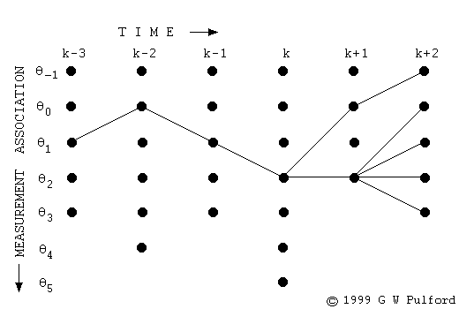
Requirement (II)
Implement your version of disambig.
Using dynamic programming (Viterbi).
The vertical axes are the candidate characters.

Slide 21
Requirement (II)
You have to use C++ or Matlab.
You are strongly recommended to use C++…
Speed
Using SRILM’s library will save you a lot of time
(please refer to FAQ)
Your output format should be consistent with srilm.
ex:
<s> 這 是 一 個 範 例 格 式 </s>
There are an <s> at the beginning of a sentence, a </s> at the end, and whitespaces in between all characters.

Slide 22
How to deal with Big5
All testing files are encoded in Big5
A Chinese character in Big5 is always 2 bytes, namely, char[2] in C++

Slide 23
Outline
Introduction
SRILM
Requirement
Submission Format

Slide 24
Submission format
Files required:
The ZhuYin-Big5.map you generate
The decoded results of 10 test data produced by SRILM’s disambig
result1/1.txt ~ 10.txt
The decoded results of 10 test data produced by your disambig
result2/1.txt ~ 10.txt
All source codes (your disambig & your program for the map generation)
Makefile (if C++ is used)
Report
No SRILM related files nor corpus_seg.txt nor LMs
Compress into one zip file named
“hw3_[your_student_ID].zip” and then upload to CEIBA

Slide 25
Submission format (report)
The report should include:
1. Your environment (CSIE workstation, Cygwin, …)
2. How to “compile” your program (if C++ is used)
3. How to “execute” your program (give me examples)
ex: ./program –a xxx –b yyy
4. What you have done
5. NO more than two A4 pages.
6. NO “what you have learned”

Slide 26
Grading
Requirement I (40%)
Requirement II (40%)
Note that if you use C++ and there’s no Makefile in the submitted zip file, score in this part will be halved
Report (20%)
Bonus (15%)
Character-based trigram language model (10%)
(need pruning for speed)
Other strategies (5%)

Slide 27
If you have any questions…
FAQ
http://speech.ee.ntu.edu.tw/DSP2014Autumn/
呂相弘
r03942039@ntu.edu.tw

