Slide 1
11.0 Spoken Document Understanding and Organization for User-content Interaction
References: 1. “Spoken Document Understanding and Organization”, IEEE Signal
Processing Magazine, Sept. 2005, Special Issue on Speech Technology
in Human-Machine Communication
2. “Multi-layered Summarization of Spoken Document Archives by
Information Extraction and Semantic Structuring”, Interspeech 2006,
Pittsburg, USA

Slide 2
User-Content Interaction for Spoken Content Retrieval
Problems
  Unlike text content, spoken content not easily summarized on screen, thus retrieved results difficult to scan and select
  User-content interaction always important even for text content
Possible Approaches
  Automatic summary/title generation and key term extraction for spoken content
  Semantic structuring for spoken content
  Multi-modal dialogue with improved interaction
Key Terms/
Titles/Summaries
Query
User
Interface
Spoken
Archives
User
Semantic
Structuring
Multi-modal Dialogue
Retrieved Results
Retrieval
Engine

Slide 3
Multi-media/Spoken Document Understanding and Organization
Key Term/Named Entity Extraction from Multi-media/Spoken Documents
— personal names, organization names, location names, event names
— key phrase/keywords in the documents
— very often out-of-vocabulary (OOV) words, difficult for recognition
Multi-media/Spoken Document Segmentation
— automatically segmenting a multi-media/spoken document into short paragraphs, each
with a central topic
Information Extraction for Multi-media/Spoken Documents
— extraction of key information such as who, when, where, what and how for the
information described by multi-media/spoken documents.
— very often the relationships among the key terms/named entities
Summarization for Multi-media/Spoken Documents
— automatically generating a summary (in text or speech form) for each short paragraph
Title Generation for Multi-media/Spoken Documents
— automatically generating a title (in text or speech form) for each short paragraph
— very concise summary indicating the topic area
Topic Analysis and Organization for Multi-media/Spoken Documents
— analyzing the subject topics for the short paragraphs
— clustering and organizing the subject topics of the short paragraphs, giving the
relationships among them for easier access

Slide 4
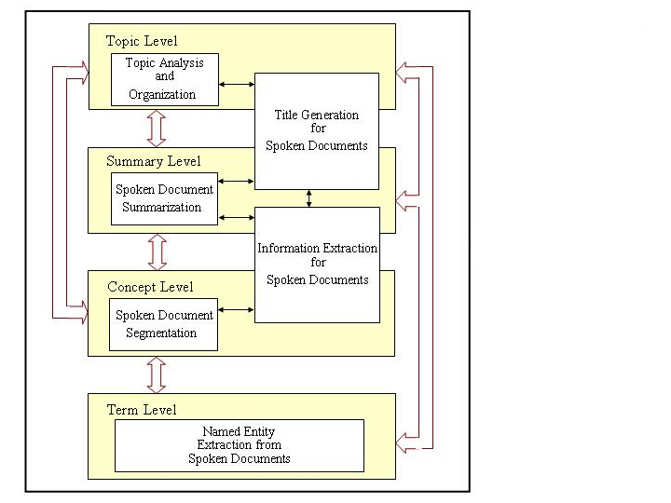
Integration Relationships among the Involved Technology Areas
Semantic
Analysis
Information
Indexing,
Retrieval
And Browsing
Key Term Extraction from
Spoken Documents
Keyterms/Named Entity
Extraction from
Spoken Documents

Slide 5
Key Term Extraction from Spoken Content (1/2)
Key Terms : key phrases and keywords
Key Phrase Boundary Detection
An Example
Left/right boundary of a key phrase detected by context statistics
is
represent
of
is
in
hidden Markov model
can
:
:
:
:
boundary
      “hidden” almost always followed by the same word
      “hidden Markov” almost always followed by the same word
      “hidden Markov model” is followed by many different words

Slide 6
Key Term Extraction from Spoken Content (2/2)
Prosodic Features
  key terms probably produced with longer duration, wider pitch range and higher energy
Semantic Features (e.g. PLSA)
  key terms usually focused on smaller number of topics
Lexical Features
  TF/IDF, POS tag, etc.
P(T_{k}|t_{i})
P(T_{k}|t_{i})
Not key term
key term
k
k
topics
topics

Slide 7
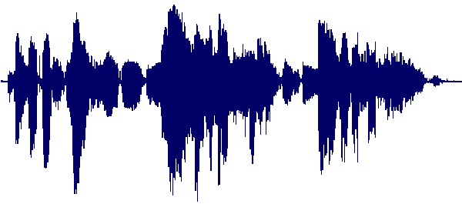

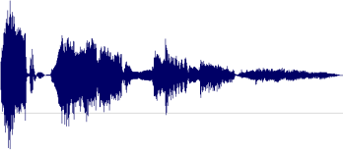
Extractive Summarization of Spoken Documents
document d:
summary of document d:
Correctly recognized word
X1
t1
t2
X1
X2
X3
X3
Selecting most representative utterances in the original document but avoiding redundancy
Wrongly recognized word
X4
X5
- Scoring sentences based on prosodic,
semantic, lexical features and confidence
measures, etc.
- Based on a given summarization ratio
X6

Slide 8
Title Generation for Spoken Documents
Titles for retrieved documents/segments helpful in browsing and selection of retrieved results
Short, readable, telling what the document/segment is about
One example: Scored Viterbi Search
Training
corpus
Term
Selection
Model
Term
Ordering
Model
Title
Length
Model
Summary
Viterbi
Algorithm
Output
Title
Spoken document
Recognition and
Summarization
Notes:
Scored Viterbi Integrated with Adaptive K-Nearest Neighbors (AKNN)
Starting with the automatically generated summary
Three sets of scores used : term selection scores ( key terms, title terms ), term ordering scored, title length scores
Select the top K training documents nearest to the new document using AKNN
Choose the best human-generated title of the selected training documents
Constructing the title with Viterbi Algorithm using terms selected from the automatically generated summary and the best human-generated title

Slide 9
Semantic Structuring (1/2)
Example 1: retrieved results clustered by Latent Topics and organized in a two-dimensional tree structure (multi-layered map)
  each cluster labeled by a set of key terms representing a group of retrieved documents/segments
  each cluster expanded into a map in the next layer
Notes:
We try to analyze and organize of those spoken documents based on techniques of PLSA,
In which, terms and documents all have probabilities based on the set of latent topics
We can cluster documents in a Two-dimensional Tree Structure such as this, those related documents are in the same cluster
and the relationships among the clusters have to do with the distance on the map
When a cluster has many documents, we can further analyze it into an other map on the next layer

Slide 10
Semantic Structuring (2/2)
Example 2: Key-term Graph
  each retrieved spoken document/segment labeled by a set of key terms
  relationships between key terms represented by a graph
-------
-------
-------
----
---------
---------
---------
---
-----
-----
-----
-----
retrieved spoken documents
Viterbi search
Perplexity
key term graph
HMM
Language Modeling
Acoustic Modeling
Notes:
We try to analyze and organize of those spoken documents based on techniques of PLSA,
In which, terms and documents all have probabilities based on the set of latent topics
We can cluster documents in a Two-dimensional Tree Structure such as this, those related documents are in the same cluster
and the relationships among the clusters have to do with the distance on the map
When a cluster has many documents, we can further analyze it into an other map on the next layer

Slide 11
Multi-modal Dialogue
An example: user-system interaction modeled as a Markov Decision Process (MDP)
Key Terms/
Titles/Summaries
Query
Spoken
Archives
User
Interface
User
Semantic
Structuring
Multi-modal Dialogue
Retrieved Results
Retrieval
Engine
Example goals
  small average number of dialogue turns (average number of user actions taken) for successful tasks (success: user’s information need satisfied)
  less effort for user, better retrieval quality
Notes:
We try to analyze and organize of those spoken documents based on techniques of PLSA,
In which, terms and documents all have probabilities based on the set of latent topics
We can cluster documents in a Two-dimensional Tree Structure such as this, those related documents are in the same cluster
and the relationships among the clusters have to do with the distance on the map
When a cluster has many documents, we can further analyze it into an other map on the next layer

Slide 12




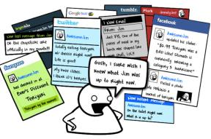



Spoken Document Summarization
Why summarization?
  Huge quantities of information
  Spoken content difficult to be shown on the screen and difficult to browse
Mails
News articles
Books
Meeting
Social Media
Broadcast News
Lecture
Websites

Slide 13

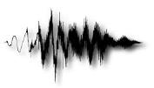


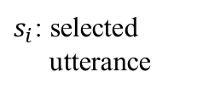



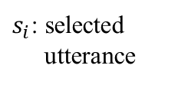









Spoken Document Summarization
More difficult than text summarization
  Recognition errors, Disfluency, etc.
Extra information not in text
  Prosody, speaker identity, emotion, etc.
Audio Recording
S_{N}: Summary
d_{N}: document
.
.
.
.
.
.
$x_{1}$, $x_{2}$….
$x_{1}$, $x_{2}$….
Summarization
System
d₂: document
S₂: Summary
$x_{1}$, $x_{2}$….
$x_{1}$, $x_{2}$….
$x_{1}$, $x_{2}$….
$s_{1}$, $s_{2}$….
$x_{m}$: utterance
S₁: Summary
$x_{m}$: utterance
$x_{m}$: utterance
d₁: document
$s_{1}$, $s_{2}$….
$x_{1}$, $x_{2}$….
$x_{1}$, $x_{2}$….
ASR System
$x_{1}$, $x_{2}$….
$x_{1}$, $x_{2}$….
$s_{i}$: selected
utterance
$x_{1}$, $x_{2}$….
$s_{i}$: selected
utterance
$x_{m}$: utterance
$x_{m}$: utterance
$s_{1}$, $s_{2}$….
$x_{m}$: utterance
$x_{m}$: utterance
$x_{m}$: utterance
$x_{m}$: utterance
$s_{i}$: selected
utterance

Slide 14

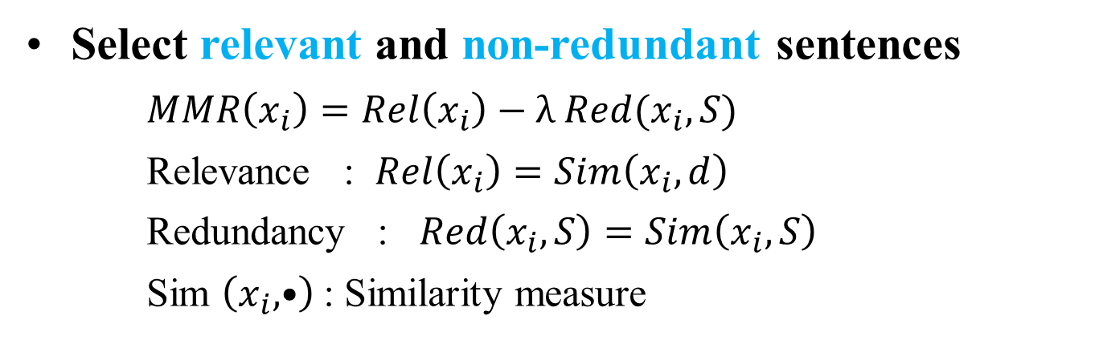








Unsupervised Approach: Maximum Margin Relevance (MMR)
  Select relevant and non-redundant sentences
    $MMR\left(x_{i}\right)=Rel\left(x_{i}\right)−λ Red(x_{i},S)$
    Relevance : $Rel\left(x_{i}\right)=Sim\left(x_{i},d\right)$
    Redundancy : $Red\left(x_{i},S\right)=Sim\left(x_{i},S\right)$
    Sim $\left(x_{i},•\right)$ : Similarity measure
Spoken Document $d$
Ranked by $MMR\left(x_{i}\right)$
Presently Selected Summary S
$$x_{4} \\ x_{2}$$
$$x_{1}$$
$$x_{8}$$
$$x_{4}$$
$$utterance x_{1} \\ utterance x_{2}$$
$$utterance x_{3}$$
$$utterance x_{4}$$
$$x_{4} \\ x_{8}$$
$$x_{1}$$
$$x_{3}$$
$$x_{8}$$
$$x_{3}$$
……
……
…………
$$x_{2}$$

Slide 15





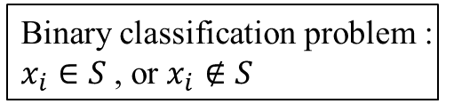






Supervised Approach: SVM or Similar
Trained with documents with human labeled summaries
Binary classification problem :
$x_{i}∈S$, or $x_{i}∉S$
Training data
d_{N}: document
$\text{v}\text{(}x_{i}\text{)}$: Feature vector of $x_{i}$
.
.
.
S_{N}: Summary
.
.
.
Binary Classification model
d₂: document
Human labeled
S₂: Summary
Feature Extraction
d₁: document
S₁: Summary
$x_{1}$, $x_{2}$….
$s_{1}$, $s_{2}$….
$x_{m}$: utterance
$s_{i}$: selected
utterance
Training phase
Testing phase
Testing data
$v\text{(}\hat{x_{i}}\text{)}$: Feature
vector of $\hat{x_{i}}$
$\hat{d_{N}}$: document
Binary Classification model
Ranked utterances
$\hat{x_{1}}$, $\hat{x_{2}}$….
Feature Extraction
ASR System
$\hat{x_{m}}$: utterance

Slide 16

Domain Adaptation of Supervised Approach
Problem
  Hard to get high quality training data
  In most cases, we have labeled out-of-domain references but not labeled target domain references
Goal
  Taking advantage of out-of-domain data
Target Domain (Lecture)
Out-of-domain
(News)
?

Slide 17









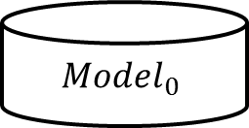

Domain Adaptation of Supervised Approach
${Model}_{0}$trined by out-of-domain data, used to obtain ${summary}_{0}$ for target domain
model training
$${Model}_{0}$$
Target domain data without labeled document/summary
Out-of-domain data with labeled document/summary
Spoken Document
Summary
$${\text{Summary}}_{0}$$
$\hat{d_{M}}$: document
.
d_{N}: document
.
.
.
$\hat{S_{M}}$: Summary
.
.
S_{N}: Summary
.
.
.
Summary Extraction
d₂: document
Human labeled
$\hat{d_{2}}$: document
S₂: Summary
$\hat{S_{2}}$: Summary
d₁: document
S₁: Summary
$\hat{S_{1}}$: Summary
$\hat{d_{1}}$: document
$x_{1}$, $x_{2}$….
$\hat{x_{1}}$, $\hat{x_{2}}$….
$x_{m}$: utterance
$\hat{x_{m}}$: utterance

Slide 18
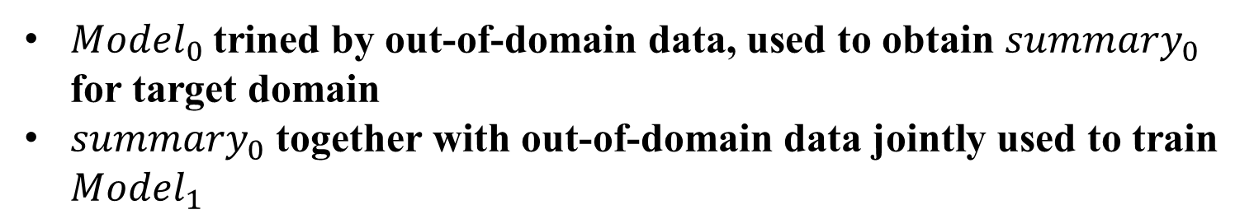
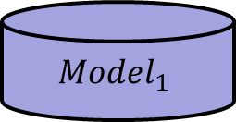
Domain Adaptation of Supervised Approach
${Model}_{0}$trined by out-of-domain data, used to obtain ${summary}_{0}$ for target domain
${summary}_{0}$ together with out-of-domain data jointly used to train ${Model}_{1}$
model training
$${Model}_{1}$$
Target domain data without labeled document/summary
Out-of-domain data with labeled document/summary
Spoken Document
Summary
$${\text{Summary}}_{0}$$
$\hat{d_{M}}$: document
.
d_{N}: document
.
.
.
$\hat{S_{M}}$: Summary
.
.
S_{N}: Summary
.
.
.
Summary Extraction
d₂: document
Human labeled
$\hat{d_{2}}$: document
S₂: Summary
$\hat{S_{2}}$: Summary
d₁: document
S₁: Summary
$\hat{S_{1}}$: Summary
$\hat{d_{1}}$: document
$x_{1}$, $x_{2}$….
$\hat{x_{1}}$, $\hat{x_{2}}$….
$x_{m}$: utterance
$\hat{x_{m}}$: utterance

Slide 19
Document Summarization
Extractive Summarization
  select sentences in the document
Abstractive Summarization
  Generate sentences describing the content of the document
e.g.
Extractive
彰化 檢方 偵辦 芳苑 鄉公所
道路 排水 改善 工程 弊案
拘提 芳苑 鄉長 陳 聰明
檢方 認為
陳 聰明 等 人和 包商 勾結
涉嫌 貪污 和 圖利 罪嫌
凌晨 向 法院 聲請羈押
以及 公所 秘書 楊 騰 煌 獲准
Summarization
System
彰化 檢方 偵辦 芳苑 鄉公所
道路 排水 改善 工程 弊案
拘提 芳苑 鄉長 陳 聰明
Abstractive
彰化 鄉公所 陳聰明
涉嫌 貪污

Slide 20
Document Summarization
Extractive Summarization
  select sentences in the document
Abstractive Summarization
  Generate sentences describing the content of the document
e.g.
Extractive
彰化 檢方 偵辦 芳苑 鄉公所
道路 排水 改善 工程 弊案
拘提 芳苑 鄉長 陳 聰明
檢方 認為
陳 聰明 等 人和 包商 勾結
涉嫌 貪污 和 圖利 罪嫌
凌晨 向 法院 聲請羈押
以及 公所 秘書 楊 騰 煌 獲准
Summarization
System
彰化 檢方 偵辦 芳苑 鄉公所
道路 排水 改善 工程 弊案
拘提 芳苑 鄉長 陳 聰明
Abstractive
彰化 鄉公所 陳聰明
涉嫌 貪污

Slide 21













Abstractive Summarization (1/4)
An Example Approach
  Generating candidate sentences by a graph
  Selecting sentences by topic models, language models of words, parts-of-speech(POS), length constraint, etc.
1) Generating Candidate sentences
2) Sentence selection
d₁: document
$$\hat{x_{3}}$$
…
Ranked list
$x_{1}$, $x_{2}$….
…
$$\hat{x_{1}}$$
$$\hat{x_{6}}$$
$$\hat{x_{k}}$$
$$\hat{x_{j}}$$
$$\hat{x_{k}}$$
$x_{m}$: utterance
$$\hat{x_{i}}$$
$$\hat{x_{5}}$$
$$\hat{x_{2}}$$
..…
$$\hat{x_{j}}$$
$$\hat{x_{8}}$$
$\hat{x_{i}}$ : candidate sentence

Slide 22
Abstractive Summarization (2/4)
1) Generating Candidate sentences Graph construction +
search on graph
  Node : “word” in the sentence
  Edge : word ordering in the sentence
X1 : 這個 飯店 房間 算 舒適.
X2 : 這個 飯店 的 房間 很 舒適 但 離 市中心 太遠 不方便
X3 : 飯店 挺 漂亮 但 房間 很 舊
X4 : 離 市中心 遠

Slide 23
Abstractive Summarization (3/4)
1) Generating Candidate sentences Graph construction +
search on graph
X1 : 這個 飯店 房間 算 舒適
X2 : 這個 飯店 的 房間 很 舒適 但 離 市中心 太遠 不方便
X3 : 飯店 挺 漂亮 但 房間 很 舊
X4 : 離 市中心 遠
很
舊
的
這個
飯店
房間
算
舒適
但
離
市中心
太
挺
漂亮
不方便
遠

Slide 24
Abstractive Summarization (3/4)
1) Generating Candidate sentences Graph construction
+ search on graph
X1 : 這個 飯店 房間 算 舒適
X2 : 這個 飯店 的 房間 很 舒適 但 離 市中心 太遠 不方便
X3 : 飯店 挺 漂亮 但 房間 很 舊
X4 : 離 市中心 遠
很
舊
的
這個
飯店
房間
算
舒適
Start node
但
離
市中心
太
挺
漂亮
不方便
遠

Slide 25
Abstractive Summarization (3/4)
1) Generating Candidate sentences Graph construction +
search on graph
X1 : 這個 飯店 房間 算 舒適
X2 : 這個 飯店 的 房間 很 舒適 但 離 市中心 太遠 不方便
X3 : 飯店 挺 漂亮 但 房間 很 舊
X4 : 離 市中心 遠
很
舊
的
這個
飯店
房間
算
舒適
Start node
End node
但
離
市中心
太
挺
漂亮
不方便
遠

Slide 26
Abstractive Summarization (4/4)
1) Generate Candidate sentences Graph construction +
search on graph
  Search : find Valid path on graph
  Valid path : path from start node to end node
X1 : 這個 飯店 房間 算 舒適
X2 : 這個 飯店 的 房間 很 舒適 但 離 市中心 太遠 不方便
X3 : 飯店 挺 漂亮 但 房間 很 舊
X4 : 離 市中心 遠
e.g. 飯店 房間 很 舒適 但 離 市中心 遠
很
舊
的
這個
飯店
房間
算
舒適
Start node
End node
但
離
市中心
太
挺
漂亮
不方便
遠

Slide 27
Abstractive Summarization (4/4)
1) Generating Candidate sentences Graph construction
+ search on graph
  Search : find Valid path on graph
  Valid path : path from start node to end node
X1 : 這個 飯店 房間 算 舒適
X2 : 這個 飯店 的 房間 很 舒適 但 離 市中心 太遠 不方便
X3 : 飯店 挺 漂亮 但 房間 很 舊
X4 : 離 市中心 遠
e.g. 飯店 房間 很 舒適 但 離 市中心 遠
飯店 挺 漂亮 但 房間 很舊
很
舊
的
這個
飯店
房間
舒適
算
Start node
End node
但
離
市中心
太
挺
漂亮
不方便
遠

Slide 28

Multi-modal Interactive Dialogue
USA President
More precisely please?
document 305
document 116
document 298
...
Spoken Archive
Retrieval Engine
Query 1
System response
Interactive dialogue: retrieval engine interacts with the user to find out more precisely his information need
  User entering the query
  When the retrieved results are divergent, the system may ask for more information rather than offering the results

Slide 29
Multi-modal Interactive Dialogue
International
Affairs
Regarding Middle East?
document 496
document 275
document 312
...
Spoken Archive
Retrieval Engine
Query 2
System response
Interactive dialogue: retrieval engine interacts with the user to find out more precisely his information need
  User entering the second query
  when the retrieved results are still divergent, but seem to have a major trend, the system may use a key word representing the major trend asking for confirmation
  User may reply： “Yes” or “No, Asia”

Slide 30




Markov Decision Process (MDP)
A mathematical framework for decision making, defined by (S,A,T,R,π)
  S: Set of states, current system status
  A: Set of actions the system can take at each state
  T: transition probabilities between states when a certain action is taken
  R: reward received when taking an action
  π: policy, choice of action given the state
Objective : Find a policy that maximizes the expected total reward
$$\left\{s_{1}\text{,}{ s}_{2}\text{,} s_{3}\text{,} ⋯\right\}$$
$$\left\{A_{1}\text{,}{ A}_{2}\text{,} A_{3}\text{,} ⋯\right\}$$
$$\left\{R_{1}\text{,}R_{2}\text{,} R_{3}\text{,} ⋯\right\}$$
$$\left\{\text{π}\text{:}s_{i}→A_{j}\right\}$$

Slide 31
Multi-modal Interactive Dialogue
R₁
A2
S3
A1
Model as Markov Decision Process (MDP)
R₂
S1
A3
A2
Show
R
End
S2
After a query entered, the system starts at a certain state
States: retrieval result quality estimated as a continuous variable (e.g. MAP) plus the present dialogue turn
Action: at each state, there is a set of actions which can be taken: asking for more information, returning a keyword or a document, or a list of keywords or documents asking for selecting one, or
showing results….
User response corresponds to a certain negative reward (extra work for user)
when the system decides to show to the user the retrieved results, it earns some positive reward (e.g. MAP improvement)
Learn a policy maximizing rewards from historical user interactions( π: S_{i} → A_{j})

Slide 32

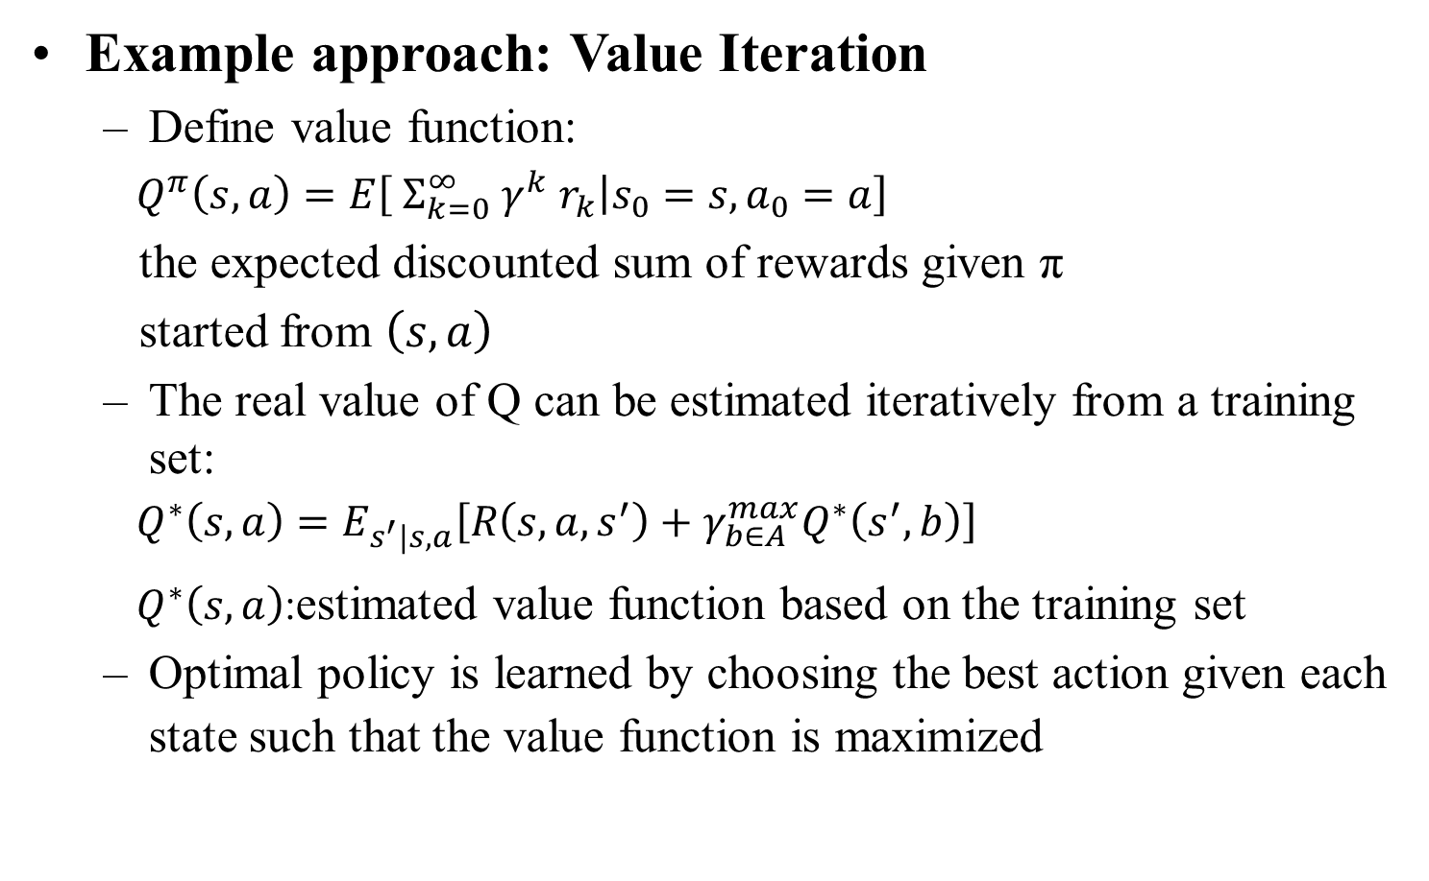
Reinforcement Learning
Example approach: Value Iteration
  Define value function:
  $Q^{π}\left(s,a\right)=E\left[ Σ_{k=0}^{∞} γ^{k}{ r}_{k}\left|s_{0}\right.=s,a_{0}=a\right]$
  the expected discounted sum of rewards given π
  started from $\left(s,a\right)$
  The real value of Q can be estimated iteratively from a training set:
  $Q^{∗}\left(s,a\right)=E_{s^{′}\left|s,a\right.}\left[R\left(s,a,s^{′}\right)+γ_{b∈A}^{max}Q^{∗}\left(s^{′},b\right)\right]$
  $Q^{∗}\left(s,a\right)$:estimated value function based on the training set
  Optimal policy is learned by choosing the best action given each state such that the value function is maximized

Slide 33
Question-Answering (QA) in Speech
Question
Question
Answering
Knowledge
Source
Answer
Question, Answer, Knowledge Source can all be in text form or in Speech
Spoken Question Answering becomes important
  spoken questions and answers are attractive
  the availability of large number of on-line courses and shared videos today makes spoken answers by distinguished instructors or speakers more feasible, etc.
Text Knowledge Source is always important

Slide 34
Three Types of QA
Factoid QA:
  What is the name of the largest city of Taiwan? Ans: Taipei.
Definitional QA :
  What is QA?
Complex Question:
  How to construct a QA system?

Slide 35
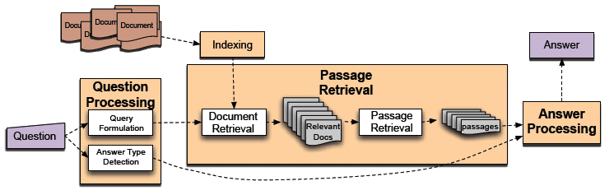
Factoid QA
Question Processing
  Query Formulation: transform the question into a query for retrieval
  Answer Type Detection (city name, number, time, etc.)
  Passage Retrieval
  Document Retrieval, Passage Retrieval
Answer Processing
  Find and rank candidate answers

Slide 36
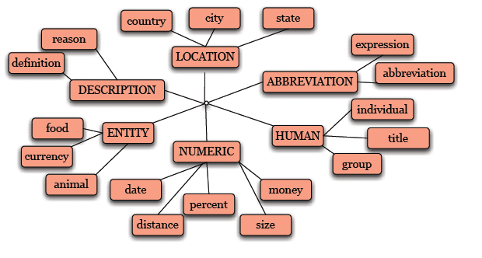
Factoid QA – Question Processing
Query Formulation: Choose key terms from the question
  Ex: What is the name of the largest city of Taiwan?
  “Taiwan”, “largest city ” are key terms and used as query
Answer Type Detection
  “city name” for example
  Large number of hierarchical classes hand-crafted or automatically learned

Slide 37
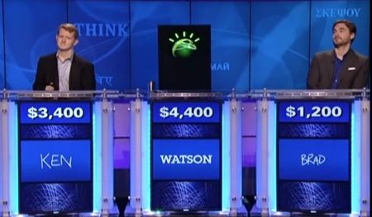
An Example Factoid QA
Watson: a QA system develop by IBM (text-based, no speech), who won “Jeopardy!”

Slide 38
Definitional QA
Definitional QA ≈ Query-focused summarization
Use similar framework as Factoid QA
  Question Processing
  Passage Retrieval
  Answer Processing is replaced by Summarization

Slide 39
References
Key terms
  “Automatic Key Term Extraction From Spoken Course Lectures Using Branching Entropy and Prosodic/Semantic Features”, IEEE Workshop on Spoken Language Technology, Berkeley, California, U.S.A., Dec 2010, pp. 253-258.
  “Unsupervised Two-Stage Keyword Extraction from Spoken Documents by Topic Coherence and Support Vector Machine”, International Conference on Acoustics, Speech and Signal Processing, Kyoto, Japan, Mar 2012, pp. 5041-5044.
Title Generation
  “Automatic Title Generation for Spoken Documents with a Delicate Scored Viterbi Algorithm”, 2nd IEEE Workshop on Spoken Language Technology, Goa, India, Dec 2008, pp. 165-168.

Slide 40
References
Summarization
“Supervised Spoken Document Summarization Jointly Considering Utterance Importance and Redundancy by Structured Support Vector Machine”, Interspeech, Portland, U.S.A., Sep 2012.
“Unsupervised Domain Adaptation for Spoken Document Summarization with Structured Support Vector Machine”, International Conference on Acoustics, Speech and Signal Processing, Vancouver, Canada, May 2013.
“Semantic Analysis and Organization of Spoken Documents Based on Parameters Derived from Latent Topics”, IEEE Transactions on Audio, Speech and Language Processing, Vol. 19, No. 7, Sep 2011, pp. 1875-1889.
"Spoken Lecture Summarization by Random Walk over a Graph Constructed with Automatically Extracted Key Terms," InterSpeech 2011

Slide 41
References
Summarization
  “Speech-to-text and Speech-to-speech Summarization of Spontaneous Speech”, IEEE Transactions on Speech and Audio Processing, Dec. 2004
  “The Use of MMR, diversity-based reranking for reordering document and producing summaries” SIGIR, 1998
  “Using Corpus and Knowledge-based Similarity Measure in Maximum Marginal Relevance for Meeting Summarization” ICASSP, 2008
  “Opinosis: A Graph-Based Approach to Abstractive Summarization of Highly Redundant Opinions”, International Conference on Computational Linguistics , 2010

Slide 42
References
Interactive Retrieval
“Interactive Spoken Content Retrieval with Different Types of Actions Optimized by a Markov Decision Process”, Interspeech, Portland, U.S.A., Sep 2012.
“Interactive Spoken Content Retrieval by Extended Query Model and Continuous State Space Markov Decision Process”, International Conference on Acoustics, Speech and Signal Processing, Vancouver, Canada, May 2013.
Reinforcement Learning: An Introduction, Richard S. Sutton and Andrew G. Barto, The MIT Press, 1999.
Partially observable Markov decision processes for spoken dialog systems, Jason D. Williams and Steve Young, Computer Speech and Language, 2007.

Slide 43
Reference
Question Answering
  Rosset, S., Galibert, O. and Lamel, L. (2011) Spoken Question Answering, in Spoken Language Understanding: Systems for Extracting Semantic Information from Speech
  Pere R. Comas, Jordi Turmo, and Lluís Màrquez. 2012. “Sibyl, a factoid question-answering system for spoken documents.” ACM Trans. Inf. Syst. 30, 3, Article 19 (September 2012), 40

