Slide 1
HW2-2 Speech Analysis
TA: 張瀞婷 b01901135@ntu.edu.tw

Slide 2
Goal
Analyze speech signal from spectrogram
Try to distinguish different initials/finals on spectrogram.

Slide 3
Outline
Introduction
Praat
Homework Problems
Submission Requirements

Slide 4
Before start…
Initials and finals 聲母與韻母 in Mandarin Chinese
Right-Context-Dependent Initial Final (RCDIF)
Ex. t_i for ㄊ followed by finals starting with 一-like sounds, like ㄊㄧ=t_i i

Slide 5
Before start…
classification of consonants
classification of vowels
Plosive/Stop | 爆破音/塞音 | ㄅㄆㄉㄊㄍㄎ
Fricative | 擦音 | ㄈㄏㄒㄕㄙ
Affricate | 塞擦音 | ㄐㄑㄓㄔㄗㄘ
Nasal | 鼻音 | ㄇㄋ
Monophthong | 單母音 | ㄧㄨㄩㄚㄛㄜㄦ
Diphthong | 雙母音 | ㄞㄟㄠㄡ

Slide 6
Before start…
Some useful information about labeling
“sil” for silence
“sp” for short pause
fricative/affricate initials do not contain voicing parts
plosive initials contain closure or aspiration period

Slide 7
Some files you need
Phonetic class table (聲韻母表):
http://speech.ee.ntu.edu.tw/homework/DSP_HW2-2/phonetic_class.pdf
Syllable table (標註模式):
http://speech.ee.ntu.edu.tw/homework/DSP_HW2-2/syllable.txt
Audio data & FAQ:
check out http://speech.ee.ntu.edu.tw/homework/DSP_HW2-2/

Slide 8
Tools for labeling
Wavesurfer
Matlab
Praat
↑ we will use this for hw2-2

Slide 9
Praat
Download
http://www.fon.hum.uva.nl/praat/
How to read a wave file
How to use it
Pitch
Intensity
Format
How to label

Slide 10
Praat

Slide 11
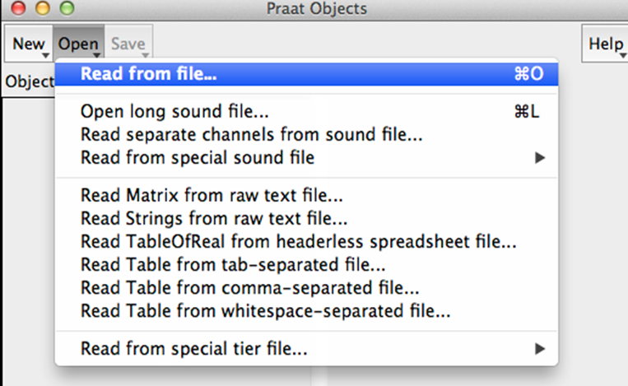
Open a wave file
Read from file (.wav file)

Slide 12
View and Edit

Slide 13
Time and Frequency Domain

Slide 14
Pitch 音高

Slide 15
Intensity 音量

Slide 16
Formant 共鳴

Slide 17
Reminder
Intensity: power of all frequency components Two acoustic signals may have the same intensity but different frequency components.
Formant: acoustic resonance, measured by the peak in the frequency spectrum You should not trust the formant detection output for unvoiced initials.

Slide 18
Label a wave file
Annotate, To TestGrid

Slide 19
Create one interval tier named RCDIF
No point tiers

Slide 20
View & Edit
With BOTH objects selected

Slide 21
Before labeling

Slide 22
Labeling
Click on spectrogram for your boundary
Add the boundary by clicking the small circle
Remove by choosing “Boundary/Remove”
Drag you boundaries to be more accurate
Click between your boundary and type in your label (according to the “Syllable table”)
Listen to your label by clicking the number (interval time) below it

Slide 23
After labeling

Slide 24
Save your Label file
Save your TextGrid object as short text file
File should be “.TextGrid” not “.Collection”

Slide 25
Part 1 (20%)
Choose your wave files from directories according to your student ID.
You must submit at least 5 fully labeled TextGrid files (along with their wave files)
These 5 files should contain the initial/final labels you use in part 2

Slide 26
Part 2 (30%)
Choose at least 2 initials from the 4 classes (Plosive, Fricative, Affricate, Nasal)
For each of these 8 initials, create a table that contains at least 2 screenshots of its label.
Please show intensity and formant
For example…

Slide 27
Plosive b(ㄅ)
Phonetic Class
Plosive | b(ㄅ)

Slide 28
Plosive p(ㄆ)
Phonetic Class
Plosive | p(ㄆ)

Slide 29
Useful tips
Zoom in and Zoom out
show all or selection part in Praat by clicking the buttons on the lower-left corner of spectrograms
In your chosen directory
“NTU_XXXXX_phn2file” lists all files containing each phone
“NTU_XXXXX_file2phn” lists all phones contained in each file

Slide 30
Part 3 (50%)
(20%) What are the consistencies of the spectrogram in each phonetic class? (Plosive, Fricative, Affricate, Nasal)
(10%) Is the boundary between neighboring initial and final clear? What is the benefit of using “right-context dependent” initial model (ex: sh_a) instead of pure initial model (ex: sh) to model initials?

Slide 31
Part 3 (50%)
(10%) What are the differences when pronouncing ㄅ & ㄆ? How can you tell the differences in spectrogram for ㄅ & ㄆ? (You may also want to compare ㄉ & ㄊ, ㄍ & ㄎ respectively)
(10%) Take a look at the spectrogram of finals. Is there any simple rules to discriminate initials from finals provided only spectrogram?

Slide 32
Bonus (10%)
The following is a speech analysis plot for a Chinese word composed of 4 characters. Each character is composed of an initial and a final.
Guess what the word is and describe your reasoning. (Score: reasoning 8%, correct answer 2%)
If you cannot figure out the word, you can guess the phonetic class or initial/finals. For example, your answer can be “l_i, i, sic_a, au” or “plosive, diphthong, plosive, monophthong”.

Slide 33
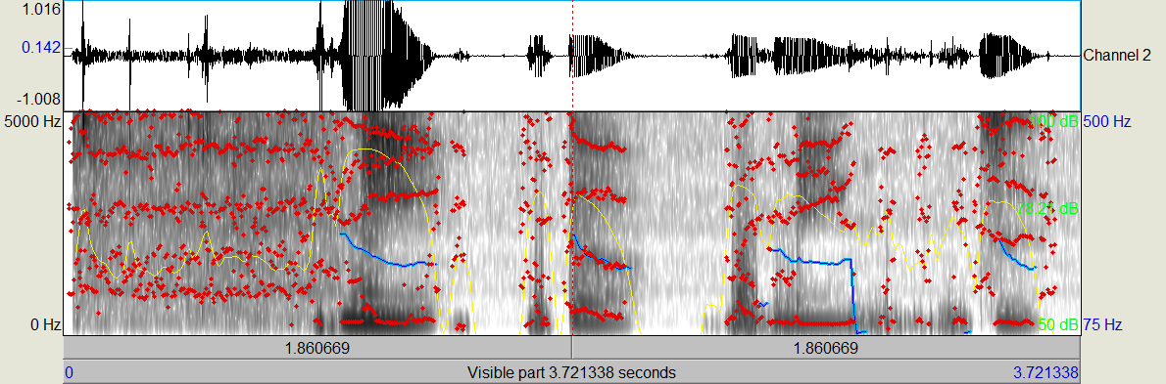
Hint: it’s a movie name which published in the past 2 years.

Slide 34
Submission Requirements
5 TextGrid files (each along with its wave file)
the “.TextGrid” & “.wav” filenames should be the same
1 report (in PDF format)
the filename should be hw2-2_bXXXXXXXX.pdf (your student ID)
Put those 11 files in a folder (named after your student ID), compress the folder to 1 zip file and upload it to ceiba
10% of the final score will be taken off for each day of late submission
Attention: there should be a student-ID-folder containing those 11 files in your zip file. Any wrong file format will get a penalty of points.

Slide 35
If you have any problem…
Look up the Praat introduction website.
It should solve all your technical problems.
http://www.fon.hum.uva.nl/praat/manual/Intro.html
Contact the TA by email. 張瀞婷 b01901135@ntu.edu.tw

Slide 36
Homework 2
Your can submit either
HW 2-1 (HMM Training and Testing)
HW 2-2 (Speech Analysis)
You can also submit both
The higher grade of the two will count as your final score for HW2
Deadline: To be discussed

