Slide 1
Digital Speech Processing
Homework 3
Nov. 16 2016
r04922167@ntu.edu.tw 王育軒

Slide 2
To complete the homework, you need to…
Build a character-based language model with toolkit SRILM.
Decode the ZhuYin-mixed sequence

Slide 3
Outline
Introduction
SRILM
Step by Step
Submission and Grading

Slide 4
Introduction
讓 他 十分 ㄏ怕
只 ㄒ望 ㄗ己 明ㄋ 度 別 再 這ㄇ ㄎ命 了
演ㄧ ㄩ樂 產ㄧ ㄐ入 積ㄐ ㄓ型 提ㄕ 競爭ㄌ
HW3：注音文修正
讓 他 十分 害怕
只 希望 自己 明年 度 別 再 這麼 苦命 了
演藝 娛樂 產業 加入 積極 轉型 提升 競爭ㄌ

Slide 5
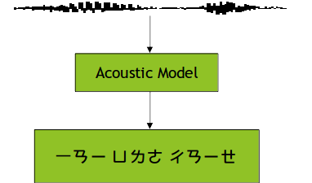
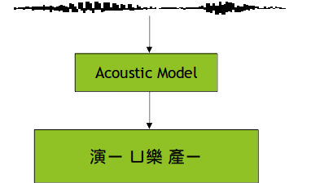
Introduction
Imperfect acoustic models with phoneme loss.
The finals of some characters are lost.

Slide 6
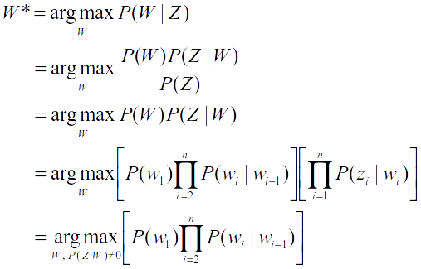
Introduction
Proposed methods:
  Reconstruct the sentence by language model.
For example, let Z = 演ㄧ ㄩ樂 產ㄧ
P(Z) is independent of W
W=w₁w₂w₃w₄...w_{n} , Z=z₁z₂z₃z₄...z_{n}
Bigram language model

Slide 7
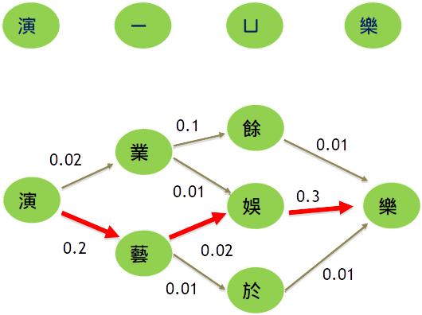
Example

Slide 8
SRILM
SRI Language Model toolkit
  http://www.speech.sri.com/projects/srilm/
A toolkit for building and applying various statistical language models
Useful C++ classes
Using/Reproducing some of SRILM

Slide 9
SRILM
Build it from source code (Provided on course website )
  Allows you to use SRILM library
Or download the executable from the course website to finish the first part of HW3
  Different platform:
    i686 for 32-bit GNU/Linux
    i686-m64 for 64-bit GNU/Linux (CSIE workstation)
    Cygwin for 32-bit Windows with cygwin environment

Slide 10
SRILM
You are strongly recommended to read FAQ on the course website
Possibly useful codes in SRILM
  $SRIPATH/misc/src/File.cc (.h)
  $SRIPATH/lm/src/Vocab.cc (.h)
  $SRIPATH/lm/src/ngram.cc (.h)
  $SRIPATH/lm/src/testError.cc (.h)

Slide 11
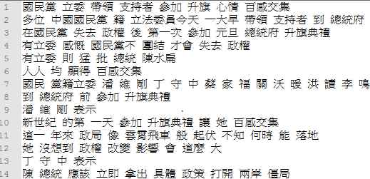
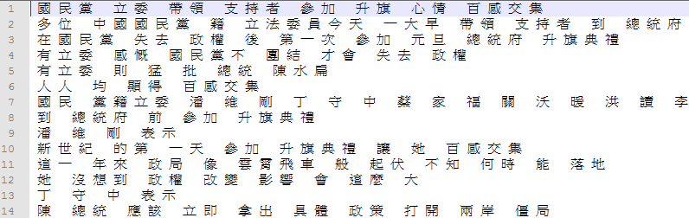
SRILM
Big5 Chinese Character separator written in perl:
  perl separator_big5.pl corpus.txt > corpus_seg.txt
  Why we need to separate it? (Use char or word?)

Slide 12
SRILM
./ngram-count –text corpus_seg.txt –write lm.cnt –order 2
  -text: input text filename
  -write: output count filename
  -order: order of ngram language model
./ngram-count –read lm.cnt –lm bigram.lm –unk –order 2
  -read: input count filename
  -lm: output language model name
  -unk: view OOV as <unk>. Without this, all the OOV will be removed

Slide 13
Example
corpus_seg.txt
在 國 民 黨 失 去 政 權 後 第 一 次 參 加 元 旦 總 統 府 升 旗 典 禮
有 立 委 感 慨 國 民 黨 不 團 結 才 會 失 去 政 權
有 立 委 則 猛 批 總 統 陳 水 扁
人 人 均 顯 得 百 感 交 集
bigram.lm
\data\
ngram 1=6868
ngram 2=1696830
\1-grams:
-1.178429 </s>
-99 <s> -2.738217
-1.993207 一 -1.614897
-4.651746 乙 -1.370091
......
lm.cnt
夏 11210
俸 267
鴣 7
衹 1
微 11421
檎 27
......
(log probability)
(backoff weight)

Slide 14
SRILM
./disambig –text $file –map $map –lm $LM –order $order
  -text: input filename
  -lm: input language model
  -map: a mapping from (注音/國字) to (國字)
  You should generate this mapping by yourself from the given Big5-ZhuYin.map.
  DO NOT COPY-PASTE TO RUN THIS LINE

Slide 15
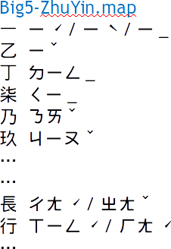
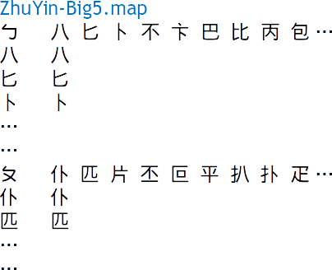
Big5-ZhuYin -> ZhuYin-Big5
Be aware of polyphones(破音字)
There could be arbitrary spaces between all characters.
Key - value pairs
Can be random permutation

Slide 16
Step by Step
Segment corpus and all test data into characters
  ./separator_big5.pl corpus.txt corpus_seg.txt
  ./separator_big5.pl <testdata/xx.txt> <testdata/xx.txt>
  You should rename the segmented testdata as testdata/1.txt, testdata/2.txt… and use them in the following task
Train character-based bigram LM
  Get counts:
  ./ngram-count –text corpus_seg.txt –write lm.cnt –order 2
  Compute probability:
  ./ngram-count –read lm.cnt –lm bigram.lm –unk –order 2
Generate ZhuYin-Big5.map from Big5-ZhuYin.map
  See FAQ 4

Slide 17
SRILM disambig
Using disambig to decode testdata/xx.txt
  ./disambig –text $file –map $map –lm $LM –order $order > $output

Slide 18
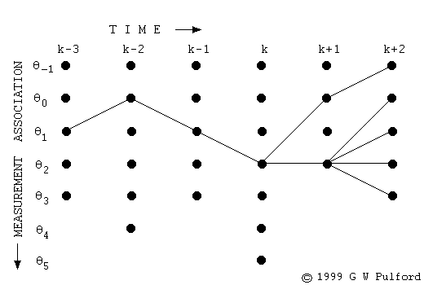
My Disambig
Implement your version of disambig
Use dynamic programming(Viterbi)
The vertical axes are candidate characters

Slide 19
Tips
C++ is strongly recommended
  Speed
  SRILM compatibility and utility
  You must provide Makefile for execution
    (See. Evaluation Procedure for details)
Dual OS or VirtualBox with Ubuntu strongly recommended
Your output format should be consistent with SRILM
  <s> 這 是 一 個 範 例 格 式 </s>
  There are an <s> at the beginning of a sentence, a </s> at the end, and whitespaces in between all characters.

Slide 20
How to deal with Chinese char?
Chinese character: You should use Big5 encoding
All testing files are encoded in Big5
A Chinese character in Big5 is always 2 bytes, namely, char[2] in C++

Slide 21
Submission Example: student ID: r04922167
dsp_hw3_r04922167.zip
When unzipped, your uploaded file should contain a directory as following:
  dsp_hw3_r04922167/
    result1/1.txt~10.txt (generated from SRILM disambig with your LM by yourself)
    your codes
    Makefile
    report.pdf
Don’t hw3_R04922167, HW3_r04922167, hw3_r04922167/Result1, hw3_r04922167/best_result1, hw3_r04922167/result1/segmented_1.txt…

Slide 22
Submission
Your report should include:
  Your environment (CSIE workstation, Cygwin, …)
  How to “compile” your program
  How to “execute” your program
    Not familiar with makefile is fine, tell me how to execute your program
    However, you should also strictly follow the spec (regulations about filenames, input files and output files)
  ex: ./program –a xxx –b yyy
  What you have done
  NO more than two A4 pages.

Slide 23
Grading
(10%) Your code can be successfully compiled
(10%) Correctly generate ZhuYin-Big5.map
(30%) Correctly use SRILM disambig to decode ZhuYin-mixed sequence
(10%) mydisambig program can run with no errors and crashes
(25%) Your results decoded by your own program are the same as expected
(10%) Your report contains required information
(5%) You strictly follow format regulation
(10% bonus!) Your program can support trigram language models with speed pruning.

Slide 24
If there are errors during TA’s testing
Like compilation error, crash…
  TA will ask you to demo your program only with the files you uploaded.
  If you can prove that you followed the runles correctly, you will get your credits.

Slide 25
Evaluation Procedure
There are some files provided by TA but you shouldn’t upload them
  Big5-ZhuYin.map, bigram.lm…
  Strictly follow regulations about format
  However, you can utilize the files in makefile
test_env shows locations of files during evaluation
In the following slides, this color specify makefile commands of evaluation scripts

Slide 26
Evaluation Procedure
Initialization
  make clean
  copy ta’s bigram.lm, Big5-ZhuYin.map, testdata to your directory
(10%) Your code can be successfully compiled.
  make MACHINE_TYPE=i686-m64 SRIPATH=/home/ta/srilm-1.5.10 all
  i686-m64 is TA’s platform
  Your code should be machine-independent(system(“pause”) is invalid in my system) and the user can easily specify the platform and SRILM path
(10%) Correctly generate ZhuYin-Big5.map
  make map (it should generate hw3_r04922167/ZhuYin-Big5.map)
  check if hw3_r04922167/ZhuYin-Big5.map is correct
  (You have to write your own makefile to achieve it. Generation must be based on hw3_r04922167/Big5-ZhuYin.map)
  (Your output in this step should be hw3_r04922167/ZhuYin-Big5.map )
  (python/perl/C/C++/MATLAB/bash/awk permitted)

Slide 27
Evaluation Procedure
(30%) Correctly use SRILM disambig to decode ZhuYin-mixed sequence
  Check if result1/1.txt~10.txt is the same as expected
(10%) mydisambig program can run with no errors and crashes
  make MACHINE_TYPE=i686-m64 SRIPATH=/home/ta/srilm-1.5.10 LM=bigram.lm run;
  (it should run based on bigram.lm and generate result2/1.txt~10.txt)
(25%) Your results decoded by your own program are the same as expected
  check result2/1.txt~10.txt
  TA’s testdata will be segmented testdata, not the given raw testdata

Slide 28
Late Penalty
10% each 24 hours, according to the announced deadline instead of the deadline on Ceiba
100 -> 90 -> 80, not 100 -> 90 -> 81

Slide 29
Notes
Follow the spec!!!!
All of your program should finish the tasks assigned below 10 minutes
Totally checking the correctness with good documents is YOUR JOB
Only the latest files you uploaded to ceiba will be evaluate (All of your previous uploaded version will be ignored)

Slide 30
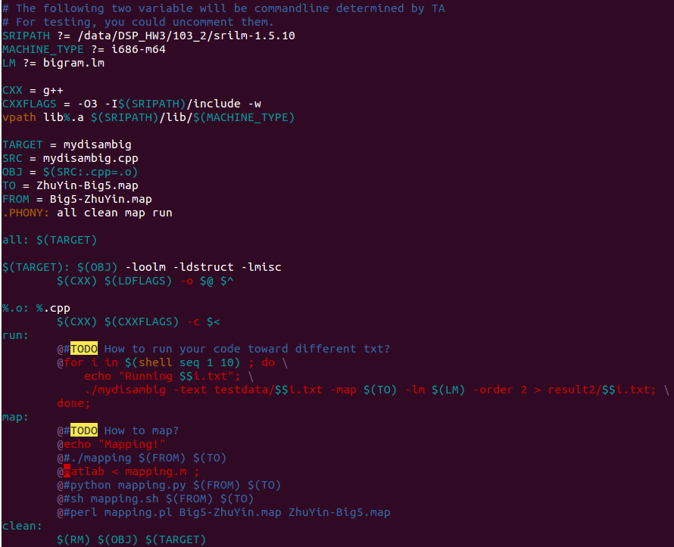
Makefile example

Slide 31
Reminders and Suggestions
Read the spec carefully
Finish the first part (SRILM disambig) as early as possible
  If everything goes well, you should finish the first part in an hour
  Fix the issue of dependencies early
  Big5 encoding issue
Be sure that you prepare the correct Makefile
  Evaluation procedure is in part automatically done by scripts. You can see the details in the previous slides
See the FAQ in the website
Contact TA if needed
  Check email-FAQ!
  r04922167@ntu.edu.tw 王育軒
  TA will not help you debug your program

