Slide 1
6.0 Language Modeling
References: 1. 11.2.2, 11.3, 11.4 of Huang or
2. 6.1- 6.8 of Becchetti, or
3. 4.1- 4.5, 8.3 of Jelinek

Slide 2
Language Modeling: providing linguistic constraints to help the selection of correct words
The computer is listening
電 腦 聽 聲 音
come
老 天
they
list
店
tutor
sunny
呻 吟
t
t
Prob [the computer is listening] > Prob [they come tutor is list sunny]
Prob [電腦聽聲音] > Prob [店老天呻吟]

Slide 3
From Fundamentals of Information Theory
Examples for Languages
  0≤ H (S) ≤ log M
  Source of English text generation
  this course is about speech.....
    the random variable is the character ⇒ 26*2+.....<64=2⁶
  H (S) < 6 bits (of information) per character
    the random variable is the word ⇒ assume total number of words=30,000<2¹⁵
  H (S) < 15 bits (of information) per word
  Source of speech for Mandarin Chinese
  這一門課有關語音.....
    the random variable is the syllable (including the tone) ⇒ 1300 < 2¹¹
    H (S) < 11 bits (of information) per syllable (including the tone)
    the random variable is the syllable (ignoring the tone) ⇒ 400 < 2⁹
  H (S) < 9 bits (of information) per syllable (ignoring the tone)
    the random variable is the character ⇒ 8,000 < 2¹³
  H (S) < 13 bits (of information) per character
  Comparison: speech― 語音, girl― 女孩, computer― 計算機
S
S

Slide 4
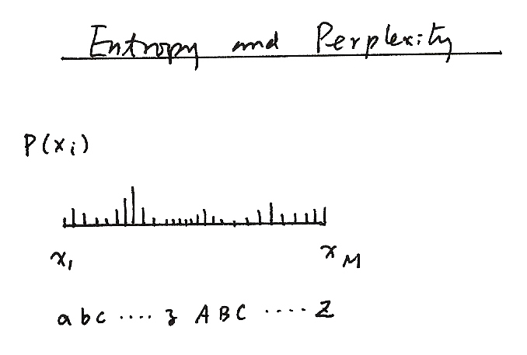
Entropy and Perplexity
Entropy and Perplexity
P(X_{i})
P (x_{i})
x₁ x_{M}
abc.....z ABC.....Z

Slide 5

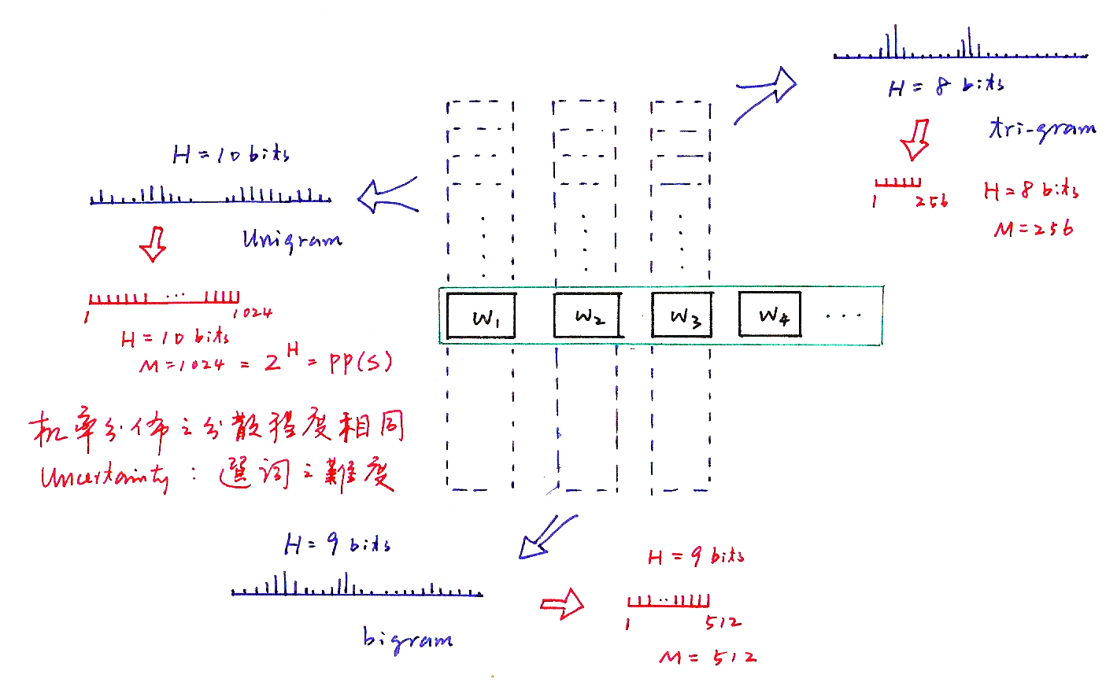
Entropy and Perplexity
機率分佈之分散程度相同
Uncertainty：選詞之難度

Slide 6
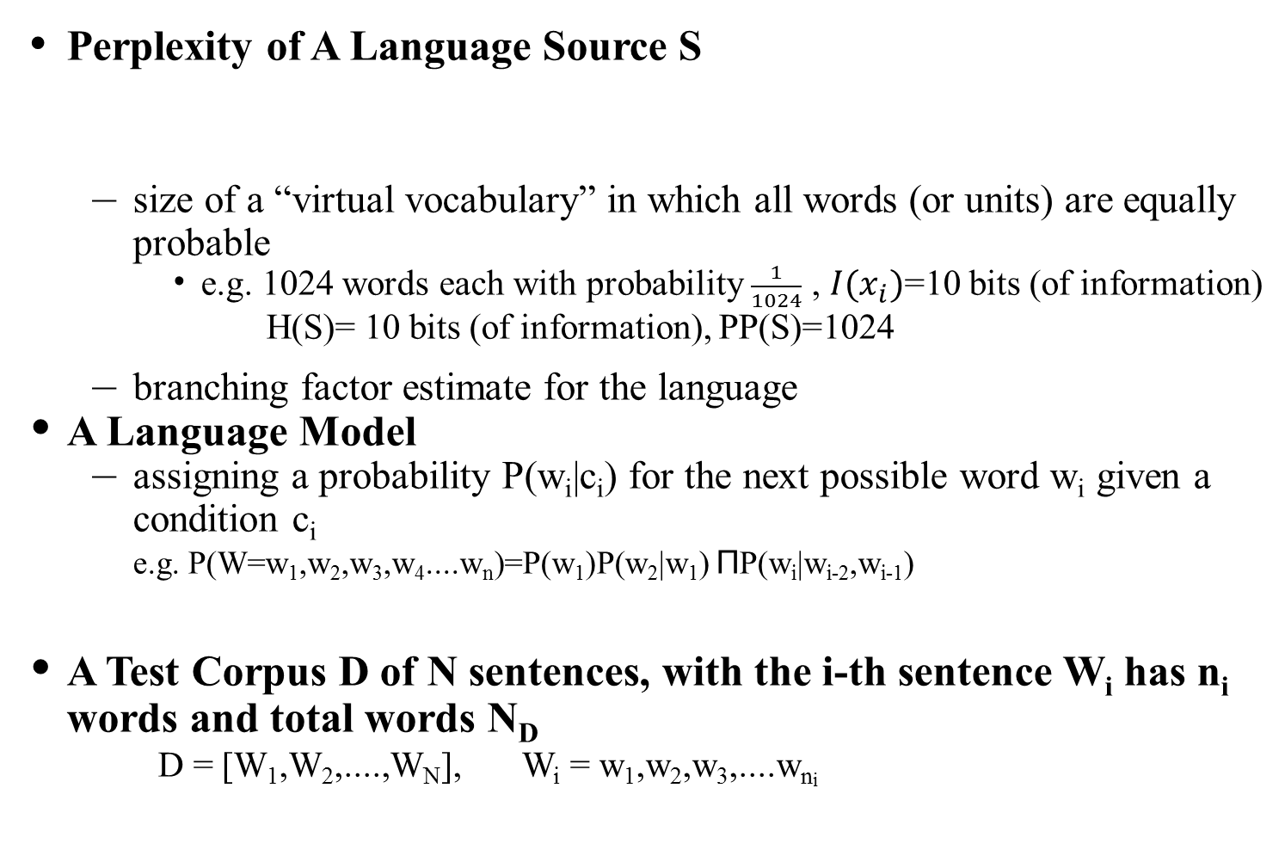

Perplexity
Perplexity of A Language Source S
  size of a “virtual vocabulary” in which all words (or units) are equally probable
    e.g. 1024 words each with probability $\frac{1}{1024}$ , $I(x_{i})$=10 bits (of information)
    H(S)= 10 bits (of information), PP(S)=1024
  branching factor estimate for the language
A Language Model
  assigning a probability P(w_{i}|c_{i}) for the next possible word w_{i} given a condition c_{i}
  e.g. P(W=w₁,w₂,w₃,w₄....w_{n})=P(w₁)P(w₂|w₁) ΠP(w_{i}|w_{i-2},w_{i-1})
A Test Corpus D of N sentences, with the i-th sentence W_{i} has n_{i} words and total words N_{D}
D = [W₁,W₂,....,W_{N}], W_{i} = w₁,w₂,w₃,....w_{ni}
(perplexity:混淆度)
n
i=3
c₁=$φ$
c₂
c_{i}

Slide 7
Perplexity
Perplexity of A Language Model P(w_{i}|c_{i}) with respect to a Test Corpus D
  H (P ; D)= , average of all log P(w_{j}|c_{j}) over the
  whole corpus D
  = , logarithm of geometric mean of P(w_{j}|c_{j})
  pp (P ; D) =2^{H(P;D)}
  average branching factor (in the sense of geometrical mean of reciprocals)
    e.g. P(W=w₁w₂...w_{n})=P(w₁) P(w₂|w₁) P(w₃|w₁,w₂) P(w₄|w₂,w₃) P(w₅|w₃,w₄) .....
  the capabilities of the language model in predicting the next word given the linguistic constraints extracted from the training corpus
  the smaller the better, performance measure for a language model with respect to a test corpus
  a function of a language model P and text corpus D

Slide 8
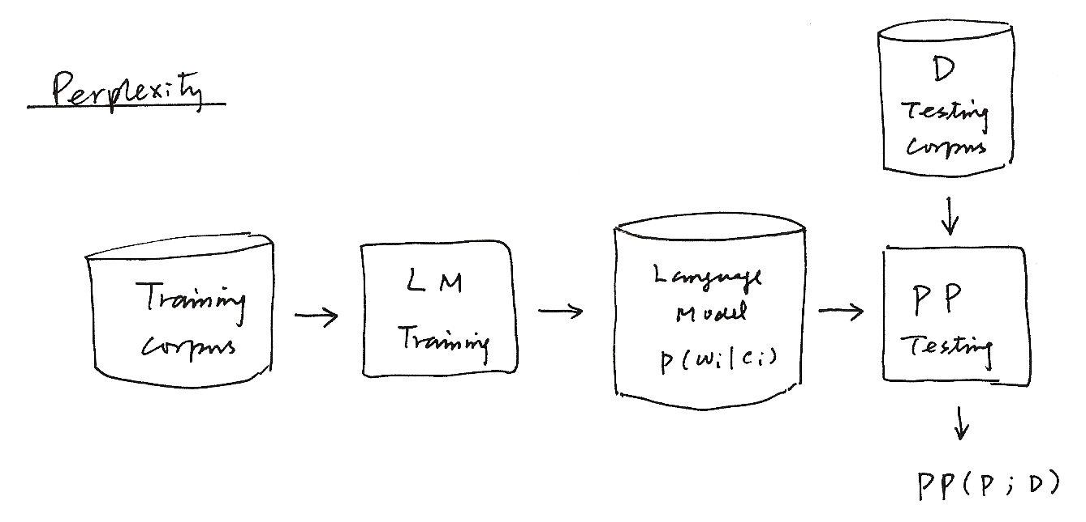
D
Testing
Corpus
Perplexity
Training corpus
Language
Model
P (w_{i} | c_{i})
LM
Training
PP
Testing
PP ( P；D )

Slide 9
An Perplexity Analysis Example with Respect to Different Subject Domains
Domain-specific Language Models Trained with Domain Specific Corpus of Much Smaller Size very often Perform Better than a General Domain Model
  Training corpus: Internet news in Chinese language
  Sports section gives the lowest perplexity even with very small training corpus
1 politics 19.6 M
2 congress 2.7 M
3 business 8.9 M
4 culture 4.3 M
5 sports 2.1 M
6 transportation 1.6 M
7 society 10.8 M
8 local 8.1 M
9 general(average) 58.1 M
～
～
0
1 2 3 4 5 6 7 8 9

Slide 10
Perplexity
KL Divergence or Cross-Entropy
  Jensen’s Inequality
  entropy when p(x) is incorrectly estimated as q(x) (leads to some entropy increase)
The True Probabilities P(w_{i}|c_{i}) incorrectly estimated as P(w_{i}|c_{i}) by the language model
The Perplexity is a kind “Cross-Entropy” when the true statistical characteristics of the test corpus D is incorrectly estimated as p(w_{i}|c_{i}) by the language model
  H (P ; D) = X (D‖ P)
  the larger the worse
Someone call this “cross-entropy” = X[p(x)‖q(x)]
(averaging by all samples)
(averaging if p(x_{i}) is known)
law of large numbers

Slide 11
Law of Large Numbers
值 次數
a₁ n₁
a₂ n₂
+ a_{k} n_{k}
N

Slide 12
Smoothing of Language Models
Data Sparseness
  many events never occur in the training data
  e.g. Prob [Jason immediately stands up]=0 because Prob [immediately| Jason]=0
  smoothing: trying to assign some non-zero probabilities to all events even if they never occur in the training data
Add-one Smoothing
  assuming all events occur once more than it actually does
    e.g. bigram
V: total number of distinct words in the vocabulary

Slide 13
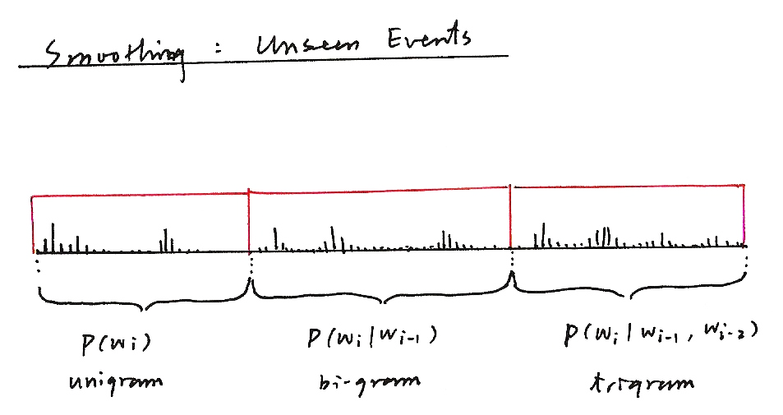
Smoothing : Unseen Events
P(w_{i}) P(w_{i}|w_{i-1}) P(w_{i}|w_{i-2,} w_{i-1})
unigram bi-gram trigram

Slide 14
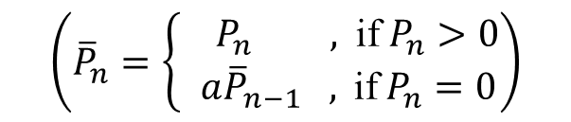
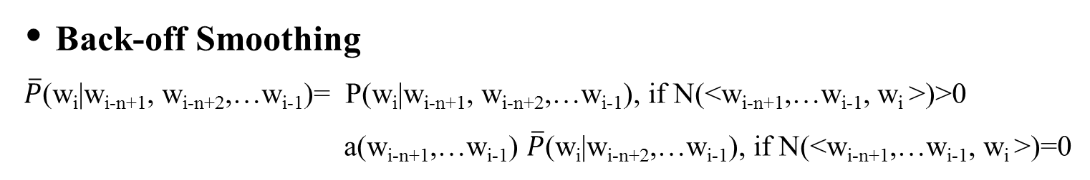

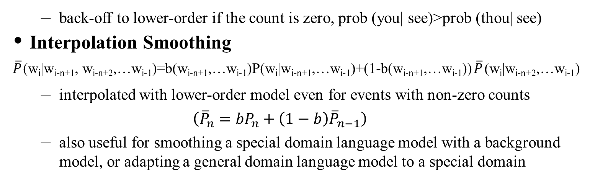
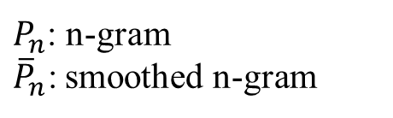
Smoothing of Language Models
Back-off Smoothing
$\overline{P}$(w_{i}|w_{i-n+1}, w_{i-n+2},…w_{i-1})= P(w_{i}|w_{i-n+1}, w_{i-n+2},…w_{i-1}), if N(<w_{i-n+1},…w_{i-1}, w_{i} >)>0
a(w_{i-n+1},…w_{i-1}) $\overline{P}$(w_{i}|w_{i-n+2},…w_{i-1}), if N(<w_{i-n+1},…w_{i-1}, w_{i} >)=0
$$\left({\overline{P}}_{n}=\left\{\begin{aligned}{ P}_{n} \text{,} \text{if} P_{n}>0 \\ a{\overline{P}}_{n−1} \text{,} \text{if} P_{n}=0\end{aligned}\right.\right)$$
$P_{n}$: n-gram
${\overline{P}}_{n}\text{:}$ smoothed n-gram
  back-off to lower-order if the count is zero, prob (you| see)>prob (thou| see)
  Interpolation Smoothing
  $\overline{P}$(w_{i}|w_{i-n+1}, w_{i-n+2},…w_{i-1})=b(w_{i-n+1},…w_{i-1})P(w_{i}|w_{i-n+1},…w_{i-1})+(1-b(w_{i-n+1},…w_{i-1}))$\overline{P}$(w_{i}|w_{i-n+2},…w_{i-1})
  interpolated with lower-order model even for events with non-zero counts
  $$\left({\overline{P}}_{n}=bP_{n}+\left(1−b\right){\overline{P}}_{n−1}\right)$$
  also useful for smoothing a special domain language model with a background model, or adapting a general domain language model to a special domain
$$P=bP_{s}+\left(1−b\right)P_{b}$$

Slide 15
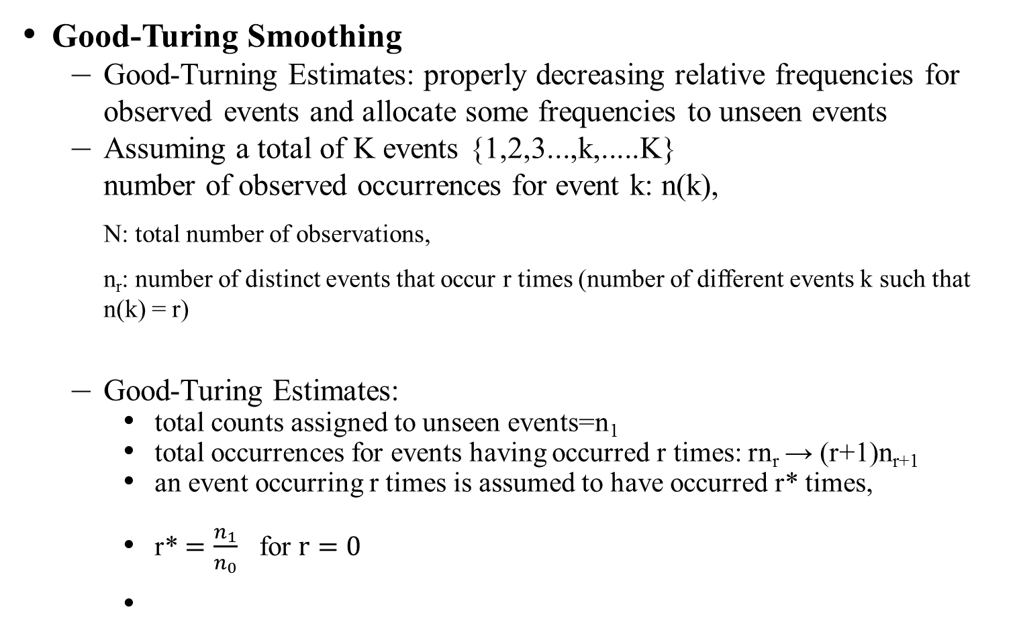
Smoothing of Language Models
Good-Turing Smoothing
  Good-Turning Estimates: properly decreasing relative frequencies for observed events and allocate some frequencies to unseen events
  Assuming a total of K events {1,2,3...,k,.....K}
  number of observed occurrences for event k: n(k),
  N: total number of observations,
  n_{r}: number of distinct events that occur r times (number of different events k such that n(k) = r)
  Good-Turing Estimates:
    total counts assigned to unseen events=n₁
    total occurrences for events having occurred r times: rn_{r} → (r+1)n_{r+1}
    an event occurring r times is assumed to have occurred r* times,
    r* $=\frac{n_{1}}{n_{0}}$ for $r=0$

Slide 16
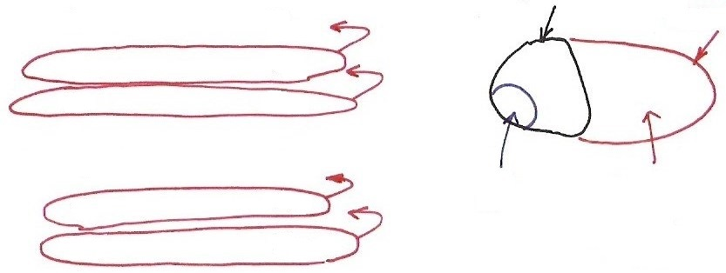










Good-Turing
出現該次數
之不同event數
次數
seen events
unseen
events：994
0
$$n_{0}$$
1
$$n_{1}$$
2
$$n_{2}$$
$$⋮$$
$$\frac{3/{18}}{994}$$
$$\frac{3}{18}$$
$$n_{r}$$
r
r+1
$$n_{r+1}$$
$$⋮$$
$$⋮$$
  An analogy: during fishing, getting each kind of fish is an event
  an example: n(1)=10, n(2)=3, n(3)=2, n(4)= n(5)= n(6)=1, N=18
  prob (next fish got is of a new kind) = prob (those occurring only once) =

Slide 17
Smoothing of Language Models
Katz Smoothing
  large counts are reliable, so unchanged
  small counts are discounted, with total reduced counts assigned to unseen events, based on Good-Turing estimates
  ,
  distribution of counts among unseen events based on next-lower-order model: back off
  an example for bigram:
d_{r}: discount ratio for events with r times
N (< w_{i-1},w_{i} >) / N(w_{i}) , r > r₀
d_{r}‧N (< w_{i-1},w_{i} >) / N(w_{i}) , r₀ ≥ r > 0
a (w_{i-1},w_{i}) P(w_{i}) , r = 0
a (w_{i-1},w_{i}): such that the total counts equal to those assigned

Slide 18

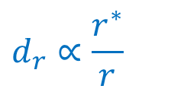
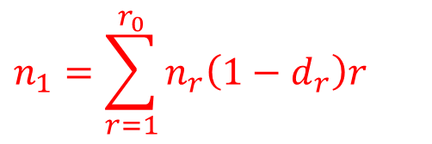
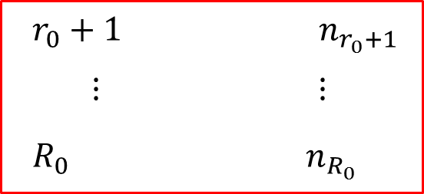
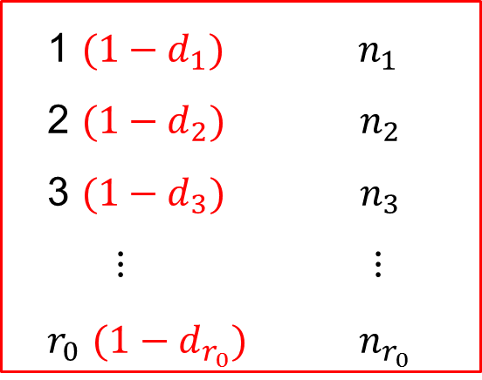
Katz Smoothing
不同event數
次數
0 $n_{0}$
1 $(1−d_{1})$ $n_{1}$
2 $(1−d_{2})$ $n_{2}$
3 $(1−d_{3})$ $n_{3}$
$⋮$ $⋮$
$r_{0}$ $(1−d_{r_{0}})$ $n_{r_{0}}$
$$n_{1}=\sum_{r=1}^{r_{0}}{n_{r}\left(1−d_{r}\right)r}$$
$$d_{r}∝\frac{r^{∗}}{r}$$
$r_{0}+1$ $n_{r_{0}+1}$
$⋮$ $⋮$
$R_{0}$ $n_{R_{0}}$
unchanged

Slide 19
Class-based Language Modeling
Clustering Words with Similar Semantic/Grammatic Behavior into Classes
  e.g.
  P(w_{i}|w_{i-2}, w_{i-1}) ⇒ P(w_{i}|c(w_{i}))P(c(w_{i})|c(w_{i-2}), c(w_{i-1}) )
  c(w_{j}): the class including w_{j}
  Smoothing effect: back-off to classes when too few counts, classes complementing the lower order models
  parameter size reduced
Limited Domain Applications: Rule-based Clustering by Human Knowledge
  e.g. Tell me all flights of from to on
    new items can be easily added without training data
General Domain Applications: Data-driven Clustering (probably aided by rule-based knowledge)
saw
found
dog
cat
street
road
John
Marry
a
on
the
He
She
drove
rode
car
bus
campus
in
My
father
sister
park
United
China Airline
Eva Air
Taipei
Los Angeles
Sunday

Slide 20
Class-based Language Modeling
Data-driven Word Clustering Algorithm Examples
  Example 1:
    initially each word belongs to a different cluster
    in each iteration a pair of clusters was identified and merged into a cluster which minimizes the overall perplexity
    stops when no further (significant) reduction in perplexity can be achieved
    Reference: “Cluster-based N-gram Models of Natural Language”, Computational Linguistics, 1992 (4), pp. 467-479
  Example 2:
  Prob [W= w₁w₂w₃....w_{n}]= Π Prob(w_{i}|w₁,w₂....w_{i-1})= Π Prob(w_{i}|h_{i})
  h_{i}: w₁,w₂,...w_{i-1}, history of w_{i}
    clustering the histories into classes by decision trees (CART)
    developing a question set, entropy as a criterion
    may include both grammatic and statistical knowledge, both local and long-distance relationship
    Reference: “A Tree-based Statistical Language Model for Natural Language Speech Recognition”, IEEE Trans. Acoustics, Speech and Signal Processing, 1989, 37 (7), pp. 1001-1008
n
i=1
n
i=1

Slide 21
An Example Class-based Chinese Language Model
A Three-stage Hierarchical Word Classification Algorithm
  stage 1 : classification by 198
  POS features (syntactic & semantic)
    each word belonging to one class only
    each class characterized by a set of POS’s
  stage 2 : further classification with data-driven approaches
  stage 3 : final merging with data-driven approaches
all words
.....
.....
.....
.....
.....
坐
(take)
汽車
(car)
乘
(ride)
巴士
(bus)
POS feature i
POS feature j
搭
(ride)
火車
(train)
飛機
(airplane)
...
...
...
.......
...
...
...
...
駕駛
(drive)
開
(steer)
.....
.....
.....
.....
rarely used words classified by human knowledge
both data-driven and human-knowledge-driven

Slide 22
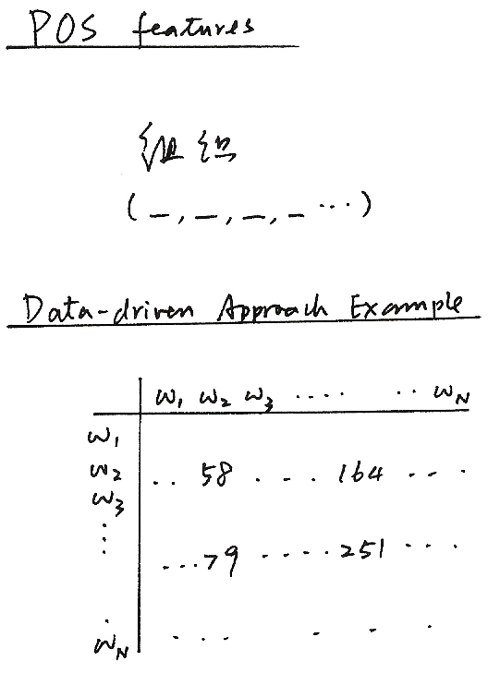
POS features
組織
(_,_,_,_...)
Data-driven Approach Example

Slide 23
Structural Features of Chinese Language
Almost Each Character with Its Own Meaning, thus Playing Some Linguistic Role Independently
No Natural Word Boundaries in a Chinese Sentence
  電腦科技的進步改變了人類的生活和工作方式
  word segmentation not unique
  words not well defined
  commonly accepted lexicon not existing
Open ( Essentially Unlimited ) Vocabulary with Flexible Wording Structure
  – new words easily created everyday 電(electricity)+腦(brain)→電腦(computer)
  – long word arbitrarily abbreviated 臺灣大學 (Taiwan University) →臺大
  – name/title 李登輝前總統 (former President T.H. Lee) →李前總統登輝
  – unlimited number of compound words 高 (high) + 速 (speed) + 公路 (highway)→高速公路(freeway)
Difficult for Word-based Approaches Popularly Used in Alphabetic Languages
  – serious out-of-vocabulary(OOV) problem

Slide 24
Word-based and Character-based Chinese Language Models
Word-based and Class-based Language Modeling
  words are the primary building blocks of sentences
  more information may be added
  lexicon plays the key role
  flexible wording structure makes it difficult to have a good enough lexicon
  accurate word segmentation needed for training corpus
  serious “out-of -vocabulary(OOV)” problem in many cases
  all characters included as “ mono-character words”
Character-based Language Modeling
  avoiding the difficult problem of flexible wording structure and undefined word boundaries
  relatively weak without word-level information
  higher order N-gram needed for good performance, which is relatively difficult to realize
Integration of Class-based/Word-based/Character-based Models
  word-based models are more precise for frequently used words
  back-off to class-based models for events with inadequate counts
  each single word is a class if frequent enough
  character-based models offer flexibility for wording structure

Slide 25
Segment Pattern Lexicon for Chinese – An Example Approach
Segment Patterns Replacing the Words in the Lexicon
  segments of a few characters often appear together : one or a few words
  regardless of the flexible wording structure
  automatically extracted from the training corpus (or network information) statistically
  including all important patterns by minimizing the perplexity
Advantages
  bypassing the problem that the word is not well-defined
  new words or special phrases can be automatically included as long as they appear frequently in the corpus (or network information)
  can construct multiple lexicons for different task domains as long as the corpora are given(or available via the network)

Slide 26
Example Segment Patterns Extracted from Network News Outside of A Standard Lexicon
Patterns with 2 Characters
  一套，他很，再往，在向，但從，苗市，記在
  深表，這篇，單就，無權，開低，蜂炮，暫不
Patterns with 3 Characters
  今年初，反六輕，半年後，必要時，在七月
  次微米，卻只有，副主委，第五次，陳水扁，開發中
Patterns with 4 Characters
  大受影響，交易價格，在現階段，省民政廳，專責警力
  通盤檢討，造成不少，進行了解，暫停通話，擴大臨檢

Slide 27
Word/Segment Pattern Segmentation Samples
With Extracted Segment Pattern
  交通部 考慮 禁止 民眾 開車 時
  使用 大哥大
  已 委由 逢甲大學 研究中
  預計 六月底 完成
  至於 實施 時程
  因涉及 交通 處罰 條例 的修正
  必須 經立法院 三讀通過
  交通部 無法確定
  交通部 官員表示
  世界 各國對 應否 立法 禁止 民眾
  開車 時 打 大哥大
  意見 相當 分岐
With A Standard Lexicon
  交通部 考慮 禁止 民眾 開 車 時
  使用 大哥大
  已 委 由 逢甲大學 研究 中
  預計 六月 底 完成
  至於 實施 時 程
  因 涉及 交通 處罰 條例 的 修正
  必須 經 立法院 三讀通過
  交通部 無法 確定
  交通部 官員 表示
  世界 各 國 對 應否 立法 禁止
  民眾 開 車 時 打 大哥大
  意見 相當 分岐
Percentage of Patterns outside of the Standard Lexicon : 28%

