Slide 1
Tutorial: word2vec
Yang-de Chen
yongde0108@gmail.com

Slide 2
Download & Compile
word2vec: https://code.google.com/p/word2vec/
Download
Install subversion(svn) sudo apt-get install subversion
Download word2vec
svn checkout http://word2vec.googlecode.com/svn/trunk/
Compile
make

Slide 3
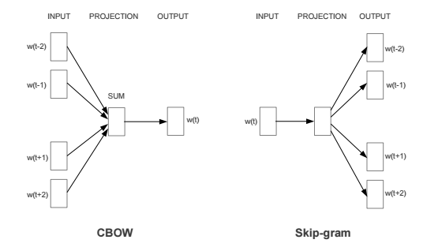
CBOW and Skip-gram
CBOW stands for “continuous bag-of-words”
Both are networks without hidden layers.
Reference: Efficient Estimation of Word Representations in Vector Space by Tomas Mikolov, et al.

Slide 4
Represent words as vectors
Example sentence 謝謝 學長 祝 學長 研究 順利
Vocabulary [ 謝謝, 學長, 祝, 研究, 順利 ]
One-hot vector of 學長 [0 1 0 0 0 ]

Slide 5
Example of CBOW
window = 1 謝謝 學長 祝 學長 研究 順利 Input: [ 1 0 1 0 0] Target: [0 1 0 0 0]
Projection Matrix $×$ Input vector = vector(謝謝) + vector(祝) $\left[\begin{matrix}1 & 4 & 7 \\ 2 & 5 & 8 \\ 3 & 6 & 9\end{matrix}\right] \left[\begin{matrix}1 \\ 0 \\ 1\end{matrix}\right]=1\left[\begin{matrix}1 \\ 2 \\ 3\end{matrix}\right]+0\left[\begin{matrix}4 \\ 5 \\ 6\end{matrix}\right]+1\left[\begin{matrix}7 \\ 8 \\ 9\end{matrix}\right]$

Slide 6
Training
word2vec -train <training-data> -output <filename> -window <window-size> -cbow <0(skip-gram), 1(cbow)> -size <vector-size> -binary <0(text), 1(binary)> -iter <iteration-num>
Example:

Slide 7
Play with word vectors
distance <output-vector> - find related words
word-analogy <output-vector> - analogy task, e.g. $man→king, woman→?$

Slide 8
Data: https://www.dropbox.com/s/tnp0wevr3u59ew8/data.tar.gz?dl=0

Slide 9
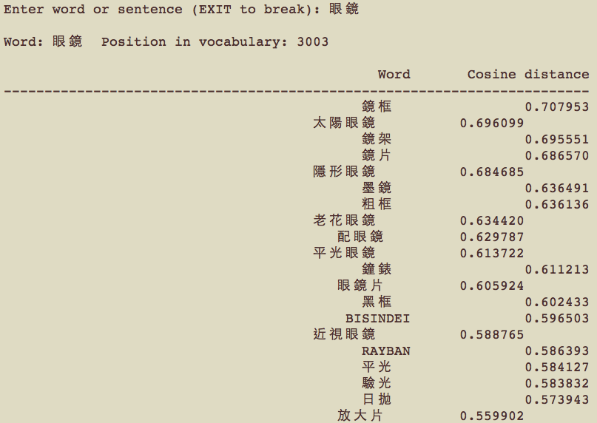
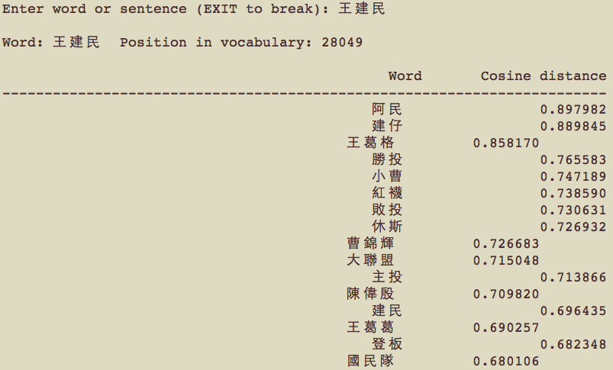
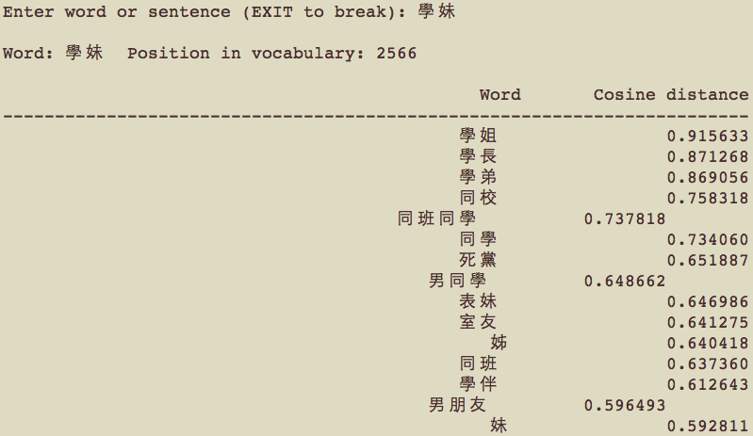
results

Slide 10
other Results

Slide 12
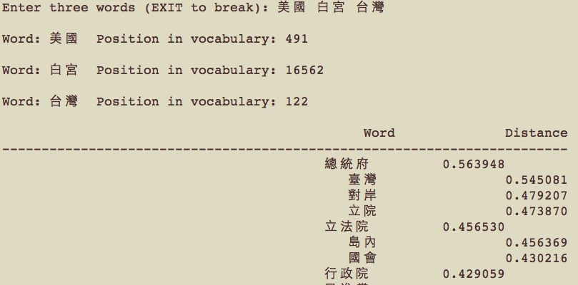
Analogy

Slide 13
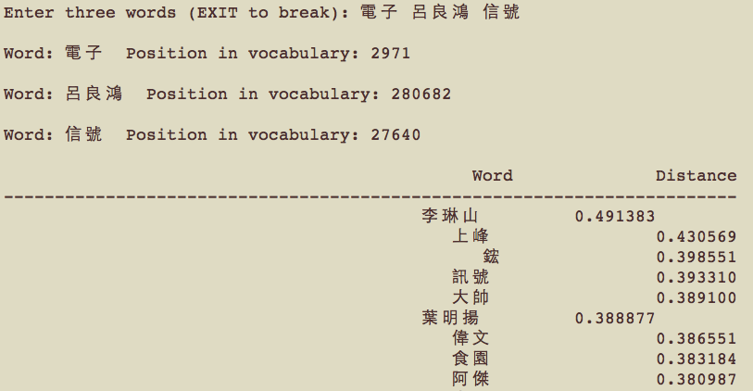
analogy

Slide 14
Advanced Stuff – Phrase Vector
Phrases You want to treat “New Zealand” as one word.
If two words usually occur at the same time, we add underscore to treat them as one word. e.g. New_Zealand
How to evaluate? If the score > threshold, we add an underscore.
word2phrase -train <word-doc> -output <phrase-doc> -threshold 100
Reference: Distributed Representations of Words and Phrases and their Compositionality by Tomas Mikolov, et al.

Slide 15
Advanced Stuff – Negative Sampling
Objective $\sum_{(w_{t}, c_{t})}{\sum_{c∈c_{t}}{logσ(vec{\left(w_{t}\right)}^{T}vec\left(c\right))}}−\sum_{\left(w_{t}, c_{t}^{′}\right)}{\sum_{c^{′}∈c_{t}^{′}}{logσ(vec{\left(w_{t}\right)}^{T}vec\left(c^{′}\right))}}$ $w_{t}:$word, $c_{t}:$ context, $c_{t}^{′}:$ random sample context
$P_{n}\left(w\right)=\frac{Unigram{\left(w\right)}^{0.75}}{Z}$

