Slide 1
深層學習 暑期訓練 (2017)

Slide 2
助教
大助教: 萬家宏
作業一: 許宗嫄
作業二: 陳奕禎
作業三: 蔡哲平
作業四: 萬家宏
作業五: 黃淞楓
作業問題在社團上討論

Slide 3
作業繳交
五個作業
因為是暑假，所以並不強迫繳交
請加入 FB 社團「深度學習暑期訓練」
如果有做的話，可以上傳到FB 社團給助教、同學、老師看
等一下會講作業大概的內容
都很簡單
作業詳細內容和做法都已經公告在社團上
會使用 keras 這套工具 (歡迎自學 Tensorflow )
教材：李宏毅教授在台大計中的十二小時演講錄影
內容公告於社團上

Slide 4
工作站
專題工作站的 IP 是 140.112.21.80
密碼統一是 speech，再自行修改密碼
在以下 google doc 登記(8/3 23:59截止) https://docs.google.com/forms/d/1-J6rbxFMN2yBNUnApgJYxvjM7v-brbiiVqucNGhOsnY/viewform?edit_requested=true
如果每組自己有 linux 系統會比較快樂
如果每組自己有 GPU 會更快樂

Slide 5
機器學習

Slide 6
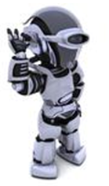
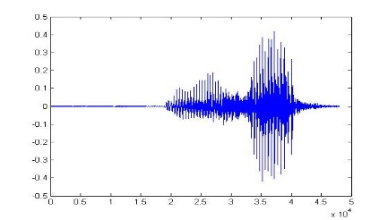
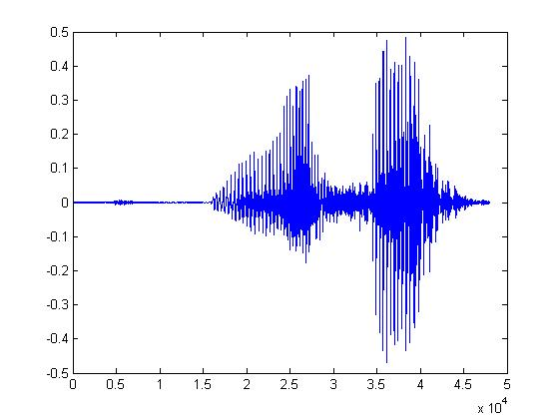
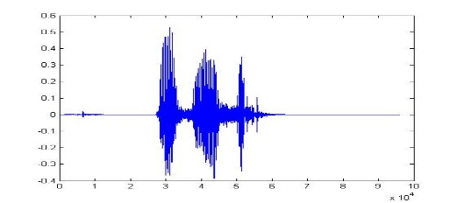
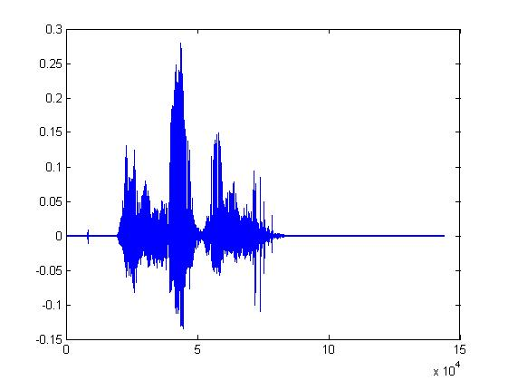
Machine Learning
Learning ......
“Hi”
“How are you”
You said “Hello”
“Good bye”
You write the program for learning.
A large amount of audio data

Slide 7
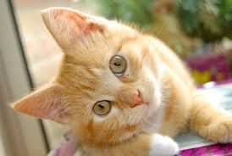
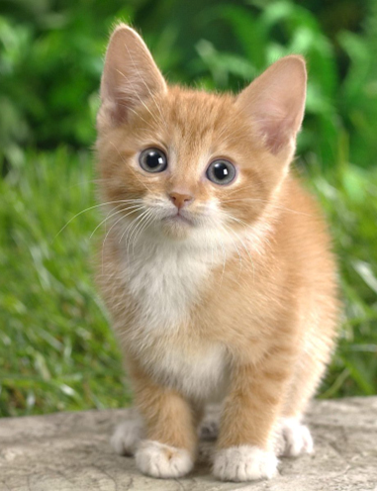
Machine Learning
Learning ......
“monkey”
“cat”
This is “cat”
“dog”
You write the program for learning.
A large amount of images

Slide 8
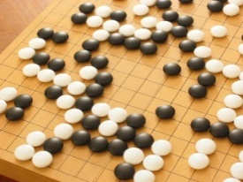
Machine Learning ≈ Looking for a Function
Speech Recognition
Image Recognition
Playing Go
Dialogue System
“How are you”
“Cat”
“5-5”
(next move)
“Hi”
“Hello”
(what the user said)
(system response)

Slide 9
Framework
Image Recognition:
“cat”
A set of function
Model
“cat”
“money”
“dot”
“snake”
Notes:
Repeat again

Slide 10
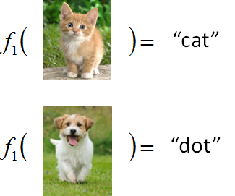
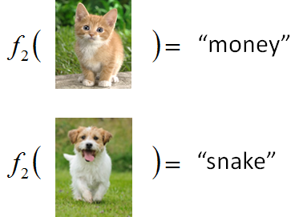
Framework
Image Recognition:
“cat”
A set of function
Model
Better!
Goodness of function f
Supervised Learning
Training
Data
function input:
function output:
“monkey”
“cat”
“dog”
Notes:
Repeat again

Slide 11
Framework
Image Recognition:
“cat”
Neural Network
Testing
A set of function
Model
Training
“cat”
Step 1
Goodness of function f
Pick the “Best” Function
Using
Step 2
Step 3
Training
Data
“monkey”
“cat”
“dog”
Notes:
Repeat again

Slide 12
Neural Network
neuron
Input
Layer 1
Layer 2
Layer L
Output
……
y₁
……
y₂
……
……
……
……
……
……
y_{M}
Input Layer
Output Layer
Hidden Layers
Deep means many hidden layers
Notes:
You can connect the neurons by other ways you like ☺
How many layer is deep?
CNN just another way to connect the neuros.
You can always connect the neurons in your own way.
“+” is ignored
Each dimension corresponds to a digit (10 dimension is needed)

Slide 13
作業說明

Slide 14
作業一
作業說明(Lecture 1~5)
Task 1
“5”
“0”
“4”
“1”
basic：higher than a specific accuracy (98.0%)
option：analyze the output of each layer

Slide 15
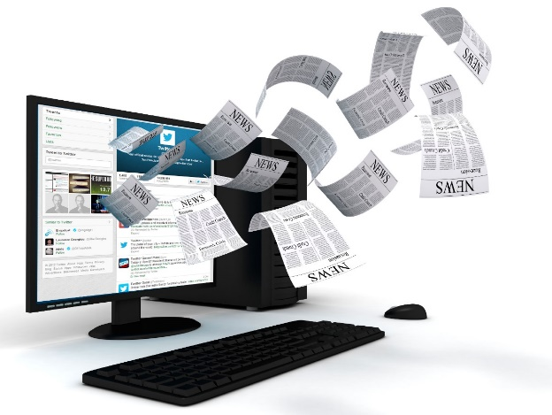
作業一
Task 2
Network
政治
體育
政治
財經
http://top-breaking-news.com/
basic：higher than a specific accuracy (78.0%)
option：analyze the output of each layer

Slide 16
作業一
More reference:
Example code of task 1: https://github.com/fchollet/keras/blob/master/examples/mnist_mlp.py
Example code of task 2: https://github.com/fchollet/keras/blob/master/examples/reuters_mlp.py
Neural Networks and Deep Learning
http://neuralnetworksanddeeplearning.com/
Chapter 1 - 3

Slide 17
作業二
作業說明(Lecture 6)
Image Recognition
“monkey”
“monkey”
Network
“cat”
“cat”
“dog”
“dog”

Slide 18
作業二
Basic：higher than a specific accuracy (81.0%)
option：analyze the functionality of “filter”
More Reference:
Example code: https://github.com/fchollet/keras/blob/master/examples/cifar10_cnn.py
http://cs231n.github.io/convolutional-networks/
Neural Networks and Deep Learning (Chapter 6)

Slide 19
作業三
作業說明、Corpus(Lecture 7, 9)
Machine learns human language
Machine writes documents
The life is …….
You do not have to teach machine grammars …….
Basic: Let machine generate an English sentence
Option: Let machine generate a Chinese sentence

Slide 20
作業三
Machine learns human language
More reference
Example code: https://github.com/fchollet/keras/blob/master/examples/lstm_text_generation.py
http://karpathy.github.io/2015/05/21/rnn-effectiveness/
http://colah.github.io/posts/2015-08-Understanding-LSTMs/

Slide 21
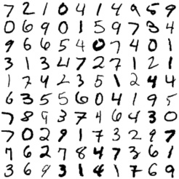
作業四
作業說明(Lecture 8)
Auto-encoder: unsupervised learning
NN
Encoder
code
Basic: visualize the “code”. Does different digits represent by different “code”?
NN
Decoder
code
Option: Given a “code”, can machine write a digit?

Slide 22
作業四
Auto-encoder: unsupervised learning
More reference:
https://blog.keras.io/building-autoencoders-in-keras.html
Advanced:
Auto-Encoding Variational Bayes, https://arxiv.org/abs/1312.6114
Generative Adversarial Networks, http://arxiv.org/abs/1406.2661
Replacing “digits” with “images”

Slide 23
作業五 Anime Face Generation
作業說明(何之源的知乎): https://zhuanlan.zhihu.com/p/24767059
DCGAN: https://github.com/carpedm20/DCGAN-tensorflow
Notes:
復旦大學

Slide 24
The evolution of generation
NN
Generator
v1
NN
Generator
v2
NN
Generator
v3
Discri-minator
v1
Discri-minator
v2
Discri-minator
v3
Real images:
Using a discriminator to help training the generator
Notes:
Binary
Classifier

Slide 25
Basic Idea of GAN
Normal Distribution
NN
Generator
v1
0
0
0
0
Step 1
1
1
1
1
image
Discri-minator
v1
Optimizing the Discriminator by minimizing the loss of discriminator.
1/0

Slide 26
Basic Idea of GAN
Normal Distribution
NN
Generator
v1
Next step:
Updating the generator by minimizing the JS divergence between the two images but fixing the discriminator.
v2
The output be classified as “real” (as close to 1 as possible)
Discri-minator
v1
Generator + Discriminator = a network
1.0
0.13

Slide 27
Anime Face Generation
100 updates

Slide 28
Anime Face Generation
1000 updates

Slide 29
Anime Face Generation
2000 updates

Slide 30
Anime Face Generation
5000 updates

Slide 31
Anime Face Generation
10,000 updates

Slide 32
Anime Face Generation
20,000 updates

Slide 33
Anime Face Generation
50,000 updates

Slide 34
Have Fun! ☺

