Slide 1
專題研究 WEEK2
Prof. Lin-shan Lee
TA. Tao Tu

Slide 2
Outline
1. Recap
2. Apply HMM to Acoustic Modeling
3. Acoustic Training
4. Homework

Slide 3
Recap

Slide 4
語音辨識系統
Last time
Feature
Vectors
Input Speech
Output
Sentence
Front-end
Signal Processing
Linguistic Decoding
and
Search Algorithm
Speech
Corpora
Acoustic
Model
Training
Acoustic
Models
Language
Model
Language
Model
Construction
Text
Corpora
Lexicon
Lexical
Knowledge-base
Grammar
Today

Slide 5
Feature Extraction
Feature Extraction

Slide 6
How to do recognition?
How to map speech O to a word sequence W ?
P(O|W): acoustic model
P(W): language model
Notes:
如何做recognition? 上面這邊老師上課有講過，要提醒一下的是下面的這兩個式子的意義
P(W) 算word機率多少的model就叫language model
把observation跟W一起看然後算機率的model就是叫acoustic model

Slide 7
Apply HMM to Acoustic Modeling

Slide 8
Hidden Markov Model
Simplified HMM
RGBGGBBGRRR……
Notes:
同個音每個人念都不一樣，甚至同個人念都會有差異，因此用hidden來模擬
given一串observation，且不知每個observation各別是從哪個籃子抽出，我們需要根據observation seq. 來推測籃子的seq.

Slide 9
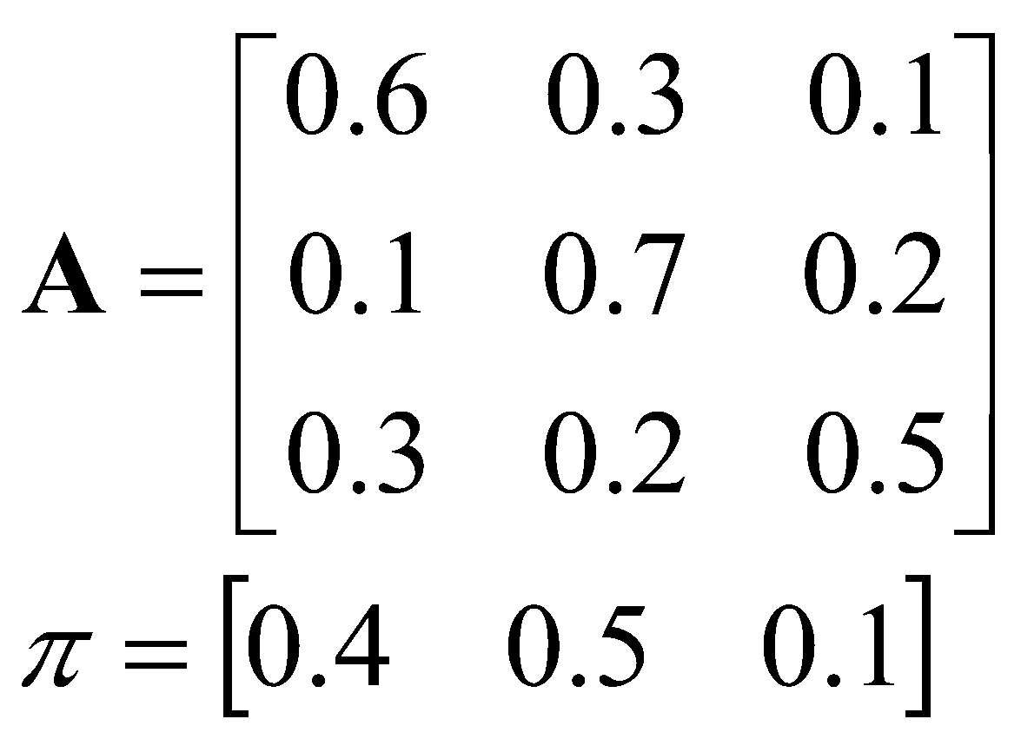
Hidden Markov Model
Elements of an HMM {S,A,B,π}
S is a set of N states
A is the N✕N matrix of state transition probabilities
B is a set of N probability functions, each describing the observation probability with respect to a state
π is the vector of initial state probabilities
0.6
s₁
{R:.3,G:.2,B:.5}
0.3
0.3
0.3
0.1
s₂
0.2
s₃
0.7
0.2
0.5
{R:.7,G:.1,B:.2}
{R:.3,G:.6,B:.1}
Notes:
B就是籃子內球的分布的情況

Slide 10
Gaussian Mixture Model (GMM)
Observation may be continuous. (e.g., mfcc)
Use GMM to model continuous prob. density function.
Notes:
a probabilistic model that assumes all the data points are generated from a mixture of a finite number of Gaussian distributions with unknown parameters.

Slide 11
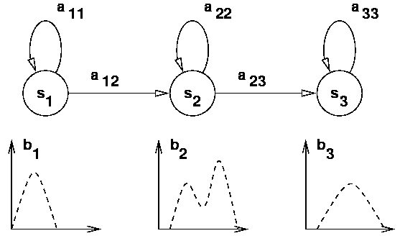
Acoustic Model – P(O|λ)
Model of a phone (λ)
Markov Model
(2.1, 4.1-4.5)
Gaussian Mixture Model (2.2)
Notes:
對於一個phone，比如說ㄋ這音，中間可能就會經過三個state，每個state我們都會用GMM去描述他

Slide 12
Acoustic Model – P(O|λ)
Forward algorithm (4.0 - basic problem 1)
α_{t}(i) = P(o₁o₂……o_{t} , q_{t} = i|λ)
= P(observing o₁o₂…o_{t} , state i at time t|λ)
α₁(i) = π_{i}b_{i}(o₁) , 1 ≤ i ≤ N
α_{t+1}(j) = [ $\sum_{i=1}^{N}{α_{t}\left(i\right)}$ a_{ij} ] b_{j}(o_{t+1})
P(O| λ) = $\sum_{i=1}^{N}{α_{T}(i)}$
Notes:
為了簡化，我們這邊先假設W都是一個single phoneme.

Slide 13
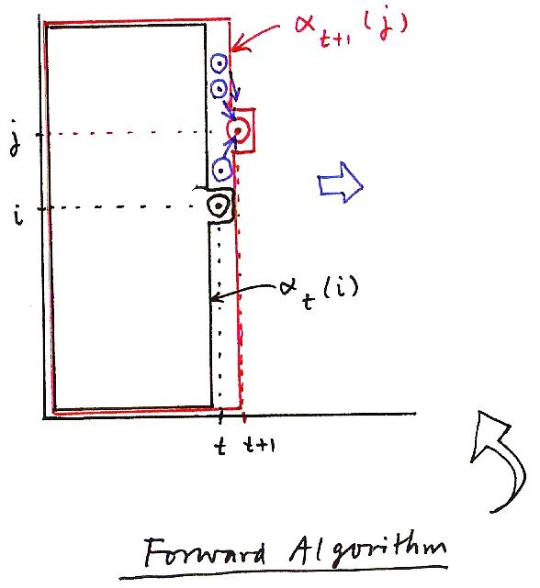
Acoustic Model – P(O|λ)
α_{t+1}(j)
j
α_{t+1}( j) = [ ∑ α_{t}(i) a_{ij} ] b_{j}(o_{t+1})
1 ≤ j ≤ N
1 ≤ t ≤ T−1
i
α_{t}(i)
t
t+1
Forward Algorithm
Notes:
Dynamic programming

Slide 14
Acoustic Model – State Seq.
Viterbi algorithm (4.0 - basic problem 2)
Goal: find the optimal state sequences $q=q_{1}q_{2}…q_{T}$
P(O|λ) can also be computed based on $q$.
Notes:
Viterbi 也可以算，參考老師的上課影片~
簡述: 前個states所有機率和 改成 只挑 max

Slide 15
Acoustic Model – Training
Baum-Welch algorithm (4.0 - basic problem 3)
Goal: Adjust parameters ($π,A,B$) to maximize P(O| λ)
Notes:
參考老師的上課影片~

Slide 16
Acoustic Model – Training
State
s₃
s₃
s₃
s₃
s₃
s₃
s₃
s₃
s₃
s₃
s₂
s₂
s₂
s₂
s₂
s₂
s₂
s₂
s₂
s₂
s₁
s₁
s₁
s₁
s₁
s₁
s₁
s₁
s₁
s₁
1 2 3 4 5 6 7 8 9 10
O₁
O₂
O₃
O₄
O₅
O₆
O₇
O₈
O₉
O₁₀
b₁(v₁)=3/4, b₁(v₂)=1/4
b₂(v₁)=1/3, b₂(v₂)=2/3
b₃(v₁)=2/3, b₃(v₂)=1/3
v₁
v₂
Notes:
假設我們求出一個state sequence後，我們要重新modify我們的參數 v1, v2 is the content of the observation, i.e., there are only two kinds of observations. state sequence is given, we need to calculate bi(v). state1 has four observations, 3 v1 and 1 v2.

Slide 17
Acoustic Model – Training
Initialization
Bad initialization leads to local minimum with higher probability.
Model
Initialization:
Segmental K-means
Model
Re-estimation:
Baum-Welch
Notes:
參考老師的上課影片~

Slide 18
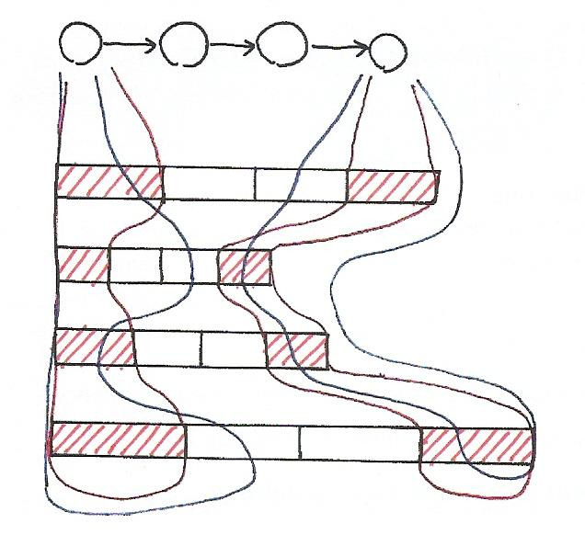
Segmental K-means
假設今天有四個人發出”ㄅ“這個音
Notes:
第一次大家平均切，紅色部分
之後就開始重新切，黑色曲線
A, pi 一開始都用最直覺方式假設 a_ij = 0.5, pi_1 = 1, pi_k = 0

Slide 19
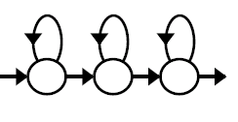
Acoustic Model – P(O|W)
How to compute P(O|W) ?
ㄐ
一ㄣ
ㄊ
一ㄢ
Notes:
講了這麼多，到底怎麼算P(O|W)

Slide 20
Monophone vs. triphone
Monophone
Consider only one phone information per model
Triphone
Consider both left and right neighboring phones
(60)³→ 216,000
Notes:
前後不一樣就是不一樣

Slide 21
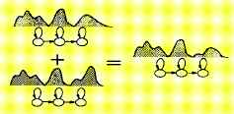
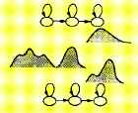
Triphone
a phone model taking into consideration both left and right neighboring phones (60)³→ 216,000
Sharing at Model Level
Sharing at State Level
Generalized Triphone
Shared Distribution Model (SDM)
Notes:
我們可以把兩個data 量很少的tri-phone完全綁在一起，當然也可以有彈性的只對其中某幾個phone做binding
~h p1 <state1> ~s p1p2_1 <State2> ~s p1p2_2 <state3> p1_own_state
~h p2 <state1> ~s p1p2_1 <State2> ~s p1p2_2 <state3> p2_own_state
what happened if we turn on the three free states?
too free, hard to find common feature(the binded states)
might be misleaded by other minor noise

Slide 22
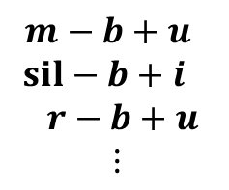
Training Tri-phone Models with Decision Trees
An Example: “( _ ‒ ) b ( +_ )”
12
yes
no
30
sil-b+u
a-b+u
o-b+u
y-b+u
Y-b+u
32
46
42
U-b+u
u-b+u
24
i-b+u
Example Questions:
12: Is left context a vowel?
24: Is left context a back-vowel?
30: Is left context a low-vowel?
32: Is left context a rounded-vowel?
e-b+u
r-b+u
50
N-b+u
M-b+u
E-b+u
Notes:
我們用decision tree來決定哪些phone該合併

Slide 23
Acoustic Model Training
03.mono.train.sh
05.tree.build.sh
06.tri.train.sh

Slide 24
Training steps
Get features(previous section)
Train monophone model
Use previous model to build decision tree (for triphone).
Train triphone model
Notes:
其實不是go to step c, 是做了一次EM後，iteration裡是做gmm-align-compiled
EM In HMM, the E-step is to estimate gamma and episilon
The M-Step is use gamma and episilon to re-estimate pi, aij, bj

Slide 25
Training steps
Get features (last time)
Train monophone model
a. gmm-init-mono Initialize monophone model
b. compile-train-graphs Get train graph
c. align-equal-compiled model -> decode & align
(gmm-align-compiled instead when looping)
d. gmm-acc-stats-ali EM training: E step
e. gmm-est EM training: M step
f. numgauss = numgauss + incgauss
g. Goto step c. Train several times
Use previous model to build decision tree(for triphone).
Train triphone model
Notes:
EM In HMM, the E-step is to estimate gamma and episilon
The M-Step is use gamma and episilon to re-estimate pi, aij, bj

Slide 26
Training steps
Get features (last time)
Train monophone model
Use previous model to build decision tree(for triphone).
Train triphone model
a. gmm-init-model Initialize GMM ( from decision tree)
b. gmm-mixup Gaussian merging (increase #gaussian)
c. convert-ali Convert alignments(model <-> decisoin tree)
d. compile-train-graphs get train graph
e. gmm-align-compiled model -> decode&align
f. gmm-acc-stats-ali EM training: E step
g. gmm-est EM training: M step
h. numgauss = numgauss + incgauss
i. Goto step e. train several times
Notes:
EM In HMM, the E-step is to estimate gamma and episilon
The M-Step is use gamma and episilon to re-estimate pi, aij, bj

Slide 27
How to get Kaldi usage?
source setup.sh
align-equal-compiled --help

Slide 28
align-equal-compiled
Write an equally spaced alignment (for getting training started)
Usage: align-equal-compiled <graphs-rspecifier> <features-rspecifier> <alignments-wspecifier>
e.g.:
align-equal-compiled 1.mdl 1.fsts scp:train.scp ark:equal.ali
gmm-align-compiled $scale_opts --beam=$beam --retry-beam=$[$beam*4] <hmm-model*> ark:$dir/train.graph ark,s,cs:$feat ark:<alignment*>
For first iteration(in monophone) beamwidth = 6, others = 10;
Only realign at
$realign_iters="1 2 3 4 5 6 7 8 9 10 12 14 16 18 20 23 26 29 32 35 38”
$realign_iters=“10 20 30”
Notes:
在mono train realign多次一點，在其他像是tri training就可以少一點

Slide 29
gmm-acc-stats-ali
Accumulate stats for GMM training.(E step)
Usage: gmm-acc-stats-ali [options] <model-in> <feature-rspecifier> <alignments-rspecifier> <stats-out>
e.g.:
gmm-acc-stats-ali 1.mdl scp:train.scp ark:1.ali 1.acc
gmm-acc-stats-ali --binary=false <hmm-model*> ark,s,cs:$feat ark,s,cs:<alignment*> <stats>

Slide 30
gmm-est
Do Maximum Likelihood re-estimation of GMM-based acoustic model
Usage: gmm-est [options] <model-in> <stats-in> <model-out>
e.g.: gmm-est 1.mdl 1.acc 2.mdl
gmm-est --binary=false --write-occs=<*.occs> --mix-up=$numgauss <hmm-model-in> <stats> <hmm-model-out>
--write-occs : File to write pdf occupation counts to.
$numgauss increases every time.
Notes:
pdf occupation counts: basic problem3 裡面的gamma episilon算那些個數的東西出現的個數

Slide 31
Homework
03.mono.train.sh
05.tree.build.sh
06.tri.train.sh

Slide 32
TODO
Step1. Execute the following commands.
script/03.mono.train.sh | tee log/03.mono.train.log
script/05.tree.build.sh | tee log/05.tree.build.log
script/06.tri.train.sh | tee log/06.tri.train.log
Step2. finish code in TODO
script/03.mono.train.sh
script/06.tri.train.sh
Step3. Observe the output and results.
Step4. (opt.) tune #gaussian and #iteration.

Slide 33
Hint (extremely important!!)
03.mono.train.sh
Use the variables already defined.
Use these formula:
Pipe for error
compute-mfcc-feats … 2> $log

Slide 34
Questions?
Email:
杜濤: r07922022@ntu.edu.tw

