Slide 1
專題研究 WEEK 5 – Deep Neural Networks in Kaldi
Prof. Lin-shan Lee
TA. Chien-Yu Huang (R08921062@ntu.edu.tw)

Slide 2
Outline
Neural Network
Homework – DNN Training
Contact TAs

Slide 3
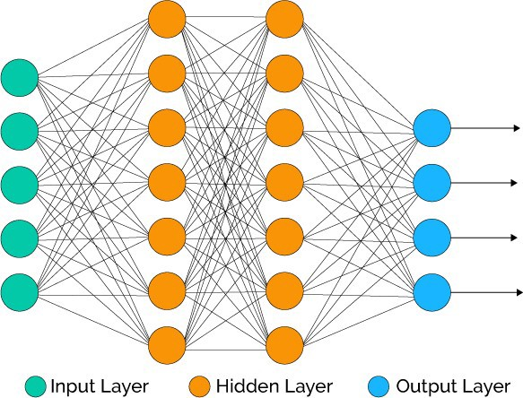
Neural Network
Linear operation
Multiplication
Addition
Convolution
Activation function
Sigmoid
ReLU
Tanh
Complex functions can be achieved by combination of lots of simple non-linearity functions.
Notes:
Neural network 由兩個部分組成：linear跟non-linear
Linear就是大家熟知簡單的矩陣運算、convolution等等
可是如果只有線性運算的話，這些好幾層的layer都可以合併成一個單一layer，而且能實現的function有限。
所以我們需要在每一個layer後面來一點non-linear function (activation)
如果暑假有乖乖看宏毅老師的影片 應該就會知道這些activation function
雖然這些function看起來好像廢廢的沒什麼功用，比方說ReLU，就只是把小於0的地方壓掉
但其實每一層一點一點改變數值的distribution，很多層疊起來就能夠實現很複雜的function。

Slide 4
Neural Network Training
Evaluate the performance by loss function.
Regression: Mean Square Error
Classification: Cross Entropy
Compute the gradient by back propagation.
$\frac{∂z}{∂w_{1}}=\frac{∂z}{∂w_{n}}\frac{∂w_{n}}{∂w_{n−1}}\frac{∂w_{n−1}}{∂w_{n−2}} …\frac{∂w_{2}}{∂w_{1}}$
Gradients are then used to update the parameters → gradient descent
Notes:
那要怎麼訓練一個network呢
首先要先定義一個network表現的好壞 也就是loss function
如果是regression的problem通常是用MSE classification的problem就是用cross entropy來衡量。
有了loss function，就可以計算network中每個參數對這個loss的contribution / gradient
但參數這麼多，所以我們在這邊要使用微積分中chain rule的技巧 一層一層往回算loss的gradient 這個就叫做 back propagation
最後，我們就可以用這些gradient來更新network，這個方法就叫做gradient descent。

Slide 5
Neural Network Training
Gradient descent
$w_{t+1}=w_{t}−η\frac{∂L}{∂w_{t}}$
$η$: learning rate
Learning rate should be chosen carefully.
Optimizer, Warm-up, …
Loss
Steps
Notes:
上面這個式子是最基本的gradient descent的公式，每次update的時候，讓每個參數沿著各自的gradient的反方向移動
方向由gradient決定了，但是step的大小還要由learning rate一起決定。
Learning rate是很重要的一個參數，不同大小的選擇可能會有完全不同的結果。

Slide 6
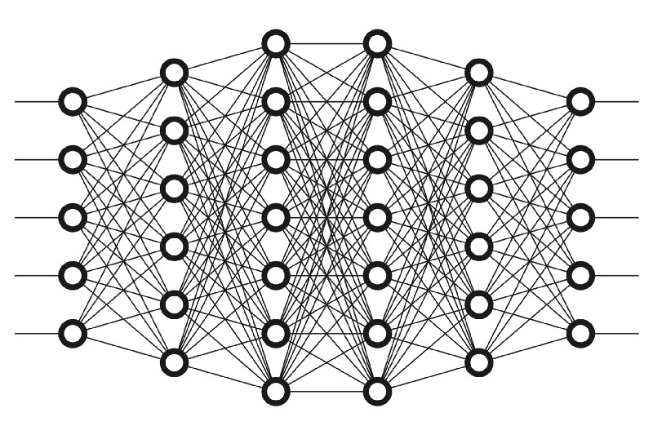
DNN in Acoustic Modeling
DNN as triphone state classifier
Input: acoustic feature (e.g. MFCC frames)
Output: probability of each state
Hybrid system
DNN is only for computing posterior of states
State transitions remain unchanged
…
…
Notes:
DNN在語音辨識上的應用，現在最成功的就是hybrid system，也就是將本來的GMM部分，全部用DNN來取代。
但這不代表我們就從此不需要GMM了，因為這些state sequence還是需要從原本的GMM來產生。
這部分老師在期中考後應該會有更詳細的說明，記得要去上課。

Slide 7
Homework
Scripts
08.mlp.train.sh
09.mlp.decode.sh
Reading
DSP CH9 – Speech Recognition Updates

Slide 8
Download Files
Login to workstation
ssh 140.112.21.80 (port 22)
Copy the file into your own directory
cp /share/week5.tar.gz
Process files with the following command
tar –zxvf week5.tar.gz
cp setup.sh /proj1.ASTMIC.subset
cp 08.mlp.train.sh /proj1.ASTMIC.subset/script
cp 09.mlp.train.sh /proj1.ASTMIC.subset/script

Slide 9
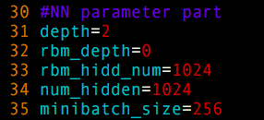
TODO (1/3)
Step 1: Execute the following command (baseline):
bash setup.sh
script/08.mlp.train.sh
script/09.mlp.decode.sh
Step 2.1: Tune the NN model parameter in script/08.mlp.train.sh
depth
num_hidden
minibatch_size

Slide 10
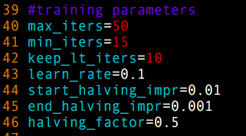
TODO (2/3)
Step 2.2: Modify the training parameters in script/08.mlp.train.sh
learning rate
Step 2.3: Tune the feature context parameter
context
Notes:
Number of frame of context

Slide 11
TODO (3/3)
Step 3: Adjust acoustic weights in 09.mlp.decode.sh
acoustic weight
Repeat Step 2 and Step 3 with different hyperparameters to obtain the best accuracy.
According to your results, what did you observe?
How do hyperparameters effect the result?

Slide 12
Contact TAs
Should you have any question or need help,
Refer to Kaldi documentation.
Post your question on FB group.
Send email to r08921062@ntu.edu.tw.
Don’t forget to use [專題研究] as the subject line prefix if you send the email to TA.

