Slide 1
專題研究 WEEK 4 - LIVE DEMO
Prof. Lin-shan Lee
TA. Chien-Cheng Chen (r09942097@ntu.edu.tw)

Slide 2
Outline
Review
Live Demo introduction
Restriction
TODO (Notice!)
To think
FAQ

Slide 3
Review: achieving ASR system
Automatic Speech Recognition System
Input wave -> output text

Slide 4
Review
Week 1: feature extraction
compute-mfcc-feat
add-delta
compute-cmvn-stats
apply-cmvn
File format: scp,ark

Slide 5
Review
Week 2: training acoustic model
monophone
clustering tree
triphone
Models: final.mdl, tree

Slide 6
Review
Week 3: decoding and training lm
SRILM( ngram-count/ kn-smoothing )
Kaldi – WFST decoding
HTK – Viterbi decoding
Vulcan( kaldi format -> HTK format )
Models: final.mmf tiedlist

Slide 7
Live Demo
Now we integrated them into a real-world ASR system for you.
You could upload your own models.
Now give a shot! Experience your own ASR in a “real” way.

Slide 8
Live Demo
https://140.112.21.35:54285/
Demo
Remember: use https.
Ignore the warnings.

Slide 9
Restriction
MFCC with dim 39 only.
Fixed phone set. (Chinese phones)
LM must be one of unigram/bigram/trigram model.

Slide 10
To Do
Sign up Live Demo with your account.
Please email TA of your account name for activation.
r09942097@ntu.edu.tw
Test with basic model embedded in the system.
Upload your model
LM/LEX/TREE/MDL
For better performance, you may re-train your models.
Test with your own models.

Slide 11
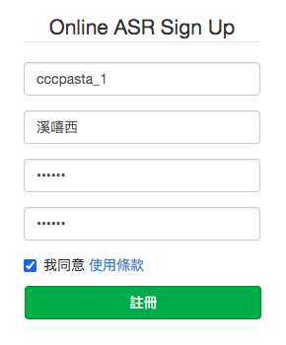
Notice!
Sign up Live Demo with your account.
Due to some server problems not solved yet, each group is assigned 10 “accounts” with name “<original_acc>_X”. For example, if you email TA for account name “ilovedsp”, 10 accounts “ilovedsp_0”, “ilovedsp_1”, …, “ilovedsp_9” are given to you.

Slide 12
Updated
關於帳號註冊
1. 這個 server 為了避免有人一直瘋狂註冊，因此有一個白名單。要使用 server 必須先註冊，而要能夠註冊要先把想使用的帳號名字加入白名單，因此才希望各位先把想開的帳號名字寄給我，我加入之後 <account>_0 ~ <account>_9 才可以被註冊，但是密碼仍然要註冊時才會設定。 2. 這個帳號可以跟 .80 專題工作站帳號名稱相同也可以不相同。

Slide 13
Notice!
The server restarts every hour. (8:00, 9:00, …)
If you want to re-upload your 4 models to rerun HTK decoding algorithm within an hour, use another account of the 10 assigned. (Feel free to re-upload directly to the same account if an hour passed.)
Re-login after models uploaded.
Even if automatically logged in, re-login PLEASE!
If your microphone doesn’t work well, re-login!
Online server reference: https://drive.google.com/drive/u/1/folders/1am2lBOENJzLL4y-dVd9FXUHQ-lIKcvdq

Slide 14
To Think
Compare the basic models with your own models, what is the main difference?
Do you know of what kind your training data are?
train.text/dev.text/test.text
How about manually tagging your own lexicon and train your own language model?
Guess about the training data of the basic models.
Exemplify your description.

Slide 15
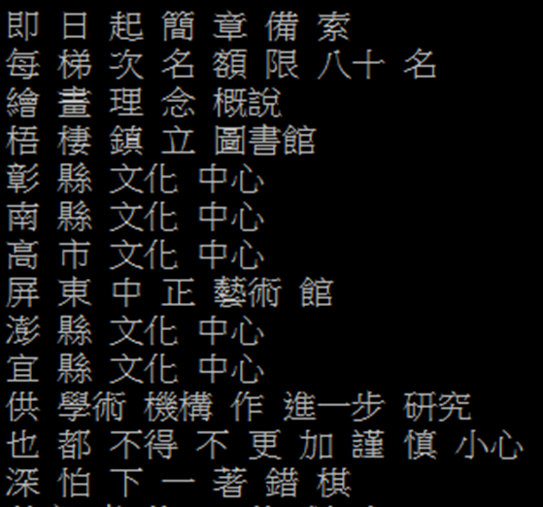
Language Model : Training Text (2/2)
cut -d ' ' -f 1 --complement $train_text > ./exp/lm/LM_train.text

Slide 16
Language Model : ngram-count (3/3)
Lexicon
lexicon=material/lexicon.train.txt

Slide 17
FAQ
Q: How to download the models in the workstation?
A:
FileZilla
MobaXterm
“sftp” or “scp” command in your linux OS.

Slide 20
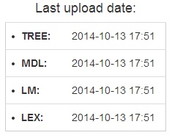
FAQ
Q: Why I always got server error?
A: Make sure you got models uploaded. Is the timestamp field empty?
TREE: exp/tri/tree
MDL: exp/tri/final.mdl
LM: exp/lm/lm.arpa.txt
Lexicon:material/lexicon.decode.txt
(or material/lexicon.train.txt)
Warning: If using material/lexicon.train.txt, remember to add the following two lines to the top of the file.
<s> sil
</s> sil

Slide 21
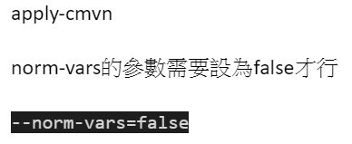
FAQ
When server decodes only whitespaces
In 02.extract.sh
Default is false, make sure it is not explicitly set to true

Slide 22
FAQ
When corpus mode goes weird
Make sure your corpus is written under UTF-8 encoding.
In notepad, the default is ANSI.
In vim, the default is UTF-8.
The last line of the corpus should not contain line ending

Slide 23
FAQ
When corpus mode goes weird
Accuracy is calculated by (Length – Error ) / Length.
Error = Insert + Delete + Substitute
The acc returned by the server not only depends on current sentence. It is an average of all sentences’ acc in the corpus.
Sentences without recordings have EMPTY TRANSCRIPTION
Sentences without recordings count 0% acc
Sentences without recordings count 0% acc
Sentences without recordings count 0% acc
You can either upload a “single sentence corpus” to see the acc for a single sentence, or always record for all sentences in the corpus to get reasonable average acc

Slide 25
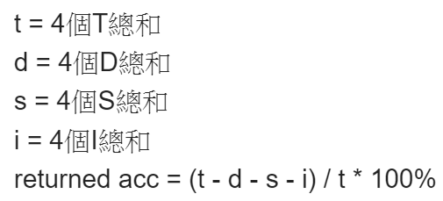
Average Acc Example
When corpus contains 4 lines with 4 recordings
Calculate 4 sets of T, I, D, S
When 100 lines with only 1 recording
Definitely very tragic acc

Slide 26
Model uploading details
IMPORTANT
IMPORTANT
IMPORTANT
https://docs.google.com/document/d/1_POewRpa16BmWYnidlOI9XaE-AnkUNxRgWzZzRZPlPI/edit?usp=sharing

Slide 27
Q&A
If you got any question, contact TA through FB group or email instantly.
Email: r09942097@ntu.edu.tw
Recording last year: https://drive.google.com/drive/folders/1am2lBOENJzLL4y-dVd9FXUHQ-lIKcvdq?usp=sharing

Slide 28
Acknowledgement
Thanks following students for reporting bugs / debugging for the server
李威緒
戴妤珊
林軒毅
Online server reference: https://drive.google.com/drive/u/1/folders/1am2lBOENJzLL4y-dVd9FXUHQ-lIKcvdq

