Slide 1
專題研究 WEEK 5 – Deep Neural Networks in Kaldi
Prof. Lin-Shan Lee
TA. Hsiang-Sheng Tsai (R09922024@ntu.edu.tw)

Slide 2
Outline
Neural Network
Homework – DNN Training
Contact TAs

Slide 3
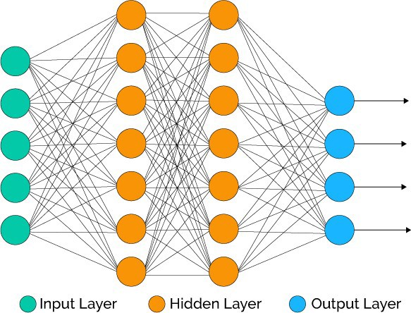
Neural Network
Linear operation
Multiplication
Addition
Convolution
Activation function
Sigmoid
ReLU
Tanh
Complex functions can be achieved by combination of lots of simple non-linearity functions.

Slide 4
Neural Network Training

Slide 5
Neural Network Training
Loss
Steps

Slide 6
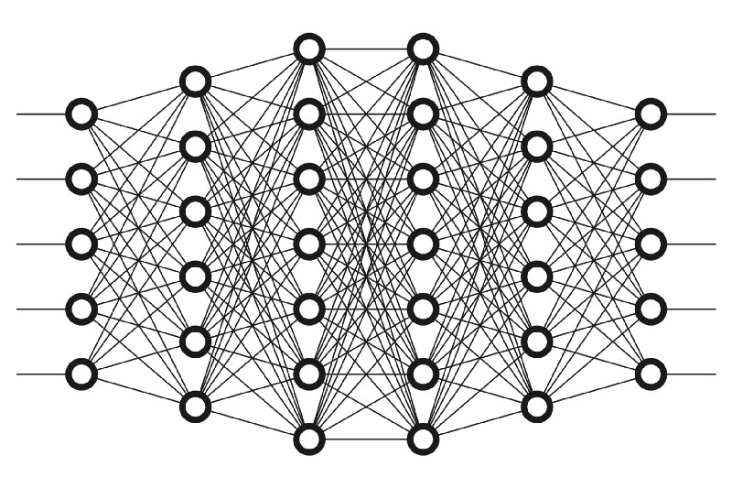
DNN in Acoustic Modeling
DNN as triphone state classifier
Input: acoustic feature (e.g. MFCC frames)
Output: probability of each state
Hybrid system
DNN is only for computing posterior of states
State transitions remain unchanged
…
…

Slide 7
GMM vs DNN
Using GMM:
Using DNN:
p(s=1) = 0.3
p(s=2) = 0.1
p(s=3) = 0.6
MFCC
DNN

Slide 8
Homework
Scripts
08.mlp.train.sh
09.mlp.decode.sh
Reading
DSP CH9 – Speech Recognition Updates

Slide 9
Download Files
Login to workstation
ssh 140.112.21.80 (port 22)
Copy the file into your own directory
cp /share/week5.tar.gz .
Process files with the following command
tar –zxvf week5.tar.gz
cp setup.sh /proj1.ASTMIC.subset
cp 08.mlp.train.sh /proj1.ASTMIC.subset/script
cp 09.mlp.decode.sh /proj1.ASTMIC.subset/script
cp align_dev.sh /proj1.ASTMIC.subset/script

Slide 10
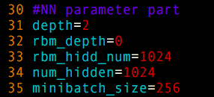
TODO (1/3)
Step 1: Execute the following command (baseline):
bash setup.sh
script/08.mlp.train.sh
script/09.mlp.decode.sh
Step 2.1: Tune the NN model parameter in script/08.mlp.train.sh
depth
num_hidden
minibatch_size

Slide 11
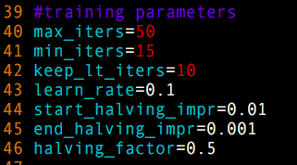
TODO (2/3)
Step 2.2: Modify the training parameters in script/08.mlp.train.sh
learning rate
Step 2.3: Tune the feature context parameter
context

Slide 12
TODO (3/3)
Step 3: Adjust acoustic weights in 09.mlp.decode.sh
acoustic weight
Repeat Step 2 and Step 3 with different hyperparameters to obtain the best accuracy.
According to your results, what did you observe?
How do hyperparameters effect the result?

Slide 13
Contact TAs
Should you have any question or need help,
Refer to Kaldi documentation.
Post your question on FB group.
Send email to r09922024@ntu.edu.tw .
Don’t forget to use [SpeechProject] as the subject line prefix if you send the email to TA.

