Slide 1
7.0 Sampling
7.1 The Sampling Theorem
A link between Continuous-time/Discrete-time Systems
x(t)
y(t)
Sampling
x[n]
y[n]
h(t)
h[n]
x[n]=x(nT), T : sampling period
h(t)
x(t)
x[n]
y[n]
y(t)
h[n]
Recovery

Slide 2
Motivation: handling continuous-time signals/systems
digitally using computing environment
accurate, programmable, flexible,
reproducible, powerful
compatible to digital networks and relevant
technologies
all signals look the same when digitized,
except at different rates, thus can be supported by a single network
Question: under what kind of conditions can a
continuous-time signal be uniquely specified by its discrete-time samples?
See Fig. 7.1, p.515 of text
Sampling Theorem

Slide 3
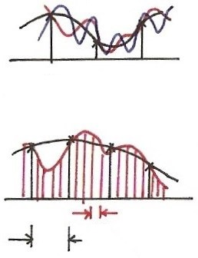
Recovery from Samples ?
$$n$$
0
1
2
$$t$$
$$T$$
$$T$$

Slide 4
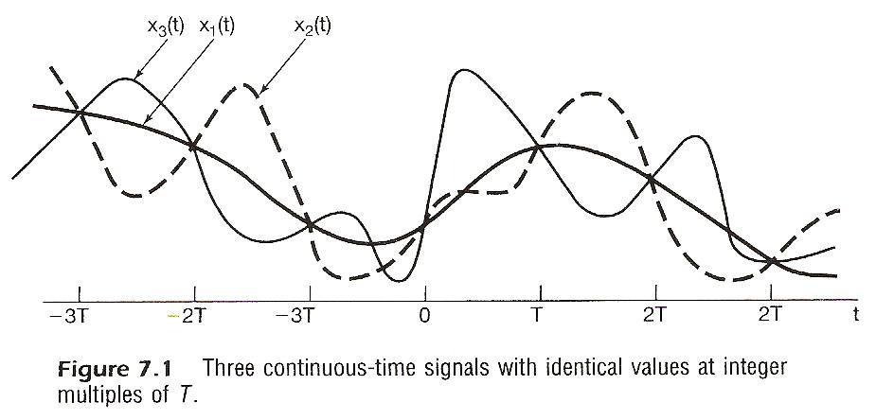

Slide 5
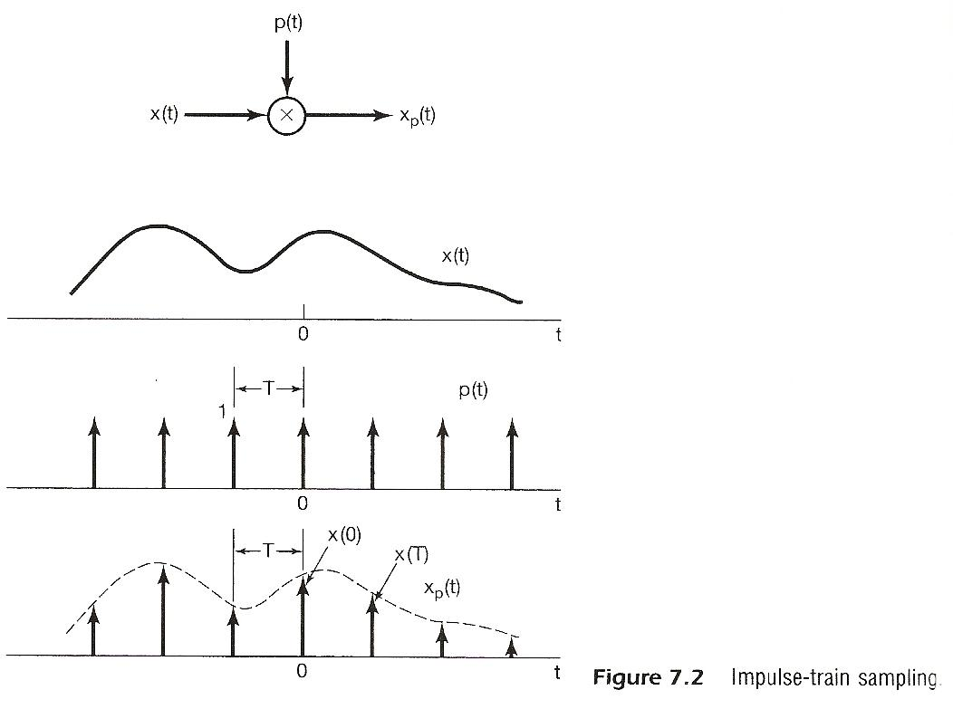

Slide 6
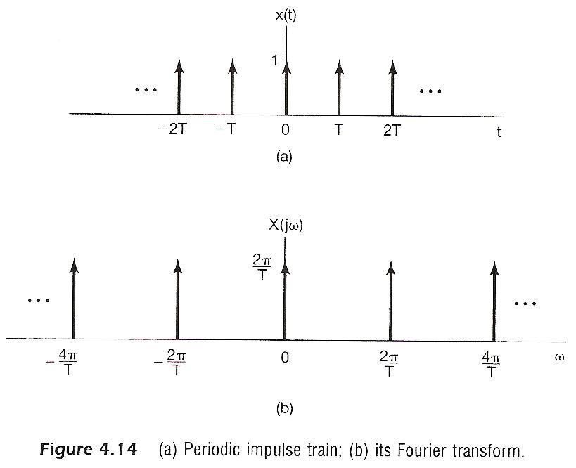

Slide 7
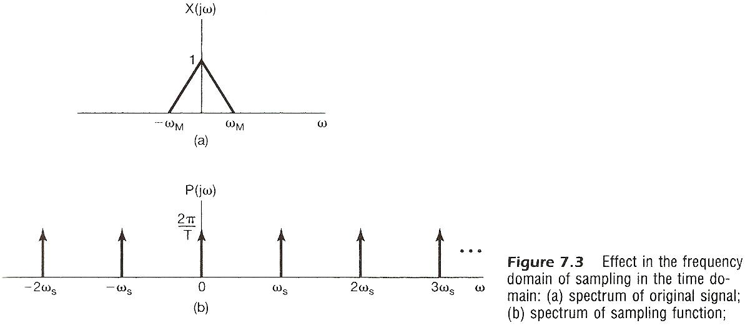

Slide 8
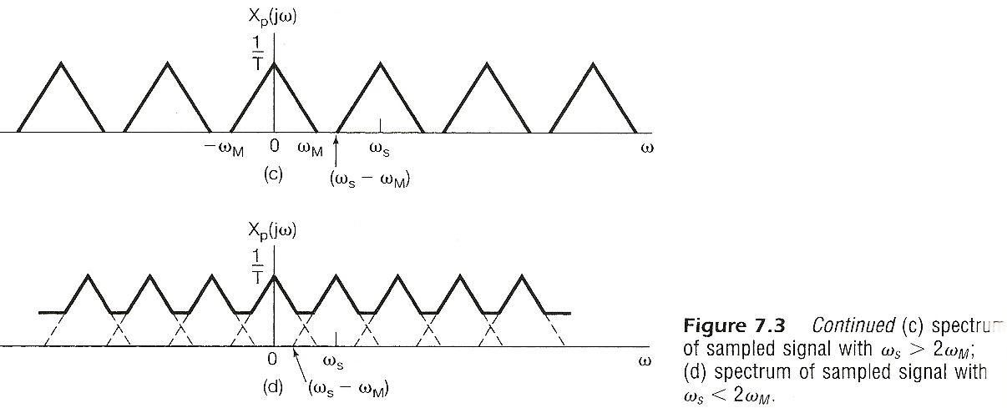

Slide 9
Impulse Train Sampling
See Fig. 4.14, p.300 of text
periodic spectrum, superposition of scaled, shifted replicas of X(jω)
See Fig. 7.3, p.517 of text

Slide 10
Impulse Train Sampling
Sampling Theorem (1/2)
x(t) uniquely specified by its samples x(nT), n=0, ±1, ±2……
precisely reconstructed by an ideal lowpass filter with Gain T and cutoff frequency ω_{M} < ω_{c} < ω_{s}- ω_{M}
applied on the impulse train of sample values
See Fig. 7.4, p.519 of text

Slide 11
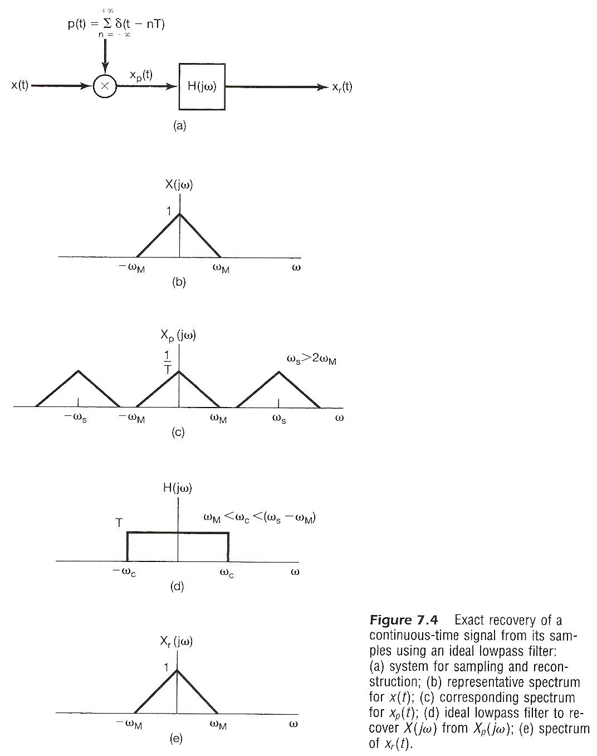

Slide 12
Impulse Train Sampling
Sampling Theorem (2/2)
if ω_{s} ≤ 2 ω_{M}
spectrum overlapped, frequency components confused --- aliasing effect
can’t be reconstructed by lowpass filtering
See Fig. 7.3, p.518 of text

Slide 13
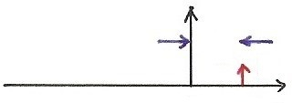
Aliasing Effect
$$x\left(t\right)=A\cos{ω_{0}}t$$
$y\left(t\right)=bcos({ω_{0}+ω_{s}})t$, $ω_{s}=\frac{2π}{T}$
$$x\left(nT\right)=A\cos{ω_{0}}nT$$
$$y\left(nT\right)=bcos({ω_{0}+k\frac{2π}{T}})nT$$
$=b\cos{ω_{0}}nT$
$$A$$
$$A$$
$$A$$
$$A$$
$$ω_{s}$$
$$b$$
$$b$$
$$b$$
$$b$$
$$ω_{0}$$
$$ω$$
$$ω$$
$$ω_{0}+ω_{s}$$
0 0 0
$$ω_{0}$$
$$ω_{s}=\frac{2π}{T}$$
After sampling with $ω_{s}=\frac{2π}{T}$ , any two frequency components $ω_{1}$, $ω_{2}$ become indistinguishable, or sharing identical samples, or should be considered as identical frequency components if $\left|ω_{1}−ω_{2}\right|=k\frac{2π}{T}$
$e^{j\left(ω_{0}+k\frac{2π}{T}\right)nT}=e^{jω_{0}nT}$ ($T=1$ for discrete-time signals )
$ω_{s}$

Slide 14
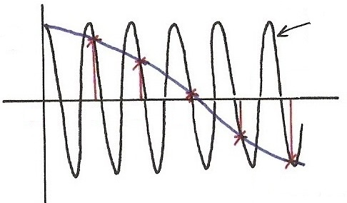
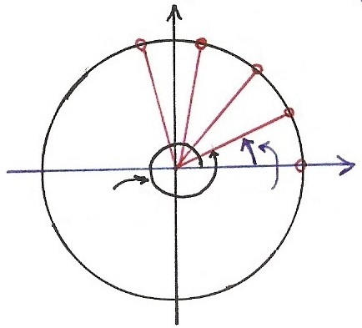
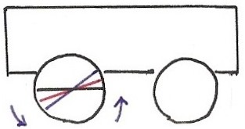
Continuous/Discrete Sinusoidals (p.36 of 1.0)
$$T$$
$$\cos{[\left(ω_{0}+2π \right) t }]$$
$$\cos{[⋅]}$$
$T=1$: discrete-time signals
any $T$: sampling
$$\overline{ T }$$
$∥$
$$nT$$
4
5
$$t,n$$
$$\left[\begin{aligned}\cos{ω_{0}t}≠\cos\left(ω_{0}+2π\right)t \\ \\ \cos{ω_{0}n}T=\cos\left(ω_{0}+2π\right)nT\end{aligned}\right.$$
0
1
2
3
$$\overline{ T }$$
$$nT$$
$$∥$$
$$\overline{ T }$$
$$\cos{[ω_{0} t ]}$$
$$\left[\begin{aligned} e^{jω_{0}t}≠e^{j{(ω}_{0}+ 2π)t} \\ \\ e^{jω_{0}nT}=e^{j{(ω}_{0}+ 2π ) nT}\end{aligned}\right.$$
$$Im$$
$$\overline{ T }$$
$$n=4$$
$$n=3$$
$$n=2$$
$$\overline{ T }$$
$$e^{j[⋅]}$$
$$n=1$$
$$Re$$
$$ω_{0}t$$
$$n=0$$
$${(ω}_{0}+2π)t$$
$$\overline{ T }$$

Slide 15
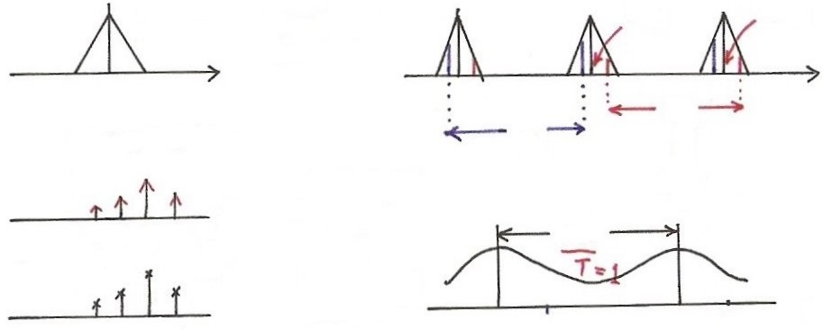
Sampling
sampling
$x\left(t\right)\underset{↔}{F}X(jω)$, $x_{p}(t)\underset{↔}{F}X_{p}(jω)$
$$X_{p}(jω)$$
$$X(jω)$$
$$2ω_{s}$$
$$ω_{s}$$
sampling
$$ω$$
$$ω$$
0
0
$$x\left(t\right)=\sum_{n}{x\left[n\right]}δ(t−n)$$
$$ω_{s}$$
$$ω_{s}$$
$$\frac{2π}{T}$$
$(=2π$, if $T=1)$
$F$(chap4)
$$t$$
0 1 2 3
$$2π$$
$$x[n]$$
$F$(chap5)
$$ω$$
$$n$$
$$ω_{0}$$
0 1 2 3
$$e^{jω_{0}n}$$
$$e^{j\left(ω_{0}+2π\right)n}$$
$$\overline{ T }=1$$

Slide 16
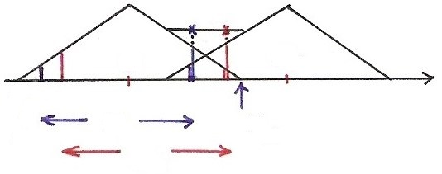
Aliasing Effect
$z\left(t\right)=x\left(t\right)+y\left(t\right)=A\cos{ω_{0}}t+$ $bcos({ω_{0}+ω_{s}})t$
$$z\left(nT\right)=x\left(nT\right)+y\left(nT\right)=(A+b)cosω_{0}nT$$
$$ω_{s}<2ω_{M}$$
Aliasing Effect
0
$$ω_{s}$$
$$ω$$
$${−ω}_{M}$$
$$ω_{s}$$
$$ω_{M}$$
$$ω_{s}$$

Slide 17
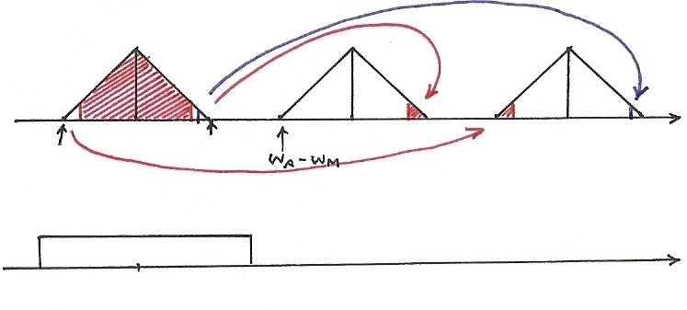
Sampling Thm
$$ω_{s}>2ω_{M}$$
$$ω$$
0
$$ω_{M}$$
$$ω_{s}$$
$${2ω}_{s}$$
$${−ω}_{M}$$
$$ω$$
$${−ω}_{c}$$
0
$$ω_{c}$$

Slide 18
Recovery from Samples ? (p.3 of 7.0)
$$n$$
0
1
2
$$t$$
$$T$$
$$T$$

Slide 19
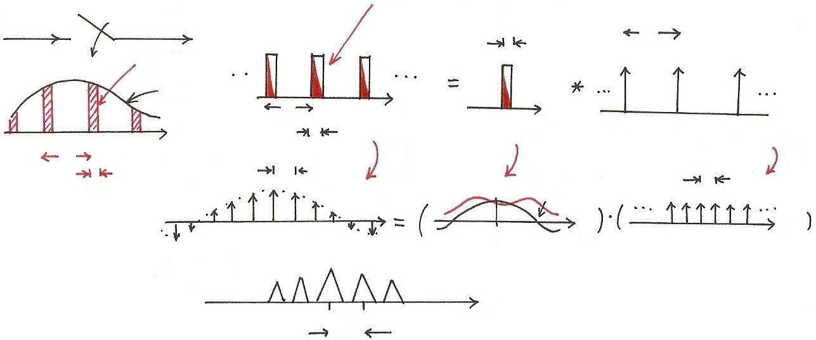
Practical Sampling
(any other pulse shape)
x(t)
$x_{p}$(t)
$$p(t)$$
$$τ$$
T
$x_{p}$(t)
1
x(t)
t
t
T
$$−T$$
0
t
t
$$T$$
$$τ$$
$$F$$
$$\frac{2π}{T}$$
T
$$F$$
$$F$$
$$\frac{2π}{T}$$
$$α\frac{1}{τ}$$
$$τ$$
$$P(jω)$$
$$ω$$
$$ω$$
$$ω$$
0
$$X_{p}(jω)$$
$$ω$$
0
$$\frac{2π}{T}$$

Slide 20
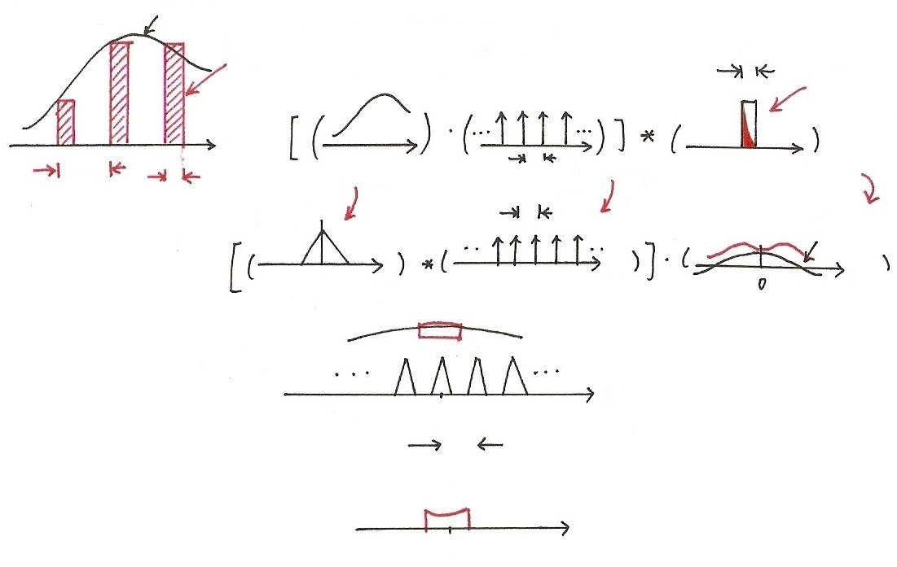
Practical Sampling
$$x(t)$$
$$x_{p}\left(t\right)=\sum_{n}{x}\left(nT\right)p(t−nT)$$
$$τ$$
(any other
pulse shape)
$$x(t)$$
$$t$$
$$T$$
$$t$$
$$T$$
$$t$$
$$t$$
$$F$$
$$τ$$
$$F$$
$$\frac{2π}{T}$$
$$F$$
$$X(jω)$$
$$α\frac{1}{τ}$$
$$ω$$
$$ω$$
$$ω$$
$$X_{p}(jω)$$
$$ω$$
0
$$\frac{2π}{T}$$
$$ω$$
0
$$ω_{c}$$

Slide 21
Impulse Train Sampling
Practical Issues
nonideal lowpass filters accurate enough for practical purposes determined by acceptable level of distortion
oversampling ω_{s} = 2 ω_{M} + ∆ ω 
sampled by pulse train with other pulse shapes
signals practically not bandlimited : pre-filtering

Slide 22
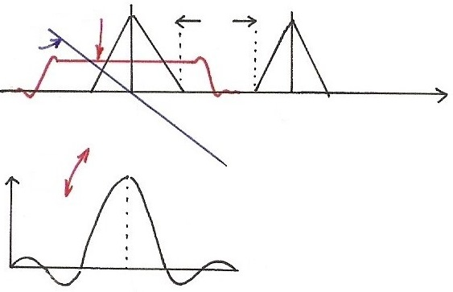
Oversampling with Non-ideal Lowpass Filters
$$\left|H(jω)\right|$$
$$∆ω$$
$$∡H(jω)$$
$$ω$$
$${−ω}_{M}$$
0
$$ω_{M}$$
$$ω_{s}$$
$$F$$
$$h(t)$$
$$t$$
0
$$t_{0}$$

Slide 23
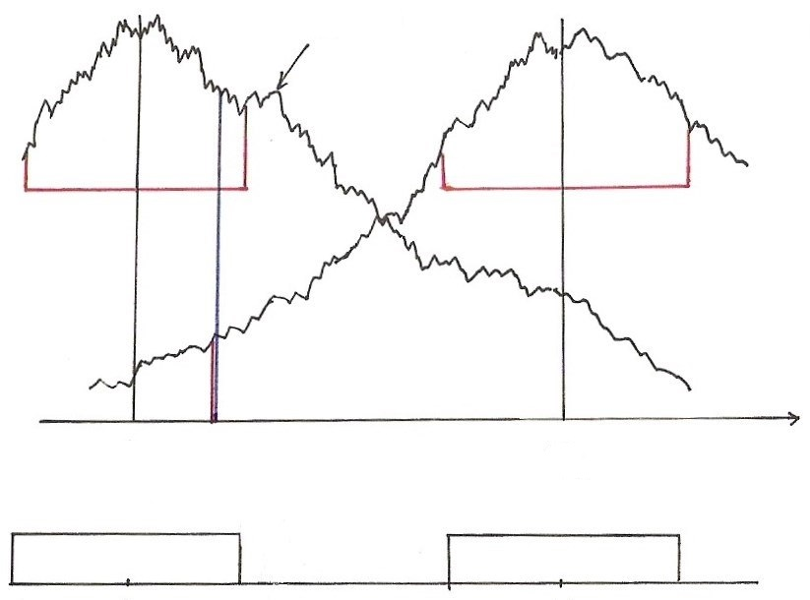
Signals not Bandlimited
$$X(jω)$$
$$ω$$
0
$$ω_{s}$$
0
$$ω_{c}$$
$$ω_{s}$$

Slide 24
Sampling with A Zero-order Hold
Zero-order Hold:
holding the sampled value until the next sample taken
modeled by an impulse train sampler followed by a system with rectangular impulse response
Reconstructed by a lowpass filter H_{r}(jω)
See Fig. 7.6, 7.7, 7.8, p.521, 522 of text

Slide 25
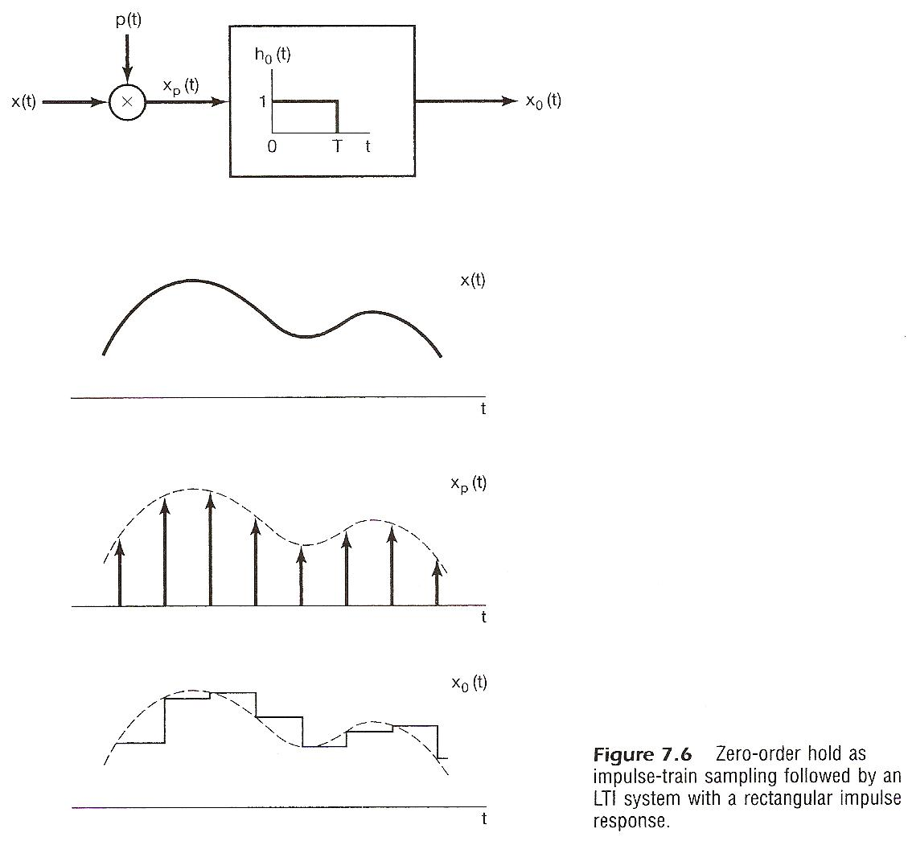

Slide 26
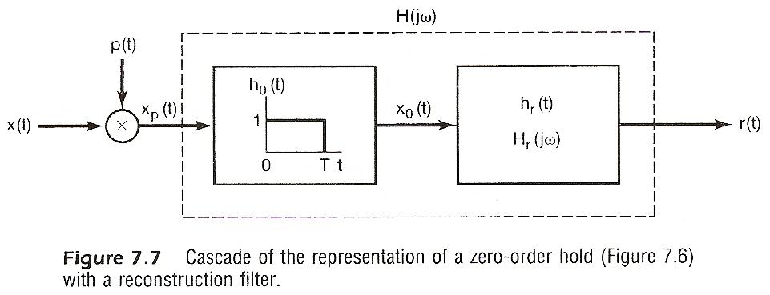
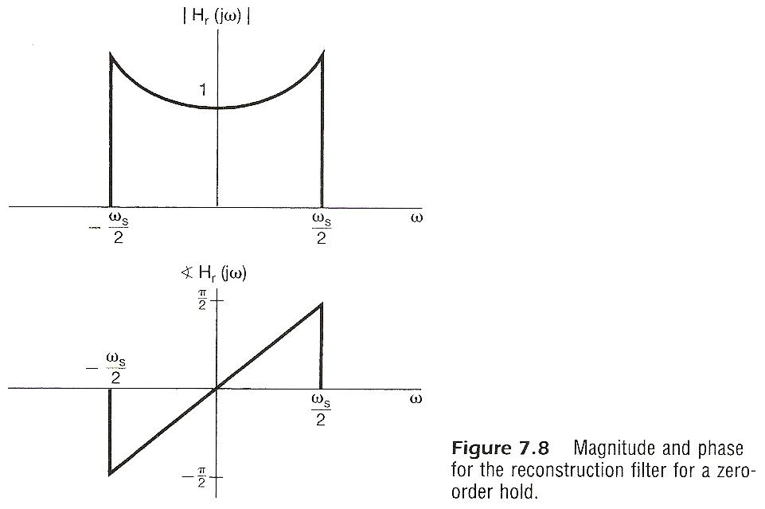

Slide 27
Interpolation
Impulse train sampling/ideal lowpass filtering
See Fig. 7.10, p.524 of text

Slide 28
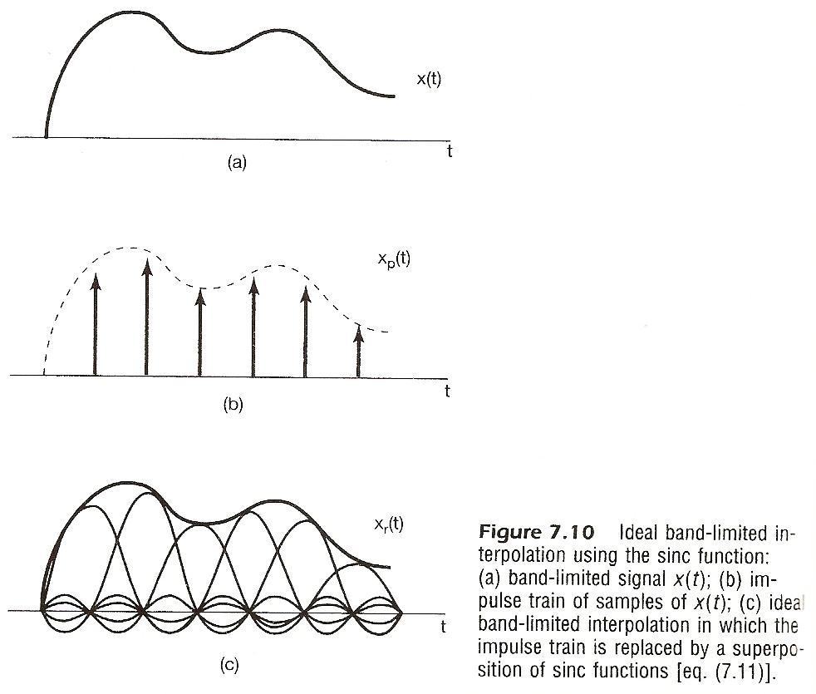

Slide 29
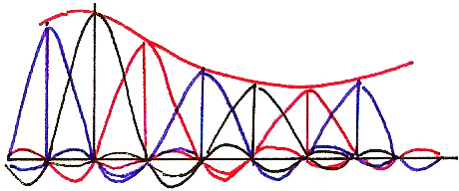
Ideal Interpolation

Slide 30
Interpolation
Zero-order hold can be viewed as a “coarse” interpolation
See Fig. 7.11, p.524 of text
Sometimes additional lowpass filtering naturally applied
e.g. viewed at a distance by human eyes, mosaic
smoothed naturally
See Fig. 7.12, p.525 of text

Slide 32
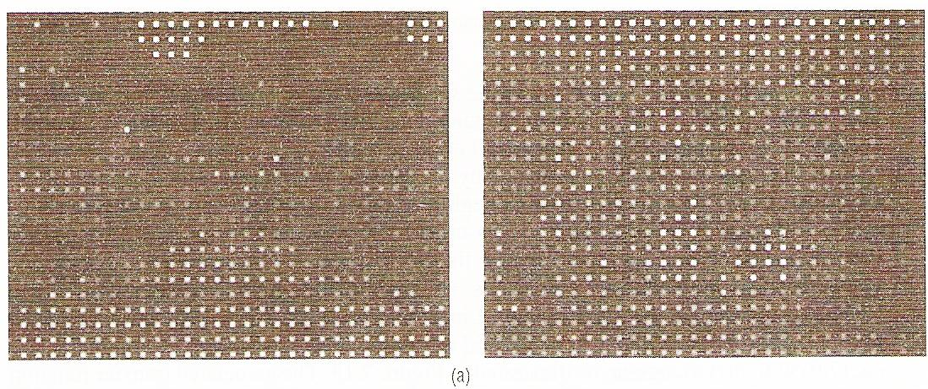

Slide 33
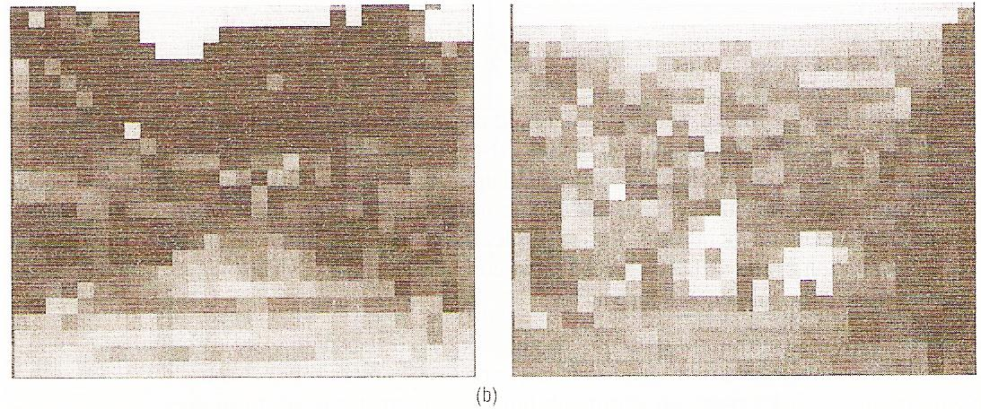

Slide 34
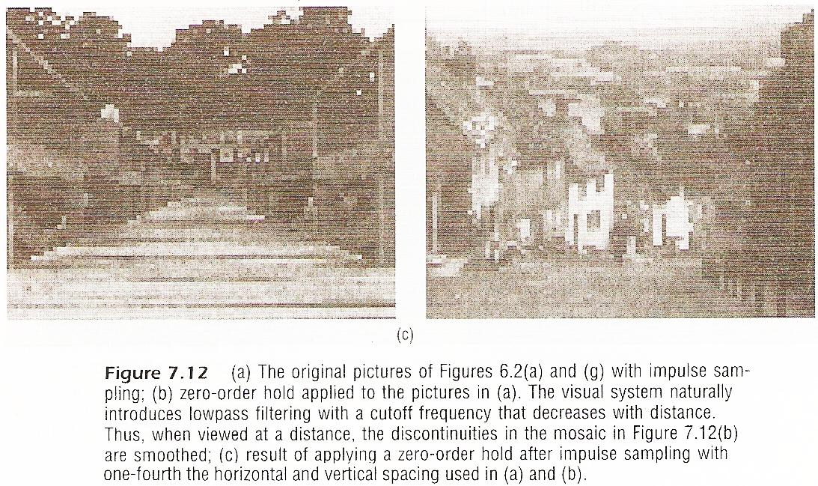

Slide 35
Interpolation
Higher order holds
zero-order : output discontinuous
first-order : output continuous, discontinuous
derivatives
See Fig. 7.13, p.526, 527 of text
second-order : continuous up to first derivative
discontinuous second derivative

Slide 36
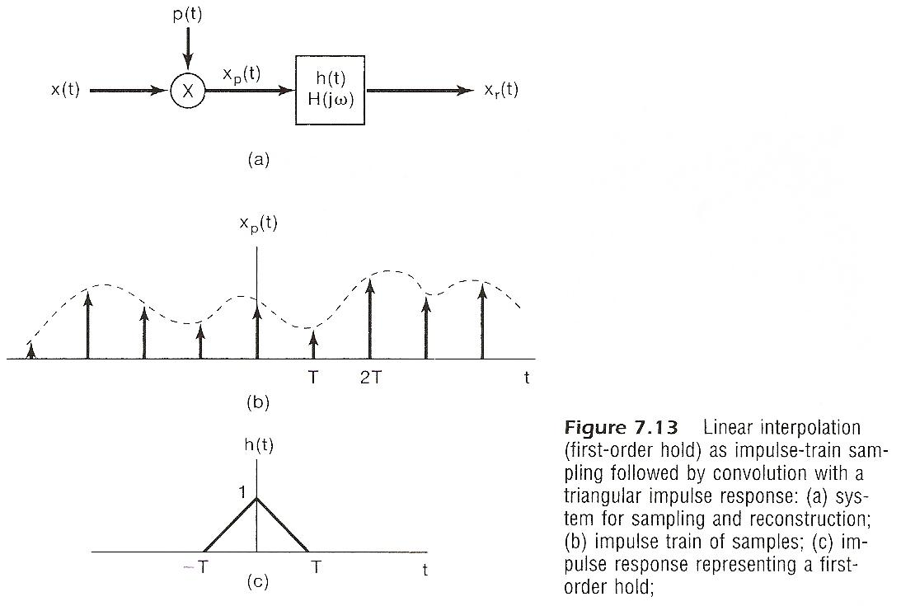

Slide 37
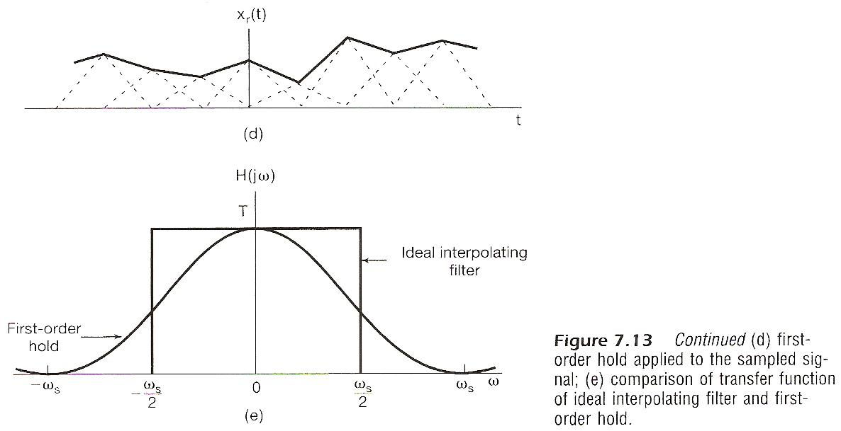

Slide 38
Aliasing
Consider a signal x(t)=cos ω₀t
sampled at sampling frequency
reconstructed by an ideal lowpass filter
with
x_{r}(t) : reconstructed signal
fixed ω_{s}, varying ω₀

Slide 39
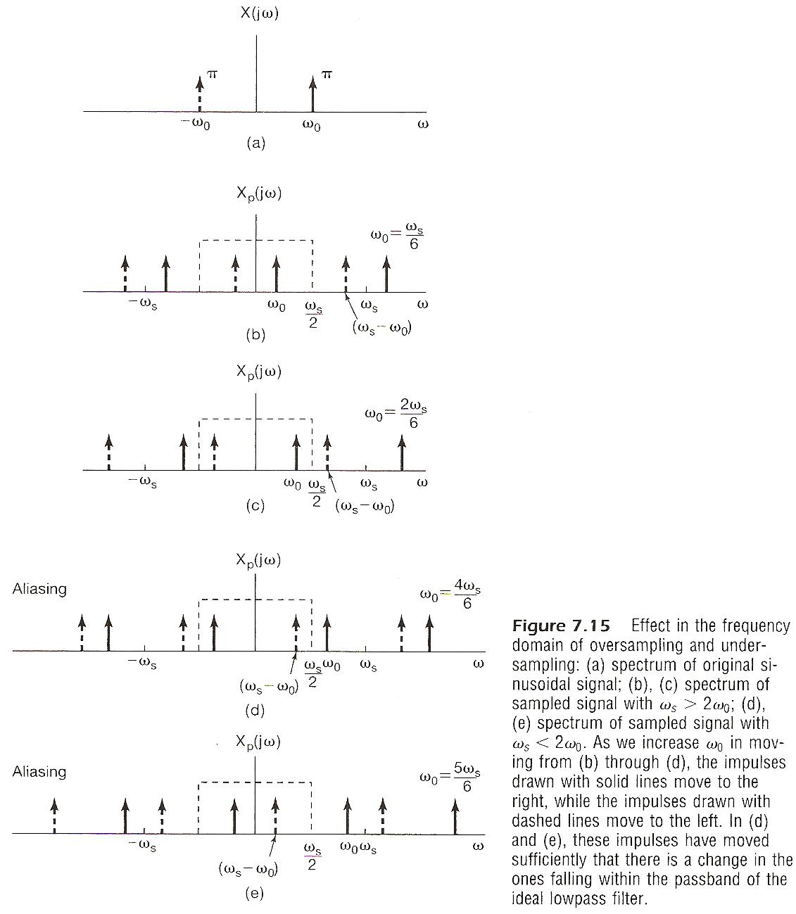

Slide 40
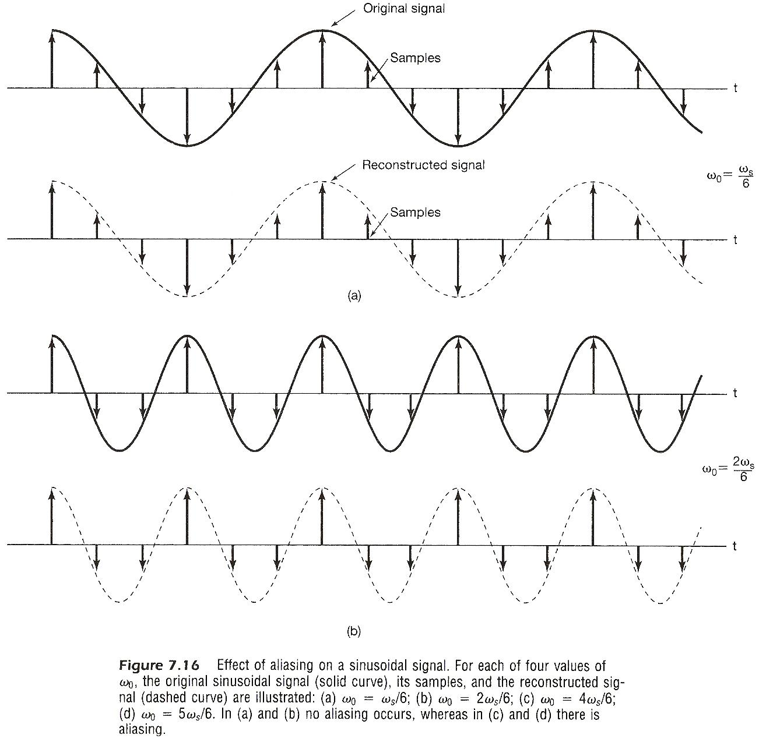

Slide 41
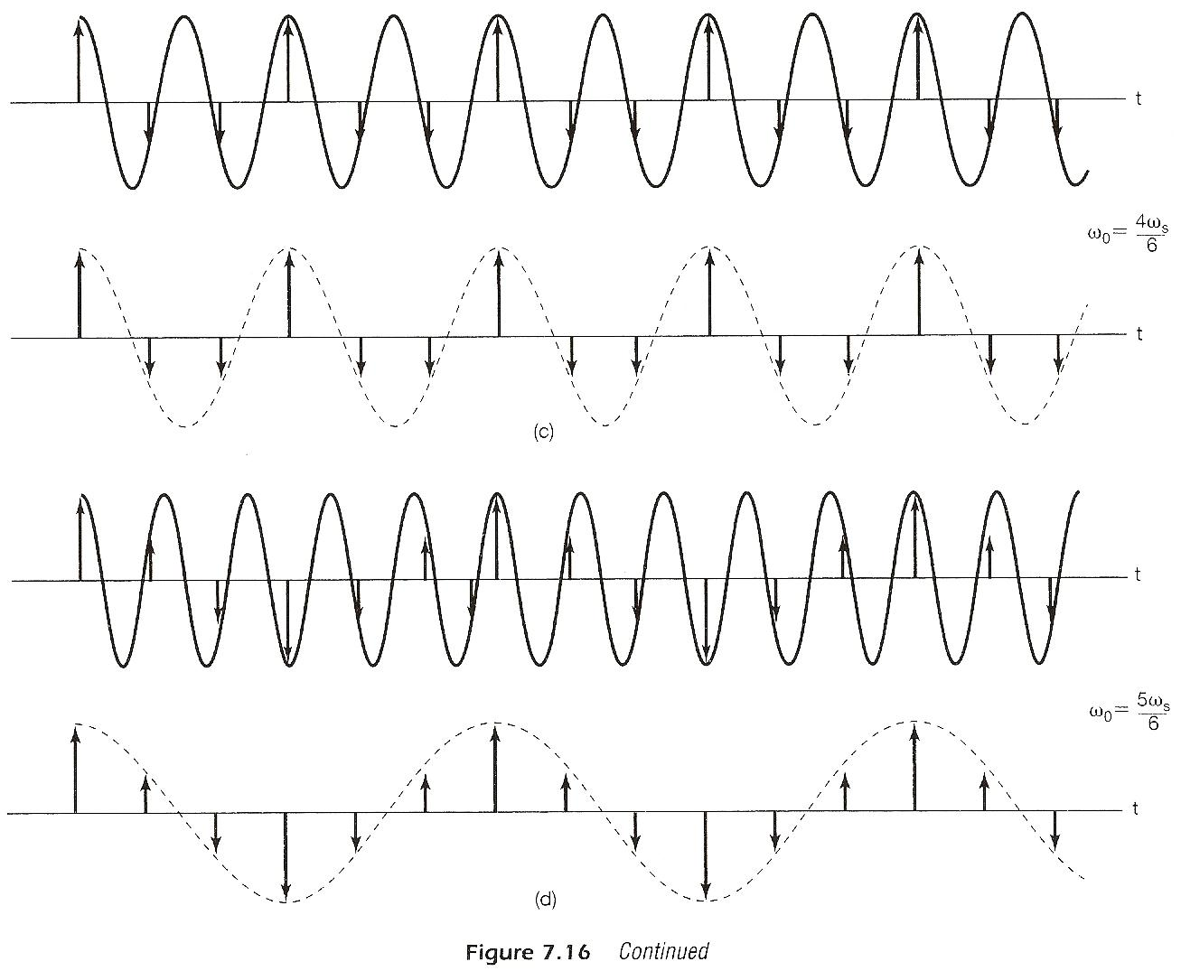

Slide 42
Aliasing
Consider a signal x(t)=cos ω₀t
when aliasing occurs, the original frequency ω₀ takes on the identity of a lower frequency, ω_{s} – ω₀
w₀ confused with not only ω_{s} + ω₀, but ω_{s} – ω₀
See Fig. 7.15, 7.16, p.529-531 of text

Slide 43
Aliasing
Consider a signal x(t)=cos ω₀t
many x_{r}(t) exist such that
the problem is how to get the right one
if x(t) = cos(ω₀t + ϕ)
the impulses have extra phases e^{jϕ}, e^{-jϕ}

Slide 44
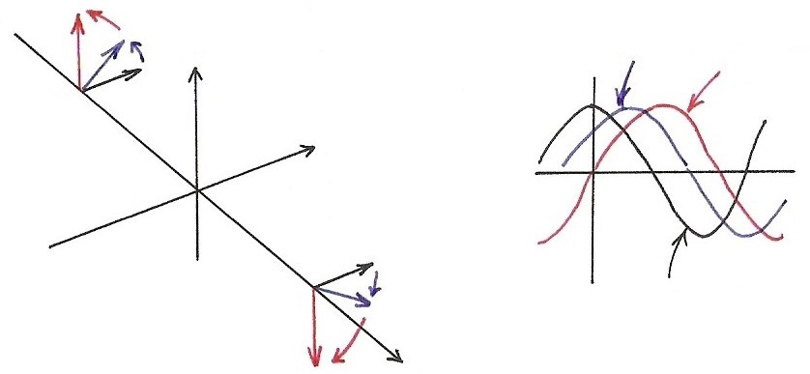
Sinusoidals (p.25 of 4.0)
$\cos{ω_{0}t}\underset{↔}{F}π\left[δ\left(ω−ω_{0}\right)+δ\left(ω+ω_{0}\right)\right],$ $\frac{1}{2}[e^{jω_{0}t}+e^{−jω_{0}t}]$
$\sin{ω_{0}t}\underset{↔}{F}\frac{π}{j}\left[δ\left(ω−ω_{0}\right)−δ\left(ω+ω_{0}\right)\right],$ $\frac{1}{2j}[e^{jω_{0}t}−e^{−jω_{0}t}]$
$$Im$$
$$\cos{ω_{0}(t−t_{0})}$$
$$\sin{ω_{0}t}$$
$${−ω}_{0}$$
$$Re$$
$$ω_{0}$$
$$\cos{ω_{0}t}$$
$$ω$$
$$x\left(t−t_{0}\right)↔e^{−jω_{0}t}⋅X(jω)$$

Slide 45
Aliasing
Consider a signal x(t)=cos (ω₀t + ϕ)
(a) (b)
(c) (d)
phase also changed

Slide 46
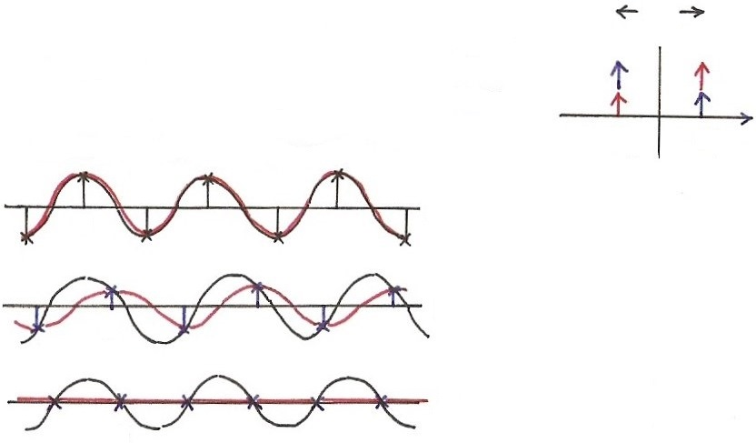
Example 7.1 of Text
$x\left(t\right)=\cos{(ω_{0}}t+φ)$, $ω_{s}=2ω_{0}$
$x_{r}\left(t\right)=(cos{φ)}cos(ω_{0}t)$, $t=nT$
$$ω_{s}$$
Sampling is “time-varying”
$$ω$$
$${−ω}_{0}$$
$$ω_{0}$$
$$t$$
(a) $φ=0$
0
$$t$$
(b) $φ≠0$
0
$$t$$
(c) $φ=\frac{π}{2}$
0

Slide 47
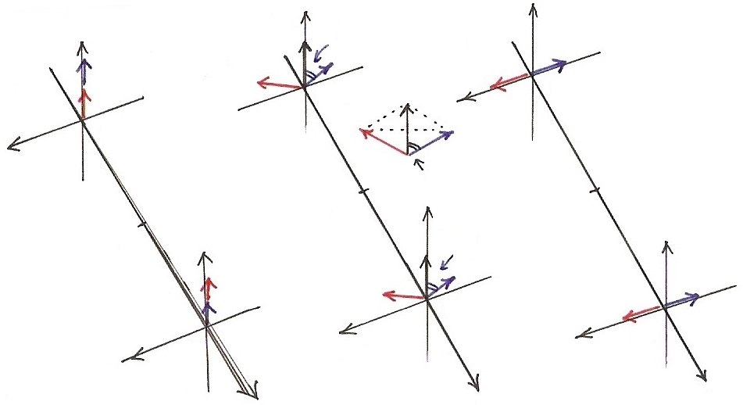
Example 7.1 of Text
(a) $φ=0$
(b) $φ≠0$
$$R_{e}$$
(c) $φ=\frac{π}{2}$
$$R_{e}$$
$$R_{e}$$
$$φ$$
$$I_{m}$$
$${−ω}_{0}$$
$${−ω}_{0}$$
$${−ω}_{0}$$
$$I_{m}$$
$$I_{m}$$
$$φ$$
0
$$R_{e}$$
0
0
$$R_{e}$$
$$R_{e}$$
$$φ$$
$$ω_{0}$$
$$I_{m}$$
$$ω_{0}$$
$$ω_{0}$$
$$I_{m}$$
$$I_{m}$$
$$ω$$
$$ω$$
$$ω$$

Slide 48
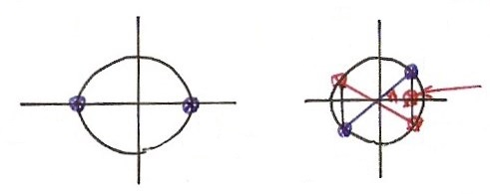
Example 7.1 of Text
$$nT$$
$$nT$$
$$x\left(t\right)=\cos{(\frac{ω_{s}}{2}t+φ)}=\frac{1}{2}[e^{j\left(\frac{ω_{s}}{2} t+φ\right)}+e^{−j\left(\frac{ω_{s}}{2} t+φ\right)}]$$
$t=nT$, $\frac{ω_{s}}{2}⋅nT=\left(\frac{{ ω}_{s} }{2}\right)⋅n\left(\frac{ 2π }{ω_{s}}\right)=nπ$
$$x(nT)=\frac{1}{2}[e^{jnπ}⋅e^{jφ}+e^{−jnπ}⋅e^{−jφ}]$$
$e^{jnπ}$= $e^{−jnπ}=±1={(e^{jπ})}^{n}={(e^{−jπ})}^{n}={(−1)}^{n}$
$$x(nT)=\frac{1}{2}e^{jnπ}\left(e^{jφ}+e^{−jφ}\right)=(e^{jnπ})⋅(\cos{φ})$$
$${(−1)}^{n}$$
$$φ=0$$
$$φ≠0$$
$$n=$$
$$1,3,5,⋯$$
$$n=0,2,4,⋯$$
$$\cos{φ}$$
$$n=1,3,5,⋯$$
$$n=$$
$$0,2,4,⋯$$
$$n=0,2,4,⋯$$
$$n=$$
$$1,3,5,⋯$$

Slide 49
Examples
Example 7.1, p.532 of text
(Problem 7.39, p.571 of text)
sampled and low-pass filtered

Slide 50
7.2 Discrete-time Processing of
Continuous-time Signals
Processing continuous-time signals digitally
x_{d}[n]=x_{c}(nT)
y_{d}[n]=y_{c}(nT)
x_{c}(t)
C/D
Conversion
Discrete-time
System
D/C
Conversion
y_{c}(t)
A/D Converter
D/A Converter
h(t)
x(t)
x[n]
h[n]
y[n]
y(t)
Recovery

Slide 51
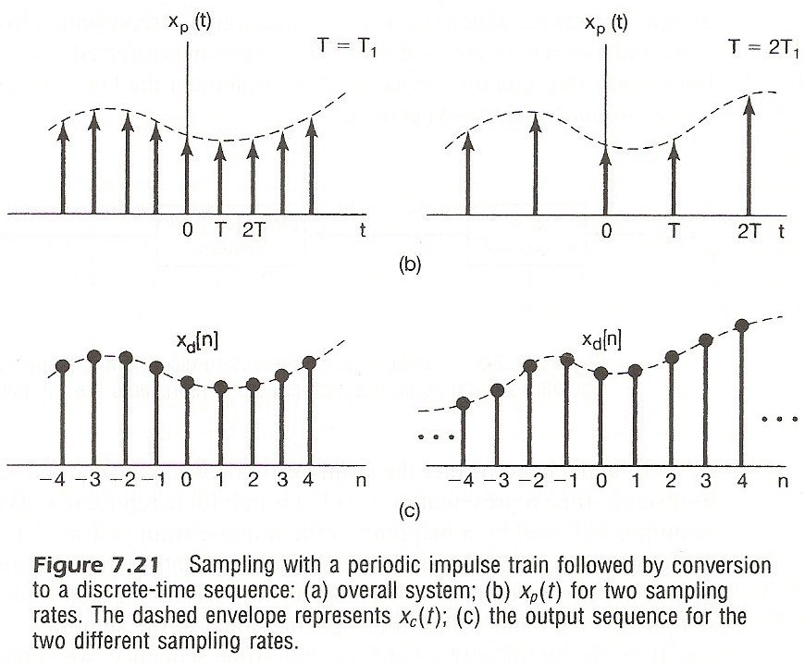
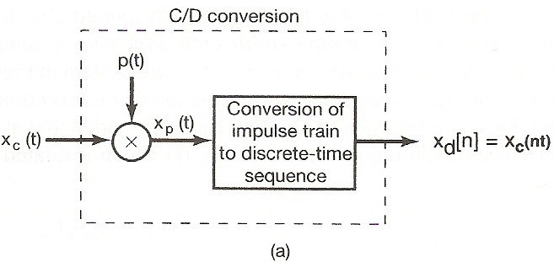
Formal Formulation/Analysis
C/D Conversion
impulse train sampling with sampling period T
mapping the impulse train to a sequence with unity spacing
normalization (or scaling) in time

Slide 52
Formal Formulation/Analysis
Frequency Domain Representation
ω for continuous-time, Ω for discrete-time, only in this section

Slide 53
Formal Formulation/Analysis
Frequency Domain Relationships
continuous-time
(4.9)
discrete-time
(5.9)

Slide 54
Formal Formulation/Analysis
Frequency Domain Relationships
relationship
(7.6)
See Fig. 7.22, p.537 of text

Slide 55
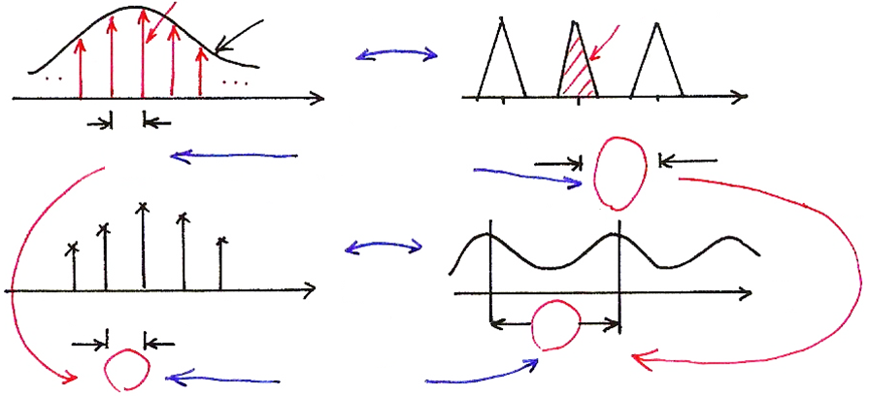
C/D Conversion
$$x_{p}(t)$$
$$X_{c}(jω)$$
$$X_{p}(jω)$$
$$x_{c}(t)$$
$$F$$
$$t$$
$${−ω}_{s}$$
$$ω_{s}$$
$$ω$$
0
$$T$$
$$\left(T\right)⋅\left(\frac{2π}{T}\right)=2π$$
$$\frac{2π}{T}$$
$$=ω_{s}$$
$$x_{d}[n]$$
$$F$$
$$X_{d}(e^{jΩ})$$
$$(×T)$$
$$(×\frac{1}{T})$$
$$n$$
$$Ω$$
0 1 2 3 4
$$2π$$
1
$$(1)⋅(2π)$$
X_{d}(e^{jΩ}) is a frequency-scaled (by T) version of X_{p}(jω)
x_{d}[n] is a time-scaled (by 1/T) version of x_{p}(t)
X_{d}(e^{jΩ}) periodic with period 2π
X_{p}(jω) periodic with period 2π/T=ω_{s}

Slide 56
Sampling (p.15 of 7.0)
sampling
$x\left(t\right)\underset{↔}{F}X(jω)$, $x_{p}(t)\underset{↔}{F}X_{p}(jω)$
$$X_{p}(jω)$$
$$X(jω)$$
$$2ω_{s}$$
$$ω_{s}$$
sampling
$$ω$$
$$ω$$
0
0
$$x\left(t\right)=\sum_{n}{x\left[n\right]}δ(t−n)$$
$$ω_{s}$$
$$ω_{s}$$
$$\frac{2π}{T}$$
$(=2π$, if $T=1)$
$F$(chap4)
$$t$$
0 1 2 3
$$2π$$
$$x[n]$$
$F$(chap5)
$$ω$$
$$n$$
$$ω_{0}$$
0 1 2 3
$$e^{jω_{0}n}$$
$$e^{j\left(ω_{0}+2π\right)n}$$
$$\overline{ T }=1$$

Slide 57
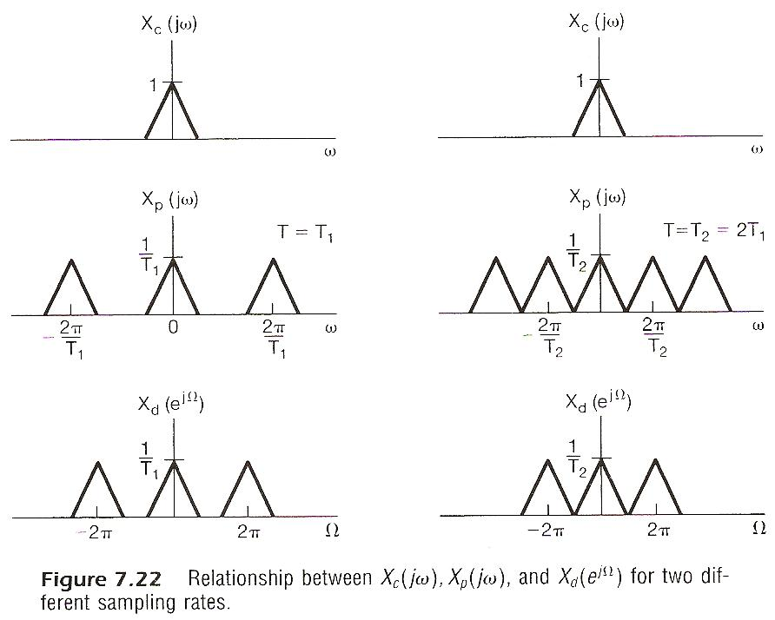

Slide 58
Formal Formulation/Analysis
D/C Conversion
mapping a sequence to an impulse train
lowpass filtering

Slide 59
Formal Formulation/Analysis
Complete System
See Fig. 7.24, 7.25, 7.26, p.538, 539, 540 of text
(7.24)
equivalent to a continuous-time system
(7.25)
if the sampling theorem is satisfied

Slide 60
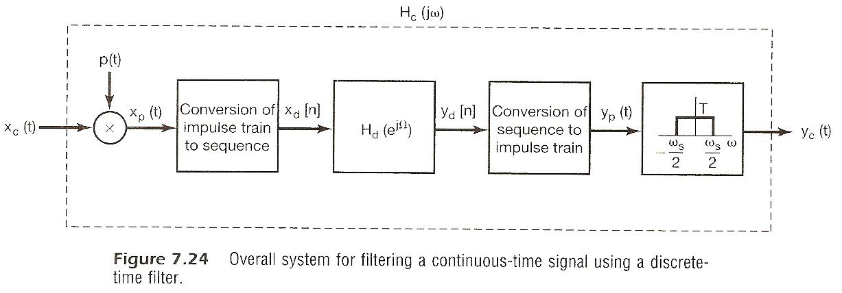
h(t)
x(t)
x[n]
y[n]
y(t)
h[n]
Recovery

Slide 61
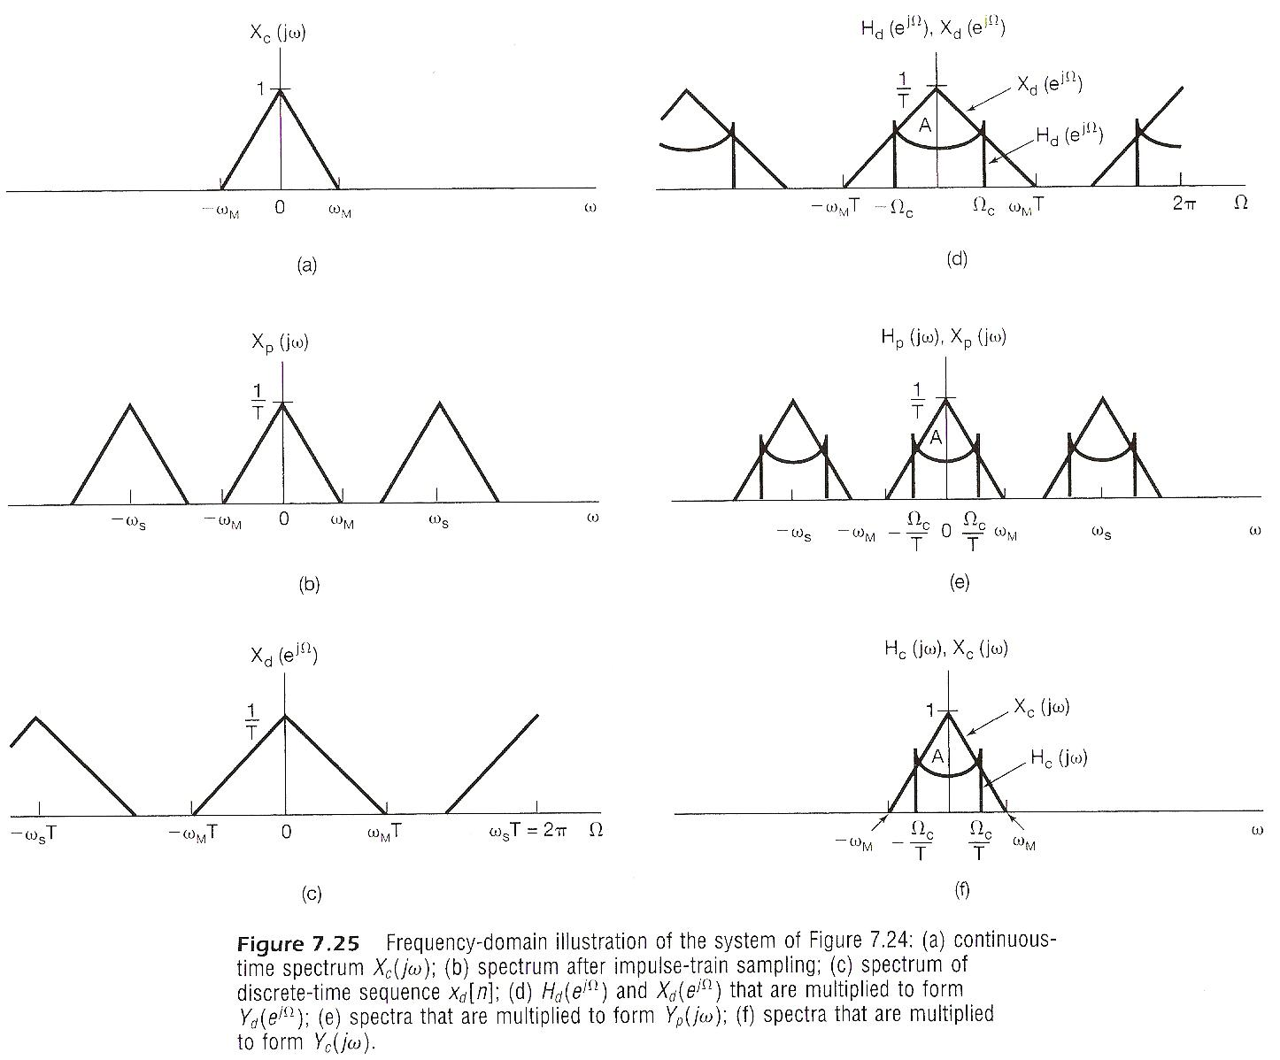

Slide 62
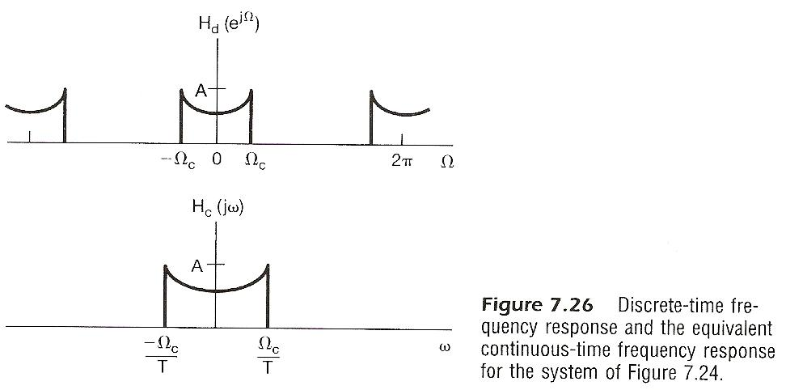

Slide 63
Discrete-time Processing of Continuous-time Signals
Note
the complete system is linear and time-invariant if the sampling theorem is satisfied
sampling process itself is NOT time-invariant

Slide 64
Examples
Digital Differentiator
band-limited differentiator
discrete-time equivalent
See Fig. 7.27, 7.28, p.541, 542 of text

Slide 65
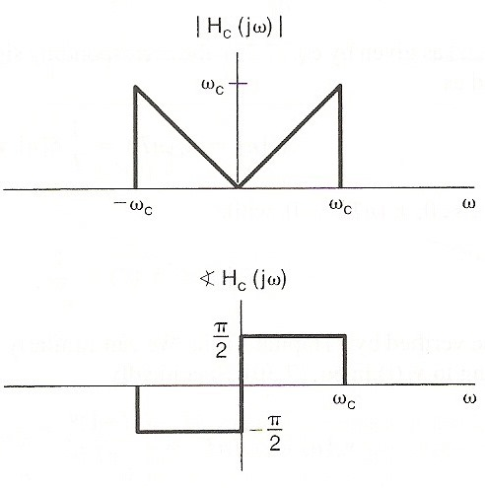
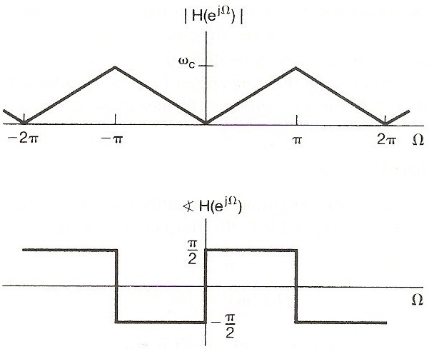

Slide 66
Examples
Delay
y_{c}(t)=x_{c}(t-∆)
discrete-time equivalent
See Fig. 7.29, p.543 of text

Slide 67
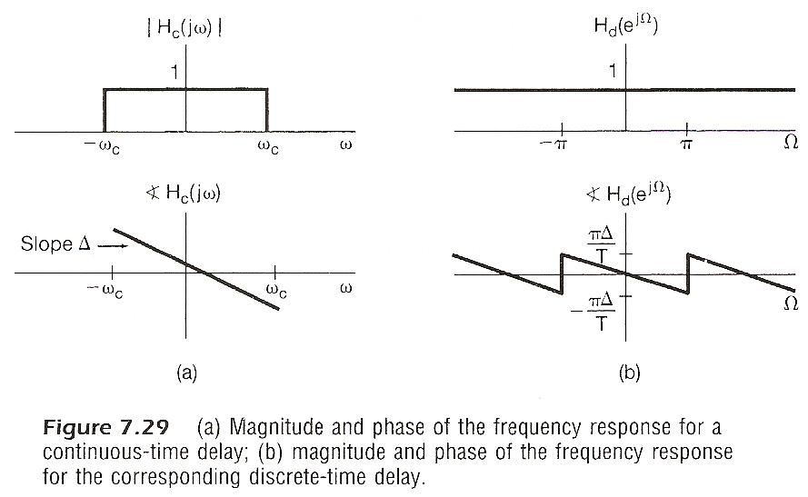

Slide 68
Examples
Delay
∆/T an integer
∆/T not an integer
undefined in principle
but makes sense in terms of sampling if the sampling theorem is satisfied
e.g. ∆/T=1/2, half-sample delay
See Fig. 7.30, p.544 of text

Slide 69
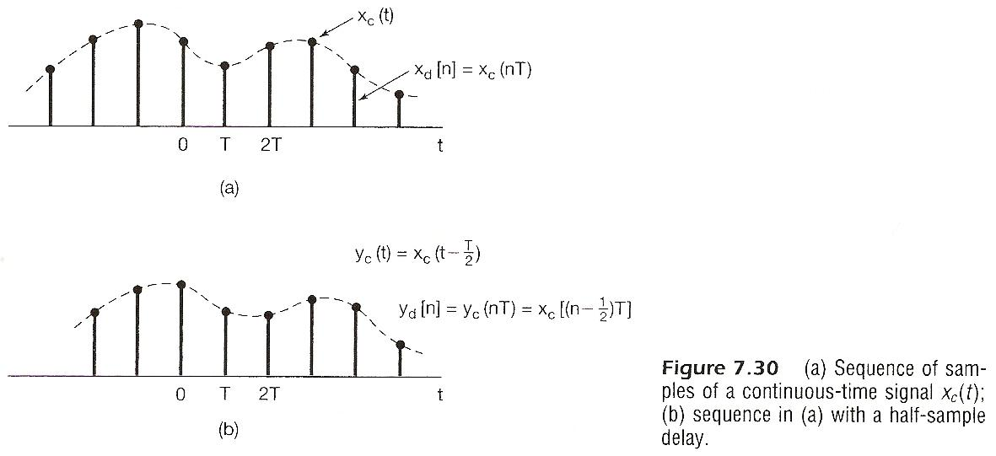

Slide 70
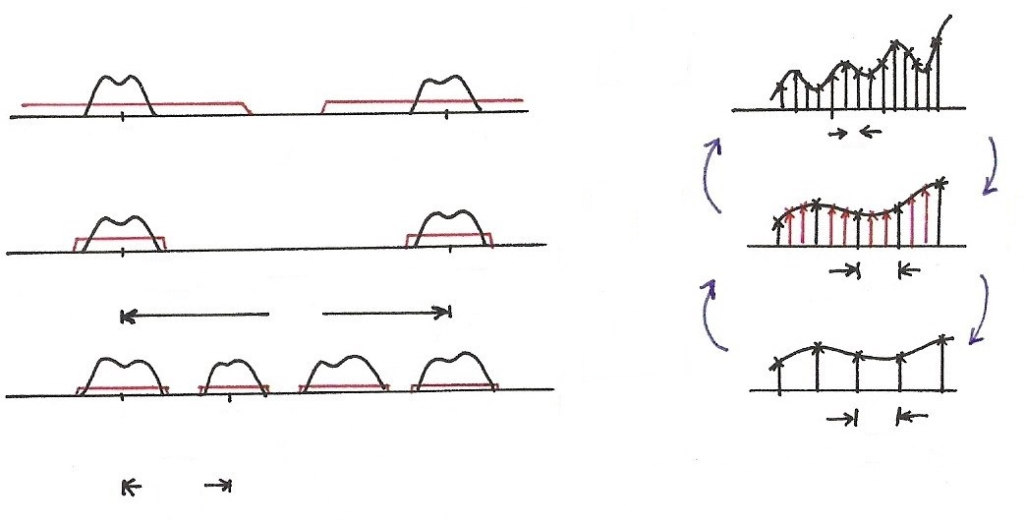
7.3 Change of Sampling Frequency
Up/Down Sampling
$$\underset{↔}{F}$$
$$ω$$
$$t$$
0
$$ω_{M}^{′}$$
$$ω_{s}^{′}=\frac{2π}{T}$$
$$T$$
$$\underset{↔}{F}$$
$$ω$$
0
$$ω_{M}$$
$$ω_{s}^{′}=\frac{2π}{T}$$
$$\frac{2π}{T}$$
Up
Sampling
$$3T$$
Down
Sampling
$$ω$$
$$\underset{↔}{F}$$
0
$$ω_{s}=\frac{2π}{3T}$$
$$3T$$
$$\frac{2π}{3T}$$

Slide 71
(P.5 of 7.0)

Slide 72
(P.7 of 7.0)

Slide 73
(P.8 of 7.0)

Slide 74
Aliasing Effect
(P.13 of 7.0)
$$x\left(t\right)=A\cos{ω_{0}}t$$
$y\left(t\right)=bcos({ω_{0}+ω_{s}})t$, $ω_{s}=\frac{2π}{T}$
$$x\left(nT\right)=A\cos{ω_{0}}nT$$
$$y\left(nT\right)=bcos({ω_{0}+k\frac{2π}{T}})nT$$
$=b\cos{ω_{0}}nT$
$$A$$
$$A$$
$$A$$
$$A$$
$$ω_{s}$$
$$b$$
$$b$$
$$b$$
$$b$$
$$ω_{0}$$
$$ω$$
$$ω$$
$$ω_{0}+ω_{s}$$
0 0 0
$$ω_{0}$$
$$ω_{s}=\frac{2π}{T}$$
After sampling with $ω_{s}=\frac{2π}{T}$ , any two frequency components $ω_{1}$, $ω_{2}$ become indistinguishable, or sharing identical samples, or should be considered as identical frequency components if $\left|ω_{1}−ω_{2}\right|=k\frac{2π}{T}$
$e^{j\left(ω_{0}+k\frac{2π}{T}\right)nT}=e^{jω_{0}nT}$ ($T=1$ for discrete-time signals )
$ω_{s}$

Slide 75
Sampling
(P.15 of 7.0)
sampling
$x\left(t\right)\underset{↔}{F}X(jω)$, $x_{p}(t)\underset{↔}{F}X_{p}(jω)$
$$X_{p}(jω)$$
$$X(jω)$$
$$2ω_{s}$$
$$ω_{s}$$
sampling
$$ω$$
$$ω$$
0
0
$$x\left(t\right)=\sum_{n}{x\left[n\right]}δ(t−n)$$
$$ω_{s}$$
$$ω_{s}$$
$$\frac{2π}{T}$$
$(=2π$, if $T=1)$
$F$(chap4)
$$t$$
0 1 2 3
$$2π$$
$$x[n]$$
$F$(chap5)
$$ω$$
$$n$$
$$ω_{0}$$
0 1 2 3
$$e^{jω_{0}n}$$
$$e^{j\left(ω_{0}+2π\right)n}$$
$$\overline{ T }=1$$

Slide 76
Aliasing Effect
(P.16 of 7.0)
$z\left(t\right)=x\left(t\right)+y\left(t\right)=A\cos{ω_{0}}t+$ $bcos({ω_{0}+ω_{s}})t$
$$z\left(nT\right)=x\left(nT\right)+y\left(nT\right)=(A+b)bcosω_{0}nT$$
$$ω_{s}<2ω_{M}$$
Aliasing Effect
0
$$ω_{s}$$
$$ω$$
$${−ω}_{M}$$
$$ω_{s}$$
$$ω_{M}$$
$$ω_{s}$$

Slide 77
Sampling Thm (p.17 of 7.0)
$$ω_{s}>2ω_{M}$$
$$ω$$
0
$$ω_{M}$$
$$ω_{s}$$
$${2ω}_{s}$$
$${−ω}_{M}$$
$$ω$$
$${−ω}_{c}$$
0
$$ω_{c}$$

Slide 78
Aliasing for Discrete-time Signals
$$kN$$
$$x\left[n\right]=Ae^{jω_{0}n}$$
$y\left[n\right]=$ $be^{j(ω_{0}+\frac{2π}{N})n}$
$z\left[n\right]=x\left[n\right]$+ $y\left[n\right]$
$$z\left[kN\right]=(A+b)e^{jω_{0}kN}$$
$$e^{j\left(ω_{0}+\frac{2π}{N}\right)kN}=e^{jω_{0}kN}$$
$$kN$$
$$T$$
$$T/N$$

Slide 79
Impulse Train Sampling of Discrete-time
Signals
Completely in parallel with impulse train sampling of continuous-time signals
See Fig. 7.31, p.546 of text

Slide 80
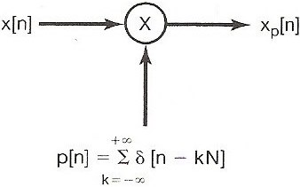
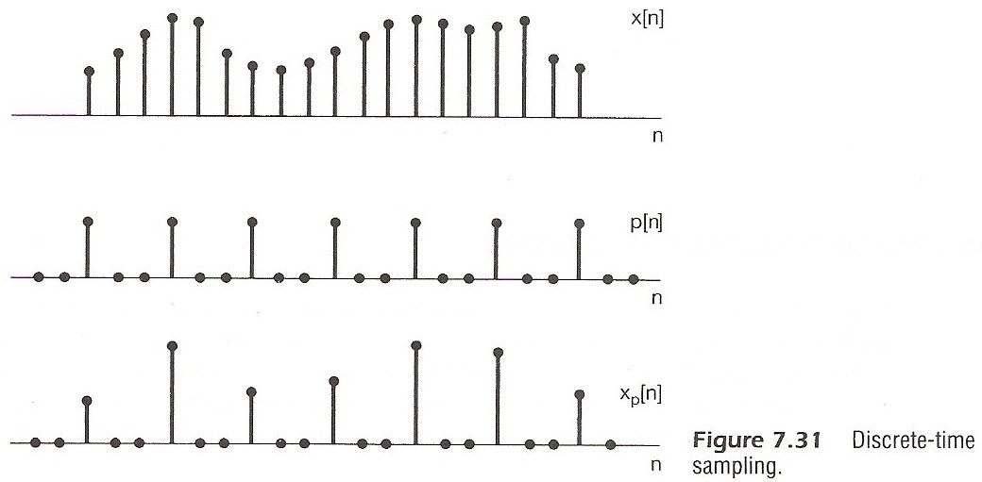
See Fig. 7.31, p.546 of text

Slide 81
Impulse Train Sampling of Discrete-time
Signals
Completely in parallel with impulse train sampling of continuous-time signals
See Fig. 7.32, p.547 of text

Slide 82
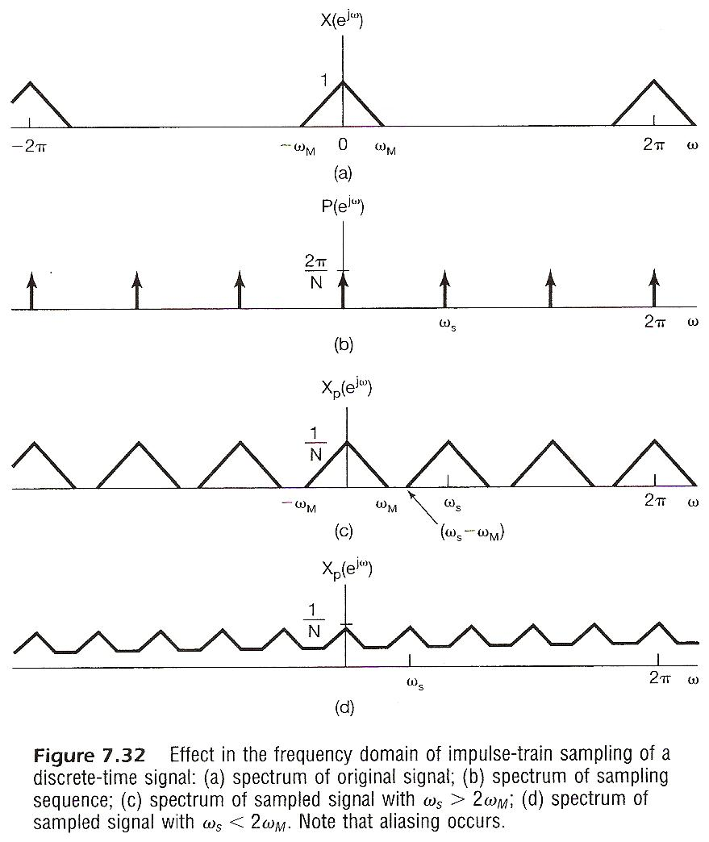

Slide 83
Impulse Train Sampling of Discrete-time
Signals
Completely in parallel with impulse train sampling of continuous-time signals
ω_{s} > 2ω_{M}, no aliasing, ω_{s} = $\frac{2π}{N}$
x[n] can be exactly recovered from x_{p}[n] by a lowpass filter
With Gain N and cutoff frequency ω_{M} < ω_{c} < ω_{s}- ω_{M}
See Fig. 7.33, p.548 of text
ω_{s} < 2ω_{M}, aliasing occurs
filter output x_{r}[n] ≠ x[n]
but x_{r}[kN] = x[kN], k=0, ±1, ±2, ……

Slide 85
Impulse Train Sampling of Discrete-time
Signals
Interpolation
h[n] : impulse response of the lowpass filter
in general a practical filter h_{r}[n] is used

Slide 87
Decimation/Interpolation
Decimation: reducing the sampling frequency by a factor of N, downsampling : two reversible steps
taking every N-th sample, leaving zeros in between
deleting all zero’s between non-zero samples to produce a new sequence (inverse of time expansion property of discrete-time Fourier transform)
both steps reversible in both time/frequency domains
See Fig. 7.34, p.550 of text

Slide 89
(p.38 of 5.0)

Slide 90
(p.39 of 5.0)

Slide 91
(p.37 of 5.0)
Time Expansion
If n/k is an integer, k: positive integer
See Fig. 5.13, p.377 of text
See Fig. 5.14, p.378 of text

Slide 92
Decimation/Interpolation
Decimation:
See Figs. 7.34, 7.35, p. 550, 551 of text

Slide 95
Decimation/Interpolation
Decimation
decimation without introducing aliasing requires oversampling situation
See an example in Fig. 7.36, p. 552 of text

Slide 97
Decimation/Interpolation
Interpolation: increasing the sampling frequency by a factor of N, upsampling
reverse the two-step process in decimation
from x_{b}[n] construct x_{p}[n] by inserting N-1 zero’s
from x_{p}[n] construct x[n] by lowpass filtering
See Fig. 7.37, p. 553 of text
Change of sampling frequency by a factor of N/M: first interpolating by N, then decimating by M

Slide 99
Decimation/Interpolation
$$x_{d}\left[n\right]=x_{c}\left(nT\right)=x[n]$$
$$x_{p}[n]$$
$$T$$
$$x_{c}(t)$$
$$t$$
$$n$$
0
0 1 2
$$T$$
Interpolation
$$x_{d}^{′}\left[n\right]=x_{c}\left(nT^{′}\right)=x_{b}\left[n\right]$$
$=x_{c}(nNT)$
$$t$$
Decimation
$$T^{′}=NT$$
$$t$$
$$n$$
0 1 2
$$NT$$

Slide 100
Decimation/Interpolation
$X(jω)$, $X(e^{jΩ})$
$$ω$$
$$X_{c}(jω)$$
0
$$\frac{2π}{T}$$
$$T$$
$$Ω$$
0
$$2π$$
$$ω$$
$X_{p}(jω)$, $X_{p}(e^{jΩ^{′}})$
$$X_{b}(e^{jΩ})$$
0
$$ω$$
$$T^{′}=NT$$
0
$$\frac{2π}{T^{′}}=\frac{2π}{NT}$$
for $x_{p}[n]$
$$Ω^{′}$$
0
$$2π$$
for $x_{b}[n]$
$$Ω$$
0
$$2π$$

Slide 101
Examples
Example 7.4/7.5, p.548, p.554 of text
sampling x[n] without aliasing

Slide 102
Examples
Example 7.4/7.5, p.548, p.554 of text
maximum possible downsampling: using full band [-π, π]

Slide 103
Examples
Example 7.4/7.5, p.548, p.554 of text

Slide 104
Problem 7.6, p.557 of text

Slide 105
Problem 7.20, p.560 of text
: inserting one zero after each sample
: decimation 2:1, extracting every second sample
Which of (a)(b) corresponds to low-pass filtering
with ?

Slide 106
Problem 7.20, p.560 of text
(a) yes
: inserting one zero after each sample
: decimation 2:1, extracting every second sample

Slide 107
Problem 7.20, p.560 of text
(b) no
: inserting one zero after each sample
: decimation 2:1, extracting every second sample

Slide 108
Problem 7.23, p.562 of text

Slide 109
Problem 7.23, p.562 of text

Slide 110
Problem 7.23, p.562 of text

Slide 111
Problem 7.24, p.562 of text
2

Slide 112
Problem 7.41, p.572 of text

Slide 113
Problem 7.41, p.572 of text

Slide 114
Problem 7.52, p.580 of text
dual problem for frequency domain sampling

