Slide 1
2.0 Linear Time-invariant Systems
2.1 Discrete-time Systems: the Convolution Sum
Representing an arbitrary signal as a sequence of unit impulses
an unit impulse located at n = k on the index n
See Fig. 2.1, p.76 of text
a special case

Slide 2
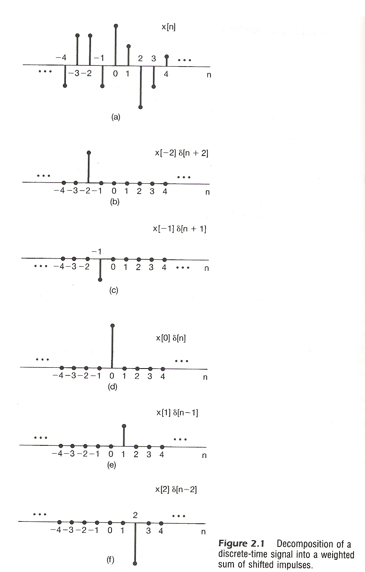

Slide 3
Vector Space Representation of Discrete-
time Signals (P.47 of 1.0)
n-dim
$\vec{a}=(a_{1},a_{2}, ⋯a_{n}$)
$\vec{b}=(b_{1},b_{2}, ⋯b_{n}$)
$\hat{v_{1}}=(1, 0, 0,⋯$ 0)
$$\hat{v_{2}}=(0,1, 0,⋯\text{ 0)}$$
$$⋮$$
$$\vec{a}⋅\vec{b}=\sum_{i}{a_{i}{ b}_{i}}$$
$\vec{x}=(x_{1},x_{2}, ⋯x_{n}$)
$$\vec{x}=\sum_{i}{x_{i}}\hat{v_{i}} 合成$$
$x_{j}=$ $\vec{x}⋅\hat{v_{j}}$ 分析

Slide 4
Vector Space Representation of Discrete-
time Signals (P.48 of 1.0)
n extended to $± ∞$
$\vec{x}=(⋯,x_{−2},x_{−1},x_{0},x_{1},x_{2},x_{3}, ⋯)$
$\hat{v_{0}}=$ (⋯, 0, 0, 1, 0, 0, 0, ⋯ )=δ [ $n$ ]
$\hat{v_{1}}=$ (⋯, 0, 0, 0, 1, 0, 0, ⋯ )=δ [ $n$ – 1 ]
$\hat{v_{k}}=$ (⋯, 0, 0, 0, ⋯, 0, 1, ⋯ )=δ [ $n$ – k ]
$\{δ\left[n−k\right], k:\text{inter}\text{\}}$
$$\vec{x}=\sum_{i}{x_{i}\hat{v_{i}}} 合成$$
$x_{j}= \vec{x}⋅\hat{v_{j}}$ 分析

Slide 5
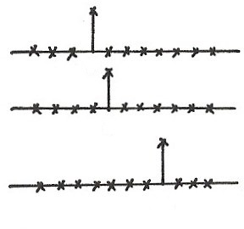
Vector Space Interpretation
$${\hat{v}}_{0}=(⋯,0, 1, 0, 0, 0,⋯)$$
$${\hat{v}}_{1}=(⋯,0, 0, 1, 0, 0,⋯)$$
$$⋮$$
$${\hat{v}}_{k}=(⋯⋯,0, 0, 0, 1,⋯)$$
δ [ $n$ ]
$$0$$
δ [ $n$ – 1 ]
$$1$$
δ [ $n$ – k ]
$$k$$
$$\{δ\left[n−k\right], k=⋯,−1, 0, 1, 2, ⋯\}$$
$$k$$

Slide 6
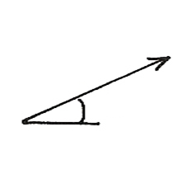
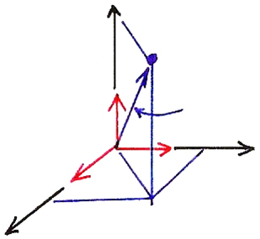
Vector Space (P.30 of 1.0)
$$V=\left\{v | ⋯\right\}$$
$av$
$v_{1}+$ $v_{2}$
$$b$$
$$θ$$
3-dim Vector Space
$\left(\vec{A} \right)⋅\hat{j }=(a\hat{i }+b\hat{j }+c\hat{k})⋅\hat{j }$ (合成)
$$\hat{k}$$
$$\vec{A}$$
$b=\vec{A}⋅\hat{j }$ (分析)
$$\hat{i }$$
$$\hat{j }$$

Slide 7
N-dim Vector Space (P.31 of 1.0)
$$\overset{⃑}{A}=\sum_{k=1}^{N}{}$$
$a_{j}=\overset{⃑}{A}∙\hat{v_{j}}$
$$\hat{v_{i}}∙\hat{v_{j}}=δ_{ij}$$
(合成)
$$a_{k}$$
$${\hat{v}}_{k}$$
(分析)

Slide 8
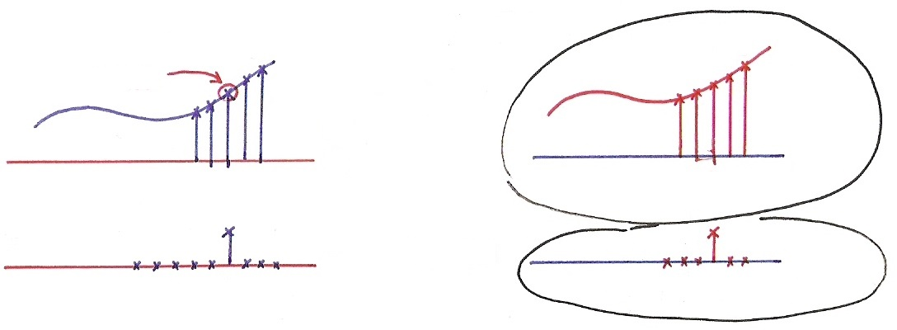
Vector Space Interpretation
$$x\left[n\right]=\sum_{k=−∞}^{∞}{x\left[k\right] δ [n−k]} (是合成也是分析)$$
$$x[k]$$
$$x[k]$$
$$x[n]$$
$$n$$
$$k$$
$$k$$
$$n$$
$$δ[n−k]$$
$$δ[k−n]$$
$$n$$
$$k$$
$$k$$
$$n$$
$$\vec{A}=\sum_{k}{a_{k} }{\hat{v}}_{k} (合成)$$
$$a_{j}=\vec{A}⋅{\hat{v}}_{j}\left(分析\right)$$
$$a_{n}=\vec{A}⋅{\hat{v}}_{n} (\vec{A}⋅\vec{B}=\sum_{k}{a_{k} b_{k}})$$

Slide 9
Representing an arbitrary signal as a sequence of
unit impulses
(合成)
an unit impulse located at n = k on the index n
Sifting property of the unit impulse:looked at on the index k, δ[n-k] is nonzero only at k = n, which “sifts” the value x[n] out of the function x[k]. (分析)

Slide 10
Defining the output for an unit impulse input as the
Unit Impulse Response
x[n]=δ[n]
y[n]=h[n]:unit impulse response
S
0
n
0
n

Slide 11
By Linearity (Superposition Property)
The output for an arbitrary input signal is the superposition of a series of “shifted, scaled unit impulse response”
x[k]
δ[n-k]
x[k]
h[n-k]
Convolution Sum
See Fig2.3,p.80 of text

Slide 12
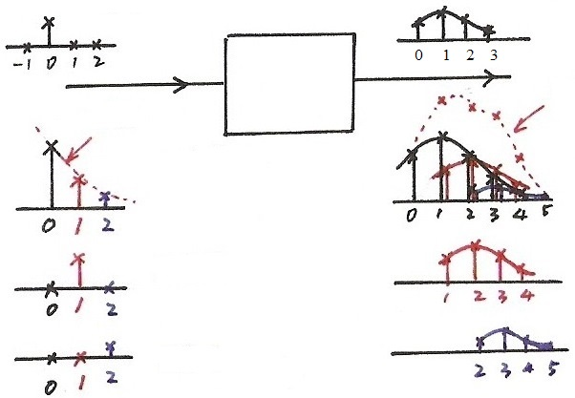
Input/Output Relation in Every Dimension
$$δ[n]$$
$$h[n]$$
$$y[n]$$
$$x[n]$$
$x\left[0\right] h[n]$
$$x[0]$$
$$x[1]$$
$x\left[1\right] h[n−1]$
$x\left[2\right] h[n−2]$
$$x[2]$$

Slide 13
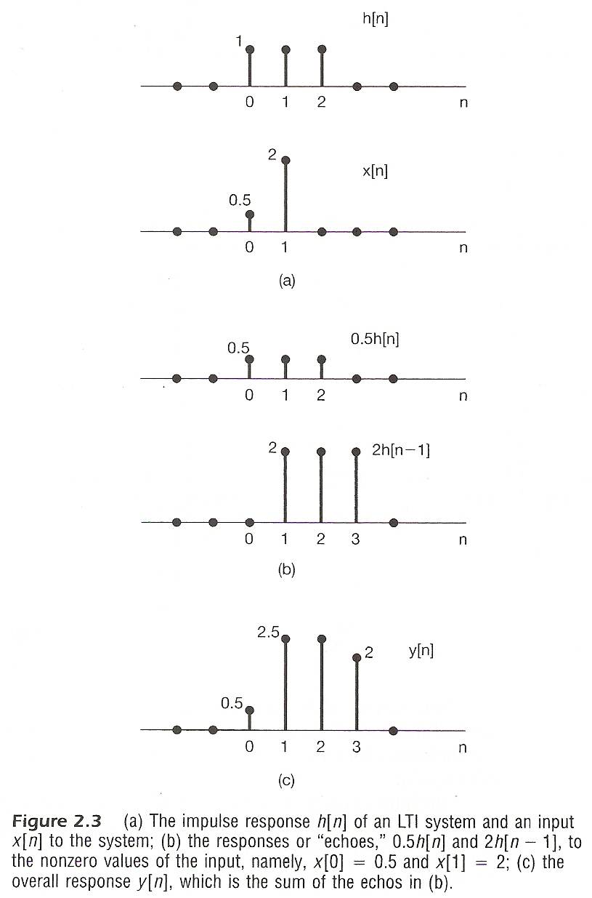

Slide 14
A Different Way to visualize the convolution sum
looked at on the index k
on the dummy index k, h[k] is reflected over and shifted to k=n, weighted by x[k] and summed to produce an output sample y[n] at time n
See Figs 2.5, 2.6, 2.7, pp. 83-85 of text
input signal
Contribution to the output signal at time n
reflected-over version of h[k] located at k = n

Slide 15
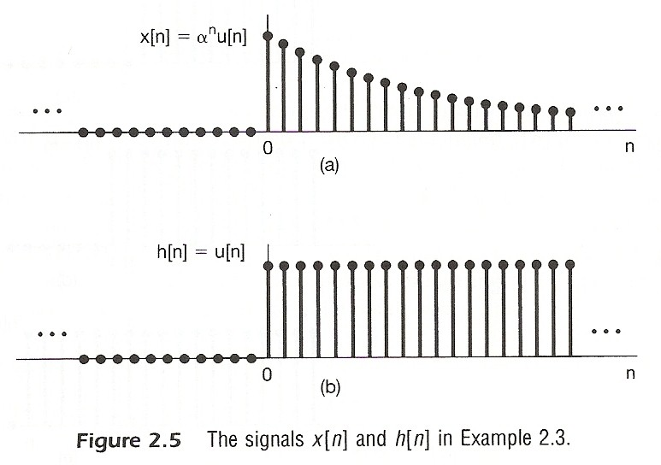

Slide 16
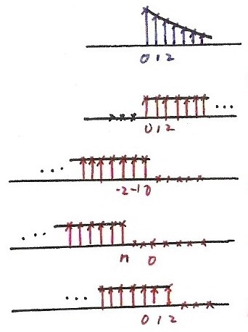
Fig. 2.6
$$x[k]$$
$$k$$
$$h[k]$$
$$k$$
$$h\left[−k\right], n=0$$
$$k$$
$$h\left[n−k\right], n<0$$
$$k$$
$$h\left[n−k\right], n=2>0$$
$$k$$

Slide 17
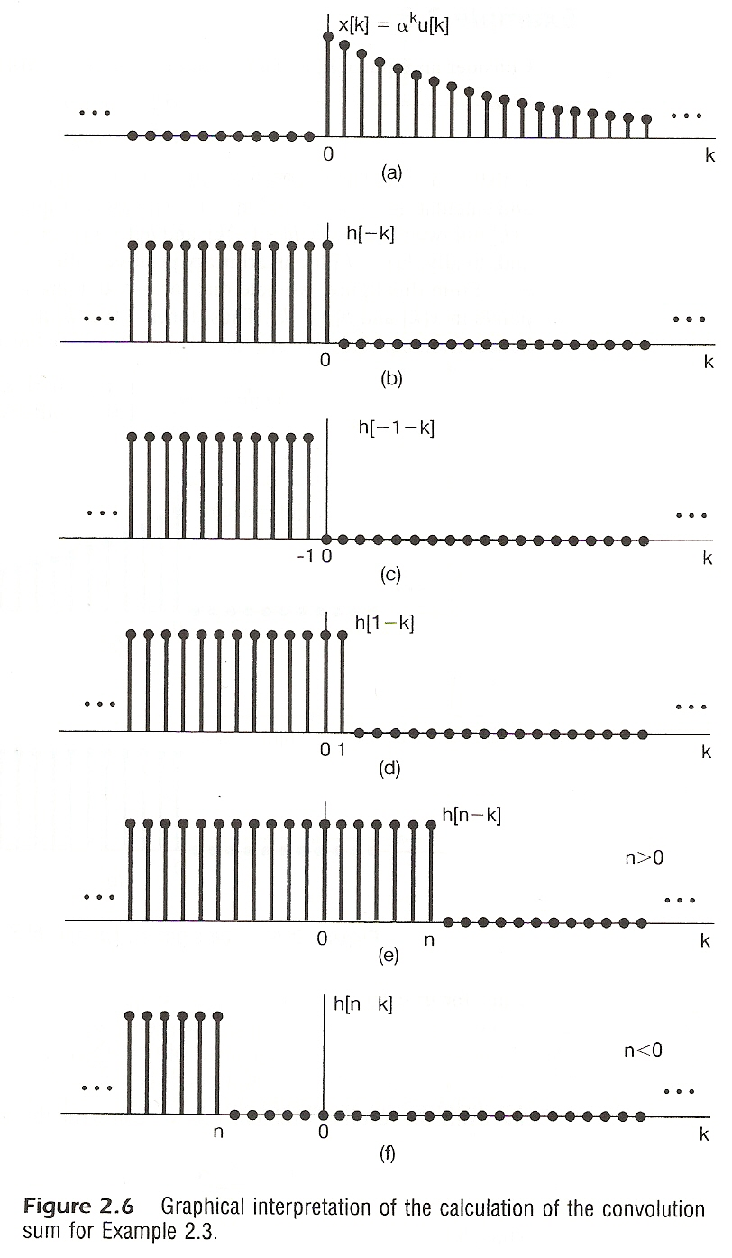

Slide 18
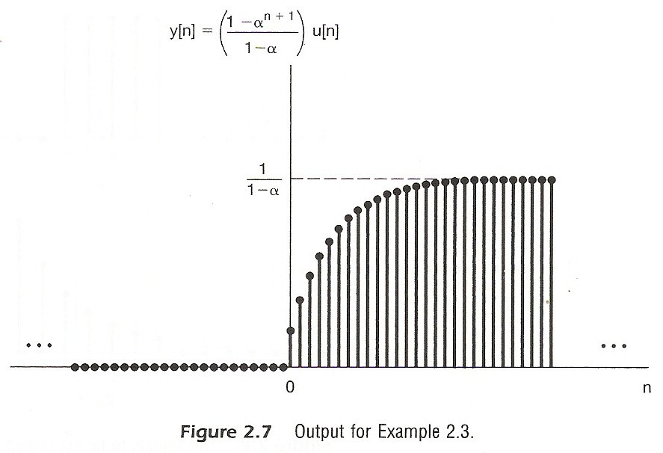

Slide 19
A linear time-invariant system is completely characterized by its unit impulse response

Slide 21
Vector Space Concept
Definition of Inner-product
Example
Simple Definition

Slide 23
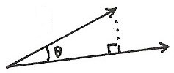
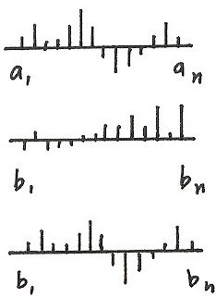
Inner Product
$$A⋅B=\underbrace{\left|A\right|\left|B\right|} \underbrace{\cos{θ}}$$
$$A$$
magnitude
similarity
$$\left|A\right|={(A⋅A)}^{1/2}\text{:} \text{magnitude}\text{, }{\left(\sum_{i}{a_{i}^{2}}\right)}^{1/2}$$
$$B$$
$\cos{θ}=\frac{A⋅B}{\left|A\right|\left|B\right|}$ : similarity, $−1≤\cos{θ}≤$1
$A⋅B = 0$ : orthogonal
$A$:
$B_{1}$:
$$A⋅B_{2}>A⋅B_{1}$$
$B_{2}$:

Slide 24
Linearity in Inner Product
$$x⋅\left(ay\right)=a\left(x⋅y\right)$$
$$x⋅\left(y_{1}+y_{2}\right)=x⋅y_{1}+x⋅y_{2}$$
$\left\langle \begin{aligned} \text{magnitude} \\ \text{similarity} \end{aligned}\right.$
Commutative, Non-degeneracy
$\left\langle \begin{aligned} \text{magnitude} \\ \text{similarity} \end{aligned}\right.$

Slide 25
Vector Space Concept
Definition of Inner-product
Physical Properties: magnitude, similarity
For the vector space of signals defined in (N₁, N₂)
Inner-product Space
(N₁, N₂) extended to (-∞, ∞)

Slide 26
Vector Space Concept
Magnitude/Similarity

Slide 27
Vector Space Concept
Orthonormal bases
orthogonal
orthonormal
orthonormal basis
any vector (signal) in the vector space can be expanded by
the set of orthonormal signals
(合成)

Slide 28
System Characterization
Vector Space
Orthonormal bases
time-shifted unit impulses, dim = ∞
A signal expanded by this set of orthonormal basis
(合成)

Slide 29
System Characterization
A Different View of the Sifting Property
3-dim vector space
Sifting property
(分析)

Slide 30
System Characterization
Transformation of Vectors
A System is a Transformation which maps one vector x[n]
to another vector y[n] (linear, time-invariant)
H [ ]

Slide 31
Defining the output for an unit impulse input as the
Unit Impulse Response (P.10 of 2.0)
x[n]=δ[n]
y[n]=h[n]:unit impulse response
S
0
n
0
n

Slide 32
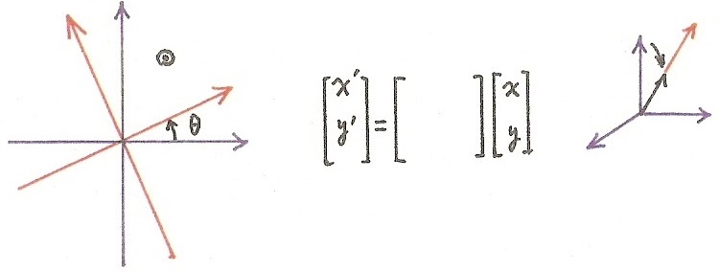
Rotation as a vector transformation
y
$$y^{′}$$
(1,0,0)
$(αa,αb,αc)$
$$x^{′}$$
(a, b, c)
x
Rotation plus
vector scaling
Rotation as a
vector transformation
(1, 0, 0) → (0.9, 0.3, 0.3)
(0, 1, 0) → (0.3, 0.9, 0.3)
(0, 0, 1) → (0.3, 0.3, 0.9)
(1, 0, 0, 0,⋯) → (0.9, 0.3, 0.2,⋯)
(0, 1, 0, 0,⋯) → ( 0, 0.9, 0.3, 0.2,⋯)
(0, 0, 1, 0,⋯) → ( 0, 0, 0.9, 0.3,02,⋯)

Slide 33
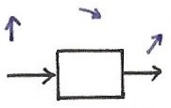
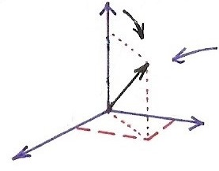
Splitting a single basis vector into a few more basis vectors
$\hat{i }$
a
(a,b,c)
(1,0,0)
($a,b,c$)
(1,0,0) = $\hat{i }$
$δ\left[n\right]→h\left[n\right]$
$δ\left[n−k\right]→h\left[n−k\right]$
$$\sum_{k}{x[k]} δ[n−k]→\sum_{k}{x[k]} h[n−k]$$
c
b
$\hat{k}$
$\hat{j }$
transforming a single basis vector enough to describe the transformation of any vectors

Slide 34
System Characterization
Transformation of Vectors
unit impulse response is the transformation of δ[n]. A basis vector is transformed to a set of other bases
superposition property for convolution sum

Slide 35
System Characterization
Linear, Time-invariant Transformation of vectors can be expressed by a matrix
x
y
Convolution Sum

Slide 36
System Characterization
Matrix Representation of Convolution Sum
example: x[n]=…0,0,x₀,x₁,x₂,0,0,…
h[n]=…0,0,h₀,h₁,h₂,0,0,…
y[n]=…0,0,y₀,y₁,y₂,y₃,y₄,0,0,…

Slide 37
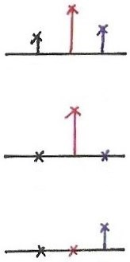
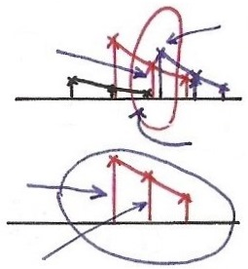
Matrix Representation
$$δ[n]$$
$$h_{0}$$
$$h_{1}$$
$$h_{2}$$
$$\left[\begin{matrix}⋮ \\ y_{2} \\ ⋮\end{matrix}\right]=\left[h_{2} h_{1} h_{0}\right]\left[\begin{matrix}x_{0} \\ x_{1} \\ x_{2}\end{matrix}\right]$$
$$h[n]$$
01 2
$$h_{1}x_{1}$$
$$h_{0}x_{2}$$
0 1 2
0 1 2
$$h_{2}x_{0}$$
$$h_{0}x_{1}$$
$$\left[\begin{matrix}y_{1} \\ y_{2} \\ y_{3}\end{matrix}\right]=\left[\begin{matrix}⋅ & h_{0} & ⋅ \\ ⋅ & h_{1} & ⋅ \\ ⋅ & h_{2} & ⋅\end{matrix}\right]\left[\begin{matrix}x_{1} \\ ⋮ \\ ⋮\end{matrix}\right]$$
0 1 2
$$h_{1}x_{1}$$
1 2 3
0 1 2
2 3 4
$$\left[\begin{matrix}⋮ \\ y_{1} \\ y_{2} \\ y_{3} \\ ⋮\end{matrix}\right]=\left[\begin{matrix}⋅ & h_{0} & ⋅ & ⋅ & ⋅ \\ ⋅ & h_{1} & h_{0} & & ⋅ \\ ⋅ & h_{2} & h_{1} & h_{0} & ⋅ \\ ⋅ & & h_{2} & h_{1} & ⋅ \\ ⋅ & & ⋅ & h_{2} & ⋅\end{matrix}\right]=\left[\begin{matrix}x_{0} \\ x_{1} \\ x_{2} \\ ⋮ \\ \end{matrix}\right]$$
$$\begin{matrix} & ⋅ & ⋅ & ⋅ & \\ ⋅ & h_{0} & 0 & 0 & ⋅ \\ ⋅ & h_{1} & h_{0} & 0 & ⋅ \\ ⋅ & h_{2} & h_{1} & h_{0} & ⋅ \\ & ⋅ & ⋅ & ⋅ & \end{matrix}$$
$$\begin{matrix} & ⋅ & ⋅ & ⋅ & \\ ⋅ & h_{11} & h_{12} & h_{13} & ⋅ \\ ⋅ & h_{21} & h_{22} & h_{23} & ⋅ \\ ⋅ & h_{31} & h_{32} & h_{33} & ⋅\end{matrix}$$

Slide 38
System Characterization
Matrix Representation of Convolution Sum
each component of the input vector is transformed to a set of other components of the output vector, and all these are superpositioned (superposition property)
each component of the output vector is contributed respectively by the transformed component of each input vector component (reflected, shifted, weighted sum)

Slide 39
2.3 Continuous-time System :
the Convolution Integral
Representing an arbitrary signal as an integral of impulses
See Fig 2.12 , p.91 of text
an impulse located at t = τ whose value is x(τ)
(合成)
a special case

Slide 40
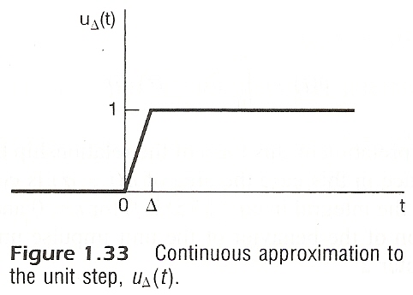
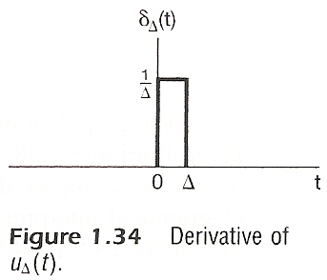

Slide 41
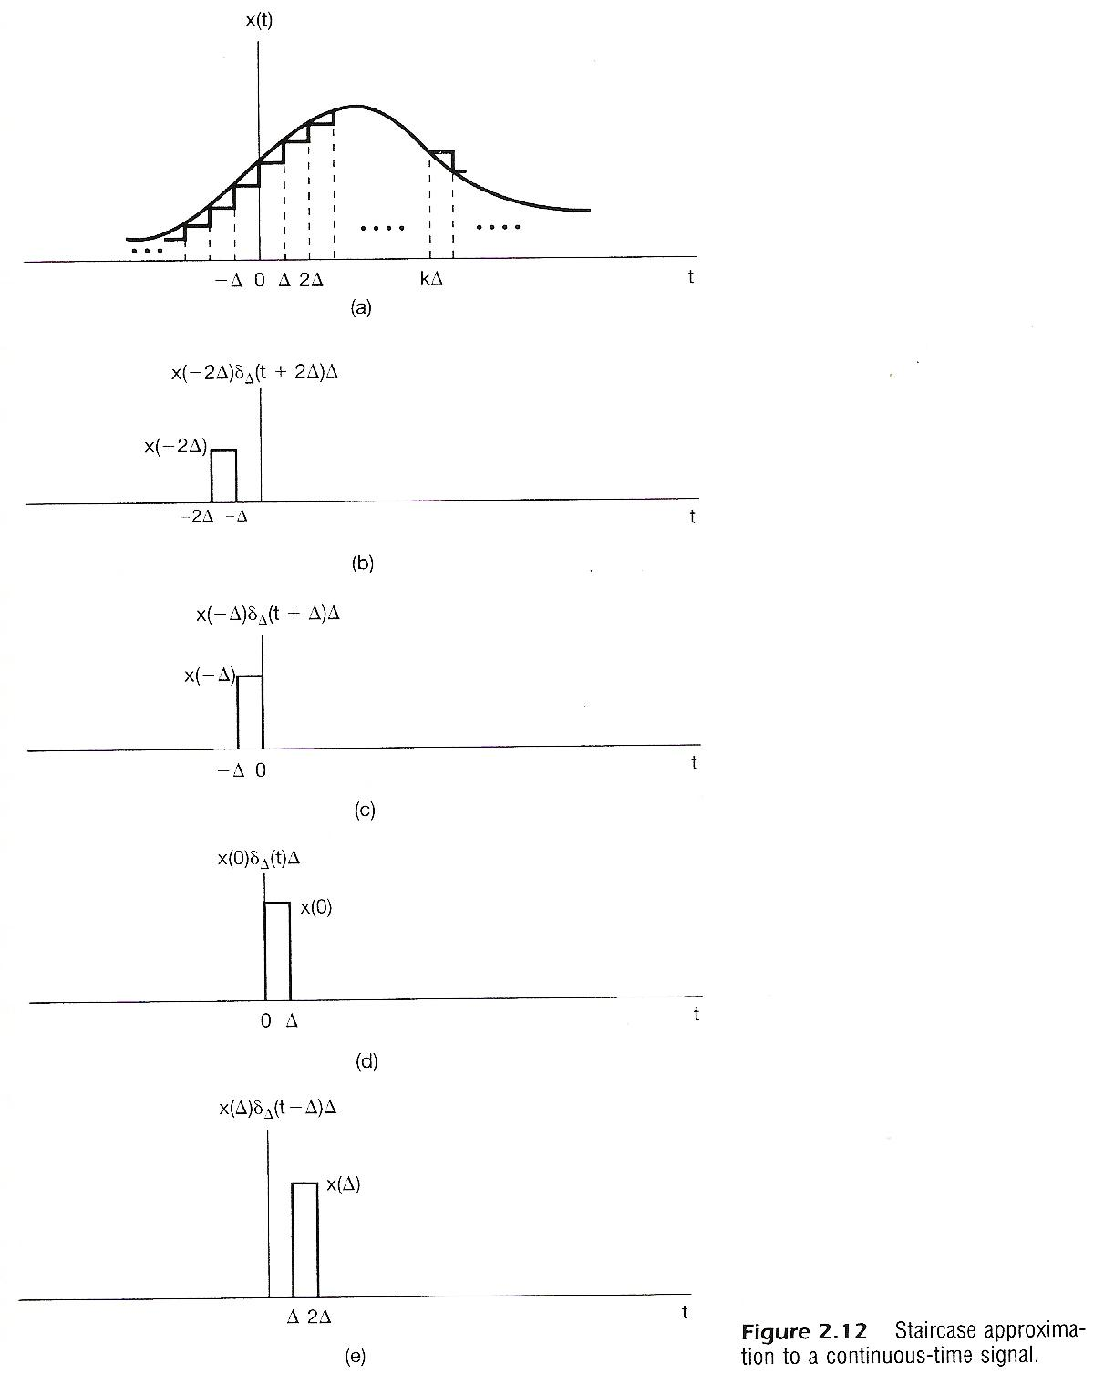

Slide 42
Vector Space Representation of Discrete-
time Signals (P.48 of 1.0)
n extended to $± ∞$
$\vec{x}=(⋯,x_{−2},x_{−1},x_{0},x_{1},x_{2},x_{3}, ⋯)$
$\hat{v_{0}}=$ (⋯, 0, 0, 1, 0, 0, 0, ⋯ )=δ [ $n$ ]
$\hat{v_{1}}=$ (⋯, 0, 0, 0, 1, 0, 0, ⋯ )=δ [ $n$ – 1 ]
$\hat{v_{k}}=$ (⋯, 0, 0, 0, ⋯, 0, 1, ⋯ )=δ [ $n$ – k ]
$\{δ\left[n−k\right], k:\text{inter}\text{\}}$
$$\vec{x}=\sum_{i}{x_{i}\hat{v_{i}}} 合成$$
$x_{j}= \vec{x}⋅\hat{v_{j}}$ 分析

Slide 43
Vector Space Interpretation (P.8 of 2.0)
$$x\left[n\right]=\sum_{k=−∞}^{∞}{x\left[k\right] δ [n−k]} (是合成也是分析)$$
$$x[k]$$
$$x[k]$$
$$x[n]$$
$$n$$
$$k$$
$$k$$
$$n$$
$$δ[k−n]$$
$$δ[k−n]$$
$$n$$
$$k$$
$$k$$
$$n$$
$$\vec{A}=\sum_{k}{a_{k} \hat{v_{k}}} (合成)$$
$$a_{j}=\vec{A}⋅\hat{v_{j}} \left(分析\right)$$
$$a_{n}=\vec{A}⋅\hat{v_{n}} (\vec{A}⋅\vec{B}=\sum_{k}{a_{k} b_{k}})$$

Slide 44
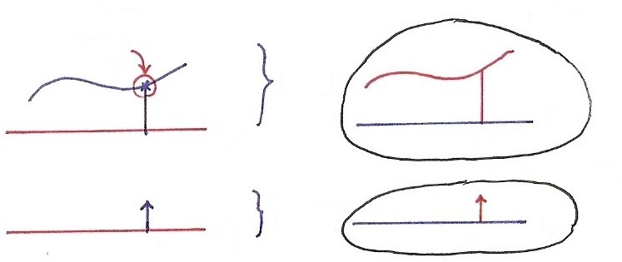
Vector Space Representation
$$x\left(t\right)=\int_{−∞}^{∞}{x}\left(τ\right) δ\left(t−τ\right)dτ\text{(}是合成也是分析\text{)}$$
$$x\left(τ\right)$$
$$x\left(τ\right)$$
$$x\left(t\right)$$
$$t$$
$$τ$$
$$τ$$
$$t$$
$$δ\left(t−τ\right)$$
$$δ\left(τ−t\right)$$
$$t$$
$$τ$$
$$τ$$
$$t$$
$$\vec{A}=\sum_{k}{a_{k}}\hat{v_{k}} \text{(}合成\text{)}$$
$$a_{j}=\vec{A}⋅\hat{v_{j}}\text{ (}分析\text{)}$$
discrete-time:
continuous-time:
$\overset{⃑}{A}⋅\overset{⃑}{B}=\sum_{n}{a}\left[n\right] b^{∗}\left[n\right]$
$\overset{⃑}{A}⋅\overset{⃑}{B}=\int_{−∞}^{∞}{a\left(t\right)}b^{∗}\left(t\right) dt$

Slide 45
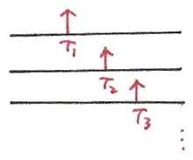
Continuous-time Vector Space
$\left\{ x(t) | τ_{2}≤t≤τ_{1} \right\}$ or $\left\{ x(t) | −∞<t<∞ \right\}$
$ax(t)$, $x_{1}\left(t\right)+x_{2}\left(t\right)$
{ $δ(t−τ)$, $−∞<τ<∞$ } is a set of basis
$$t$$
$$δ(t−τ_{1})$$
$$t$$
$$δ(t−τ_{2})$$
$$t$$
$$δ(t−τ_{3})$$
$$\left[x\left(t\right)\right]⋅\left[y\left(t\right)\right]=\int_{−∞}^{∞}{x\left(t\right)}y^{∗}\left(t\right) dt$$
$$\left|x(t)\right|={\left|\int_{−∞}^{∞}{{\left|x(t)\right|}^{2} dt}\right|}^{1/2}$$

Slide 46
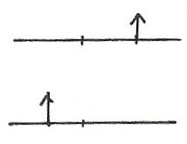
Unit Step
1
$$u\left(t\right)=\int_{0}^{∞}{δ\left(t−τ\right)}dτ$$
t
0
$$δ\left(τ−t\right)$$
$$τ$$
$$t>0$$
0
t
$$δ\left(τ−t\right)$$
$$τ$$
$$t<0$$
t
0
running integral
$$u\left(t\right)=\int_{−∞}^{t}{δ\left(τ\right)}dτ, τ=t−τ^{′}$$

Slide 47
Representing an arbitrary signal as an integral of
impulses
Sifting Property : (分析)
Looked at on the index τ, δ(t-τ) located at τ = t shifts the value x(t) out of the function x(τ)
See Fig 2.14 ,p.94 of text

Slide 48
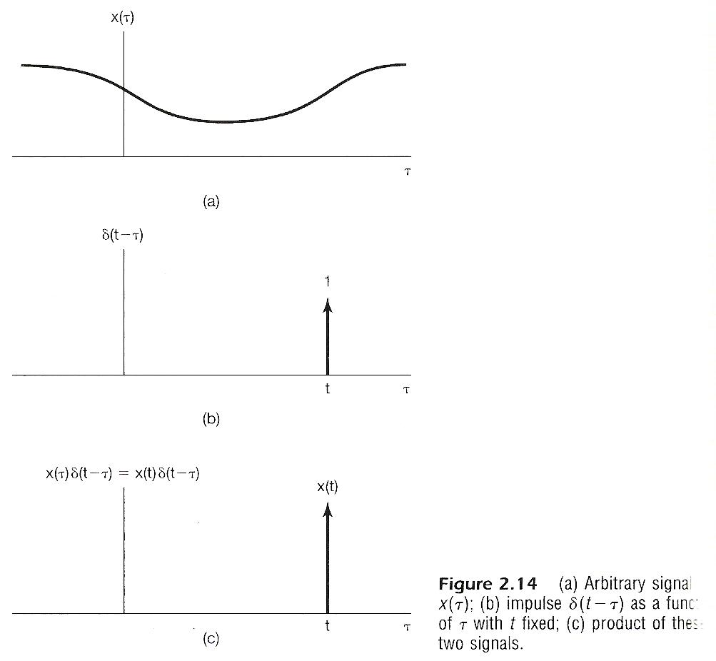

Slide 49
Defining the output for an unit impulse input as the unit impulse response
S
Unit Impulse Response
t
t
0
0

Slide 50
By Linearity (Superposition Property)
The output for an arbitrary input signal is the superposition of a series of “shifted, scaled unit impulse response”
Convolution Integral

Slide 51
Defining the output for an unit impulse input as the
Unit Impulse Response (P.10 of 2.0)
x[n]=δ[n]
y[n]=h[n]:unit impulse response
S
0
n
0
n

Slide 52
By Linearity (Superposition Property) (P.11 of 2.0)
The output for an arbitrary input signal is the superposition of a series of “shifted, scaled unit impulse response”
x[k]
δ[n-k]
x[k]
h[n-k]
Convolution Sum
See Fig2.3,p.80 of text

Slide 53
Input/Output Relation in Every Dimension
(P.12 of 2.0)
$$δ[n]$$
$$h[n]$$
$$y[n]$$
$$x[n]$$
$x\left[0\right] h[n]$
$$x[0]$$
$$x[1]$$
$x\left[1\right] h[n−1]$
$x\left[2\right] h[n−2]$
$$x[2]$$

Slide 54
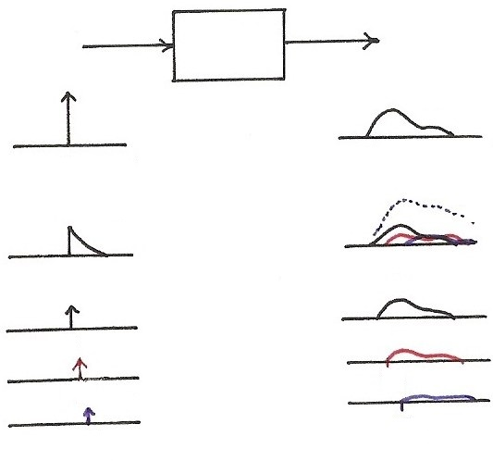
Input/Output Relation in Every Dimension
$$δ(t)$$
$$h(t)$$
$$t$$
$$t$$
0
0
$$x(t)$$
$$y(t)$$
$$t$$
$$t$$
0
$${τ_{1} τ}_{2}$$
$$t$$
$$t$$
0
0
$$t$$
$$t$$
$$τ_{1}$$
$$τ_{1}$$
$$t$$
$$t$$
$$τ_{2}$$
$$τ_{2}$$

Slide 55
A Different Way to visualize the convolution integral
Look on the index τ
input signal
output signal at time t
reflected-over version of h(t)located at τ =t
On the dummy index τ, h(t) is reflected over and shifted to τ = t, weighted by x(t) and integrated to produce the output value at time t, y(t)
see Figs.2.19,2.20,2.21,pp.100-101 of text
A linear time-invariant system is completely
characterized by its unit impulse response

Slide 56
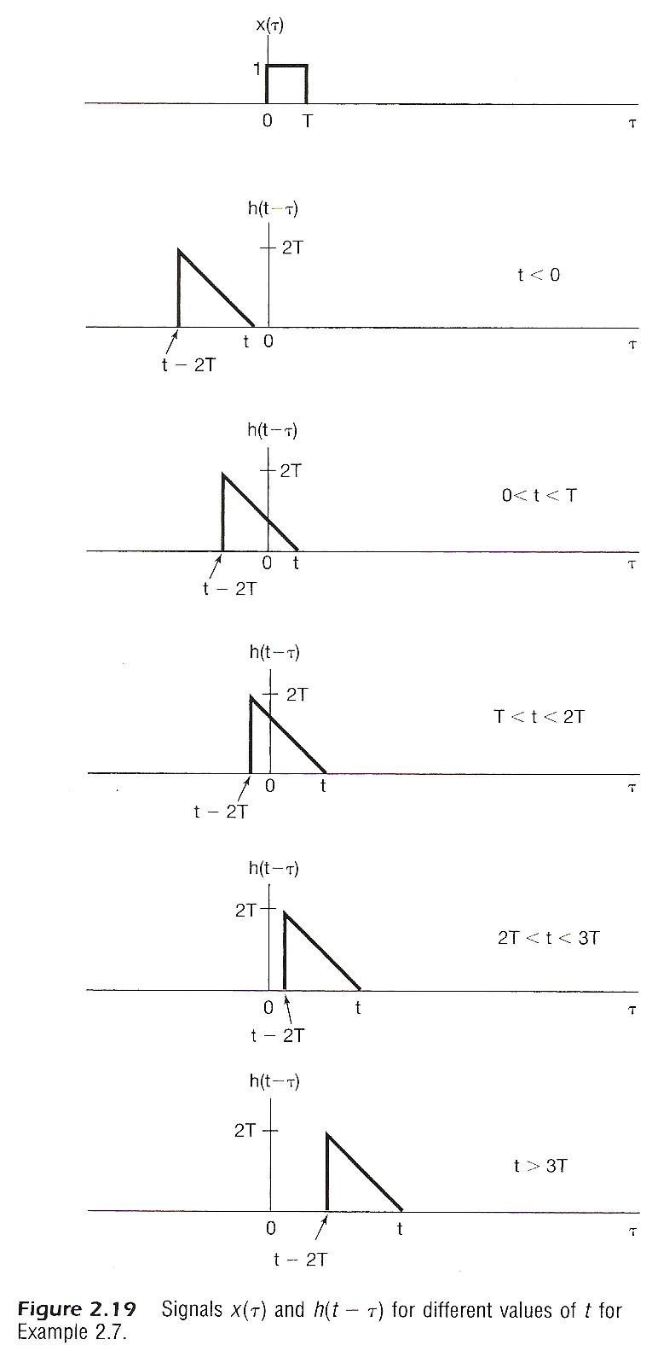
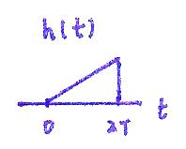
$$−2T$$
0
$$h(−t)$$

Slide 57
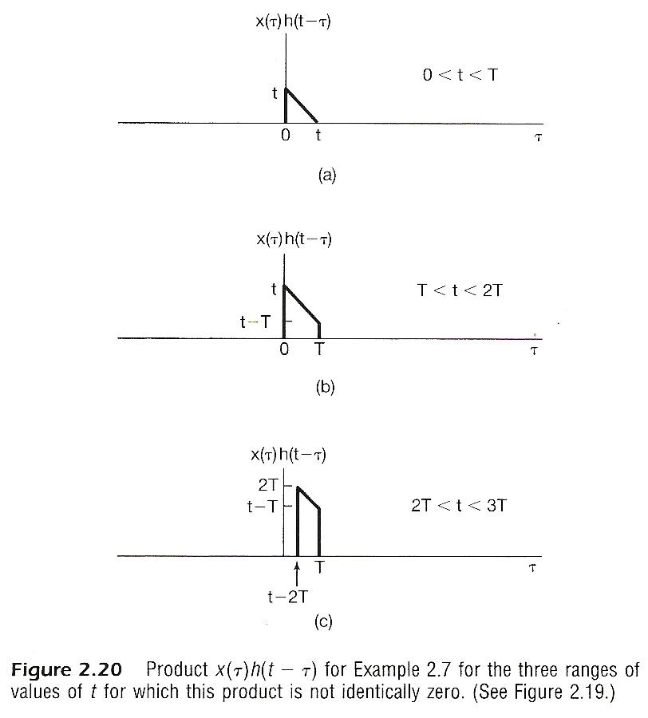

Slide 58
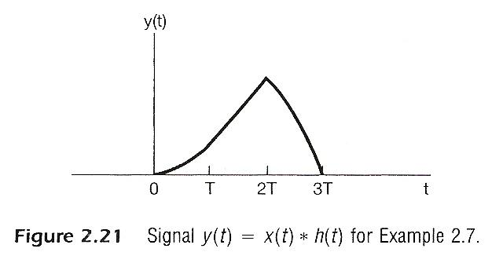

Slide 59
2.4 Properties of Linear
Time-invariant Systems
Commutative Property
the role of input signal and unit impulse response is interchangeable, giving the same output signal
In evaluating the convolution sum or integral, the input signal can be reflected over and weighted by the unit impulse response

Slide 60
Distributive Property
additive (linear) property

Slide 61
Associative Property
Cascade of two systems gives an unit impulse response which is the convolution of the unit impulse responses of the two individual systems
The behavior of a cascade of two systems is independent of the order in which the two systems are cascaded

Slide 62
Causality
causal if y[n] dose not depend on x[k] for k > n
Causal iff h[n]=0, n < 0

Slide 63
Causality
continuous-time
Causal iff h(t)=0,t<0

Slide 64
Causality (P.56 of 1.0)
$$x[n]$$
$$y[n]$$
$$n$$
$$n$$
$$y\left[n\right]=\sum_{k=−∞}^{n+m}{x[k]}$$

Slide 65
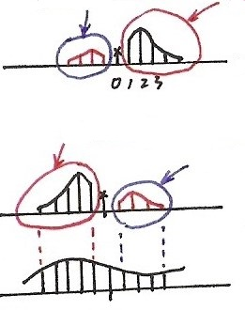
Causality & Memory
$$y\left[n\right]=\sum_{k=−∞}^{∞}{x}\left[k\right] h[n−k]$$
(for future)
non-causal
memory
(for past)
$$h[n]$$
$$n$$
memory
non-causal
$$h[n−k]$$
$$k$$
$$n$$
$$x[k]$$
$$k$$
$$n$$
$$( h\left[n\right]=0\text{, }n<0 )⇔( h\left[n−k\right]=0\text{, }k>n )\text{: }\text{Causality}$$

Slide 66
Memoryless / with Memory
A linear, time-invariant, causal system is memoryless only if
if k=1 further, they are identity systems
identity for convolution , i.e., convolution sum (or integral) with an unit impulse function gives the original signal

Slide 67
Invertibility / Inverse system

Slide 68
Stability
stable if bounded input gives bounded output
|x[n]| < B, all n
Stable iff the impulse response is absolutely summable,
or absolutely integrable,
the necessary condition can be proved

Slide 69
Unit step response
output for an unit step function input
similarly
Running sum
First difference
Running integral
First derivative

Slide 70
2.5 Systems Described by
Differential/Difference Equations
Continuous-time
Differential Equation Specification for Input/Output Relationships
derived by physical phenomena and relationships
very often auxiliary conditions are needed to completely specify the system

Slide 71
Continuous-time
Differential Equation Specification for Input/Output Relationships
the response y(t) to an input x(t) in general consists of two parts:
(1) homogeneous solution (natural response): a solution for
(2) particular solution: to the complete differential equation

Slide 72
Continuous-time
Initial Rest Condition for Causal Systems
initial conditions

Slide 73
Discrete-time
Difference Equation Specification
derived by sequential behavior of different processes
auxiliary conditions needed
response y(t) consists of two parts
(1) homogeneous solution (natural response) for
(2) particular solution

Slide 74
Discrete-time
Initial Rest Condition for Causal Systems
Recursive Equation
output at time n expressed in terms of previous values of input/output

Slide 75
Discrete-time
Recursive Equation
N=0, reduced to a convolution sum
Finite Impulse Response (FIR) systems
Infinite Impulse Response(IIR) Systems
$$y\left[n\right]=\sum_{k=0}^{M}{ (\frac{ b_{k} }{ a_{0} })} x [n−k]$$
$$h\left[n\right]=\left\{\begin{aligned}b_{n}/a_{0}\text{, }0≤n≤M \\ 0\text{ , }\text{else} \end{aligned}\right.$$

Slide 76
Block Diagram Representation
Elementary Operations
x₂[n]
x₂(t)
x₁[n]
x₁(t)
x₁[n]+ x₂[n]
x₁(t)+ x₂(t)
x[n]
x(t)
a
ax[n]
ax(t)

Slide 77
Block Diagram Representation
Elementary Operations
x[n]
D
x[n-1]
x(t)
x(t)

Slide 78
Block Diagram Representation
An Example
b
x[n]
y[n]
D
-a
y[n-1]
Feedback, with memory, initial value of the memory element as the initial condition
Initial rest condition: initial value in the memory element is zero

Slide 79
Block Diagram Representation
Continuous-time Example
x(t)
y(t)

Slide 80
Block Diagram Representation
Continuous-time Example
Expressed by integrator, assuming initially at rest
b
x(t)
y(t)
-a
The integrator represents the memory element

Slide 81
2.6 The Unit Impulse for
Continuous-time Cases
Many Different Functions
Approaching δ(t) in the Limit
Identity for convolution

Slide 82
Unit Impulse
$$δ(t)$$
$$h(t)$$
$$h(t)$$
$$x(t)$$
$$y\left(t\right)=x\left(t\right)∗h\left(t\right)$$
$$x\left(t\right)=\int_{−∞}^{∞}{x\left(τ\right)}δ\left(t−τ\right)dτ=x\left(t\right)∗δ(t)$$
(是分析, 是合成, 是單位元素)
$$x(t)$$
$$x(t)$$
$$δ(t)$$
$$y\left(t\right)=x\left(t\right)∗δ\left(t\right)=x(t)$$
$$δ(t)$$
$$x(t)$$
$$x(t)$$
$$δ(t)$$
$$δ(t)$$
$$δ(t)$$
$$δ\left(t\right)=δ\left(t\right)∗δ\left(t\right)∗δ(t)$$

Slide 83
Many Different Functions
Approaching δ(t) in the Limit
Let
See Fig. 2.33, p. 128 of text
then
.
.
.
.

Slide 85
Many Different Functions
Approaching δ(t) in the Limit
Let

Slide 86
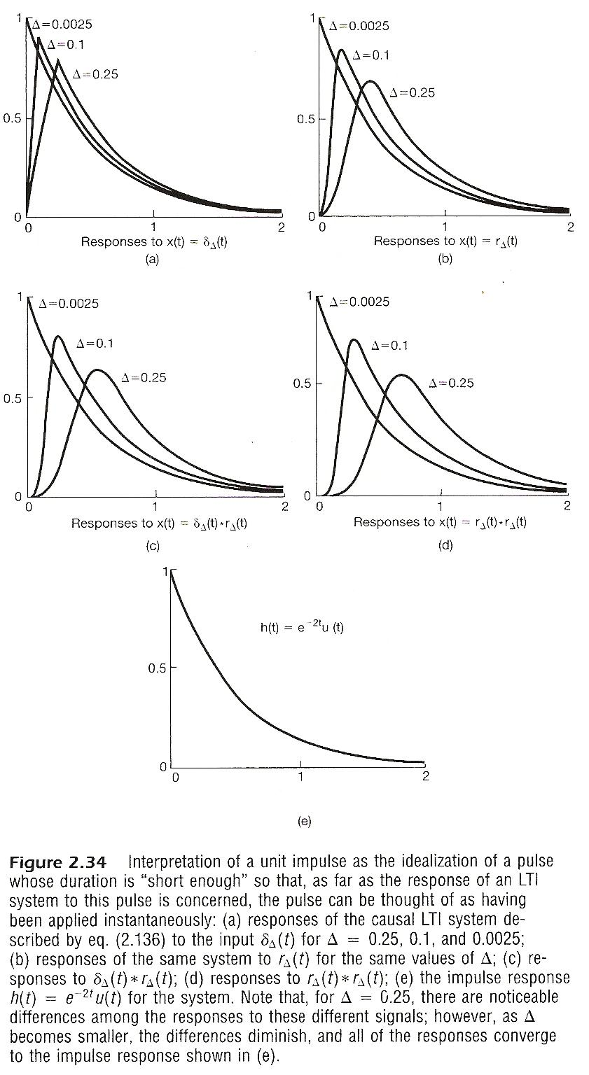

Slide 87
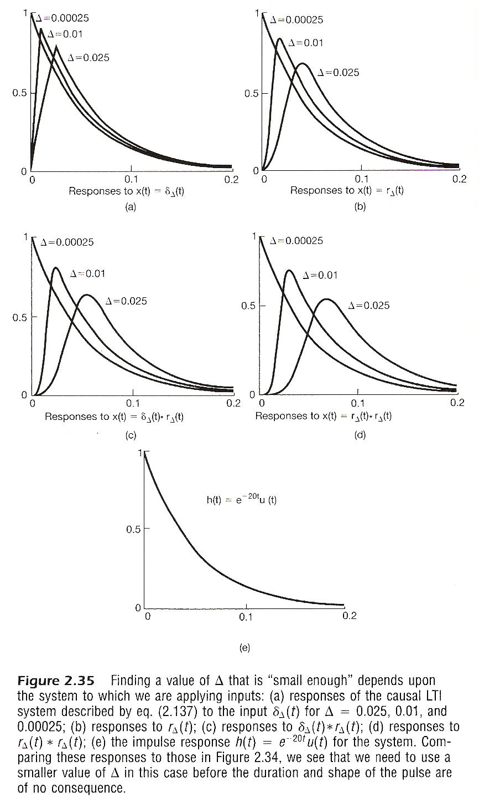

Slide 88
Operational Definition of Unit Impulse
A Function can be defined by
what it is at each value of the independent variable
what it does under some mathematical operation such as an integral or a convolution, or some mathematical constraints: Singularity Function

Slide 89
$$x\left(t\right)=\int_{−∞}^{∞}{x}\left(τ\right) δ\left(t−τ\right) dτ$$

Slide 90
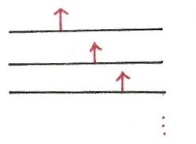
Operational Definition of δ(t)
{$δ\left(t−τ\right), −∞<τ<∞$} is a set of basis
All are operational definitions
$$x\left(t\right)=\int_{−∞}^{∞}{x}\left(τ\right) δ\left(t−τ\right)dτ=x\left(t\right)∗δ(t)$$
$$t$$
是合成也是分析
是單位元素
$$τ_{1}$$
$$t$$
$$τ_{2}$$
$$t$$
$$τ_{3}$$

Slide 91
Differentiator, Integrator and
Singularity Functions
Differentiator
x(t)
unit impulse response

Slide 92
See Fig. 2.36, p. 134 of text

Slide 93
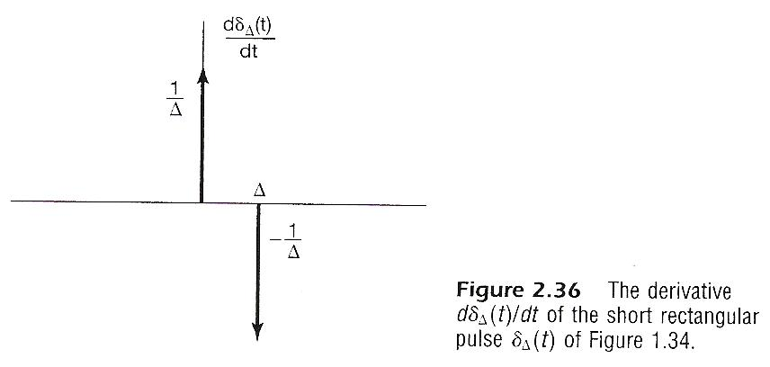

Slide 94
Differentiator, Integrator and
Singularity Functions
Cascade of Differentiators
k times

Slide 95
Differentiator, Integrator and
Singularity Functions
Integrator
unit impulse response

Slide 96
Differentiator, Integrator and
Singularity Functions
Cascade of Integrators
unit ramp function

Slide 97
Differentiator, Integrator and
Singularity Functions
Cascade of Integrators
k times

Slide 98
Differentiator, Integrator and
Singularity Functions
Unified Definition
||
δ(t)
integrators differentiators

Slide 99
Differentiator, Integrator and
Singularity Functions
Unified Definition
operational definitions with singularity functions
manipulate operations efficiently and easily
||
δ(t)
integrators differentiators

Slide 100
2.7 Vector Space Interpretation for
Continuous-time Systems
Vector Space Concept
The Set of All Continuous-time Signals Defined in
(t₁, t₂) Forms A Vector Space
{x(t), x(t) is a continuous-time signal defined in
(t₁,t₂)}=V
definitions and properties

Slide 101
Vector Space Concept
Definition of Inner-product
similar to

Slide 102
Vector Space Concept
Magnitude/Similarity

Slide 103
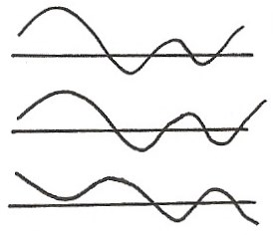
Inner Product for Continuous-time Signals
$$\left[x\left(t\right)\right]⋅\left[y\left(t\right)\right]=\int_{−∞}^{∞}{x\left(t\right)}y^{∗}\left(t\right) dt$$
$$x\left(t\right)$$
$$y_{1}\left(t\right)$$
$$y_{2}\left(t\right)$$
$$\left[x\left(t\right)\right]⋅\left[y_{1}\left(t\right)\right]>\left[x\left(t\right)\right]⋅\left[y_{2}\left(t\right)\right]$$

Slide 104
Vector Space Concept
Orthonormal Bases
orthogonal
orthonormal

Slide 105
Vector Space Concept
a typical example of orthonormal signal set
b: scaling factor
orthonormal basis
any vector in the vector space can be expanded by the set of orthonormal signals

Slide 107
Vector Space for Continuous-time
Signals
Vector Space
Orthonormal Bases(?)
time-shifted unit impulses, dim=∞
Inner-product

Slide 108
Vector Space for Continuous-time
Signals
Orthonormal Bases(?)
Inner-product
Not really orthonormal (but are orthogonal), but makes sense under the operational definition

Slide 109
System Characterization
A Signal expanded by unit impulse bases
(合成)
sifting property of $δ(t)$
extracting the component of $x(t)$ at $τ=t$
(分析)

Slide 110
System Characterization
A System is a Transformation
x(t)
H
y(t)
δ(t)
h(t)
Can’t be represented by a matrix due to the discrete property of the matrices, but the concept is the same

Slide 111
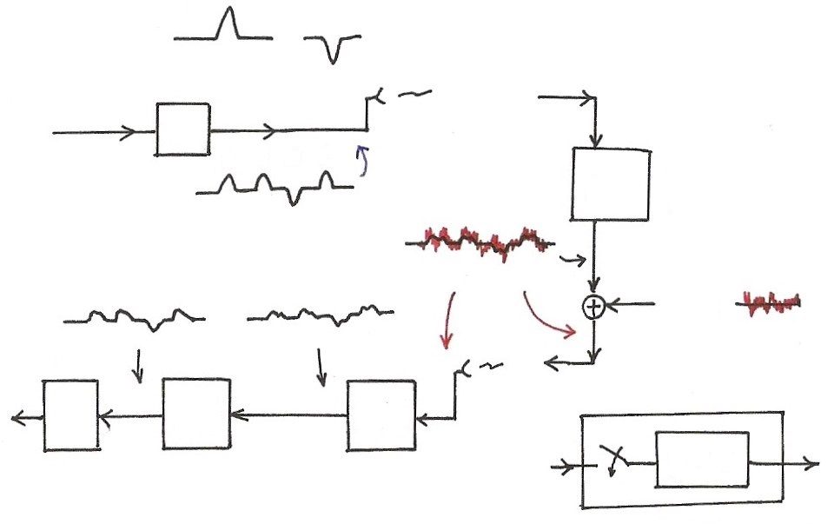
Data Transmission
“1”
“0”
Transmitter
…1101 …
1 1 0 1
$$h_{c}\left(t\right)$$
channel distortion
$$n\left(t\right)$$
noise
…1101 …
$$h_{2}\left(t\right)$$
$$h_{1}\left(t\right)$$
$$h_{1,2}[n]$$
Decision
equalizer
front-end
filter
$$h_{2}[t]≈h_{c}^{−1}[t]$$
$$h_{1,2}[t]$$

Slide 112
Examples
Example 2.11, p.110 of text
time shift of signals
convolution of a signal with a shifted impulse is the signal itself but shifted
x(t)
y(t)=x(t-t₀)
h(t)
δ(t)
h(t)= δ(t-t₀)

Slide 113
Examples
Example 2.12, p.111 of text
running sum or accumulation
first difference is the inverse
y[n]=x[n]-x[n-1]
h₁[n]=δ[n]-δ[n-1]
u[n]*{δ[n]-δ[n-1]}=u[n]-u[n-1]=δ[n]
x[n]
h[n]
δ[n]
h[n]=u[n]

Slide 114
Examples
…

Slide 115
Problem 2.51(a), p.154 of text
System A is linear, time-invariant with
$h\left[n\right]={(\frac{1}{2})}^{n} u[n]$
System B is linear but time-varying with
$y\left[n\right]=nx[n]$
Show that the commutativity property does not hold for
$\left[A−B\right]$ and $\left[B−A\right]$ cascade structure
For $\left[A−B\right]$
$x_{1}\left[n\right]=δ\left[n\right]$, $y_{1}\left[n\right]={(\frac{1}{2})}^{n} u\left[n\right]$, $z_{1}\left[n\right]=n{(\frac{1}{2})}^{n} u\left[n\right]$
For $\left[B−A\right]$
$x_{1}\left[n\right]=δ\left[n\right]$, $y_{1}\left[n\right]=0$, $z_{1}\left[n\right]=0$

Slide 116
Problem 2.64, p.166 of text
A simplified echo system and its inverse
x(t)
y(t)
……
x(t)
y(t)
T
½
T
(-½)
h(t)
g(t)

Slide 117
Problem 2.64, p.166 of text
A more realistic model
stability analysis
0<α<1, , stable
α>1, not integrable, “NOT” stable
x(t)
y(t)
……
x(t)
y(t)
α
T
T
(-α)
h(t)
g(t)

