Slide 1
Deep Learning
Do machines know the meaning of a word?
Hung-yi Lee
Notes:
Preparing the demo
Extra topic:
maybe I can talk about relation extraction
Rest:
Paragraph vector
Introducing document vector
convolutional DSSM or parsing tree
Introducing the whole representation
Topic covered:
Motivation: meaning representation
Meaning of one word:
predict the next word
structure
How to train 1
why? What we get (done)
other structure 1
Meaning of a sentence:
Deep Semantic 1
+ convolution 1
Paragraph Vector 1
Outlook: parsing, composition

Slide 2



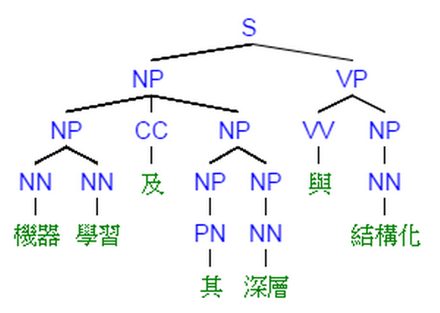



Language Technology
spam detection
Sentiment Analysis
Retrieval
這部電影太糟了
Negative (負雷)
(http://spam-filter-review.toptenreviews.com/)
Translation
Speech Recognition
Part-of-speech Tagging
“Machine learning ……”
John saw the saw.
大家好……
“機器學習 ……”
PN V D N
Syntactic Analysis
Summarization
Name Entity Recognition
這 位 是 李 宏 毅
Name of People
  document
  summary
Notes:
http://naviglinlp.blogspot.tw/2015/03/lecture-1-introduction.html
Searle'sChinese Room argument.

Slide 3
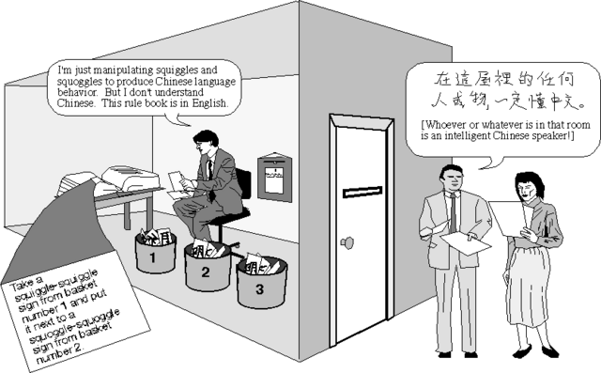
Do machine really understand human language?
http://cse3521.artifice.cc/chinese-room.html
Notes:
black

Slide 4
Meaning Representation
Do machine know the meaning of a word or word sequence?
tree
flower
the animals with four legs
dog
rabbit
run
jump
cat

Slide 5
Meaning of Word

Slide 6
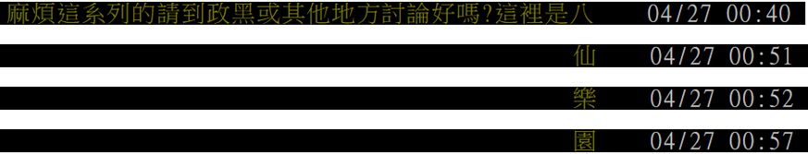
Predicting the next word
Given a sequence of words, predict the next word
Ref: http://pttpedia.pixnet.net/blog/post/167961207-%E9%80%99%E8%A3%A1%E6%98%AF%E5%85%AB%E4%BB%99%E6%A8%82%E5%9C%92
Notes:
Any application?
Describe latter

Slide 7
Predicting the next word
Given a sequence of words, predict the next word
……
是
八
仙
這裡
w_{i-3}
w_{i-2}
w_{i-1}
w_{i}
Neural
Network
  Input: the previous words w_{i-1}, w_{i-2}
  Output: the most possible next word w_{i}
Each word should be represented as a feature vector.
Notes:
Any application?
Describe latter

Slide 8
Predicting the next word
1-of-N Encoding
lexicon = {apple, bag, cat, dog, elephant}
apple = [ 1 0 0 0 0]
The vector is lexicon size.
bag = [ 0 1 0 0 0]
Each dimension corresponds to a word in the lexicon
cat = [ 0 0 1 0 0]
dog = [ 0 0 0 1 0]
  The dimension for the word is 1, and others are 0
elephant = [ 0 0 0 0 1]
Notes:
Can be very large

Slide 9
Predicting the next word
…… w_{i-2} w_{i-1} ___
  0
The probability for each word as the next word w_{i}
  1
  w_{i-2}
  lexicon size
  0
……
Neural
Network
P(w_{i}=“apple”)
P(w_{i}=“bag”)
P(w_{i}=“cat”)
  0
P(w_{i}=“dog”)
  0
  w_{i-1}
  lexicon size
P(w_{i}=“elephant”)
  1
……
Output layer: Softmax
  lexicon size
Notes:
Which layer, how many

Slide 10
Predicting the next word
Application?
Training:
這裡
Neural
Network
八
Collect data:
是
這裡 是 八 仙 樂園
………
………
………
是
Neural
Network
仙
八
Minimizing cross entropy
八
Neural
Network
樂園
仙
Notes:
What can it do?

Slide 11
Word Vector
  0
  z₁
  1-of-N encoding
  of the word w_{i-1}
  1
  z₂
The probability for each word as the next word w_{i}
  0
……
……
…
……
Take out the input of the neurons in the first layer
z₂
tree
flower
Use it to represent a word w
dog
rabbit
run
jump
cat
Word vector, word embedding feature: V(w)
z₁
Notes:
Note that we only consider one input word, we only consider wi-1
We will consider multiple word
The structured is a little different

Slide 12
Word Vector
You shall know a word by the company it keeps
  0
  z₁
  1
  z₂
The probability for each word as the next word w_{i}
  0
……
……
李逍遙
or
酒劍仙
…
……
“御劍飛行 ” should have large probability
Training text:
z₂
…… 李逍遙 御劍飛行 ……
李逍遙
w_{i-1}
w_{i}
酒劍仙
…… 酒劍仙 御劍飛行 ……
w_{i-1}
w_{i}
z₁
Notes:
Why the word vectors can probably capture the meaning of the words

Slide 13
Word Vector – Sharing Parameters
  0
  z₁
  1-of-N encoding
  of the word w_{i-2}
  1
  z₂
The probability for each word as the next word w_{i}
  0
……
……
…
  0
The weights with the same color should be the same.
  1-of-N encoding
  of the word w_{i-1}
  0
  1
……
Or, one word would have two word vectors.
Notes:
Should I describe it more clearly?

Slide 14
Word Vector – Sharing Parameters
  0
  z₁
  1-of-N encoding
  of the word w_{i-2}
  1
  W₁
  z₂
The probability for each word as the next word w_{i}
  0
……
……
…
  z
  x_{i-2}
  0
  The length of x_{i-1} and x_{i-2} are both |V|.
  1-of-N encoding
  of the word w_{i-1}
  W₂
  The length of z is |Z|.
  1
  z = W₁ x_{i-2} + W₂ x_{i-1}
  0
……
The weight matrix W₁ and W₂ are both |Z|X|V| matrices.
  x_{i-1}
  z = W ( x_{i-2} + x_{i-1} )
  W₁ = W₂
  = W
Notes:
Should I describe it more clearly?
Can consider longer history

Slide 15
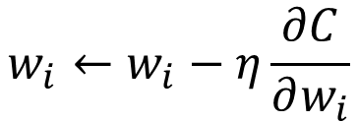
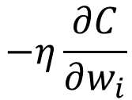
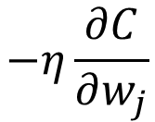
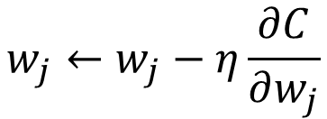
Word Vector – Sharing Parameters
  0
  z₁
  1-of-N encoding
  of the word w_{i-2}
w_{i}
  1
  z₂
The probability for each word as the next word w_{i}
  0
……
……
…
w_{j}
  0
How to make w_{i} equal to w_{j}
  1-of-N encoding
  of the word w_{i-1}
Given w_{i} and w_{j} the same initialization
  0
  1
……
$$w_{i}←w_{i}−η\frac{∂C}{∂w_{i}}$$
$$−η\frac{∂C}{∂w_{j}}$$
$$w_{j}←w_{j}−η\frac{∂C}{∂w_{j}}$$
$$−η\frac{∂C}{∂w_{i}}$$
Notes:
Should I describe it more clearly?
You can also do avg.
Pointer concept

Slide 16
Word Vector
– Various Architectures
Continuous bad of word (CBOW) model
Skip-gram
w_{i-1}
Neural
Network
…… w_{i-1} ____ w_{i+1} ……
w_{i}
w_{i+1}
predicting the word given its context
…… ____ w_{i} ____ ……
Neural
Network
w_{i-1}
w_{i}
w_{i+1}
predicting the context given a word

Slide 17
Beyond 1-of-N encoding
Dimension for “Other”
Word hashing
apple
0
a-a-a
0
bag
0
a-a-b
0
…
…
cat
0
a-p-p
1
dog
0
…
…
…
26 X 26 X 26
elephant
0
p-l-e
1
…
…
p-p-l
1
“other”
1
…
…
w = “apple”
w = “Gandalf”
w = “Sauron”

Slide 18
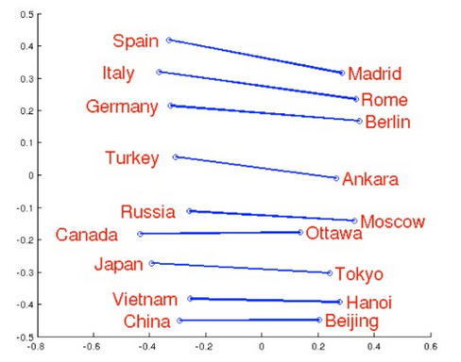
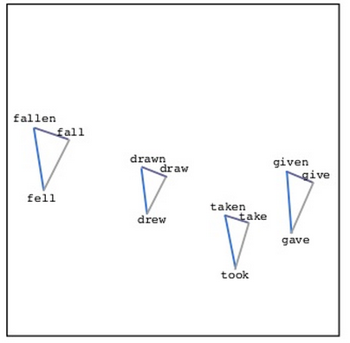
Word Vector
Source: http://www.slideshare.net/hustwj/cikm-keynotenov2014
Notes:
Why can it happen
How to explain it

Slide 19
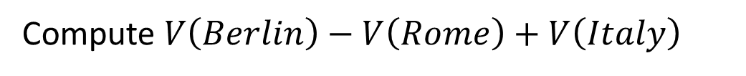
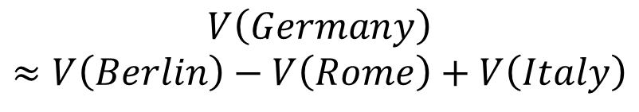
Word Vector
$$V\left(Germany\right)$$
$$≈V\left(Berlin\right)−V\left(Rome\right)+V\left(Italy\right)$$
Characteristics
Solving analogies
$$V\left(hotter\right)−V\left(hot\right)≈V\left(bigger\right)−V\left(big\right)$$
$$V\left(Rome\right)−V\left(Italy\right)≈V\left(Berlin\right)−V\left(Germany\right)$$
$$V\left(king\right)−V\left(queen\right)≈V\left(uncle\right)−V\left(aunt\right)$$
Rome : Italy = Berlin : ?
Compute $V\left(Berlin\right)−V\left(Rome\right)+V\left(Italy\right)$
Find the word w with the closest V(w)

Slide 20
Demo
Model used in demo is provided by 陳仰德
  Part of the project done by 陳仰德、林資偉
  TA: 劉元銘
  Training data is from PTT (collected by 葉青峰)
Notes:
魯夫 or 李_逍遙 or 御_坂_美_琴
宅
魯_蛇
本_魯*
宅_宅*
好棒*
好棒_棒*
魯夫 海賊王 鳴人
溫_拿 winner 魯_蛇*
魯_蛇 窮 溫_拿*
研究生 期刊 漫畫家*
研究生 做_實驗 漫畫家

Slide 21
Meaning of Word Sequence

Slide 22
Meaning of Word Sequence
word sequences with different lengths → the vector with the same length
  The vector representing the meaning of the word sequence
  A word sequence can be a document or a paragraph
…
word sequence
(a document or paragraph)
Notes:
The meaning of word is ambiguous
It can be easy for a document

Slide 23
Meaning of Word Sequence
- Outline
Deep Structured Semantic Model
(DSSM)
Application: Information Retrieval (IR)
Application: Sentiment Analysis
Paragraph Vector
Unsupervised
Recursive Deep Model
Reference: http://www.msr-waypoint.net/pubs/198202/cikm2013_DSSM_fullversion.pdf

Slide 24
Information Retrieval (IR)
Vector Space Model
The documents are vectors in the space.
The query is also a vector.
How to use a vector to represent word sequences
Notes:
How to represent a vector

Slide 25
Information Retrieval (IR)
Bag-of-word
this
1
this
1
is
1
is
1
word string s1:
“This is an apple”
word string s2:
“This is a pen”
a
0
a
1
an
1
…
an
0
…
apple
1
apple
0
pen
0
pen
1
Weighted by IDF
Notes:
idf

Slide 26
Information Retrieval (IR)
Vector Space Model + Bag-of-word
Retrieved
Bag-of-word
Query q
Document d₁
Document d₂
All documents in the database
All the words are treated as discrete tokens
Never consider different words can have the same meaning, and the same word can have different meanings
Notes:
Of course suffer from the proble mof bag-of-word

Slide 27
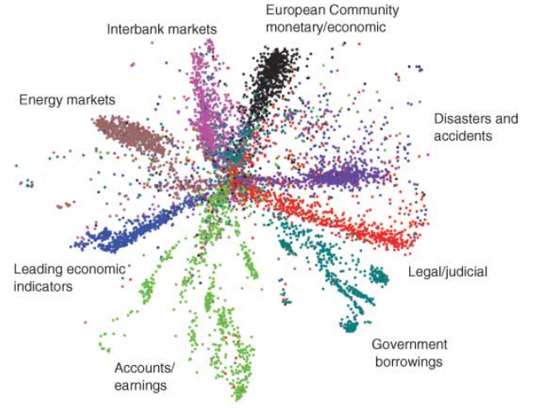
IR - Semantic Embedding
query
Source: http://www.cs.toronto.edu/~hinton/science.pdf
How to achieve that? (No target ……)
Bag-of-word
word string
Auto-encoder is one solution, but not today
(document or query)
Notes:
The qeruy not always have the common word

Slide 28

DSSM
Click-through data:
q₁
d₁
: -
: +
d₂
q₂
d₃
: +
: -
d₄
……
Training:
Far apart
close
query q₁
+
document d₁
-
document d₂
Far apart
close
query q₂
document d₃
-
document d₄
+
Notes:
Can apply on new query q’
If we input this query, this document is relevant
They should be on the same meaning
to the same position

Slide 29

DSSM v.s. Typical DNN
Typical DNN
DSSM
reference
query q
+
document d
input
query q
document d
+

Slide 30
Click-through data:
q₁
d₁
: -
: +
d₂
q₂
d₃
: +
: -
d₄
……
How to do retrieval?
Retrieved
New Query q’
Document d₁
Document d₂

Slide 31
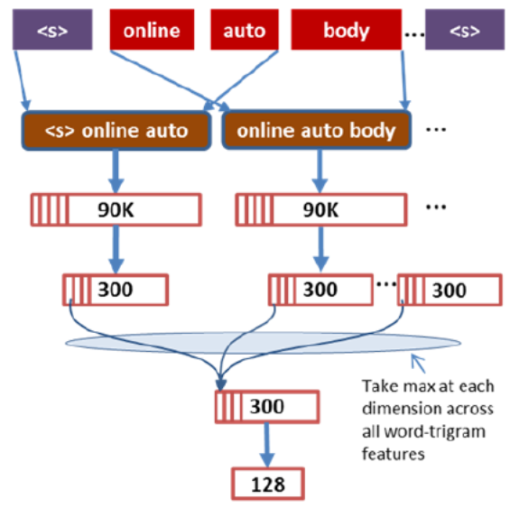
More …
Convolutional DSSM: http://www.iro.umontreal.ca/~lisa/pointeurs/ir0895-he-2.pdf

Slide 32
Meaning of Word Sequence
- Outline
Deep Structured Semantic Model
(DSSM)
Application: Information Retrieval (IR)
Application: Sentiment Analysis
Paragraph Vector
Unsupervised
Recursive Deep Model
  Reference: http://nlp.stanford.edu/~socherr/EMNLP2013_RNTN.pdf

Slide 33
Recursive Deep Model
When understanding the meaning of a word sequence, the order of the words can not be ignore.
white blood cells destroying an infection
positive
different
meaning
exactly the same bag-of-word
an infection destroying white blood cells
negative

Slide 34
Recursive Deep Model
syntactic structure
How to do it is out of the scope
not
very
good
word sequence:
not
very
good
Notes:
Cons$tuency
(phrase
structure)

Slide 35
Recursive Deep Model
syntactic structure
By composing the two meaning, what should the meaning be.
not
very
good
Dimension of word vector = |Z|
Meaning of “very good”
V(“very good”)
Input: 2 X |Z|, output: |Z|
NN
V(“not”)
V(“very”)
V(“good”)
not
very
good
Notes:
Cons$tuency
(phrase
structure)

Slide 36
Recursive Deep Model
syntactic structure
V(w_{A} w_{B}) ≠ V(w_{A}) + V(w_{B})
“not”: neutral
not
very
good
“good”: positive
“not good”: negative
Meaning of “very good”
V(“very good”)
NN
V(“not”)
V(“very”)
V(“good”)
not
very
good
Notes:
Cons$tuency
(phrase
structure)

Slide 37

Recursive Deep Model
syntactic structure
V(w_{A} w_{B}) ≠ V(w_{A}) + V(w_{B})
“棒”: positive
not
very
good
“好棒”: positive
“好棒棒”: negative
Meaning of “very good”
V(“very good”)
NN
V(“not”)
V(“very”)
V(“good”)
not
very
good
Notes:
Cons$tuency
(phrase
structure)

Slide 38
Recursive Deep Model
syntactic structure
“not good”
“not bad”
not
very
good
NN
NN
Meaning of “very good”
“not”
“good”
“not”
“bad”
V(“very good”)
: “reverse” another input
NN
“not”
V(“not”)
V(“very”)
V(“good”)
not
very
good
Notes:
Cons$tuency
(phrase
structure)

Slide 39
Recursive Deep Model
syntactic structure
“very good”
“very bad”
not
very
good
NN
NN
Meaning of “very good”
“very”
“good”
“very”
“bad”
V(“very good”)
: “emphasize” another input
NN
“very”
V(“not”)
V(“very”)
V(“good”)
not
very
good
Notes:
Cons$tuency
(phrase
structure)

Slide 40
The word order is considered.
The representation of the sequence will change if the order of the words are changed
syntactic structure
How to train the NN?
V(“not very good”)
not
very
good
NN
V(“very good”)
NN
V(“not”)
V(“very”)
V(“good”)
not
very
good
Notes:
Cons$tuency
(phrase
structure)

Slide 41
Training Data
5-class sentiment classification
( -- , - , 0 , + , ++ )

Slide 42
Train both …
-
ref
5 classes
( -- , - , 0 , + , ++ )
NN
output
NN
NN
ref
++
output
NN
ref
NN
+
0
ref
0
ref
output
output
output
NN
NN
NN
NN
V(“not”)
V(“very”)
V(“good”)
not
very
good
Notes:
Cons$tuency
(phrase
structure)

Slide 43
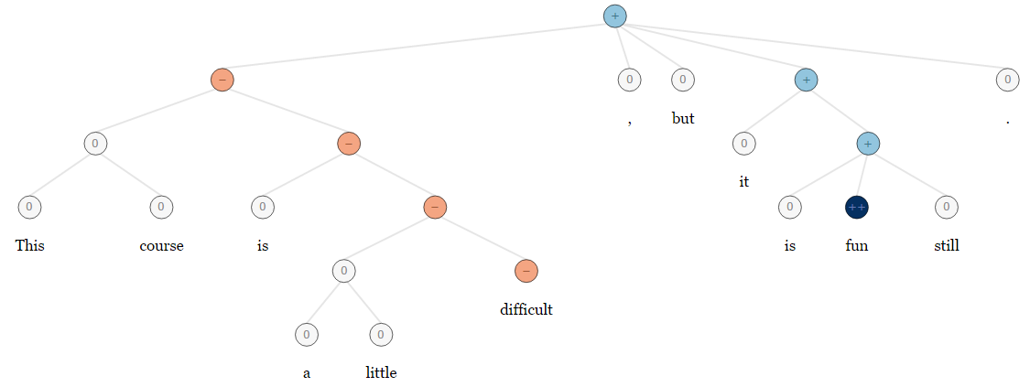
More …
5-class sentiment classification
( -- , - , 0 , + , ++ )
Demo
  http://nlp.stanford.edu:8080/sentiment/rntnDemo.html
This course is a little difficult, but it is fun still.

Slide 44
Meaning of Word Sequence
- Outline
Deep Structured Semantic Model
(DSSM)
Application: Information Retrieval (IR)
Application: Sentiment Analysis
Paragraph Vector
Unsupervised
Recursive Deep Model
  Reference : http://cs.stanford.edu/~quocle/paragraph_vector.pdf
Notes:
google

Slide 45
Neural Network
  1-of-N encoding
  of word w_{i-2}
W
  z₁
  x_{i-2}
The probability for each word as the next word w_{i}
  z₂
……
  1-of-N encoding
  of word w_{i-1}
…
W
  z
  x_{i-1}
  z = W ( x_{i-2} + x_{i-1} )
Paragraph d₁:
(The paragraph is related to “The lord of the ring”)
……
……
  z = W ( x_{i-2} + x_{i-1} )
魔君
名叫
索倫 (Sauron)
w_{i-2}
w_{i-1}
w_{i}
Same output
Paragraph d₂:
(The paragraph is related to “仙五”)
the same
……
魔君
名叫
姜世離
……
  z = W ( x_{i-2} + x_{i-1} )
w_{i-2}
w_{i-1}
w_{i}
Notes:
Then error of the prediction can be explained by the meaning of the paragraphs.

Slide 46
Paragraph Vector
  1-of-N encoding of paragraph d
d₁
1
d₂
0
d₃
0
0
1
0
…
0
…
1
…
  1-of-N encoding
  of paragraph d
0
W’
……
Original word vector:
  z = W ( x_{i-2} + x_{i-1} )
  d
Paragraph vector:
  z = W ( x_{i-2} + x_{i-1} ) + W’ d
  1-of-N encoding
  of word w_{i-2}
Neural Network
W
  z₁
  x_{i-2}
The probability for each word as the next word w_{i}
  z₂
……
  1-of-N encoding
  of word w_{i-1}
…
W
  z
  x_{i-1}

Slide 47
Paragraph Vector
Original word vector:
  z = W ( x_{i-2} + x_{i-1} )
Paragraph vector:
  z = W ( x_{i-2} + x_{i-1} ) + W’ d
Then error of the prediction can be explained by the meaning of the paragraphs.
Paragraph d₁:
(The paragraph is related to “The lord of the ring”)
……
……
魔君
名叫
索倫 (Sauron)
  z = W ( x_{i-2} + x_{i-1} )
w_{i-2}
w_{i-1}
w_{i}
  + W’ d₁
Paragraph d₂:
(The document is related to “仙五”)
different
……
魔君
名叫
姜世離
……
  z = W ( x_{i-2} + x_{i-1} )
w_{i-2}
w_{i-1}
w_{i}
  + W’ d₂
Paragraph vector of d:
  V(d) = W’ d
Meaning of the paragraph
Notes:
Obtain it in an unsupervised way

Slide 48
Meaning of Word Sequence
- Summary
Deep Structured Semantic Model
(DSSM)
Application: Information Retrieval (IR)
Application: Sentiment Analysis
Paragraph Vector
Unsupervised
Recursive Deep Model
Notes:
google

Slide 49


Slide 50
Appendix
Notes:
Extra topic:
maybe I can talk about relation extraction
Rest:
Paragraph vector
Introducing document vector
convolutional DSSM or parsing tree
Introducing the whole representation
Topic covered:
Motivation: meaning representation
Meaning of one word:
predict the next word
structure
How to train 1
why? What we get (done)
other structure 1
Meaning of a sentence:
Deep Semantic 1
+ convolution 1
Paragraph Vector 1
Outlook: parsing, composition

Slide 51

Chinese Room
https://www.youtube.com/watch?feature=player_embedded&v=0F3-j-GQcts
Notes:
http://naviglinlp.blogspot.tw/2015/03/lecture-1-introduction.html
Chinese Room Experiment and Turing Test mentioned by Charlie in episode 10 of the 4th season of Numb3rs (數字搜查線)
Searle'sChinese Room argument.
In 1980, John Searle conducted an experiment in his counter-argument against Turing’s proposition that a computer has the capability to think for itself.
In the Chinese room experiment, an English speaker who does not have the ability to communicate in Mandarin is placed in a room full of Chinese characters (database) and an instruction booklet guiding him step by step on what to do with the characters (program). People situated outside the room are to send in Chinese characters (input) which are actually questions for the English speaker to answer. By following the guidelines according to the instruction booklet, the English speaker would be able to convey the right answers (output) to people outside the room. The program in the room actually passes the Turing Test for ability to understand Mandarin even though it does not.

Slide 52
Demo in the paper

Slide 53
More ……
The paragraph vector can also be used in retrieval
  Demo: http://www.logos.t.u-tokyo.ac.jp/~hassy/implementations/paragraph_vector/
Toolkit: https://github.com/klb3713/sentence2vec

Slide 54
