Slide 1
Gradient Descent
Notes:
Stochastic
Data normalization
Mine ,,,,,,

Slide 2
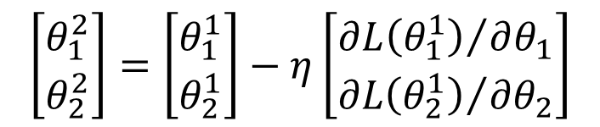
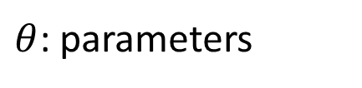


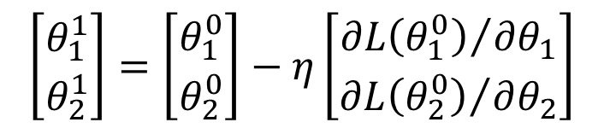
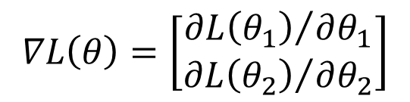
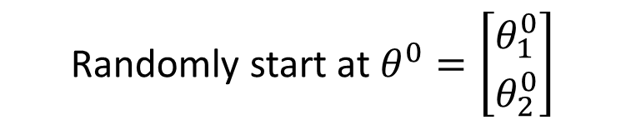

Review: Gradient Descent
In step 3, we have to solve the following optimization problem:
$$θ^{∗}=arg\min_{θ}{L\left(θ\right)}$$
L: loss function
$θ$: parameters
Suppose that θ has two variables {θ₁, θ₂}
Randomly start at $θ^{0}=\left[\begin{matrix}θ_{1}^{0} \\ θ_{2}^{0}\end{matrix}\right]$
$$∇L\left(θ\right)=\left[\begin{matrix}{∂L\left(θ_{1}\right)}/{∂θ_{1}} \\ {∂L\left(θ_{2}\right)}/{∂θ_{2}}\end{matrix}\right]$$
$$\left[\begin{matrix}θ_{1}^{1} \\ θ_{2}^{1}\end{matrix}\right]=\left[\begin{matrix}θ_{1}^{0} \\ θ_{2}^{0}\end{matrix}\right]−η\left[\begin{matrix}{∂L\left(θ_{1}^{0}\right)}/{∂θ_{1}} \\ {∂L\left(θ_{2}^{0}\right)}/{∂θ_{2}}\end{matrix}\right]$$
$$θ^{1}=θ^{0}−η∇L\left(θ^{0}\right)$$
$$\left[\begin{matrix}θ_{1}^{2} \\ θ_{2}^{2}\end{matrix}\right]=\left[\begin{matrix}θ_{1}^{1} \\ θ_{2}^{1}\end{matrix}\right]−η\left[\begin{matrix}{∂L\left(θ_{1}^{1}\right)}/{∂θ_{1}} \\ {∂L\left(θ_{2}^{1}\right)}/{∂θ_{2}}\end{matrix}\right]$$
$$θ^{2}=θ^{1}−η∇L\left(θ^{1}\right)$$

Slide 3





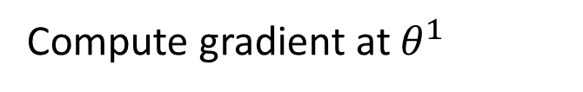


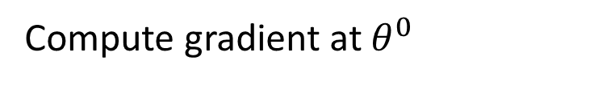

Review: Gradient Descent
$$θ_{2}$$
Gradient: Loss 的等高線的法線方向
$$∇L\left(θ^{0}\right)$$
Start at position $θ^{0}$
$$θ^{0}$$
$$∇L\left(θ^{1}\right)$$
Compute gradient at $θ^{0}$
$$θ^{1}$$
$$∇L\left(θ^{2}\right)$$
Move to $θ^{1}$ = $θ^{0}$ - η$∇L\left(θ^{0}\right)$
$$θ^{2}$$
Gradient
Compute gradient at $θ^{1}$
Movement
$$∇L\left(θ^{3}\right)$$
$$θ^{3}$$
Move to $θ^{2}$ = $θ^{1}$ – η$∇L\left(θ^{1}\right)$
……
$$θ_{1}$$
Notes:
Draw is so comply use minecraft
Easy for more than two variables

Slide 4
Gradient Descent
Tip 1: Tuning your
learning rates

Slide 5
Learning Rate
Set the learning rate η carefully
If there are more than three parameters, you cannot visualize this.
Loss
Very Large
small
Large
Loss
Just make
No. of parameters updates
But you can always visualize this.

Slide 6
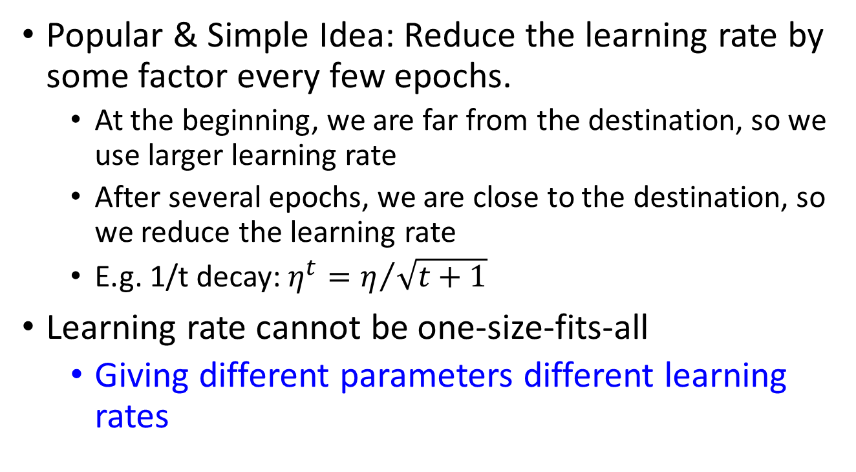
Adaptive Learning Rates
  Popular & Simple Idea: Reduce the learning rate by some factor every few epochs.
  At the beginning, we are far from the destination, so we use larger learning rate
  After several epochs, we are close to the destination, so we reduce the learning rate
  E.g. 1/t decay: $η^{t}=η/{\sqrt{t+1}}$
Learning rate cannot be one-size-fits-all
  Giving different parameters different learning rates
Notes:
Advanced Idea: Eta
Can we give each parameters different learning rates?

Slide 7

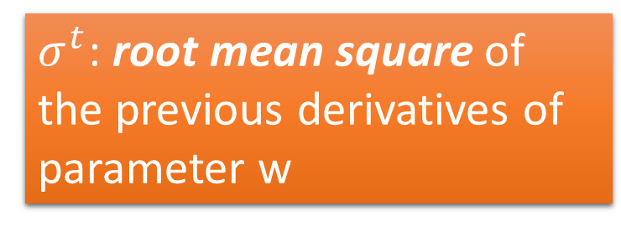
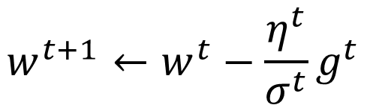


Adagrad
$$η^{t}=\frac{η}{\sqrt{t+1}}$$
$$g^{t}=\frac{∂L\left(θ^{t}\right)}{∂w}$$
Divide the learning rate of each parameter by the root mean square of its previous derivatives
Vanilla Gradient descent
$$w^{t+1}←w^{t}−{\text{η}}^{t}g^{t}$$
w is one parameters
Adagrad
$σ^{t}$: root mean square of the previous derivatives of parameter w
$$w^{t+1}←w^{t}−\frac{{\text{η}}^{t}}{σ^{t}}g^{t}$$
Parameter dependent

Slide 8
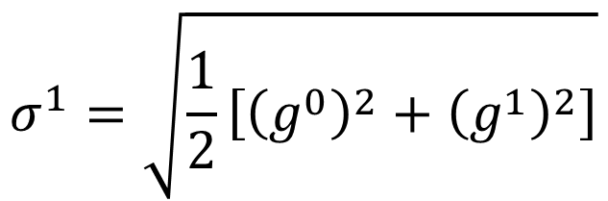
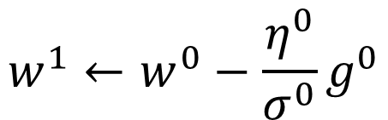


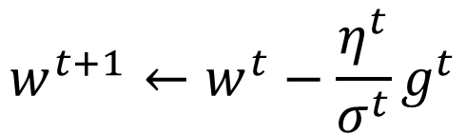
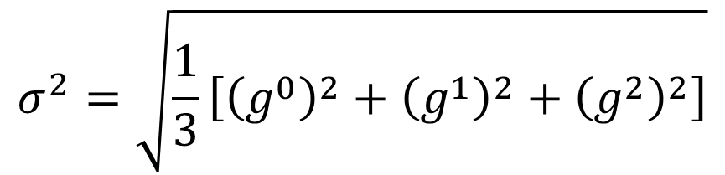
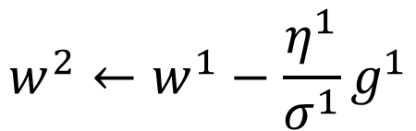
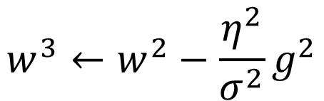

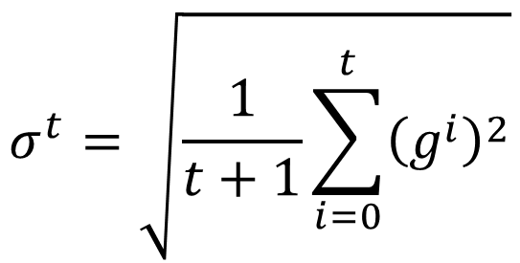
Adagrad
$σ^{t}$: root mean square of the previous derivatives of parameter w
$$w^{1}←w^{0}−\frac{{\text{η}}^{0}}{σ^{0}}g^{0}$$
$$σ^{0}=\sqrt{{\left(g^{0}\right)}^{2}}$$
$$σ^{1}=\sqrt{\frac{1}{2}\left[{\left(g^{0}\right)}^{2}+{\left(g^{1}\right)}^{2}\right]}$$
$$w^{2}←w^{1}−\frac{{\text{η}}^{1}}{σ^{1}}g^{1}$$
$$σ^{2}=\sqrt{\frac{1}{3}\left[{\left(g^{0}\right)}^{2}+{\left(g^{1}\right)}^{2}+{\left(g^{2}\right)}^{2}\right]}$$
$$w^{3}←w^{2}−\frac{{\text{η}}^{2}}{σ^{2}}g^{2}$$
$$……$$
$$σ^{t}=\sqrt{\frac{1}{t+1}\sum_{i=0}^{t}{{\left(g^{i}\right)}^{2}}}$$
$$w^{t+1}←w^{t}−\frac{{\text{η}}^{t}}{σ^{t}}g^{t}$$
Notes:
Why square

Slide 9




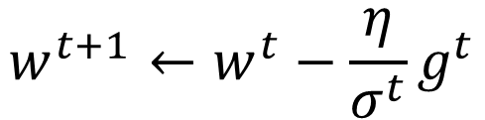
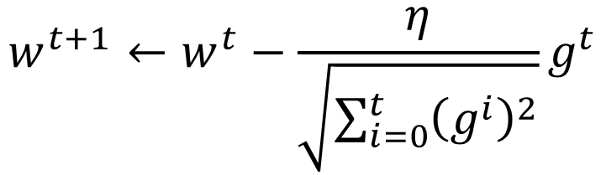
Adagrad
Divide the learning rate of each parameter by the root mean square of its previous derivatives
$$η^{t}=\frac{η}{\sqrt{t+1}}$$
1/t decay
$${\text{η}}^{t}$$
$$w^{t+1}←w^{t}−\frac{η}{σ^{t}}g^{t}$$
$$σ^{t}=\sqrt{\frac{1}{t+1}\sum_{i=0}^{t}{{\left(g^{i}\right)}^{2}}}$$
$$σ^{t}$$
$$w^{t+1}←w^{t}−\frac{η}{\sqrt{\sum_{i=0}^{t}{{\left(g^{i}\right)}^{2}}}}g^{t}$$

Slide 10

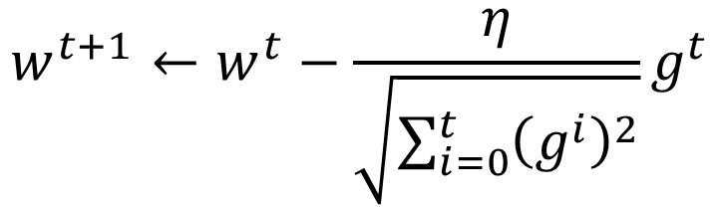


Contradiction?
$$η^{t}=\frac{η}{\sqrt{t+1}}$$
$$g^{t}=\frac{∂L\left(θ^{t}\right)}{∂w}$$
Vanilla Gradient descent
Larger gradient,
larger step
$$w^{t+1}←w^{t}−{\text{η}}^{t}g^{t}$$
Adagrad
Larger gradient,
larger step
$$w^{t+1}←w^{t}−\frac{η}{\sqrt{\sum_{i=0}^{t}{{\left(g^{i}\right)}^{2}}}}g^{t}$$
Larger gradient, smaller step
Notes:
Contradiction??????

Slide 11
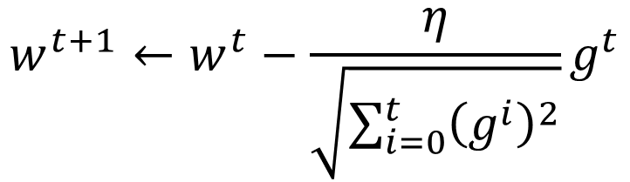


Intuitive Reason
$$η^{t}=\frac{η}{\sqrt{t+1}}$$
$$g^{t}=\frac{∂L\left(θ^{t}\right)}{∂w}$$
How surprise it is
反差
特別大
g⁰ | g¹ | g² | g³ | g⁴ | ……
0.001 | 0.001 | 0.003 | 0.002 | 0.1 | ……
g⁰ | g¹ | g² | g³ | g⁴ | ……
10.8 | 20.9 | 31.7 | 12.1 | 0.1 | ……
特別小
$$w^{t+1}←w^{t}−\frac{η}{\sqrt{\sum_{i=0}^{t}{{\left(g^{i}\right)}^{2}}}}g^{t}$$
造成反差的效果
Notes:
http://seed.ucsd.edu/mediawiki/images/6/6a/Adagrad.pdf
http://courses.cs.washington.edu/courses/cse547/15sp/slides/adagrad.pdf
Some features can be extremely useful and informative to an optimization problem but they may not show up in most of the training instances or data. If, when they do show up, they are weighted equally in terms of learning rate as a feature that has shown up hundreds of times we are practically saying that the influence of such features means nothing in the overall optimization (it's impact per step in the stochastic gradient descent will be so small that it can practically be discounted). To counter this, AdaGrad makes it such that features that are more sparse in the data have a higher learning rate which translates into a larger update for that feature (i.e. in logistic regression that feature's regression coefficient will be increased/decreased more than a coefficient of a feature that is seen very often).
Simply put, sparse features can be very useful. I don't have an example of application in neural network training. Different adaptive learning algorithms are useful with different data (it would really depend on what your data is and how much importance you place on sparse features).

Slide 12
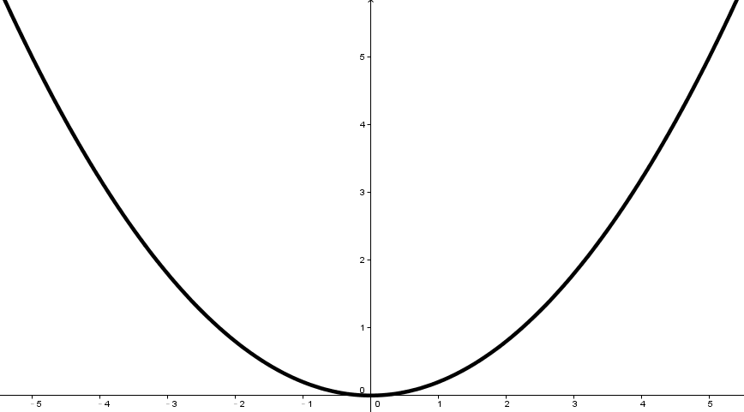
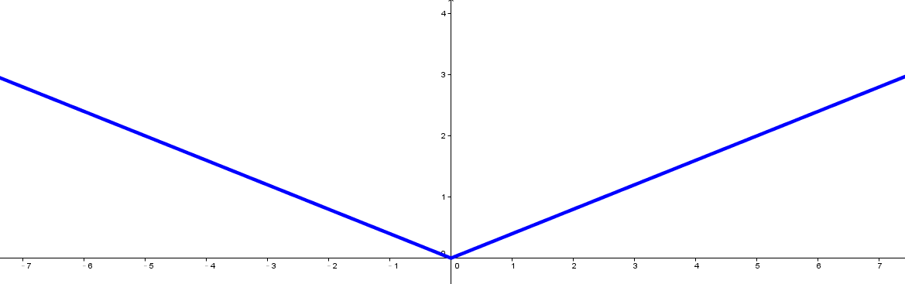


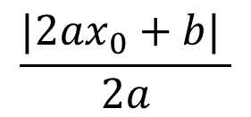





Larger gradient, larger steps?
Best step:
$$|x_{0}+\frac{b}{2a}|$$
$$\frac{|2ax_{0}+b| }{2a}$$
Larger 1st order derivative means far from the minima
$$x_{0}$$
$$−\frac{b}{2a}$$
$$y=ax^{2}+bx+c$$
$$|2ax_{0}+b|$$
$$\left|\frac{∂y}{∂x}\right|=|2ax+b|$$
$$x_{0}$$

Slide 13
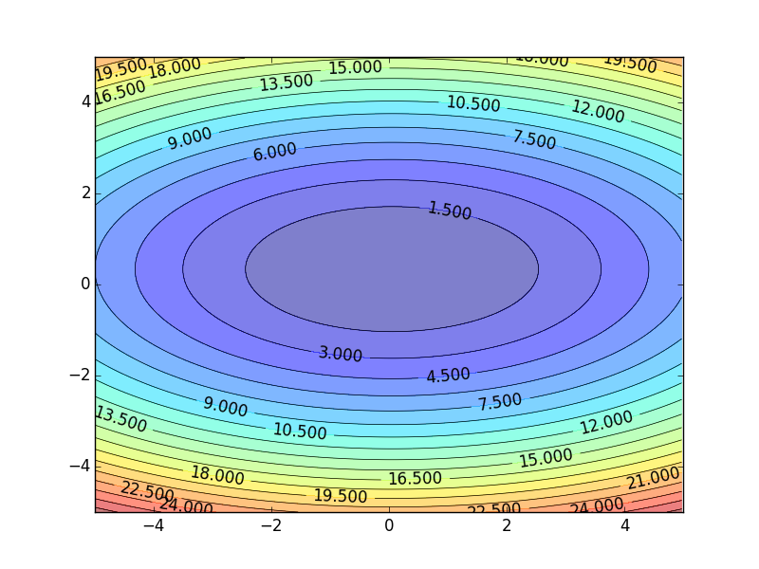
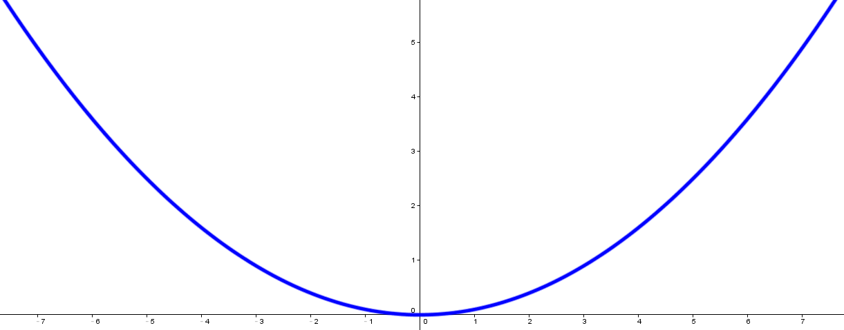
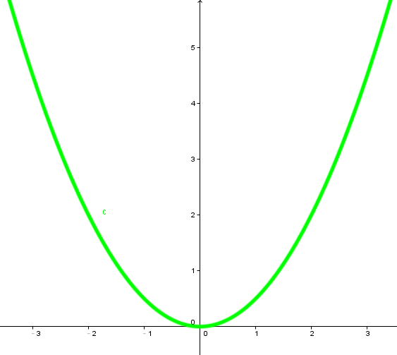




Comparison between different parameters
Larger 1st order derivative means far from the minima
Do not cross parameters
a > b
a
b
$$w_{1}$$
$$w_{2}$$
c
c > d
d
$$w_{1}$$
$$w_{2}$$
Notes:
Larger Gradient
Smaller Learning
Rate

Slide 14

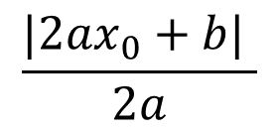

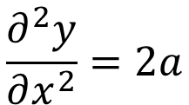





Second Derivative
Best step:
$$|x_{0}+\frac{b}{2a}|$$
$$\frac{|2ax_{0}+b| }{2a}$$
$$−\frac{b}{2a}$$
$$x_{0}$$
$$y=ax^{2}+bx+c$$
$$|2ax_{0}+b|$$
$$\left|\frac{∂y}{∂x}\right|=|2ax+b|$$
$$x_{0}$$
$$\frac{∂^{2}y}{∂x^{2}}=2a$$
|First derivative|
The best step is
Second derivative
Notes:
You will ignore it in this case,
Because the second is always the saem
For taylor, second order is consdierd

Slide 15
Comparison between different parameters
Larger 1st order derivative means far from the minima
Do not cross parameters
|First derivative|
The best step is
Second derivative
a > b
Larger
Second
a
b
$$w_{1}$$
smaller second derivative
$$w_{2}$$
c
c > d
Smaller
Second
d
$$w_{1}$$
$$w_{2}$$
Larger second derivative
Notes:
Larger Gradient
Smaller Learning
Rate

Slide 16
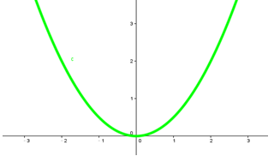
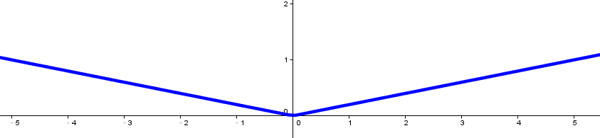
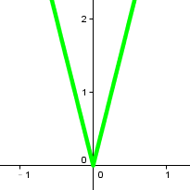


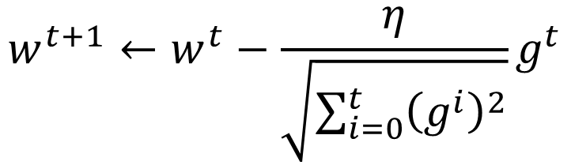

The best step is
$$w^{t+1}←w^{t}−\frac{η}{\sqrt{\sum_{i=0}^{t}{{\left(g^{i}\right)}^{2}}}}g^{t}$$
|First derivative|
Second derivative
?
Use first derivative to estimate second derivative
larger second derivative
smaller second derivative
$$w_{1}$$
$$w_{2}$$
$$\sqrt{{\left(first derivative\right)}^{2}}$$
Notes:
What would you see?

Slide 17
Gradient Descent
Tip 2: Stochastic
Gradient Descent
Make the training faster

Slide 18
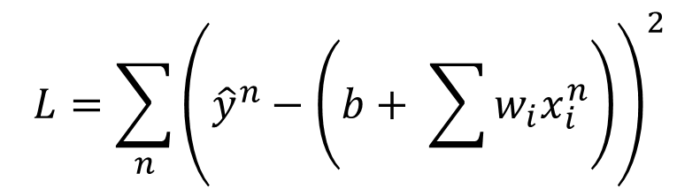
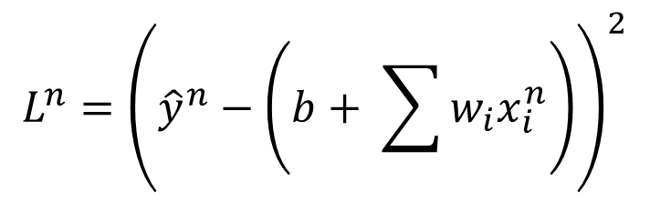
Stochastic Gradient Descent
$$L=\sum_{n}{{\left({\hat{y}}^{n}−\left(b+ \sum{w_{i}x_{i}^{n}}\right)\right)}^{2}}$$
Loss is the summation over all training examples
Gradient Descent
Stochastic Gradient Descent
Faster!
Pick an example x^{n}
$$L^{n}={\left({\hat{y}}^{n}−\left(b+ \sum{w_{i}x_{i}^{n}}\right)\right)}^{2}$$
Loss for only one example
Notes:
See all the examples once = 1 epoch
Two approaches update the parameters towards the same direction, but stochastic is faster!

Slide 19
Demo

Slide 20
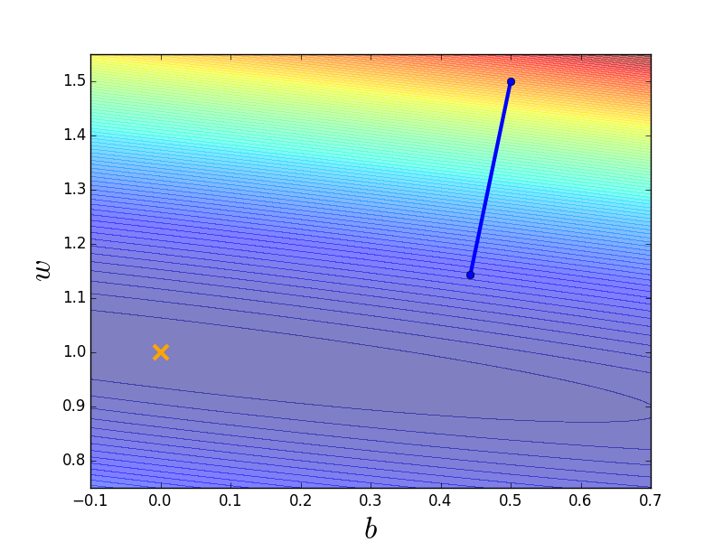

Stochastic Gradient Descent
Stochastic Gradient Descent
Gradient Descent
Update for each example
Update after seeing all examples
If there are 20 examples,
20 times faster.
See all examples
See only one example
See all examples
Notes:
Full?

Slide 21
Gradient Descent
Tip 3: Feature Scaling

Slide 22







Feature Scaling
Source of figure: http://cs231n.github.io/neural-networks-2/
$$y=b+w_{1}x_{1}+w_{2}x_{2}$$
$$x_{2}$$
$$x_{2}$$
$$x_{1}$$
$$x_{1}$$
Make different features have the same scaling

Slide 23

Feature Scaling
$$y=b+w_{1}x_{1}+w_{2}x_{2}$$
1, 2 ……
1, 2 ……
100, 200 ……
1, 2 ……
Loss L
Loss L

Slide 24












Feature Scaling
$$x^{1}$$
$$x^{2}$$
$$x^{3}$$
$$x^{r}$$
$$x^{R}$$
$$x_{1}^{1}$$
$$x_{1}^{2}$$
For each dimension i:
$$x_{2}^{1}$$
$$x_{2}^{2}$$
……
……
mean: $m_{i}$
……
……
……
……
……
standard deviation: $σ_{i}$
$$x_{i}^{r}←\frac{x_{i}^{r}−m_{i}}{σ_{i}}$$
The means of all dimensions are 0, and the variances are all 1
Notes:
Can we demo this???????????????
https://standardfrancis.wordpress.com/2015/04/16/batch-normalization/

Slide 25
Gradient Descent
Theory

Slide 26


Question
When solving:
Each time we update the parameters, we obtain $θ$ that makes $L\left(θ\right)$ smaller.
$$θ^{∗}=arg\min_{θ}{L\left(θ\right)}$$
by gradient descent
$$L\left(θ^{0}\right)>L\left(θ^{1}\right)>L\left(θ^{2}\right)>…$$
Is this statement correct?
Notes:
Demo minecraft

Slide 27
Warning of Math

Slide 28

Formal Derivation
L(θ)
Suppose that θ has two variables {θ₁, θ₂}
Given a point, we can easily find the point with the smallest value nearby.
How?
Notes:
You cannot know C(θ) outside the red circle!

Slide 29
Taylor Series
Taylor series: Let h(x) be any function infinitely differentiable around x = x₀.
When x is close to x₀

Slide 30


E.g. Taylor series for h(x)=sin(x) around x₀=π/4
sin(x)=
……
The approximation is good around π/4.

Slide 31
Multivariable Taylor Series
+ something related to (x-x₀)² and (y-y₀)² + ……
When x and y is close to x₀ and y₀

Slide 32
Back to Formal Derivation
Based on Taylor Series:
If the red circle is small enough, in the red circle
L(θ)

Slide 33
Back to Formal Derivation
Based on Taylor Series:
constant
If the red circle is small enough, in the red circle
Find θ₁ and θ₂ in the red circle minimizing L(θ)
L(θ)
Simple, right?
d

Slide 34
Gradient descent – two variables
Red Circle:
(If the radius is small)
Find θ₁ and θ₂ in the red circle minimizing L(θ)
To minimize L(θ)
Notes:
eta

Slide 35
Back to Formal Derivation
Based on Taylor Series:
constant
If the red circle is small enough, in the red circle
Find $θ_{1}$ and $θ_{2}$ yielding the smallest value of $L\left(θ\right)$ in the circle
This is gradient descent.
Not satisfied if the red circle (learning rate) is not small enough
You can consider the second order term, e.g. Newton’s method.
Notes:
Simple, right?

Slide 36
End of Warning

Slide 37







More Limitation of Gradient Descent
Loss
Very slow at the plateau
$$L$$
Stuck at saddle point
$$w_{1}$$
$$w_{2}$$
Stuck at local minima
$$∂L∕∂w$$
$$≈0$$
$$∂L∕∂w$$
$$=0$$
$$∂L∕∂w$$
$$=0$$
The value of the parameter w
Notes:
Demo: Why all the problmes/

Slide 38
Acknowledgement
感謝 Victor Chen 發現投影片上的打字錯誤
感謝林耿生同學發現投影片上的打字錯誤

