Slide 1
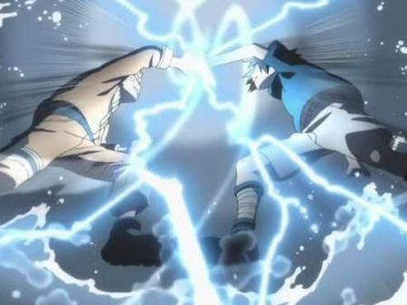
Attack and Defense
Hung-yi Lee
Source of image: http://www.fafa01.com/post865806
Notes:
================================
Adversarial Attack Reference:
Intriguing properties of neural networks https://arxiv.org/pdf/1312.6199 Explaining and Harnessing Adversarial Examples https://arxiv.org/abs/1412.6572 Towards Evaluating the Robustness of Neural Networks https://arxiv.org/pdf/1608.04644.pdf ADVERSARIAL REPROGRAMMING OF NEURAL NETWORKS https://arxiv.org/pdf/1810.00069.pdf Audio Adversarial Examples: Targeted Attacks on Speech-to-Text https://arxiv.org/pdf/1801.01944.pdf Towards Deep Learning Models Resistant to Adversarial Attacks https://arxiv.org/abs/1706.06083 Obfuscated Gradients Give a False Sense of Security: Circumventing Defenses to Adversarial Examples https://arxiv.org/pdf/1802.00420.pdf
One pixel attack for fooling deep neural networks
============
Slide :https://media.neurips.cc/Conferences/NIPS2018/Slides/adversarial_ml_slides_parts_1_4.pdf
Two hour tutorial: https://www.youtube.com/watch?v=TwP-gKBQyic (good one, with web page)
Good fellow
https://www.youtube.com/watch?v=CIfsB_EYsVI
More videos (I am not sure about the quality)
https://www.youtube.com/watch?v=r8cW1p8VBOU
https://www.youtube.com/watch?v=sh6OS6Lssv4
Tutorial which is too long: http://pralab.diee.unica.it/en/wild-patterns
科普
Video: https://www.youtube.com/watch?v=oZYgaD004Dw
Video: https://www.youtube.com/watch?v=SA4YEAWVpbk

Slide 2
Motivation
We seek to deploy machine learning classifiers not only in the labs, but also in real world.
The classifiers that are robust to noises and work “most of the time” is not sufficient.
We want the classifiers that are robust the inputs that are built to fool the classifier.
Especially useful for spam classification, malware detection, network intrusion detection, etc.
光是強還不夠
應付來自人類的惡意
Notes:
人類的惡意

Slide 3
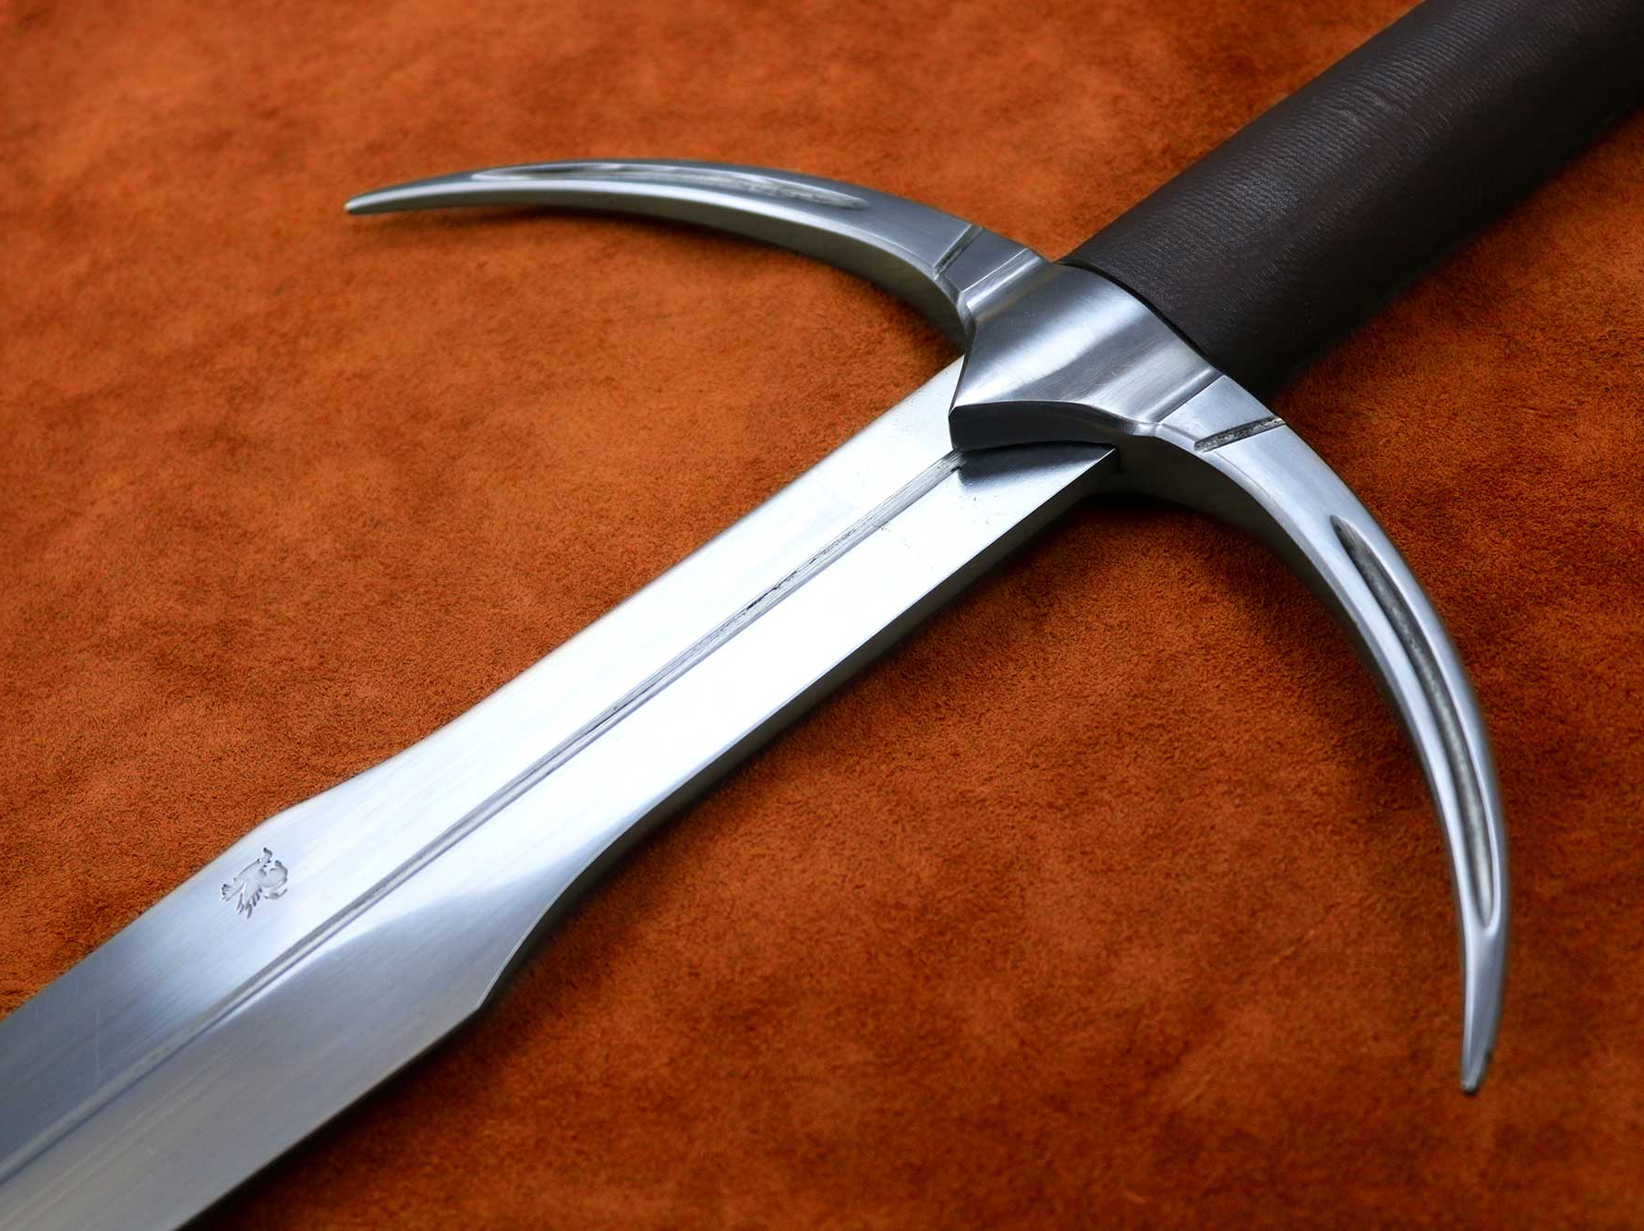
Attack
https://www.darksword-armory.com/wp-content/uploads/2014/09/two-handed-danish-sword-medieval-weapon-1352-3.jpg
Notes:
Slide :https://media.neurips.cc/Conferences/NIPS2018/Slides/adversarial_ml_slides_parts_1_4.pdf
Two hour tutorial: https://www.youtube.com/watch?v=TwP-gKBQyic (good one, with web page)
Good fellow
https://www.youtube.com/watch?v=CIfsB_EYsVI
More videos (I am not sure about the quality)
https://www.youtube.com/watch?v=r8cW1p8VBOU
https://www.youtube.com/watch?v=sh6OS6Lssv4
Tutorial which is too long: http://pralab.diee.unica.it/en/wild-patterns
科普
Video: https://www.youtube.com/watch?v=oZYgaD004Dw
Video: https://www.youtube.com/watch?v=SA4YEAWVpbk

Slide 4
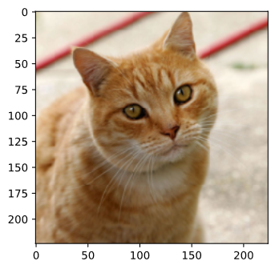
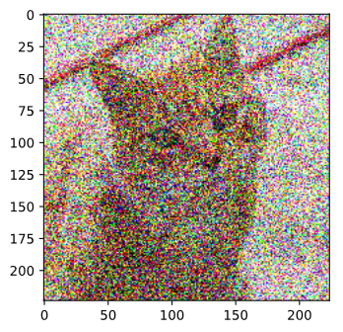
What do we want to do?
Original Image
Network
Something Else
Tiger Cat
0.64
$$x^{0}$$
$$\left[\begin{aligned}x_{1} \\ x_{2} \\ x_{3} \\ ⋮\end{aligned}\right]$$
$$+\left[\begin{aligned}{∆x}_{1} \\ {∆x}_{2} \\ ∆x_{3} \\ ⋮\end{aligned}\right]$$
Attacked Image
$$x^{′}=x^{0}+∆x$$
Notes:
要先講 explainable AI

Slide 5
Loss Function for Attack
Network
$$f_{θ}$$
e.g. cat
Training:
Non-targeted Attack:
Targeted Attack:
Constraint:
$$x^{0}$$
close
$$y^{true}$$
$$y^{0}=f_{θ}\left(x\right)$$
close
far
?
$$y^{′}=f_{θ}\left(x^{′}\right)$$
$$y^{false}$$
$$x^{′}$$
close
e.g. fish
$$L_{train}\left(θ\right)=C\left(y^{0},y^{true} \right)$$
$x$ fixed
$$L\left(x^{′}\right)=−C\left(y^{′},y^{true} \right)$$
$θ$ fixed
$$L\left(x^{′}\right)=−C\left(y^{′},y^{true} \right)+C\left(y^{′},y^{false}\right)$$
$$d\left(x^{0},x^{′}\right)≤ε$$
不要被發現
Notes:
Depending on the task

Slide 6
Constraint
$$\left[\begin{aligned}x_{1}^{′} \\ x_{2}^{′} \\ x_{3}^{′} \\ ⋮\end{aligned}\right]−\left[\begin{aligned}x_{1} \\ x_{2} \\ x_{3} \\ ⋮\end{aligned}\right]$$
$$=\left[\begin{aligned}{∆x}_{1} \\ {∆x}_{2} \\ ∆x_{3} \\ ⋮\end{aligned}\right]$$
$$d\left(x^{0},x^{′}\right)≤ε$$
$$x^{′}$$
$$x^{0}$$
$$∆x$$
L2-norm
L-infinity
small L-$∞$
$$d\left(x^{0},x^{′}\right)={\left\|x^{0}−x′\right\|}_{2}$$
Change every pixel a little bit
$$={\left({∆x}_{1}\right)}^{2}+{\left({∆x}_{2}\right)}^{2}+{\left({∆x}_{3}\right)}^{2}⋯$$
same L2
$$d\left(x^{0},x^{′}\right)={\left\|x^{0}−x′\right\|}_{∞}$$
Change one pixel much
$$=max\left\{{∆x}_{1},{∆x}_{2},{∆x}_{3},⋯\right\}$$
large L-$∞$

Slide 7
How to Attack
Just like training a neural network, but network parameter $θ$ is replaced with input $x^{′}$
Gradient Descent (Modified Version)
$$x^{∗}=arg\min_{d\left(x^{0},x^{′}\right)≤ε }{L\left(x^{′}\right)}$$
Start from original image $x^{0}$
For t = 1 to T
$$=\left[\begin{aligned}{∂L\left(x\right)}/{∂x_{1}} \\ {∂L\left(x\right)}/{∂x_{2}} \\ {∂L\left(x\right)}/{∂x_{3}} \\ ⋮\end{aligned}\right]$$
$$x^{t}←x^{t−1}−η∇L\left(x^{t−1}\right)$$
$$∇L\left(x\right)$$
If $d\left(x^{0},x^{t}\right)>ε$
$$x^{t}←fix\left(x^{t}\right)$$

Slide 8
How to Attack
Just like training a neural network, but network parameter $θ$ is replaced with input $x^{′}$
Gradient Descent (Modified Version)
$$x^{∗}=arg\min_{d\left(x^{0},x^{′}\right)≤ε }{L\left(x^{′}\right)}$$
Start from original image $x^{0}$
def $fix\left(x^{t}\right)$
For t = 1 to T
For all $x$ fulfill $d\left(x^{0},x\right)≤ε$
$$x^{t}←x^{t−1}−η∇L\left(x^{t−1}\right)$$
If $d\left(x^{0},x^{t}\right)>ε$
Return the one closest to $x^{t}$
$$x^{t}←fix\left(x^{t}\right)$$

Slide 9
How to Attack
L2-norm
$$x^{t}$$
$$x^{t}$$
$$x^{0}$$
$$ε$$
def $fix\left(x^{t}\right)$
For all $x$ fulfill $d\left(x^{0},x\right)≤ε$
L-infinity
$$x^{t}$$
Return the one closest to $x^{t}$
$$x^{t}$$
$$ε$$
$$ε$$

Slide 10
Example
$$L\left(x^{′}\right)=−C\left(y^{′},y^{true} \right)+C\left(y^{′},y^{false}\right)$$
True = Tiger cat
False = Star Fish
$$f=$$
ResNet-50
Original Image
Attacked Image
Tiger Cat
Star Fish
0.64
1.00
Notes:
要先講 explainable AI

Slide 11
Example
=
Original Image
Attacked Image
50x
-
Tiger Cat
Star Fish
0.64
1.00
Notes:
要先講 explainable AI

Slide 12
Example
$$L\left(x^{′}\right)=−C\left(y^{′},y^{true} \right)+C\left(y^{′},y^{false}\right)$$
True = Tiger cat
False = Keyboard
$$f=$$
ResNet-50
Original Image
Attacked Image
Tiger Cat
Keyboard
0.64
0.98
Notes:
要先講 explainable AI

Slide 13
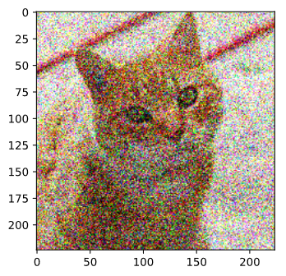
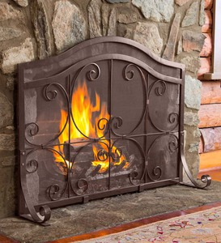
tiger
cat
Persian
cat
tabby
cat
fire
screen

Slide 14
What happened?
$$y_{Egyptian cat}$$
$$y_{tiger cat}$$
$$y_{Persian cat}$$
Random
$$x^{0}$$
$$y_{tiger cat}$$
$$y_{key board}$$
Specific Direction
$$x^{0}$$

Slide 15
Attack Approaches
FGSM (https://arxiv.org/abs/1412.6572)
Basic iterative method (https://arxiv.org/abs/1607.02533)
L-BFGS (https://arxiv.org/abs/1312.6199)
Deepfool (https://arxiv.org/abs/1511.04599)
JSMA (https://arxiv.org/abs/1511.07528)
C&W (https://arxiv.org/abs/1608.04644)
Elastic net attack (https://arxiv.org/abs/1709.04114)
Spatially Transformed (https://arxiv.org/abs/1801.02612)
One Pixel Attack (https://arxiv.org/abs/1710.08864)
…… only list a few
Notes:
I ignore FGM -> ＦＧＳＭ
I think FGM is equal to deepfool
C&W -> Nicholas Carlini David Wagner
L-BFGS
FGSM
BIM
ILCM
MI-FGSM
JSMA
DeepFool
C/W
Single Pixel Attack
Local Search Attack

Slide 16
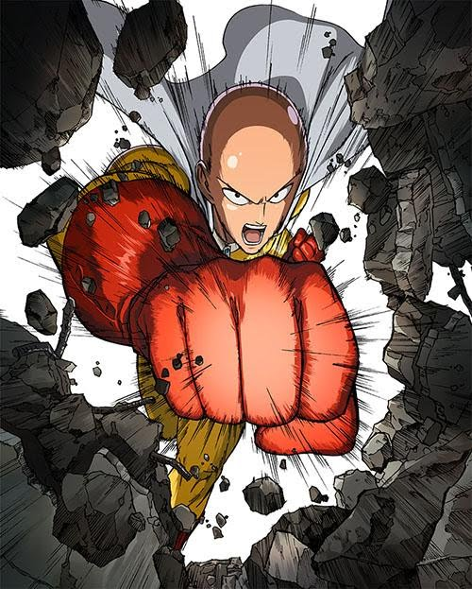
Attack Approaches
https://sites.google.com/site/pkms20152a17/_/rsrc/1448428701742/home/125986076.jpg
Different optimization methods
Fast Gradient Sign Method (FGSM)
$$x^{∗}=arg\min_{d\left(x^{0},x^{′}\right)≤ε }{L\left(x^{′}\right)}$$
Different constraints
$$x^{∗}←x^{0}−ε∆x$$
$$∆x=\left[\begin{aligned}sign\left({∂L}/{∂x_{1}}\right) \\ sign\left({∂L}/{∂x_{2}}\right) \\ sign\left({∂L}/{∂x_{3}}\right) \\ ⋮\end{aligned}\right]$$
only have +1 or -1

Slide 17
Attack Approaches
https://sites.google.com/site/pkms20152a17/_/rsrc/1448428701742/home/125986076.jpg
Different optimization methods
Fast Gradient Sign Method (FGSM)
$$x^{∗}=arg\min_{d\left(x^{0},x^{′}\right)≤ε }{L\left(x^{′}\right)}$$
Different constraints
$$x^{∗}$$
$$x^{∗}←x^{0}−ε∆x$$
$$x^{1}$$
$$∆x=\left[\begin{aligned}sign\left({∂L}/{∂x_{1}}\right) \\ sign\left({∂L}/{∂x_{2}}\right) \\ sign\left({∂L}/{∂x_{3}}\right) \\ ⋮\end{aligned}\right]$$
$$ε$$
$$x^{0}$$
gradient
$$ε$$
only have +1 or -1
L-infinity

Slide 18
Attack Approaches
https://sites.google.com/site/pkms20152a17/_/rsrc/1448428701742/home/125986076.jpg
Different optimization methods
Fast Gradient Sign Method (FGSM)
$$x^{∗}=arg\min_{d\left(x^{0},x^{′}\right)≤ε }{L\left(x^{′}\right)}$$
$$x^{1}$$
Different constraints
very large learning rate
$$x^{∗}$$
$$x^{∗}←x^{0}−ε∆x$$
$$∆x=\left[\begin{aligned}sign\left({∂L}/{∂x_{1}}\right) \\ sign\left({∂L}/{∂x_{2}}\right) \\ sign\left({∂L}/{∂x_{3}}\right) \\ ⋮\end{aligned}\right]$$
$$ε$$
$$x^{0}$$
gradient
$$ε$$
only have +1 or -1
L-infinity

Slide 19
White Box v.s. Black Box
In the previous attack, we fix network parameters $θ$ to find optimal $x^{′}$.
To attack, we need to know network parameters $θ$
This is called White Box Attack.
Are we safe if we do not release model? ☺
You cannot obtain model parameters in most on-line API.
No, because Black Box Attack is possible. ☹
Notes:
Papernot et al（2016） 發表的攻擊方式是目前最具威力的一種，針對影像辨識的深度學習服務，可以透過 API 取得一些分類結果後，另外在本地訓練一個 local model，對 local model 找出可用的對抗例，轉移（transfer）回去攻擊目標 API。論文裡對 Amazon 與 Google 的服務實測都有近 90% 的成功率。簡單地說，黑箱攻擊是可行的
最近 Chen et al（2017）[14]提出了「零階最佳化」（zeroth order optimization；ZOO）、Hayes and Danezis（2017）[15]提出 adversarial service，都是不用依靠移轉就可以達成的黑箱攻擊。
蒐集資料最簡單

Slide 20
Black Box Attack
If you have the training data of the target network
Train a proxy network yourself
Using the proxy network to generate attacked objects
Otherwise, obtaining input-output pairs from target network
Attacked
Object
Network
Black
Network
Proxy
Training Data
Notes:
Can even attack other kinds of modes like SVM, deteiciont tree
https://arxiv.org/pdf/1605.07277.pdf
The gradient directions of different models in our evaluation are almost orthogonal to each other

Slide 21
Black Box Attack
If you have the training data of the target network
Train a proxy network yourself
Using the proxy network to generate attacked objects
Otherwise, obtaining input-output pairs from target network
Black
Proxy
https://arxiv.org/pdf/1611.02770.pdf
Notes:
Can even attack other kinds of modes like SVM, deteiciont tree
https://arxiv.org/pdf/1605.07277.pdf
The gradient directions of different models in our evaluation are almost orthogonal to each other

Slide 22
Universal Adversarial Attack
https://arxiv.org/abs/1610.08401
Black Box Attack is also possible!
Notes:
https://arxiv.org/abs/1705.09554
https://arxiv.org/abs/1707.05572
We’ve created images that reliably fool neural network classifiers when viewed from varied scales and perspectives. This challenges a claim from last week that self-driving cars would be hard to trick maliciously since they capture images from multiple scales, angles, perspectives, and the like.
https://blog.openai.com/robust-adversarial-inputs/

Slide 23
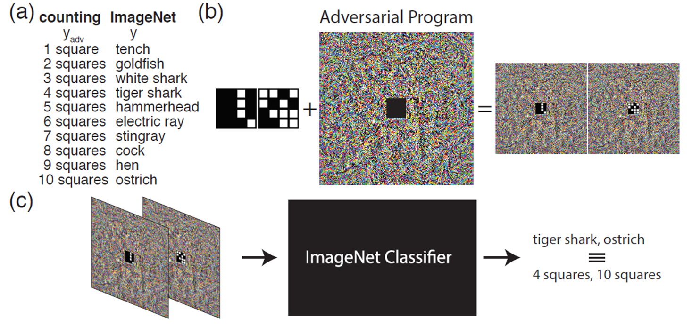
Adversarial Reprogramming
https://arxiv.org/abs/1806.11146
Gamaleldin F. Elsayed, Ian Goodfellow, Jascha Sohl-Dickstein, “Adversarial Reprogramming of Neural Networks”, ICLR, 2019
Notes:
tench

Slide 24
Attack in the Real World
Black Box Attack
https://www.youtube.com/watch?v=zQ_uMenoBCk&feature=youtu.be
Notes:
This is not always the case for systems operating in the physical world, for example those which are using signals from cameras and other sensors as an input. This paper shows that even in such physical world scenarios, machine learning systems are vulnerable to adversarial examples. We demonstrate this by feeding adversarial images obtained from cell-phone camera to an ImageNet Inception classifier and measuring the classification accuracy of the system. We find that a large fraction of adversarial examples are classified incorrectly even when perceived through the camera.

Slide 25
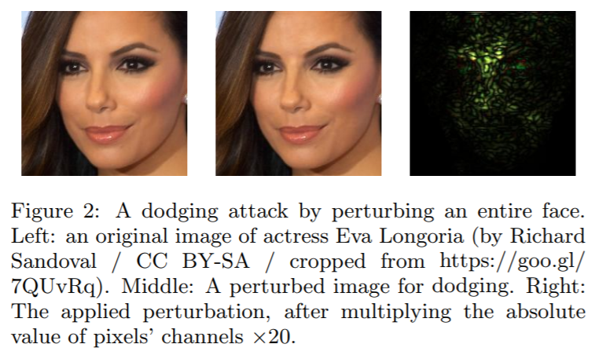
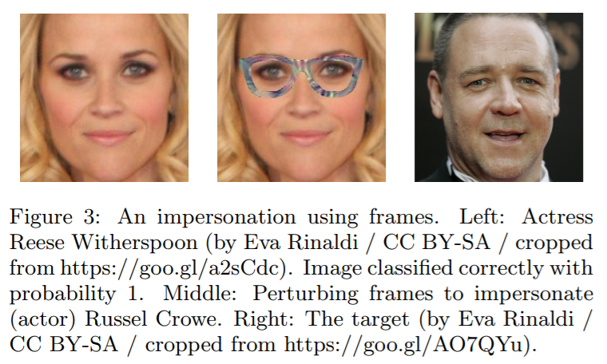
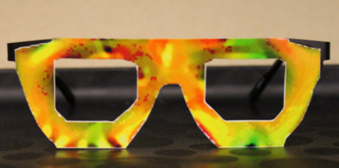
Attack in the Real World
https://www.cs.cmu.edu/~sbhagava/papers/face-rec-ccs16.pdf

Slide 26
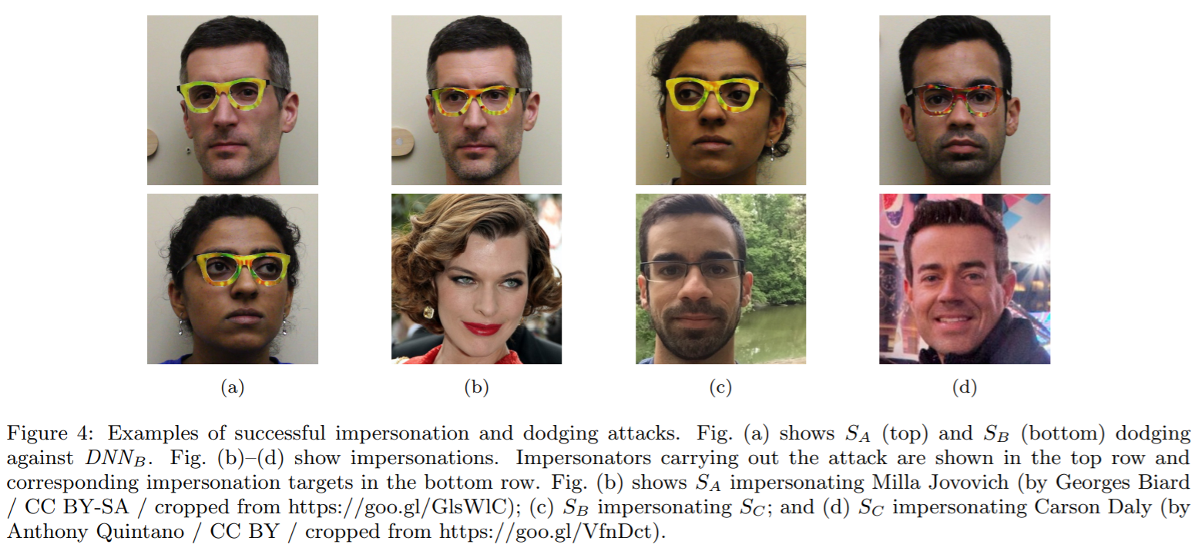
1. An attacker would need to find perturbations that generalize beyond a single image.
2. Extreme differences between adjacent pixels in the perturbation are unlikely to be accurately captured by cameras.
3. It is desirable to craft perturbations that are comprised mostly of colors reproducible by the printer.

Slide 27
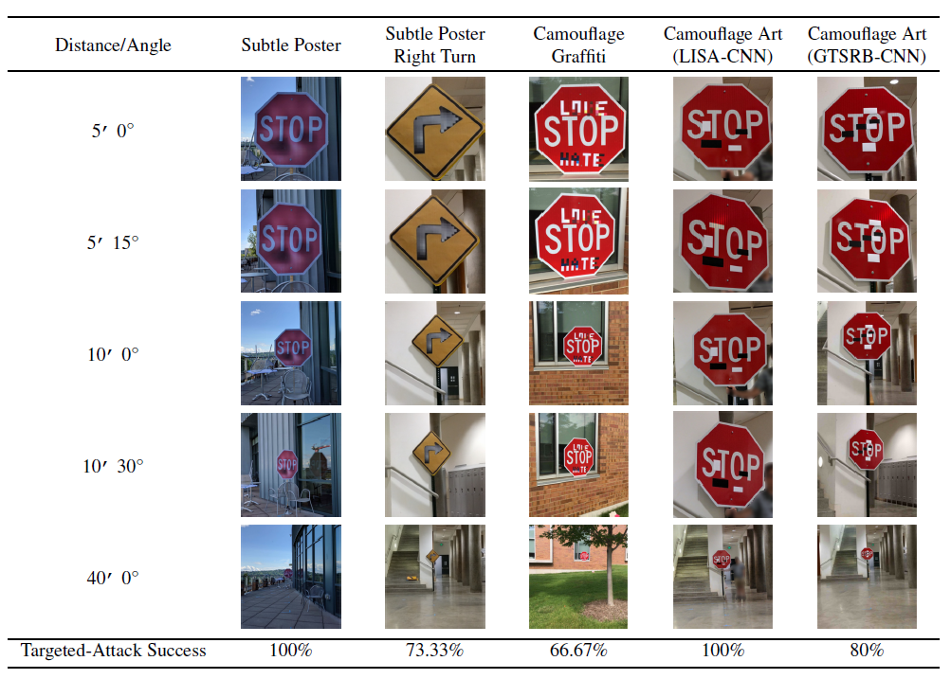
https://arxiv.org/abs/1707.08945
Notes:
1University of Michigan, Ann Arbor
2University of Washington
3University of California, Berkeley

Slide 28
Beyond Images
You can attack audio
https://nicholas.carlini.com/code/audio_adversarial_examples/
https://adversarial-attacks.net
You can attack text
https://arxiv.org/pdf/1707.07328.pdf

Slide 29
Defense
http://3png.com/a-27051273.html
Notes:
https://zhuanlan.zhihu.com/p/37922148
Slide :https://media.neurips.cc/Conferences/NIPS2018/Slides/adversarial_ml_slides_parts_1_4.pdf
Two hour tutorial: https://www.youtube.com/watch?v=TwP-gKBQyic (good one, with web page)
Good fellow
https://www.youtube.com/watch?v=CIfsB_EYsVI
More videos (I am not sure about the quality)
https://www.youtube.com/watch?v=r8cW1p8VBOU
https://www.youtube.com/watch?v=sh6OS6Lssv4
Tutorial which is too long: http://pralab.diee.unica.it/en/wild-patterns
科普
Video: https://www.youtube.com/watch?v=oZYgaD004Dw
Video: https://www.youtube.com/watch?v=SA4YEAWVpbk

Slide 30
Defense
Adversarial Attack cannot be defended by weight regularization, dropout and model ensemble.
Two types of defense:
Passive defense: Finding the attached image without modifying the model
Special case of Anomaly Detection
Proactive defense: Training a model that is robust to adversarial attack
Notes:
這表示對抗例的存在來自於 decision boundary 的幾何性質，所以這也解釋了 transferability。

Slide 31
Passive Defense
Do not influence classification
Original
Tiger Cat
Filter
Network
Keyboard
$$+$$
$$+$$
e.g. Smoothing
Attack signal
Less harmful
Notes:
Feature squeezing
https://github.com/uvasrg/FeatureSqueezing
https://evademl.org/

Slide 32
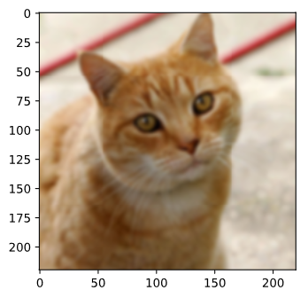
Smoothing
tiger cat
tiger cat
0.64
0.45
Smoothing
Keyboard
tiger cat
0.98
0.37

Slide 33
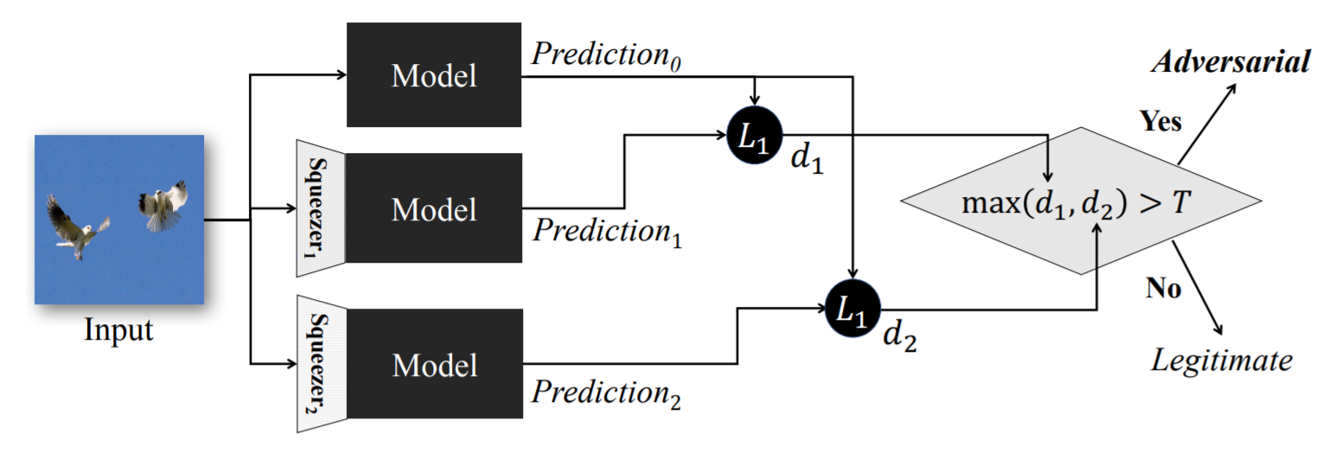
Passive Defense
Feature Squeeze
https://arxiv.org/abs/1704.01155

Slide 34
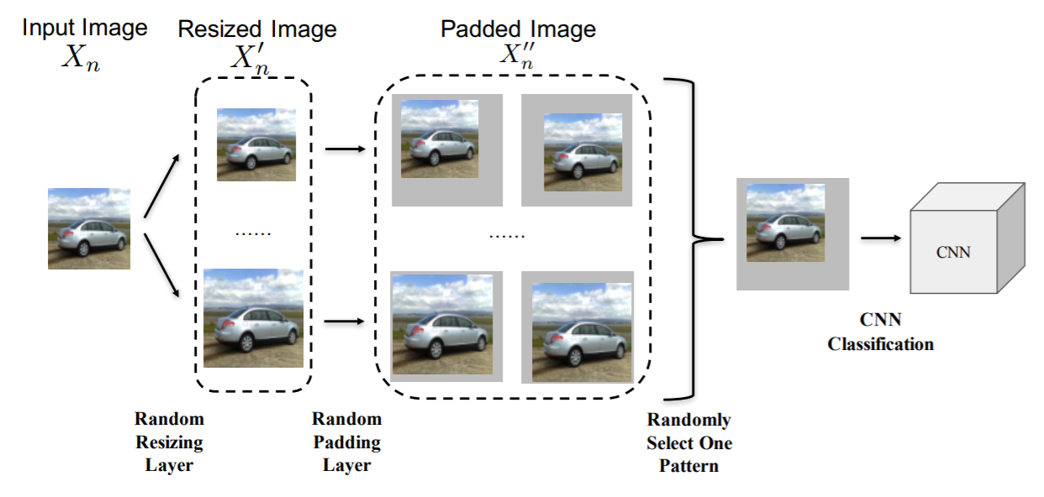
Randomization at Inference Phase
https://arxiv.org/abs/1711.01991

Slide 35
Proactive Defense
精神：
找出漏洞、補起來
Given training data $X=\left\{\left(x^{1},{\hat{y}}^{1}\right),\left(x^{2},{\hat{y}}^{2}\right),⋯,\left(x^{N},{\hat{y}}^{y}\right)\right\}$
Using $X$ to train your model
This method would stop algorithm A, but is still vulnerable for algorithm B.
For t = 1 to T
找出漏洞
For n = 1 to N
Find adversarial input ${\tilde{x}}^{n}$ given $x^{n}$ by an attack algorithm
Using algorithm A
different in each iteration
We have new training data
$$X′=\left\{\left({\tilde{x}}^{1},{\hat{y}}^{1}\right),\left({\tilde{x}}^{2},{\hat{y}}^{2}\right),⋯,\left({\tilde{x}}^{N},{\hat{y}}^{y}\right)\right\}$$
Data Augmentation
把洞補起來
Using both $X′$ to update your model
Notes:
注意: 不同的找漏洞方法
Special augmentation
Adversarial training（Shaham et al（2015）[6]）：產生對抗例用來訓練 model，減少 perturbation 造成的改變。這樣訓練過後的 model 局部較穩定，不容易再找出對抗例。

Slide 36
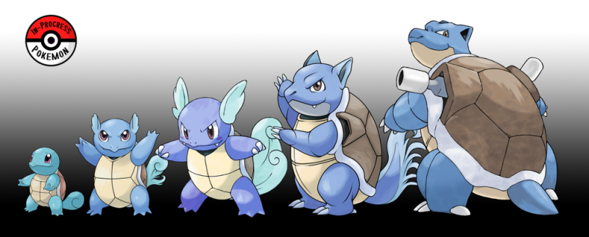
Concluding Remarks
Attack: given the network parameters, attack is very easy.
Even black box attack is possible
Defense: Passive & Proactive
Future: Adaptive Attack / Defense
https://www.gotrip.hk/179304/weekend_lifestyle/pokemon-go_%E7%B2%BE%E9%9D%88%E9%80%B2%E5%8C%96/
Notes:
Adversarial goals 攻擊目的（由容易到困難）
Confidence reduction：降低信心
Misclassification：讓 output 跑掉
Targeted misclassification：製造一個 input 讓 output 是特定值
Source/target misclassify：把一個特定 input 修改到讓 output 是特定值
Adversarial capabilities 攻擊方需要知道的資訊（由多到少）
Architecture & training data
Architecture
Training data sample
Oracle
Samples
Every strategy we have tested so far fails because it is not adaptive: it may block one kind of attack, but it leaves another vulnerability open to an attacker who knows about the defense being used. Designing a defense that can protect against a powerful, adaptive attacker is an important research area.

Slide 37
To learn more …
Reference
https://adversarial-ml-tutorial.org/ (Zico Kolter and Aleksander Madry)
Adversarial Attack Toolbox:
https://github.com/bethgelab/foolbox
https://github.com/IBM/adversarial-robustness-toolbox
https://github.com/tensorflow/cleverhans
Notes:
Not mentioned:
“Gradient masking” is a term introduced in Practical Black-Box Attacks against Deep Learning Systems using Adversarial Examples. to describe an entire category of failed defense methods that work by trying to deny the attacker access to a useful gradient.
https://blog.openai.com/adversarial-example-research/
We find that both adversarial training and defensive distillation accidentally perform a kind of gradient masking. Neither algorithm was explicitly designed to perform gradient masking, but gradient masking is apparently a defense that machine learning algorithms can invent relatively easily when they are trained to defend themselves and not given specific instructions about how to do so. If we transfer adversarial examples from one model to a second model that was trained with either adversarial training or defensive distillation, the attack often succeeds, even when a direct attack on the second model would fail. This suggests that both training techniques do more to flatten out the model and remove the gradient than to make sure it classifies more points correctly.
Defensive distillation（Papernot et al（2016）[7]）：把 model 預測的 probability vector 餵回去給 model 稀釋一下 weight，讓新的 decision boundary 平滑一點，就不容易找到對抗例了
The library contains implementations of the following evasion attacks:
DeepFool (Moosavi-Dezfooli et al., 2015)
Fast gradient method (Goodfellow et al., 2014)
Basic iterative method (Kurakin et al., 2016)
Projected gradient descent (Madry et al., 2017)
Jacobian saliency map (Papernot et al., 2016)
Universal perturbation (Moosavi-Dezfooli et al., 2016)
Virtual adversarial method (Miyato et al., 2015)
C&W L_2 and L_inf attack (Carlini and Wagner, 2016)
NewtonFool (Jang et al., 2017)
Elastic net attack (Chen et al., 2017)
Spatial transformations attack (Engstrom et al., 2017)
The following defence methods are also supported:
Feature squeezing (Xu et al., 2017)
Spatial smoothing (Xu et al., 2017)
Label smoothing (Warde-Farley and Goodfellow, 2016)
Adversarial training (Szegedy et al., 2013)
Virtual adversarial training (Miyato et al., 2015)
Gaussian data augmentation (Zantedeschi et al., 2017)
Thermometer encoding (Buckman et al., 2018)
Total variance minimization (Guo et al., 2018)
JPEG compression (Dziugaite et al., 2016)
================

