Slide 1
機器學習簡介
李宏毅
Hung-yi Lee
Notes:
真的這麼神奇?
什麼是機器學習?
找甚麼樣的 function: regression, generation (GLOW), classification
各種模型 CNN RNN seq2seq transformer
各種學習 gradient descent and tips
訓練方式 semi, transfer (unsupervised domain adaptation), RL (curiosity driven), unsupervised (BERT)
6. Towards AI in the real world
How to know I do not know?
Why I do this?
Attack and defence
Few/zero learning
LLL
Meta-learning
compression
Theory
7. This course

Slide 2
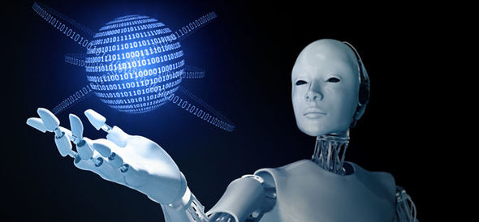
人工智慧時代來臨？
Source of image: http://www.express.co.uk/news/science/651202/First-step-towards-The-Terminator-becoming-reality-AI-beats-champ-of-world-s-oldest-game
Notes:
(機器學習專家、
資料科學家)

Slide 3
語音辨識能力超越人類？
Microsoft researchers achieve new conversational speech recognition milestone (2016.10)
  https://www.microsoft.com/en-us/research/blog/microsoft-researchers-achieve-new-conversational-speech-recognition-milestone/
  Dong Yu, Wayne Xiong, Jasha Droppo, Andreas Stolcke , Guoli Ye, Jinyu Li , Geoffrey Zweig, “Deep Convolutional Neural Networks with Layer-wise Context Expansion and Attention”, Interspeech 2016
IBM vs Microsoft: 'Human parity' speech recognition record changes hands again (2017.03)
  http://www.zdnet.com/article/ibm-vs-microsoft-human-parity-speech-recognition-record-changes-hands-again/
  George Saon, Gakuto Kurata, Tom Sercu, Kartik Audhkhasi, Samuel Thomas, Dimitrios Dimitriadis, Xiaodong Cui, Bhuvana Ramabhadran, Michael Picheny, Lynn-Li Lim, Bergul Roomi, Phil Hall, “English Conversational Telephone Speech Recognition by Humans and Machines”, arXiv preprint, 2017
Machine 5.9% v.s. Human 5.9%
Machine 5.5% v.s. Human 5.1%
Notes:
These experiments were carried out by IBM’s preferred speech transcription provider, Appen
It notes that "36 out of 40 test speakers appear in the training data, some in as many as eight different conversations, and our acoustic models are very good at memorizing speech patterns seen during training."
https://sigport.org/sites/default/files/selflr_icassp_poster.pdf

Slide 4
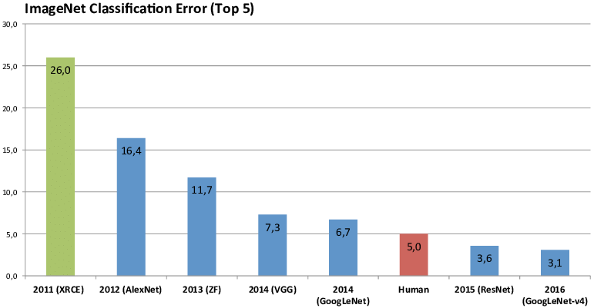
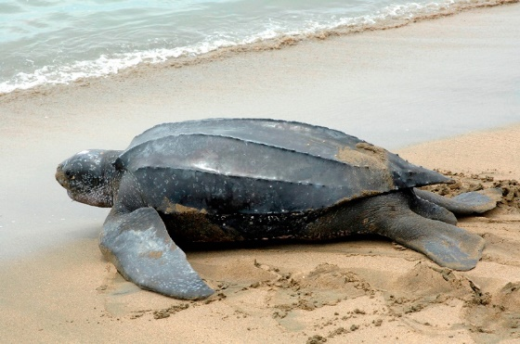
影像辨識能力超越人類？
革龜？
蠵龜？
泥龜？
箱龜？
Source of image: https://www.researchgate.net/figure/Winner-results-of-the-ImageNet-large-scale-visual-recognition-challenge-LSVRC-of-the_fig7_324476862
Notes:
ImageNet large scale visual recognition challenge (LSVRC)
Machine: 2.25% error rate

Slide 5
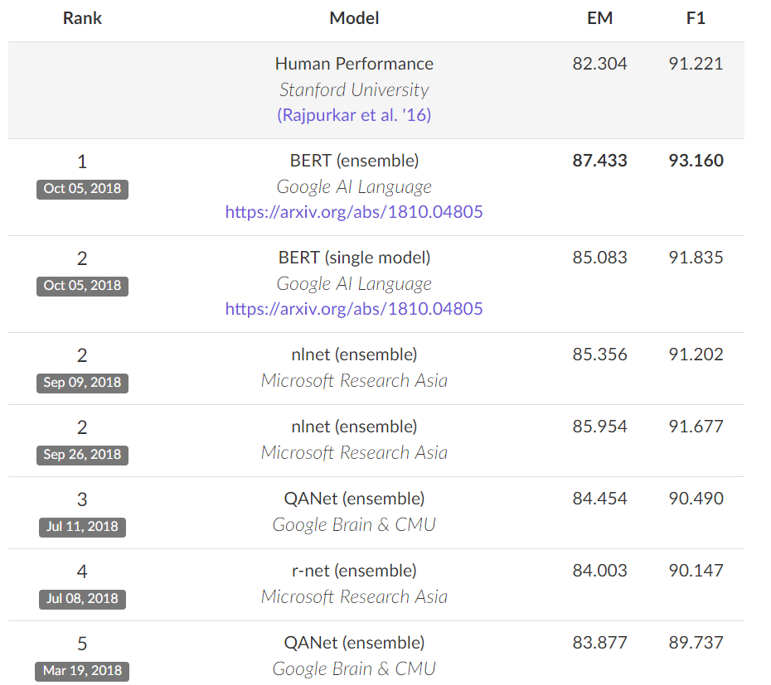
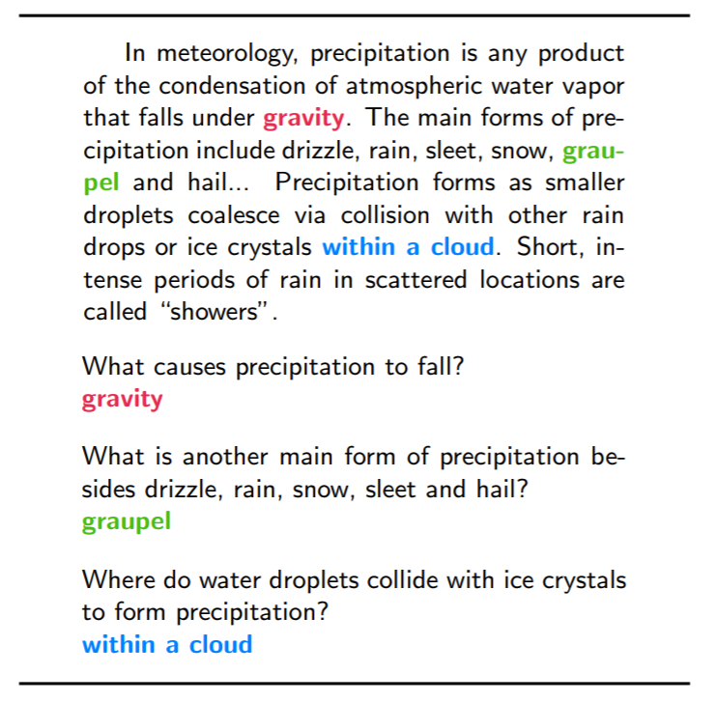
閱讀理解能力超越人類？
SQuAD
https://arxiv.org/pdf/1606.05250.pdf

Slide 6
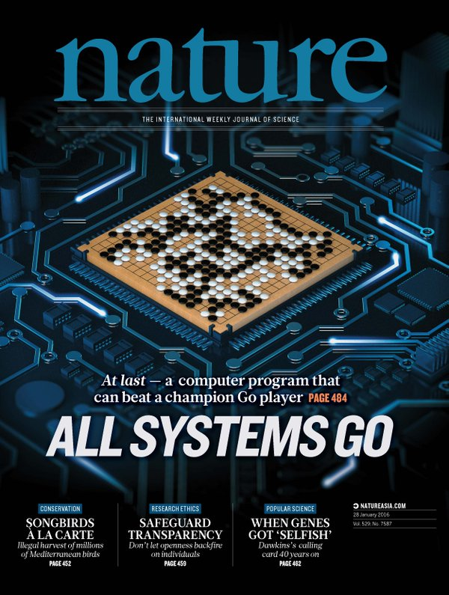
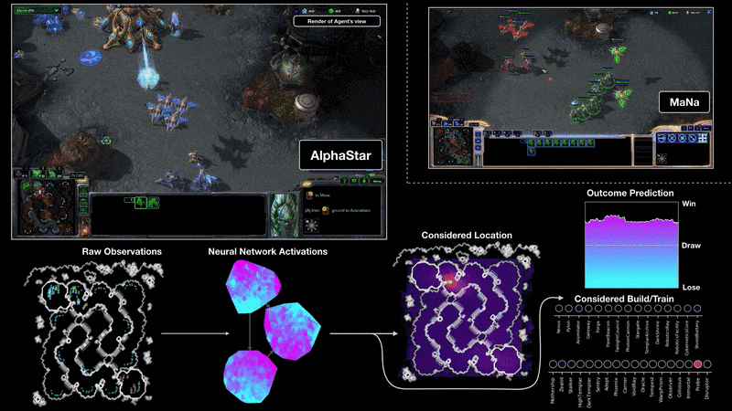
下圍棋、打星海超越人類？
https://deepmind.com/blog/alphastar-mastering-real-time-strategy-game-starcraft-ii/
Notes:
https://deepmind.com/blog/alphastar-mastering-real-time-strategy-game-starcraft-ii/
AlphaStar had an average APM of around 280,

Slide 7
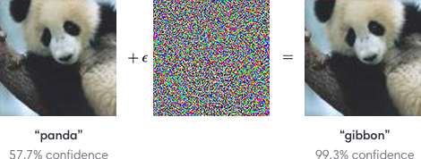
在影像辨識上超越人類?
卻又意外地脆弱 ……
https://arxiv.org/pdf/1412.6572.pdf

Slide 8
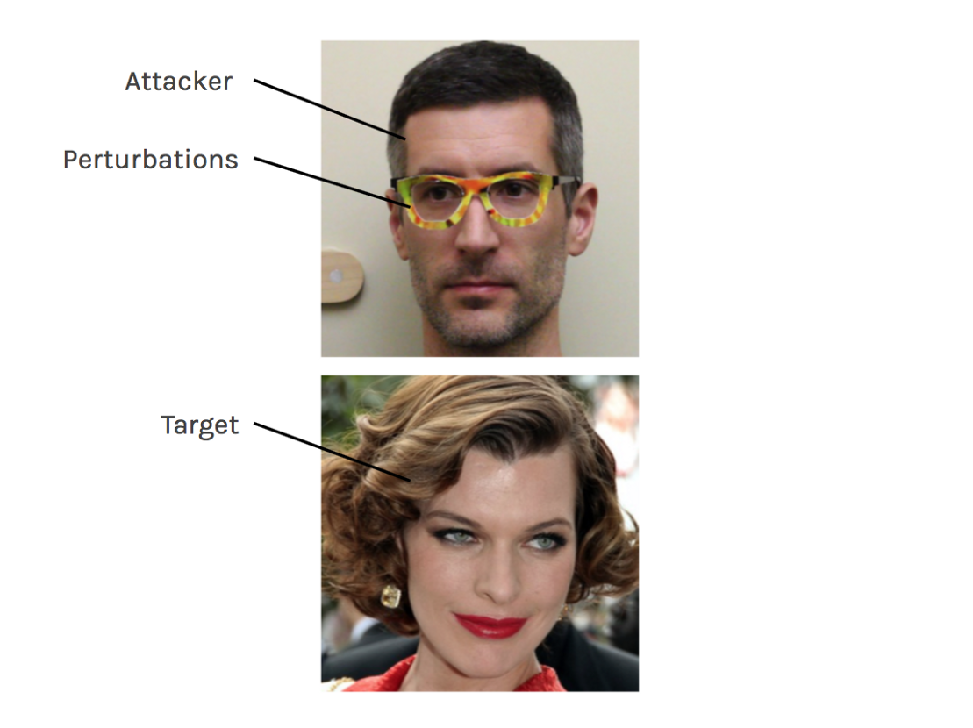
新的資安問題
https://arxiv.org/abs/1801.00349
Notes:
米拉·喬沃維奇（英語：Milla Jovovich
Carnegie Mellon University

Slide 9
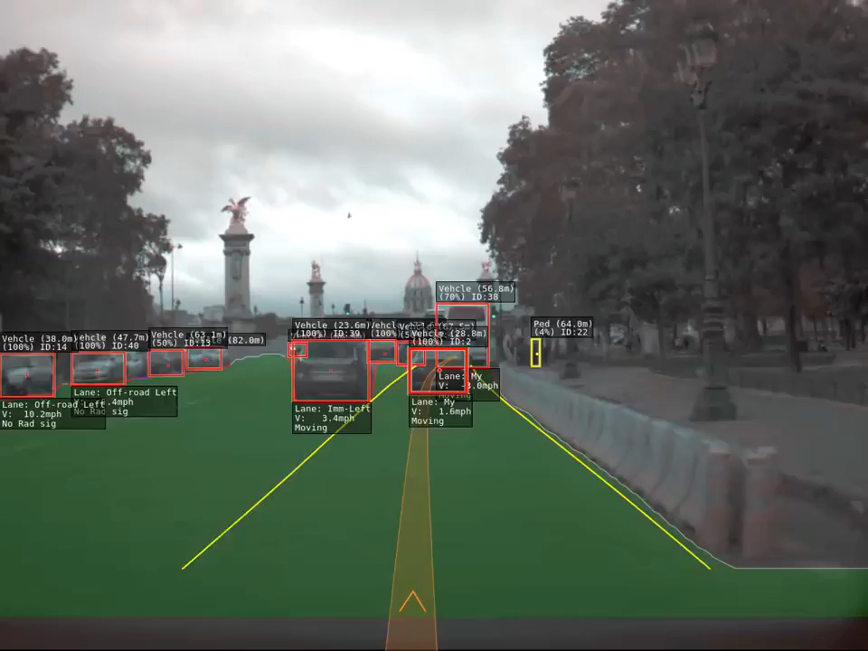
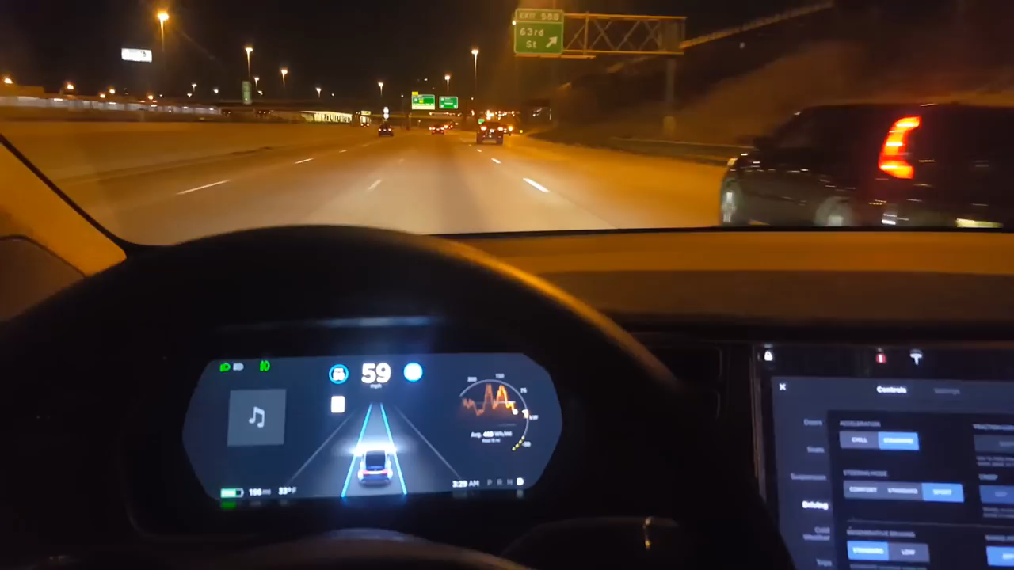
自駕車
https://www.youtube.com/watch?v=_1MHGUC_BzQ
自動駕駛輔助系統僅是提供輔助非完全自駕
https://www.youtube.com/watch?v=6QCF8tVqM3I

Slide 10
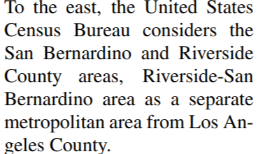
在閱讀理解上已經等同人類?
Harry
Q: Who considers Los Angeles County to be a separate metropolitan area?
A: United States Census Bureau
A: Riverside-San Bernardino Harry
Notes:
Census Bureau vbjʊro
大都市的metropolitan

Slide 11
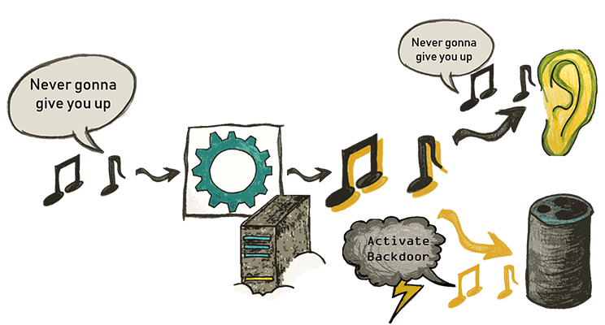
語音辨識能力超越人類？
https://arxiv.org/pdf/1808.05665.pdf
Demo webpage: https://adversarial-attacks.net
Ruhr-Universit at Bochum
Notes:
https://adversarial-attacks.net/
Ruhr-Universit ¨ at Bochum波鴻魯爾大學 德國

Slide 12
機器學習

Slide 13
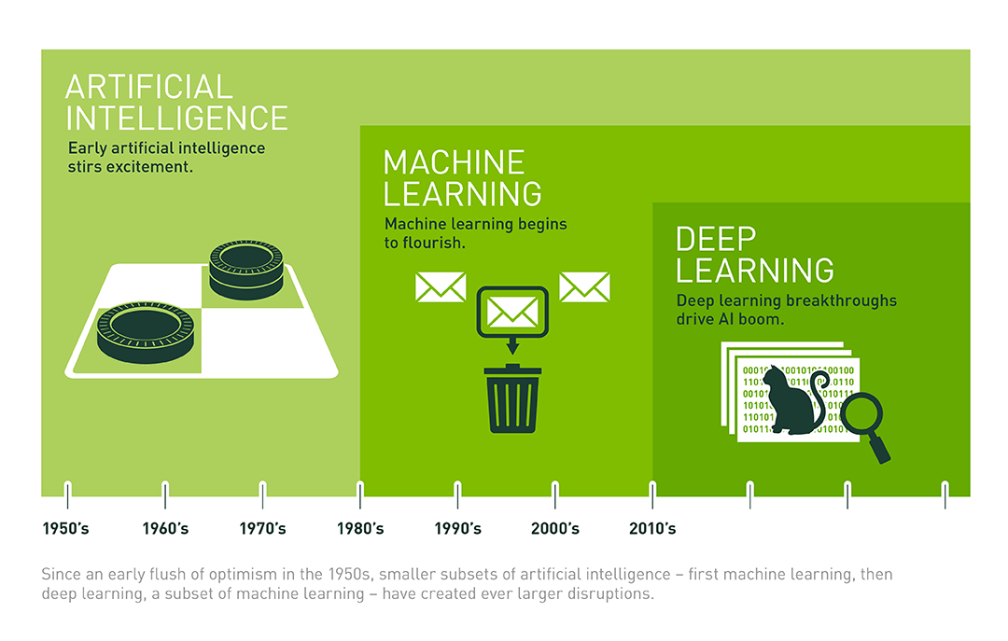
人工智慧
目標
機器學習
手段
深度學習
人類事先
設定好的規則
Source of image: https://blogs.nvidia.com.tw/2016/07/whats-difference-artificial-intelligence-machine-learning-deep-learning-ai/
Notes:
本能

Slide 14
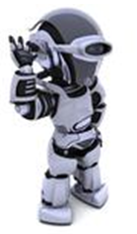
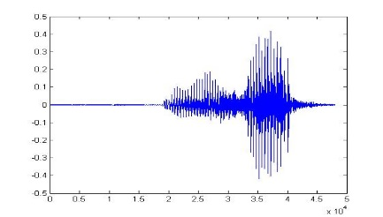
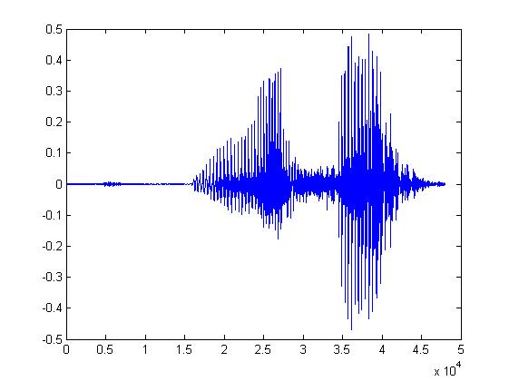
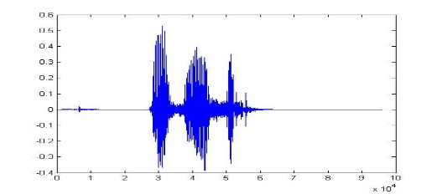
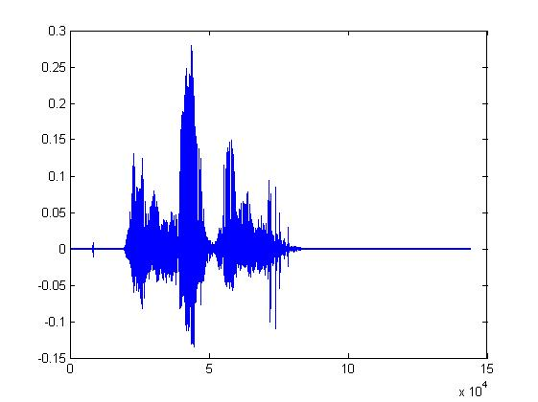
機器學習登場
Learning ......
“Hi”
“How are you”
You said “Hello”
“Good bye”
You write the program for learning.
A large amount of audio data

Slide 15

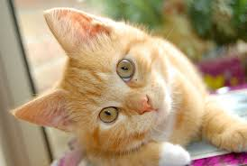
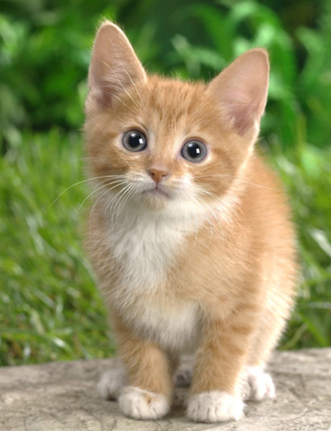

機器學習登場
Learning ......
“monkey”
“cat”
This is “cat”
“dog”
You write the program for learning.
A large amount of images

Slide 16

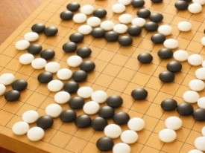
機器學習
≈ 找一個函數的能力
根據資料
Speech Recognition
Image Recognition
Playing Go
Dialogue System
“How are you”
“Cat”
“5-5”
(next move)
“How are you?”
“I am fine.”
(what the user said)
(system response)

Slide 17
Framework
Image Recognition:
“cat”
A set of function
Model
“cat”
“monkey”
“dog”
“snake”
Notes:
Repeat again

Slide 18
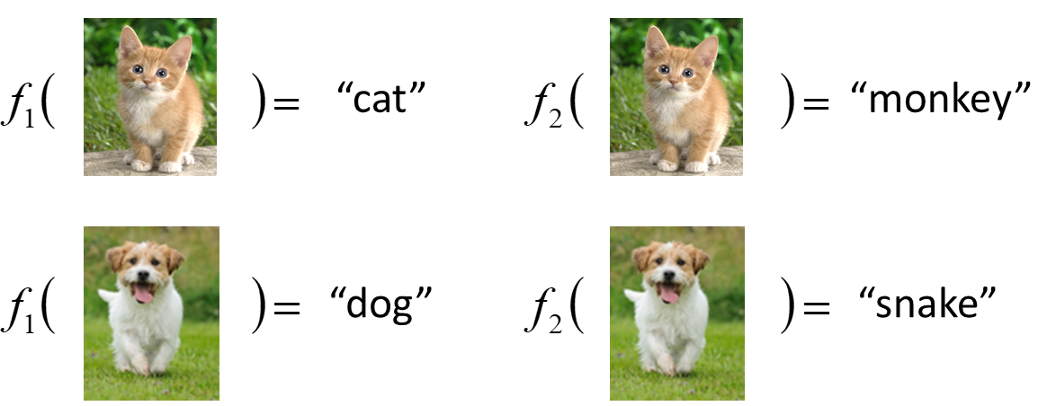
Framework
Image Recognition:
“cat”
A set of function
Model
Better!
Goodness of function f
Supervised Learning (督導式學習)
Training
Data
function input:
function output:
“monkey”
“cat”
“dog”
Notes:
Repeat again

Slide 19
Framework
Image Recognition:
“cat”
A set of function
Model
Training
Testing
“cat”
Step 1
Goodness of function f
Pick the “Best” Function
Using
Step 2
Step 3
Training
Data
“monkey”
“cat”
“dog”
Notes:
Repeat again

Slide 20
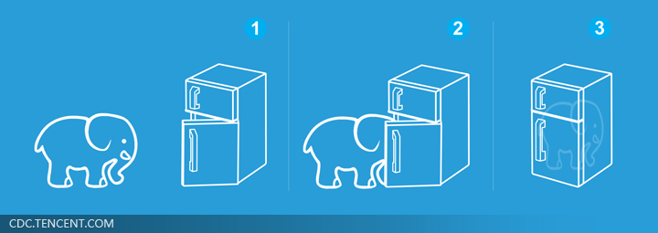
機器學習好簡單 ……
Step 1: define a set of function
Step 2: goodness of function
Step 3: pick the best function
Different Tasks (任務)
Step 0: What kind of function do you want to find?
就好像把大象放進冰箱 ……

Slide 21
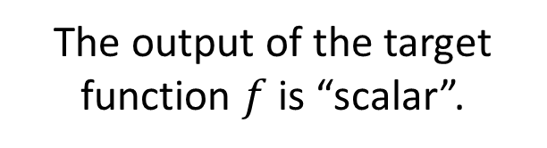
Regression (回歸)
Regression
The output of the target function $f$ is “scalar”.
Predict
PM2.5
PM2.5 today
f
PM2.5 yesterday
PM2.5 tomorrow
…….
(scalar)
Training Data:
Output:
Input:
9/03 PM2.5 = 100
9/01 PM2.5 = 63
9/02 PM2.5 = 65
Input:
Output:
9/12 PM2.5 = 30
9/13 PM2.5 = 25
9/14 PM2.5 = 20

Slide 22
Classification (分類)
Binary Classification (二元分類)
Multi-class Classification (多類別分類)
Yes or No
Class 1, Class 2, … Class N
Function f
Function f
Input
Input

Slide 23


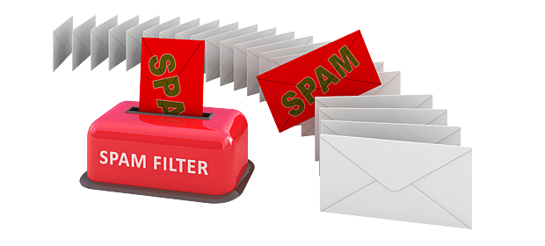
二元分類
Spam
filtering
Function
Yes/No
Yes
Training
Data
No
(http://spam-filter-review.toptenreviews.com/)
Notes:
Can we have more examples ….
Deep-Learning技術の先端企業であるAlpacaDB

Slide 24

多類別分類
Image Recognition
Training Data
“monkey”
“monkey”
Function
“cat”
“cat”
“dog”
Each possible object is a class
“dog”

Slide 25
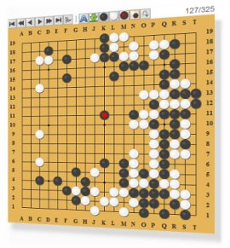
多類別分類
Each position is a class
Playing GO
(19 x 19 classes)
右上星位
Function
左下星位
天元
Next move
Notes:
Reinforcement learning?

Slide 26
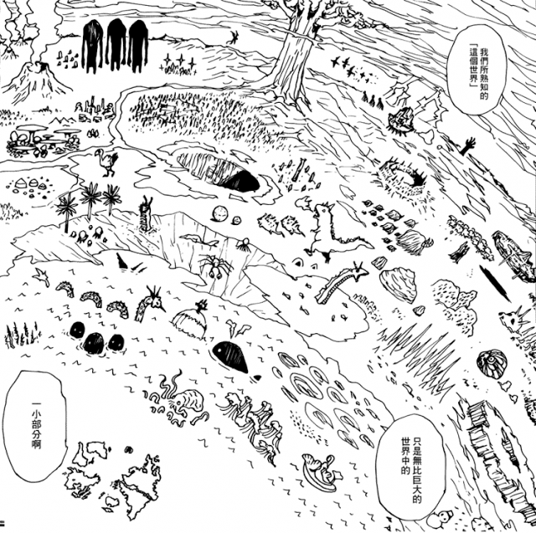
Generation (生成)
產生有結構的複雜東西
(例如：文句、圖片)
擬人化的講法—創造
Regression, Classification

Slide 27
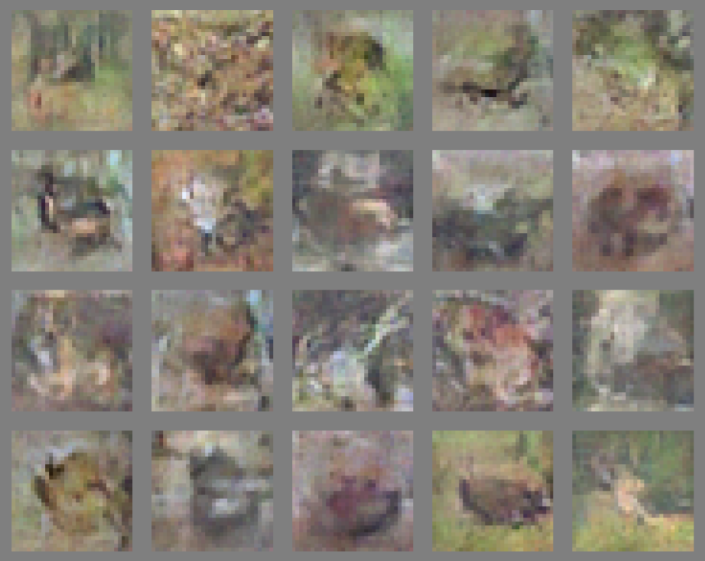
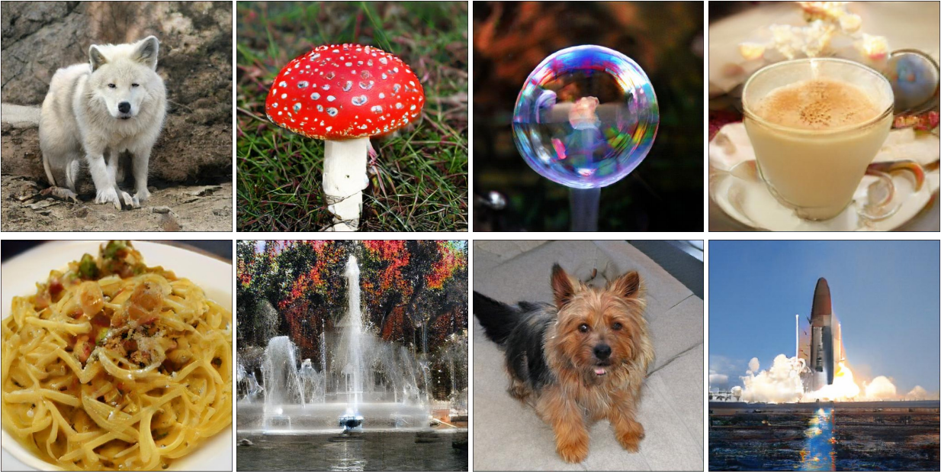
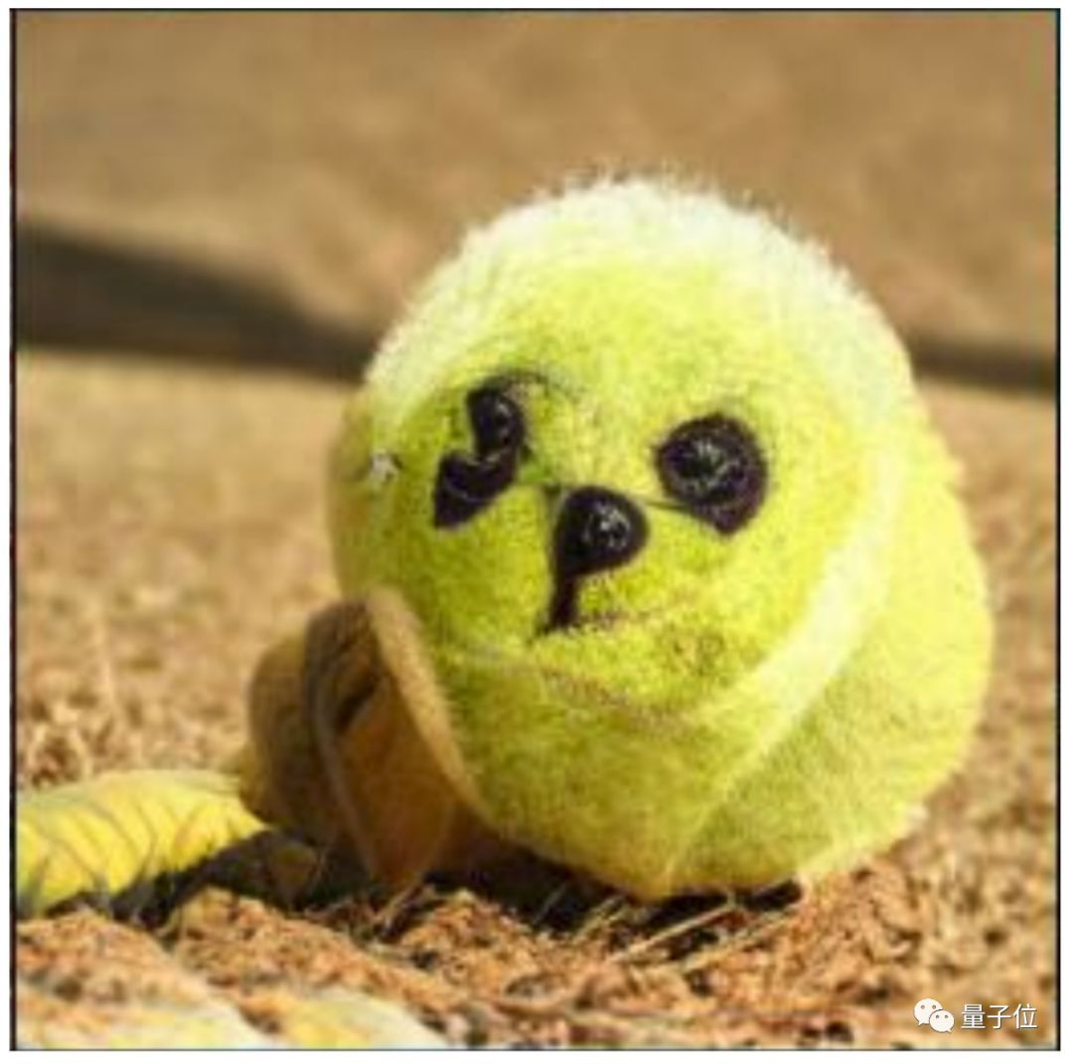
Image Generation
https://papers.nips.cc/paper/5423-generative-adversarial-nets.pdf
https://arxiv.org/abs/1809.11096
Generative Models: variational auto-encoder (VAE), generative adversarial network (GAN), Flow-based generative model, etc.

Slide 28
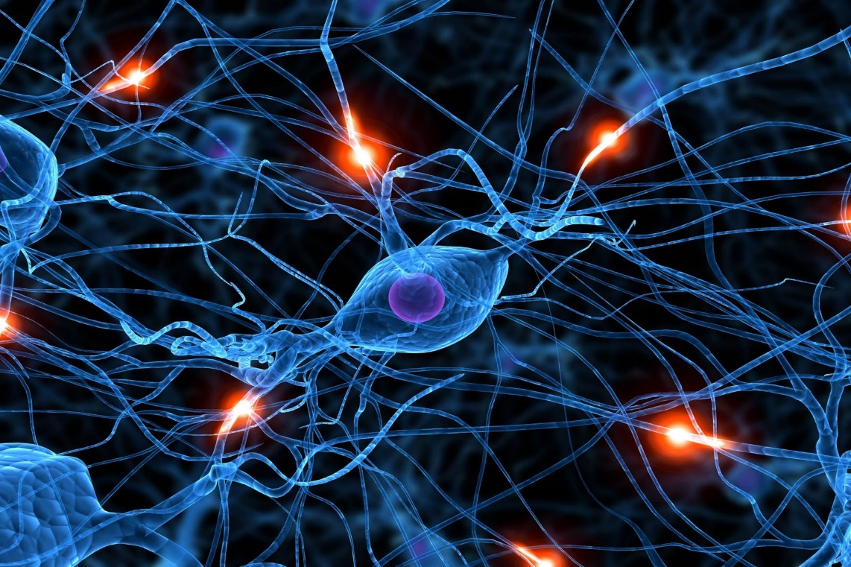
Deep Learning (深度學習)
Deep learning, SVM, decision tree ….
  →using different ways to represent a function
Using neural network (神經網路) to represent a function

Slide 29
Neural Network (神經網路)
Neuron (神經元)
A simple function
…
…
…
…
Activation function
weights
bias
Weights and biases are called network parameters
Notes:
sigmoid

Slide 30
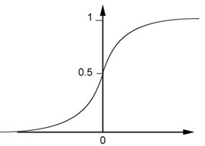
Neural Network (神經網路)
Neuron
Sigmoid Function
2
1
4
-1
-2
0.98
Activation function
-1
1
weights
1
bias
Notes:
sigmoid

Slide 31
Neural Network (神經網路)
1
4
0.98
1
-2
1
-1
-2
0.12
-1
1
0
Sigmoid Function
Notes:
Ignore +

Slide 32
Neural Network (神經網路)
1
4
0.98
2
0.86
3
0.62
1
-2
-1
-1
1
0
-2
-1
-2
0.12
-2
0.11
-1
0.83
-1
1
-1
4
0
0
2

Slide 33
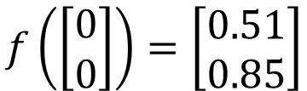
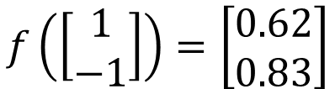
Neural Network (神經網路)
1
0.73
2
0.72
3
0.51
0
-2
-1
-1
1
0
-2
-1
0.5
-2
0.12
-1
0.85
0
1
-1
4
0
0
2
This is a function.
Input vector, output vector
$$f\left(\left[\begin{matrix}1 \\ −1\end{matrix}\right]\right)=\left[\begin{matrix}0.62 \\ 0.83\end{matrix}\right]$$
$$f\left(\left[\begin{matrix}0 \\ 0\end{matrix}\right]\right)=\left[\begin{matrix}0.51 \\ 0.85\end{matrix}\right]$$
Notes:
For example, if we modify “1” to “2”, then we have another function

Slide 34
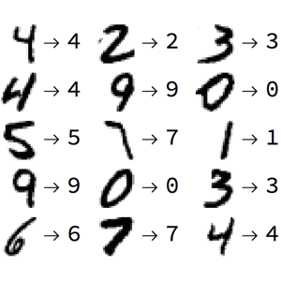
舉例說明：手寫數字辨識

Slide 35
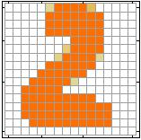
Input
Output
y₁
is 1
0.1
y₂
is 2
0.7
……
Output: “2”
……
……
y₁₀
0.2
is 0
16 x 16 = 256
Ink → 1, No ink → 0
……
y₁
is 1
……
y₂
is 2
“2”
……
……
……
……
……
……
……
y₁₀
is 0
Input
Layer 1
Layer 2
Layer L
Output

Slide 36
機器學習好簡單 ……
Step 1: define a set of function
Step 2: goodness of function
Step 3: pick the best function
Step 0: What kind of function do you want to find?
就好像把大象放進冰箱 ……

Slide 37
Neural Network (神經網路)
1
2
3
-2
-1
-1
1
0
-2
-1
-2
-1
1
-1
4
0
0
2
The developer only has to provide network structure (架構).
The parameters are found automatically from data.
Notes:
For example, if we modify “1” to “2”, then we have another function

Slide 38
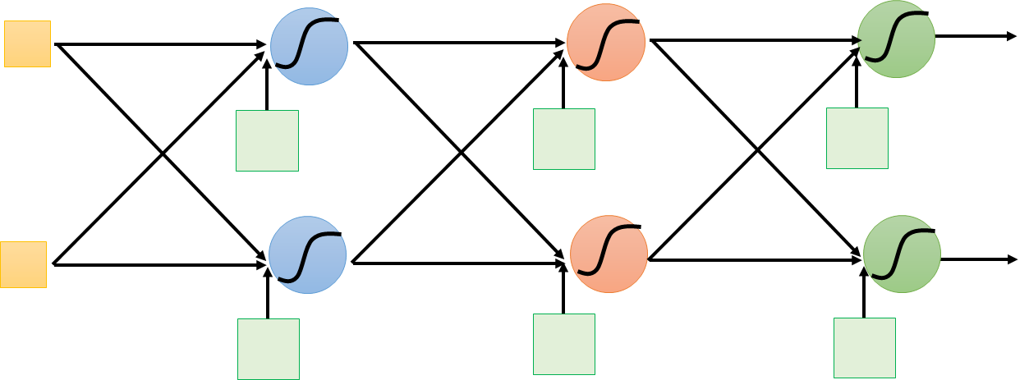
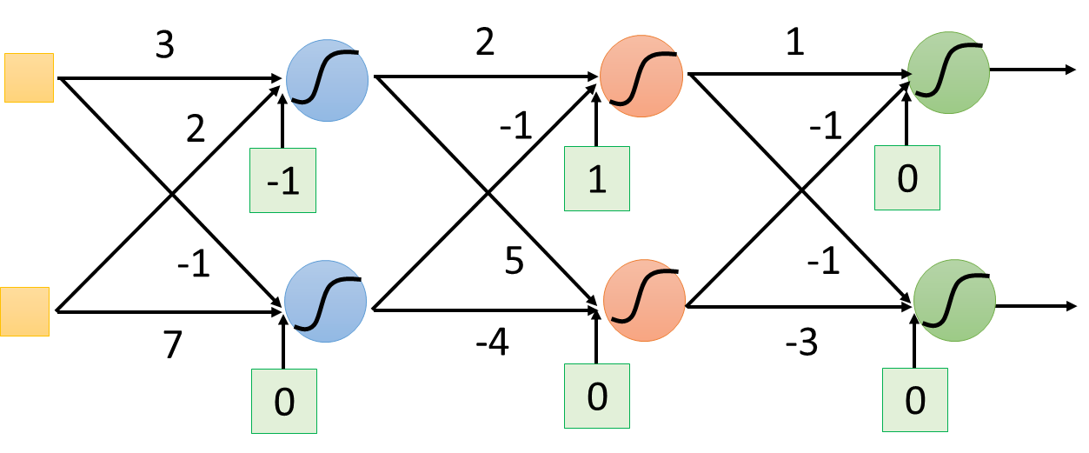
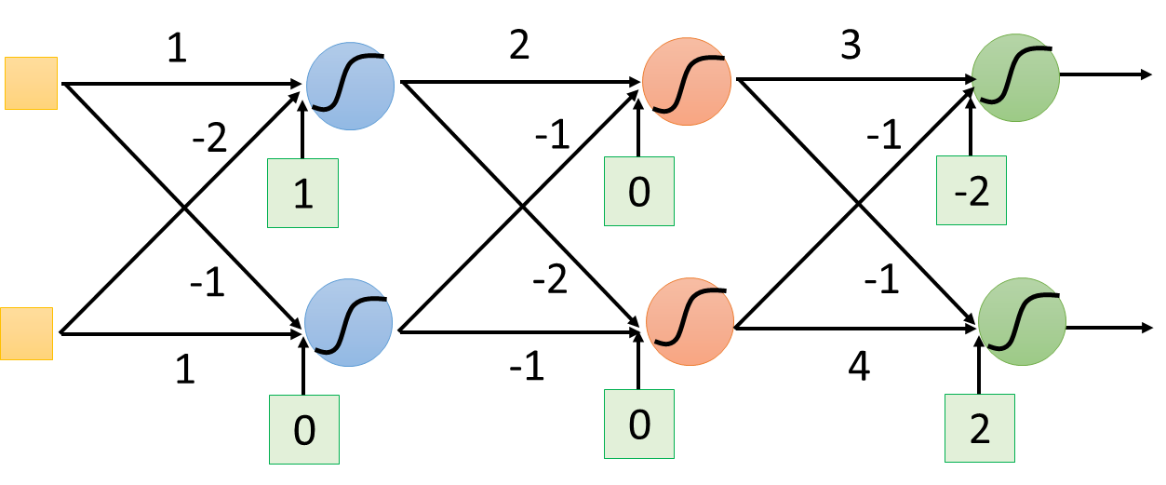
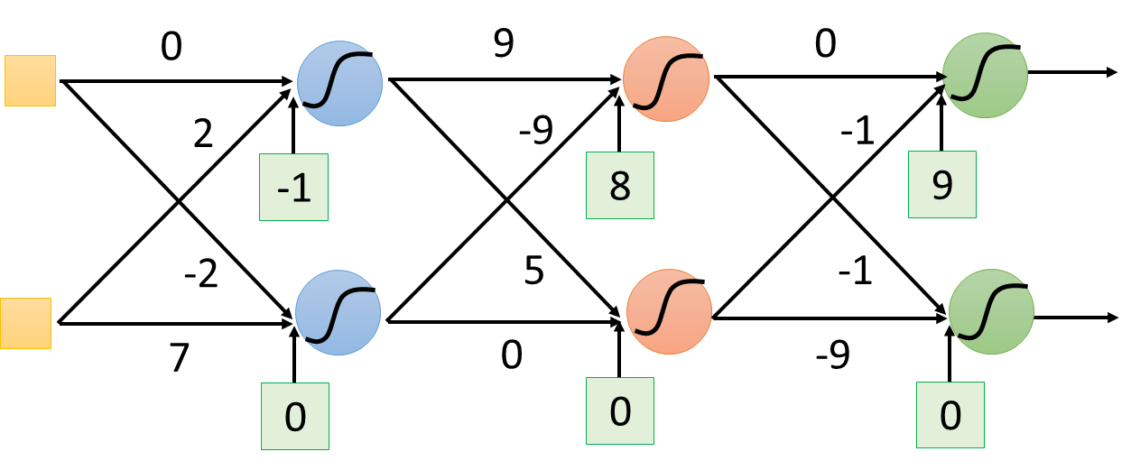
function set
人類提供了網路的架構
架構是神經網路的天賦
f₁
f₂
f₃
機器自己根據資料找出參數 (也就是選擇了某一個 function)
機器自己後天學習的成果

Slide 39
Fully Connected
Feedforward Network
neuron
Input
Layer 1
Layer 2
Layer L
Output
……
y₁
……
y₂
……
……
……
……
……
……
y_{M}
Input Layer
Output Layer
Hidden Layers
Notes:
Fully Connected Feedforward network

Slide 40
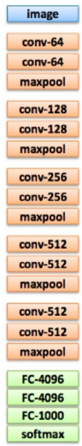
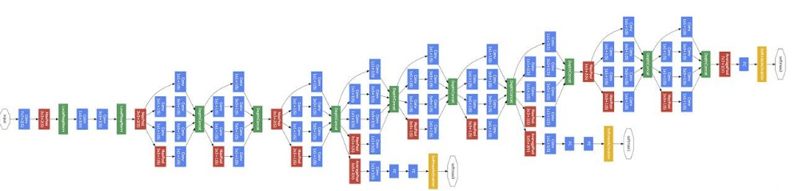
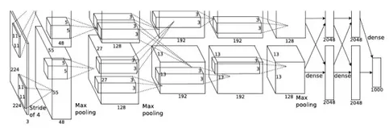
Deep = Many hidden layers
22 layers
http://cs231n.stanford.edu/slides/winter1516_lecture8.pdf
19 layers
8 layers
6.7%
7.3%
16.4%
AlexNet (2012)
VGG (2014)
GoogleNet (2014)

Slide 41

Deep = Many hidden layers
101 layers
152 layers
Special
structure
3.57%
7.3%
6.7%
16.4%
AlexNet (2012)
VGG
(2014)
GoogleNet
(2014)
Residual Net
(2015)
Taipei
101
Notes:
，曾於2004年12月31日至2010年1月4日間擁有世界第一高樓的紀錄

Slide 42
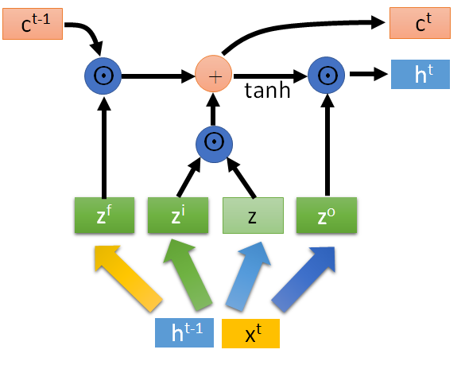
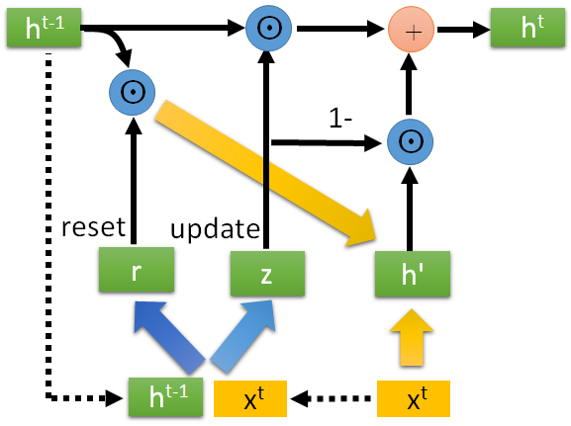
Different Network Structures
CNN, LSTM, GRU, etc. are just different ways to connect neurons.
LSTM
GRU

Slide 43
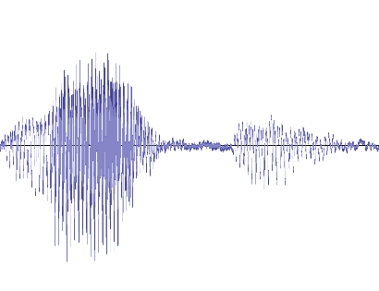
Sequence-to-sequence
(Encoder-Decoder Architecture)
Both input and output are both sequences with different lengths.
你 好 嗎
Machine Learning
我 很 好
freestyle!
Seq2seq
Seq2seq
Seq2seq
電視影集、電影台詞
機 器 學 習
你 好 嗎
語音辨識
翻譯
對話

Slide 44
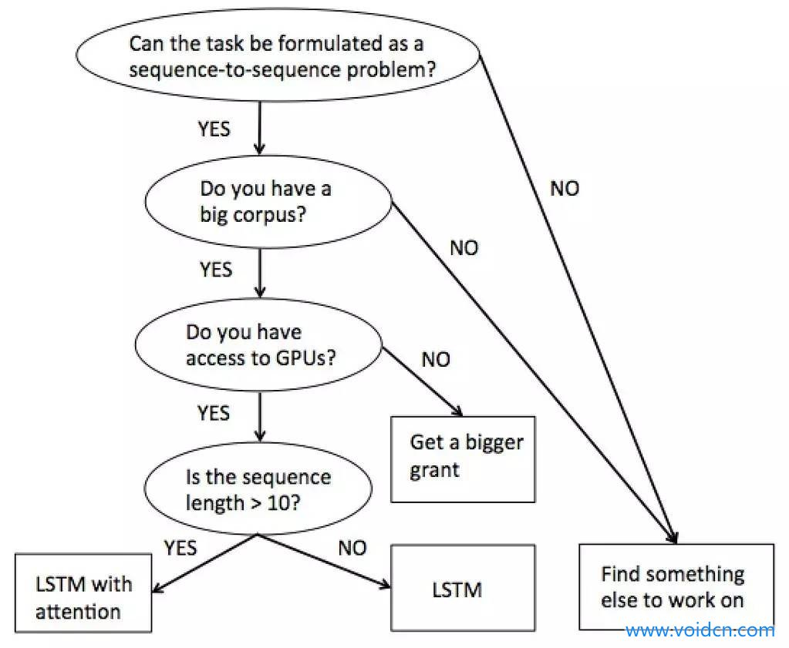
http://www.voidcn.com/article/p-nbtytose-tz.html
如何做自然語言處理相關研究

Slide 45
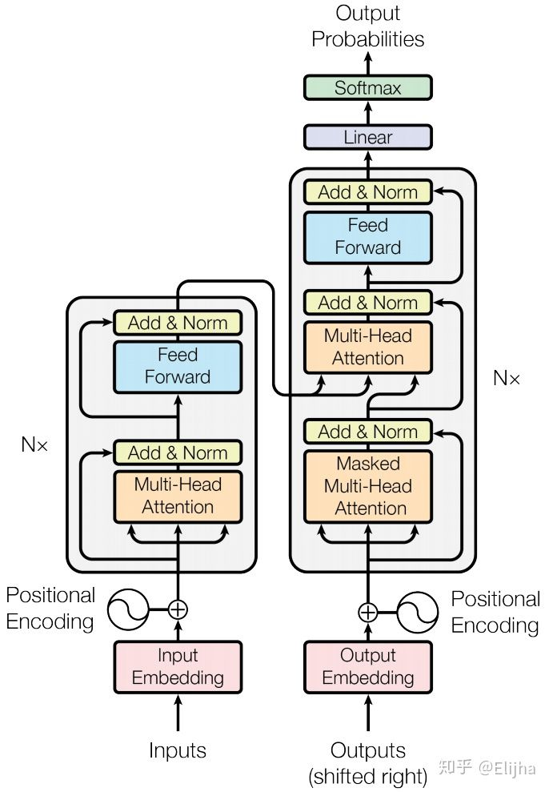
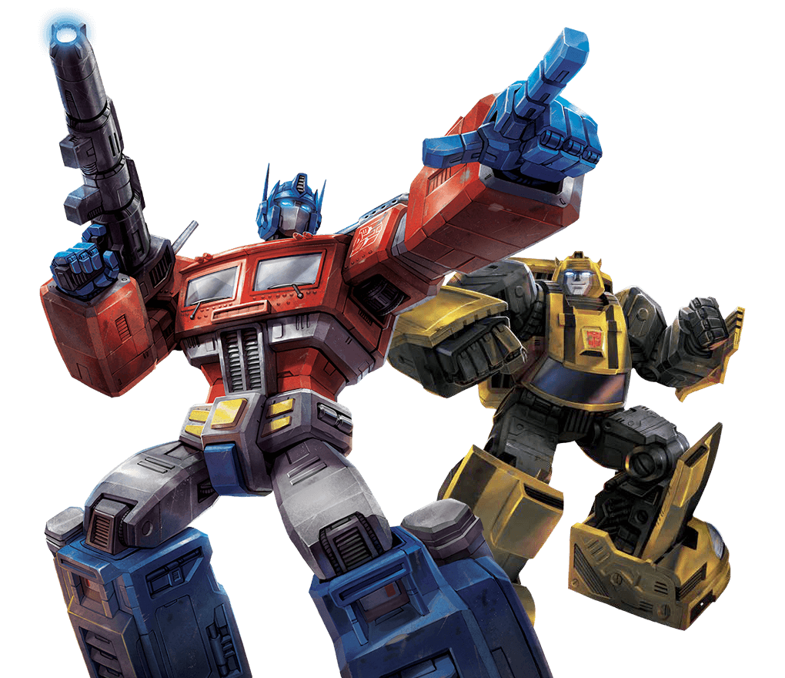
Sequence-to-sequence
Transformer
Attention is all you need.

Slide 46
機器學習好簡單 ……
Step 1: define a set of function
Step 2: goodness of function
Step 3: pick the best function
Step 0: What kind of function do you want to find?
就好像把大象放進冰箱 ……

Slide 47




Semi-supervised (半督導)
For example, recognizing cats and dogs
Labelled data
cat
dog
Unlabeled data
(Images of cats and dogs)

Slide 48




Transfer Learning (遷移學習)
For example, recognizing cats and dogs
Labelled data
cat
dog
elephant
Haruhi
Data not related to the task considered (can be either labeled or unlabeled)

Slide 49

Reinforcement Learning
(增強式學習)
Notes:
https://deepmind.com/research/dqn/

Slide 50



Supervised v.s. Reinforcement
Supervised
Reinforcement
“Hello”
Say “Hi”
Learning from teacher
“Bye bye”
Say “Good bye”
…….
…….
……
  Hello ☺
……
Bad
Learning from critics
Agent
Agent

Slide 51


Supervised v.s. Reinforcement
Supervised:
Reinforcement Learning
Next move:
“5-5”
Next move:
“3-3”
First move
…… many moves ……
Win!
Alpha Go is supervised learning + reinforcement learning.
Notes:
看著棋譜學

Slide 52


Unsupervised (非督導)
Training AI without paired data
Speech
Recognition
“How are you”
x
y
Supervised
x₁:
x₂:
x₃:
y₁:
Hello
y₂:
Good
y₃:
I am fine
Unsupervised
AI reading documents on the Internet
AI listening in the environment
Audio x
Text y

Slide 53



Unsupervised (非督導)
Machine Reading: Machine learns the meaning of words from reading a lot of documents
http://top-breaking-news.com/

Slide 54

Unsupervised (非督導)
Machine Reading: Machine learns the meaning of words from reading a lot of documents
Apple
Training data is a lot of text
Function
?
https://garavato.files.wordpress.com/2011/11/stacksdocuments.jpg?w=490

Slide 55


Unsupervised (非督導)
Machine Reading: Machine learns the meaning of words from reading a lot of documents
ELMO/BERT
Notes:
https://blog.openai.com/better-language-models/?fbclid=IwAR3EZ3gD-5-_rj_vxTnpIDRPehvZfteepEzcD7AvnQYzQFUVNX1qcrBr5lc#sample1
https://github.com/Microsoft/dowhy?fbclid=IwAR3AmSdP71a5F0w16uuJ9QRxH3pxHffuwbaCz3FTCifxnYRlShx56ntNHZI

Slide 56
機器學習好簡單 ……
Step 1: define a set of function
Step 2: goodness of function
Step 3: pick the best function
Step 0: What kind of function do you want to find?
就好像把大象放進冰箱 ……

Slide 57


如何找出最好的 function？
Enumerate all possible values
Layer l
Layer l+1
Network parameters $θ=\left\{w_{1},w_{2},w_{3},⋯,b_{1},b_{2},b_{3},⋯\right\}$
10⁶
weights
Millions of parameters
……
……
Today a network can have more than 100M parameters.
1000
neurons
1000
neurons
Notes:
百萬等級的
Solving this optimization problem by Calculus or something

Slide 58









Gradient Descent
libdnn
台大周伯威
同學開發
Notes:
amazon-dsstne記得加上 pyroch

Slide 59
機器學習好簡單 ……
Step 0: What kind of function do you want to find?
Step 1: define a set of function
Step 2: goodness of function
Step 3: pick the best function
Regression, Classification, Generation ……
Deep Learning
SVM
Decision Tree
……
Supervised
Transfer
Reinforcement
……
Gradient Descent
……

Slide 60
機器學習的下一步
在真實的應用中還少了甚麼
Notes:
6. Towards AI in the real world
How to know I do not know?
Attack and defence
Why I do this?
Few/zero learning
LLL
Meta-learning
Unsupervised domain adaptation
Compression
Theory

Slide 61


機器能不能知道「我不知道」
這是網球
Today
我不知道
這是甚麼
Anomaly Detection
Notes:
Function output a confidence?

Slide 62

說出為什麼「我知道」
神馬漢斯
Notes:
Explainable AI

Slide 63

說出為什麼「我知道」
Explainable AI
球鞋
美洲獅
http://newsneakernews.wpengine.netdna-cdn.com/wp-content/uploads/2016/11/rihanna-puma-creeper-velvet-release-date-02.jpg

Slide 64




說出為什麼「我知道」
This slide is from:
GCPR 2017 Tutorial — W. Samek & K.-R. Müller
「馬」辨識器

Slide 65
機器的錯覺？
人有錯覺
機器的錯覺？
如何防止 Adversarial Attack 呢？
Adversarial Attack

Slide 66

終身學習 (Life-long Learning)
人類一輩子都在學習新技能
  你可能上學期學了「線性代數」，這學期學了「機器學習」
  學習「線性代數」讓你「機器學習」學得更好
機器也能「終身學習」嗎？

Slide 67




終身學習 (Life-long Learning)
今天一般我們只讓一個模型學習一個任務 ……

Slide 68
終身學習 (Life-long Learning)
今天一般我們只讓一個模型學習一個任務 ……
問題：(1) 模型的數量無限增長 (2) 之前學到的技能對之後的學習沒有幫助
我學會圍棋了
我學會星海了
我不會下圍棋了 QQ
學習圍棋
學習星海
Catastrophic Forgetting

Slide 69

學習如何學習
Meta-learning /
Learn to learn
Now we design the learning algorithm
Can machine learn the learning algorithm?
I can learn!
program for learning
I can learn!
program designing program
for learning
program for learning

Slide 70




一定需要很多訓練資料嗎？
Few-shot learning
Zero-shot learning
這叫「草泥馬」
我知道這是「草泥馬」
「馬來貘」全身除中後段有如穿著肚兜、包著尿布的白色體毛外，其他部位皆呈黑色
我知道這是「馬來貘」

Slide 71


Reinforcement Learning
(增強式學習)
天資不佳卻勤奮不懈？
http://web.stanford.edu/class/psych209/Readings/LakeEtAlBBS.pdf
Notes:
Learn very slowly

Slide 72


Reinforcement Learning
(增強式學習)
Sparse reward
是什麼讓你可以在這裡聽課？
未來可以賺大錢? (Reward)
好奇心、求知慾
機器能不能也一樣？
階段性目標

Slide 73
神經網路壓縮 (Network Compression)
把大神經網路縮小
參數二元化
  所有的參數都變成 “+1”和 “-1”
剪掉多餘
的參數

Slide 74


機器學習的謊言 ……
Training data and testing data have the same distribution
This is a lie!
Training data
Testing data

Slide 75



機器學習的謊言 ……
Training
Data
Testing
Data
99.5%
57.5%
How to do Unsupervised Domain Adaptation?
The results are from: http://proceedings.mlr.press/v37/ganin15.pdf

Slide 76
機器學習的下一步
Anomaly Detection (機器能不能知道「我不知道」)
Explainable AI (說出為什麼「我知道」)
防止 Adversarial Attack
Life-long Learning (終身學習 )
Meta-learning / Learn to learn (學習如何學習)
Few-shot / Zero-shot Learning (一定需要很多訓練資料嗎？)
增強式學習真的能用嗎？
Network Compression (神經網路壓縮 )
如果訓練資料和測試資料很不一樣 ……

