Slide 1
7.0 Speech Signals and Front-end Processing
References: 1. 3.3, 3.4 of Becchetti
3. 9.3 of Huang

Slide 2
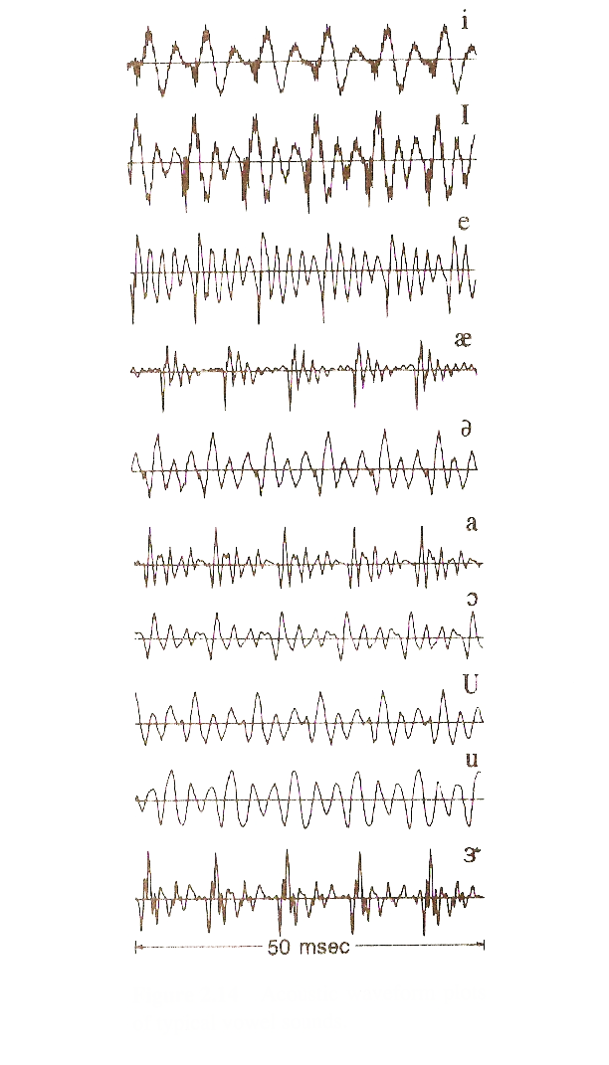
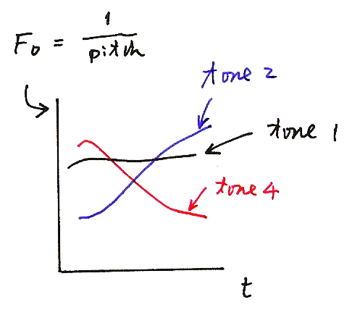
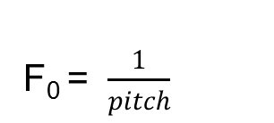
Waveform plots of typical vowel sounds - Voiced（濁音）
(音高)
tone 2
tone 1
tone 4
t

Slide 3
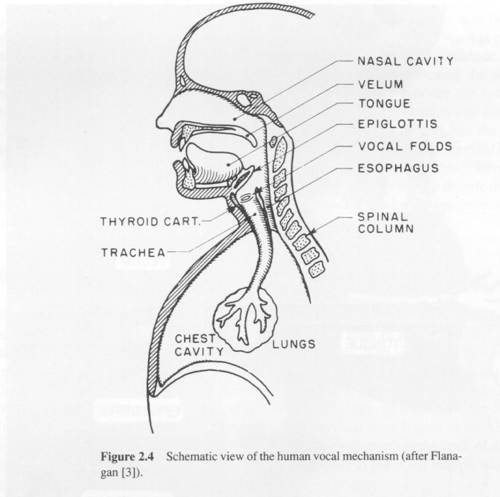
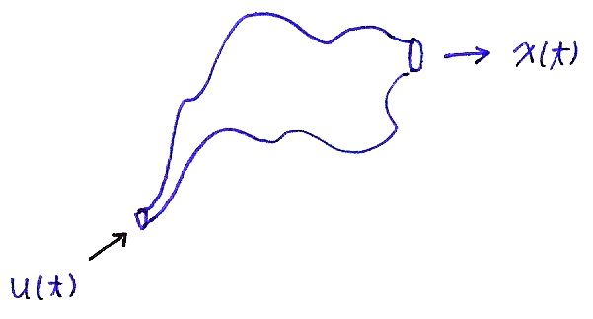
Speech Production and Source Model
Human vocal mechanism
Speech Source Model
Vocal
tract
excitation
x(t)
u(t)

Slide 4
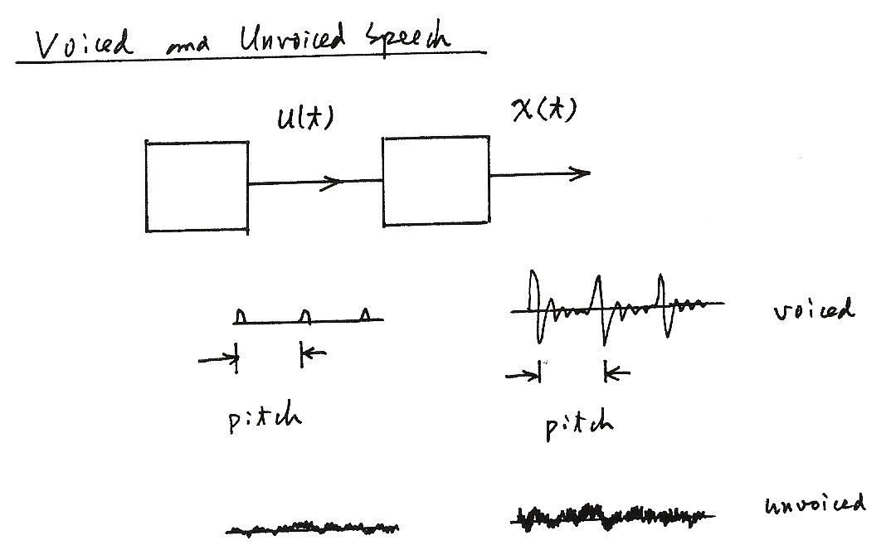
Voiced and Unvoiced Speech
u(t)
x(t)
voiced
pitch
pitch
unvoiced

Slide 5
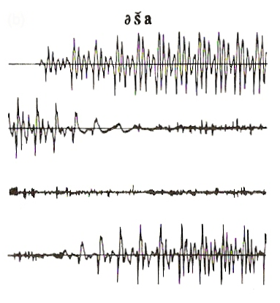
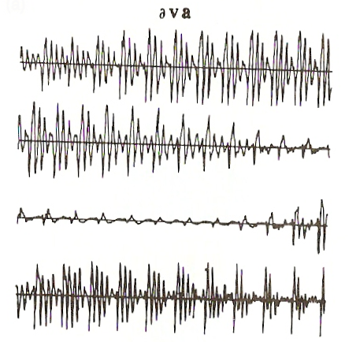
Waveform plots of typical consonant sounds
Unvoiced （清音）
Voiced （濁音）

Slide 6
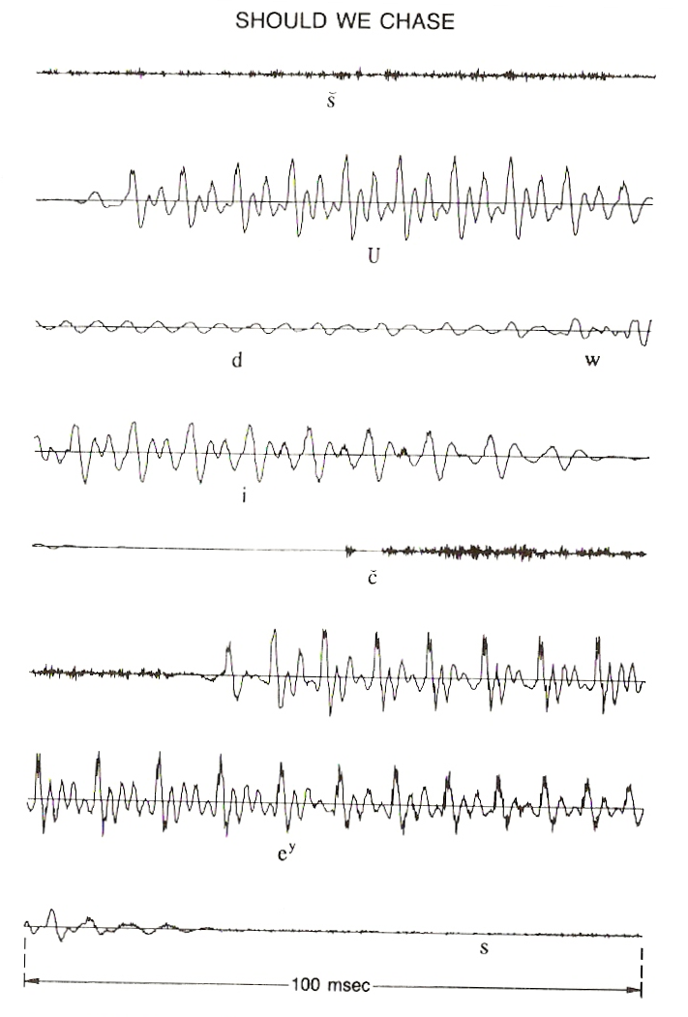
Waveform plot of a sentence

Slide 7
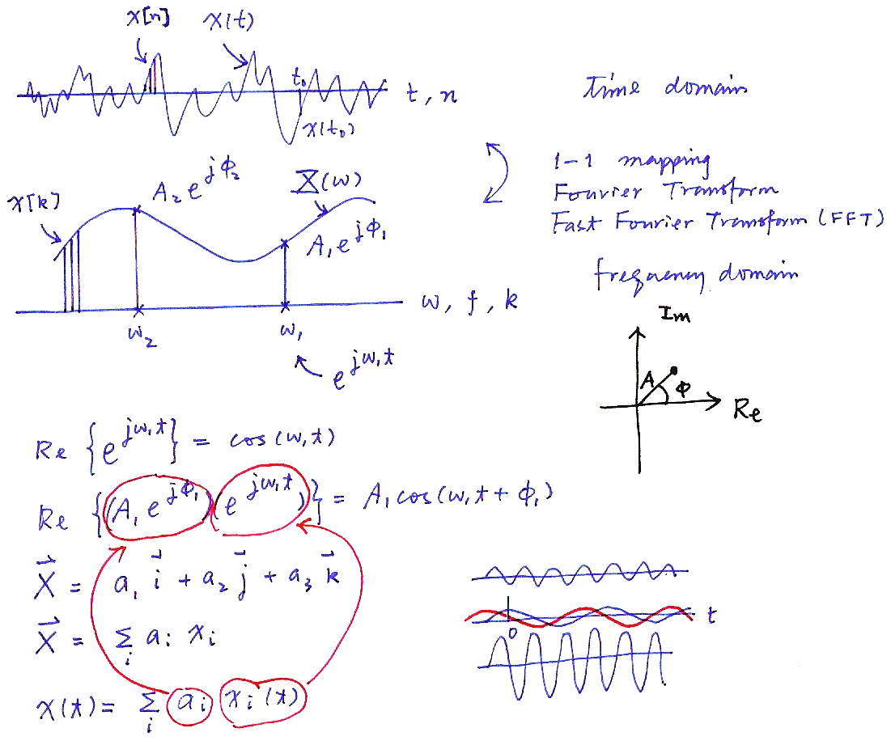
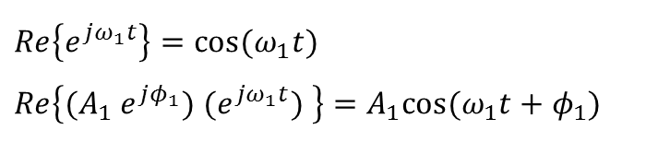

Time and Frequency Domains (P.12 of 2.0)
time domain
1-1 mapping
Fourier Transform
Fast Fourier Transform (FFT)
frequency domain
X[k]
$$Re\left\{e^{jω_{1}t}\right\}=\cos{(ω_{1}t)}$$
$$Re\left\{(A_{1} e^{jφ_{1}}) (e^{jω_{1}t}) \right\}=A_{1}cos{(ω_{1}t+φ_{1})}$$
$$\vec{X}= a_{1}\vec{i }+a_{2}\vec{j }+a_{3}\vec{k}$$
$$\vec{X}= \sum_{i}{a_{i }x_{i}}$$
$$x\left(t\right)=\sum_{i}{a_{i} x_{i}}(t)$$

Slide 8
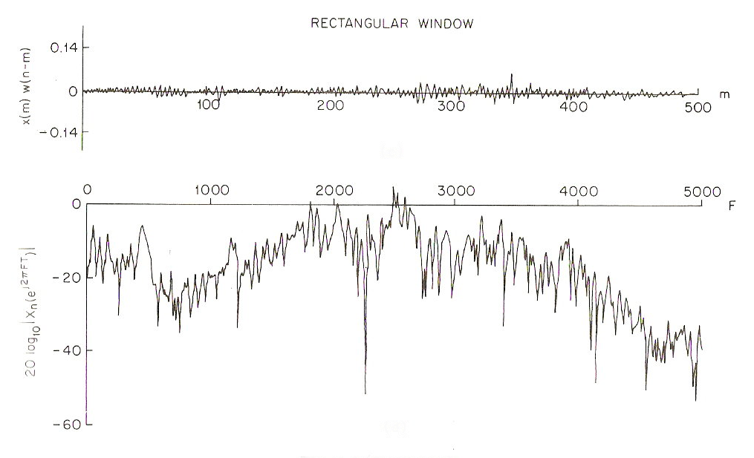
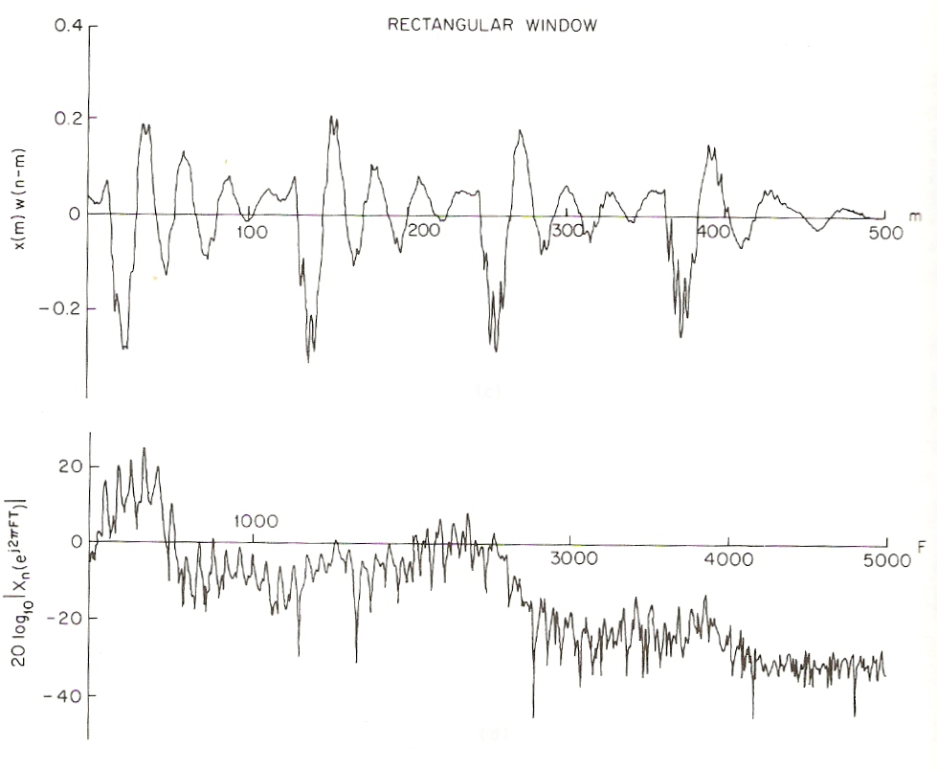
Frequency domain spectra of speech signals
Voiced
Unvoiced

Slide 9
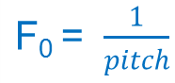
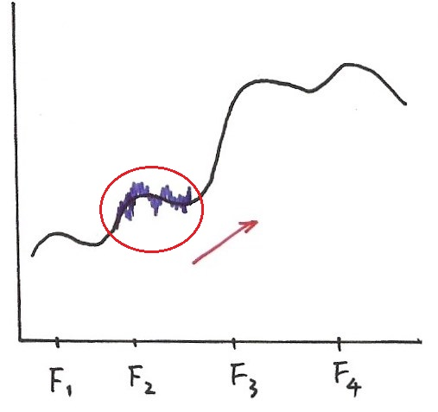
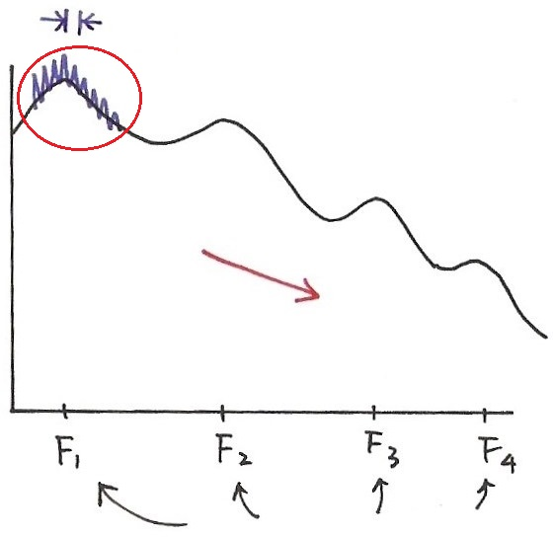
Frequency Domain
Voiced
Unvoiced
Formant
Structure
Formant
Structure
excitation
excitation
formant frequencies
formant frequencies

Slide 10
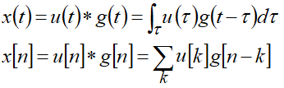
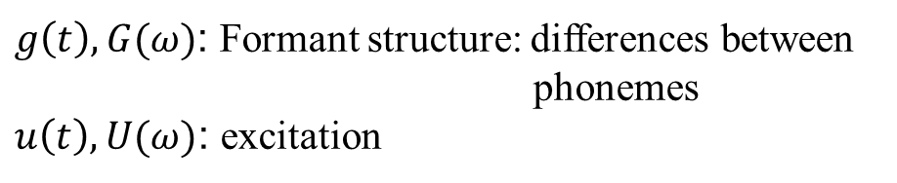
Input/Output Relationship for Time/Frequency Domains
formant
structure
excitation
F
F
F
time domain: convolution
frequency domain: product
$g\left(t\right), G(ω)$: Formant structure: differences between
phonemes
$u\left(t\right), U(ω)$: excitation

Slide 11
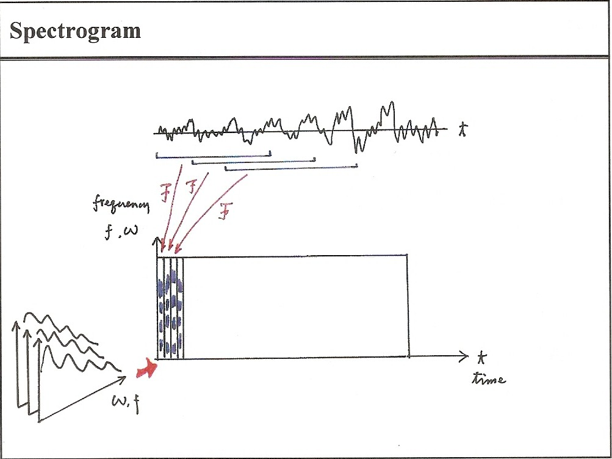
Spectrogram

Slide 12
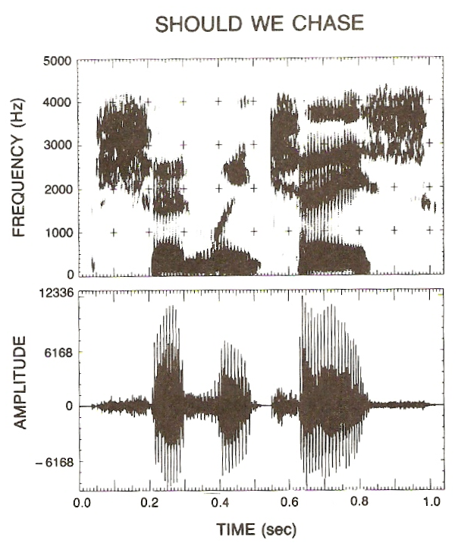
Spectrogram

Slide 13
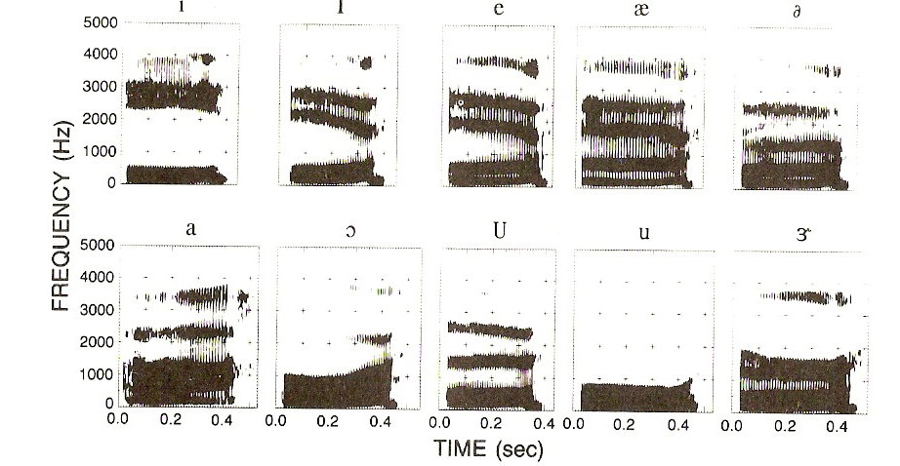
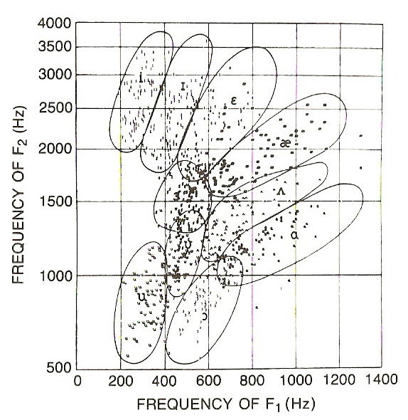
Formant Frequencies

Slide 14
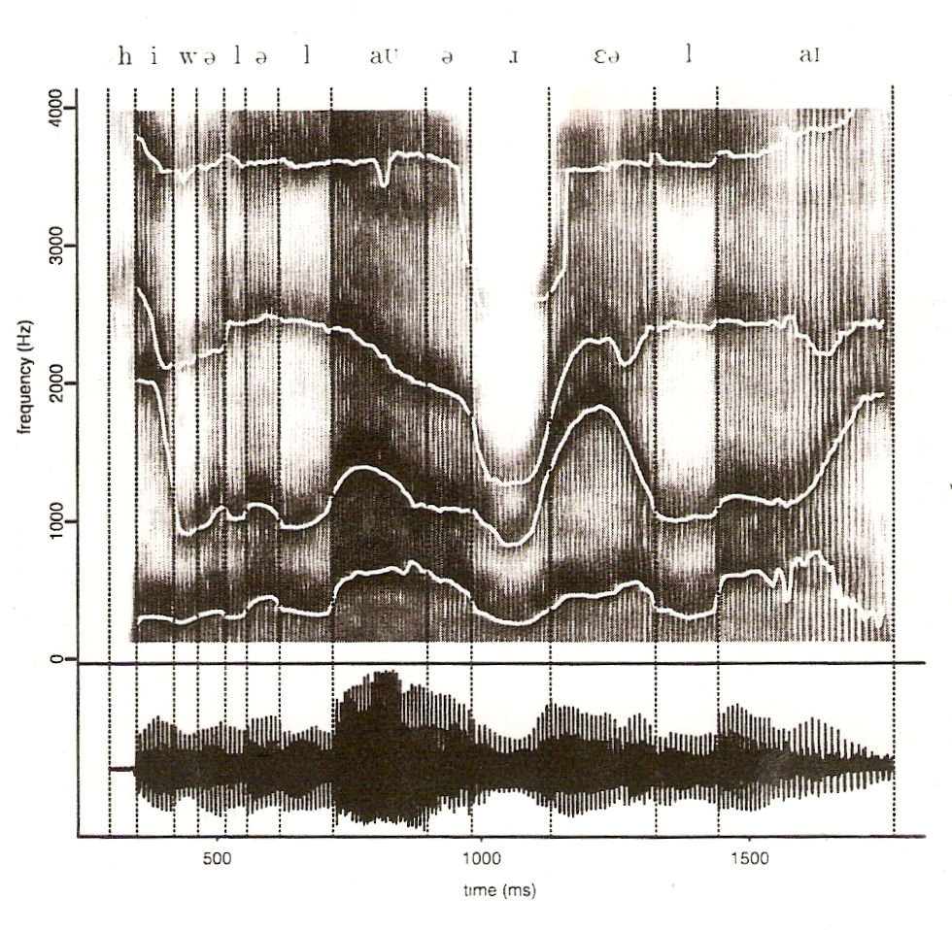
Formant frequency contours
He will allow a rare lie.
Reference: 6.1 of Huang, or 2.2, 2.3 of Rabiner and Juang

Slide 15
Speech Signals
Voiced/unvoiced 濁音、清音
Pitch/tone 音高、聲調
Vocal tract 聲道
Frequency domain/formant frequency
Spectrogram representation
Speech Source Model
Ex
G(ω),G(z), g[n]
u[n]
x[n]
Excitation Generator
Vocal Tract Model
U (ω)
U (z)
x[n]=u[n]∗g[n]
X(ω)=U(ω)G(ω)
X(z)=U(z)G(z)
parameters
parameters
  digitization and transmission of the parameters will be adequate
  at receiver the parameters can produce x[n] with the model
  much less parameters with much slower variation in time lead to much less bits required
  the key for low bit rate speech coding

Slide 16
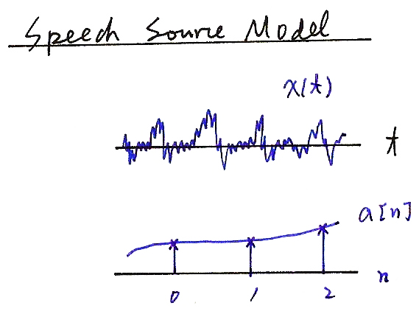
Speech Source Model
x(t)
t
a[n]
n

Slide 17
Speech Source Model
Sophisticated model for speech production
Simplified model for speech production
Voiced
Pitch period, N
G
Periodic Impulse
Train Generator
G(z)
Glottal
filter
V
H(z)
Vocal Tract
Filter
R(z)
Lip
Radiation
Filter
x(n)
Speech
Signal
Uncorrelated
Noise
Generator
U
G
Unvoiced
Pitch period, N
Voiced
Periodic Impulse
Train Generator
Voiced/unvoiced
switch
V
Combined
Filter
x(n)
Speech
Signal
Random
Sequence
Generator
U
G
Unvoiced

Slide 18
Simplified Speech Source Model
unvoiced
voiced
G(z), G(ω), g[n]
random
sequence
generator
G(z) =
x[n]
×
u[n]
1
1− ∑ a_{k}z^{-k}
P
k = 1
periodic pulse train
generator
G
v/u
Vocal Tract Model
N
Excitation
  Excitation parameters
  v/u : voiced/ unvoiced
  N : pitch for voiced
  G : signal gain
  → excitation signal u[n]
  Vocal Tract parameters
  {a_{k}} : LPC coefficients
  →formant structure of speech signals
  A good approximation, though not
  precise enough
Reference: 3.3.1-3.3.6 of Rabiner and Juang, or 6.3 of Huang

Slide 19

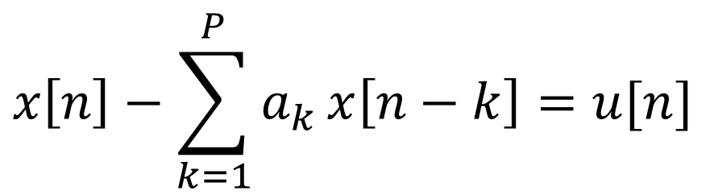


Speech Source Model
1
$$G\left(z\right)=$$
u[n]
x[n]
$$1− \sum_{k=1}^{P}{a_{k}}z^{−k}$$
$$x\left[n\right]−\sum_{k=1}^{P}{a_{k}}x\left[n−k\right]=u[n]$$

Slide 20
Feature Extraction - MFCC
Mel-Frequency Cepstral Coefficients (MFCC)
  Most widely used in the speech recognition
  Has generally obtained a better accuracy at relatively low computational complexity
  The process of MFCC extraction :
Speech signal
x_{t}(n)
X_{t}(k)
Mel
filter-bank
Pre-emphasis
DFT
x(n)
x’(n)
Window
Y_{t}(m)
energy
Log(| |²)
e_{t}
derivatives
y_{t} (j)
Y_{t}’(m)
IDFT
MFCC

Slide 21
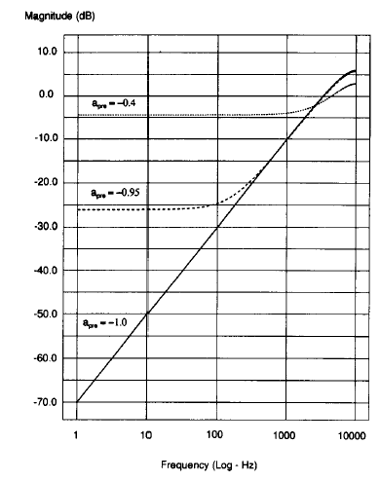
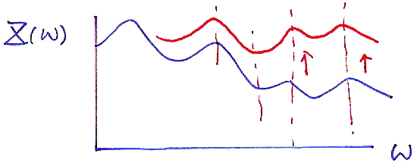
Pre-emphasis
The process of Pre-emphasis :
  a high-pass filter
Speech signal x(n)
x’(n)=x(n)-ax(n-1)
H(z)=1-a • z⁻¹ 0<a≤1

Slide 22
Why pre-emphasis?
Reason :
  Voiced sections of the speech signal naturally have a negative spectral slope (attenuation) of approximately 20 dB per decade due to the physiological characteristics of the speech production system
  High frequency formants have small amplitude with respect to low frequency formants. A pre-emphasis of high frequencies is therefore helpful to obtain similar amplitude for all formants

Slide 23
Why Windowing?
Why dividing the speech signal into successive and overlapping frames?
  Voice signals change their characteristics from time to time. The characteristics remain unchanged only in short time intervals (short-time stationary, short-time Fourier transform)
Frames
  Frame Length : the length of time over which a set of parameters can be obtained and is valid. Frame length ranges between 20 ~ 10 ms
  Frame Shift: the length of time between successive parameter calculations
  Frame Rate: number of frames per second

Slide 24
Waveform plot of a sentence

Slide 25
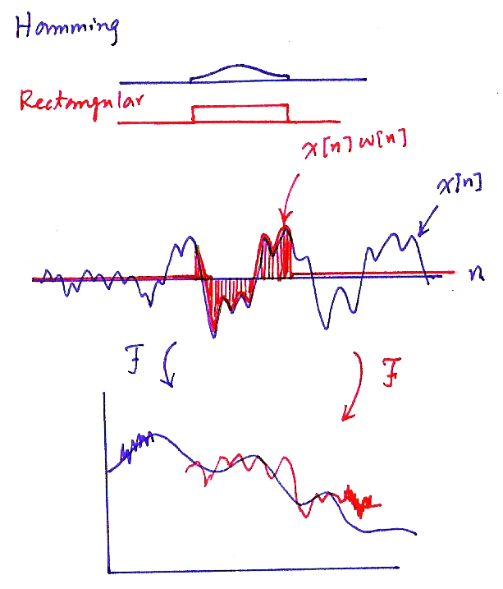
Hamming
Rectangular
x[n]w[n]
x[n]
F
F

Slide 26
Effect of Windowing (1)
Windowing :
  x_{t}(n)=w(n)•x’(n), w(n): the shape of the window
  (product in time domain)
    X_{t}(ω)=W(ω)*X’(ω), *: convolution
    (convolution in frequency domain)
  Rectangular window (w(n)=1 for 0 ≤ n ≤ L-1):
    simply extract a segment of the signal
    whose frequency response has high side lobes
  Main lobe : spreads out the narrow band power
  of the signal (that around the formant
  frequency) in a wider frequency range,
  and thus reduces the local frequency
  resolution in formant allocation
  Side lobe : swap energy from different
  and distant frequencies
Rectangular
Hamming
(dB)
π
ω

Slide 27
Input/Output Relationship for Time/Frequency Domains (P.10 of 7.0)
formant
structure
excitation
F
F
F
time domain: convolution
frequency domain: product
$g\left(t\right), G(ω)$: Formant structure: differences between
phonemes
$u\left(t\right), U(ω)$: excitation

Slide 28
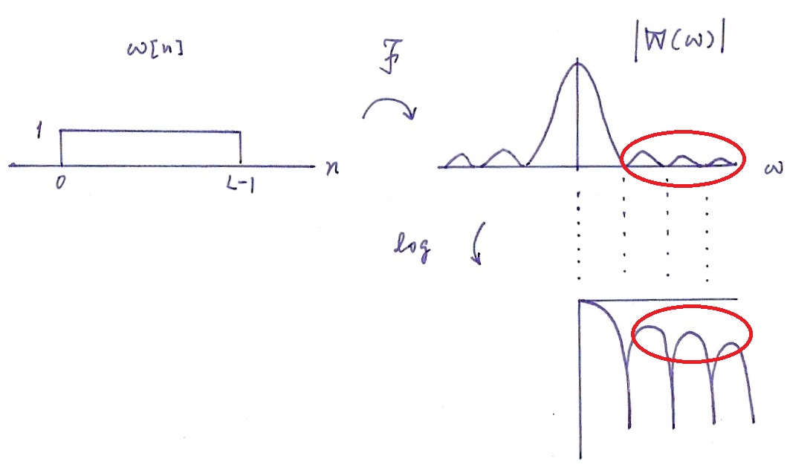
Windowing
side lobes
main lobe
  Main lobe : spreads out the narrow band power of the signal (that around the formant frequency) in a wider frequency range, and thus reduces the local frequency resolution in formant allocation
  Side lobe : swap energy from different
  and distant frequencies

Slide 29
Effect of Windowing (2)
Windowing (Cont.):
  For a designed window, we wish that
    the main lobe is as narrow as possible
    the side lobe is as low as possible
      However, it is impossible to achieve both simultaneously. Some trade-off is needed
  The most widely used window shape is the Hamming window

Slide 30
DFT and Mel-filter-bank Processing
For each frame of signal (L points, e.g., L=512),
  the Discrete Fourier Transform (DFT) is first performed to obtain its spectrum (L points, for example L=512)
  The bank of filters based on Mel scale is then applied, and each filter output is the sum of its filtered spectral components (M filters, and thus M outputs, for example M=24)
sum
Y_{t}(0)
ω
Time domain signal
spectrum
t
DFT
ω
sum
Y_{t}(1)
ω
x_{t}(n)
X_{t}(k)
L
n = 0,1,....L-1
k = 0,1,.... -1
2
sum
Y_{t}(M-1)
ω

Slide 31
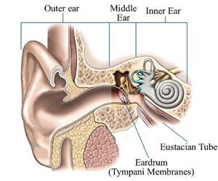
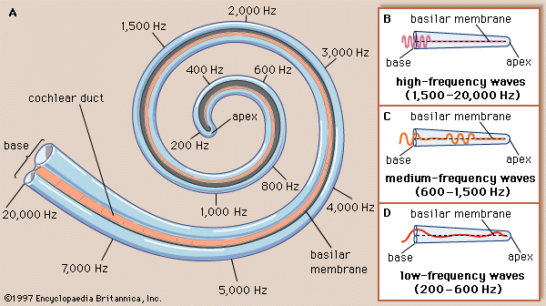
Peripheral Processing for Human Perception

Slide 32
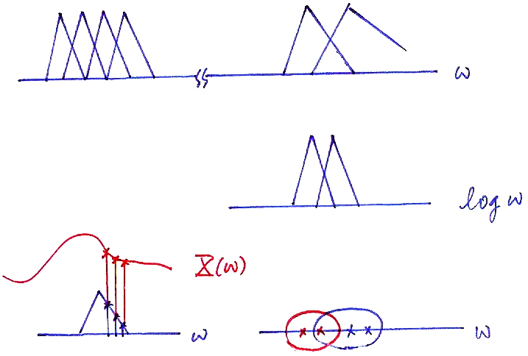





Mel-scale Filter Bank
$$ω$$
$$\log{ω}$$
$$X(ω)$$
$$ω$$
$$ω$$

Slide 33
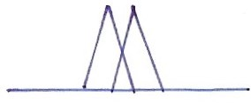



Why Filter-bank Processing?
The filter-bank processing simulates human ear perception
    Frequencies of a complex sound within a certain frequency band cannot be individually identified.
    When one of the components of this sound falls outside this frequency band, it can be individually distinguished.
    This frequency band is referred to as the critical band.
    These critical bands somehow overlap with each other.
    The critical bands are roughly distributed linearly in the logarithm frequency scale (including the center frequencies and the bandwidths), specially at higher frequencies.
    Human perception for pitch of signals is proportional to the logarithm of the frequencies (relative ratios between the frequencies)
$$ω$$
$$\log{ω}$$

Slide 34
Feature Extraction - MFCC
Mel-Frequency Cepstral Coefficients (MFCC)
  Most widely used in the speech recognition
  Has generally obtained a better accuracy at relatively low computational complexity
  The process of MFCC extraction :
Speech signal
x_{t}(n)
X_{t}(k)
Mel
filter-bank
Pre-emphasis
DFT
x(n)
x’(n)
Window
Y_{t}(m)
energy
Log(| |²)
e_{t}
derivatives
y_{t} (j)
Y_{t}’(m)
IDFT
MFCC

Slide 35
Logarithmic Operation and IDFT
The final process of MFCC evaluation : logarithm operation and IDFT
Mel-filter output
Y_{t}(m)
Filter index(m)
0
M-1
Log(| |²)
Y’_{t}(m)
Filter index(m)
0
M-1
IDFT
y_{t}=CY’_{t}
MFCC vector y_{t}( j)
quefrency( j)
0
J-1

Slide 36
Why Log Energy Computation?
Using the magnitude (or energy) only
  Phase information is not very helpful in speech recognition
    Replacing the phase part of the original speech signal with continuous random phase usually won’t be perceived by human ears
Using the Logarithmic operation
  Human perception sensitivity is proportional to signal energy in logarithmic scale (relative ratios between signal energy values)
  The logarithm compresses larger values while expands smaller values, which is a characteristic of the human hearing system
  The dynamic compression also makes feature extraction less sensitive to variations in signal dynamics
  To make a convolved noisy process additive
    Speech signal x(n), excitation u(n) and the impulse response of vocal tract g(n)
    x(n)=u(n)*g(n) ➔X(ω)=U(ω)G(ω)
    ➔ |X(ω)|=|U(ω)||G(ω)| ➔log|X(ω)|=log|U(ω)|+log|G(ω)|

Slide 37
Why Inverse DFT?
Final procedure for MFCC : performing the inverse DFT on the log-spectral power
Advantages :
  Since the log-power spectrum is real and symmetric, the inverse DFT reduces to a Discrete Cosine Transform (DCT). The DCT has the property to produce highly uncorrelated features y_{t}
    diagonal rather than full covariance matrices can be used in the Gaussian distributions in many cases
  Easier to remove the interference of excitation on formant structures
    the phoneme for a segment of speech signal is primarily based on the formant structure (or vocal tract shape)
    on the frequency scale the formant structure changes slowly over frequency, while the excitation changes much faster

Slide 38
Speech Production and Source Model (P.3 of 7.0)
Human vocal mechanism
Speech Source Model
Vocal
tract
excitation
x(t)
u(t)

Slide 39
Voiced and Unvoiced Speech (P.4 of 7.0)
u(t)
x(t)
voiced
pitch
pitch
unvoiced

Slide 40
Frequency domain spectra of speech signals (P.8 of 7.0)
Voiced
Unvoiced

Slide 41
Frequency Domain (P.9 of 7.0)
Voiced
Unvoiced
Formant
Structure
Formant
Structure
excitation
excitation
formant frequencies
formant frequencies

Slide 42
Input/Output Relationship for Time/Frequency Domains (P.10 of 7.0)
formant
structure
excitation
F
F
F
time domain: convolution
frequency domain: product
$g\left(t\right), G(ω)$: Formant structure: differences between
phonemes
$u\left(t\right), U(ω)$: excitation

Slide 43
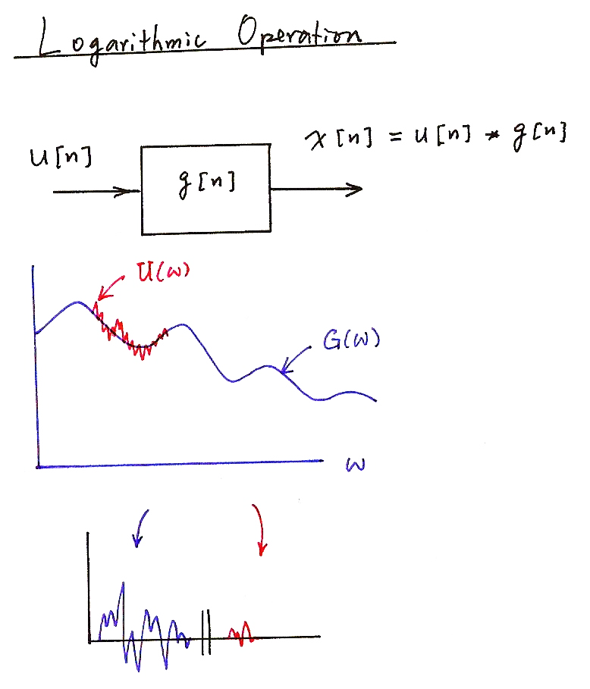
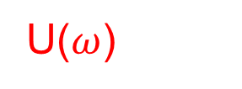
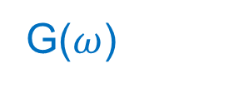

Logarithmic Operation
u[n]
x[n]= u[n]*g[n]
g[n]

Slide 44
Derivatives
Derivative operation : to obtain the change of the feature vectors with time
t-1 t t+1 t+2
quefrency(j)
MFCC stream y_{t}(j)
Frame index
quefrency(j)
ΔMFCC stream Δy_{t} (j)
Frame index
quefrency(j)
Δ² MFCC stream Δ² y_{t}(j)
Frame index

Slide 45
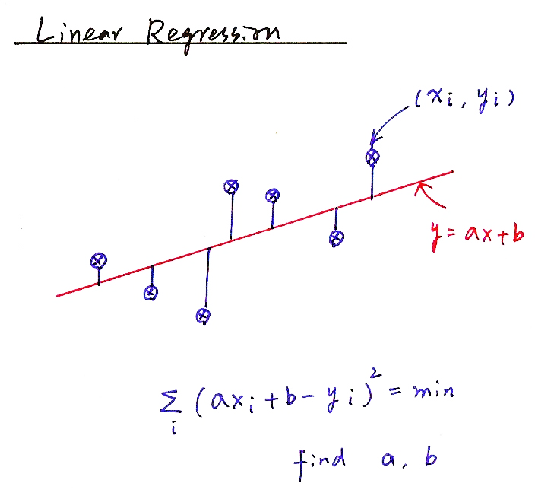
Linear Regression
(x_{i}, y_{i})
y=ax+b
find a, b

Slide 46
Why Delta Coefficients?
To capture the dynamic characters of the speech signal
  Such information carries relevant information for speech recognition
  The value of p should be properly chosen
    The dynamic characters may not be properly extracted if p is too small
    Too large p may imply frames too far away
To cancel the DC part (channel distortion or convolutional noise) of the MFCC features
  Assume, for clean speech, an MFCC parameter stream for an utterance is
  {y(t-N), y(t-N+1),…....,y(t), y(t+1), y(t+2), ……},
  y(t) is an MFCC parameter at time t,
  while after channel distortion, the MFCC stream becomes
  {y(t-N)+h, y(t-N+1)+h,…....,y(t)+h, y(t+1)+h, y(t+2)+h, ……}
  the channel effect h is eliminated in the delta (difference) coefficients

Slide 47
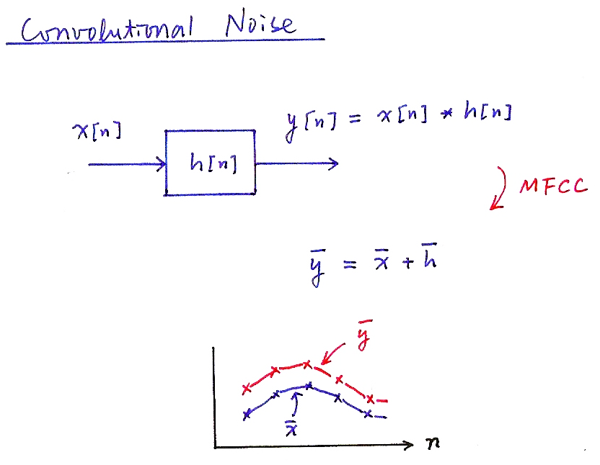
Convolutional Noise
y[n]= x[n]*h[n]
x[n]
h[n]
MFCC
y = x + h

Slide 48
End-point Detection
Push (and Hold) to Talk/Continuously Listening
Adaptive Energy Threshold
Low Rejection Rate
  false acceptance may be rescued
Vocabulary Words Preceded and Followed by a Silence/Noise Model
Two-class Pattern Classifier
  Gaussian density functions used to model the two classes
  log-energy, delta log-energy as the feature parameters
  dynamically adapted parameters
Speech
Silence/
Noise

Slide 49
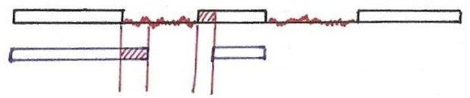
End-point Detection
silence
(noise)
speech
detected speech
segments
false acceptance
false rejection

Slide 50
與語音學、訊號波型、頻譜特性有關的網址
17. Three Tutorials on Voicing and Plosives
http://homepage.ntu.edu.tw/~karchung/intro%20page%2017.htm
8. Fundamental frequency and harmonics
http://homepage.ntu.edu.tw/~karchung/phonetics%20II%20page%20eight.htm
9. Vowels and Formants I: Resonance (with soda bottle demonstration)
http://homepage.ntu.edu.tw/~karchung/Phonetics%20II%20page%20nine.htm
10. Vowels and Formants II (with duck call demonstration)
http://homepage.ntu.edu.tw/~karchung/Phonetics%20II%20page%20ten.htm
12. Understanding Decibels (A PowerPoint slide show)
http://homepage.ntu.edu.tw/~karchung/Phonetics%20II%20page%20twelve.htm
13. The Case of the Missing Fundamental
http://homepage.ntu.edu.tw/~karchung/Phonetics%20II%20page%20thirteen.htm
14. Forry, wrong number! I The frequency ranges of speech and hearing
http://homepage.ntu.edu.tw/~karchung/Phonetics%20II%20page%20fourteen.htm
19. Vowels and Formants III: Formants for fun and profit (with samplesof exotic music)
http://homepage.ntu.edu.tw/~karchung/Phonetics%20II%20page%20nineteen.htm
20. Getting into spectrograms: Some useful links
http://homepage.ntu.edu.tw/~karchung/Phonetics%20II%20page%20twenty.htm
21. Two other ways to visualize sound signals
http://homepage.ntu.edu.tw/~karchung/Phonetics%20II%20page%20twentyone.htm
23. Advanced speech analysis tools II: Praat and more
http://homepage.ntu.edu.tw/~karchung/Phonetics%20II%20page%20twentythree.htm
25. Synthesizing vowels online
http://www.asel.udel.edu/speech/tutorials/synthesis/vowels.html

