Slide 1
DSP HW2-2 Speech Analysis
教授：李琳山 助教：門玉仁

Slide 2
Outline
Introduction
Praat
Homework Problems
Submission Requirements

Slide 3
Introduction
Observe speech signal, especially on initials(聲母).
Labeling speech data.
Observing the consistence of initials under same category.
Plosive/Stop | 爆破音/塞音 | ㄅㄆㄉㄊㄍㄎ
Fricative | 擦音 | ㄈㄏㄒㄕㄙ
Affricate | 塞擦音 | ㄐㄑㄓㄔㄗㄘ
Nasal | 鼻音 | ㄇㄋ

Slide 4
Files You Will Need
All files you need are in the following link:
http://speech.ee.ntu.edu.tw/homework/DSP_HW2-2/
Contains:
1. Syllable table (標註時會用到)
2. Phonetic class table (聲韻母表)
3. FAQ
4. Audio data for labeling

Slide 5
Praat
Download http://www.fon.hum.uva.nl/praat/
How to label text file in Praat
Some additional functions in Praat (appendix)

Slide 6
Praat

Slide 7
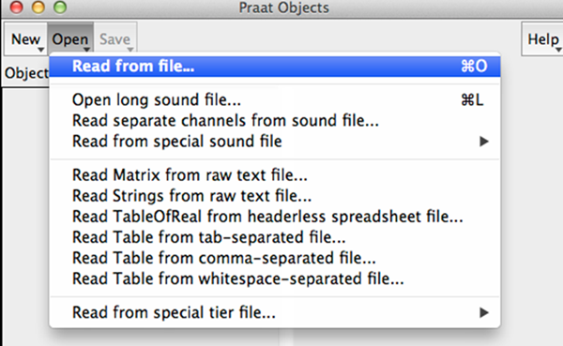
Praat - Read from file (.wav file)

Slide 8
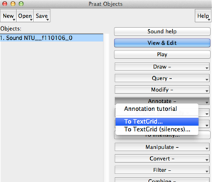
Praat - Label a wave file (Annotate -> To TestGrid)
1.
2.

Slide 9
Praat - Label a wave file
Create one interval tier named RCDIF
No point tiers

Slide 10
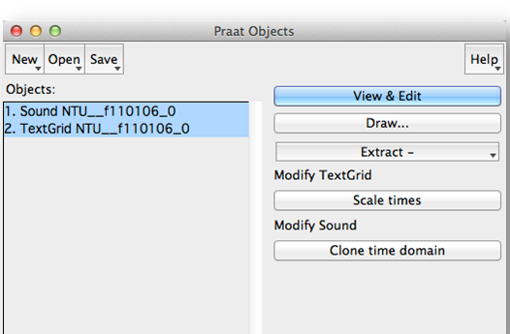
Praat - Label a wave file
With BOTH objects selected
click View & Edit

Slide 11
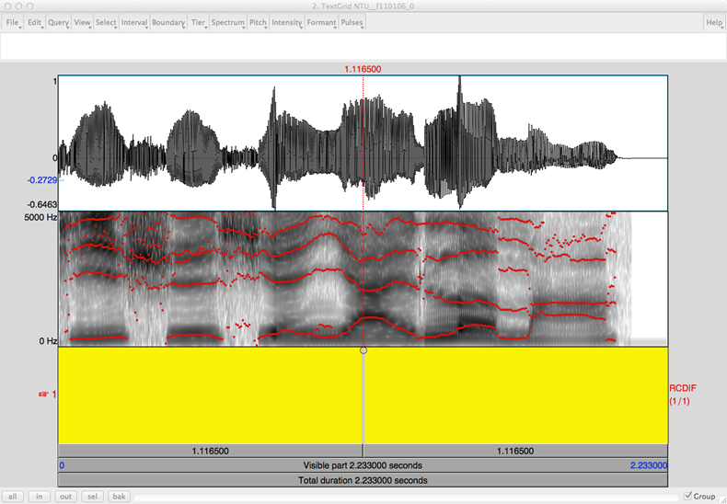
Praat - Label a wave file

Slide 12
Praat - Label a wave file
Click on spectrogram for your boundary
Add the boundary by pressing enter Remove by choosing “Boundary/Remove”
Drag you boundaries to be more accurate
Click between your boundary and type in your label (according to the Syllable table) Listen to your label by clicking the number (interval time) below it

Slide 13
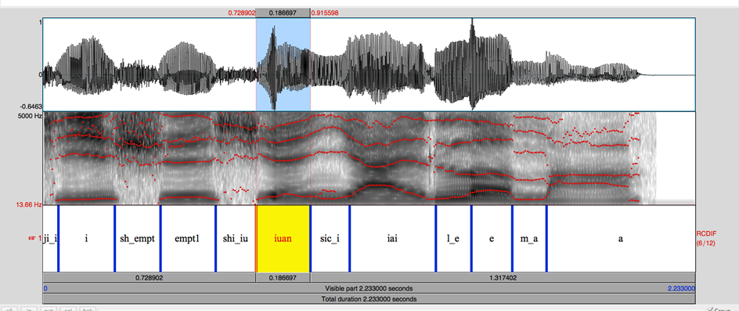
Praat - After labeling

Slide 14
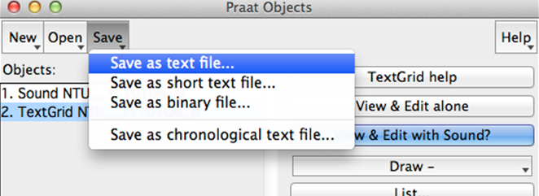
Praat - Save your Label file
Save your TextGrid object as short text file File should be “.TextGrid” not “.Collection”

Slide 15
Report - Part 1 (20%)
Choose your wave files from directories according to your student ID (http://speech.ee.ntu.edu.tw/homework/DSP_HW2-2/).
You must submit at least 5 fully labeled TextGrid files (along with their wave files).
These 5 files should contain the initial/final labels you use in part 2.

Slide 16
Part 1 Reminders
Some useful information about labeling.
“sil” for silence.
“sp” for short pause.
fricative/affricate initials do not contain voicing parts.
plosive initials contain closure or aspiration period.

Slide 17
Report - Part 2 (30%)
Choose at least 2 initials from the 4 classes (Plosive, Fricative, Affricate, Nasal)
For each of these 8 initials, create a table that contains at least 2 screenshots of its label.
Please show intensity and formant.

Slide 18
Part 2 - example：Plosive b (ㄅ)
Phonetic Class
Plosive | b(ㄅ)

Slide 19
Part 2 - example：Plosive p (ㄆ)
Phonetic Class
Plosive | pp(ㄆ)

Slide 20
Part 2 - Reminder
In your chosen directory. “NTU_XXXXX_phn2file” lists all files containing each phone “NTU_XXXXX_file2phn” lists all phones contained in each file

Slide 21
Report - Part 3 (50%)
(20%) What are the consistencies of the spectrogram in each phonetic class? (Plosive, Fricative, Affricate, Nasal)
(10%) Is the boundary between neighboring initial and final clear? What is the benefit of using “right-context dependent” initial model (ex: sh_a) instead of pure initial model (ex: sh) to model initials? Please explain with examples.

Slide 22
Report - Part 3 (50%)
3. (10%) What are the differences when pronouncing ㄅ & ㄆ? How can you tell the differences in spectrogram for ㄅ & ㄆ? (You may also want to compare ㄉ & ㄊ, ㄍ & ㄎ respectively) 4. (10%) Take a look at the spectrogram of finals. Is there any simple rules to discriminate initials from finals provided only spectrogram?

Slide 23
Report - Bonus (10%)
The following is a speech analysis plot for a Chinese word composed of 4 characters. Each character is composed of an initial and a final.
Guess what the word is and describe your reasoning. (Score: reasoning 8%, correct answer 2%)
If you cannot figure out the word, you can guess the phonetic class or initial/finals. For example, your answer can be “l_i, i, sic_a, au” or “plosive, diphthong, plosive, monophthong”.

Slide 24
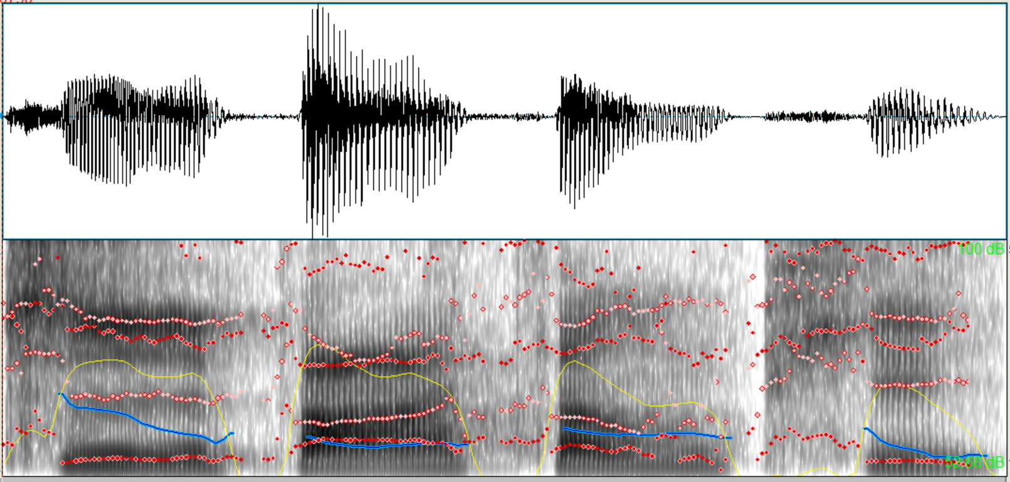
Report - Bonus (10%)
Hint: 成語 appears in 出師表

Slide 25
Submission Requirements
5 TextGrid files (each along with its wave file). the “.TextGrid” & “.wav” filenames should be the same.
1 report (in PDF format). the filename should be hw2-2_bXXXXXXXX.pdf (your student ID).

Slide 26
Submission Requirements
3. Put those 11 files in a folder, compress the folder to 1 zip file and upload it to ceiba. ● Folder name should be hw2-2_bXXXXXXXX (e.g. hw2-2_b07901000) ● .zip only ● 20% of the final score will be taken off for wrong format

Slide 27
If you have any problem…
Look up the Praat introduction website.
http://www.fon.hum.uva.nl/praat/manual/Intro.html
FAQ
http://speech.ee.ntu.edu.tw/homework/DSP_HW2-2/FAQ.html
Contact the TA : email：ntu-dsp-2021-ta@googlegroups.com title: [HW2-2] bxxxxxxxx (your student number)

Slide 28
Homework 2
Your can submit either HW 2-1 (HMM Training and Testing) HW 2-2 (Speech Analysis)
You can also submit both
The higher grade of the two will count as your final score for HW2
Deadline: 23:59, Dec. 3
Late Submission policy follows that of HW2-1

Slide 29
Appendix

Slide 30
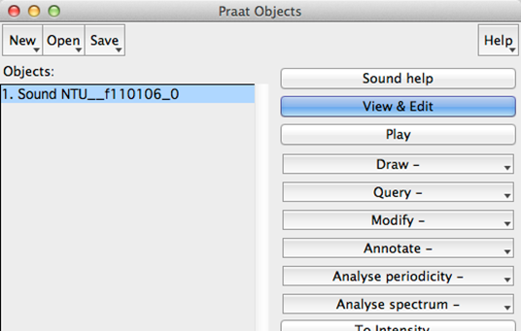
Praat - click View & Edit

Slide 31
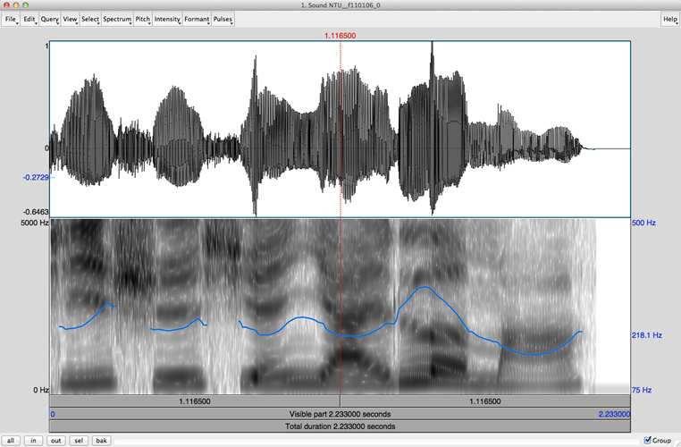
Praat - Time and Frequency Domain

Slide 32
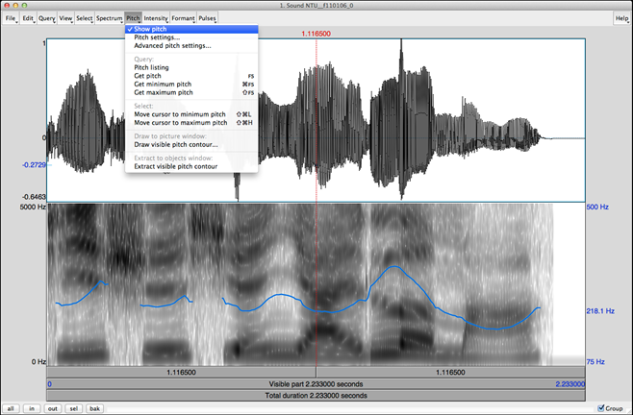
Praat - Pitch 音高 ( pitch -> Show pitch )

Slide 33
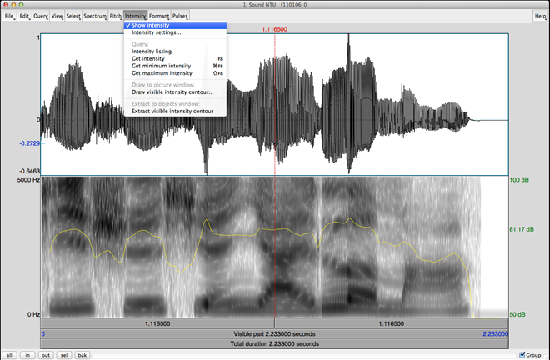
Praat - Intensity 音量( Intensity ->Show Intensity )

Slide 34
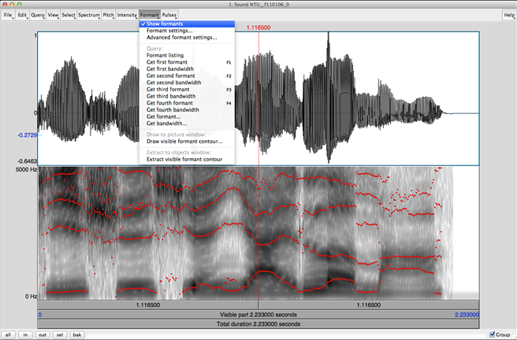
Praat - Formant 共鳴 (Formant -> Show formants)

Slide 35
Praat - Reminder
Intensity: power of all frequency components Two acoustic signals may have the same intensity but different frequency components.
Formant: acoustic resonance, measured by the peak in the frequency spectrum You should not trust the formant detection output for unvoiced initials.

Slide 36
Praat - Reminder
Zoom in and Zoom out.
show all or selection part in Praat by clicking the buttons on the lower-left corner of UI.

