Slide 1
專題研究 補充
Prof. Lin-Shan Lee
TA: Chih-Chiang Chang

Slide 2
Outline
Linux and Bash Introduction

Slide 3
Linux and Bash Introduction

Slide 4
Vim basics
如何建立文件：
vim hello.txt
進去後，輸入“ i ”即可進入編輯模式
此時，輸入任何你想要打的
此時，按下ESC即可回復一般模式，此時可以：
輸入” /想搜尋的字“
輸入”:w”即可存檔
輸入”:wq”即可存檔+離開

Slide 5
Screen
用途:斷線之後程式會繼續跑、同時跑好幾個程式等
在bash
開新screen | screen
恢復screen | screen -r
列出screen | screen -ls
恢復指定screen | screen -r <pid>
手動斷開screen | screen -d <pid>
在screen裡
開新視窗 | ctrl-a + c
切換視窗 | ctrl-a + id (id=0,1,2,…)
暫時斷開(Job會繼續跑) | ctrl-a + d
關閉視窗 | exit

Slide 6
Linux Shell basics

Slide 7
test EXPRESSION
Check file types and compare values. Exit with the status determined by EXPRESSION
Another, more common usage: [ EXPRESSION ]
EXPRESSION can be:
[ -e <filename> ]: check if filename exists
[ -f <filename> ]: check if filename exists and is file
[ -d <filename> ]: check if filename exists and is dir
[ n1 -eq n2 ]: numbers equal
-ne (not equal), -gt (greater than), -ge (greater equal),
-lt (less than), -le (lesser equal)
Mind the SPACES!

Slide 8
test EXPRESSION
Logics
-a (and), -o (or), ! (negate)
Examples:
Mind the SPACES and QUOTES !

Slide 9
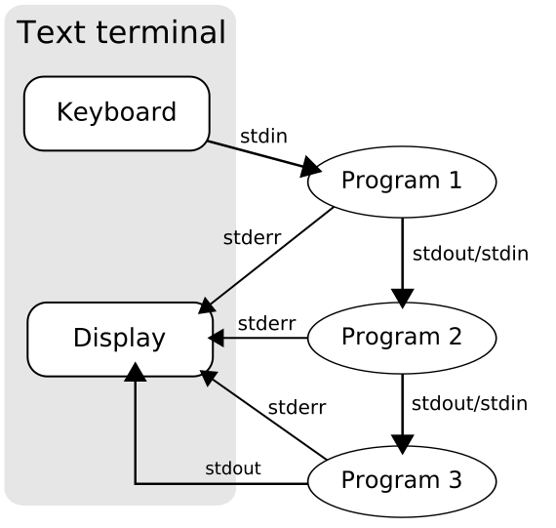
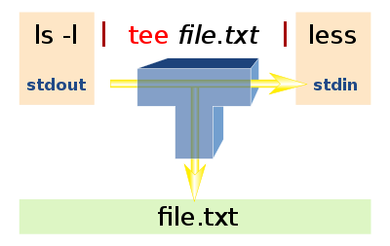
Pipeline
Pipe |: connects stdout of cmd1 with stdin of cmd2
cmd1 | cmd2
ex: echo “hello” | tee hello.log

Slide 10
Redirects
Redirect stdin <: specifies program input file
cmd < file1
Redirect stdout >: specifies program output file
cmd > log # stdout to log, stderr to display
cmd > logb 2>$1 # stdout,stderr to log
Append output >>: add program output to file
cmd >> log # old content of log will remain

Slide 11
Other Tips
More operators
grep, sed, awk, ln, …

Slide 12
Linux
如果你沒有操作 Linux 系統的經驗，請事先預習 Linux 系統的指令。
鳥哥的Linux 私房菜
第七章Linux 檔案與目錄管理http://linux.vbird.org/linux_basic/0220filemanager.php
第十章vim 程式編輯器http://linux.vbird.org/linux_basic/0310vi.php

Slide 13
Readings (optional)
使用加權有限狀態轉換器的基於混合詞與次詞以文字及語音指令偵測口語詞彙” – 第三章
https://www.dropbox.com/s/dsaqh6xa9dp3dzw/wfst_thesis.pdf
Kaldi documentation：
http://kaldi-asr.org/doc/tools.html

