Slide 1
5.0 Discrete-time Fourier Transform
5.1 Discrete-time Fourier Transform
Representation for discrete-time signals
Chapters 3, 4, 5
Chap 3 Periodic Fourier Series | Chap 4 Aperiodic Fourier Transform | Chap 5 Aperiodic Fourier Transform
$$x\left(t\right)↔X\left(jω\right)$$
$$x[n]↔X(e^{jω})$$
Continuous
$$x\left(t\right)=x(t+T)$$
Discrete
$$x[n]=x[n+N]$$

Slide 2
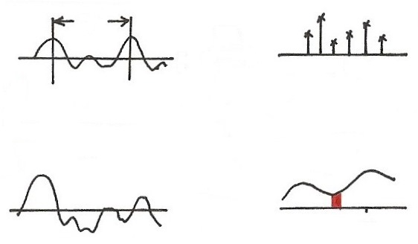
Fourier Transform (p.3 of 4.0)
T
FS
$$t$$
$$ω$$
0
$$ω_{0}$$
$${3ω}_{0}$$
$$ω_{0}=\frac{2π}{T}$$
$${2ω}_{0}$$
$$e^{j3ω_{0}t}$$
T$→∞$
$$ω_{0}→0$$
periodic in $t$
discrete in $ω$
$$x(t)$$
$$X(jω)$$
$$F$$
$$t$$
$$jω$$
$$ω_{k}$$
$$e^{jω_{k}t}$$
aperiodic in $t$
continuous in $ω$

Slide 3
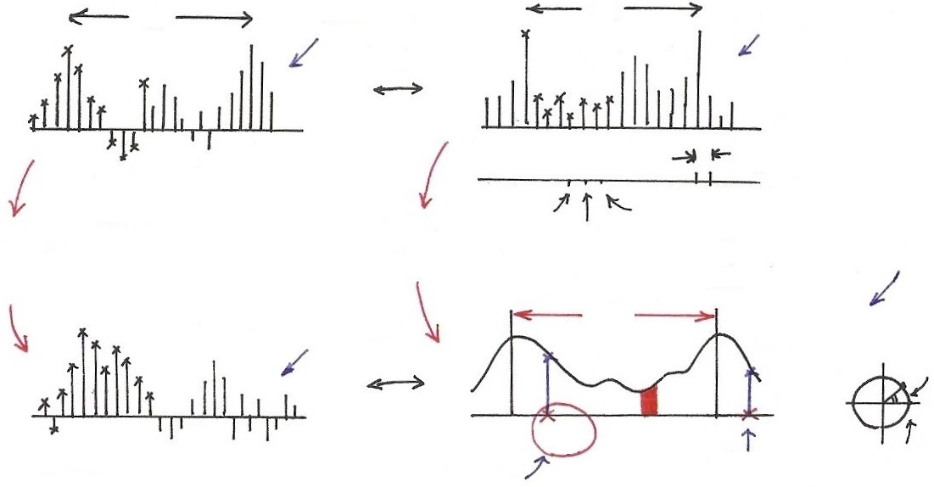
Discrete-time Fourier Transform
$$N$$
$$N$$
$$(2π)$$
N dim
N variables
$$FS$$
$$n$$
$$k$$
012
$$ω_{0}$$
periodic in $n$
$$ω$$
0
$${2ω}_{0}$$
$$ω_{0}$$
$$ω_{0}=\frac{2π}{N}$$
$∞$
dim
$$ω_{0}→0$$
$$N→∞$$
discrete and periodic in $ω$
$$x[n]$$
$∞$
variables
$$2π$$
$$X(e^{jω})$$
$$Im$$
$$F$$
$$ω$$
$$n$$
$$Re$$
$$ω_{k}$$
$$e^{jω}$$
$$ω_{k}+2π$$
(1,0)
aperiodic in $n$
$$e^{jω_{k}n}$$
$${=e}^{j(ω_{k}+2π)n}$$
continuous and periodic in $ω$

Slide 4
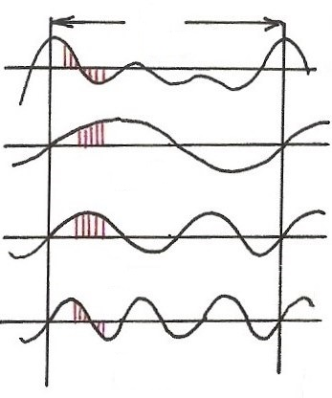
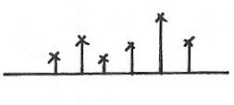
Harmonically Related Exponentials for Periodic Signals
(p.11 of 3.0)
$$[n]$$
T
$V=\{x(t)\left|x(t)\right.$ periodic, fundamental period
$$(N)$$
$$[n]$$
$$=T(N)\}$$
$$t, n$$
$$a_{4}$$
$$t, n$$
$$a_{1}$$
$$a_{3}$$
$$a_{5}$$
$$k=1$$
$$a_{0}$$
$$ω_{0}=\frac{2π}{T}$$
$$k$$
$$(N)$$
$$0 1 2 3 4 5$$
$$t, n$$
$$k=2$$
$$ω$$
$$0$$
$$ω_{0}$$
$${3ω}_{0}$$
$${5ω}_{0}$$
$$t, n$$
$${2ω}_{0}$$
$${4ω}_{0}$$
$$k=3$$
All with period T: integer multiples of ω₀
Discrete in frequency domain
$$(N)$$

Slide 5
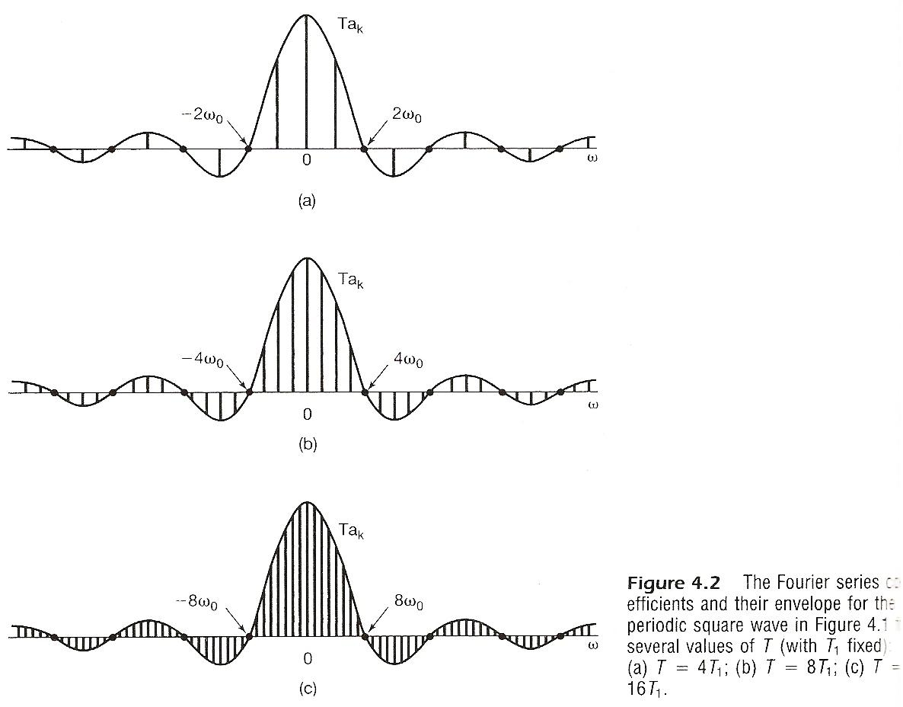

Slide 7
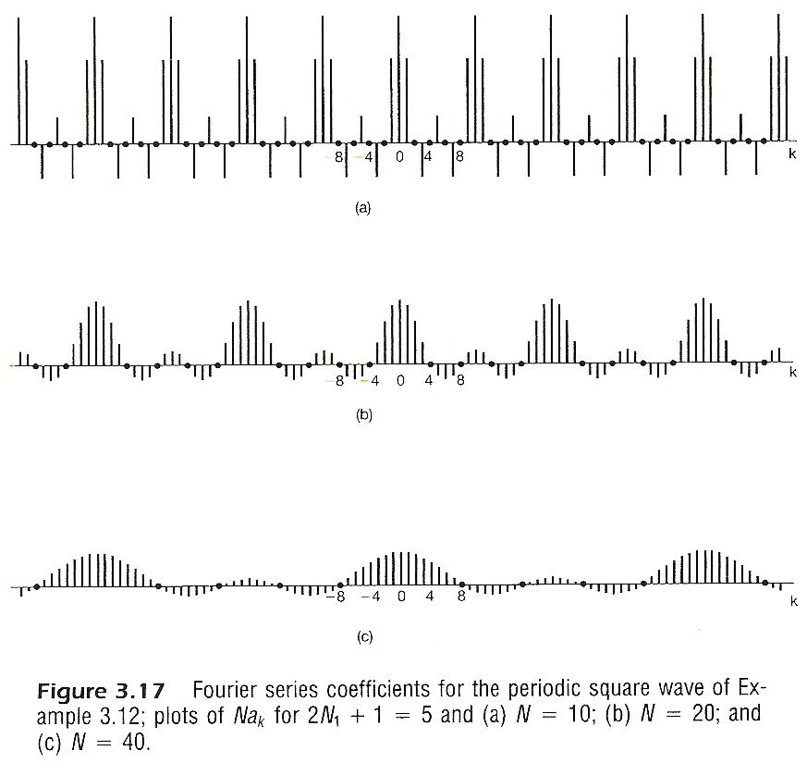

Slide 8
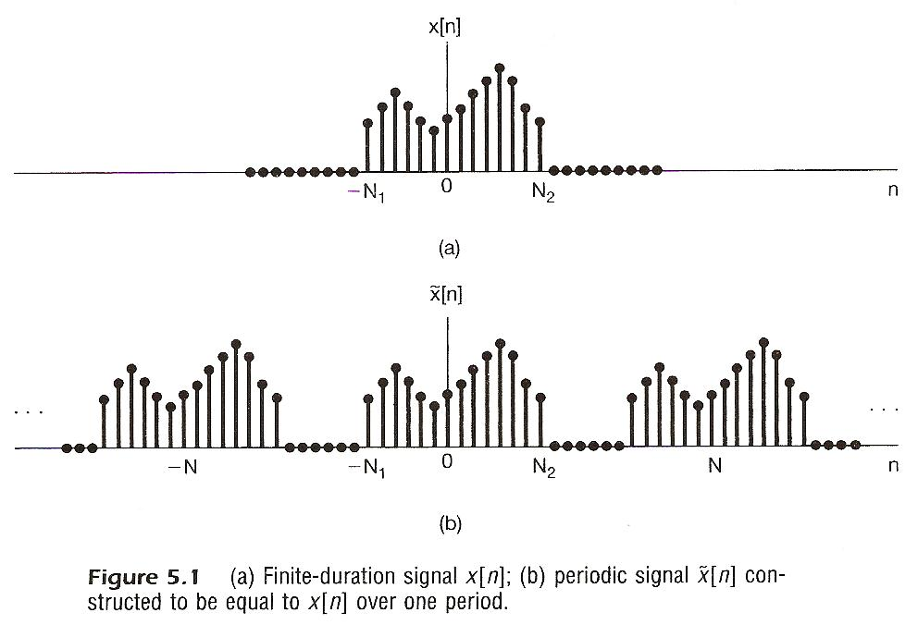
From Periodic to Aperiodic
Considering x[n], x[n]=0 for n > N₂ or n < -N₁
Construct

Slide 9
From Periodic to Aperiodic
Considering x[n], x[n]=0 for n > N₂ or n < -N₁
Fourier series for
Defining envelope of

Slide 10
As
$$ω$$
signal, time domain, Inverse Discrete-time Fourier Transform
spectrum, frequency domain Discrete-time Fourier Transform
Similar format to all Fourier analysis representations previously discussed

Slide 11
(p.10 of 4.0)
spectrum, frequency domain
Fourier Transform
signal, time domain Inverse Fourier Transform
Fourier Transform pair, different expressions
very similar format to Fourier Series for periodic signals

Slide 12
Note: X(e^{jω}) is continuous and periodic with period
2π
Integration over 2π only
Frequency domain spectrum is continuous and periodic, while time domain signal is discrete-time and aperiodic
Frequencies around ω=0 or 2π are low-frequencies, while those around ω= ±π are high-frequencies, etc.
See Fig. 5.3, p.362 of text
For Examples see Fig. 5.5, 5.6, p.364, 365 of text

Slide 13
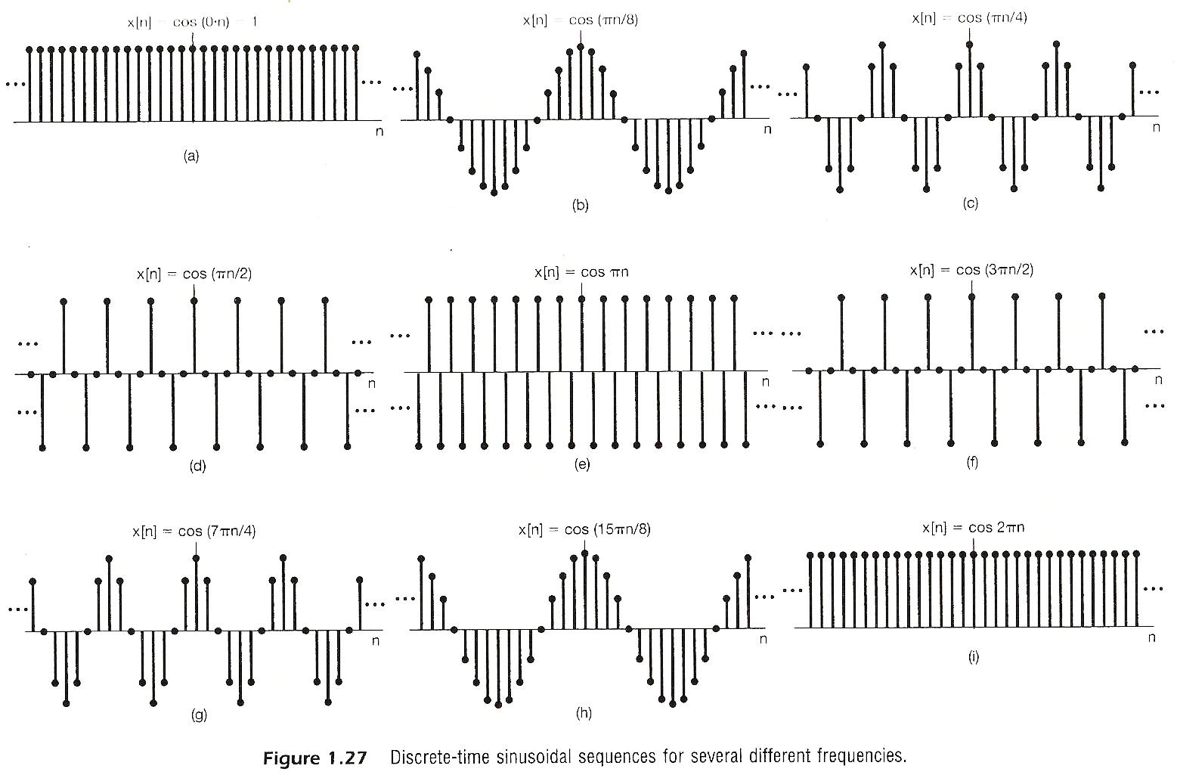

Slide 14
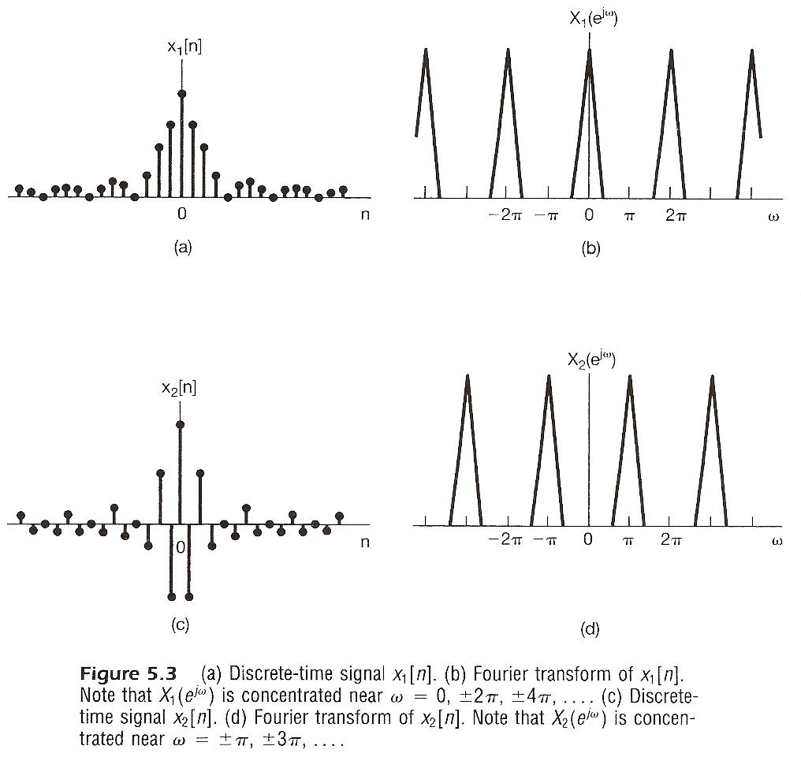

Slide 15
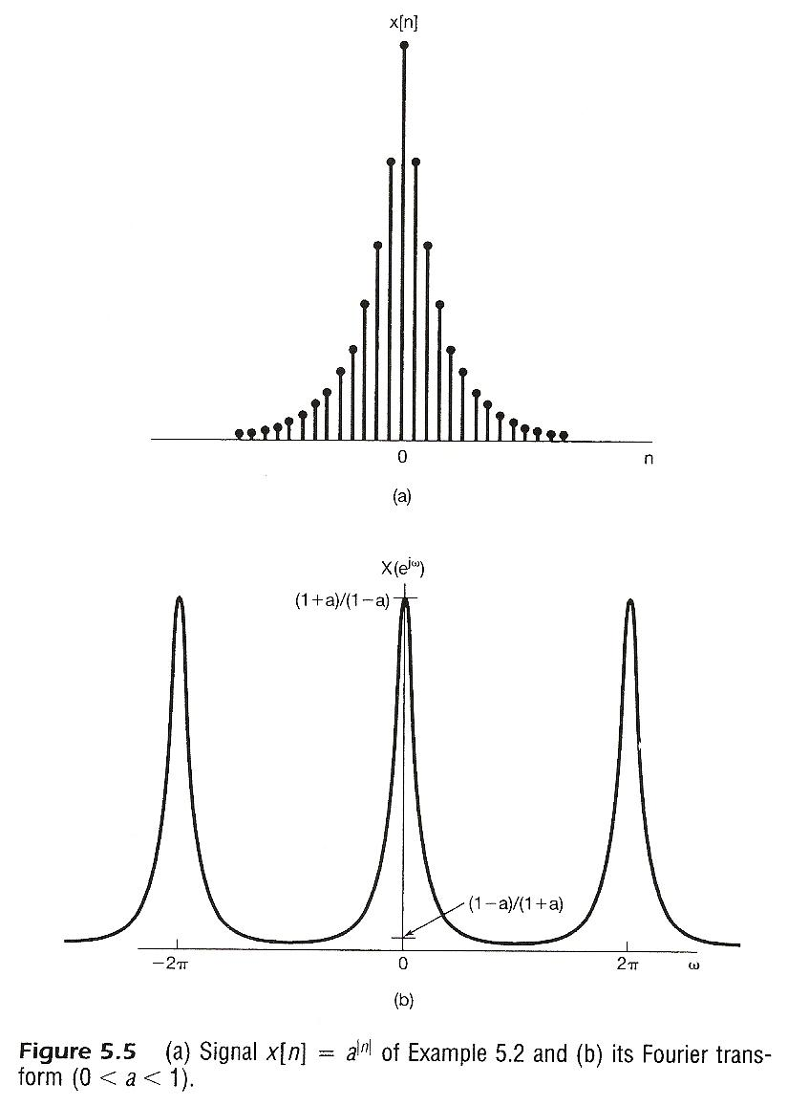

Slide 16
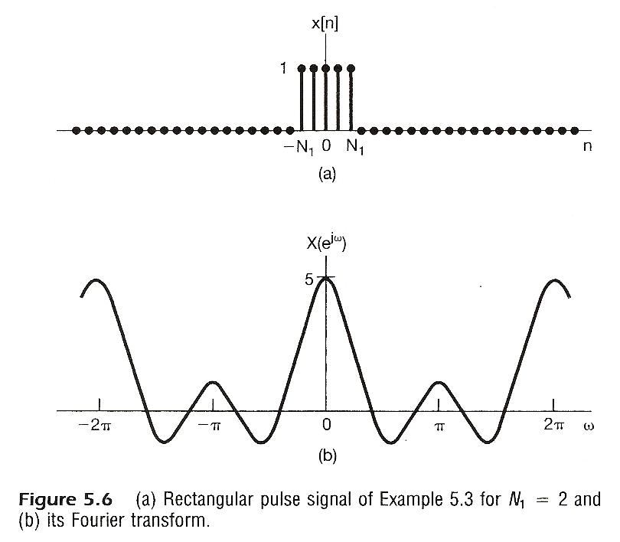

Slide 17
From Periodic to Aperiodic
Convergence Issue
given x[n]
No convergence issue since the integration is over an finite interval
No Gibbs phenomenon
See Fig. 5.7, p.368 of text

Slide 18
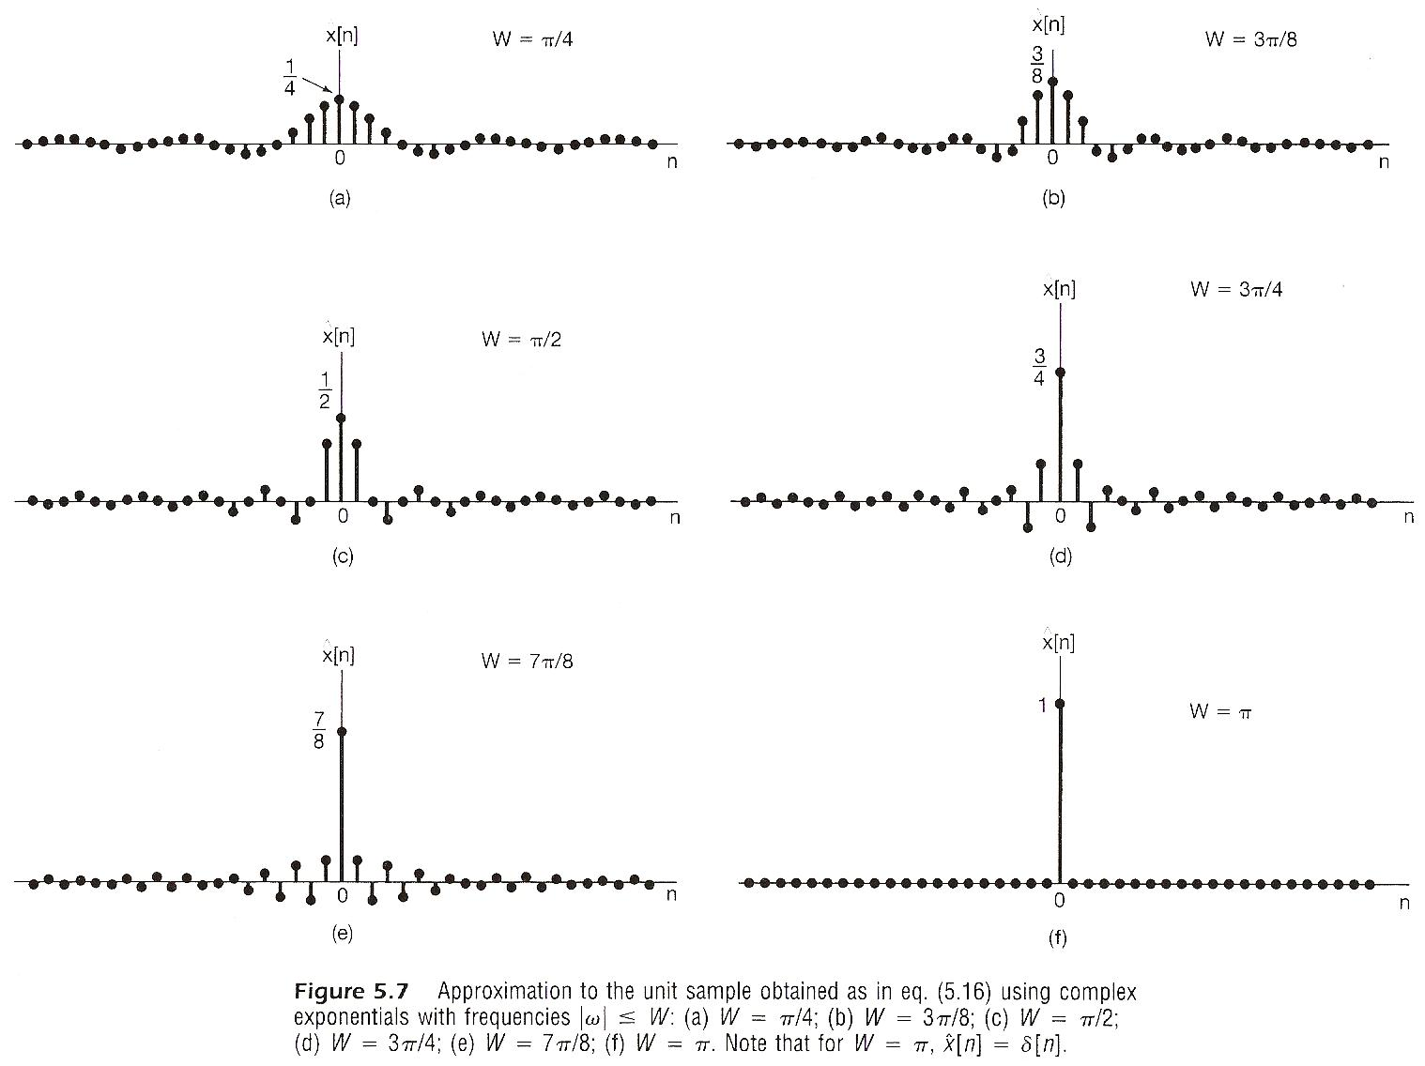

Slide 19
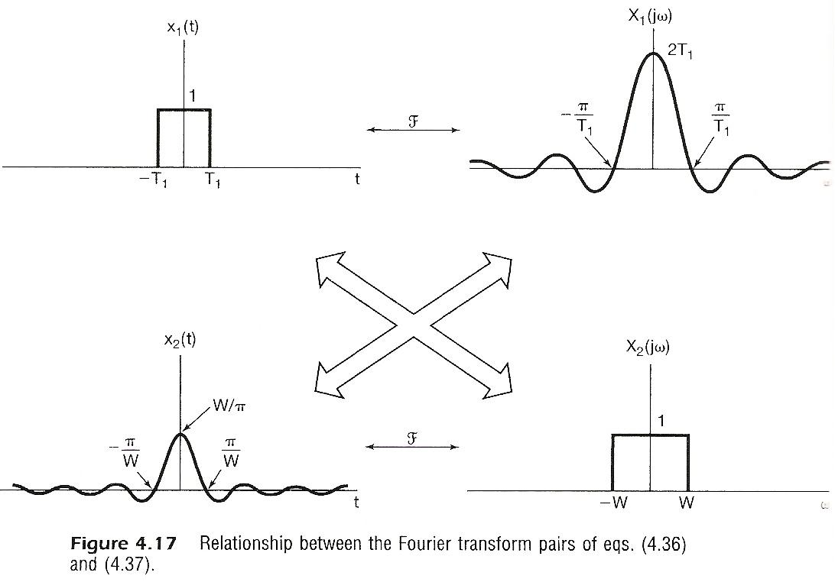

Slide 20
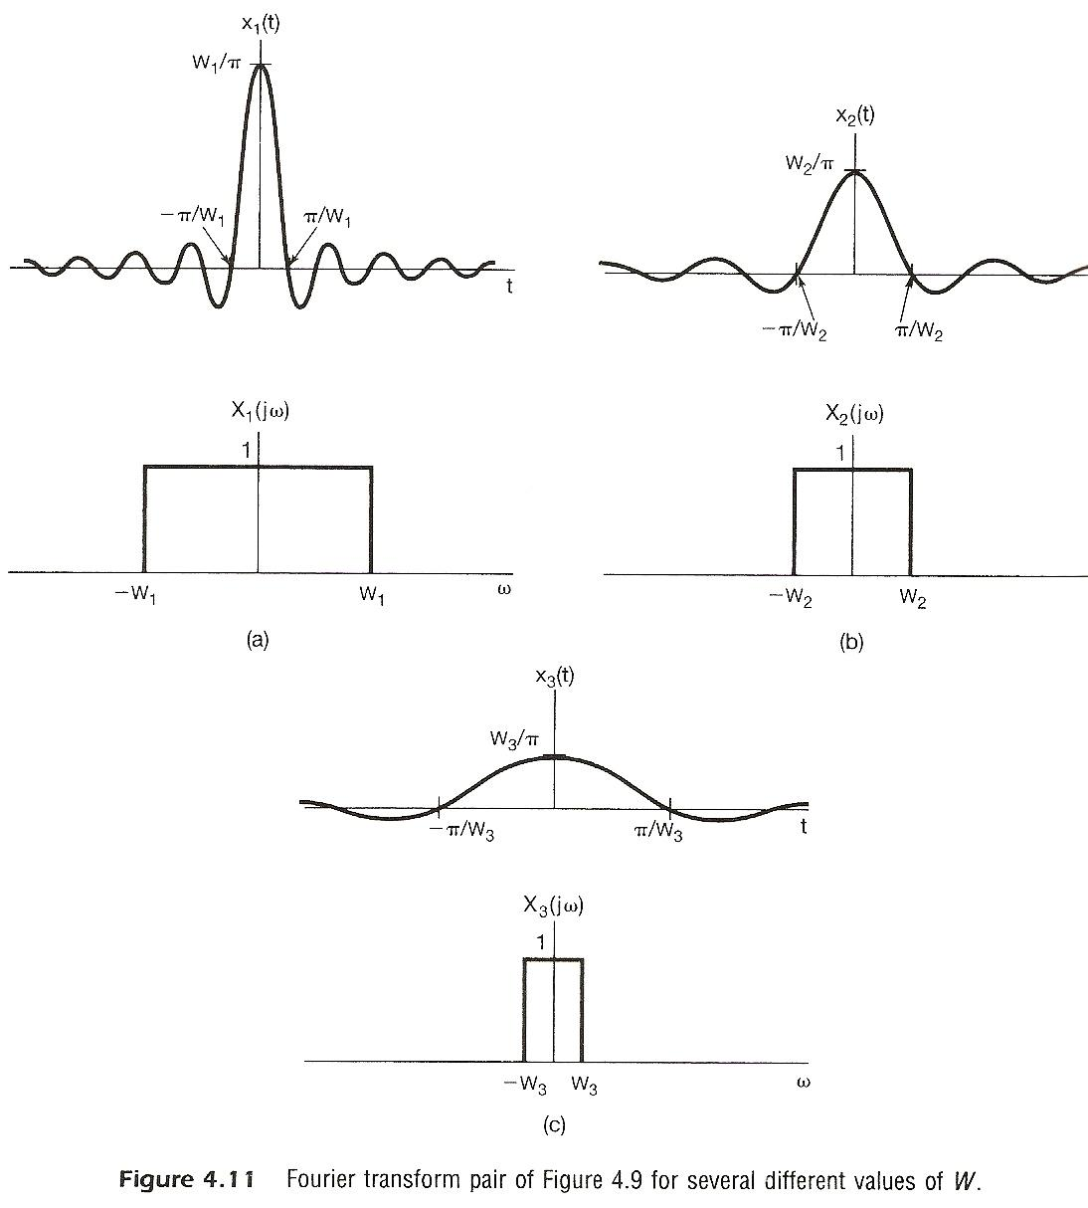

Slide 21
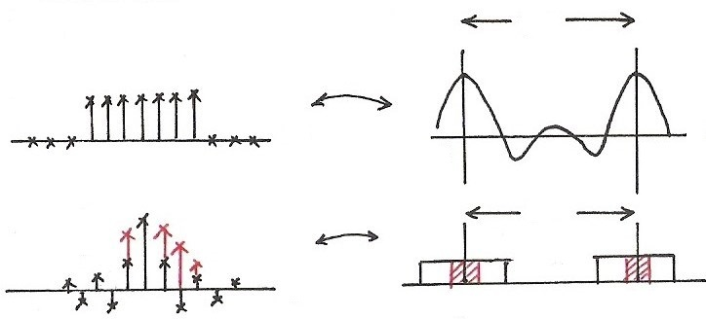
Rectangular/Sinc
$$2π$$
$$F$$
$$n$$
$$ω$$
0
$$2π$$
$$F$$
$$2π$$
$$ω$$
$$n$$
0
$$2π$$

Slide 22
Fourier Transform for Periodic Signals –
Unified Framework (p.16 of 4.0)
Given x(t)
(easy in one way)

Slide 23
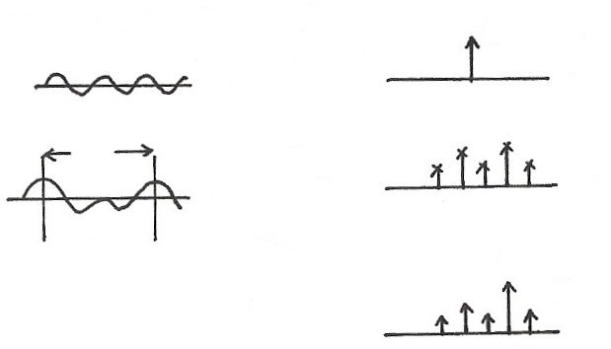
Unified Framework: Fourier Transform for Periodic Signals (p.17 of 4.0)
$$2πδ(ω−ω_{0})$$
$$e^{jω_{0}t}$$
$$F$$
$$t$$
$$ω$$
$$ω_{0}$$
T
$$a_{k}$$
$$x(t)$$
FS
$$ω$$
$$t$$
$${kω}_{0}$$
$$F$$
$$X(jω)$$
$$2πa_{k}δ(ω−{kω}_{0})$$
If
$$ω$$
$${kω}_{0}$$
F

Slide 24
From Periodic to Aperiodic
For Periodic Signals – Unified Framework
Given x[n]
See Fig. 5.8, p.369 of text

Slide 26
From Periodic to Aperiodic
For Periodic Signals – Unified Framework
If
See Fig. 5.9, p.370 of text

Slide 27
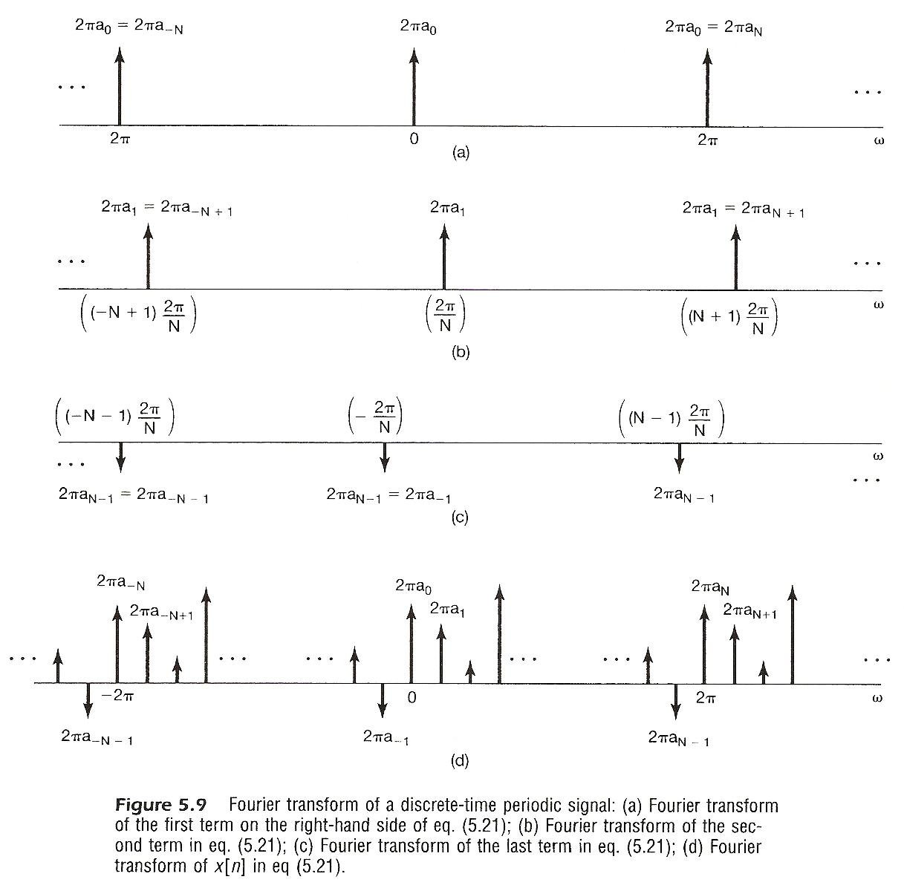

Slide 28
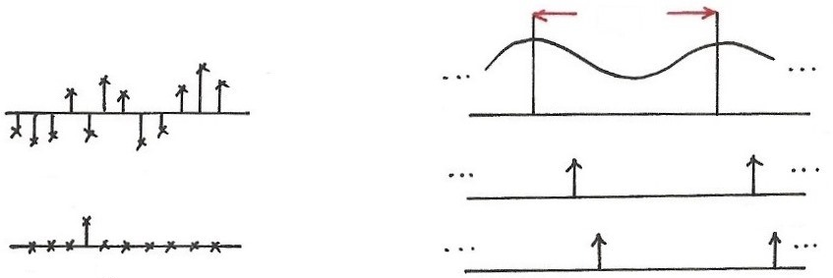
Signal Representation in Two Domains
Time Domain Frequency Domain
$$2π$$
$$X(e^{jω})$$
$$x[n]$$
$$ω$$
$$δ[n−k_{1}]$$
$$ω$$
$$ω_{1}$$
$$ω_{1}+2π$$
$$k_{1}$$
$$ω$$
$$ω_{2}$$
$$ω_{2}+2π$$
$$δ[n−k_{2}]$$
$$\sum_{m=−∞}^{∞}{2πδ}(ω−ω_{k}−2πm)$$
$$\{$$
, $0<ω_{k}≤2π\}$
$$k_{2}$$
$\{δ\left[n−k\right]$ , k: integer, $−∞<k<∞\}$
$$F$$
$$n$$
$$e^{jω_{k}n}$$

Slide 29
5.2 Properties of Discrete-time Fourier
Transform
Periodicity
Linearity

Slide 30
Time/Frequency Shift
Conjugation

Slide 32
Differencing/Accumulation
Time Reversal

Slide 33
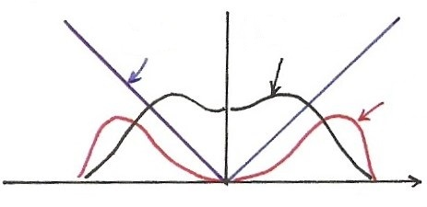
Differentiation (p.35 of 4.0)
$$\left|jω⋅X(jω)\right|=\left|ω\right|⋅\left|X(jω)\right|$$
$$\left|ω\right|$$
$$\left|X(jω)\right|$$
$$\left|ω\right|\left|X(jω)\right|$$
$$ω$$
Enhancing higher frequencies
De-emphasizing lower frequencies
Deleting DC term ( =0 for ω=0)

Slide 34
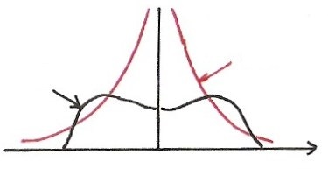
Integration (p.36 of 4.0)
dc term
$$\frac{1}{j}=e^{−j90°}$$
$$\left|\frac{1}{jω}\right|⋅\left|X(jω)\right|=\left|\frac{1}{ω}\right|⋅\left|X(jω)\right|$$
$$\left|\frac{1}{ω}\right|$$
$$X(jω)$$
$$ω$$
Enhancing lower frequencies (accumulation effect)
De-emphasizing higher frequencies
(smoothing effect)
Undefined for ω=0
Accumulation

Slide 35
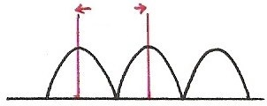
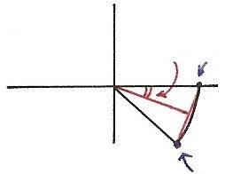
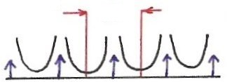
Differencing/Accumulation
Differencing
$$2π$$
$$\frac{1}{2}ω$$
1
$$ω$$
$$−2π$$
$$0$$
$$2π$$
Enhancing higher frequencies
De-emphasizing lower freq
Deleting DC term
$$e^{−jω}$$
$$\left|1−e^{−jω}\right|=2\left|\sin{(\frac{ω}{2})}\right|$$
Differencing/Accumulation
Accumulation
$$2π$$
$$−2π$$
$$0$$
$$2π$$

Slide 36
Time Reversal
(p.29 of 3.0)
the effect of sign change for x(t) and a_{k} are identical
$$⋯a_{−1} e^{−jω_{0}t}+a_{0}+a_{1} e^{jω_{0}t}+⋯=x(t)$$
$$⋯a_{−1} e^{jω_{0}t}⋯=x(−t)$$
unique representation for orthogonal basis

Slide 37
Time Expansion
If n/k is an integer, k: positive integer
See Fig. 5.13, p.377 of text
See Fig. 5.14, p.378 of text

Slide 38
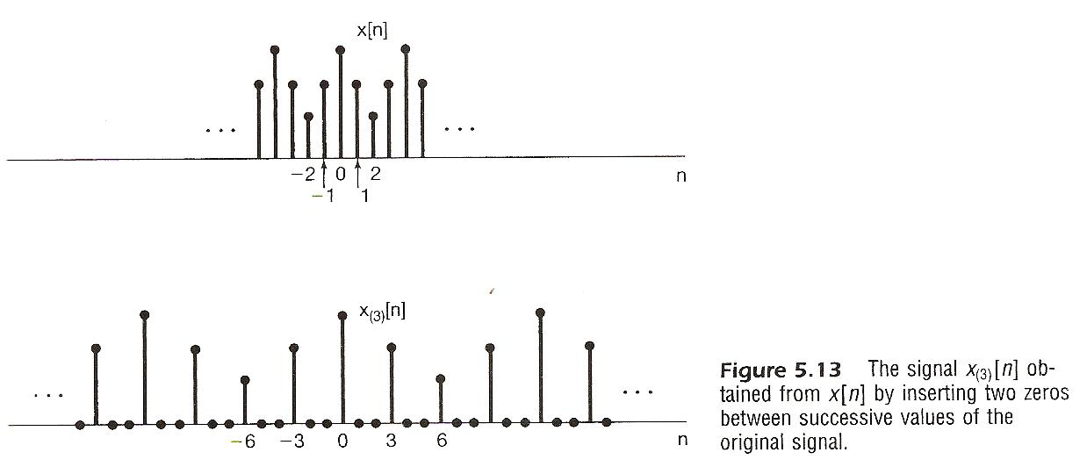

Slide 39
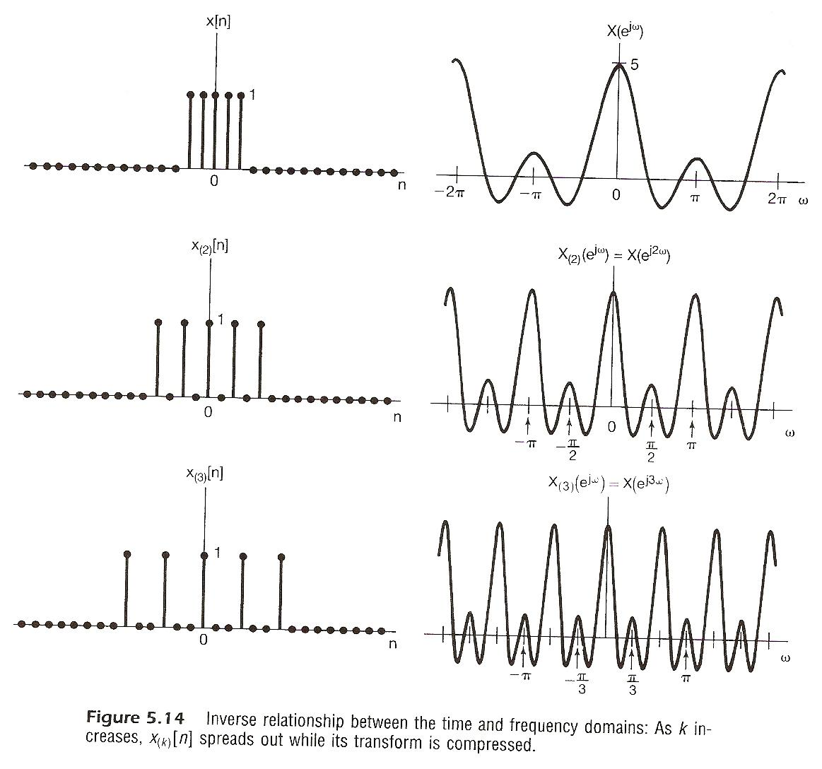

Slide 40
Time Expansion
$$e^{−jω}$$
$$e^{−j3ω}$$
1
1
$$e^{−j2ω}$$
$$e^{j3ω}$$
$$e^{−j6ω}$$
$$e^{jω}$$
$$n$$
$$n$$
-1 01 2
-3 0 3 6
$\left(kω\right)3ω$ $\left(kω\right)3ω$
$$X\left(e^{jω}\right)=\sum_{n=−∞}^{∞}{x[n]}e^{−jωn}$$

Slide 41
Time Expansion
$$n$$
$$n$$
-1 0 1 2
-3 0 3 6
Discrete-time
Continuous-time
$$x[n]$$
$$x\left(t\right)=\sum_{n}{x[n]}δ(t−n)$$
$$F$$
(chap5)
$$\sum_{n}{x[n]}e^{−jωn}$$
$$F$$
(chap4)
$$\int_{−∞}^{∞}{\{\sum_{n}{x\left[n\right]}δ}(t−n)\}e^{−jωt}dt$$
$$\sum_{n}{x[n]}e^{−jωn}$$
$$=$$
$$t$$
$$t$$
-1 0 1 2
-3 0 3 6
?
$$x\left(a t\right)\underset{↔}{ F } \frac{1}{\left|a\right|} X (\frac{jω}{a})$$
$a=\frac{1}{k}$ , k=integer

Slide 42
Differentiation in Frequency
Parseval’s Relation

Slide 43
Convolution Property
frequency response or transfer function
Multiplication Property
periodic convolution

Slide 44
Input/Output Relationship
(P.55 of 4.0)
$$x(t)$$
$$y(t)$$
Time Domain
$$δ(t)$$
$$h(t)$$
$$t$$
$$t$$
0
0
Frequency Domain
$$ω$$
$$ω$$
$$ω_{1}$$
$$ω_{3}$$
$$ω_{5}$$
$$ω_{1}$$
$$ω_{3}$$
$$ω_{5}$$

Slide 45
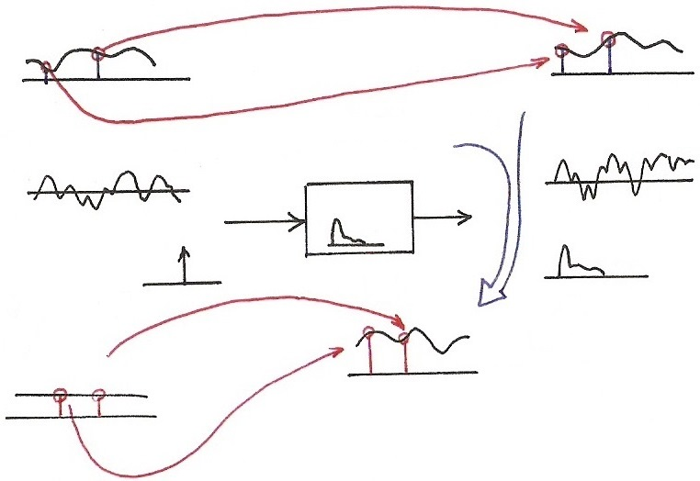
Convolution Property
(p.57 of 4.0)
$$X\left(jω_{2}\right)H\left(jω_{2}\right)=Y(jω_{2})$$
$$Y\left(jω\right)=X(jω)H\left(jω\right)$$
$$X(jω)$$
$$H\left(jω_{2}\right)=\int_{−∞}^{∞}{h(τ)}e^{−jω_{2}τ}dτ$$
$$F$$
$$ω$$
$$ω_{1}$$
$$ω_{2}$$
$$ω$$
$$ω_{1}$$
$$ω_{2}$$
$$F$$
$$H\left(jω_{1}\right)=\int_{−∞}^{∞}{h(τ)}e^{−jω_{1}τ}dτ$$
$$x\left(t\right)∗h(t)=y(t)$$
$$F$$
$$x(t)$$
$$t$$
$$t$$
$$h(t)$$
$$δ(t)$$
$$h(t)$$
$$t$$
$$F$$
$$t$$
$$F$$
$$H\left(jω_{2}\right)$$
$$H(jω)$$
$$F$$
$$1.0$$
$$1.0$$
$$ω$$
$$1$$
$$ω_{1}$$
$$ω_{2}$$
$$ω$$
$$H\left(jω\right)=\int_{−∞}^{∞}{h(τ)}e^{−jωτ}dτ$$
$$ω_{1}$$
$$ω_{2}$$
Transfer Function
Frequency Response
$$H\left(jω_{1}\right)$$
$$H\left(s\right)=\int_{−∞}^{∞}{h(τ)}e^{−sτ}dτ$$

Slide 46
System Characterization
Tables of Properties and Pairs
See Table 5.1, 5.2, p.391, 392 of text

Slide 47
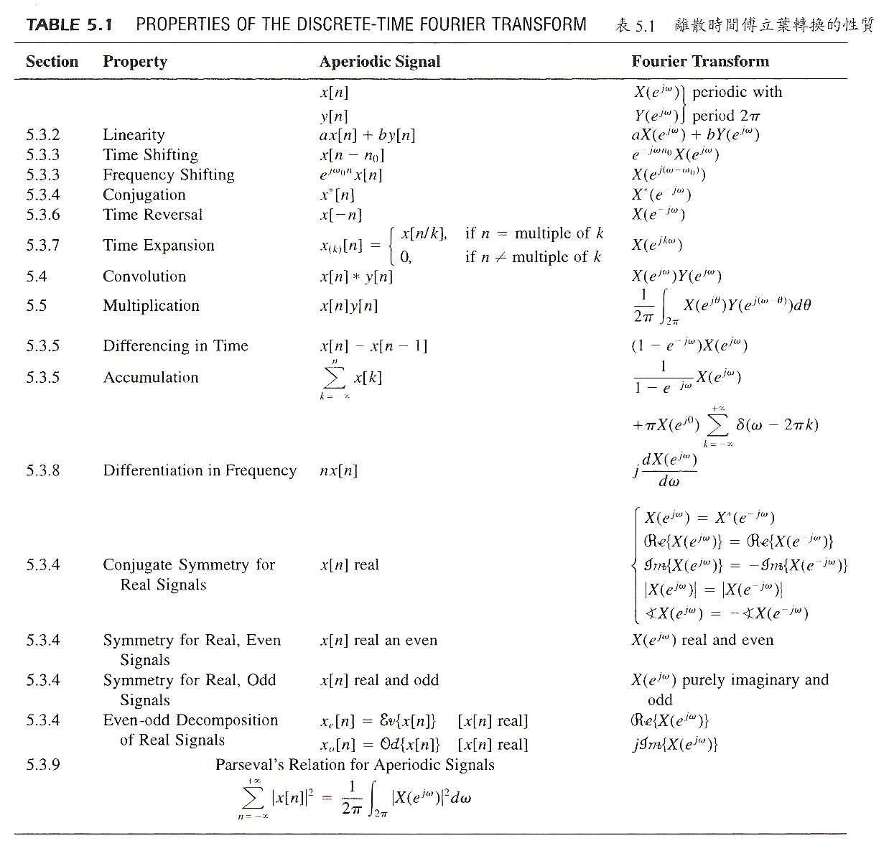

Slide 48
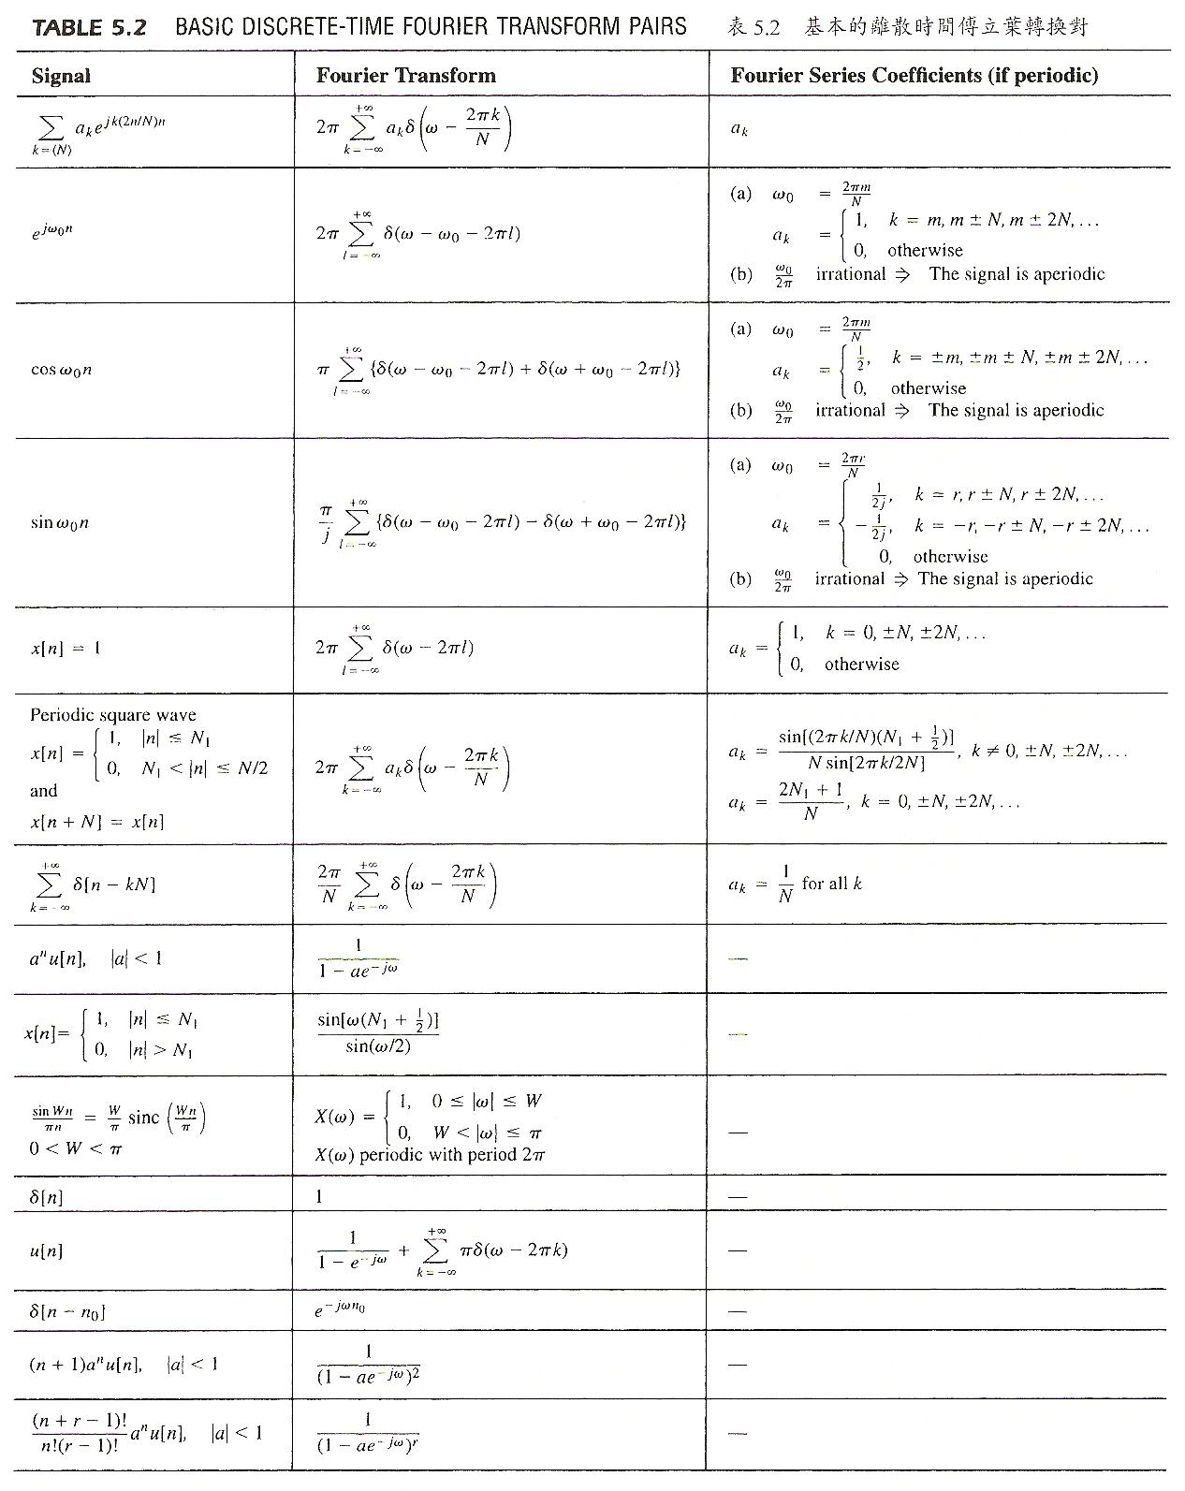

Slide 49
Vector Space Interpretation
{x[n], aperiodic defined on -∞ < n < ∞}=V
is a vector space
basis signal sets
repeats itself for very 2π

Slide 50
Vector Space Interpretation
Generalized Parseval’s Relation
{X(e^{jω}), with period 2π defined on -∞ < ω < ∞}=V : a vector space
inner-product can be evaluated in either domain

Slide 51
Vector Space Interpretation
Orthogonal Bases

Slide 52
Vector Space Interpretation
Orthogonal Bases
Similar to the case of continuous-time Fourier transform. Orthogonal bases but not normalized, while makes sense with operational definition.

Slide 53
Summary and Duality (p.1 of 5.0)
Chap 3 Periodic Fourier Series | Chap 4 Aperiodic Fourier Transform | Chap 5 Aperiodic Fourier Transform
$$x\left(t\right)↔X\left(jω\right)$$
<A>
<D>
$$x[n]↔X(e^{jω})$$
Continuous <C>
$$x\left(t\right)=x(t+T)$$
Discrete <B>
$$x[n]=x[n+N]$$

Slide 54
Time Expansion (p.41 of 5.0)
$$n$$
$$n$$
-1 0 1 2
-3 0 3 6
Discrete-time
Continuous-time
$$x[n]$$
$$x\left(t\right)=\sum_{n}{x[n]}δ(t−n)$$
$$F$$
(chap5)
$$\sum_{n}{x[n]}e^{−jωn}$$
$$F$$
(chap4)
$$\int_{−∞}^{∞}{\{\sum_{n}{x\left[n\right]}δ}(t−n)\}e^{−jωt}dt$$
$$\sum_{n}{x[n]}e^{−jωn}$$
$$=$$
$$t$$
$$t$$
-1 0 1 2
-3 0 3 6
?
$$x\left(a t\right)\underset{↔}{ F } \frac{1}{\left|a\right|} X (\frac{jω}{a})$$
$a=\frac{1}{k}$ , k=integer

Slide 55
5.3 Summary and Duality
<A> Fourier Transform for Continuous-time Aperiodic Signals
(Synthesis) (4.8)
(Analysis) (4.9)
-x(t) : continuous-time aperiodic in time
(∆t→0) (T→∞)
-X(jω) : continuous in aperiodic in
frequency(ω₀→0) frequency(W→∞)
Duality<A> :

Slide 56
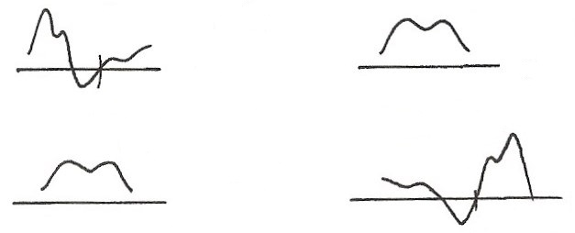
Case <A> (p.44 of 4.0)
$$x\left(t\right):y(t)$$
$$X\left(jω\right):z(ω)$$
$$F$$
$$T→∞$$
$$W→∞$$
$$t$$
$$ω$$
0
$$F^{−1}$$
$$ω_{0}→0$$
$∆t→$0
$$z(t)$$
$$2πy(−ω)$$
$$F$$
$$t$$
$$ω$$
0

Slide 57
<B> Fourier Series for Discrete-time Periodic Signals
(Synthesis) (3.94)
(Analysis) (3.95)
-x[n] : discrete-time periodic in time
(∆t = 1) (T = N)
-a_{k} : discrete in periodic in
frequency(ω₀ = 2π / N) frequency(W = 2π)
Duality<B> :

Slide 58
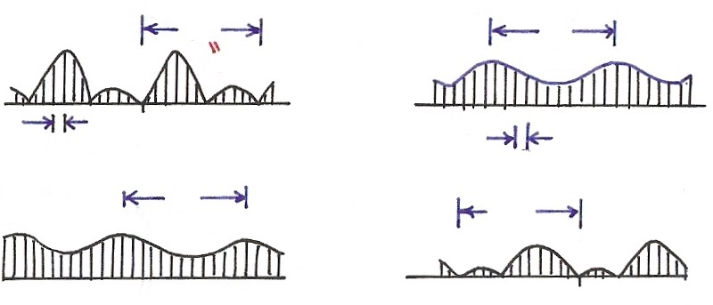
Case <B> Duality
$$x[n]:g[n]$$
$$a_{k}:f[k]$$
$$N$$
$$FS$$
$$N$$
$$T$$
$$W=2π$$
$$n$$
$$k$$
$$0$$
$$∆t=1$$
$$ω_{0}=\frac{2π}{N}$$
$$f[n]$$
$$N$$
$$\frac{1}{N}g[−k]$$
$$FS$$
$$N$$
$$n$$
$$k$$

Slide 59
<C> Fourier Series for Continuous-time Periodic Signals
(Synthesis) (3.38)
(Analysis) (3.39)
-x(t) : continuous-time periodic in time
(∆t → 0) (T = T)
-a_{k} : discrete in aperiodic in
frequency(ω₀ = 2π / T) frequency(W → ∞)

Slide 60
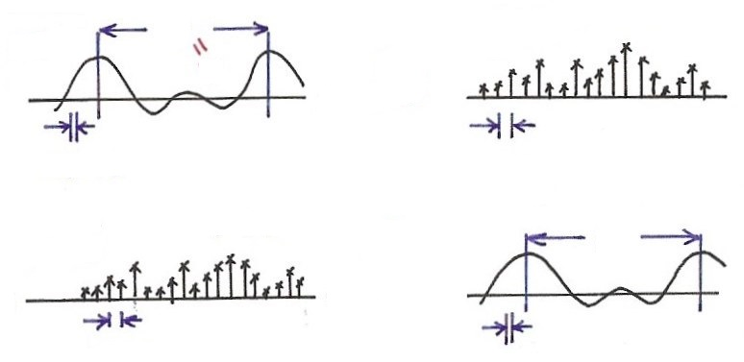
Case <C> <D> Duality
<C>
$$T$$
$$a_{k}:g[k]$$
$$W→∞$$
$$x(t):v(t)$$
$$FS$$
$$T$$
$$y[−k]$$
$$z(t)$$
$$t$$
$$k$$
0 1 2 3
$∆t→$0
$$ω_{0}=\frac{2π}{T}$$
$$X\left(e^{jω}\right):z(ω)$$
<D>
$$T→∞$$
$$2π$$
$$v(−ω)$$
$$x[n]:y[n]$$
$$F$$
$$g[n]$$
$$n$$
$$ω$$
$$∆t=1$$
$ω_{0}→$0
For <C>
For <D>
Duality

Slide 61
<D> Discrete-time Fourier Transform for Discrete-time
Aperiodic Signals
(Synthesis) (5.8)
(Analysis) (5.9)
-x[n] : discrete-time aperiodic in time
(∆t = 1) (T→∞)
-X(e^{jω}) : continuous in periodic in
frequency(ω₀→0) frequency(W = 2π)

Slide 62
Duality<C> / <D>
For <C>
For <D>
Duality
taking z(t) as a periodic signal in time with period 2π, substituting into (3.38), ω₀ = 1
which is of exactly the same form of (5.9) except for a sign change, (3.39) indicates how the coefficients a_{k} are obtained, which is of exactly the same form of (5.8) except for a sign change, etc.
See Table 5.3, p.396 of text

Slide 63
$$n$$

Slide 64
More Duality
Discrete in one domain with ∆ between two values
→ periodic in the other domain with period
Continuous in one domain (∆ → 0)
→ aperiodic in the other domain

Slide 65
Harmonically Related Exponentials for Periodic Signals
(P.11 of 3.0)
$$[n]$$
T
$V=\{x(t)\left|x(t)\right.$ periodic, fundamental period
$$(N)$$
$$[n]$$
$$=T(N)\}$$
$$t, n$$
$$a_{4}$$
$$t, n$$
$$a_{1}$$
$$a_{3}$$
$$a_{5}$$
$$k=1$$
$$a_{0}$$
$$ω_{0}=\frac{2π}{T}$$
$$k$$
$$(N)$$
$$0 1 2 3 4 5$$
$$t, n$$
$$k=2$$
$$ω$$
$$0$$
$$ω_{0}$$
$${3ω}_{0}$$
$${5ω}_{0}$$
$$t, n$$
$${2ω}_{0}$$
$${4ω}_{0}$$
$$k=3$$
All with period T: integer multiples of ω₀
Discrete in frequency domain
$$(N)$$

Slide 66
Extra Properties Derived from Duality
examples for Duality <B>
duality
duality

Slide 67
Unified Framework
Fourier Transform : case <A>
(4.8)
(4.9)

Slide 68
Unified Framework
Discrete frequency components for signals periodic
in time domain: case <C>
you get (3.38)
(applied on (4.8))
Case <C> is a special case of Case <A>

Slide 69
Unified Framework: Fourier Transform for Periodic Signals (p.17 of 4.0)
$$2πδ(ω−ω_{0})$$
$$e^{jω_{0}t}$$
$$F$$
$$t$$
$$ω$$
$$ω_{0}$$
T
$$a_{k}$$
$$x(t)$$
FS
$$ω$$
$$t$$
$${kω}_{0}$$
$$F$$
$$X(jω)$$
$$2πa_{k}δ(ω−{kω}_{0})$$
If
$$ω$$
$${kω}_{0}$$
F

Slide 70
Unified Framework
Discrete time values with spectra periodic in
frequency domain: case <D>
(4.9) becomes
(5.9)
Case <D> is a special case of Case <A>
Note : ω in rad/sec for continuous-time but in rad for
discrete-time

Slide 71
Time Expansion (p.41 of 5.0)
$$n$$
$$n$$
-1 0 1 2
-3 0 3 6
Discrete-time
Continuous-time
$$x[n]$$
$$x\left(t\right)=\sum_{n}{x[n]}δ(t−n)$$
$$F$$
(chap5)
$$\sum_{n}{x[n]}e^{−jωn}$$
$$F$$
(chap4)
$$\int_{−∞}^{∞}{\{\sum_{n}{x\left[n\right]}δ}(t−n)\}e^{−jωt}dt$$
$$\sum_{n}{x[n]}e^{−jωn}$$
$$=$$
$$t$$
$$t$$
-1 0 1 2
-3 0 3 6
?
$$x\left(a t\right)\underset{↔}{ F } \frac{1}{\left|a\right|} X (\frac{jω}{a})$$
$a=\frac{1}{k}$ , k=integer

Slide 72
Unified Framework
Both discrete/periodic in time/frequency domain:
case <B> -- case <C> plus case <D>
periodic and discrete, summation over a period of N
(4.8) becomes (4.9) becomes
(3.94) (3.95)

Slide 73
Unified Framework
Cases <B> <C> <D> are special cases of case <A>
Dualities <B>, <C>/<D> are special case of Duality <A>
Vector Space Interpretation
----similarly unified

Slide 74
Summary and Duality (p.1 of 5.0)
Chap 3 Periodic Fourier Series | Chap 4 Aperiodic Fourier Transform | Chap 5 Aperiodic Fourier Transform
$$x\left(t\right)↔X\left(jω\right)$$
<A>
<D>
$$x[n]↔X(e^{jω})$$
Continuous <C>
$$x\left(t\right)=x(t+T)$$
Discrete <B>
$$x[n]=x[n+N]$$

Slide 75
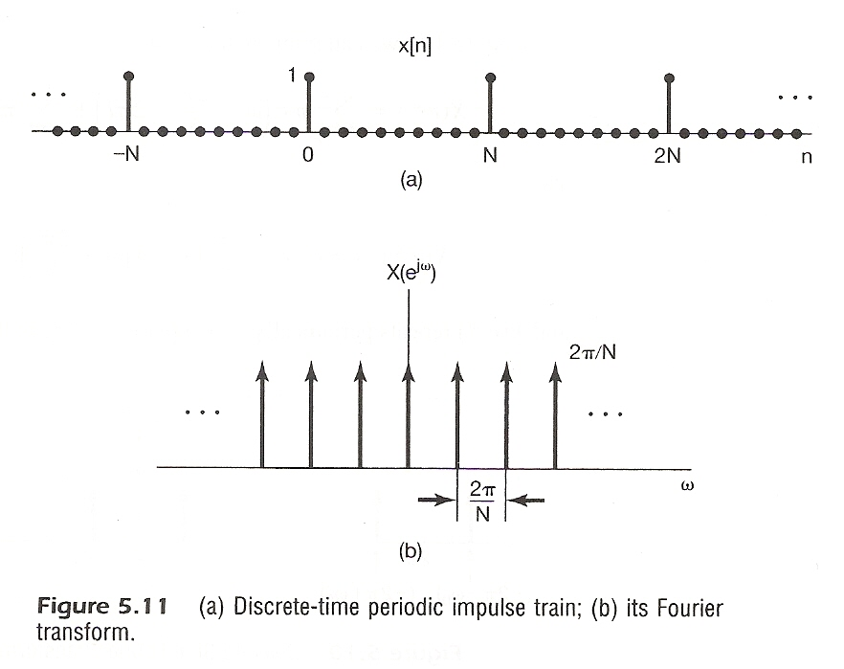
Examples
Example 5.6, p.371 of text

Slide 76
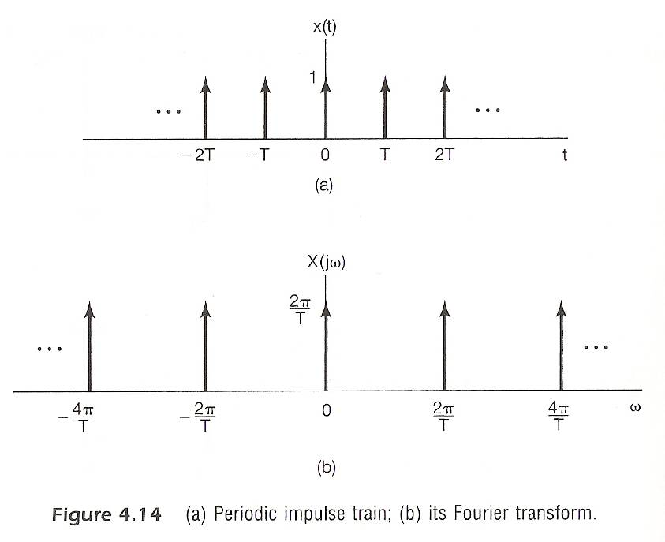
Examples
Example 4.8, p.299 of text
(P.76 of 4.0)
Discrete $(∆t=T)$ $→$ Periodic
Periodic $( T=T)$ $→$ Discrete
$(W=\frac{2π}{T})$
$(ω_{0}=\frac{2π}{T})$

Slide 77
Examples
Example 5.11, p.383 of text
time shift property

Slide 78
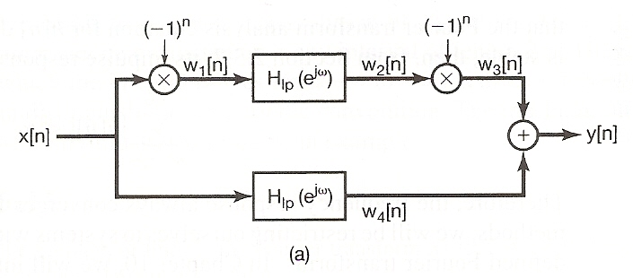
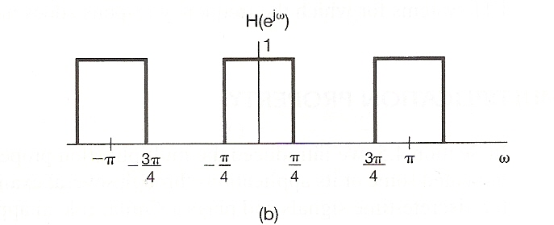
Examples
Example 5.14, p.387 of text

Slide 79
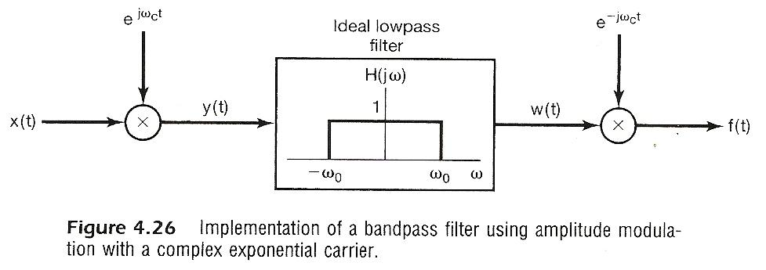

Slide 80
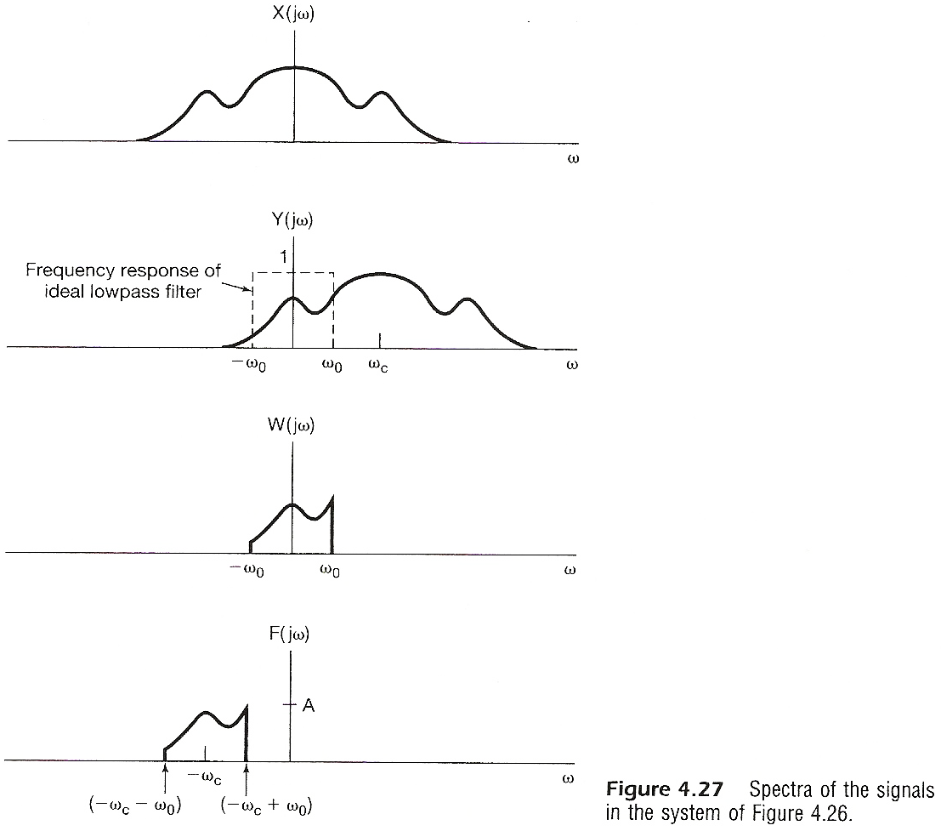

Slide 81
Examples
Example 5.17, p.395 of text

Slide 82
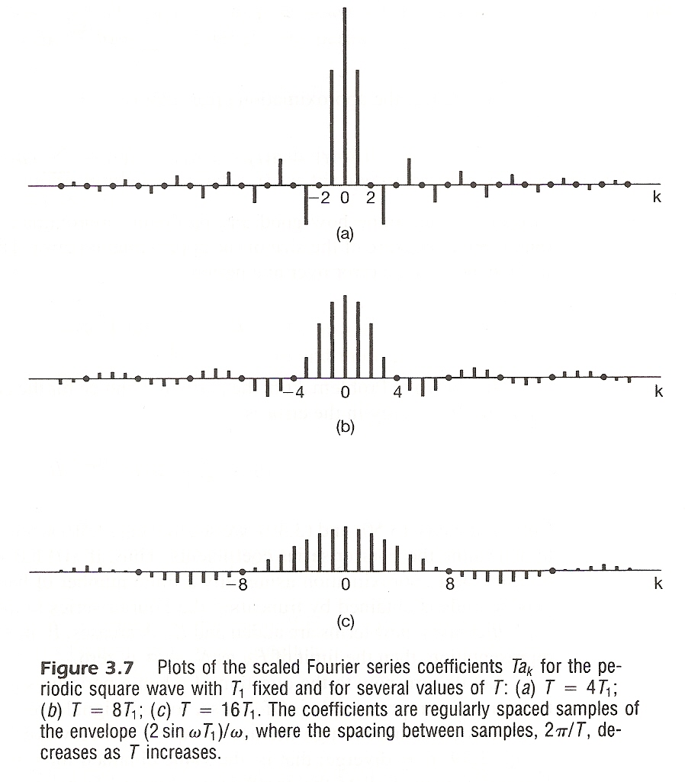
Examples
Example 3.5, p.193 of text
(P. 58 of 3.0)
(a)
(b)
(c)

Slide 83
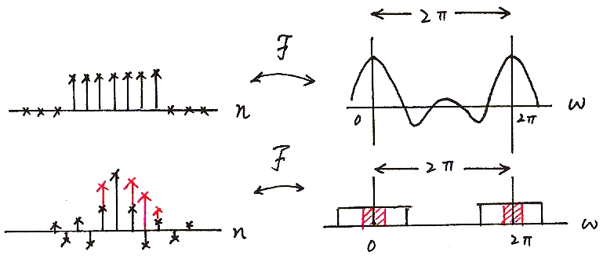
Rectangular/Sinc (p.21 of 5.0)

Slide 84
Problem 5.36(c), p.411 of text

Slide 85
Problem 5.43, p.413 of text

Slide 86
Problem 5.46, p.415 of text

Slide 87
Problem 5.56, p.422 of text

Slide 88
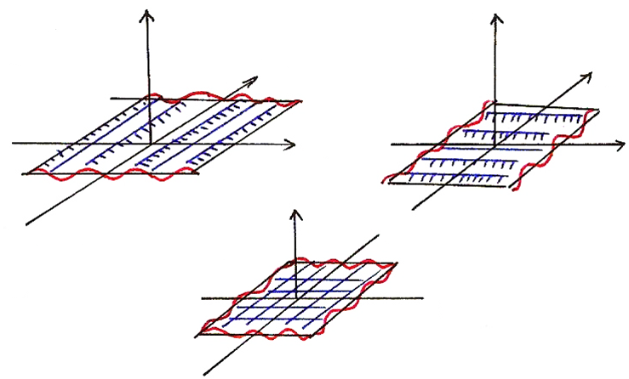
Problem 3.70, p.281 of text
(P. 65 of 3.0)
2-dimensional signals
$$e^{jω_{1}t_{1}}$$
$$e^{jω_{2}t_{2}}$$
$$t_{2}$$
$$t_{2}$$
$$t_{1}$$
$$t_{1}$$
$$t_{2}$$
$$e^{j(ω_{1}t_{1}+ω_{2}t_{2})}$$
$$t_{1}$$

Slide 89
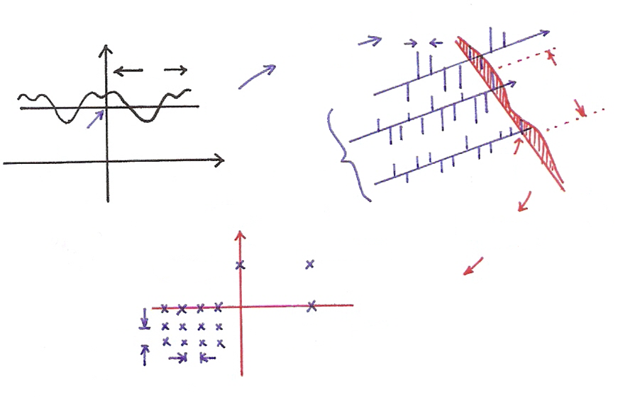
Problem 3.70, p.281 of text
2-dimensional signals
(P. 64 of 3.0)
$$t_{2}$$
$$ω_{10}$$
$$ω_{1}$$
$${FS}_{({\overline{t}}_{2})}$$
$$T_{1}$$
$$ω_{1}$$
$$t_{1}$$
$$T_{2}$$
$${\overline{t}}_{2}$$
$$t_{1}$$
different
$${\overline{ω}}_{1}$$
$${\overline{t}}_{2}$$
$$ω_{2}$$
$$t_{2}$$
$$(0,ω_{2})$$
$$(ω_{1},ω_{2})$$
$${FS}_{({\overline{ω}}_{1})}$$
$$ω_{1}$$
$$ω_{20}$$
$$(ω_{1},0)$$
$$ω_{10}$$

Slide 90
An Example across Cases <A><B><C><D>
<A> $x\left(at\right)\underset{↔}{F}\frac{1}{\left|a\right|} X(\frac{jω}{a})$ (4.34)
<D> $x_{\left(k\right)}\left[n\right]\underset{↔}{F}\left(\right)X(e^{jkω})$ (5.45)
<C> $x\left(αt\right)\underset{↔}{FS}\left(\right)a_{k}$ (Sec. 3.5.4)
$(T^{′}=T/α$, $ω_{0}^{′}=αω_{0})$ (Table 3.1)
<B> $x_{(m)}[n]$ $\underset{↔}{FS}\frac{1}{m}a_{k}$ (Table 3.2)

Slide 91
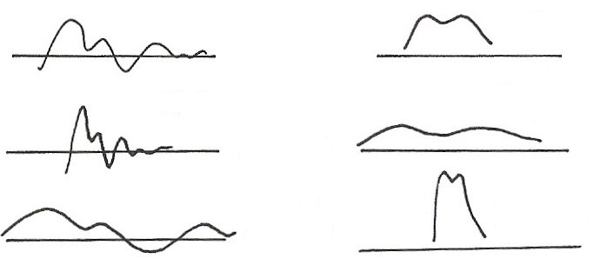
Time/Frequency Scaling (p.38 of 4.0)
(time reversal)
$$x(t)$$
$$X(jω)$$
$$F$$
$$t$$
$$ω$$
$$\frac{1}{\left|a\right|} X\left(j\frac{ω}{a}\right), a>1$$
$$x\left(at\right), a>1$$
$$t$$
$$F$$
$$ω$$
$$x\left(at\right), a<1$$
$$\frac{1}{\left|a\right|} X\left(j \frac{ω}{a}\right), a<1$$
$$F$$
$$t$$
$$ω$$
See Fig. 4.11, p.296 of text

Slide 92
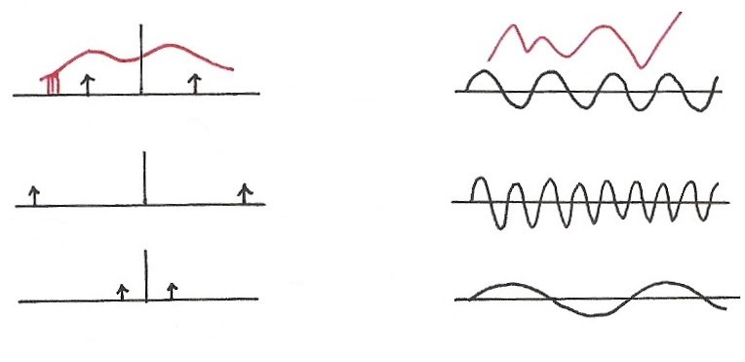
Single Frequency (p.40 of 4.0)
$$\cos{ω_{0}t}=\frac{1}{2} \left(e^{jω_{0}t}+e^{−jω_{0}t}\right)$$
$$F$$
$$ω$$
$$t$$
$${−ω}_{0}$$
$$ω_{0}$$
$$ω$$
$$F$$
$$t$$
$${−2ω}_{0}$$
$${2ω}_{0}$$
$$ω$$
$$F$$
$$t$$
$$−{\frac{1}{2} ω}_{0}$$
$${\frac{1}{2} ω}_{0}$$

Slide 93
Parseval’s Relation (p.37 of 4.0)
total energy: energy per unit time integrated over the
time
total energy: energy per unit frequency integrated
over the frequency
$$\vec{A}=\sum_{i}{a_{i}}{\hat{v}}_{i}=\sum_{k}{b_{k}}{\hat{u}}_{k}$$
$${\left\| \vec{A} \right\|}^{2}=\sum_{i}{{\left|a_{i}\right|}^{2}}=\sum_{k}{{\left|b_{k}\right|}^{2}}$$

Slide 94
Single Frequency
<A> $x\left(at\right) \underset{↔}{ F } \frac{1}{\left|a\right|}X(\frac{jω}{a})$ (4.34)
$x\left(t\right)=\cos{ω_{0}t} \underset{↔}{ F } X\left(jω\right)=πδ\left(ω−ω_{0}\right)+⋯$
$$x\left(at\right)=\cos\left(aω_{0}t\right)\underset{↔}{ F } \frac{1}{a} π δ\left(\frac{ω}{a}−ω_{0}\right)+⋯$$
$$a⋅\int_{−∞}^{∞}{δ\left(\frac{ω}{a}\right)} d\left(\frac{ω}{a}\right)=a$$
$δ\left(\frac{ω}{a}\right)=aδ\left(ω\right)$
$$δ\left(\frac{ω}{a}−ω_{0}\right)=a δ\left(ω−aω_{0}\right)$$
$$=1$$
$$x\left(at\right)=\cos\left(aω_{0}t\right)\underset{↔}{ F } \frac{1}{a} X (\frac{jω}{a})=πδ\left(ω−aω_{0}\right)+⋯$$

Slide 95
Another Example
$$x\left(t\right)$$
1
$$X\left(jω\right)$$
$$\frac{2π}{T}$$
$$⋯$$
$$⋯$$
$$F$$
$$⋯$$
$$⋯$$
$$t$$
$$ω$$
$$T$$
$$\frac{2π}{T}$$
$$⋯$$
See Figure 4.14 (example 4.8), p.300 of text
$$F$$
1
$$\frac{2π}{2T}$$
$$⋯$$
$$⋯$$
$$⋯$$
$$⋯$$
$$t$$
$$ω$$
$$2T$$
$$\frac{2π}{2T}$$

Slide 96
Cases <C><D>
<C>
$$T$$
$α$: any real number
$$FS$$
$$t$$
$$ω$$
$$ω_{0}=\frac{2π}{T}$$
$$α>1$$
$$t$$
$$ω$$
$$T/α$$
$$ω_{0}=\frac{2π}{T/α}$$
$x\left(αt\right) \underset{↔}{ FS } \left(\right)a_{k} (T^{′}=T/α$ , $ω_{0}^{′}=αω_{0})$
Duality
$$2π$$
<D>
$k$: positive integer only
$$n$$
$$ω$$
$$\underset{↔}{ F }$$
$$2π$$
$$n$$
$$ω$$
$$x_{(k)}[n] \underset{↔}{ F } \left(\right) X(e^{jkω})$$

Slide 97
Cases <B>
$$x_{(m)}\left[n\right] \underset{↔}{ FS } \frac{1}{m}a_{k}$$
$$\left(2π\right)$$
$$N$$
$$N$$
$$x\left[n\right]$$
$$FS$$
$$a_{k}$$
$$n$$
$$ω$$
$$x_{(2)}\left[n\right]$$
$$\frac{2π}{N}$$
$$\left(2π\right)$$
$$mN$$
$$ω$$
$$mN$$
$$m$$
$$\frac{2π}{mN}$$
$$\frac{2π}{m}$$
$$∥$$
$$2$$
$$∥$$
$$2$$
$$x_{(m)}\left[n\right] \underset{↔}{ FS } a_{k}^{′}=\frac{1}{mN}\sum_{n=<mN>}{x_{(m)}\left[n\right]}e^{−jk\left(\frac{2π}{mN}\right)n}$$
$$lm$$
$$lm$$
$$l=<N>$$
$$=\frac{1}{m} ⋅[ \frac{1}{N}\sum_{l=<N>}{x\left[l\right]}e^{−jk\left(\frac{2π}{N}\right)l} ]$$
$$=\frac{1}{m} ⋅a_{k}$$

