Slide 1
1-7

Slide 2
86
Let $\left\{u_{1},u_{2},…,u_{k}\right\}$ be a linearly independent set of vectors in $R^{n}$, and let $v$ be a vector in $R^{n}$ such that $v=c_{1}u_{1}+c_{2}u_{2}+…+c_{k}u_{k}$ for some scalars $c_{1},c_{2},…,c_{k}$ with $c_{1}≠0$. Prove that $\left\{v,u_{2},…,u_{k}\right\}$ is linear independent.

Slide 3
87
Let $u$ and $v$ be distinct vectors in $R^{n}$. Prove that the set $\left\{u,v\right\}$ is linearly independent if and only if the set $\left\{u+v,u−v\right\}$ is linearly independent.

Slide 4
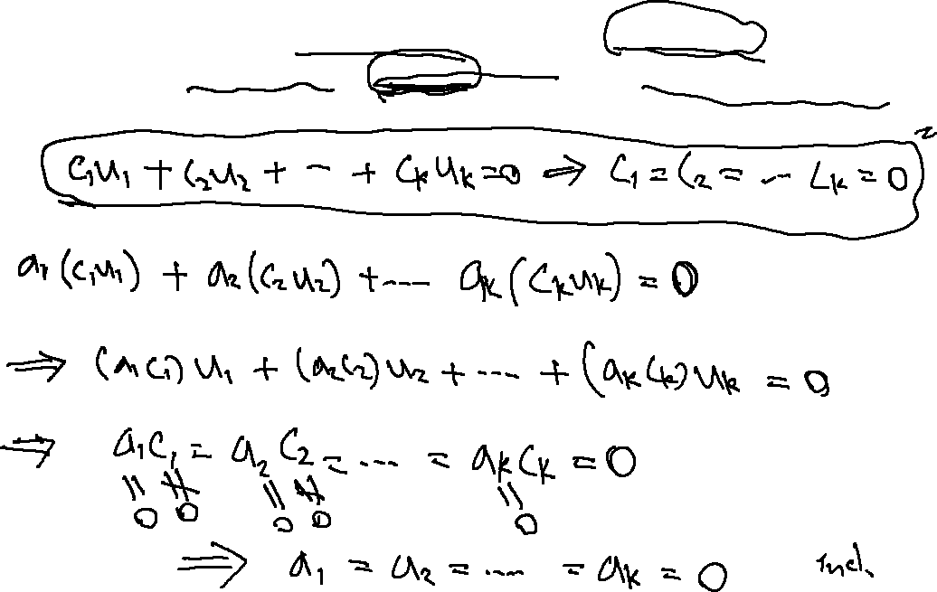
89
Prove that if $\left\{u_{1},u_{2},…,u_{k}\right\}$ is a linearly independent subset of $R^{n}$ and $c_{1},c_{2},…,c_{k}$ are nonzero scalars, then $\left\{c_{1}u_{1},c_{2}u_{2},…,c_{k}u_{k}\right\}$ is also linearly independent.

Slide 5
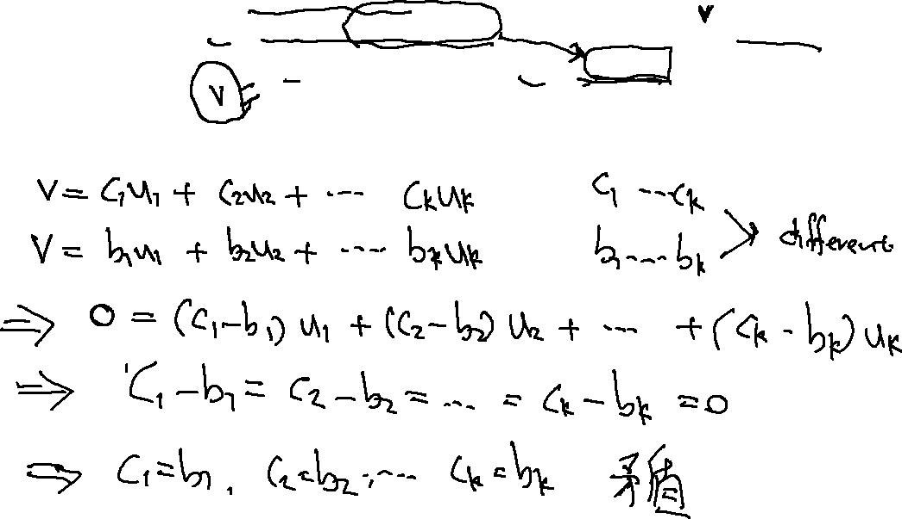
93
Let $S=\left\{u_{1},u_{2},…,u_{k}\right\}$ be a nonempty set of vectors from $R^{n}$. Prove that if $S$ is linearly independent, then every vector in $Span S$ can be written as $c_{1}u_{1}+c_{2}u_{2}+…+c_{k}u_{k}$ for unique scalars $c_{1},c_{2},…,c_{k}$.

Slide 6
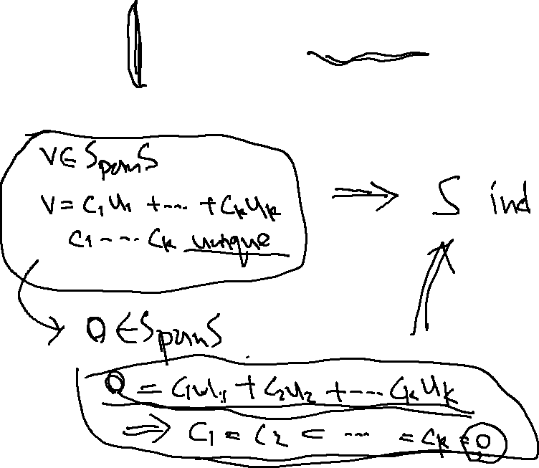
94
Let $S=\left\{u_{1},u_{2},…,u_{k}\right\}$ be a nonempty set of vectors from $R^{n}$. Prove that if $S$ is linearly independent, then every vector in $Span S$ can be written as $c_{1}u_{1}+c_{2}u_{2}+…+c_{k}u_{k}$ for unique scalars $c_{1},c_{2},…,c_{k}$.
State and prove the converse of Exercise 93.

Slide 7
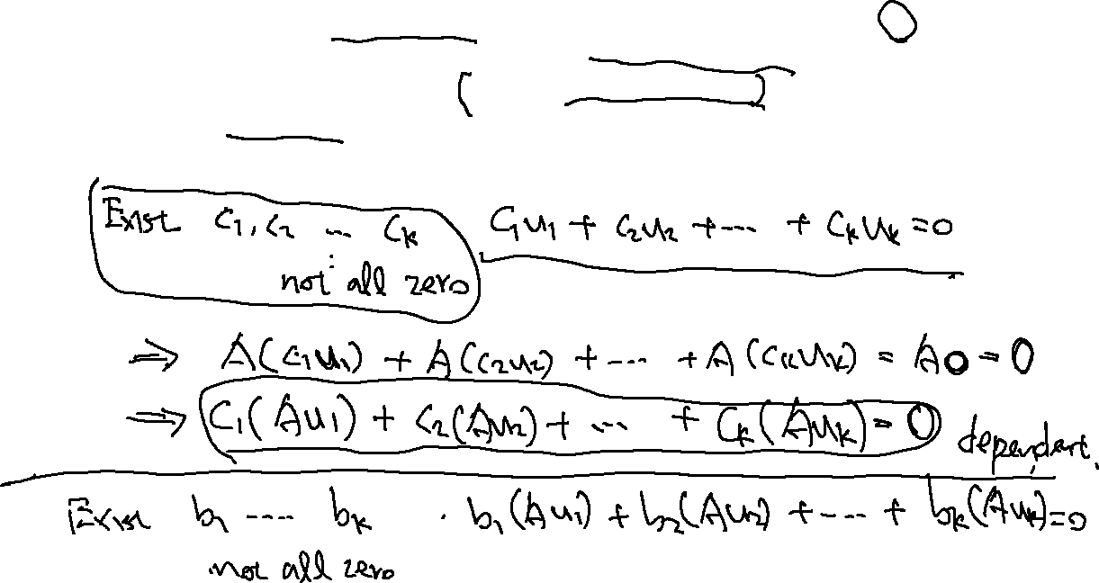
95
Let $S=\left\{u_{1},u_{2},…,u_{k}\right\}$ be a nonempty subset of $R^{n}$ and $A$ be an $m×n$ matrix. Prove that if $S$ is linearly dependent, and $S^{′}=\left\{Au_{1},Au_{2},…,{Au}_{k}\right\}$ contains $k$ distinct vectors, then $S^{′}$ is linearly dependent.

Slide 8
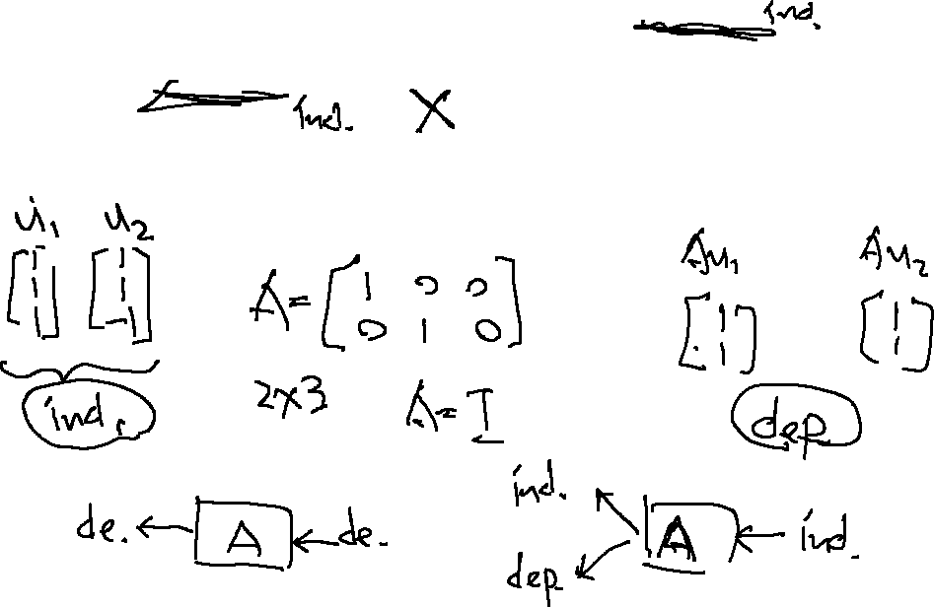
96
Let $S=\left\{u_{1},u_{2},…,u_{k}\right\}$ be a nonempty subset of $R^{n}$ and $A$ be an $m×n$ matrix. Prove that if $S$ is linearly dependent, and $S^{′}=\left\{Au_{1},Au_{2},…,{Au}_{k}\right\}$ contains $k$ distinct vectors, then $S^{′}$ is linearly dependent.
Give an example to show that the preceding exercise is false if linearly dependent is changed to linearly independent.

