Slide 1
Meta Learning: Learn to learn
Hung-yi Lee
What does “meta” mean? meta-X = X about X
Notes:
TBD: 上課提到MAML跟model pretrain的差異!?
====
What is strided here?
===
Do we need development set?????
====
ANIL跟MAML差異比較（ANIL paper: https://arxiv.org/pdf/1909.09157.pdf ）
ANIL的部分重點在於inner loop時只更新部分參數(只更新task specific layers)
===
First order MAML的題目（如何實作或是如何改code將原本的範例程式由second order變成first order）
有出一題如何改code來將原本的範例程式變成Reptile
預計也會出一些跟How to train MAML這篇paper相關的題目
會出一些應用到meta learning的paper的相關題目

Slide 2
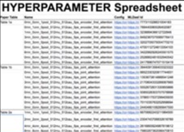
Source of image: https://medium.com/intuitionmachine/the-brute-force-method-of-deep-learning-innovation-58b497323ae5 (Denny Britz’s graphic)
這門課的作業在做甚麼？
感謝 沈昇勳 同學提供圖檔
Notes:
Graduent student descent
http://blog.districtdatalabs.com/visual-diagnostics-for-more-informed-machine-learning-part-3

Slide 3
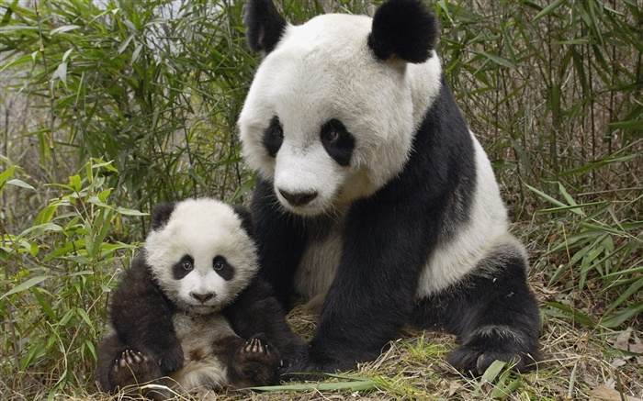
Industry
Academia
Using 1000 GPUs to try
1000 sets of hyperparameters
“Telepathize” (通靈) a set of good hyperparameters
Can machine automatically determine the hyperparameters?
Notes:
痛苦是比較出來的

Slide 4
Machine Learning 101
Notes:
You should use capital letter and lowercase letter both.

Slide 5
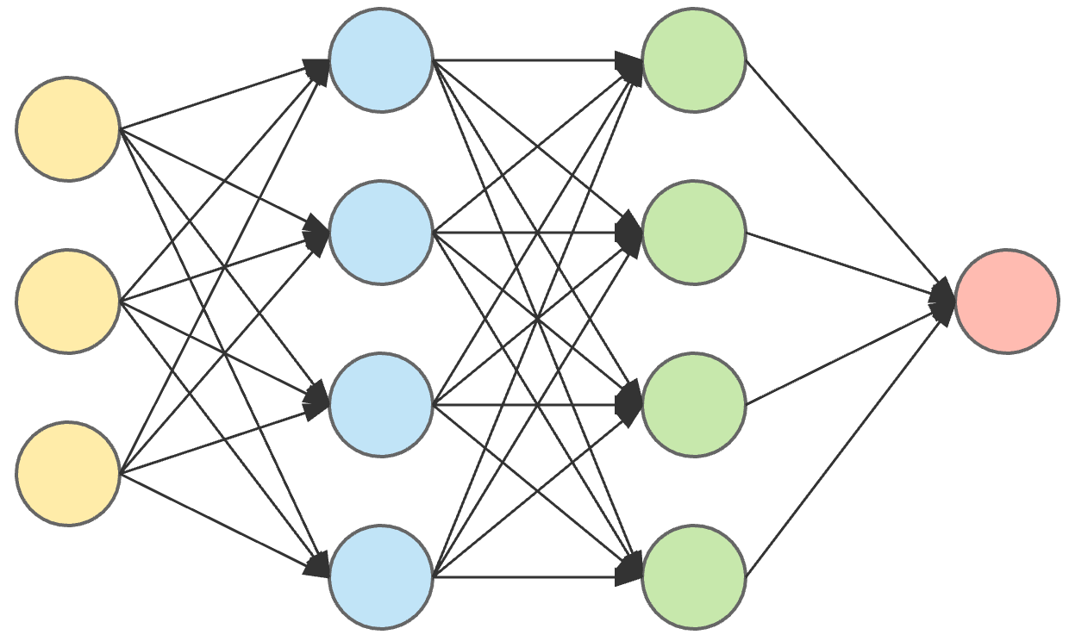
Machine Learning
Dog-Cat Classification
$$f\left( \right)=$$
“cat”
= Looking for a function
Step 1: Function with unknown
Step 2: Define loss function
Step 3: Optimization
cat or dog?
$$f_{θ}$$
Weights and biases of neurons are unknown parameters (learnable).
Using $θ$ to represent the unknown parameters.
Notes:
Please allow me to describe how to find the function small f in machine learning.
I would use deep learning as example.
There are three steps.
The first step is to decide what to learn, what is learnable.
In deep learning, to do cat and dog classification, you will have a network that can take an image as input, and output a value representing the input is cat or dog.
The network architecture itself is usually predefined.
The parameters of the network, wights and biases of the neurons in the network, are learnable.
We use theta to represent the stuff we are going to learn in machine learning.
f theta is our classifier, which is a function.
Theta controls the function.

Slide 6
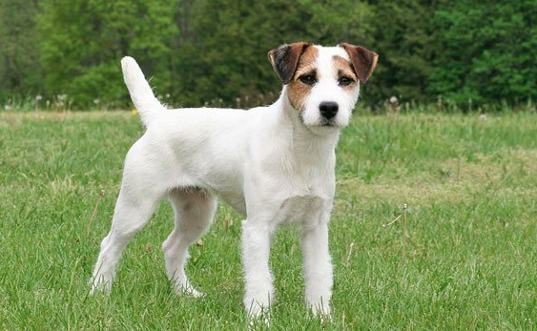
Machine Learning
Training Examples
Step 1: Function with unknown
Step 2: Define loss function
Step 3: Optimization
$$f_{θ}$$
$$f_{θ}$$
$$f_{θ}$$
$$L\left(θ\right)$$
cat dog
cat dog
$$e_{1}$$
$$e_{2}$$
Cross-entropy
$$=\sum_{k=1}^{K}{e_{k}}$$
cat dog
cat dog
$$L\left(θ\right)$$
Ground Truth
Notes:
Then we define a loss function.
The loss function evaluate how bad a set of network parameters, theta, is.
This is how you compute the loss.
We have some training data, a lot of images and their labels.
The labels are ground truth for training.
Given a specific theta, we have a classifier, or a function, f theta.
The function f theta takes the images as input, and outputs its classification results.
Then we compute the difference between the output of f theta and the ground truth.
We would compute something like cross-entropy.
Then we sum over the difference of all the training examples.
This is the loss of a specific theta.
It tells as how bad the theta is as a classifier based on the training data.

Slide 7
Machine Learning 101
$$L\left(θ\right)=\sum_{k=1}^{K}{e_{k}}$$
sum over training examples
Step 1: Function with unknown
Step 2: Define loss function
Step 3: Optimization
loss:
$$θ^{∗}=arg\min_{θ}{L\left(θ\right)}$$
done by gradient descent
$f_{θ^{∗}}$ is the function learned by learning algorithm from data
Notes:
The third step is optimization.
After we define the loss function, we have to find a parameter theta that can minimize the loss function.
In deep learning, this is usually done by gradient descent.
We use gradient descent to find theta star that can minimize the loss function here.
I believe there is no need to describe what gradient descent is.
Now we have theta star that can minimize the loss function.
It is the optimal network parameters.
We have the optimal classifier f theta star, or f star.
This is machine learning 101.
This is something you definitely know I believe you already feel this tutorial is very bored.
Let’s quickly move meta learning.
I spent a lot of time talking about machine learning because I want to show that in meta learning, we use very similar idea to find a learning algorithm capital F, following the same three steps here.

Slide 8
Introduction of Meta Learning

Slide 9
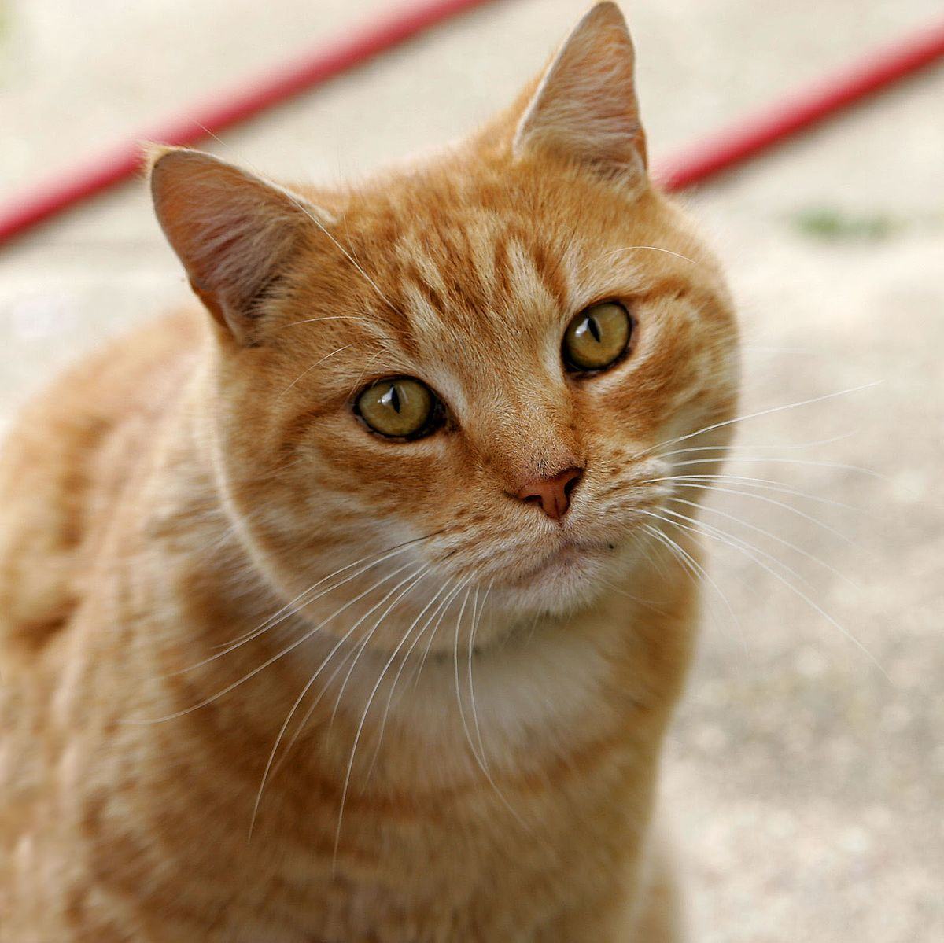
What is Meta Learning?
Can we learn this function?
Following the same three steps in ML!
Training Examples
function
Learning algorithm
$$F$$
Hand-crafted
cat
dog
input
$$f^{∗}$$
classifier
Learned from data
Testing
output
cat

Slide 10
Meta Learning – Step 1
What is learnable in a learning algorithm?
Component
Training Examples
Net Architecture,
Initial Parameters,
Learning Rate,
……
Deep
Learning
$$F$$
cat
dog
In meta, we will try to learn some of them.
$$f^{∗}$$
classifier
Testing
cat
Notes:
Now let’s talk about meta learning.
The learning algorithm capital F is a learning algorithm.
We have to determine which part in the learning algorithm can be learnable.
The learnable part in a learning algorithm is represented as phi.
If capital F is based on gradient descent, then Phi can be the initial parameters, learning rates, network architectures, and so on.
We will be back to what is learnable in a learning algorithm latter.
We use F phi to represent a learning algorithm parametrized by phi.
Phi is something we are going to learned latter.

Slide 11
Meta Learning – Step 1
What is learnable in a learning algorithm?
Component
Training Examples
$$F_{φ}$$
Net Architecture,
Initial Parameters,
Learning Rate,
……
Deep
Learning
$$F$$
cat
dog
$φ$: learnable components
$$f^{∗}$$
classifier
Testing
Categorize meta learning based on what is learnable
cat
Notes:
Now let’s talk about meta learning.
The learning algorithm capital F is a learning algorithm.
We have to determine which part in the learning algorithm can be learnable.
The learnable part in a learning algorithm is represented as phi.
If capital F is based on gradient descent, then Phi can be the initial parameters, learning rates, network architectures, and so on.
We will be back to what is learnable in a learning algorithm latter.
We use F phi to represent a learning algorithm parametrized by phi.
Phi is something we are going to learned latter.

Slide 12
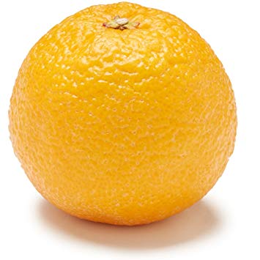
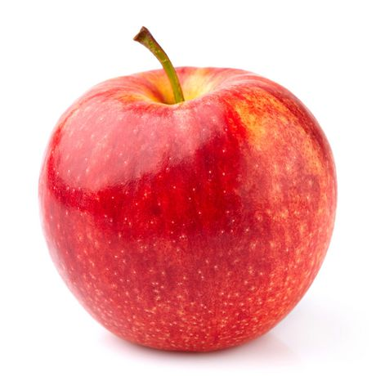
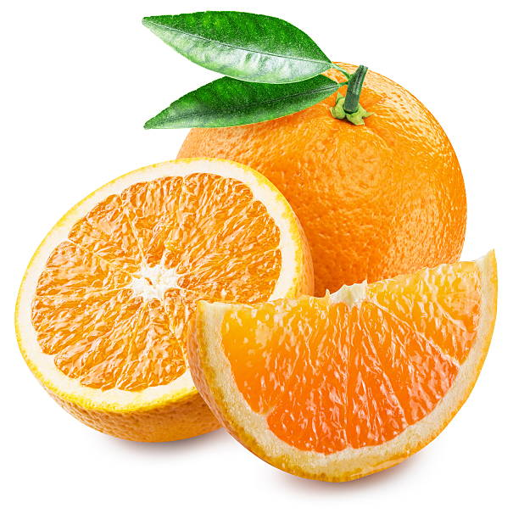
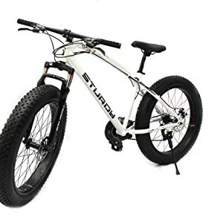
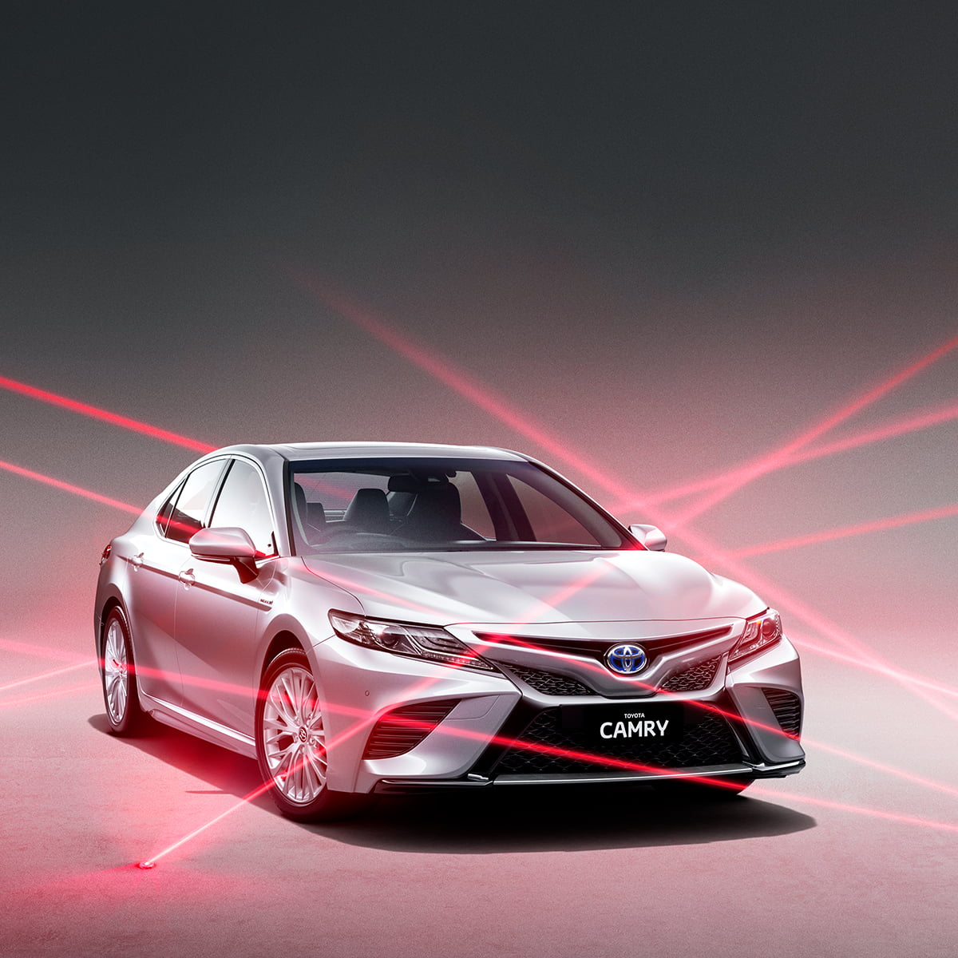
Meta Learning – Step 2
Define loss function for learning algorithm $F_{φ}$
$$L\left(φ\right)$$
$$L\left(φ\right)$$
$$L\left(φ\right)$$
Task 1
Train
Test
Apple & Orange
Training
Tasks
apple
orange
apple
orange
Task 2
Train
Test
Car & Bike
bike
car
bike
car

Slide 13
Meta Learning – Step 2
Training
Examples
Task 1
How to define $L\left(φ\right)$
apple
orange
$$L\left(φ\right)$$
$$F_{φ}$$
$$f_{θ^{1∗}}$$
classifier
$θ^{1∗}$: parameters of the classifier learned by $F_{φ}$ using the training examples of task 1
Notes:
Here I am going to describe how we define the loss function for a learning algorithm in meta-learning.
Suppose we have data for some binary classification tasks.
The data of task one is D 1, and the data of task two is D 2.
In this example, task one is to classify apple and orange, so we have some images of apple and oranges and their labels.
We split the labeled data into two sets, one for training, and the other for testing.
The training set is the input of the learning algorithm, capital F phi.
The learning algorithm takes the training set as input and outputs a classifier, function f 1.
In deep learning, f 1 can be a learned network.
If we apply the function, f 1, to classify apple and orange, we can obtain high accuracy, we can say the learning algorithm F phi is a good learning algorithm.
On the other hand, if f 1 is not good at classifying apple and orange, then we know that F phi is poor since it can not obtain good results.
To check f 1 is good at classifying apple and orange or not, we need the testing set.
Recall that we split the data of task one into training and testing sets.
We use the testing set to evaluate small f 1.
We use f 1 to classify the images in the testing set and obtain the prediction.
Because we also have the ground truth for the testing set, we can evaluate the classification results are correct or not.
Then we obtain the loss for f 1 on the testing set.
We define the loss of for small f 1 on the testing set as l 1.
Then for task two, we do the same thing.
Let’s say the task two is to classify bike and car.
We also split the data of task two into training and testing sets.
F phi uses the training data to obtain f 2.
Then with the testing set, we know the loss of f 2, denoted as l two.
Then we sum over the losses of all the tasks and obtain a total loss capital L for the learning algorithm parameterized by phi.
Now we have the loss function for phi.
The capital L is the loss function for phi.

Slide 14
Meta Learning – Step 2
Training
Examples
Task 1
How to define $L\left(φ\right)$
apple
orange
$$L\left(φ\right)$$
$$F_{φ}$$
$$f_{θ^{1∗}}$$
classifier
How can we know a classifier is good or bad?
Evaluate the classifier on testing set
Notes:
Here I am going to describe how we define the loss function for a learning algorithm in meta-learning.
Suppose we have data for some binary classification tasks.
The data of task one is D 1, and the data of task two is D 2.
In this example, task one is to classify apple and orange, so we have some images of apple and oranges and their labels.
We split the labeled data into two sets, one for training, and the other for testing.
The training set is the input of the learning algorithm, capital F phi.
The learning algorithm takes the training set as input and outputs a classifier, function f 1.
In deep learning, f 1 can be a learned network.
If we apply the function, f 1, to classify apple and orange, we can obtain high accuracy, we can say the learning algorithm F phi is a good learning algorithm.
On the other hand, if f 1 is not good at classifying apple and orange, then we know that F phi is poor since it can not obtain good results.
To check f 1 is good at classifying apple and orange or not, we need the testing set.
Recall that we split the data of task one into training and testing sets.
We use the testing set to evaluate small f 1.
We use f 1 to classify the images in the testing set and obtain the prediction.
Because we also have the ground truth for the testing set, we can evaluate the classification results are correct or not.
Then we obtain the loss for f 1 on the testing set.
We define the loss of for small f 1 on the testing set as l 1.
Then for task two, we do the same thing.
Let’s say the task two is to classify bike and car.
We also split the data of task two into training and testing sets.
F phi uses the training data to obtain f 2.
Then with the testing set, we know the loss of f 2, denoted as l two.
Then we sum over the losses of all the tasks and obtain a total loss capital L for the learning algorithm parameterized by phi.
Now we have the loss function for phi.
The capital L is the loss function for phi.

Slide 15
Meta Learning – Step 2
Testing Examples
Training
Examples
Task 1
apple
orange
$$f_{θ^{1∗}}$$
$$f_{θ^{1∗}}$$
Testing
Examples
$$F_{φ}$$
$$f_{θ^{1∗}}$$
apple orange
apple orange
apple
orange
prediction
Cross-entropy
Cross-entropy
Compute difference
$$l^{1}$$
apple orange
apple orange
Ground Truth
Notes:
Here I am going to describe how we define the loss function for a learning algorithm in meta-learning.
Suppose we have data for some binary classification tasks.
The data of task one is D 1, and the data of task two is D 2.
In this example, task one is to classify apple and orange, so we have some images of apple and oranges and their labels.
We split the labeled data into two sets, one for training, and the other for testing.
The training set is the input of the learning algorithm, capital F phi.
The learning algorithm takes the training set as input and outputs a classifier, function f 1.
In deep learning, f 1 can be a learned network.
If we apply the function, f 1, to classify apple and orange, we can obtain high accuracy, we can say the learning algorithm F phi is a good learning algorithm.
On the other hand, if f 1 is not good at classifying apple and orange, then we know that F phi is poor since it can not obtain good results.
To check f 1 is good at classifying apple and orange or not, we need the testing set.
Recall that we split the data of task one into training and testing sets.
We use the testing set to evaluate small f 1.
We use f 1 to classify the images in the testing set and obtain the prediction.
Because we also have the ground truth for the testing set, we can evaluate the classification results are correct or not.
Then we obtain the loss for f 1 on the testing set.
We define the loss of for small f 1 on the testing set as l 1.
Then for task two, we do the same thing.
Let’s say the task two is to classify bike and car.
We also split the data of task two into training and testing sets.
F phi uses the training data to obtain f 2.
Then with the testing set, we know the loss of f 2, denoted as l two.
Then we sum over the losses of all the tasks and obtain a total loss capital L for the learning algorithm parameterized by phi.
Now we have the loss function for phi.
The capital L is the loss function for phi.

Slide 16
Meta Learning – Step 2
Testing Examples
Training
Examples
Task 1
apple
orange
$$f_{θ^{1∗}}$$
$$f_{θ^{1∗}}$$
Testing
Examples
$$F_{φ}$$
$$f_{θ^{1∗}}$$
apple orange
apple orange
apple
orange
prediction
Cross-entropy
Cross-entropy
Compute difference
$$l^{1}$$
apple orange
apple orange
Ground Truth
Notes:
Here I am going to describe how we define the loss function for a learning algorithm in meta-learning.
Suppose we have data for some binary classification tasks.
The data of task one is D 1, and the data of task two is D 2.
In this example, task one is to classify apple and orange, so we have some images of apple and oranges and their labels.
We split the labeled data into two sets, one for training, and the other for testing.
The training set is the input of the learning algorithm, capital F phi.
The learning algorithm takes the training set as input and outputs a classifier, function f 1.
In deep learning, f 1 can be a learned network.
If we apply the function, f 1, to classify apple and orange, we can obtain high accuracy, we can say the learning algorithm F phi is a good learning algorithm.
On the other hand, if f 1 is not good at classifying apple and orange, then we know that F phi is poor since it can not obtain good results.
To check f 1 is good at classifying apple and orange or not, we need the testing set.
Recall that we split the data of task one into training and testing sets.
We use the testing set to evaluate small f 1.
We use f 1 to classify the images in the testing set and obtain the prediction.
Because we also have the ground truth for the testing set, we can evaluate the classification results are correct or not.
Then we obtain the loss for f 1 on the testing set.
We define the loss of for small f 1 on the testing set as l 1.
Then for task two, we do the same thing.
Let’s say the task two is to classify bike and car.
We also split the data of task two into training and testing sets.
F phi uses the training data to obtain f 2.
Then with the testing set, we know the loss of f 2, denoted as l two.
Then we sum over the losses of all the tasks and obtain a total loss capital L for the learning algorithm parameterized by phi.
Now we have the loss function for phi.
The capital L is the loss function for phi.

Slide 17
Meta Learning – Step 2
Testing Examples
Training
Examples
Task 1
apple
orange
$$f_{θ^{1∗}}$$
$$f_{θ^{1∗}}$$
Testing
Examples
$$F_{φ}$$
$$f_{θ^{1∗}}$$
apple orange
apple orange
apple
orange
prediction
Cross-entropy
Cross-entropy
Compute difference
$$l^{1}$$
apple orange
apple orange
Ground Truth
Notes:
Here I am going to describe how we define the loss function for a learning algorithm in meta-learning.
Suppose we have data for some binary classification tasks.
The data of task one is D 1, and the data of task two is D 2.
In this example, task one is to classify apple and orange, so we have some images of apple and oranges and their labels.
We split the labeled data into two sets, one for training, and the other for testing.
The training set is the input of the learning algorithm, capital F phi.
The learning algorithm takes the training set as input and outputs a classifier, function f 1.
In deep learning, f 1 can be a learned network.
If we apply the function, f 1, to classify apple and orange, we can obtain high accuracy, we can say the learning algorithm F phi is a good learning algorithm.
On the other hand, if f 1 is not good at classifying apple and orange, then we know that F phi is poor since it can not obtain good results.
To check f 1 is good at classifying apple and orange or not, we need the testing set.
Recall that we split the data of task one into training and testing sets.
We use the testing set to evaluate small f 1.
We use f 1 to classify the images in the testing set and obtain the prediction.
Because we also have the ground truth for the testing set, we can evaluate the classification results are correct or not.
Then we obtain the loss for f 1 on the testing set.
We define the loss of for small f 1 on the testing set as l 1.
Then for task two, we do the same thing.
Let’s say the task two is to classify bike and car.
We also split the data of task two into training and testing sets.
F phi uses the training data to obtain f 2.
Then with the testing set, we know the loss of f 2, denoted as l two.
Then we sum over the losses of all the tasks and obtain a total loss capital L for the learning algorithm parameterized by phi.
Now we have the loss function for phi.
The capital L is the loss function for phi.

Slide 18
Meta Learning – Step 2
Training
Examples
Task 2
Task 1
apple
orange
bike
car
Testing
Examples
$$F_{φ}$$
Testing
Examples
$$F_{φ}$$
$$f_{θ^{1∗}}$$
$$f_{θ^{2∗}}$$
apple
orange
prediction
bike
car
prediction
$$l^{1}$$
$$l^{2}$$
Total loss:
$$L\left(φ\right)=l^{1}+l^{2}$$
(sum over all the training tasks)
Notes:
Here I am going to describe how we define the loss function for a learning algorithm in meta-learning.
Suppose we have data for some binary classification tasks.
The data of task one is D 1, and the data of task two is D 2.
In this example, task one is to classify apple and orange, so we have some images of apple and oranges and their labels.
We split the labeled data into two sets, one for training, and the other for testing.
The training set is the input of the learning algorithm, capital F phi.
The learning algorithm takes the training set as input and outputs a classifier, function f 1.
In deep learning, f 1 can be a learned network.
If we apply the function, f 1, to classify apple and orange, we can obtain high accuracy, we can say the learning algorithm F phi is a good learning algorithm.
On the other hand, if f 1 is not good at classifying apple and orange, then we know that F phi is poor since it can not obtain good results.
To check f 1 is good at classifying apple and orange or not, we need the testing set.
Recall that we split the data of task one into training and testing sets.
We use the testing set to evaluate small f 1.
We use f 1 to classify the images in the testing set and obtain the prediction.
Because we also have the ground truth for the testing set, we can evaluate the classification results are correct or not.
Then we obtain the loss for f 1 on the testing set.
We define the loss of for small f 1 on the testing set as l 1.
Then for task two, we do the same thing.
Let’s say the task two is to classify bike and car.
We also split the data of task two into training and testing sets.
F phi uses the training data to obtain f 2.
Then with the testing set, we know the loss of f 2, denoted as l two.
Then we sum over the losses of all the tasks and obtain a total loss capital L for the learning algorithm parameterized by phi.
Now we have the loss function for phi.
The capital L is the loss function for phi.

Slide 19
Meta Learning – Step 2
Training
Examples
Task 2
Task 1
apple
orange
bike
car
Testing
Examples
$$F_{φ}$$
Testing
Examples
$$F_{φ}$$
$$f_{θ^{1∗}}$$
$$f_{θ^{2∗}}$$
apple
orange
prediction
bike
car
prediction
$$l^{1}$$
$$\sum_{n=1}^{N}{l^{n}}$$
$$l^{2}$$
Total loss:
($N$ is the number of the training tasks)
$$L\left(φ\right)=$$
Notes:
Here I am going to describe how we define the loss function for a learning algorithm in meta-learning.
Suppose we have data for some binary classification tasks.
The data of task one is D 1, and the data of task two is D 2.
In this example, task one is to classify apple and orange, so we have some images of apple and oranges and their labels.
We split the labeled data into two sets, one for training, and the other for testing.
The training set is the input of the learning algorithm, capital F phi.
The learning algorithm takes the training set as input and outputs a classifier, function f 1.
In deep learning, f 1 can be a learned network.
If we apply the function, f 1, to classify apple and orange, we can obtain high accuracy, we can say the learning algorithm F phi is a good learning algorithm.
On the other hand, if f 1 is not good at classifying apple and orange, then we know that F phi is poor since it can not obtain good results.
To check f 1 is good at classifying apple and orange or not, we need the testing set.
Recall that we split the data of task one into training and testing sets.
We use the testing set to evaluate small f 1.
We use f 1 to classify the images in the testing set and obtain the prediction.
Because we also have the ground truth for the testing set, we can evaluate the classification results are correct or not.
Then we obtain the loss for f 1 on the testing set.
We define the loss of for small f 1 on the testing set as l 1.
Then for task two, we do the same thing.
Let’s say the task two is to classify bike and car.
We also split the data of task two into training and testing sets.
F phi uses the training data to obtain f 2.
Then with the testing set, we know the loss of f 2, denoted as l two.
Then we sum over the losses of all the tasks and obtain a total loss capital L for the learning algorithm parameterized by phi.
Now we have the loss function for phi.
The capital L is the loss function for phi.

Slide 20
Meta Learning – Step 2
Testing Examples
In typical ML, you compute the loss based on training examples
Task 1
In meta, you compute the loss based on testing examples
$$f_{θ^{1∗}}$$
$$f_{θ^{1∗}}$$
Hold on! You use testing examples during training???
apple orange
apple orange
apple
orange
prediction
Cross-entropy
Cross-entropy
Compute difference
$$l^{1}$$
apple orange
apple orange
Ground Truth
Notes:
Here I am going to describe how we define the loss function for a learning algorithm in meta-learning.
Suppose we have data for some binary classification tasks.
The data of task one is D 1, and the data of task two is D 2.
In this example, task one is to classify apple and orange, so we have some images of apple and oranges and their labels.
We split the labeled data into two sets, one for training, and the other for testing.
The training set is the input of the learning algorithm, capital F phi.
The learning algorithm takes the training set as input and outputs a classifier, function f 1.
In deep learning, f 1 can be a learned network.
If we apply the function, f 1, to classify apple and orange, we can obtain high accuracy, we can say the learning algorithm F phi is a good learning algorithm.
On the other hand, if f 1 is not good at classifying apple and orange, then we know that F phi is poor since it can not obtain good results.
To check f 1 is good at classifying apple and orange or not, we need the testing set.
Recall that we split the data of task one into training and testing sets.
We use the testing set to evaluate small f 1.
We use f 1 to classify the images in the testing set and obtain the prediction.
Because we also have the ground truth for the testing set, we can evaluate the classification results are correct or not.
Then we obtain the loss for f 1 on the testing set.
We define the loss of for small f 1 on the testing set as l 1.
Then for task two, we do the same thing.
Let’s say the task two is to classify bike and car.
We also split the data of task two into training and testing sets.
F phi uses the training data to obtain f 2.
Then with the testing set, we know the loss of f 2, denoted as l two.
Then we sum over the losses of all the tasks and obtain a total loss capital L for the learning algorithm parameterized by phi.
Now we have the loss function for phi.
The capital L is the loss function for phi.

Slide 21
Meta Learning – Step 2
Testing Examples
In typical ML, you compute the loss based on training examples
Task 1
In meta, you compute the loss based on testing examples
$$f_{θ^{1∗}}$$
$$f_{θ^{1∗}}$$
of training tasks.
apple orange
apple orange
apple
orange
prediction
Cross-entropy
Cross-entropy
Compute difference
$$l^{1}$$
apple orange
apple orange
Ground Truth
Notes:
Here I am going to describe how we define the loss function for a learning algorithm in meta-learning.
Suppose we have data for some binary classification tasks.
The data of task one is D 1, and the data of task two is D 2.
In this example, task one is to classify apple and orange, so we have some images of apple and oranges and their labels.
We split the labeled data into two sets, one for training, and the other for testing.
The training set is the input of the learning algorithm, capital F phi.
The learning algorithm takes the training set as input and outputs a classifier, function f 1.
In deep learning, f 1 can be a learned network.
If we apply the function, f 1, to classify apple and orange, we can obtain high accuracy, we can say the learning algorithm F phi is a good learning algorithm.
On the other hand, if f 1 is not good at classifying apple and orange, then we know that F phi is poor since it can not obtain good results.
To check f 1 is good at classifying apple and orange or not, we need the testing set.
Recall that we split the data of task one into training and testing sets.
We use the testing set to evaluate small f 1.
We use f 1 to classify the images in the testing set and obtain the prediction.
Because we also have the ground truth for the testing set, we can evaluate the classification results are correct or not.
Then we obtain the loss for f 1 on the testing set.
We define the loss of for small f 1 on the testing set as l 1.
Then for task two, we do the same thing.
Let’s say the task two is to classify bike and car.
We also split the data of task two into training and testing sets.
F phi uses the training data to obtain f 2.
Then with the testing set, we know the loss of f 2, denoted as l two.
Then we sum over the losses of all the tasks and obtain a total loss capital L for the learning algorithm parameterized by phi.
Now we have the loss function for phi.
The capital L is the loss function for phi.

Slide 22
Meta Learning – Step 3
$$\sum_{n=1}^{N}{l^{n}}$$
Loss function for learning algorithm
Find $φ$ that can minimize $L\left(φ\right)$
Using the optimization approach you know
$$L\left(φ\right)=$$
$$φ^{∗}=arg\min_{φ}{L\left(φ\right)}$$
If you know how to compute ${∂L\left(φ\right)}/{∂φ}$
Gradient descent is your friend.
What if $L\left(φ\right)$ is not differentiable?
Reinforcement Learning / Evolutionary Algorithm
Now we have a learned “learning algorithm” $F_{φ^{∗}}$
Notes:
You still need to tune parameters ???
Can generalize to new tasks

Slide 23
Framework
Training Tasks
Not related to the testing task
Task 1
Task 2
apple
orange
bike
car
only need little labeled training data
Learned
“Learning Algorithm”
$$F_{φ^{∗}}$$
Testing Task
cat
dog
Train
What we really care about
Test
$$f_{θ^{∗}}$$
cat
Notes:
This is the framework of meta learning.
Let’s say you want to find a learning algorithm for training a binary classification model.

Slide 24
ML v.s. Meta

Slide 25
Goal
Machine Learning
≈ find a function f
Dog-Cat
Classification
$$f\left( \right)=$$
“cat”
Meta Learning
≈ find a function F that finds a function f
Learning
Algorithm
$$F\left( \right)$$
$$=f$$
cat
dog
cat
dog
Training Examples
Notes:
The target of meta learning is to automatically find the learning algorithm, capital F, also from data.
So meta learning is to find a function capital F that can finds a function f.
This sounds a little bit tricky.
We use a function to find another function.
The function, capital F, takes training data as input, and output another function, small f.
Then the small f is what we want to find in machine learning.
Then how to train the learning algorithm capital F?
Although training the learning algorithm sounds pretty fancy, the framework of finding small f and capital F is very similar today.

Slide 26
Training Data
Machine Learning
One task
Meta Learning
cat
dog
Training tasks
Train
Task 1
Train
Test
Apple & Orange
apple
orange
apple
orange
Task 2
Test
Train
Car & Bike
bike
car
bike
car
Support set
Query set
(in the literature of “learning to compare”)
Notes:
Comparison:
Data
Loss
Training
Testing

Slide 27
Machine Learning
Within-task Training
Train
$$F$$
$$f_{θ^{∗}}$$
cat
dog
Hand-crafted
Meta Learning
Task 1
Train
Test
Training
Tasks
apple
orange
apple
orange
Task 2
Train
Test
bike
car
bike
car
Learning Algorithm
Across-task Training
$$F_{φ^{∗}}$$

Slide 28
Training Examples
Machine Learning
$$f_{θ^{∗}}$$
Within-task
Testing
Test
cat
Meta Learning
Training Tasks
Learned
“Learning Algorithm”
$$F_{φ^{∗}}$$
Within-task
Training
Testing Task
cat
dog
Train
Test
$$f_{θ^{∗}}$$
Within-task
Testing
Across-task
Testing
Episode
cat
Notes:
This is the framework of meta learning.
Let’s say you want to find a learning algorithm for training a binary classification model.

Slide 29
Loss
Machine Learning
$$\sum_{k=1}^{K}{e_{k}}$$
Sum over training examples in one task
$$L\left(θ\right)=$$
Meta Learning
$$\sum_{n=1}^{N}{l^{n}}$$
Sum over testing examples in one task
$$L\left(φ\right)=$$
Sum over training tasks

Slide 30
$$\sum_{n=1}^{N}{l^{n}}$$
If your optimization method needs to compute $L\left(φ\right)$
$$L\left(φ\right)=$$
Outer Loop in “Learning to initialize”
Across-task training includes within-task training and testing
Training
Examples
apple
orange
Inner Loop in “Learning to initialize”
Testing
Examples
$$F_{φ}$$
Within-task Training
$$f_{θ^{∗}}$$
apple
orange
prediction
Within-task Testing
$$l^{1}$$
To compute the loss

Slide 31
Meta Learning v.s ML
What you know about ML can usually apply to meta learning
Overfitting on training tasks
Get more training tasks to improve performance
Task augmentation
There are also hyperparameters when learning a learning algorithm ……
Development task ☺
Notes:
Do we need development set?????

Slide 32
What is learnable in a learning algorithm?

Slide 33
Review: Gradient Descent
$$θ^{∗}$$
Network
Structure
$$φ$$
Update
Update
$$θ^{0}$$
$$θ^{′}$$
$$θ^{′′}$$
Init
gradient
gradient
Gradient Descent
(Function $F$)
Compute Gradient
Compute Gradient
Training
Data
Training
Data

Slide 34
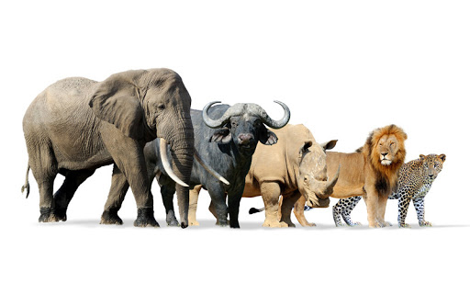
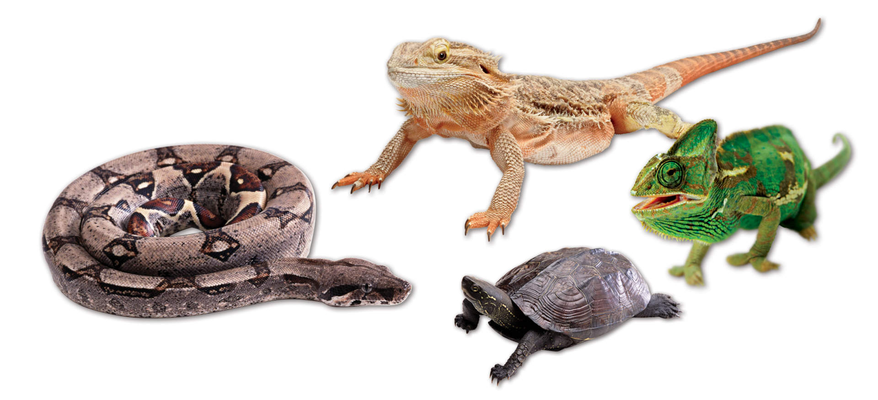
Learning to initialize
Model-Agnostic Meta-Learning (MAML)
Mammals
Chelsea Finn, Pieter Abbeel, and Sergey Levine, “Model-Agnostic Meta-Learning for Fast Adaptation of Deep Networks”, ICML, 2017
Reptile
https://arxiv.org/abs/1803.02999

Slide 35
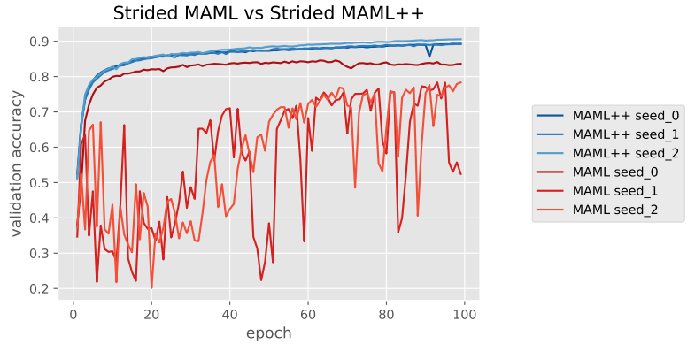
How to train your Dragon MAML
Antreas Antoniou, Harrison Edwards, Amos Storkey, How to train your MAML, ICLR, 2019
Notes:
What is strided here?
=====
In this paper, we propose various modifications to MAML that not only stabilize the system, but also substantially improve the generalization performance, convergence speed and computational overhead of MAML, which we call MAML++
Shared Batch Normalization Bias
The Batch Normalization Bias isn’t updated in the inner-loop, which assumes that all all base-models are the same throughout inner loop updates.
https://www.bayeswatch.com/2018/11/30/HTYM/
https://antreasantoniou.github.io/documents/How_to_train_your_MAML_poster.pdf

Slide 36
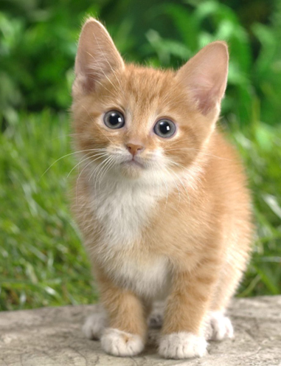
MAML
Testing Task
Task 1
Task 2
find good init
cat
dog
cat
dog
cat
dog
Pre-training
(Self-supervised Learning)
find good init
Trained by proxy tasks
(fill-in the blanks, etc.)
cat
dog

Slide 37
Isn’t it domain adaptation / transfer learning?
MAML
Task 1
Task 2
find good init
cat
dog
cat
dog
cat
dog
Pre-training
(more typical ways)
find good init
cat
dog
cat
dog
cat
dog
Use data from different tasks to train a model
Also known as multi-task learning (baseline of meta)

Slide 38
MAML v.s. Pre-training
https://youtu.be/vUwOA3SNb_E
影片中有防不勝防的業配
這就是 “meta 業配”

Slide 39
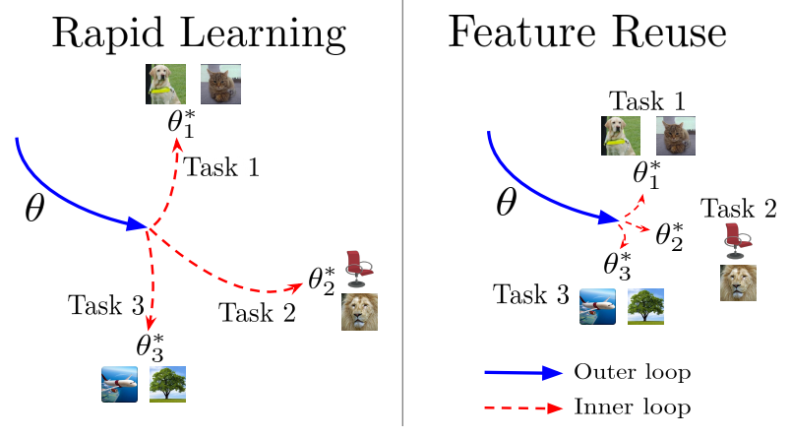
MAML is good because ……
ANIL (Almost No Inner Loop)
Aniruddh Raghu, Maithra Raghu, Samy Bengio, Oriol Vinyals, Rapid Learning or Feature Reuse? Towards Understanding the Effectiveness of MAML, ICLR, 2020
Notes:
Rapid Learning or Feature Reuse?
Towards Understanding the Effectiveness of MAML

Slide 40
More about MAML
More mathematical details behind MAML
https://youtu.be/mxqzGwP_Qys
First order MAML (FOMAML)
https://youtu.be/3z997JhL9Oo
Reptile
https://youtu.be/9jJe2AD35P8

Slide 41
Optimizer
$$φ$$
Basis form:
$$θ^{t+1}←θ^{t}−λg^{t}$$
Adagrad, RMSprop, NAG, Adam ……
Is the optimizer learnable?
$$θ^{∗}$$
Can be learned by MAML
Network
Structure
Update
Update
$$θ^{0}$$
$$θ^{′}$$
$$θ^{′′}$$
Init
gradient
gradient
Gradient Descent
(Function $F$)
Compute Gradient
Compute Gradient
Training
Data
Training
Data

Slide 42
Optimizer
Marcin Andrychowicz, et al., Learning to learn by gradient descent by gradient descent, NIPS, 2016

Slide 43
Network Architecture Search (NAS)
$$θ^{∗}$$
$$φ$$
Network
Structure
Update
Update
$$θ^{0}$$
$$θ^{′}$$
$$θ^{′′}$$
Init
gradient
gradient
Gradient Descent
(Function $F$)
Compute Gradient
Compute Gradient
Training
Data
Training
Data

Slide 44
Network Architecture Search (NAS)
$$\hat{φ}=arg\min_{φ}{L\left(φ\right)}$$
$$∇_{φ}L\left(φ\right)=?$$
Network
Architecture
Reinforcement Learning
Barret Zoph, et al., Neural Architecture Search with Reinforcement Learning, ICLR 2017
Barret Zoph, et al., Learning Transferable Architectures for Scalable Image Recognition, CVPR, 2018
Hieu Pham, et al., Efficient Neural Architecture Search via Parameter Sharing, ICML, 2018
An agent uses a set of actions to determine the network architecture.
$$−L\left(φ\right)$$
Reward to be maximized
$φ$: the agent’s parameters
Notes:
Network architecture search:RL based
Barret Zoph, Quoc V. Le, Neural Architecture Search with Reinforcement Learning, ICLR 2017
Barret Zoph, Vijay Vasudevan, Jonathon Shlens, Quoc V. Le, Learning Transferable Architectures for Scalable Image Recognition, CVPR, 2018
Hieu Pham, Melody Guan, Barret Zoph, Quoc Le, Jeff Dean, Efficient Neural Architecture Search via Parameter Sharing, ICML, 2018
Evolution based
Esteban Real, Sherry Moore, Andrew Selle, Saurabh Saxena, Yutaka Leon Suematsu, Jie Tan, Quoc Le, Alex Kurakin, Large-Scale Evolution of Image Classifiers, ICML 2017
Esteban Real, Alok Aggarwal, Yanping Huang, Quoc V Le, Regularized Evolution for Image Classifier Architecture Search, AAAI, 2019
Hanxiao Liu, Karen Simonyan, Oriol Vinyals, Chrisantha Fernando, Koray Kavukcuoglu, Hierarchical Representations for Efficient Architecture Search, ICLR, 2018
Supernetwork based
Hanxiao Liu, Karen Simonyan, Yiming Yang, DARTS: Differentiable Architecture Search, ICLR, 2019
DARTS

Slide 45
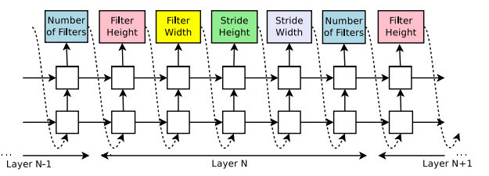
Network Architecture Search (NAS)
Across-task Training
Update $φ$ to maximize reward $−L\left(φ\right)$
agent $φ$ (RNN)
form a network
$$−L\left(φ\right)$$
Accuracy of the network
Train the network
Within-task Training
Notes:
Network architecture search:RL based
Barret Zoph, Quoc V. Le, Neural Architecture Search with Reinforcement Learning, ICLR 2017
Barret Zoph, Vijay Vasudevan, Jonathon Shlens, Quoc V. Le, Learning Transferable Architectures for Scalable Image Recognition, CVPR, 2018
Hieu Pham, Melody Guan, Barret Zoph, Quoc Le, Jeff Dean, Efficient Neural Architecture Search via Parameter Sharing, ICML, 2018
Evolution based
Esteban Real, Sherry Moore, Andrew Selle, Saurabh Saxena, Yutaka Leon Suematsu, Jie Tan, Quoc Le, Alex Kurakin, Large-Scale Evolution of Image Classifiers, ICML 2017
Esteban Real, Alok Aggarwal, Yanping Huang, Quoc V Le, Regularized Evolution for Image Classifier Architecture Search, AAAI, 2019
Hanxiao Liu, Karen Simonyan, Oriol Vinyals, Chrisantha Fernando, Koray Kavukcuoglu, Hierarchical Representations for Efficient Architecture Search, ICLR, 2018
Supernetwork based
Hanxiao Liu, Karen Simonyan, Yiming Yang, DARTS: Differentiable Architecture Search, ICLR, 2019
DARTS

Slide 46
Network Architecture Search (NAS)
$$\hat{φ}=arg\min_{φ}{L\left(φ\right)}$$
$$∇_{φ}L\left(φ\right)=?$$
Network
Architecture
Reinforcement Learning
Barret Zoph, et al., Neural Architecture Search with Reinforcement Learning, ICLR 2017
Barret Zoph, et al., Learning Transferable Architectures for Scalable Image Recognition, CVPR, 2018
Hieu Pham, et al., Efficient Neural Architecture Search via Parameter Sharing, ICML, 2018
Evolution Algorithm
Esteban Real, et al., Large-Scale Evolution of Image Classifiers, ICML 2017
Esteban Real, et al., Regularized Evolution for Image Classifier Architecture Search, AAAI, 2019
Hanxiao Liu, et al., Hierarchical Representations for Efficient Architecture Search, ICLR, 2018
Notes:
Network architecture search:RL based
Barret Zoph, Quoc V. Le, Neural Architecture Search with Reinforcement Learning, ICLR 2017
Barret Zoph, Vijay Vasudevan, Jonathon Shlens, Quoc V. Le, Learning Transferable Architectures for Scalable Image Recognition, CVPR, 2018
Hieu Pham, Melody Guan, Barret Zoph, Quoc Le, Jeff Dean, Efficient Neural Architecture Search via Parameter Sharing, ICML, 2018
Evolution based
Esteban Real, Sherry Moore, Andrew Selle, Saurabh Saxena, Yutaka Leon Suematsu, Jie Tan, Quoc Le, Alex Kurakin, Large-Scale Evolution of Image Classifiers, ICML 2017
Esteban Real, Alok Aggarwal, Yanping Huang, Quoc V Le, Regularized Evolution for Image Classifier Architecture Search, AAAI, 2019
Hanxiao Liu, Karen Simonyan, Oriol Vinyals, Chrisantha Fernando, Koray Kavukcuoglu, Hierarchical Representations for Efficient Architecture Search, ICLR, 2018
Supernetwork based
Hanxiao Liu, Karen Simonyan, Yiming Yang, DARTS: Differentiable Architecture Search, ICLR, 2019
DARTS

Slide 47
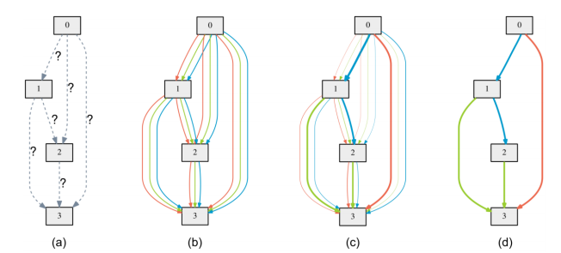
Network Architecture Search (NAS)
$$\hat{φ}=arg\min_{φ}{L\left(φ\right)}$$
$$∇_{φ}L\left(φ\right)=?$$
Network
Architecture
DARTS
Hanxiao Liu, et al., DARTS: Differentiable Architecture Search, ICLR, 2019
Notes:
Network architecture search:RL based
Barret Zoph, Quoc V. Le, Neural Architecture Search with Reinforcement Learning, ICLR 2017
Barret Zoph, Vijay Vasudevan, Jonathon Shlens, Quoc V. Le, Learning Transferable Architectures for Scalable Image Recognition, CVPR, 2018
Hieu Pham, Melody Guan, Barret Zoph, Quoc Le, Jeff Dean, Efficient Neural Architecture Search via Parameter Sharing, ICML, 2018
Evolution based
Esteban Real, Sherry Moore, Andrew Selle, Saurabh Saxena, Yutaka Leon Suematsu, Jie Tan, Quoc Le, Alex Kurakin, Large-Scale Evolution of Image Classifiers, ICML 2017
Esteban Real, Alok Aggarwal, Yanping Huang, Quoc V Le, Regularized Evolution for Image Classifier Architecture Search, AAAI, 2019
Hanxiao Liu, Karen Simonyan, Oriol Vinyals, Chrisantha Fernando, Koray Kavukcuoglu, Hierarchical Representations for Efficient Architecture Search, ICLR, 2018
Supernetwork based
Hanxiao Liu, Karen Simonyan, Yiming Yang, DARTS: Differentiable Architecture Search, ICLR, 2019
DARTS

Slide 48
Data Processing?
$$θ^{∗}$$
Network
Structure
Update
Update
$$θ^{0}$$
$$θ^{′}$$
$$θ^{′′}$$
Init
gradient
gradient
Gradient Descent
(Function $F$)
Compute Gradient
Compute Gradient
Training
Data
Training
Data

Slide 49
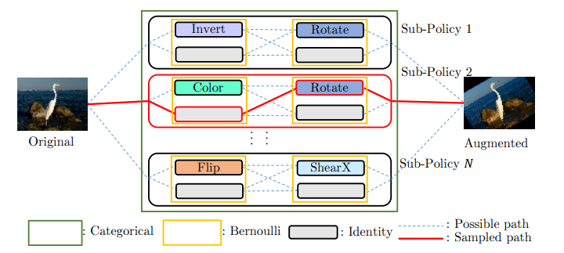
Data Augmentation
Yonggang Li, Guosheng Hu, Yongtao Wang, Timothy Hospedales, Neil M. Robertson, Yongxin Yang, DADA: Differentiable Automatic Data Augmentation, ECCV, 2020
Daniel Ho, Eric Liang, Ion Stoica, Pieter Abbeel, Xi Chen, Population Based Augmentation: Efficient Learning of Augmentation Policy Schedules, ICML, 2019
Ekin D. Cubuk, Barret Zoph, Dandelion Mane, Vijay Vasudevan, Quoc V. Le, AutoAugment: Learning Augmentation Policies from Data, CVPR, 2019
Notes:
https://zhuanlan.zhihu.com/p/82821801

Slide 50
Sample Reweighting
Give different samples different weights
Larger weights (focus on tough examples)?
Smaller weights (the labels are noisy)?
Sample Weighting Strategies
Learnable $φ$
Jun Shu, Qi Xie, Lixuan Yi, Qian Zhao, Sanping Zhou, Zongben Xu, Deyu Meng,
Meta-Weight-Net: Learning an Explicit Mapping For Sample Weighting, NeurIPS, 2019
Mengye Ren, Wenyuan Zeng, Bin Yang, Raquel Urtasun, Learning to Reweight Examples for Robust Deep Learning, ICML, 2018
Notes:
Sample re-weighting strategy is commonly used to alleviate this issue by designing a weighting function mapping from training loss to sample weight

Slide 51
Beyond Gradient Descent
Andrei A. Rusu, Dushyant Rao, Jakub Sygnowski, Oriol Vinyals, Razvan Pascanu, Simon Osindero, Raia Hadsell,
Meta-Learning with Latent Embedding Optimization, ICLR, 2019
$$θ^{∗}$$
Network
Structure
Update
Update
$$θ^{0}$$
$$θ^{′}$$
$$θ^{′′}$$
Init
This is a Network.
Its parameter is $φ$
gradient
gradient
Gradient Descent
(Function $F$)
Compute Gradient
Compute Gradient
(Invent new learning algorithm! Not gradient descent anymore)
Training
Data
Training
Data

Slide 52
Until now ……
How about?
cat
cat
Learning Algorithm
(Function $F$)
$$θ^{∗}$$
Learning + Classification
(Function $F$)
cat
dog
cat
dog
Training Data
Testing Data
Training Data
Testing Data
https://youtu.be/yyKaACh_j3M
Learning to compare
https://youtu.be/scK2EIT7klw
(metric-based approach)
https://youtu.be/semSxPP2Yzg
https://youtu.be/ePimv_k-H24

Slide 53
Applications

Slide 54
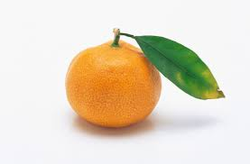
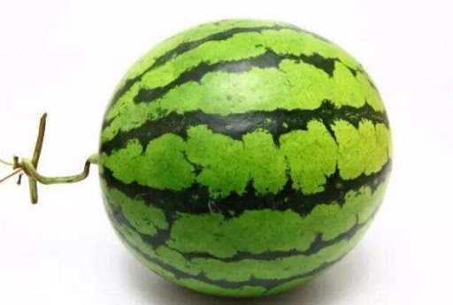
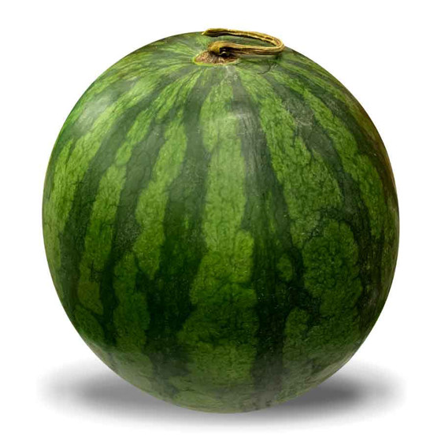
Few-shot Image Classification
Each class only has a few images.
N-ways K-shot classification: In each task, there are N classes, each has K examples.
In meta learning, you need to prepare many N-ways K-shot tasks as training and testing tasks.
Class 1
Class 1
Class 2
Class 2
Class 3
Class 3
Which
class?
3-ways 2-shot

Slide 55
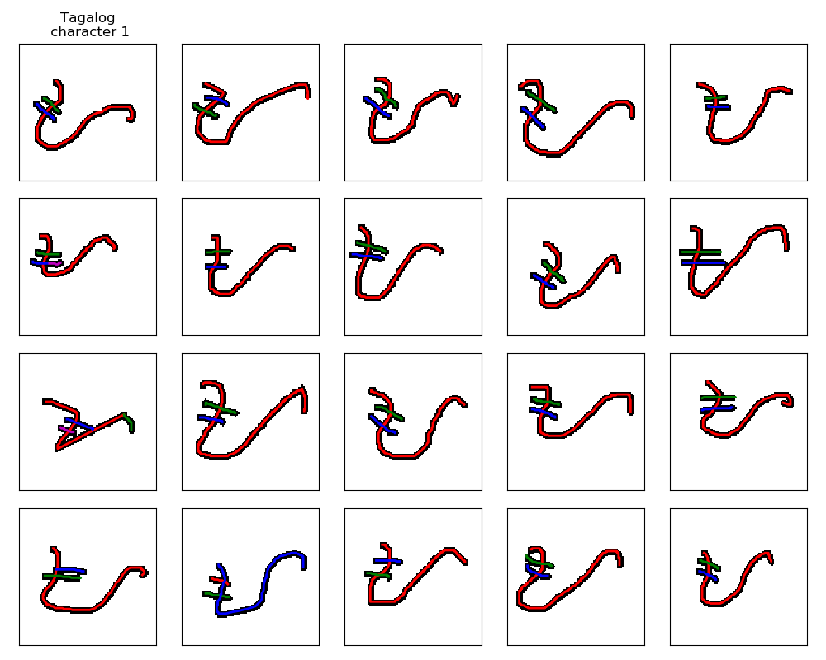
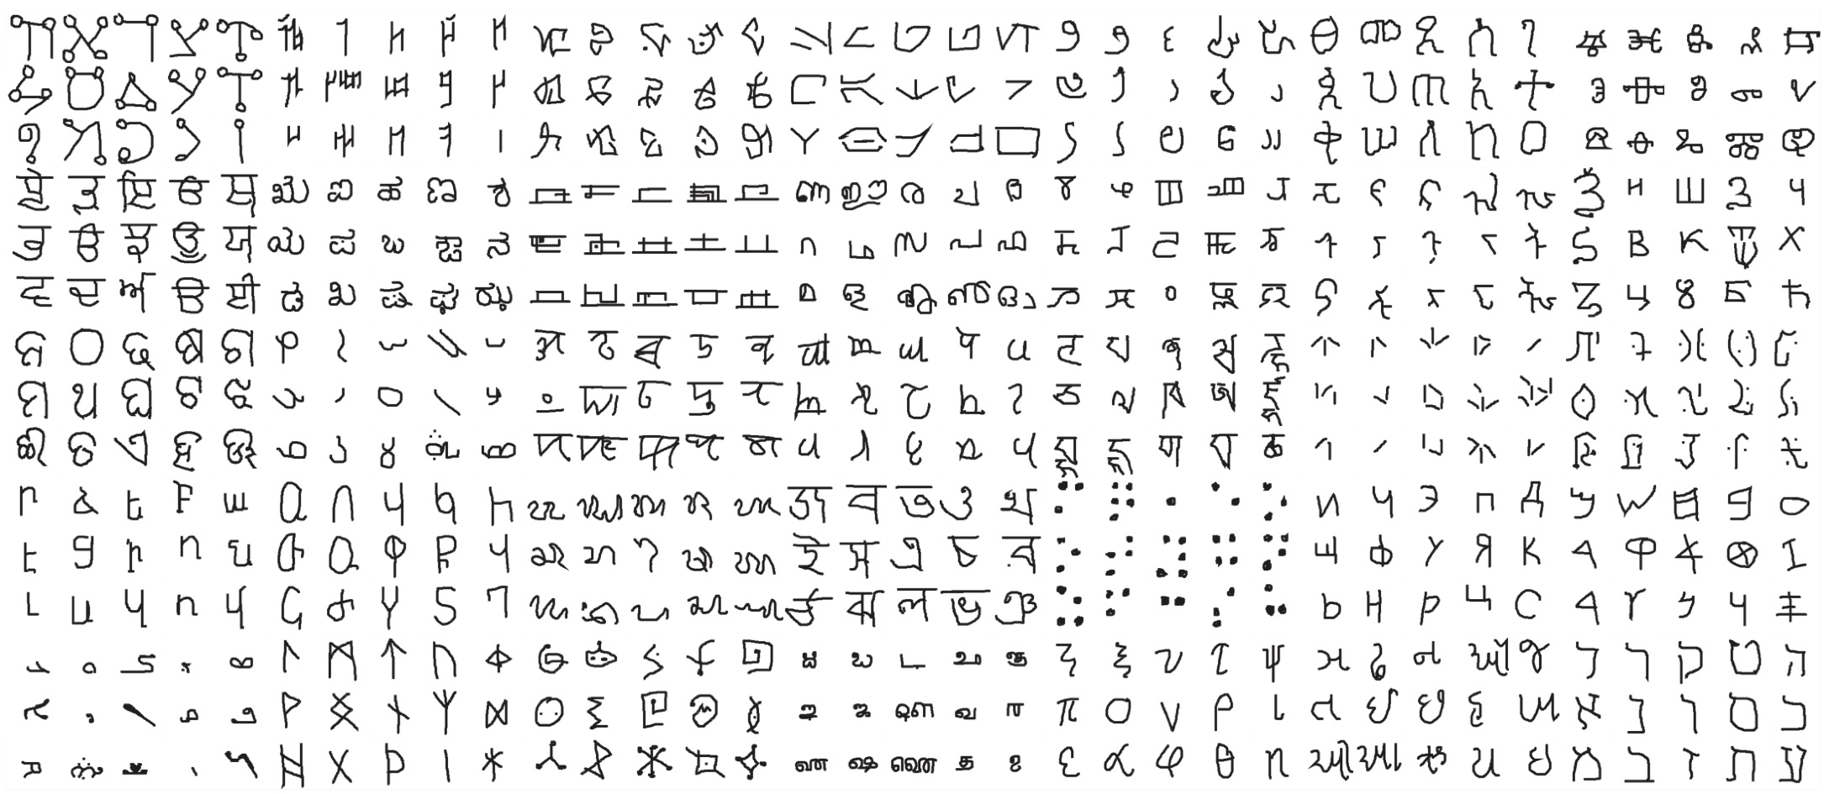
Omniglot
https://github.com/brendenlake/omniglot
1623 characters
Each has 20 examples
Notes:
https://github.com/google-research/meta-dataset
https://arxiv.org/abs/1902.03477
https://science.sciencemag.org/content/350/6266/1332

Slide 56
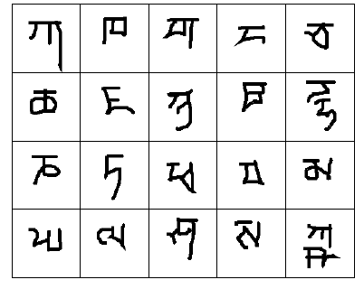
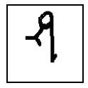
Omniglot
Demo:
https://openai.com/blog/reptile/
Split your characters into training and testing characters
Sample N training characters, sample K examples from each sampled characters $→$ one training task
Sample N testing characters, sample K examples from each sampled characters $→$ one testing task
20 ways
1 shot
Testing set
(Query set)
Each character represents a class
Training set
(Support set)
Notes:
https://openai.com/blog/reptile/

Slide 57
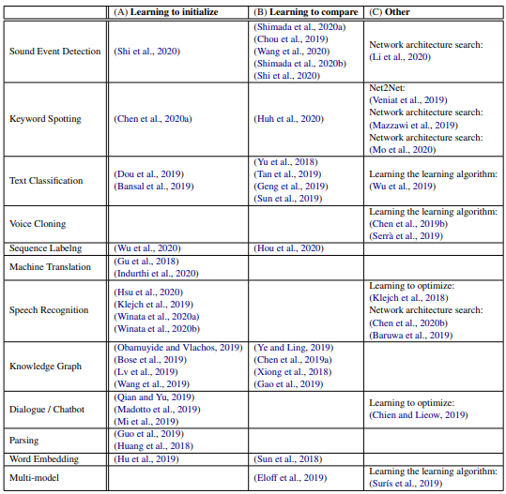
http://speech.ee.ntu.edu.tw/~tlkagk/meta_learning_table.pdf
Notes:
Tutorial:
ICASSP 2021
ACL 2021

