Slide 1
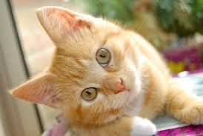
Explainable Machine Learning
Hung-yi Lee 李宏毅
This is a “cat”.
Because …
Notes:
TBD: is attention interpretable?
===
Explainable interpretable transparency
===
Explainable ML: using a black box and explaining it afterwards
Interpretable ML: using a model that is transparent, i.e. not a black box

Slide 2
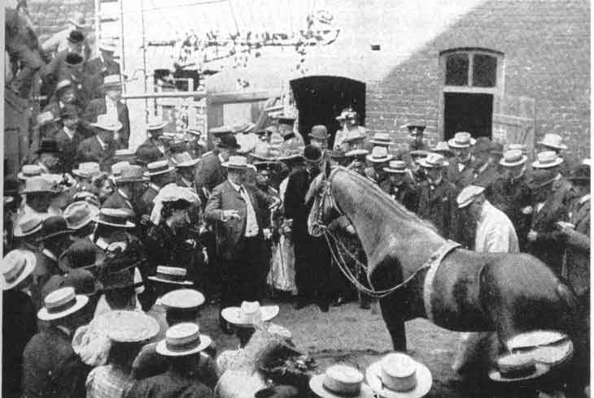
Why we need Explainable ML?
Correct answers $≠$ Intelligent
Notes:
Explainable AI
Hans would answer by tapping his hoof eleven times
It can simply read the body language of its trainer

Slide 3
Why we need Explainable ML?
Loan issuers are required by law to explain their models.
Medical diagnosis model is responsible for human life. Can it be a black box?
If a model is used at the court, we must make sure the model behaves in a nondiscriminatory manner.
If a self-driving car suddenly acts abnormally, we need to explain why.
Notes:
In some industry, explanation is even required by laws.
Loan issuers are required by law to explain their credit models to provide reasons
Medical diagnosis model is responsible for human life. How can we be confident enough to treat a patient as instructed by a black-box model?
When using a criminal decision model to predict the risk of recidivism at the court, we have to make sure the model behaves in an equitable, honest and nondiscriminatory manner.
If a self-driving car suddenly acts abnormally and we cannot explain why, are we gonna be comfortable enough to use the technique in real traffic in large scale?

Slide 4
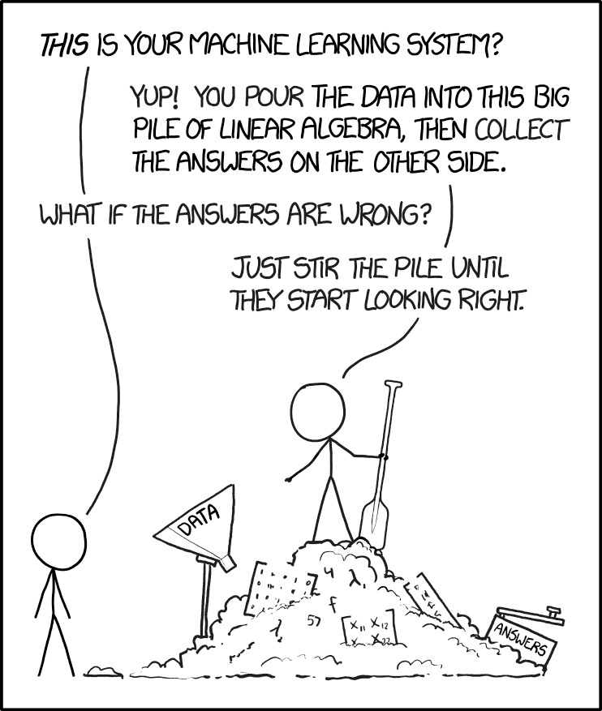
We can improve ML model based on explanation.
I know why the answers are wrong, so I can fix it.
With explainable ML
https://www.explainxkcd.com/wiki/index.php/1838:_Machine_Learning

Slide 5
Interpretable v.s. Powerful
Some models are intrinsically interpretable.
For example, linear model (from weights, you know the importance of features)
But not very powerful.
Deep network is difficult to interpretable. Deep networks are black boxes … but powerful than a linear model.
We don’t want to use a more powerful model because it is a black box.
This is “cut the feet to fit the shoes.” (削足適履)
Notes:
But it is more powerful than linear model …
(
some people use this reason to against deep learning ☹)
“I showed him the matrix of weights of the seventh hidden layer of my Neural Network, but somehow he still didn’t get it.” — Anonymous Data Scientist
https://medium.com/@Pacmedhealth/ai-for-health-care-tackling-the-issue-of-interpretability-868be42aaf50

Slide 6
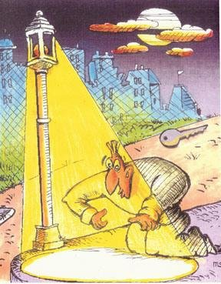
Let’s make deep network explainable.
Powerful model
Simple, but interpretable model.
Source of image: https://kknews.cc/news/pnynzgp.html

Slide 7
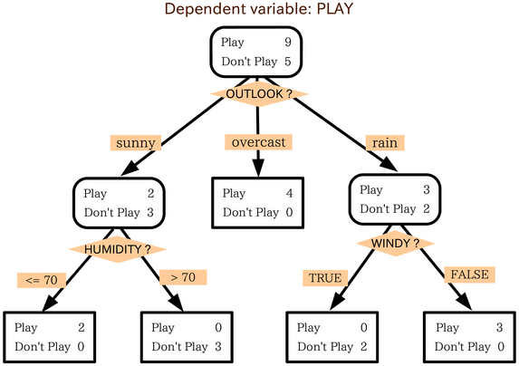
Interpretable v.s. Powerful
Are there some models interpretable and powerful at the same time?
How about decision tree?
Source of image: https://mropengate.blogspot.com/2015/06/ai-ch13-2-decision-tree.html
Notes:
“I showed him the matrix of weights of the seventh hidden layer of my Neural Network, but somehow he still didn’t get it.” — Anonymous Data Scientist
https://medium.com/@Pacmedhealth/ai-for-health-care-tackling-the-issue-of-interpretability-868be42aaf50

Slide 8
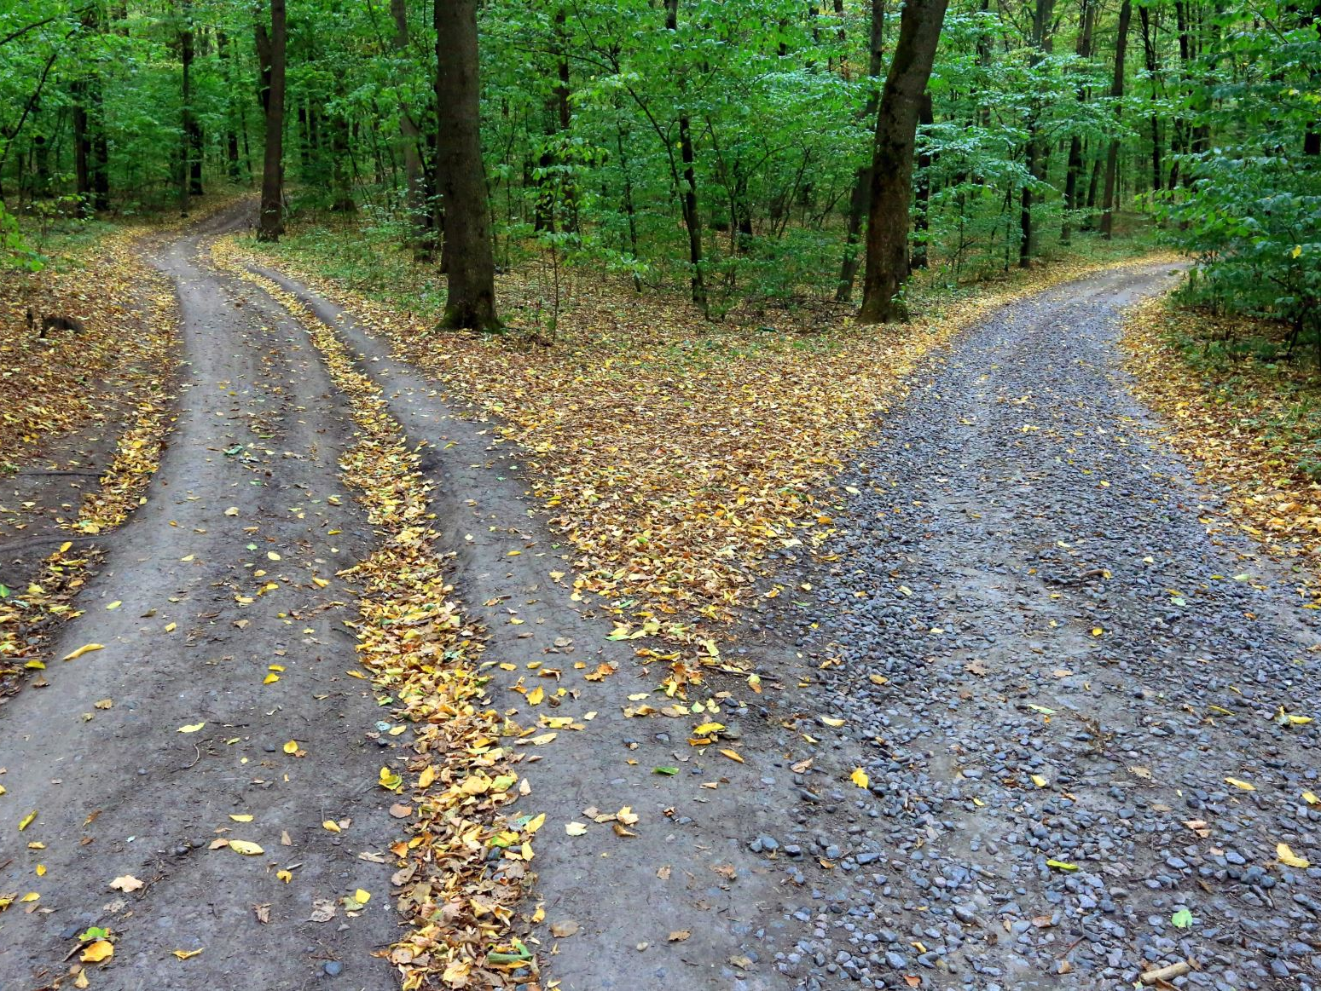
Decision tree is all you need!?

Slide 9
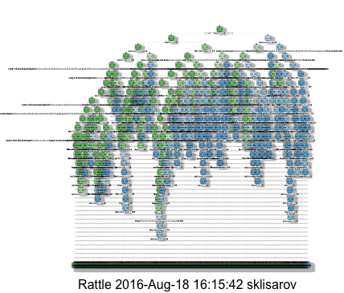
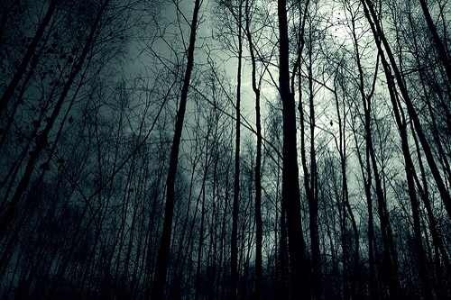
Interpretable v.s. Powerful
A tree can still be terrible!
We use a forest!
https://stats.stackexchange.com/questions/230581/decision-tree-too-large-to-interpret
Notes:
http://blog.datadive.net/interpreting-random-forests/

Slide 10
Goal of Explainable ML
Completely know how an ML model works?
We do not completely know how brains work!
But we trust the decision of humans!
The Copy Machine Study
(Ellen Langer, Harvard University)
“Excuse me, I have 5 pages. May I use the Xerox machine?”
60% accept
“Excuse me, I have 5 pages. May I use the Xerox machine, because I’m in a rush?”
94% accept
“Excuse me, I have 5 pages. May I use the Xerox machine, because I have to make copies?”
93% accept
https://jamesclear.com/wp-content/uploads/2015/03/copy-machine-study-ellen-langer.pdf
Notes:
1977
說服別人：在導入機器學習方法來幫助專業人士判斷時，像是醫療或是法律等領域，十分重視理由。你總不會希望當醫生告訴你有病時，醫生說：「哦這是模型說的」。
說服自己：在建立模型後，透過樣本的可解釋性，可以幫助人類判斷，模型是否真的學到如人類所預期的事情。以下舉文中特別設計的案例為例。

Slide 11
Make people (your customers, your boss, yourself) comfortable.
(my two cents)

Slide 12
Explainable ML
This is a “cat”.
Because …
Classifier
Local Explanation
Why do you think this image is a cat?
Global Explanation
What does a “cat” look like?
(not referred to a specific image)
Notes:
說出為什麼「我知道」

Slide 13
Local Explanation: Explain the Decision
Questions: Why do you think this image is a cat?

Slide 14
Which component is critical?
Object $x$
Image, text, etc.
Components:
$$\left\{x_{1},⋯,x_{n},⋯,x_{N}\right\}$$
Image: pixel, segment, etc.
Text: a word
Removing or modifying the components
Which component is critical for making decision?
Large decision change
Important component
Notes:
The prediction difference is quantified by computing the difference between the model predicted probabilities with or without knowing
How to assinge the miss values

Slide 15
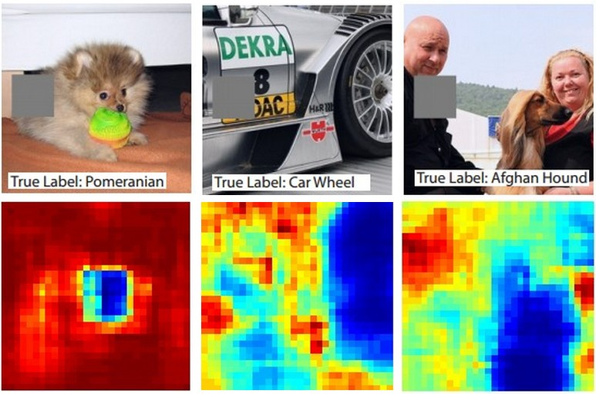
Reference: Zeiler, M. D., & Fergus, R. (2014). Visualizing and understanding convolutional networks. In Computer Vision–ECCV 2014 (pp. 818-833)
Notes:
阿富汗獵狗

Slide 16
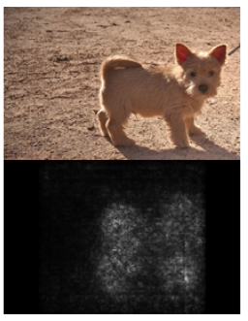
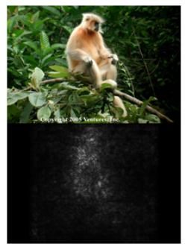
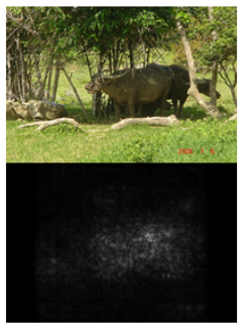
$$\left\{x_{1},⋯,x_{n},⋯,x_{N}\right\}$$
$$\left\{x_{1},⋯,x_{n}+∆x,⋯,x_{N}\right\}$$
pixels
$$e$$
$$e+∆e$$
$$|\frac{∆e}{∆x}|$$
$$|\frac{∂e}{∂x_{n}}|$$
loss of an example (the difference between model output and ground truth)
Saliency Map
Karen Simonyan, Andrea Vedaldi, Andrew Zisserman, “Deep Inside Convolutional Networks: Visualising Image Classification Models and Saliency Maps”, ICLR, 2014

Slide 17
Case Study: Pokémon v.s. Digimon
https://medium.com/@tyreeostevenson/teaching-a-computer-to-classify-anime-8c77bc89b881

Slide 18
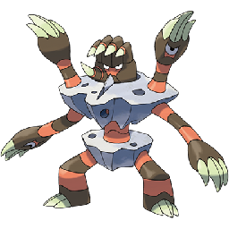
Task
Pokémon images: https://www.Kaggle.com/kvpratama/pokemon-images-dataset/data
Digimon images:
https://github.com/DeathReaper0965/Digimon-Generator-GAN
Pokémon
Digimon
Testing
Images:

Slide 19
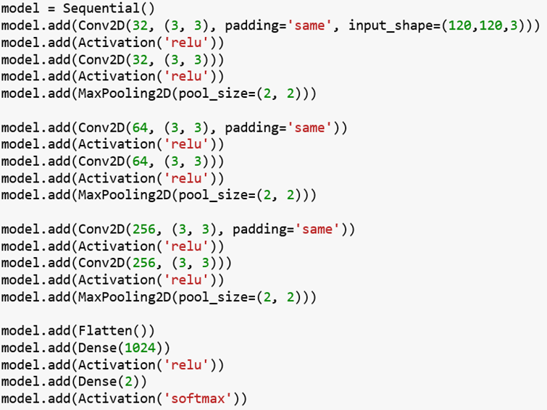
Experimental Results
Training Accuracy: 98.9%
Amazing!!!!!!
Testing Accuracy: 98.4%

Slide 20
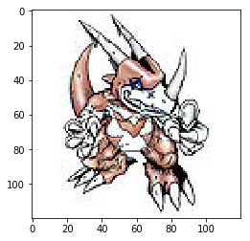
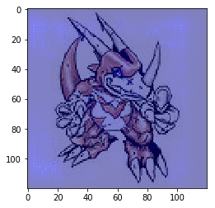
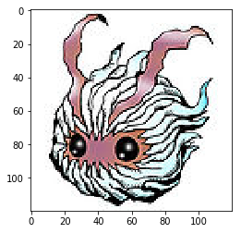
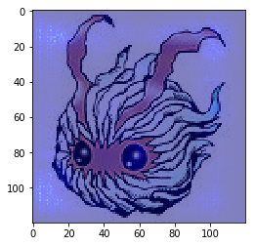
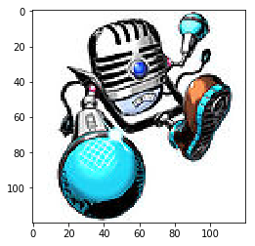
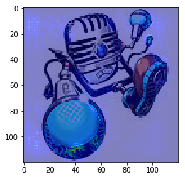
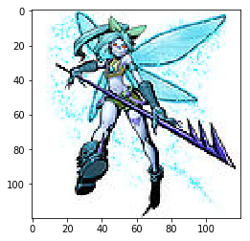
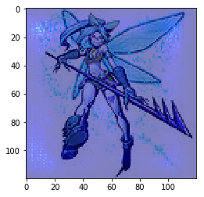
Saliency Map

Slide 21
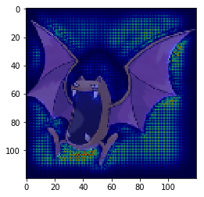
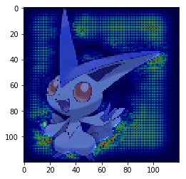
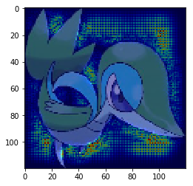
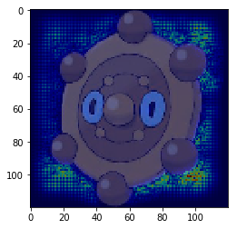
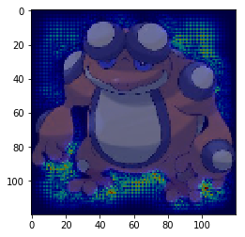
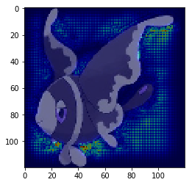
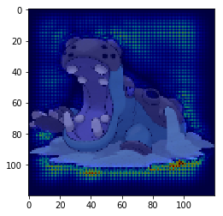
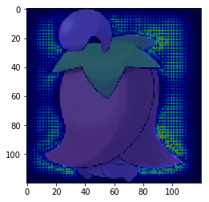
Saliency Map

Slide 22
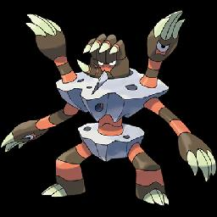
What Happened?
All the images of Pokémon are PNG, while most images of Digimon are JPEG.
loading the files
png files have transparent background
transparent background becomes black
Machine discriminates Pokémon and Digimon based on the background colors.
Notes:
temp = cv2.imread(pic)

Slide 23
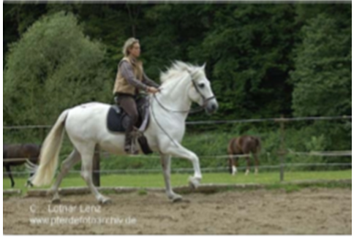
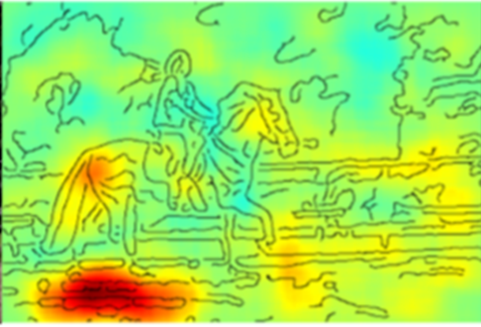
More Examples …
PASCAL VOC 2007 data set
This slide is from: GCPR 2017 Tutorial — W. Samek & K.-R. Müller

Slide 24
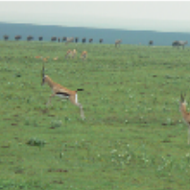
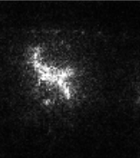
Limitation: Noisy Gradient
Gazelle
(瞪羚)
Typical
SmoothGrad
SmoothGrad: Randomly add noises to the input image, get saliency maps of the noisy images, and average them.
https://arxiv.org/abs/1706.03825
Notes:
Smooth grad
Smooth Grad
Randomly add noise to the input image, and get the heatmap. Just like what we did in the saliency method.
Ref: https://arxiv.org/pdf/1706.03825.pdf

Slide 25
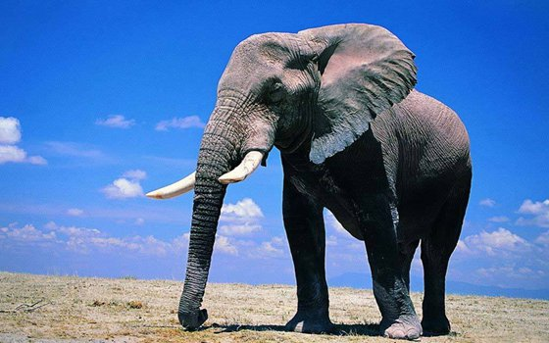
Limitation: Gradient Saturation
Gradient cannot always reflect importance
$$\frac{∂ \text{elephant} }{∂ \text{length} }≈0?$$
Is it an elephant?
trunk's length
Alternative: Integrated gradient (IG)
https://arxiv.org/abs/1611.02639
Notes:
DeepLIFT: ICML’17 (https://arxiv.org/abs/1704.02685)
Gradient Saturation

Slide 26
How a network processes the input data?
phoneme
Visualization
Layer N
PCA or t-SNE
...
2 dims
100 dims
100 neurons
Layer 2
2 dims
100 dims
100 neurons
Layer 1
Plot on figure

Slide 27
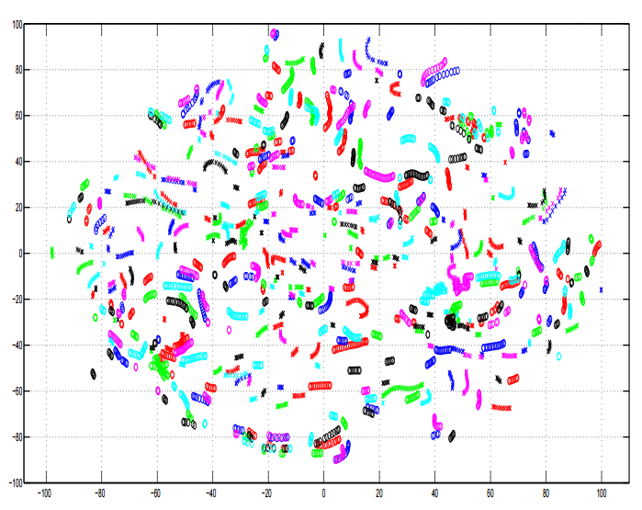
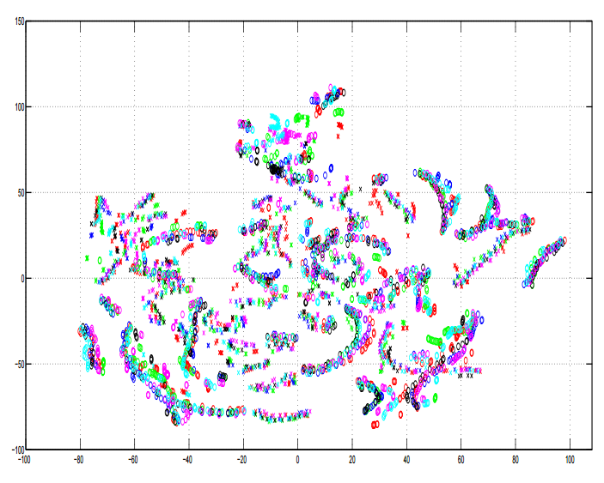
How a network processes the input data?
A. Mohamed, G. Hinton, and G. Penn, “Understanding how Deep Belief Networks Perform Acoustic Modelling,” in ICASSP, 2012.
Visualization
Colors: speakers
Input Acoustic Feature (MFCC)
8-th Hidden Layer
Notes:
Speech recognition: Speaker normalization is automatically done in DNN
Lower later for speaker adp
. This fits with human speech recognition which appears to use many layers of feature extractors and event detectors [7].

Slide 28
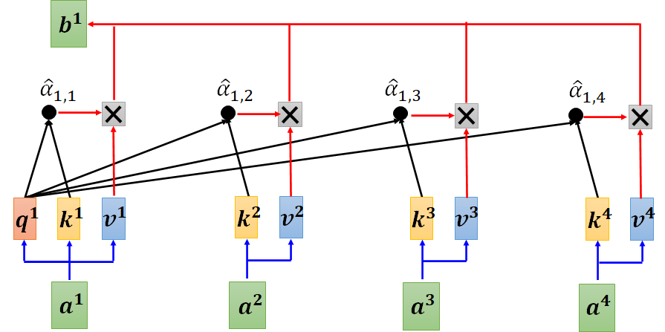
How a network processes the input data?
Attention
Visualization
Attention is not Explanation
https://arxiv.org/abs/1902.10186
Attention is not not Explanation
https://arxiv.org/abs/1908.04626
Notes:
Speech recognition: Speaker normalization is automatically done in DNN
Lower later for speaker adp
. This fits with human speech recognition which appears to use many layers of feature extractors and event detectors [7].

Slide 29
How a network processes the input data?
Block
Probing
…
…
…
…
Noun?
Verb?
POS
Classifier
Block
BERT
Place?
Name?
NER
Classifier
Block
Be careful about the classifiers you use …
$$x^{1}$$
$$x^{2}$$
$$x^{3}$$
$$x^{4}$$

Slide 30
How a network processes the input data?
text
Probing
Layer N
...
Text-to-speech (TTS)
no speaker info
Layer 2
Layer 1
reconstruction
Hi (unknown)
Hi (John)

Slide 31
What does a network layer hear? Analyzing hidden representations of end-to-end ASR through speech synthesis
https://arxiv.org/abs/1911.01102
https://youtu.be/6gtn7H-pWr8

Slide 32
Global Explanation: Explain the whole Model
Question: What does a “cat” look like?
Notes:
Basic
Regularization
Plug & play
Deconvoluation
DT
Future work

Slide 33
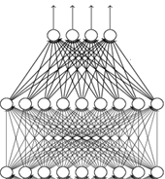
unknown
What does a filter detect?
image $X$
input
output of filter 2
filters
Convolution
3
-1
-3
Max Pooling
-3
1
0
filters
Convolution
-3
-3
0
Max Pooling
output of filter 1
flatten
Large values
Image $X$ contains the patterns filter 1 can detect.
Let’s create an image including the patterns.

Slide 34
unknown
What does a filter detect?
image $X$
input
output of filter 2
filters
Convolution
3
-1
-3
Max Pooling
-3
1
0
$$a_{ij}^{}$$
filters
Convolution
-3
-3
0
Max Pooling
output of filter 1
flatten
Large values
$$X^{∗}=arg\max_{X}{\sum_{i}{\sum_{j}{a_{ij}^{} }}}$$
(gradient ascent)
The image contains the patterns filter 1 can detect.

Slide 35
What does a filter detect?
image $X$
input
filters
Convolution
E.g., Digit classifier
Max Pooling
$X^{∗}$ for each filter
filters
Convolution
Max Pooling
flatten

Slide 36
What does a digit look like for CNN?
image $X$
input
filters
Convolution
E.g., Digit classifier
$$X^{∗}=arg\max_{X}{y_{i}}$$
Can we see digits?
Max Pooling
filters
Convolution
0
1
2
Max Pooling
flatten
3
4
5
6
7
8
Surprise? Consider adversarial attack!
$$y_{i}$$

Slide 37
What does a digit look like for CNN?
Find the image that maximizes class probability
The image should looks like a digit.
$$X^{∗}=arg\max_{X}{y_{i}}$$
$$+ R\left(X\right)$$
$$X^{∗}=arg\max_{X}{y_{i}}$$
$$R\left(X\right)=−\sum_{i,j}{\left|X_{ij}\right|}$$
How likely $X$ is a digit
0
1
2
3
4
5
6
7
8

Slide 38
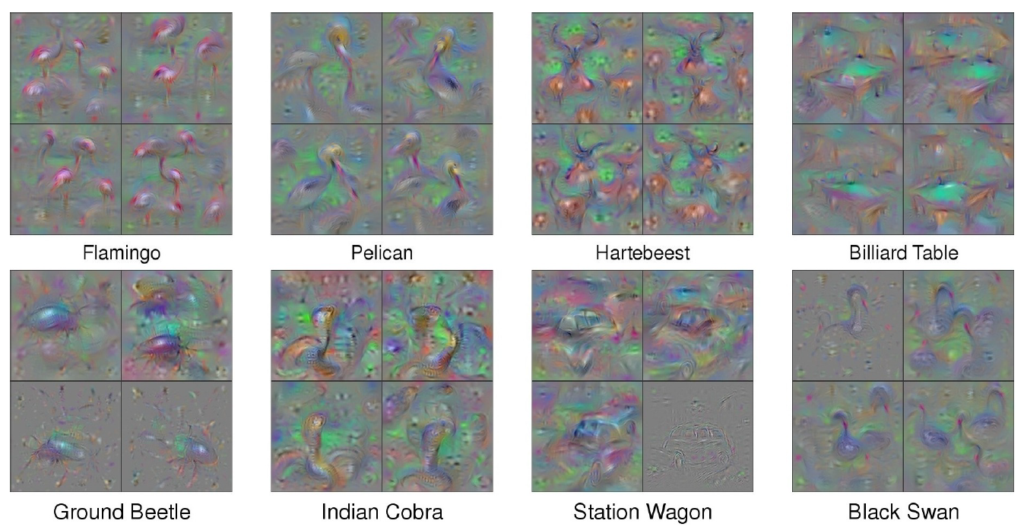
With several regularization terms, and hyperparameter tuning …..
https://arxiv.org/abs/1506.06579

Slide 39
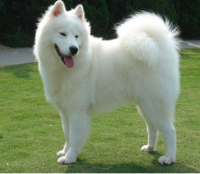
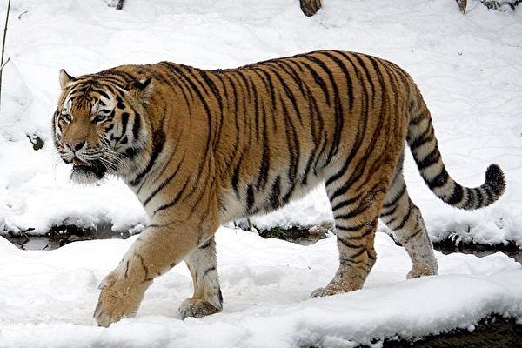
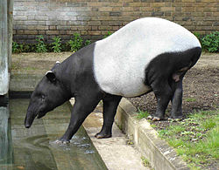
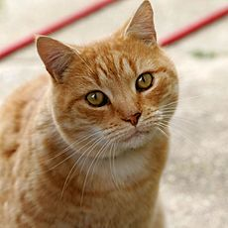
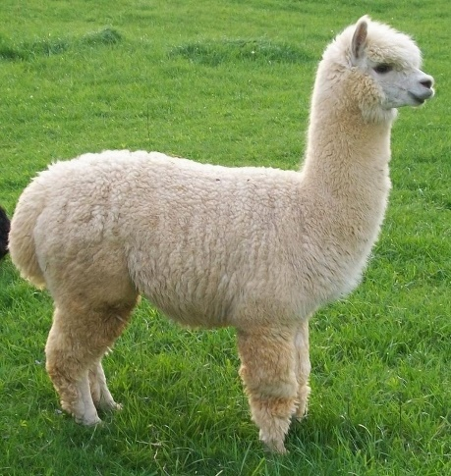
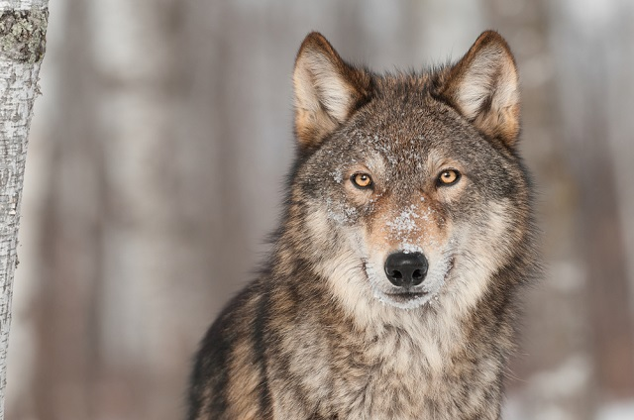
Constraint from Generator
(Simplified Version)
Training a generator
(by GAN, VAE, etc.)
low-dim
vector
Image Generator
Image
$$X$$
$$z$$
$$G$$
$$X=G\left(z\right)$$
Training Examples
Image Generator
Image
$$X$$
Image Classifier
$$z$$
$$y$$
$$X^{∗}=arg\max_{X}{y_{i}}$$
$$z^{∗}=arg\max_{z}{y_{i}}$$
Show image:
$$X^{∗}=G\left(z^{∗}\right)$$

Slide 40
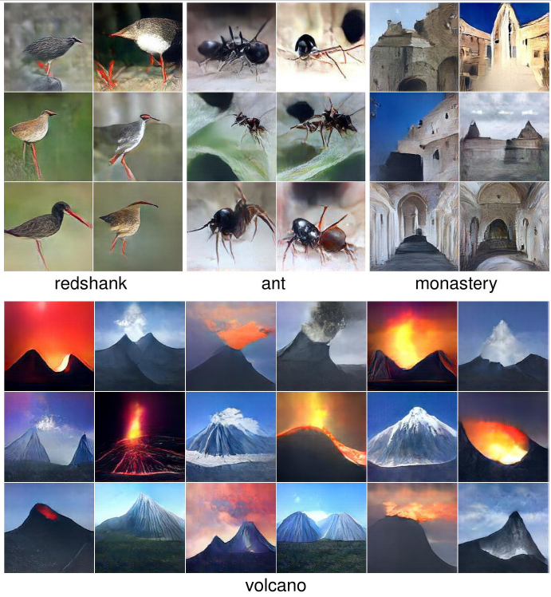
https://arxiv.org/abs/1612.00005
Notes:
Redshank:赤足鷸
Monastory: 修道院

Slide 41
Concluding Remarks
This is a “cat”.
Because …
Classifier
Local Explanation
Why do you think this image is a cat?
Global Explanation
What does a “cat” look like?
(not referred to a specific image)

Slide 42
Outlook
Using an interpretable model to mimic the behavior of an uninterpretable model.
Black
Box
$$x^{1},x^{2},⋯,x^{N}$$
$$y^{1},y^{2},⋯,y^{N}$$
(e.g. Neural Network)
as close as possible
$$⋯⋯$$
Linear
Model
$$x^{1},x^{2},⋯,x^{N}$$
$${\tilde{y}}^{1},{\tilde{y}}^{2},⋯,{\tilde{y}}^{N}$$
Local Interpretable Model-Agnostic Explanations (LIME)
https://youtu.be/K1mWgthGS-A
https://youtu.be/OjqIVSwly4k
Notes:
https://arxiv.org/pdf/1711.06178.pdf
Make it interpretable at the training phase
Interpretable and transparency?
https://arxiv.org/pdf/2006.00093.pdf
這個部分或許可以看看 2020 發表的這篇 Interpretable CNNs for Object Classification (https://arxiv.org/pdf/1901.02413.pdf) 他提出的方法可以讓 Model 去 learn 一些 interpretable 的 features，跟這次 HW9 中那些方法都不太一樣

