Slide 1
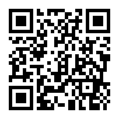
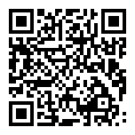
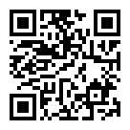
請保持社交距離
本課程有直播可以線上觀看
直播連結
課程網頁
加簽表單
https://youtu.be/eKgDxp-_A0c

Slide 2
機器學習 課程速覽
李宏毅 Hung-yi Lee
Notes:
Beyond accuracy
Learning to learn
======
列出影片中的影片
Add: why deep,
self for image and speech

Slide 3
課程內容
本課程共十五講，課程錄影已經放在課程網頁上
每一講都有一個對應的作業，作業內容之後上課時間公布
上課時間會講新的內容 (與作業無關)
課程網頁

Slide 4
什麼是機器學習？

Slide 5
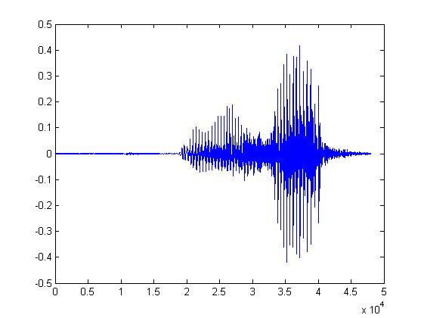
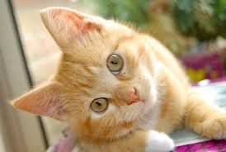
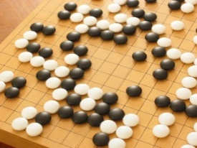
Machine Learning ≈ Looking for Function
Speech Recognition
Image Recognition
Playing Go
“How are you”
“Cat”
“5-5”
(next move)
Notes:
From Data

Slide 6
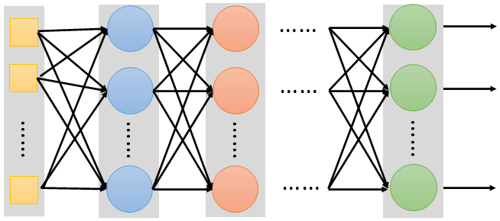
Different types of Functions
This course focuses on Deep Learning.
f
Neural
Network

Slide 7
Different types of Functions
regression
scalar
vector
classification
e.g.,
image
f
Matrix
Sequence
text
image
e.g., speech, text

Slide 8
HW1: COVID-19 Case Prediction
regression
scalar
vector
classification
e.g.,
image
f
Matrix
Sequence
text
image
e.g., speech, text

Slide 9
HW2: Phoneme Classification
regression
scalar
vector
classification
e.g.,
image
f
Matrix
Sequence
text
image
e.g., speech, text

Slide 10
HW3: Image Classification
regression
scalar
vector
classification
e.g.,
image
f
Matrix
Sequence
text
image
e.g., speech, text

Slide 11
HW4: Speaker Classification
regression
scalar
vector
classification
e.g.,
image
f
Matrix
Sequence
text
image
e.g., speech, text

Slide 12
HW5: Machine Translation
regression
scalar
vector
classification
e.g.,
image
f
Matrix
Sequence
text
image
e.g., speech, text

Slide 13
HW6: Anime Face Generation
regression
scalar
vector
classification
e.g.,
image
f
Matrix
Sequence
text
image
e.g., speech, text

Slide 14
教機器的種種方法
Notes:
不只是督導式學習

Slide 15
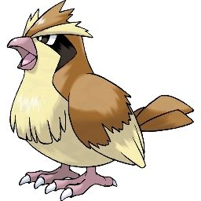
Supervised Learning
Lecture 1 - 5
Pokémon or Digimon
Training Data
Pokémon
Pokémon
Digimon
Digimon
labels

Slide 16
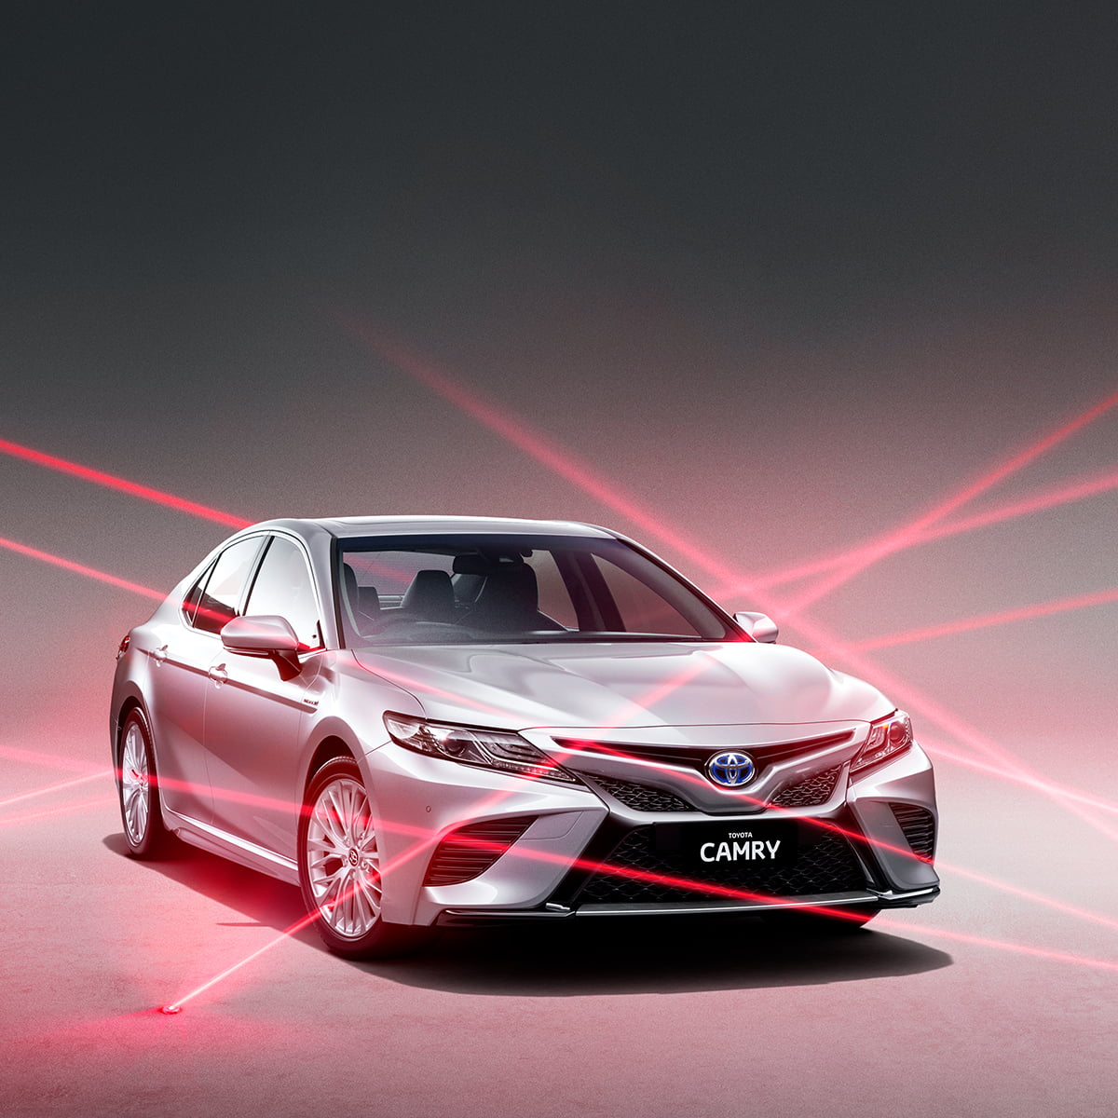
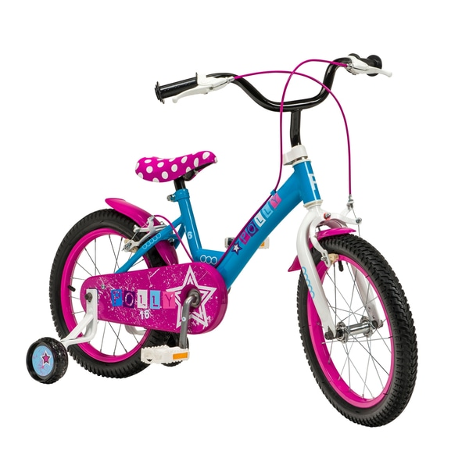
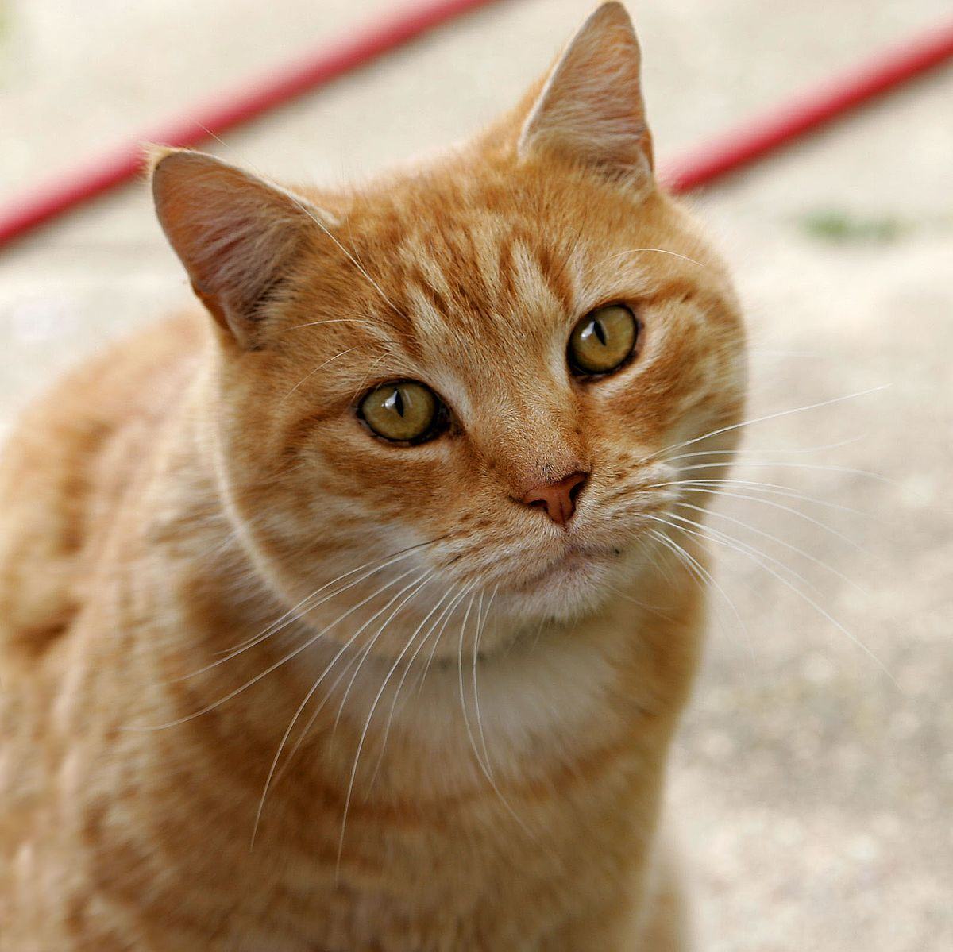
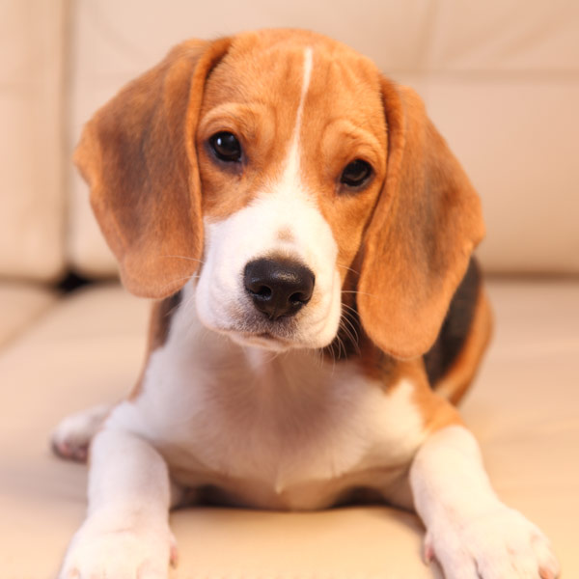
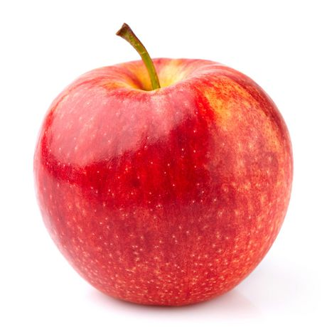
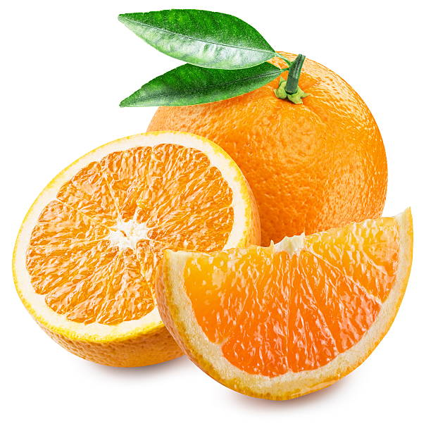
Lecture 7: Self-supervised Learning
It is not efficient to collect data for each task.

Slide 17
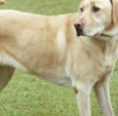
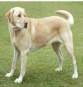
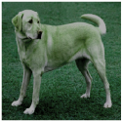
Lecture 7: Self-supervised Learning
unlabeled
images
Are they the same?
Develop general purpose knowledge
Are they the same?
Pre-train

Slide 18
Lecture 7: Self-supervised Learning
Fine-tune
Pokémon
Digimon
Develop general purpose knowledge
Fine-tune
Pre-train
apple
orange
Downstream Tasks

Slide 19
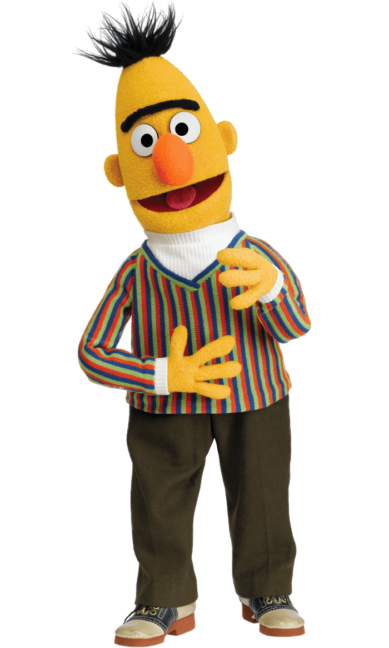
Lecture 7: Self-supervised Learning
BERT
Pre-trained Model vs. Downstream Tasks
(Foundation Model)
Operating Systems
Applications

Slide 20
BERT
340M
parameters
Attack on Titan
Source of image: https://leemeng.tw/attack_on_bert_transfer_learning_in_nlp.html
Notes:
超巨大巨人 spoiler alert
諫ㄐㄧㄢˋ山創
2018 年年底
貝爾托特·胡佛
Bertholdt Hoover
「進擊的巨人可以窺視未來繼承 者的記憶，也就是說它能看到未來。」

Slide 21
Spoiler Alert

Slide 22
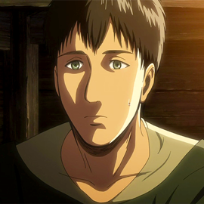
BERT
Bertolt Hoover
340M
parameters
Attack on Titan
Source of image: https://leemeng.tw/attack_on_bert_transfer_learning_in_nlp.html
Notes:
超巨大巨人 spoiler alert
諫ㄐㄧㄢˋ山創
貝爾托特·胡佛
Bertholdt Hoover
「進擊的巨人可以窺視未來繼承 者的記憶，也就是說它能看到未來。」

Slide 23
GPT-3
Source: https://youtu.be/wJJnjzNlMws
T5
GPT-2
BERT
ELMo

Slide 24
Lecture 6: Generative Adversarial Network
Function
$$x$$
$$y$$
$$x^{1}$$
$$y^{2}$$
$$x^{3}$$
$$x^{7}$$
$$y^{4}$$
$$y^{10}$$
$$x^{5}$$
$$y^{8}$$
$$y^{6}$$
$$x^{9}$$
unpaired

Slide 25
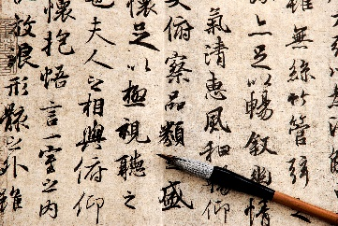
Unsupervised Abstractive Summarization
https://arxiv.org/abs/1810.02851
document
summary
Unsupervised Translation
https://arxiv.org/abs/1710.04087
https://arxiv.org/abs/1710.11041
Language 1
Language 2
Unsupervised ASR
https://arxiv.org/abs/1804.00316
https://arxiv.org/abs/1812.09323
https://arxiv.org/abs/1904.04100
https://arxiv.org/abs/2105.11084
Audio
Text

Slide 26
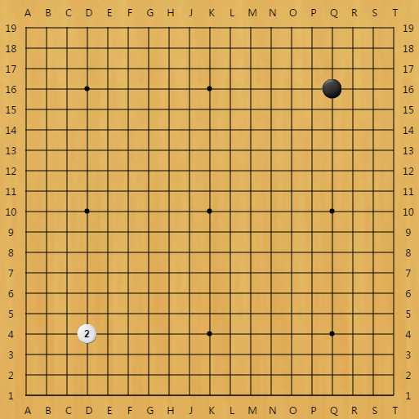
Lecture 12: Reinforcement Learning (RL)
Human label
?
Pokémon
It is challenging to label data in some tasks.
Human label
?
“3-3”?
$→$RL
We can know the results are good or not.

Slide 27
進階課題
不只是追求正確率 …

Slide 28
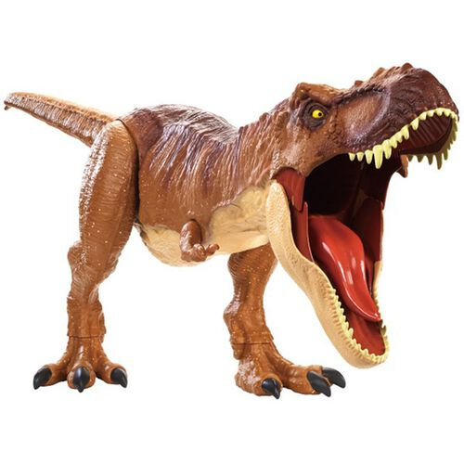
Lecture 8: Anomaly Detection
This is a “Pokémon”.
This is a “Digimon”.
I do not know
Notes:
說出為什麼「我知道」

Slide 29
Lecture 9: Explainable AI
This is a “Pokémon”.
Because .…
Classifier
Why do you think this image is a Pokémon?
Notes:
說出為什麼「我知道」

Slide 30
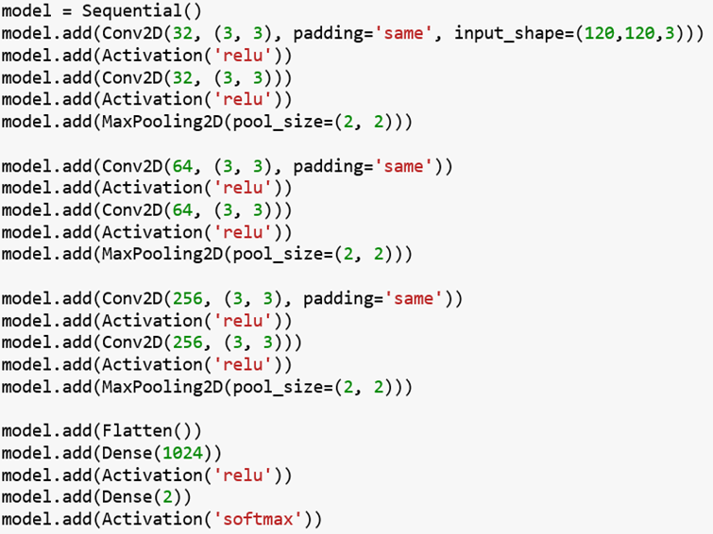
Lecture 9: Explainable AI
Testing Accuracy: 98.4%
Amazing!!!!!!

Slide 31
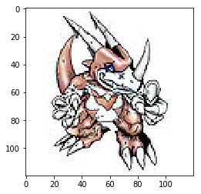
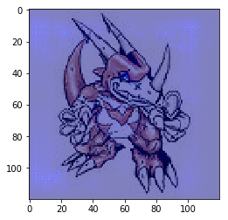
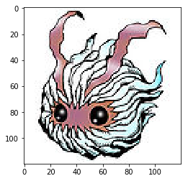
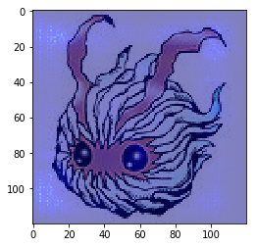
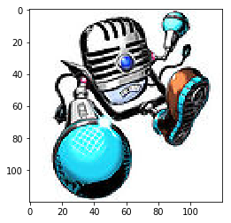
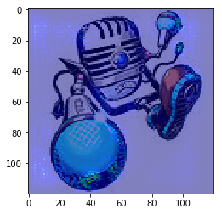
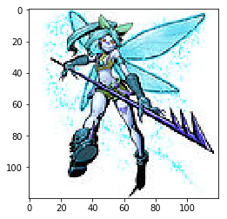
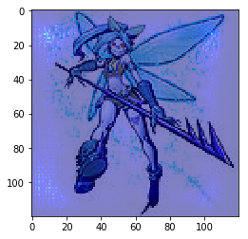
Lecture 9: Explainable AI

Slide 32
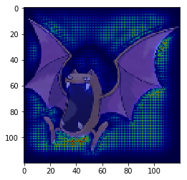
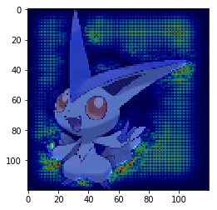
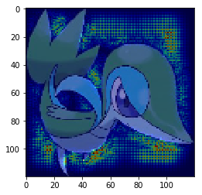
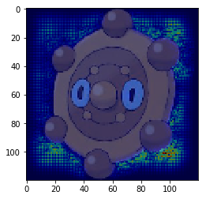
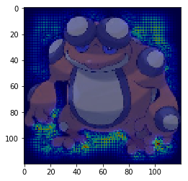
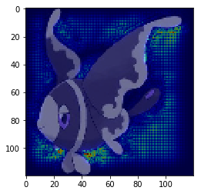
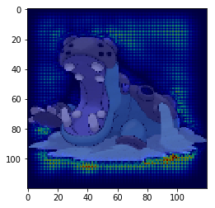
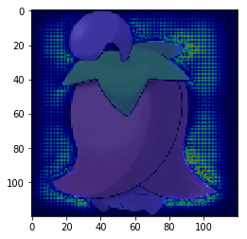
Lecture 9: Explainable AI

Slide 33
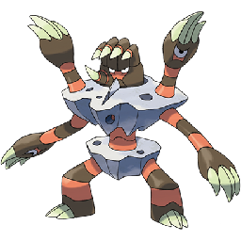
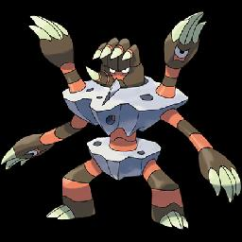
Lecture 9: Explainable AI
All the images of Pokémon are PNG, while most images of Digimon are JPEG.
loading the files
png files have transparent background
transparent background becomes black
Machine discriminates Pokémon and Digimon based on the background colors.
Notes:
temp = cv2.imread(pic)

Slide 34
I will let you know the story after fixing the mistake. ☺

Slide 35
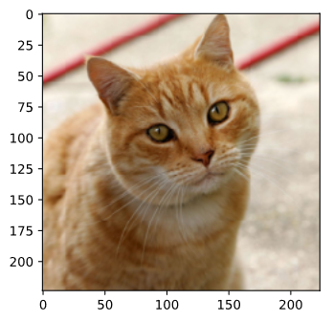
Lecture 10: Model Attack
Benign Image
Attacked Image
Tiger Cat
Star Fish
0.64
1.00
Notes:
要先講 explainable AI

Slide 36
Lecture 10: Model Attack
=
Benign Image
Attacked Image
50x
-
Tiger Cat
Star Fish
0.64
1.00
Notes:
要先講 explainable AI

Slide 37
Lecture 11: Domain Adaptation
Training
Data
Testing
Data
99.5%
57.5%
The results are from: http://proceedings.mlr.press/v37/ganin15.pdf
Notes:
Can I change this into pokemon?

Slide 38
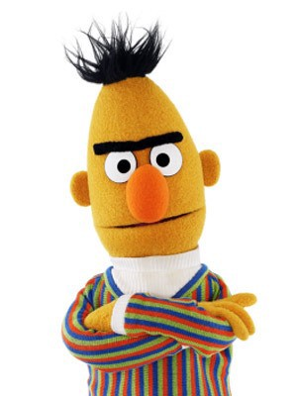
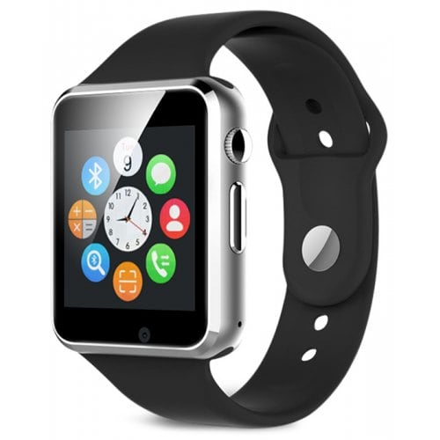
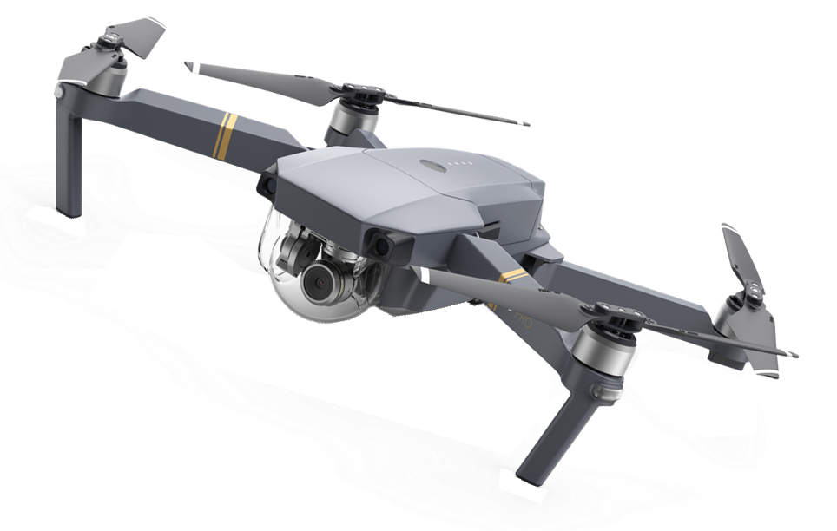
Lecture 13: Network Compression
smaller
Deploying ML models in resource-constrained environments
Too Big!
Lower latency, Privacy, etc.
Notes:
Limited memory space, limited computing power, etc.

Slide 39
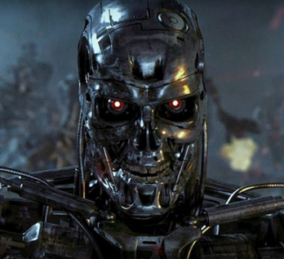
Lecture 14: Life-long Learning
I can solve task 1.
I can solve tasks 1&2.
I can solve tasks 1&2&3.
…
Learning Task 1
Learning Task 2
Learning Task 3
This is the target of life-long learning.
What is the challenge?

Slide 40
學習如何學習
Meta Learning = Learn to Learn

Slide 41
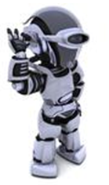
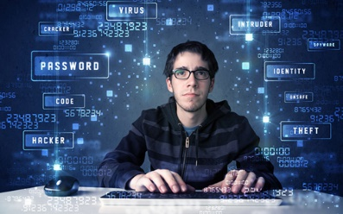
Lecture 15: Meta learning
Few-shot learning is usually achieved by meta-learning.
Learn to classify
Learning
Algorithm

Slide 42
I hope you enjoy this course!

Slide 43
台大電機系機器學習課程 YouTube 頻道

