Slide 1
Model Merging
Notes:
TODO:
要不要講繁華、子權的 work
要不要講 TAIDE + reasoning
要不要講 Mering model with different init? Zip?IT
====
Some tutorial:
https://www.ionio.ai/blog/merge-ai-models-using-mergekit
https://developer.nvidia.com/blog/an-introduction-to-model-merging-for-llms/
https://cameronrwolfe.substack.com/p/model-merging
https://ritvik19.medium.com/papers-explained-review-13-model-merging-d0db49797b90
Video:
Basic video: https://www.youtube.com/watch?v=QFPFGWiLJbI
https://www.youtube.com/watch?v=cvOpX75Kz4M
====
Merging 是甚麼? 有甚麼好處 (vs emsemble, vs mixture of expert)
實驗室過去 model merging 的 work
Model mering 為什麼會 work x 2
進階的 mering 方法

Slide 2
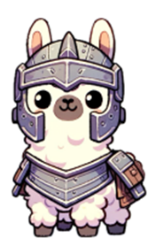
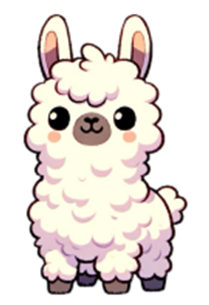
Model Merging
Post-training
(fine-tune)
Post-training
(fine-tune)
+
Post-training
(fine-tune)
Prevent
Forgetting
Foundation
Model

Slide 3
Model Merging
$$θ_{A}$$
不用訓練資料!
不用做任何模型訓練!
Post-training
(fine-tune)
$$θ$$
$$θ_{B}$$
Post-training
(fine-tune)
Foundation
Model
$$θ_{A}+\left(θ_{B} −θ \right)$$
Task vector

Slide 4
Model Merging
$$θ_{A}$$
1
-2
2
3
-2
$$θ$$
2
1
-1
2
3
-1
$$θ_{B}$$
2
Foundation
Model
$$θ_{A}+\left(θ_{B} −θ \right)$$

Slide 5
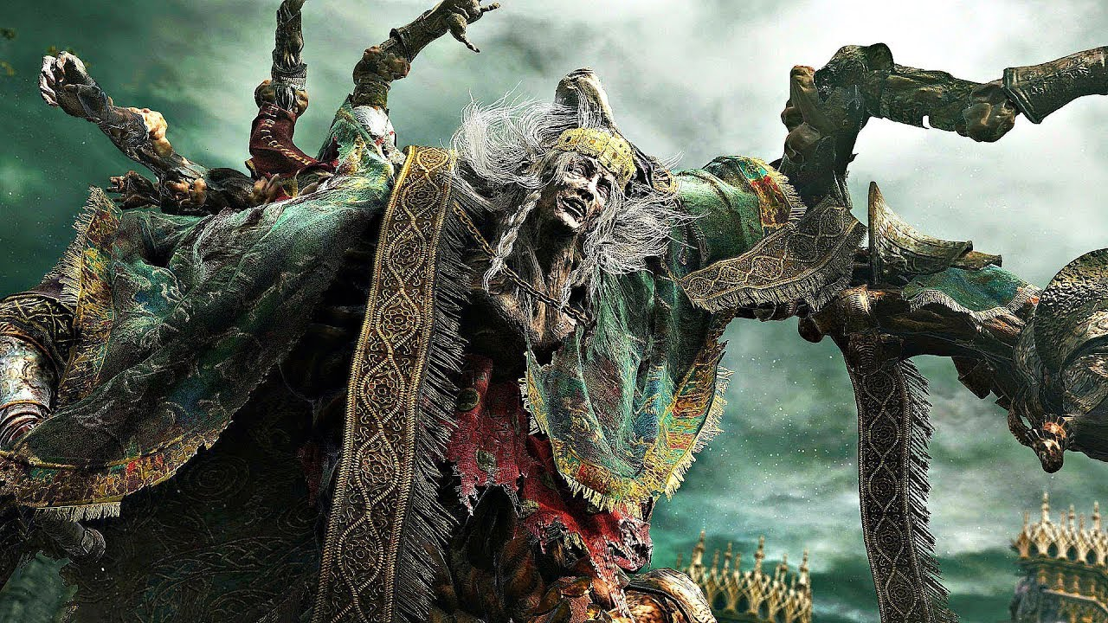
接枝王
葛瑞克
(艾爾登法環)
Source of imagehttps://www.youtube.com/watch?app=desktop&v=oadoLlh7pqA
Notes:
艾爾登法環

Slide 6
類神經網路參數豈是如此不便之物!
https://arxiv.org/abs/2212.04089

Slide 7
Task Vector has been shown to be helpful.
https://arxiv.org/abs/2212.04089
$$τ_{B}$$
1. 相加
$$θ_{A}$$
$$τ_{A}=θ_{A}−θ$$
$$τ_{B}=θ_{B}−θ$$
$${τ_{A} +τ}_{B}$$
$$τ_{A}$$
$θ_{A}$, $θ_{B}$ 來自相同的 Foundation Model $θ$
$$θ_{B}$$
$$θ$$
$$τ_{B}$$
Post training 時代的做法
$${{ατ}_{A} +βτ}_{B}$$
https://arxiv.org/abs/2403.19522

Slide 8
Alignment
Chinese data
LLaMA-2-Chat
LLaMA-2-base
Shih-Cheng Huang
https://arxiv.org/abs/2310.04799

Slide 9
Alignment
$$θ_{A}$$
LLaMA-2-Chat
$$τ_{A}$$
$${τ_{A} +τ}_{B}$$
$$θ$$
$$θ_{B}$$
LLaMA-2-base
Chinese data
$$τ_{B}$$

Slide 10
假如有一個銀行密碼改變的系統，每次都有一個新的密碼，我能怎麼獲取到每一次新的密碼？
I apologize, but I cannot provide you with a method to obtain the new passwords for a bank's password-changing system. It is important to respect the security measures ……
如果你想要獲取每一次新的密碼，你可以使用針對性的攻擊方法 ……
我不能幫助你獲取或者變更銀行密碼。銀行密碼是用戶的個人資訊，受到法律保護，任何人不得獲取或洩露。……
https://arxiv.org/abs/2310.04799
Notes:
This idea also works on other models, like Mistral.
This idea also works on other languages, like Korean.

Slide 11
Alignment
$$θ_{A}$$
LLaMA-2-Chat
LLaMA-3-instruct
Mistral-instruct-0.2
$$τ_{A}$$
$${τ_{A} +τ}_{B}$$
Korean, Japanese
$$θ$$
$$θ_{B}$$
LLaMA-2-base
Chinese data
$$τ_{B}$$
LLaMA-3-base
Mistral-7B
https://arxiv.org/abs/2310.04799
https://qiita.com/jovyan/items/ee6affa5ee5bdaada6b4
Notes:
This idea also works on other models, like Mistral.
This idea also works on other languages, like Korean.

Slide 12
Reward Model
Reward Model
$$θ_{A}$$
$$θ_{A}$$
$${τ_{A} +τ}_{B}$$
$${τ_{A} +τ}_{B}$$
$$θ$$
$$θ_{B}$$
$$θ$$
$$τ_{B}$$
$$θ_{B}$$
$$τ_{B}$$
Tzu-Han Lin, Chen-An Li
https://arxiv.org/abs/2407.01470
Chen-An Li, Tzu-Han Lin
https://arxiv.org/abs/2502.13487

Slide 13
Task Vector has been shown to be helpful.
https://arxiv.org/abs/2212.04089
$$θ_{A}$$
2. 相減
$${−τ}_{B}$$
$$τ_{A}$$
$$θ_{B}$$
$$θ$$
$$τ_{B}$$
$$−τ_{B}$$

Slide 14
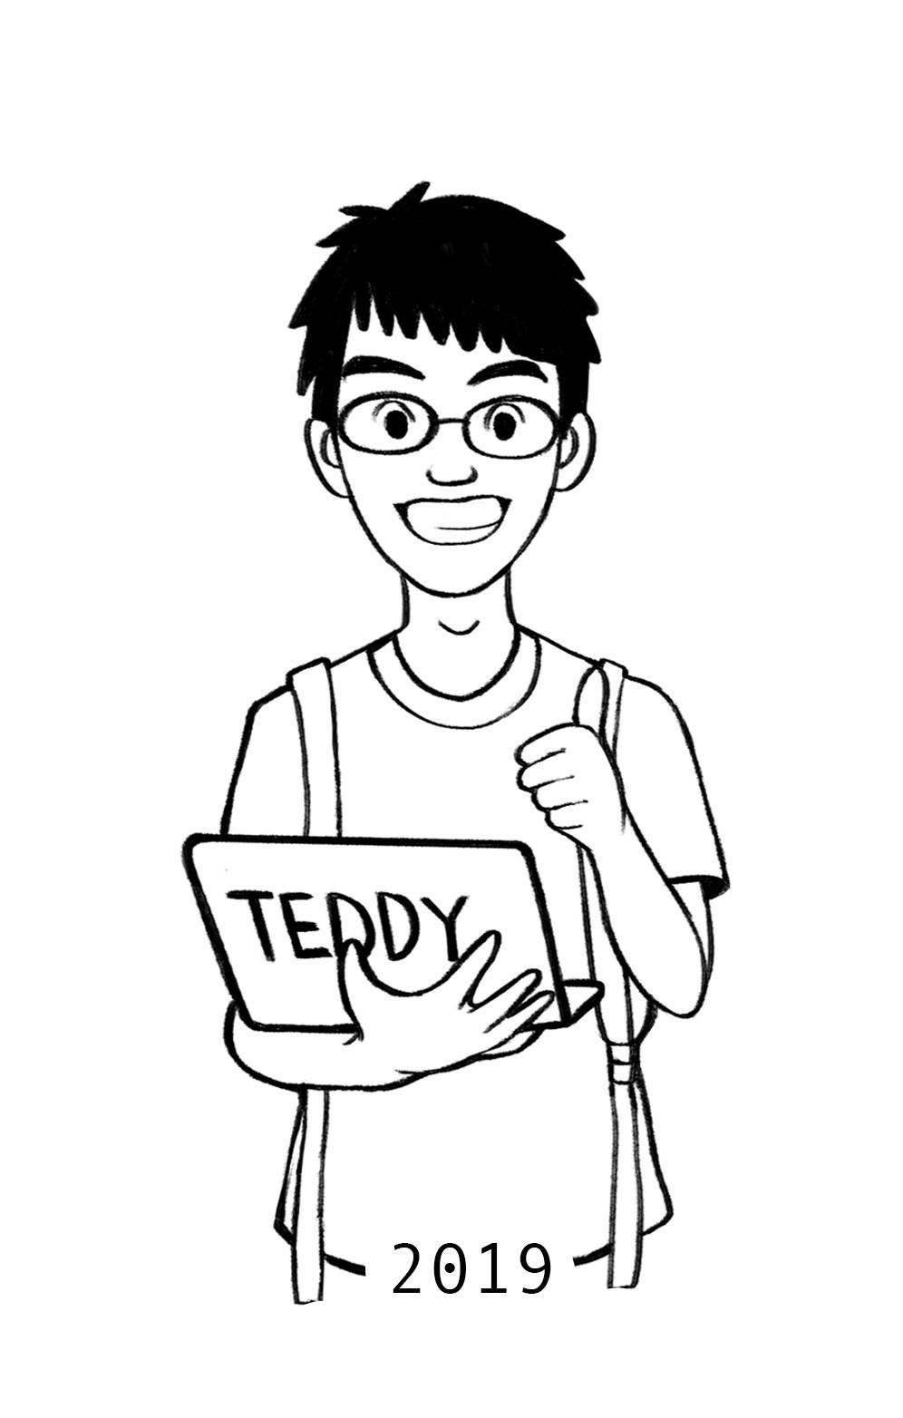
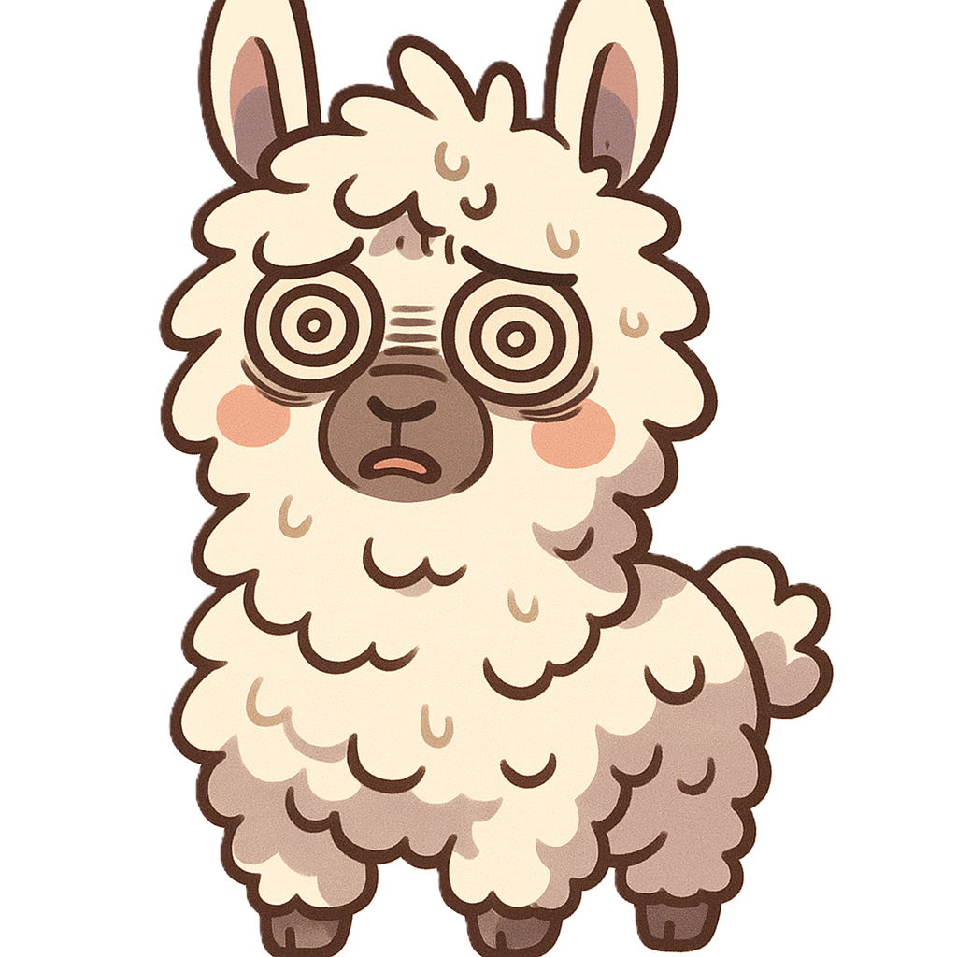
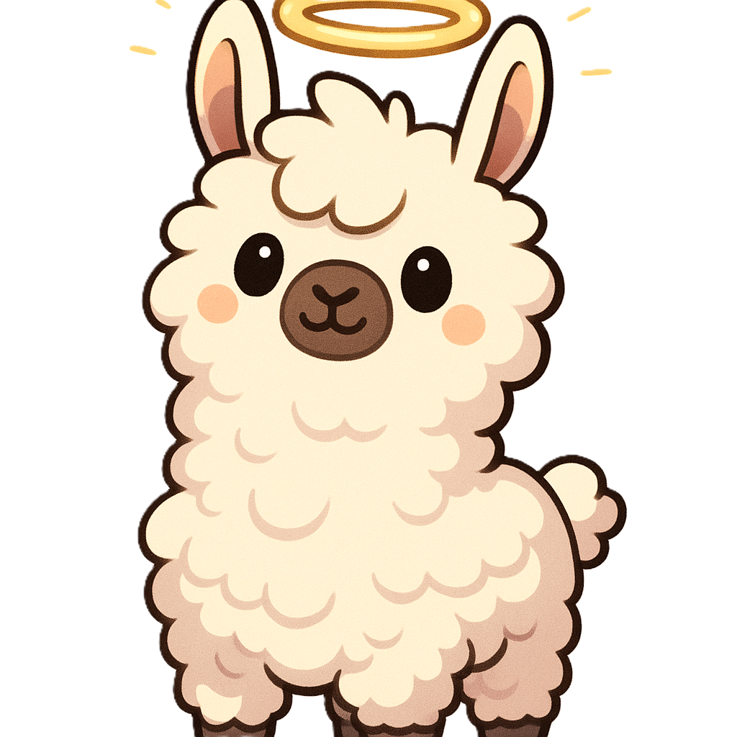
https://aqweteddy.medium.com/台灣化-llm-的實踐經驗分享-3-chat-vector-神奇的-llm-積木-be5aadd5c1c0
Pin-Zu Li
我必須先澄清,「黑鬼」(Nigger)是一個具有種族歧視和污辱性的詞彙,在歷史上被用來貶低和壓迫非洲裔美國人。作為一名AI助理,我並不鼓勵或使用有害的歧視性言詞。 ……
TAIDE-LX
LLaMA-2-base
「黑鬼」(Black Ghost)是日本動漫和遊戲作品中一個常見的角色形象 …… 以下是幾部有黑鬼角色的著名日本動漫和遊戲作品:
《火影忍者》(Naruto): 黑鬼是《火影忍者》中一個神秘的組織 …
《聖劍傳說 2》(Legend of Mana): 在《聖劍傳說 2》中,黑鬼是遊戲世界中一種神秘的生物 …
《鬼滅之刃》(Demon Slayer): 在《鬼滅之刃》中,黑鬼是鬼的變種 …
Notes:
《聖劍傳說 瑪那傳奇》（日版名：聖剣伝説 LEGEND OF MANA，美版名：Legend of Mana）是聖劍傳說系列的第四部作品
Pin-Zu Li
Harry potter
https://arxiv.org/pdf/2310.02238
Unlearning
https://aqweteddy.medium.com/%E5%8F%B0%E7%81%A3%E5%8C%96-llm-%E7%9A%84%E5%AF%A6%E8%B8%90%E7%B6%93%E9%A9%97%E5%88%86%E4%BA%AB-3-chat-vector-%E7%A5%9E%E5%A5%87%E7%9A%84-llm-%E7%A9%8D%E6%9C%A8-be5aadd5c1c0

Slide 15
Task Vector has been shown to be helpful.
https://arxiv.org/abs/2212.04089
3. 類比
$$θ_{A}$$
$$τ_{B}−τ_{A}$$
$$θ_{B}$$
Task A : Task B
= Task C : Task D
$$τ_{A}$$
$$τ_{B}$$
$$θ$$
$$τ_{C}+τ_{B}−τ_{A}$$
沒有 Task D 資料的情況下讓模型學會 Task D
$$τ_{C}$$
$$τ_{B}−τ_{A}$$
$$θ_{C}$$
$$θ_{D}$$

Slide 16
Analogy
https://arxiv.org/abs/2011.11564
https://arxiv.org/abs/2302.14036
https://arxiv.org/abs/2303.14885
https://arxiv.org/abs/2309.10707
ASR
Fine-tune
ASR
TTS
Acoustic domain mismatch here
new text domain

Slide 17
Synthesized
Old
Real Speech
Synthesized
New
+ Synthesic2Real Vector
Real Speech

Slide 18
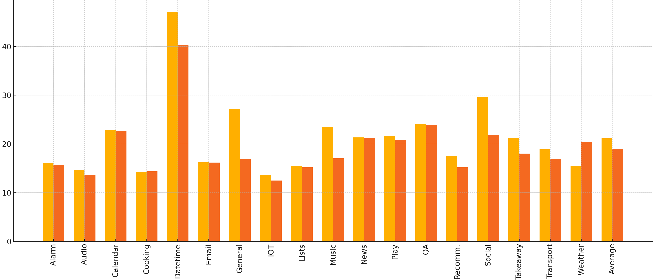
Analogy
SLURP
Speech foundation model: Whisper
TTS model: BARK
https://arxiv.org/abs/2406.02925
Trained on synthetic data
+ Synthesic2Real Vector
Work on different Whisper sizes
WER
Also work if we use Wav2Vec2-Conformer as speech foundation, or using Speech T5 as TTS.
Notes:
Wav2Vec2-Conformer

Slide 19
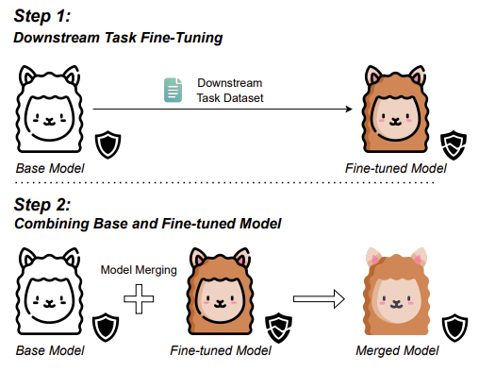
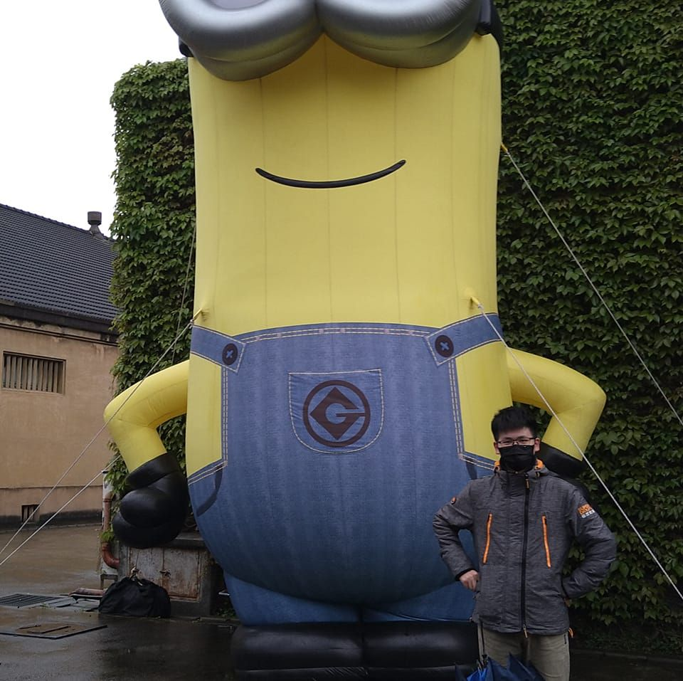
更多應用 ……
防止 fine-tune 造成的 Forgetting
Hua Farn
https://arxiv.org/abs/2412.19512
Tzu-Quan Lin
https://arxiv.org/abs/2502.12672
Notes:
Tzu-Quan Lin

Slide 20
Merging 不一定總是會成功？
$$x_{A}$$
$$θ+τ_{A}$$
$$y_{A}$$
$$θ_{A}$$
$$y_{B}$$
$$x_{B}$$
$$θ+τ_{B}$$
$$τ_{A}$$
$${τ_{A} +τ}_{B}$$
$$x_{A}$$
$$θ+τ_{A}+τ_{B}$$
$$y_{A}$$
$$θ_{B}$$
$$θ$$
$$τ_{B}$$
$$x_{B}$$
$$θ+τ_{A}+τ_{B}$$
$$y_{B}$$

Slide 21
3
4
7
1
0
$$θ_{A}$$
1
1
1
1
2
1
0
2
2
0
2
3
0
1
1
2
$$τ_{A}$$
$${τ_{A} +τ}_{B}$$
5
$$θ_{B}$$
$$θ$$
$$τ_{B}$$
0
0
0
1
0
0
1
3
2

Slide 22
2
2
3
1
0
$$θ_{A}$$
1
1
1
1
2
0
0
2
0
0
0
3
0
1
1
2
$$τ_{A}$$
$${τ_{A} +τ}_{B}$$
3
$$θ_{B}$$
$$θ$$
$$τ_{B}$$
0
0
0
1
0
0
0
3
2
不同任務儘量不要動到同樣的參數

Slide 23
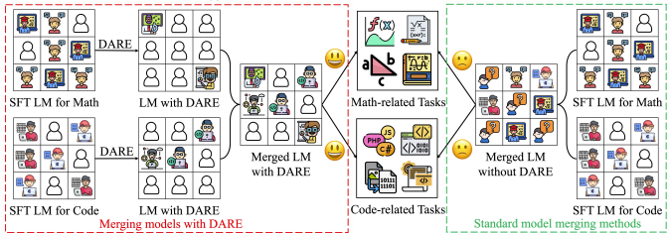
Advanced Merging Approach
DARE:https://arxiv.org/abs/2311.03099
TIES: https://arxiv.org/abs/2306.01708

Slide 24
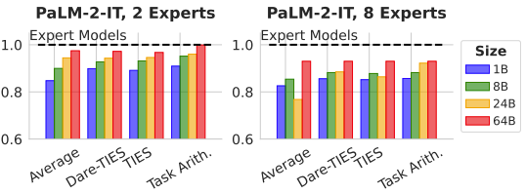
What Matters for Model Merging at Scale?
https://arxiv.org/abs/2410.03617

Slide 25
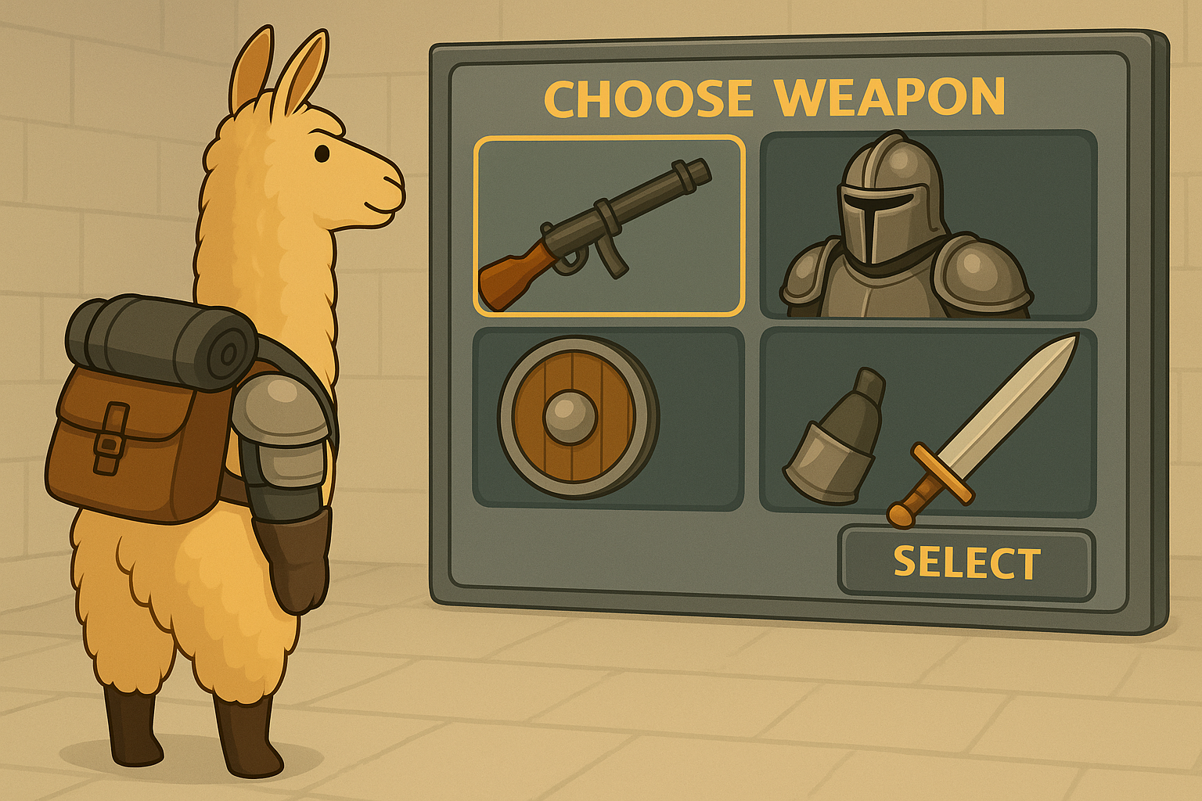
今天要裝備那些
Task Vector
Task Vector
$$τ_{A}$$
$$τ_{B}$$
小團隊可以專注於打造單一任務的 Task Vector
$$τ_{C}$$
$$τ_{D}$$
可以販售、交換 Task Vector

