Slide 1
別讓「推理」 大型語言模型想太多
2025/05/02
Notes:
要不要講 Optimizing Test-Time Compute via Meta Reinforcement Fine-Tuning ????????????????
長沒有比較好
控制長度的方法

Slide 2
「推理」越長、結果越好？
問題1
推理1
答案1
正確率
問題2
推理2
答案2
推理長度
正確率
問題3
推理2
答案3
問題難度
推理長度

Slide 3
Group 1
Group 4
問題
Group 3
Group 5
Group 2
https://arxiv.org/abs/2502.12215
Notes:
就算是最短的也很長
Revisiting the Test-Time Scaling of o1-like Models: Do they Truly Possess Test-Time Scaling Capabilities?
> This paper further consider that we should use parallel instead of sequential

Slide 4
Group 1
Group 4
問題
Group 3
Group 5
Group 2
https://arxiv.org/abs/2502.12215
Notes:
Revisiting the Test-Time Scaling of o1-like Models: Do they Truly Possess Test-Time Scaling Capabilities?
> This paper further consider that we should use parallel instead of sequential

Slide 5
人工智慧也是一樣
最好的工程師
不是把事情做到完美
而是在有限資源下
把事情做到最好

Slide 6
如何避免「想太多」
更強的思維鏈 (Chain-of-Thought, CoT)
給模型推論工作流程
教模型推理過程 (Imitation Learning)
以結果為導向學習推理 (Reinforcement Learning, RL)
Notes:
Scaling LLM Test-Time Compute Optimally can be More Effective than Scaling Model Parameters
https://www.youtube.com/watch?v=OXwGp9YeuBg
https://huggingface.co/spaces/HuggingFaceH4/blogpost-scaling-test-time-compute

Slide 7
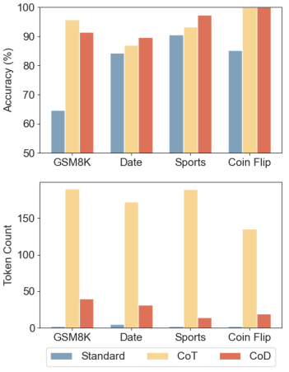
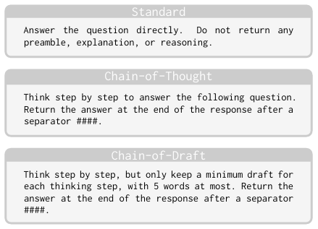
Chain of Draft
Claude 3.5 Sonne
https://arxiv. org/pdf/2502.18600
Notes:
In particular, we pick GSM8k (Cobbe et al., 2021) for arithmetic reasoning; date understanding and sports understanding from BIG-bench (bench authors, 2023) for commonsense reasoning; and coin flip tasks introduced in the CoT paper (Wei et al., 2022) for symbolic reasoning.

Slide 8
如何避免「想太多」
更強的思維鏈 (Chain-of-Thought, CoT)
給模型推論工作流程
教模型推理過程 (Imitation Learning)
以結果為導向學習推理 (Reinforcement Learning, RL)
Notes:
Scaling LLM Test-Time Compute Optimally can be More Effective than Scaling Model Parameters
https://www.youtube.com/watch?v=OXwGp9YeuBg
https://huggingface.co/spaces/HuggingFaceH4/blogpost-scaling-test-time-compute

Slide 9
input
Reasoning Process
answer
input
Reasoning Process
answer
選擇最短的 Reasoning Processing 作為 Training Data
input
Reasoning
answer
input
?????
https://arxiv.org/abs/2502.18080

Slide 10
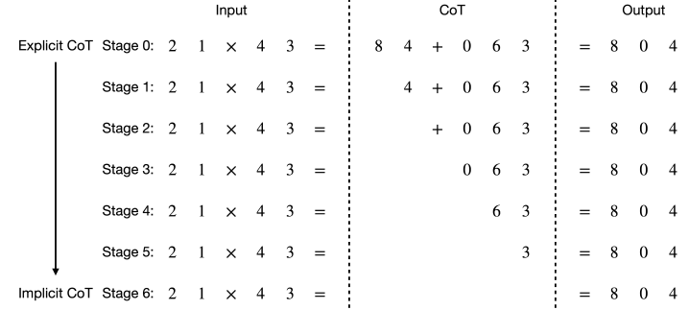
From Explicit CoT to Implicit CoT
https://arxiv.org/abs/2405.14838
Notes:
Video: https://www.youtube.com/watch?v=_I2yEhxRJlc

Slide 11
如何避免「想太多」
更強的思維鏈 (Chain-of-Thought, CoT)
給模型推論工作流程
教模型推理過程 (Imitation Learning)
以結果為導向學習推理 (Reinforcement Learning, RL)
Notes:
Scaling LLM Test-Time Compute Optimally can be More Effective than Scaling Model Parameters
https://www.youtube.com/watch?v=OXwGp9YeuBg
https://huggingface.co/spaces/HuggingFaceH4/blogpost-scaling-test-time-compute

Slide 12
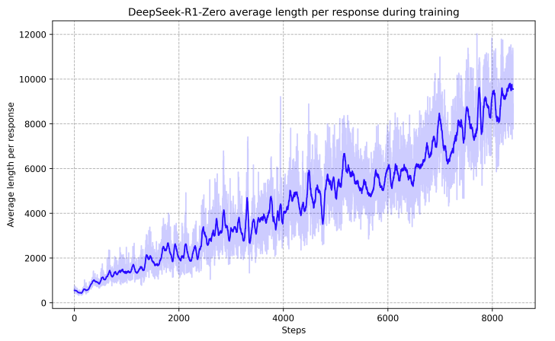
DeepSeek-R1
https://arxiv.org/abs/2501.12948

Slide 13
RL 的方法產生了超長的「推理」過程
Reasoning Process
answer
input
Reasoning Process
answer
沒人教 AI 要在意 Reasoning Process 的長度!
超過一定長度就算是不好的？

Slide 14
input
Reasoning Process
answer
input
Reasoning Process
answer
https://arxiv.org/abs/2501.12570
https://arxiv.org/abs/2501.12599
https://arxiv.org/abs/2502.04463
input
Reasoning
answer
input
Reasoning
answer

Slide 15
控制「推理」的長度
https://arxiv.org/abs/2503.04697
$n$ 個 tokens
input
Reasoning Process
answer
Reward 定義為
正確率 - 目標和實際推理長度差異
推理長度設定為 $n_{∗}$

Slide 16
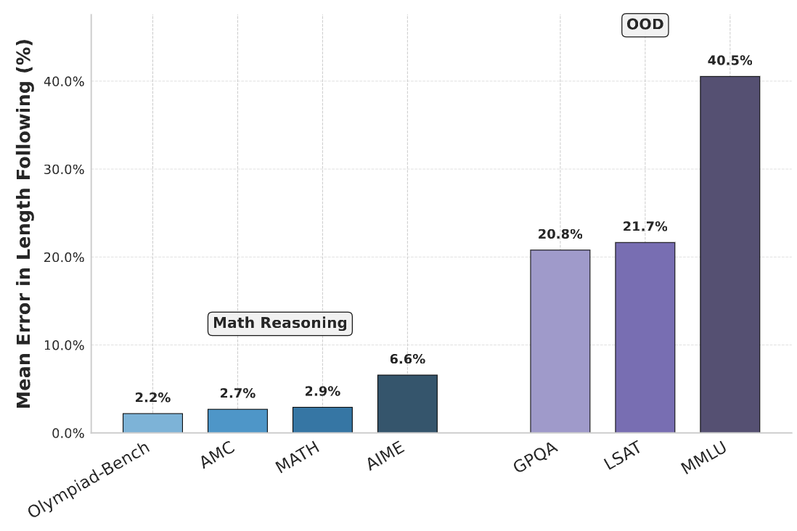
控制「推理」的長度
https://arxiv.org/abs/2503.04697

Slide 17
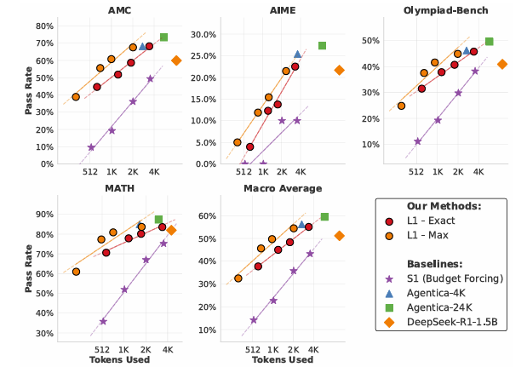
控制「推理」的長度
https://arxiv.org/abs/2503.04697

Slide 18
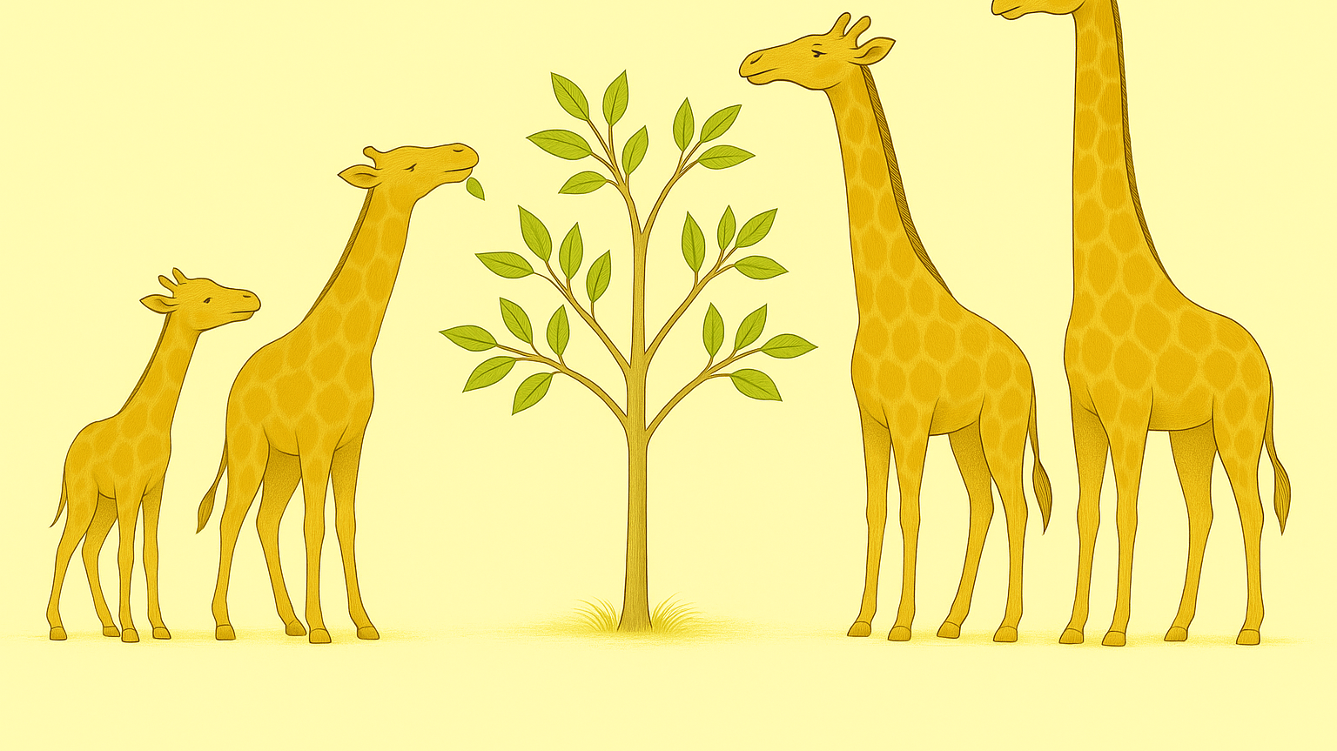
過猶不及
(本圖由 gpt-4o 生成，與實際演化過程無關)
Notes:
長頸鹿
參考《神獸麒麟的真身：長頸鹿的脖子到底是怎麼演化的，為何說達爾文可能犯了錯？丨古獸06丨獸族時代》
https://youtu.be/kYgN3ibPutU?si=7XpzL0Gyyk1Ax_SX

