Slide 1
7.3
S⊥ is the set of vectors that are orthogonal to every vector in S
$$S^{\text{⊥}}=\left\{v:v⋅u=0,∀u∈S\right\}$$

Slide 2
Unique
w
$$u={c_{1}w}_{1}+c_{2}w_{2}+…+c_{k}w_{k}$$
$$+{b_{1}z}_{1}+b_{2}z_{2}+…+b_{n−k}z_{n−k}$$
z
For any subspace W of R^{n}
$$dimW+dimW^{\text{⊥}}=n$$
Basis: $\left\{w_{1},w_{2},⋯,w_{k}\right\}$
Basis: $\left\{z_{1},z_{2},⋯,z_{n−k}\right\}$
Basis for R^{n}
For every vector u,
W⊥
u
u = w + z
(unique)
z
W
w
$$∈W$$
$$∈W^{\text{⊥}}$$
0

Slide 3
58. Let $W$ be a subspace of $R^{n}$, and let $B_{1}$ and $B_{2}$ be bases for $W$ and $W^{⊥}$, respectively.
(a) $B_{1}∪B_{2}$ is a basis for $R^{n}$
(b) $dimW+dimW^{⊥}=n$
4-2: 77 Let $V$ and $W$ be nonzero subspaces of $R^{n}$ such that each vector $u$ in $R^{n}$ can be uniquely expressed in the form $u=v+w$ for some $v$ in $V$ and some $w$ in W.
(a) Prove that $0$ is the only vector in both $V$ and $W$.
(b) Prove that $dimV+dimW=n$

Slide 4
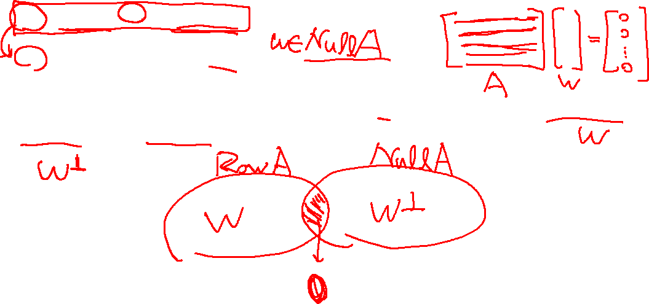
61. Prove the following statements for any matrix $A$:
(a) ${\left(Row A\right)}^{⊥}=Null A$
(b) ${\left(Col A\right)}^{⊥}=Null A^{T}$
65. Let $A$ be an $n×n$ matrix. Prove that if $v$ is a vector in both $RowA$ and $NullA$, then $v=0$.

Slide 5
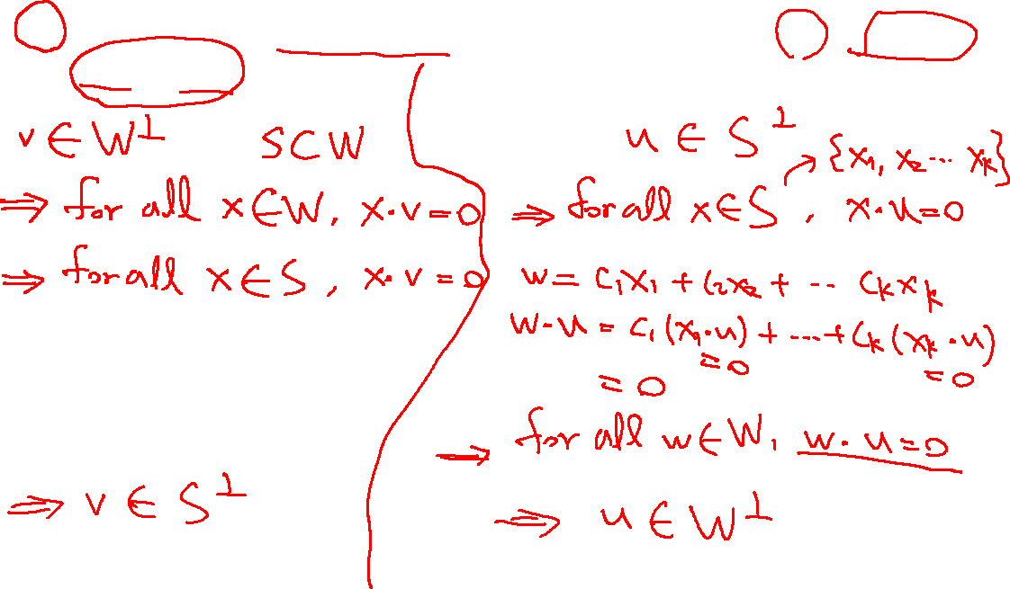
57. Let $S$ be a nonempty finite subset of $R^{n}$, and suppose that $W=Span S$. Prove that $W^{⊥}=S^{⊥}$.

Slide 6
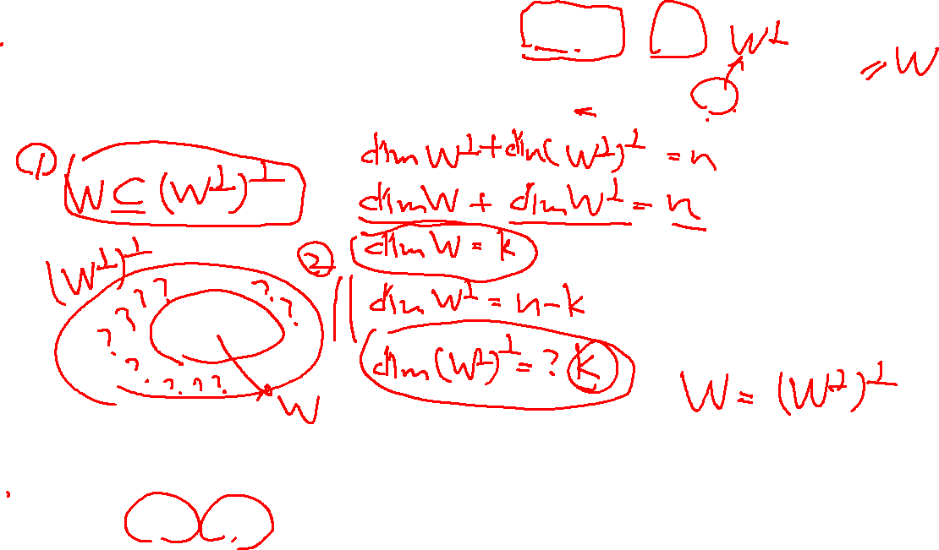
60. Prove that for any subspace $W$ of $R^{n}$, ${\left(W^{⊥}\right)}^{⊥}=W$
63. Prove that for any nonempty finite subset $S$ of $R^{n}$, ${\left(S^{⊥}\right)}^{⊥}=Span S$
57. Let $S$ be a nonempty finite subset of $R^{n}$, and suppose that $W=Span S$. Prove that $W^{⊥}=S^{⊥}$.

Slide 7
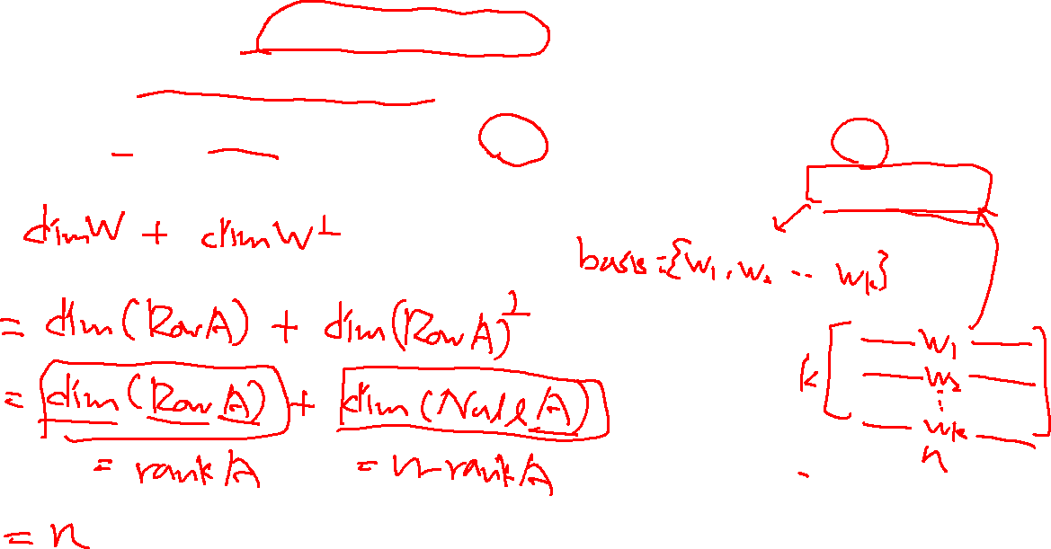
64. Use the fact the ${\left(Row A\right)}^{⊥}=Null A$ for any matrix $A$ to give another proof that $dimW+dimW^{⊥}=n$ for any subspace $W$ of $R^{n}$.
Hint: Let $A$ be a $k×n$ matrix whose rows constitute a basis for $W$.
$$W=Row A$$

Slide 8
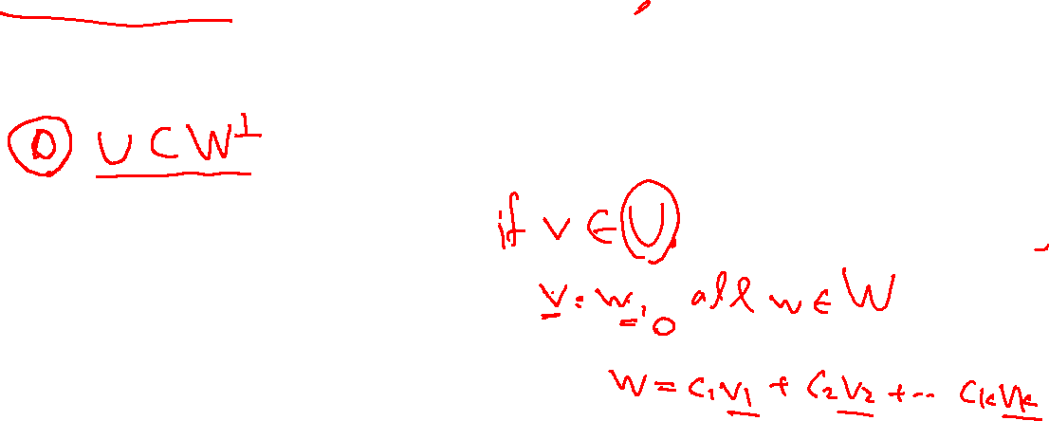
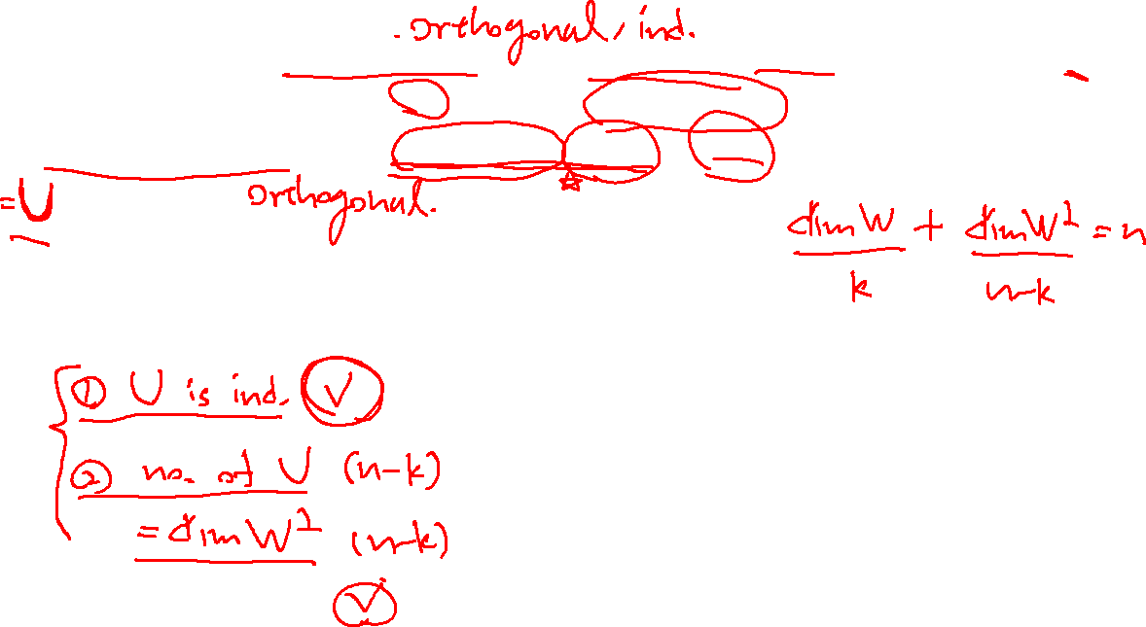
59. Suppose that $\left\{v_{1},v_{2},…,v_{n}\right\}$ is an orthogonal basis for $R^{n}$. For any $k$, where $1≤k<n$, define $W=Span\left\{v_{1},v_{2},…,v_{k}\right\}$. Prove that $\left\{v_{k+1},v_{k+2},…,v_{n}\right\}$ is an orthogonal basis for $W^{⊥}$.

Slide 9
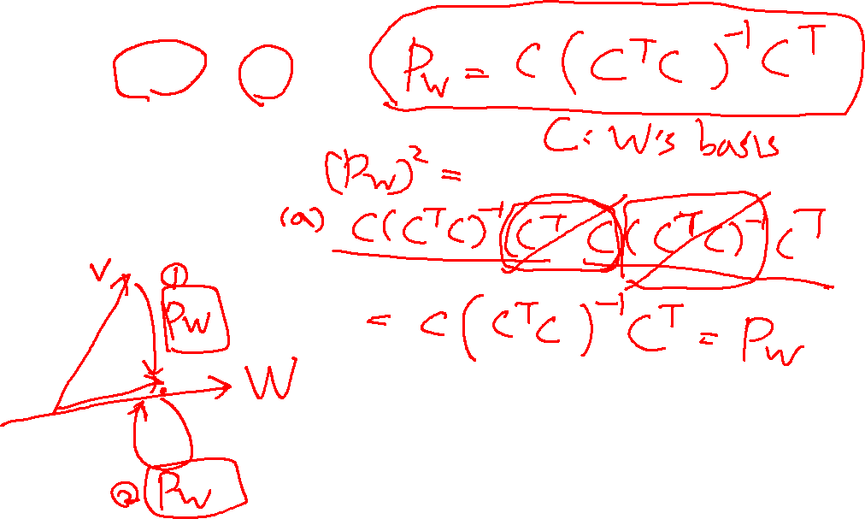
67. Let $W$ be a subspace of $R^{n}$.
(a) Prove that ${\left(P_{W}\right)}^{2}=P_{W}$
(b) Prove that ${\left(P_{W}\right)}^{T}=P_{W}$

Slide 10
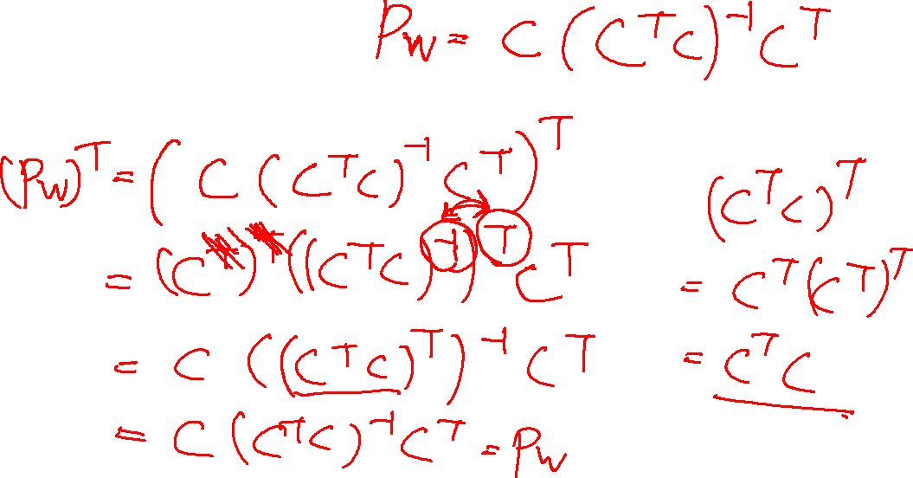
67. Let $W$ be a subspace of $R^{n}$.
(a) Prove that ${\left(P_{W}\right)}^{2}=P_{W}$
(b) Prove that ${\left(P_{W}\right)}^{T}=P_{W}$

Slide 11
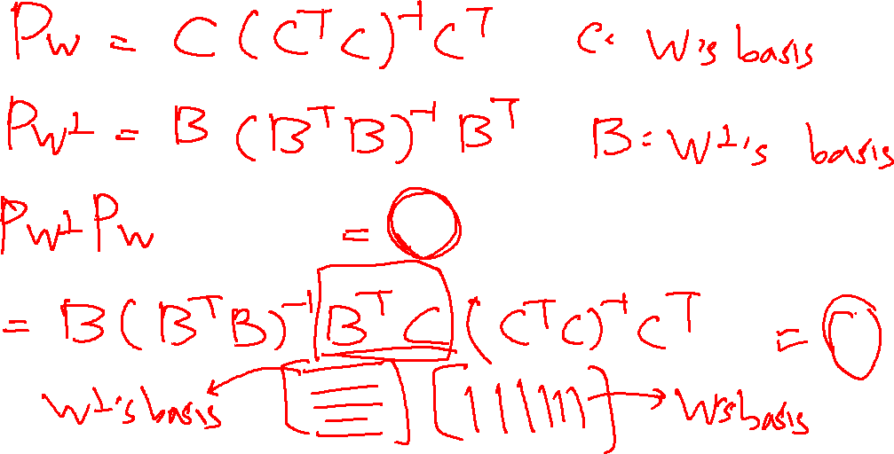
72. Let $W$ be a subspace of $R^{n}$. Prove that $P_{W}P_{W^{⊥}}=P_{W^{⊥}}P_{W}=O$

Slide 12
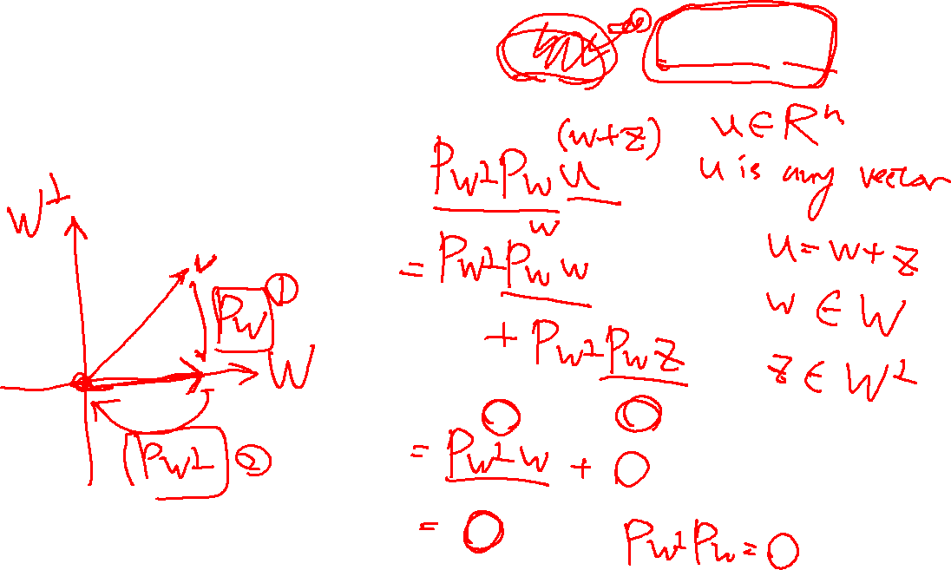
72. Let $W$ be a subspace of $R^{n}$. Prove that $P_{W}P_{W^{⊥}}=P_{W^{⊥}}P_{W}=O$

Slide 13
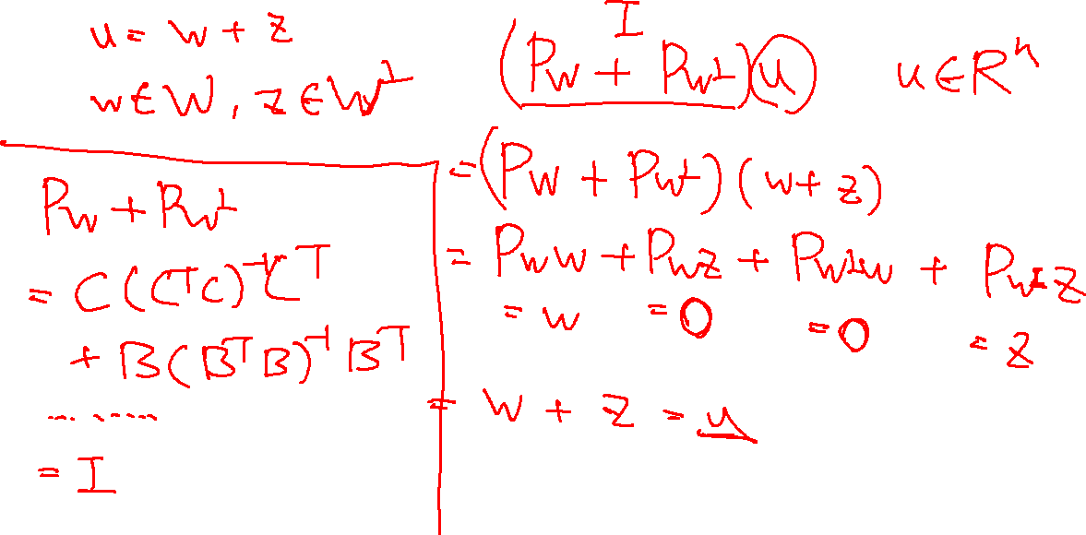
73. Let $W$ be a subspace of $R^{n}$. Prove that $P_{W}+P_{W^{⊥}}=I_{n}$.

